Slide 1
Python Workshop 2024
Department of Biomedical Engineering
California State University Long Beach
Dr. Arjang Fahim

Slide 2
Why Python?

Slide 3

What this workshop is …
Since this is a four hour workshop it is tough to decide what gets taught and what doesn’t
In that pursuit this course is intended as an introduction to the Python programming language
Focus on the fundamentals of the Python language with the goal of using Python for working data
This course is not intended to teach “how to program”
Assume a basic familiarity with “programmatic” thinking
This does not mean that if you don’t know how to program the workshop will be useless, but it will not make someone a programmer in four hours
The ideal student then has some experience with programming or “programmatic thinking” and may have written codes in other languages (Matlab, C++, R, Java) to analyze data.

Slide 4
What is Python?
Python is an interpreted, object-oriented, high-level programming language with dynamic semantic.
Some of the notable features:
Elegant easy to read syntax
Powerful high-level built-in data structures combined with dynamic typing, makes it very attractive for Rapid Application Development (RAD).
Rich standard libraries for performing variety of tasks
Runs on any platforms : Mac, Windows, Linux, Unix
100% Free – Thanks to active supporting community

Slide 5
Downloading Python: Different Distribution of the Python
The official distribution of Python can be downloaded from python.org
Additionally, there are many “alternative” distributions
IronPython – Python running on MS .Net (http://ironpython.net)
ActiveState ActivePython (https://www.activestate.com)
Enthought Canopy – Commercial distribution for scientific computing
Anaconda Python – a full Python distribution for data management, analysis and visualization of large data set. (https://www.anaconda.com)

Slide 6
Python Installation
If you haven’t already, go to the following website and follow the instruction for your operating system to install Python:
https://www.python.org/downloads/
For our workshop python version 3.0.0+ works fine.
The latest version of Python is 3.12.2

Slide 7
References for Continuing Learning
List of Python Beginners Guides (Non-Programmers)-
https://wiki.python.org/moin/BeginnersGuide/NonProgrammers
List of Python Beginners Guide (Programmers) -
https://wiki.python.org/moin/BeginnersGuide/Programmers
Codecademy
https://www.codecademy.com/learn/python
Udacity
https://www.udacity.com/catalog/all/any-price/any-school/any-skill/any-difficulty/any-duration/any-type/relevance/page-1?searchValue=python

Slide 8
Reference to this workshop
Programming in Python 3: A Complete Introduction to the Python Language
https://www.qtrac.eu/py3book.html
The book focuses on Python 3
Many examples are similar from this book
Python official documentation:
https://docs.python.org/3/

Slide 9
Todays Plan
Syntax, Variables, Numbers
Operators
Arithmetic operators
Logical operators
Membership operators
Identity operators
Flow Control
If … else
For loop
While loop
Break, continue and pass

Slide 10
Todays Plan
Data types
Lists
Tuples
Set
Dictionary
Functions
Function argument
Lambda function
Local global scope
Few built in functions

Slide 11
Programs we will be writing
Detecting Prime numbers
Detect even , odd number
Matrix Multiplication
Transpose of a Matrix
Simple Calculator
In Pythonic way

Slide 12
https://github.com/ayansengupta17/PythonWorkshop

Slide 13
Things that won’t be covered
File handling
Exception handling
Object and Class
Iterator
Generator
Assert
Decorators

Slide 14
Entrez Online Database
Entrez is a molecular biology database system that provides integrated access to nucleotide and protein sequence data, gene-centered and genomic mapping information, 3D structure data, PubMed MEDLINE, and more. The system is produced by the National Center for Biotechnology Information (NCBI) and is available via the Internet.
https://www.ncbi.nlm.nih.gov/search/

Slide 15
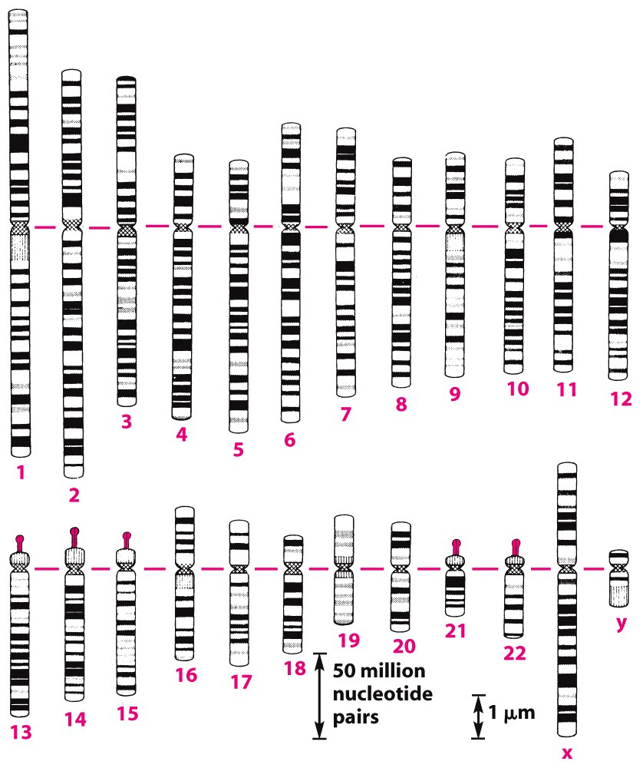
Gene structure – Chromosomal Gene Arrangement
Figure 4-11 Molecular Biology of the Cell (© Garland Science 2008)
Humans:
23 chromosome pairs
3 billion bases
~24,000 genes

Slide 16
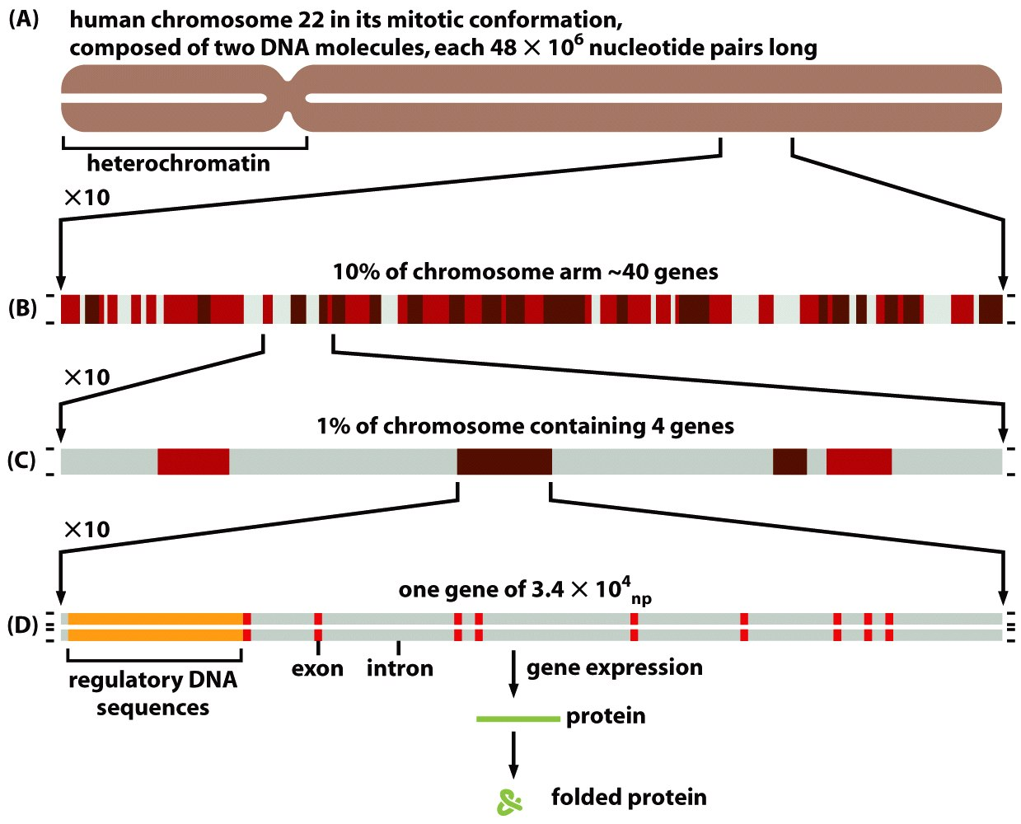
Gene structure – Chromosomal Gene Arrangement
Figure 4-15 Molecular Biology of the Cell (© Garland Science 2008)

Slide 17
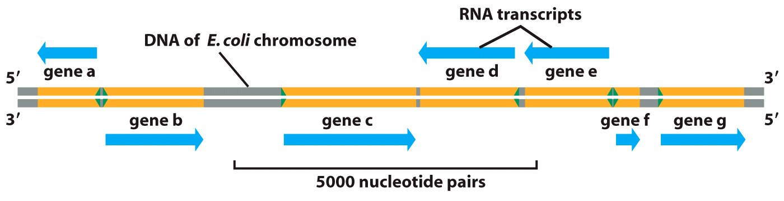
Gene structure – Chromosomal Gene Arrangement
Genes can reside on either strand
Figure 6-14 Molecular Biology of the Cell (© Garland Science 2008)

Slide 18
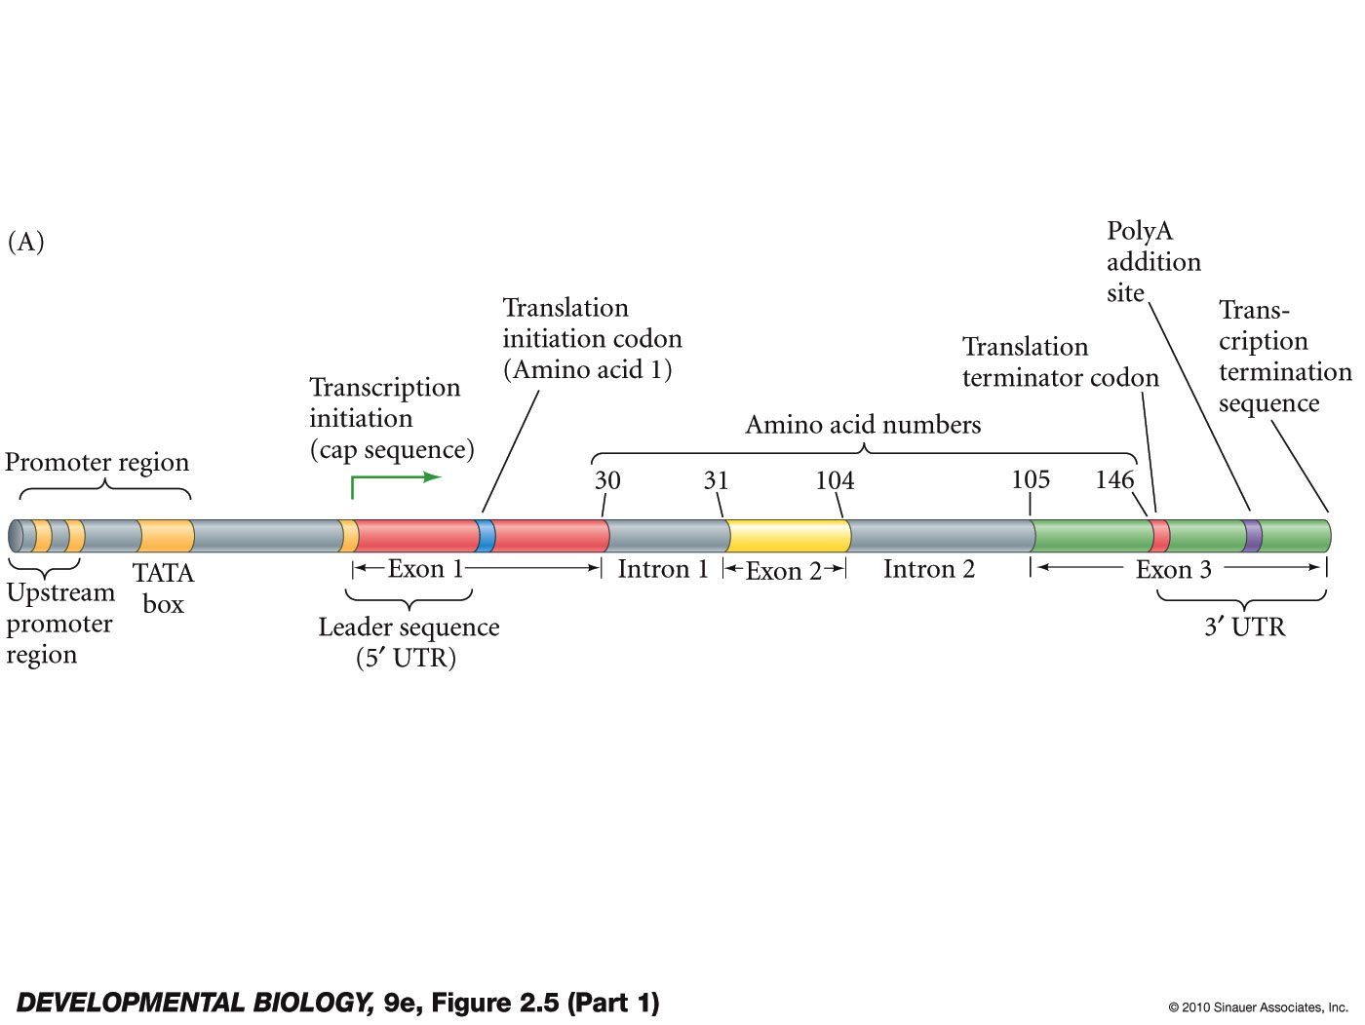
Single Gene Components
Anatomy of a Gene

Slide 19
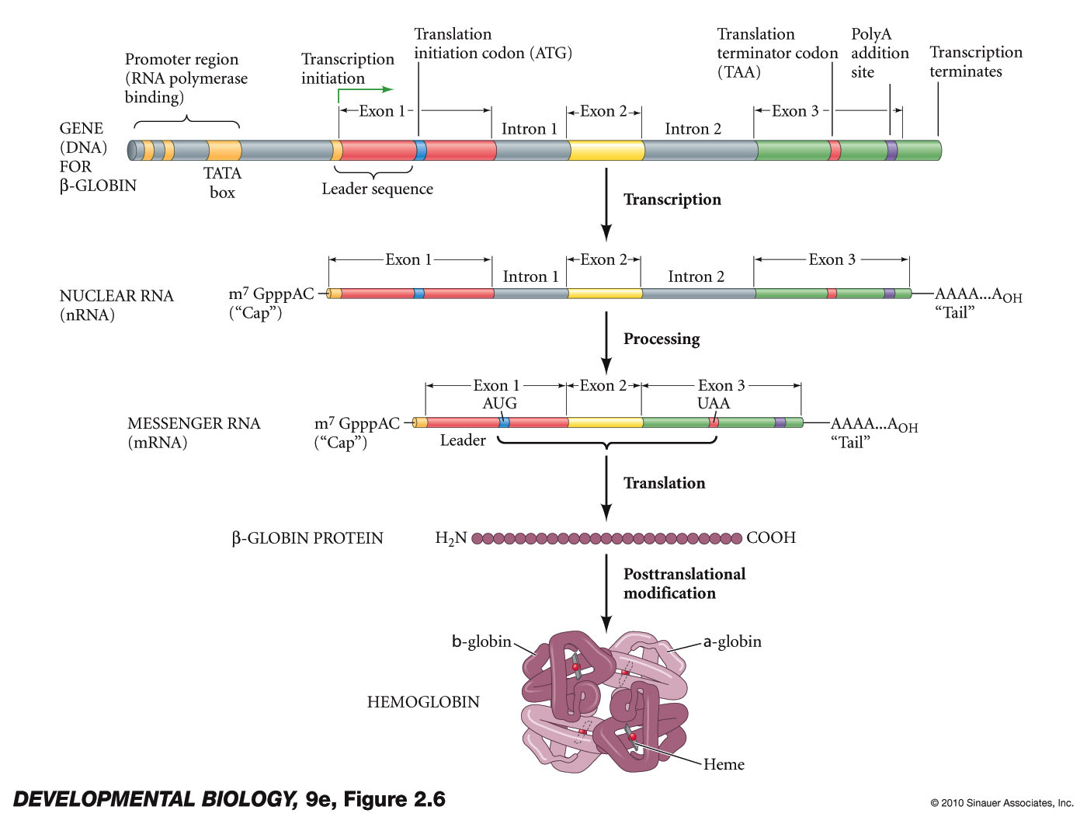
Single Gene Components
Nuclear RNA, mRNA and Protein

