Slide 1
TEAM
TECHNOHACKER
PRESENTATION

Slide 2



TEAM MEMBERS
TEAM NAME
TECHNOHACKER
MENTOR
NAME
Dr.RAKESH Kr. DIWEDI
RAJENDRA PRASAD
ARJAV JAIN (TEAM LEADER)
VARNIT JINDAL
AMAR AGARWAL
NANCY JAIN
KUNAL YADAV
REETESH JAIN

Slide 3
IMPORTANT POINTS WE AIM TO HANDLE
These tools are not affordable by farmers because in india the income of farmers are is less ,lack of knowledge to operate tools.
Hence Service boy will carry all this tools.
This service boy will go to the farm and measurement and collect the data regarding problems in a crops and soil
All data will be matched to the database and reflect to database and find the problems . After that our experts will help to grow the crops
Pros:-
Not extra expenditure of farmer.
Experts will help in disease of any crop .
Not to buy tools by the Farmer.

Slide 4
TECHNOHACKER
EXPERTS pages

Slide 5



IN OUR WEBSITE THERE WILL BE PANEL OF EXPERT
REGISTER THROUGH THE PANEL
WHEN HE OR SHE WILL BE REGISTER THEN
IT WILL GIVE THE LOCAL AREA THIS WILL BENEFITS PERSON WILL INTERACT WITH THE LOCAL FARMER
EXPERT REGISTRATION

Slide 6



IN OUR WEBSITE FIRST THE EXPERT WILL SIGNUP THROUGH THE SIGNUP PAGE
THEN AFTER THE REGISTRATION
EXPERT WILL GIVE AREA THAT WE WILL SAVE IN THE DATABASE
EXPERT WORK
THEN WE CAN INTERACT WITH THE FARMER AND COLLECT THE PROBLEM AND SOLVE THEIR QUERY THROUGH THE EXPERT
WHEN PROBLEM IS BIG THEN WE CAN REDIRECT THEIR PROBLEM THROUGH THE LOCAL AREA OF EXPERT AND OUR EXPERT TEAM WILL GO TO THEIR FARM AND COLLECT THE DATA
AFTER COLLECTION THE DATA SOME EXPERT WILL ANALYSe THEIR DATA THROUGH THE DATA ANALYSIS AND REDIRECT IT TO REFLECT IN DATABASE
AFTER THAT THIS DATA CAN BE SHOWN TO THE FARMER AND SUGGESTION OF THE FARMER.CAN BE RECORDED

Slide 7
WE CAN PROVIDE THE JOBS TO THE SMALL LEVEL OF EXPERTS OR UNEMPLOYED AGRICULTURE GRADUATES
THEIR COST WILL BE LOW THROUGH THIS WE CAN DETECT THE LOCAL AREA OF EXPERT FOR PROVIDING SUGGESTION TO THE FARMER AND DAILY BASES SALARY OF THE EXPERT
THIS WILL BE LOW COAST AND ALSO THE INTERACTION THROUGH THE FARMER
SOME TOOLS WE CAN PROVIDE TO THE EXPERT
BENIFITS OF THIS WORK

Slide 8
With these tools help, less fertilizer used in crops and more income.
More fertilizers are harmful for plants and also humans.
The fertilizer used in a farm will be used with accurate quantity .
Also employment is provided through this web application such as Service Boy that collect the data and provide the right solution to the farmer.
This service boy will be well educated in a agriculture field like-
@How to work these tools and how to collect data , more than 60% farmers are not educated so service boy help
@Our software are designed as reliable, easy access, user friendly.
Also virtual assistant is assigned for post service support , who help to right fertilizer in right crop and quantity.
not to worry about service boy salary pay can be adjusted trough inverstors from fertilizer and farming tech companies

Slide 9
TechnoHacker
Virtual Assistant

Slide 10

Virtual Assistant we are using is Engati
Attractive and with basic tapping functionality can be operated even by keypad mobile Phones effectively
Meet engati
An open source platform to create chatbots and virtual assistants-
"Engati has the potential to become one of the leading commercial chatbot platforms in the world. " The thing which I liked the most was its intuitive UX and easy learning curve. The portal allows you to develop a chatbot on multiple platforms in a matter of minutes. "Looked at AI bot from several sources.

Slide 11
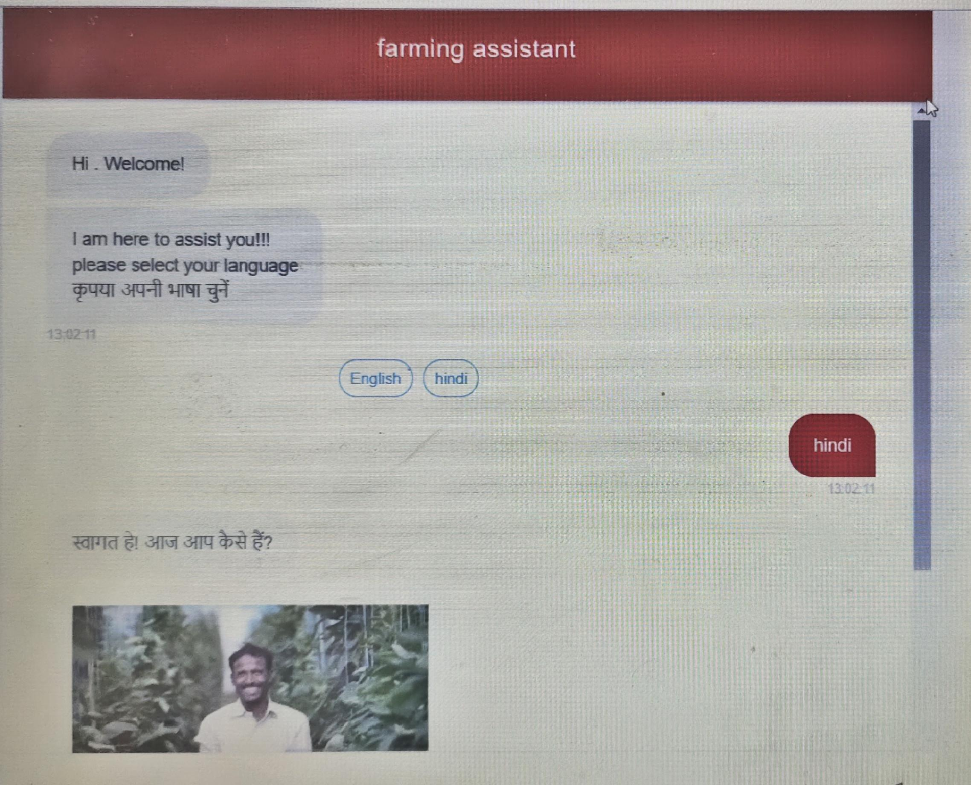
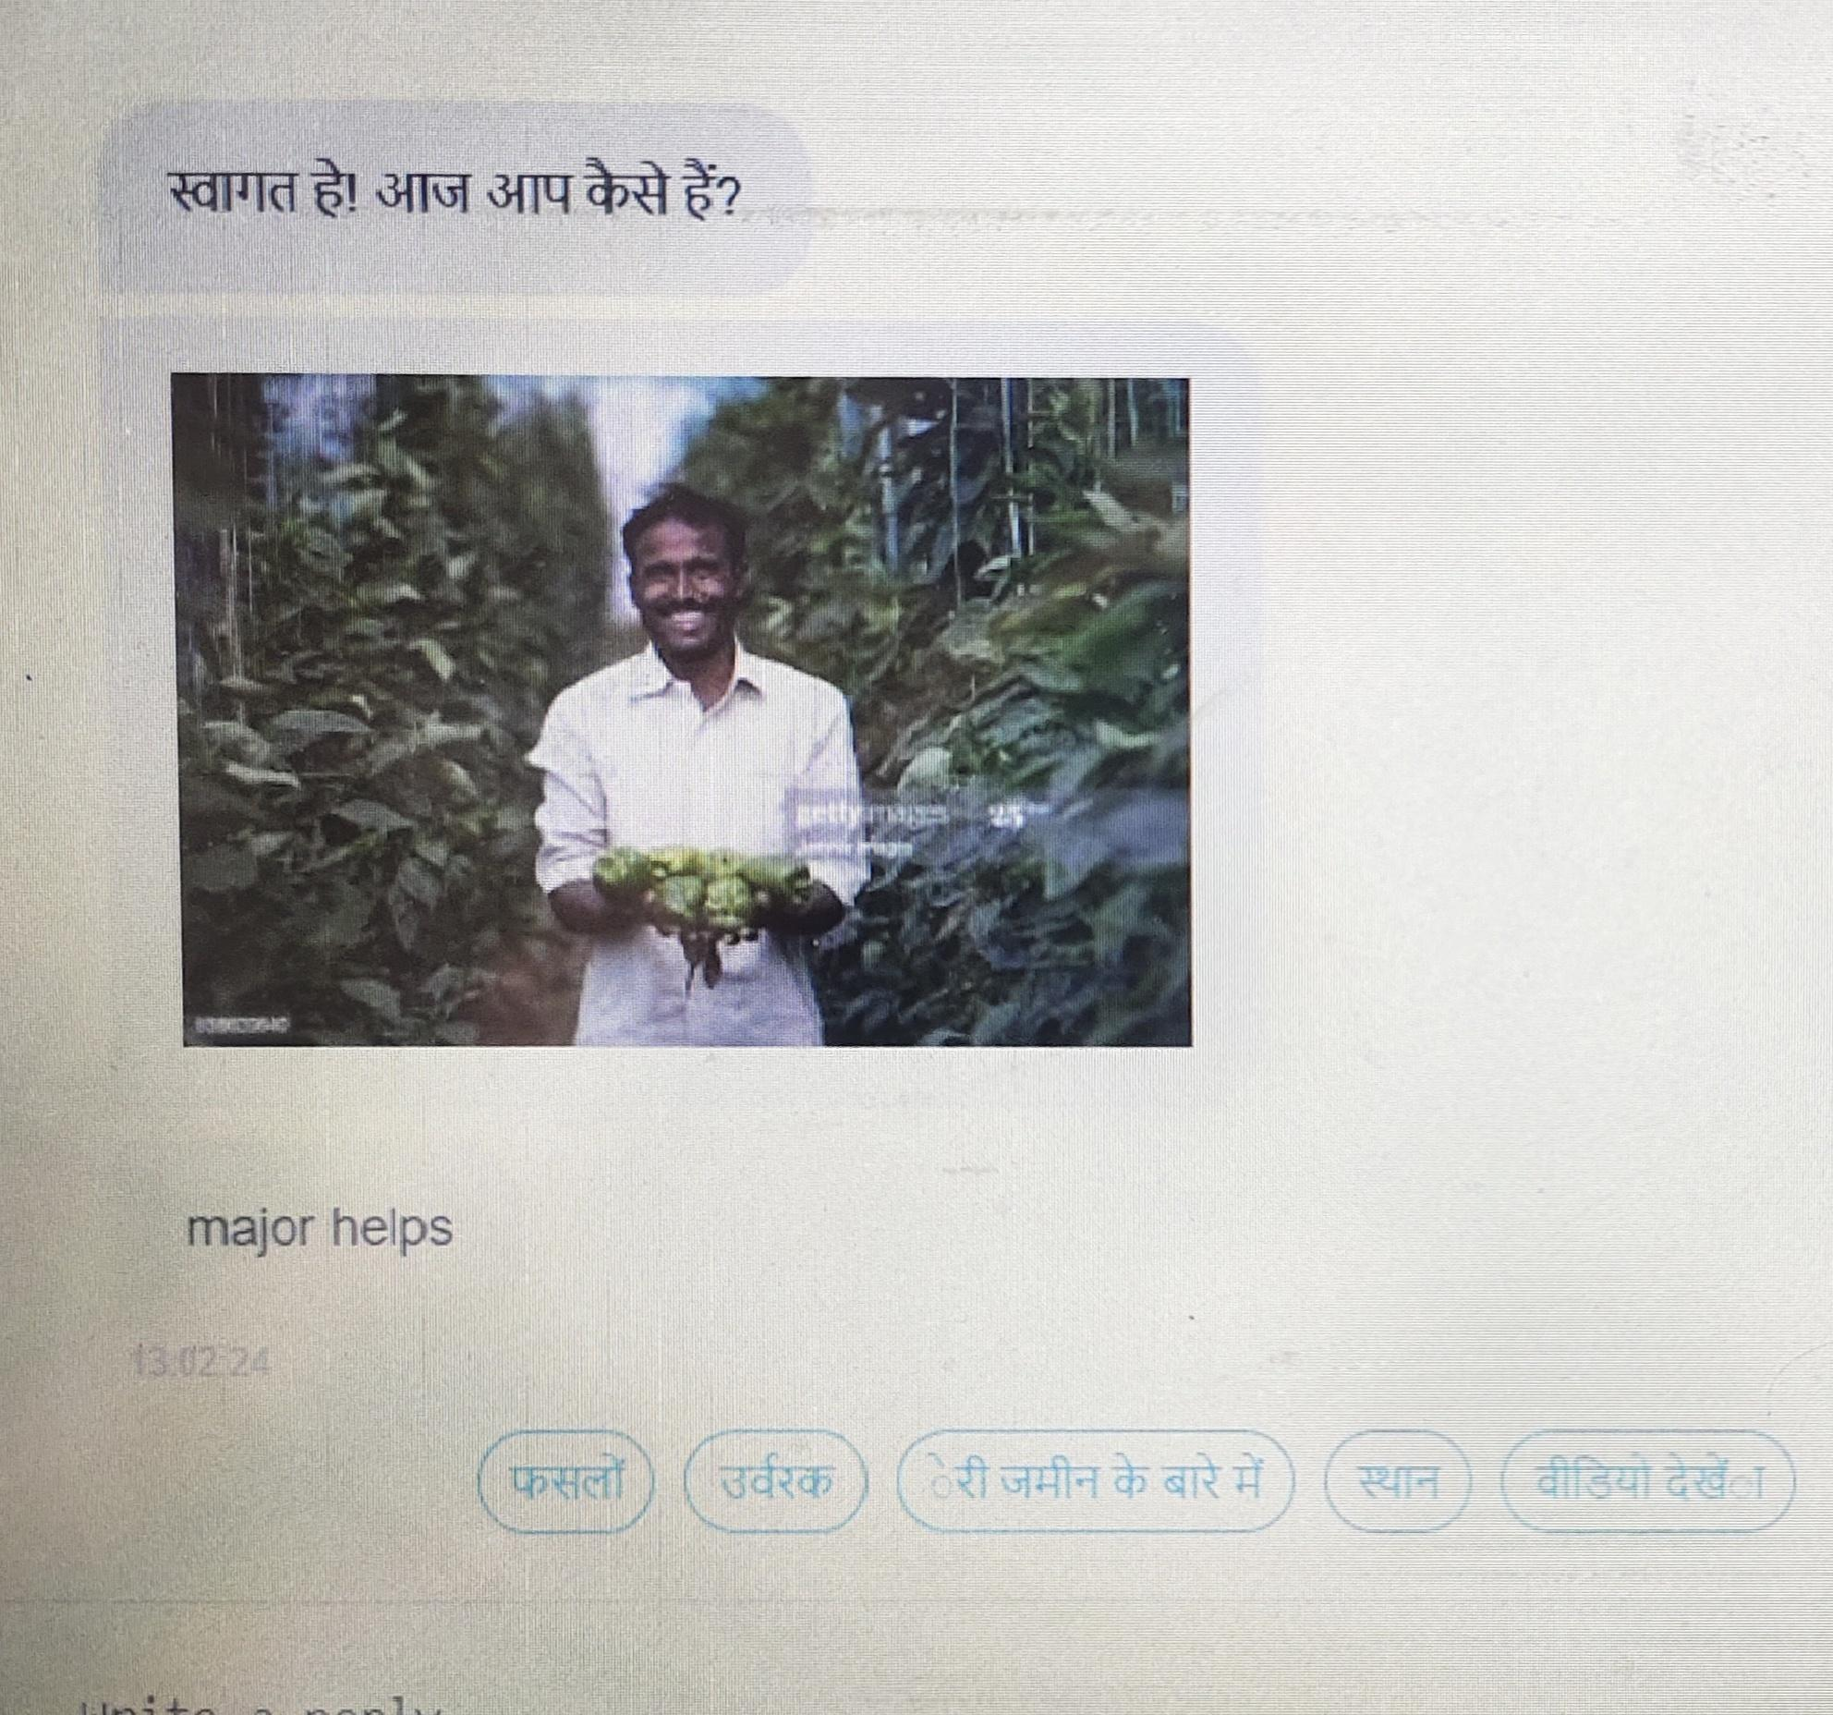
Something like what farmer see on screen

Slide 12
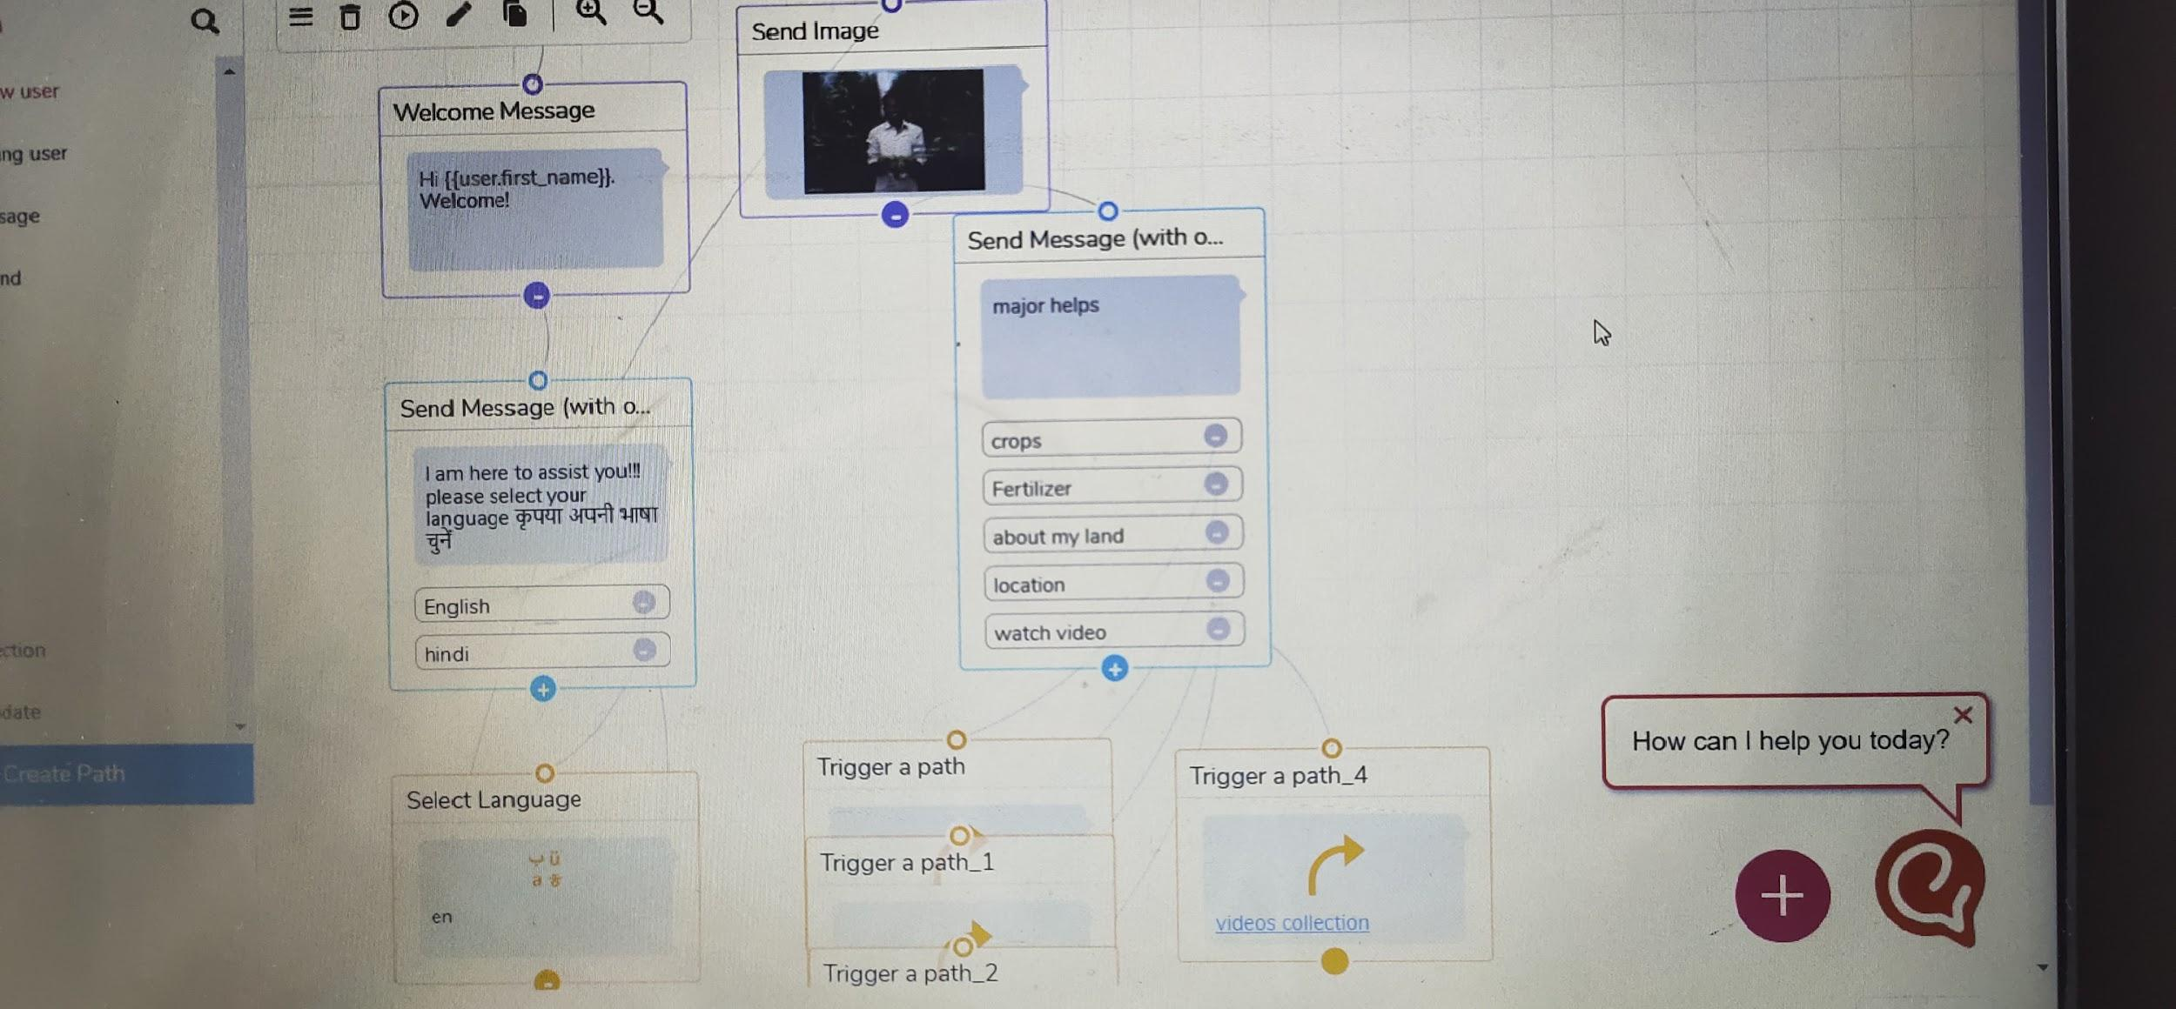
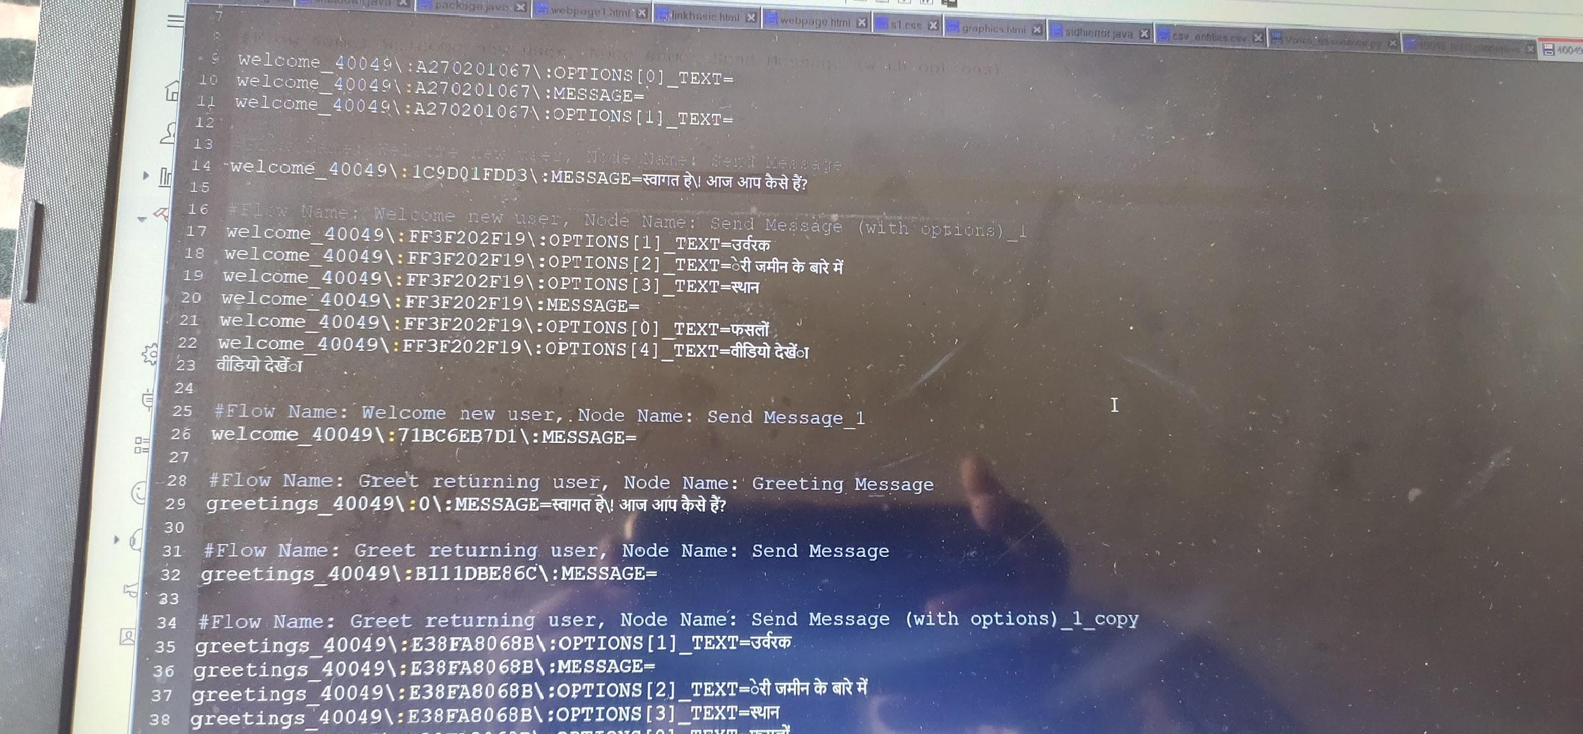
Things made at backend and code behind

Slide 13
Additional services to work on in chatbot
@Weather forecasting updates for specific location as selected by farmer
@ Feedback form,contact us page
@ Query or problem defining page
@several ApI integration like text input
Google maps,soil updates,
Latest fertilizers,tools ,irrigation in market etc news

Slide 14
IF query or problem related solution data not present in dataset
STEPS
TAKING FARMER CREDENTIALS
PHONE NUMBER OR e-MAIL OR ADDRESS
REDIRECTION AND REFLECTING IN DATABASE FOR FURTHER REFERENCES
DIRECT COMMUNICATION WITH ADMIN AND EXPER THROUGH MAIL AND PHONE NUMBER
SOLUTION ALSO TO NON SUBJECTIVE TOPICS

Slide 15
FARMING TOOLS
TECHNOHACKER

Slide 16
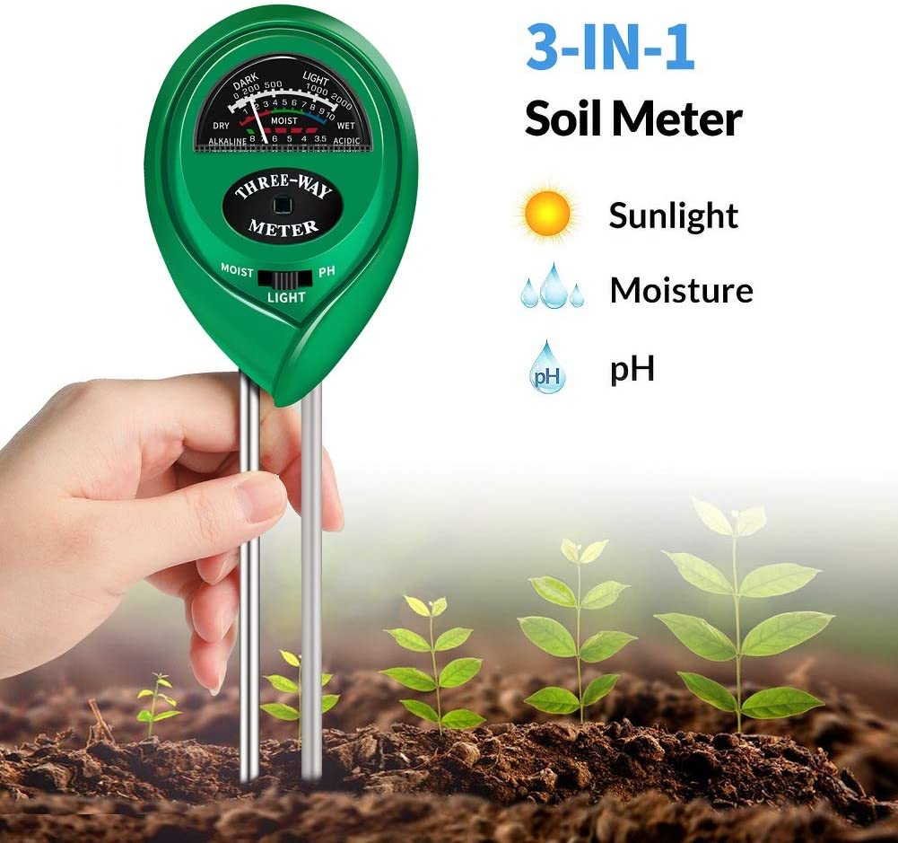
pH soil meter
You can measure the soil moisture, pH, and light levels in seconds, so your plants can grow healthy and strong.
A pH meter relies on a voltage test to determine hydrogen ion levels and thus pH.
Easy-to-read scale indicator
Incredibly simple to use - just stick it in the soil

Slide 17
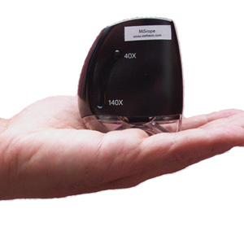
IPM SCOPE
Ideal for plant disease and pest identification applications.
Easy to access.
Capture the images of plant.
Measures 40X and 140X magnification.

Slide 18
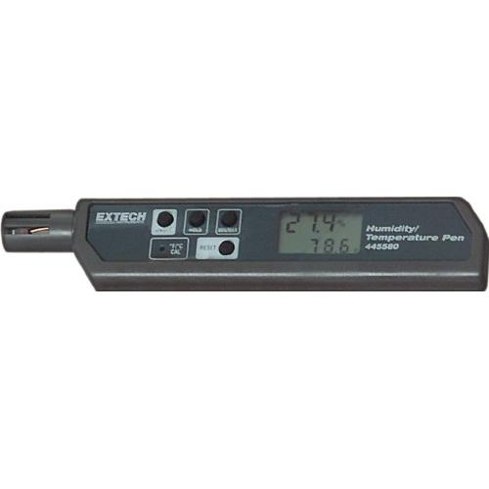
Soil Temperature measure
Fast and accurate temperature and humidity reading from a pocket sized meter.
F and C scale
Data hold
Auto power off

Slide 19
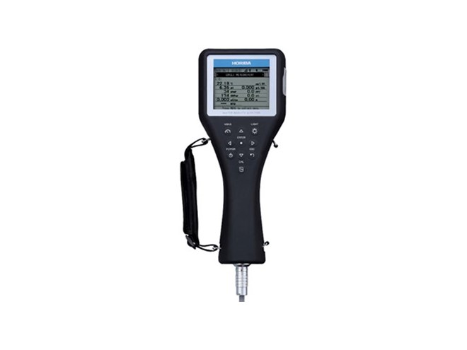
WATER QUALITY MEASUREMENT
Monitor , collect , and store upto 11 water quality parameters with high performance
Measure parameters include oxygen , salinity , TDS , temperature.
Onr hand operation.

Slide 20
THANKS
Let us consider farmer is not responsive or less literate with technology
our service boy will check the situation of land and also will create and demonstrate the functioning of farmer account
on website
JUST A CALL AWAY FROM FARMER
FARMER HELPLINE NUMBER IS HERE

