Slide 1


IIT ROORKEE
DICV HACKATHON’22
PRODUCT INNOVATION
BEST WORKPLACE FOR DRIVERS
INDIAN INSTITUTE OF TECHNOLOGY ROORKEE

Slide 2


Problems
IIT ROORKEE
Driver Routine
Drive (7h)
Break (2h)
Drive (5h)
Sleep (7h)
Driver Routine
Sleep & Breaks
(Short & Long)
Drive
Less Frequent
Poor in-cabin ventilation
Fog on wind-screen
Accident danger risk
Cabin heating
(engine heat)
Engine accessibility
Uncomfortable sleeping berth
Direct sunlight glare
Theft
(Truck & payload)
Getting In & Out of Cabin
Long ride fatigue
Fire
Uncomfortable seat
Constant pressing of accelerator
Small steering
Source - Statista

Slide 3
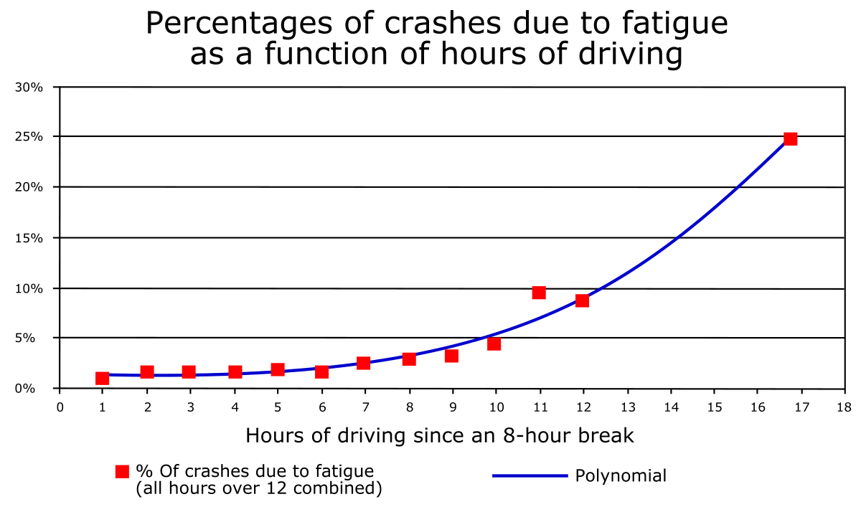
Problems
IIT ROORKEE
Decision Matrix
Fatigue - Effects
Property | Poor in-cab Ventilation | Long ride fatigue | Uncomfortable seat | Theft (Truck & Payload)
Demand | 5/5 | 4/5 | 5/5 | 3/5
Commercial viability | 4/5 | 4/5 | 3/5 | 5/5
Innovation | 5/5 | 5/5 | 3/5 | 3/5
Feasibility | 2/5 | 4/5 | 4/5 | 3/5
Scalability | 3/5 | 4/5 | 4/5 | 2/5
Social Impact | 2/5 | 4/5 | 4/5 | 5/5
Target Segment | Mining, Long-Haul Trucks | All | All | All except Construction Trucks
Target People | Driver | Driver, Owner | Driver | Owner, Company
Potential increase in accidents
Less driver performance
Longer sleeping hours
Driver health issues
Low profits for owner
Weak driver decision making
Weighted Average | 3.42/5 | 4.21/5 | 3.785/5 | 3.43/5
Priority | Weight
High | 15
Moderate | 10
Low | 5
Source1 - Ventilation
Source2 - Driver Survey
Source - Wikipedia

Slide 4
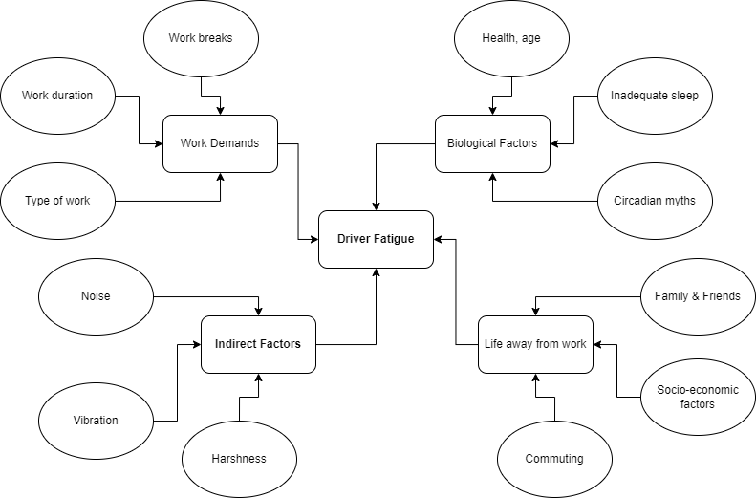
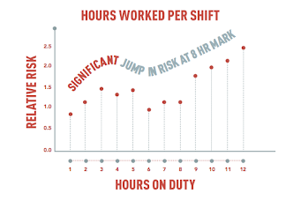
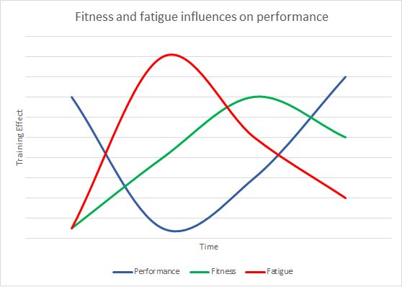
Problems
IIT ROORKEE
Fatigue - Causes
Fatigue – Effects on Performance
Source – Faradays Electrical.
Source – Dawson et al.
It is estimated that nearly 20% of all accidents is caused by fatigue as per The Royal society for prevention of accidents (RoSPA)
Outcomes:
Noise, Vibration & Harshness (NVH) are the only factors that can be solved
Novel solutions are proposed to be implemented inside the drivers’ cabin
Source – HertFordshire Sport Village.

Slide 5
Problems
IIT ROORKEE
NVH – Effects on Fatigue & Performance
Noise
Sound Levels inside Cabin
Nominal – 85 dB
Actual – 90 to 104 dB
Source –
Science Direct
Vibration
Vibration Frequency
Nominal – 0.5 to 80 Hz
Actual – 118 to 200 Hz
Vibration Amplitude
Nominal – 0.5 m/s2
Actual – 2 m/s2
Performance
Source – Roadex
Harshness
Subjective Quality
Iranian study on Bus and Truck Driver (N = 65533) | Theft (Truck & Payload)
Types of hearing aid due to Noise | %age Drivers
Some type of hearing Aid | 26.5%
Had hearing loss in both ears | 14.6%
Had hearing loss in left ear | 7.8%
Had hearing loss in right ear | 4.4%
Source – Technicon Acoustics
NVH
Fatigue
Types of health issues due to Vibration | %age Drivers
Irritation | 73.7%
Headache | 40.4%
Loss of Sleep | 29.3%
Hypertension | 8.1%

Slide 6
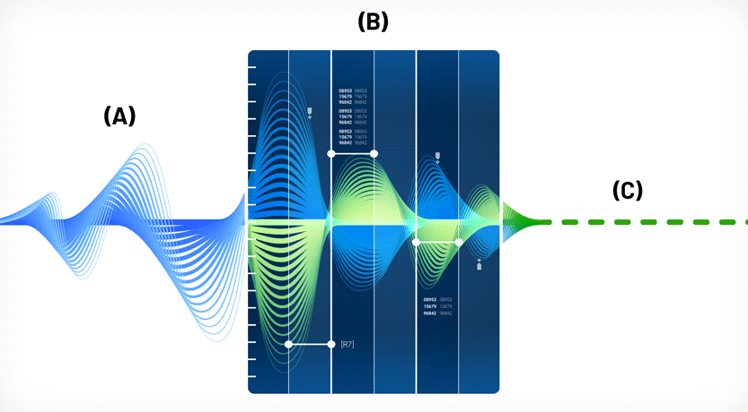
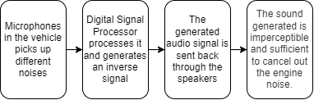
Solutions
IIT ROORKEE
Noise
Noise – Solution
ANC technology employs software and components like DSP and microphones to measure and reduce noise using destructive interference
Cabin noise refers to the combi. of sounds from the inner mechanics, tires, and wind flowing along the aerodynamics
Currently the noise levels inside the cabin lies between 90-104 dB while it should be <85dB
Active Noise Cancellation Technology
Noise – Causes
ANC – System Workflow
Conductive Vibration
Wind Noise
Engine Noise
Air Conditioning
Road Noise
Tire Noise
Source – AudioMav

Slide 7
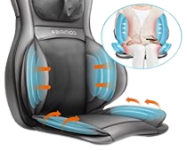
Solutions
IIT ROORKEE
Vibration
Vibration – Solution
Vibration Frequency
Nominal – 0.5 to 80 Hz
Actual – 118 to 200 Hz
Air Cushion Seating System
This system will improve the overall comfort of the driver by decreasing the vibrations transmitted to the driver and improving the support, and ergonomics thus reducing fatigue
Vibration is any motion, shaking or trembling that can be felt or seen when an object moves back & forth
Vibration Amplitude
Nominal – 0.5 m/s2
Actual – 2 m/s2
Material that dynamically absorbs the vibrations
Decision Matrix
Vibration – Causes
Property | Judgement factor | Air cushion seat | Foam Cushion seat
Vibrations score | Higher number of vibrations leading to fatigue | 33% lower vibration | More vibrations
Comfort score | Comfortability for the driver | 18% more comfort | Lower comfort
Fatigue score | Fatigue extent in Driver | 14% lower fatigue levels | Higher fatigue levels
Support score | Supported weight of the driver | 56% higher support | Lower support
Space factor | Space occupied inside the cabin | More space occupied | 15% lesser space
Ergonomics | Extent of ergonomics in seat | 20% more adjustment levels | Lesser adjustments possible
Pressure score | Average pressure in driver’s seating area | 18% lower pressure | Higher pressure constricts blood flow
Health score | Effect on health of driver | 33% lower health risk | Higher health issues
Engine Vibration
Worn suspension parts and joints
Fasteners
Brake Rotors
Road surface
Transmission Vibration

Slide 8
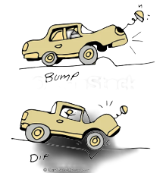
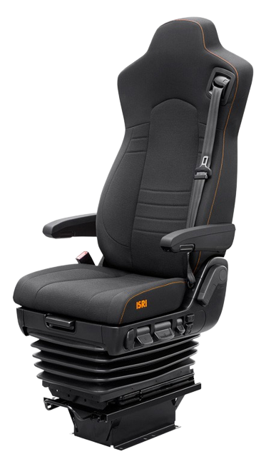



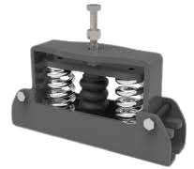

Solutions
IIT ROORKEE
Harshness
Harshness – Solution
Adapts to the seating style of the driver and provides frequency selective - load adaptive damping
Harshness is a ride quality issue where the vehicles’ response to the road is felt suddenly as a tremor or shock
Subjective Quality
Active seat suspension system
Harshness – Causes
Active suspension – Concept
Stiff Suspension
Bad Road Conditions
High Load Volume
High Accel. & Retard.

Slide 9
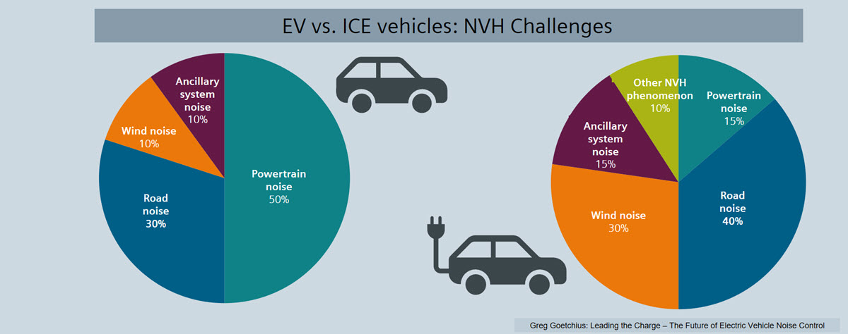
Solutions
IIT ROORKEE
Our Solution
Impact
N – Noise control device using Active Noise Cancellation Technology.
V- Vibration Control Device using
Air Cushion Seat System.
Noise levels go down by upto 43%
Vibration levels go down by upto 33%
Harshness levels reduced significantly
H – Harshness Control Device using Active Seat Suspension
H – Harshness Control Device using Active Seat Suspension
Future Aspects
Application
Mining Trucks
Medium Duty Trucks
Applications include but are not limited to:
Heavy Duty Trucks
Construction Trucks
Buses
Source – Siemens

Slide 10



Solutions
IIT ROORKEE
Benefits
Technological advancement & customer satisfaction will help increase the sales & customer retention
Commercial Viability
Reduced health issues
Increased ride comfort
Driver
Driver
As the solution is not limited to any particular category of trucks, it can be exploited in any of the available categories
Scalability
Reduced driver shortage
Lesser time for deliveries
Owner
Owner
Neither the technology used is very complicated nor the components are rare or costly
Feasibility
Increased customer loyalty
Increased customer satisfaction
As the solution leads to better health conditions of the driver which directly increases his work potential
Company
Social Impact

Slide 11
IIT ROORKEE
Thank You
Open to questions

Slide 12
Based on all these preliminary findings it may be suggested that noise may be related to a marked activation of the neuroendocrine system, resulting in increasing in blood pressure and heart rate
https://www.sciencedirect.com/science/article/pii/S2212609014000508

Slide 13
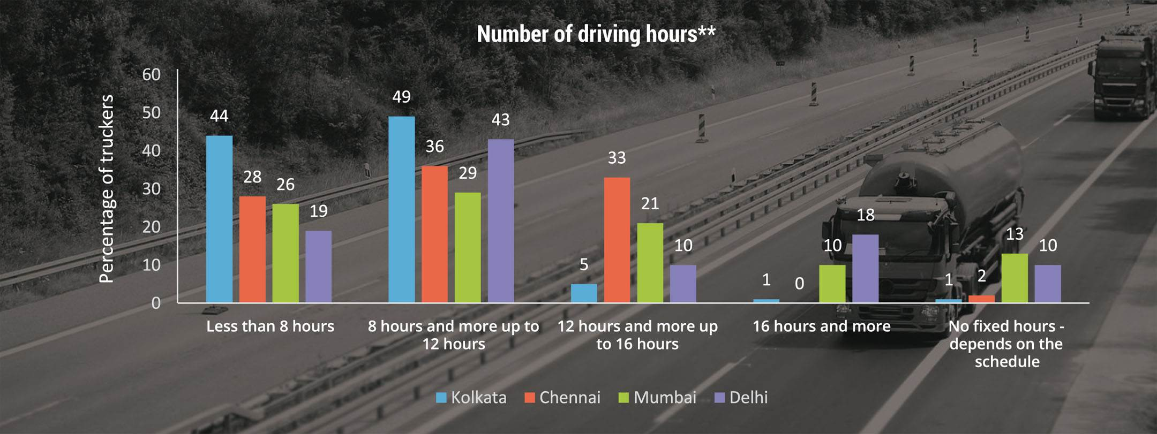
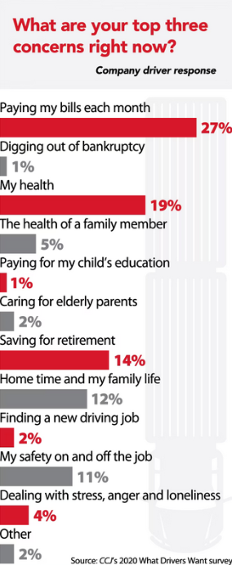
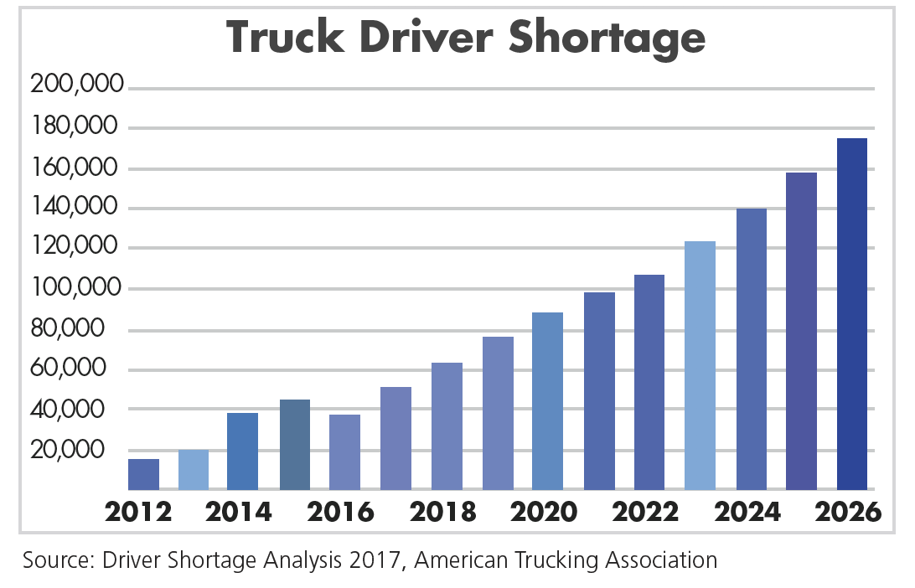
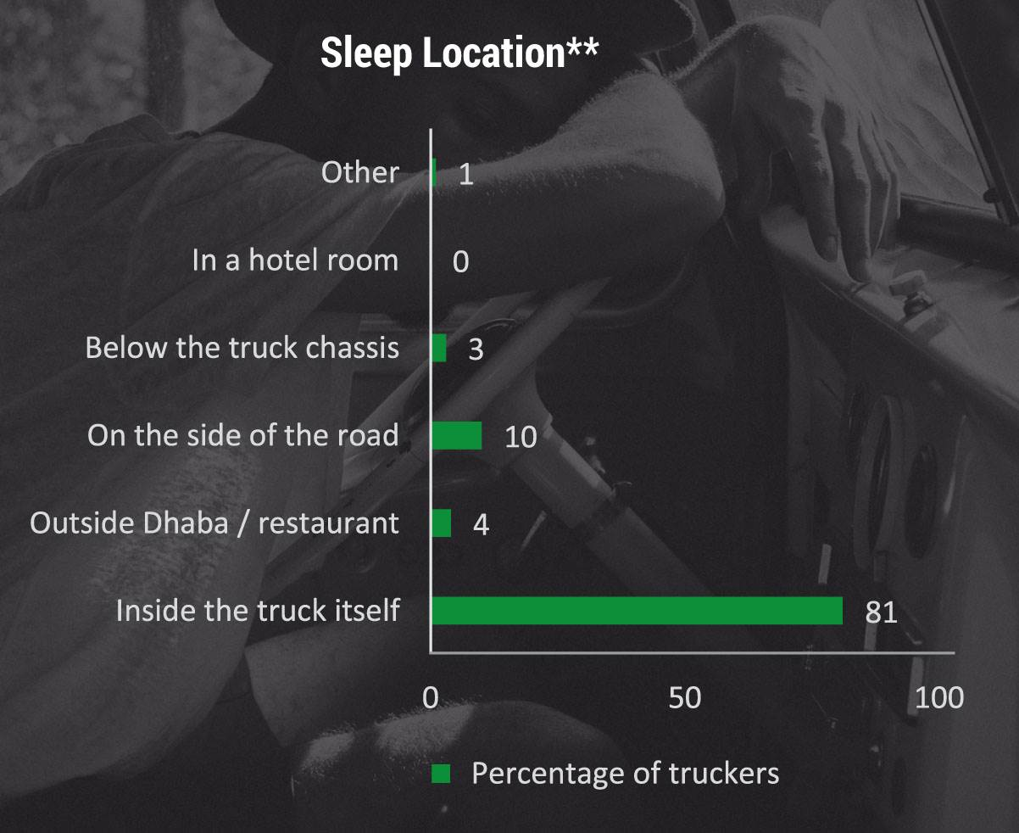
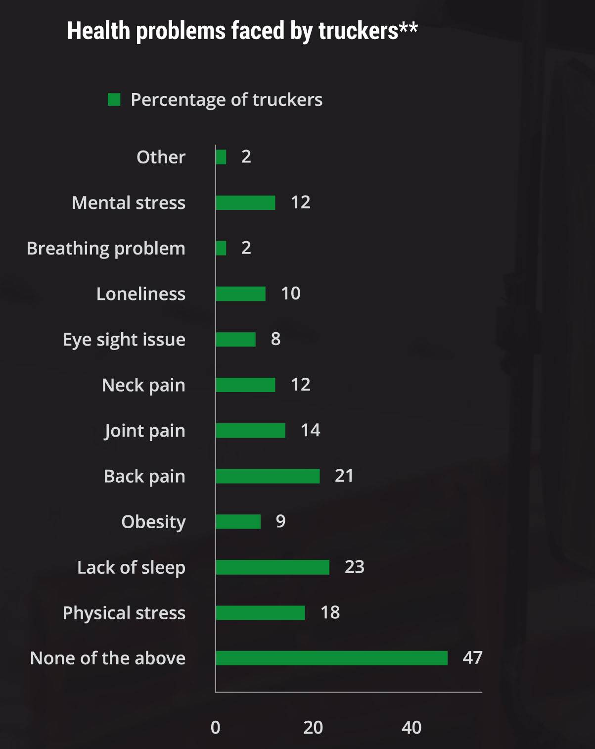
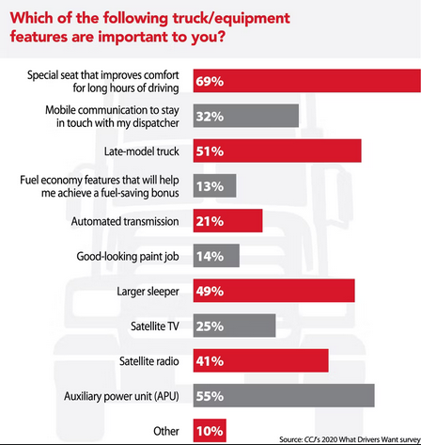
IIT ROORKEE
CCJ Digital
Autocarpro India

Slide 14
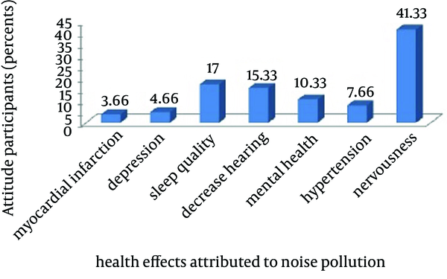
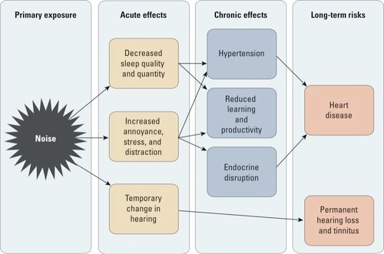
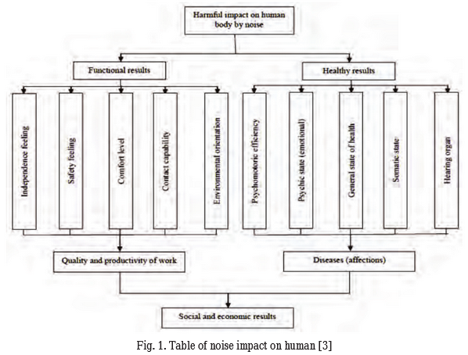
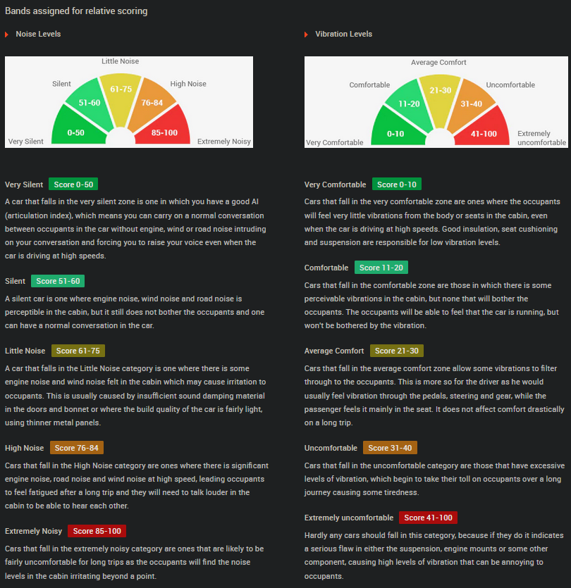
IIT ROORKEE
EHP
Brieflands
Siemens
Car Dekho
ResearchGate

Slide 15
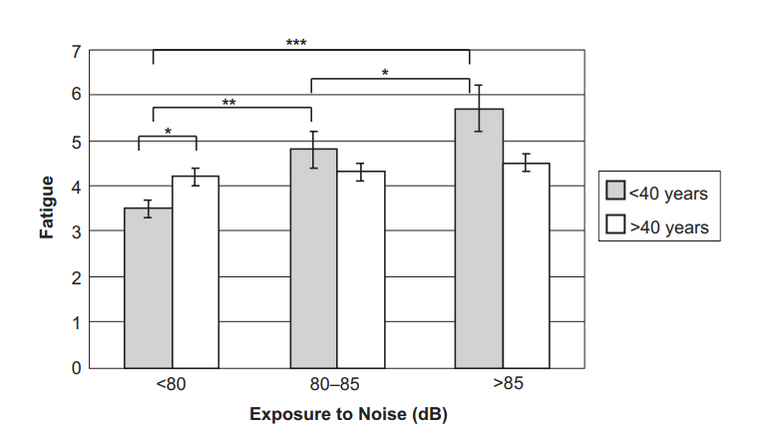
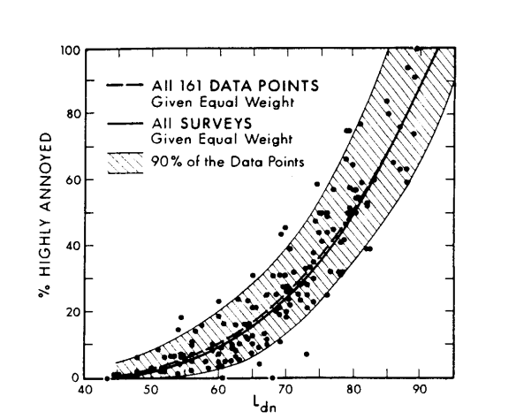
IIT ROORKEE
ResearchGate
ldn

Slide 16
NVH
How much NVH in their Trucks
How do NVH affect driver?
Real life problems with NVH with drivers
What are the different noises/vibrations in trucks
What are the NVH we need to eliminate
Cost to company for Air cushion seating system – 15,000 Rs.- Product cost (outsourced) + 5,000 - installment cost (within company)
Cost to company for Active seat suspension system – 8,000 + 3,000

Slide 17
