Slide 1
Project Overview - maybe -- intro and approach - 1 - Amogh, Bakshi 0:30
Vehicle Segment Selection -- 1 -Amogh 0:45
Performance Baselining -- 2 -Amogh, Tanisha 1:15
Modelling and Drive Cycle -- 3,4 -Sangeet, Arjav, Bakshi 3 :00
Motor Selection -- 1 -Anchit, Tanisha 1:00
Inverter Design and Selection -- 3 -Roshan 2:30
Battery Dimensioning -- 1 -Bakshi 1:15
Battery Optimization --4 -Bakshi, Anchit 1:45
EE Architecture -- 5 -Asati, Sangeet 1:30
Conclusion -- 1 (scope of improvement) -- automatic transmission, regen 1:00
fuzzy logic, modelling auxiliary loads properly, modelling batteries properly.
Segment selection 5
Baselining 10
Modelling 20
Motor , inverter design 25
Battery Dimensioning and Optimization 15
EE architecture 10
Overall/ Conclusion 5

Slide 2


INTER IIT TECH MEET 9.0
ELECTRIC VEHICLE SIMULATION
Notes:
We will be covering all the problem statements
[

Slide 3





Glimpses of Formula Student
I I T R O O R K E E
M O T O R S P O R T S
SUB-HEADING GOES HERE!
Sub-sub Heading goes here!
Wonder to the eyes
Wonder to the eyes
Excellent Work
{Highlight using extra bold}
FSEV Challenge 2021

Slide 4
Glimpses of Formula Student
I I T R O O R K E E
M O T O R S P O R T S
SUB-HEADING GOES HERE!
Sub-sub Heading goes here!
Wonder to the eyes
Wonder to the eyes
Excellent Work
{Highlight using extra bold}
FSEV Challenge 2021

Slide 5
Glimpses of Formula Student
I I T R O O R K E E
M O T O R S P O R T S
SUB-HEADING GOES HERE!
Sub-sub Heading goes here!
Wonder to the eyes
Wonder to the eyes
Excellent Work
{Highlight using extra bold}
FSEV Challenge 2021

Slide 6
Glimpses of Formula Student
I I T R O O R K E E
M O T O R S P O R T S
SUB-HEADING GOES HERE!
Sub-sub Heading goes here!
Wonder to the eyes
Wonder to the eyes
Excellent Work
{Highlight using extra bold}
FSEV Challenge 2021

Slide 7
Glimpses of Formula Student
I I T R O O R K E E
M O T O R S P O R T S
SUB-HEADING GOES HERE!
Sub-sub Heading goes here!
Wonder to the eyes
Wonder to the eyes
Excellent Work
{Highlight using extra bold}

Slide 8
Project Overview
Powertrain Sizing
Battery Optimisation
Vehicle Segment Selection
Performance Baselining
Final Vehicle Model
Final Results
Preliminary Vehicle Modelling
Electric Drive Dimensioning
Notes:
45 sec

Slide 9
Selection of Vehicle Segment
SEGMENT SELECTION
For the event, we chose to design a Ultra Light Commercial Vehicle (ULCV)
PHOTO OF A ULCV
Why? Let us have a look !

Slide 10
Selection of Vehicle Segment
SEGMENT SELECTION
EVs need to be economically viable -> B2Bs
Photo aati jayegi about each point
EVs : Maximum efficiency gains in Urban and Semi-Urban transport
Promising Market growth in ULCV segment
Small investment need in charging infrastructure
Long life cycle and Low maintenance costs gain importance
Best target for early adoption
Early mover’s advantage
Easier to offer customer support -language
Notes:
We focussed on B2Bs - Cost justification B2B focussed -
EV is better suited for cities(urban and semi-urban) rather than highways.
Low maintanance.
Demand growth due to e-commerce.(Like Tata Ace ,Tata Magic have shown cosiderable growth).
B2B will usually involve fixed routes so charging can be scheduled and managed.
Environment.
Best target for early adoption - fuel consumption and distance travelled per day - biggest impact with minimum need for drastic measures/ market disruption
Untapped market potential - passenger, vehicles - big players involved, significant development, trucks, buses - still we see electric ones, but ulcvs - NO
Story ki atrah single para ki tarah bata
Market share B2b vehicles ka, ULCVs ka, percentage growth rojections for both
Cost analysis, ex of popularity of autorickshaws, okinawa
Justification via image
Market growth till now, future projections
Normal photo / consumer vehicle ki charging infra per dependence dikha do
Avg life cycle improvement, maintenance cost reduction
Fuel, dist covered stats
Show no. of 2W/cars/buses/trucks, then show ulcvs launched in india
Torque graph comparison
Show map of registered ulcvs to show concentration in cities

Slide 11
Selection of Vehicle Segment
Target B2Bs - Economic Viability, greater Impact
Photo aati jayegi about each point
EVs : Maximum efficiency gains in Urban and Semi-Urban transport
Promising Market growth in ULCV segment
Small investment need in charging infrastructure
Long life cycle and Low maintenance costs gain importance
Early mover’s advantage,
Easier to offer customer support-language
Notes:
We focussed on B2Bs - Cost justification B2B focussed -
EV is better suited for cities(urban and semi-urban) rather than highways.
Low maintanance.
Demand growth due to e-commerce.(Like Tata Ace ,Tata Magic have shown cosiderable growth).
B2B will usually involve fixed routes so charging can be scheduled and managed.
Environment.
Best target for early adoption - fuel consumption and distance travelled per day - biggest impact with minimum need for drastic measures/ market disruption
Untapped market potential - passenger, vehicles - big players involved, significant development, trucks, buses - still we see electric ones, but ulcvs - NO
Story ki atrah single para ki tarah bata
Market share B2b vehicles ka, ULCVs ka, percentage growth rojections for both
ex of popularity of autorickshaws, okinawa
Justification via image
Market growth till now, future projections
Normal photo / consumer vehicle ki charging infra per dependence dikha do
Avg life cycle improvement, maintenance cost reduction
Fuel, dist covered stats
Show no. of 2W/cars/buses/trucks, then show ulcvs launched in india
Torque graph comparison
Show map of registered ulcvs to show concentration in cities

Slide 12
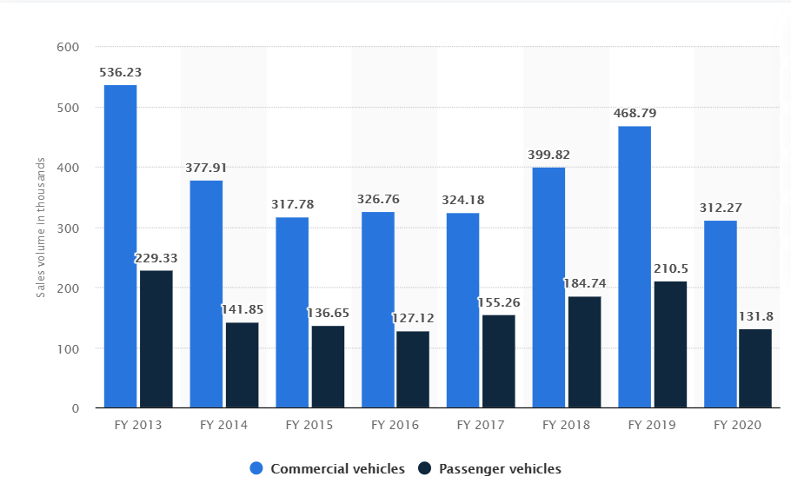
Selection of Vehicle Segment
Our Target : B2Bs - Faster adoption, Greater Impact
Segment-wise Sales figures of Tata Motors
Economic Viability and durability
Ideal segment for Efficiency gains
Promising Market segment growth ; Nascent w.r.t. EVs
Modest Charging and Service infrastructure need
Notes:
We focussed on B2Bs - Cost justification B2B focussed -
EV is better suited for cities(urban and semi-urban) rather than highways.
Low maintanance.
Demand growth due to e-commerce.(Like Tata Ace ,Tata Magic have shown cosiderable growth).
B2B will usually involve fixed routes so charging can be scheduled and managed.
Environment.
Best target for early adoption - fuel consumption and distance travelled per day - biggest impact with minimum need for drastic measures/ market disruption
Untapped market potential - passenger, vehicles - big players involved, significant development, trucks, buses - still we see electric ones, but ulcvs - NO
Story ki atrah single para ki tarah bata
Market share B2b vehicles ka, ULCVs ka, percentage growth rojections for both
ex of popularity of autorickshaws, okinawa
Justification via image
Market growth till now, future projections
Normal photo / consumer vehicle ki charging infra per dependence dikha do
Avg life cycle improvement, maintenance cost reduction
Fuel, dist covered stats
Show no. of 2W/cars/buses/trucks, then show ulcvs launched in india
Torque graph comparison
Show map of registered ulcvs to show concentration in cities

Slide 13
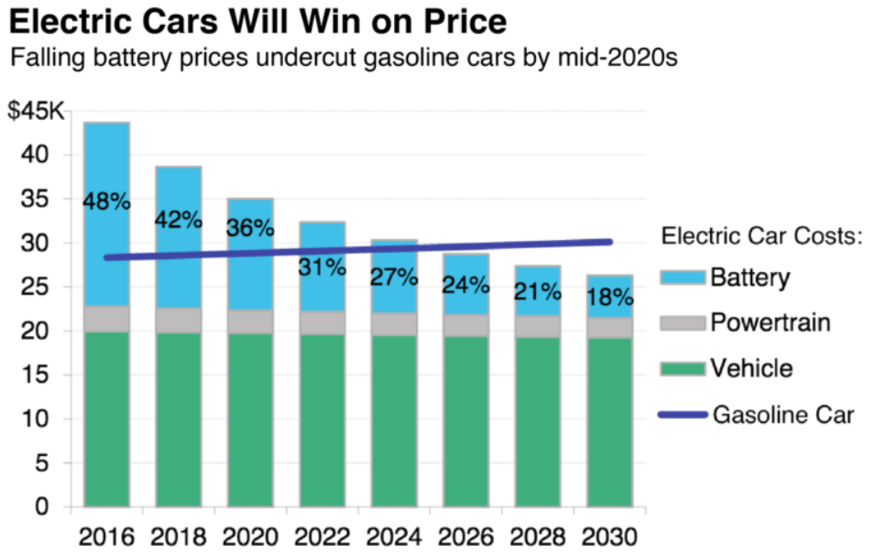
Selection of Vehicle Segment
Our Target : B2Bs - Faster adoption, Greater Impact
Economic Viability and durability
Ideal segment for Efficiency gains
Promising Market segment growth ; Nascent w.r.t. EVs
Modest Charging and Service infrastructure need
Notes:
We focussed on B2Bs - Cost justification B2B focussed -
EV is better suited for cities(urban and semi-urban) rather than highways.
Low maintanance.
Demand growth due to e-commerce.(Like Tata Ace ,Tata Magic have shown cosiderable growth).
B2B will usually involve fixed routes so charging can be scheduled and managed.
Environment.
Best target for early adoption - fuel consumption and distance travelled per day - biggest impact with minimum need for drastic measures/ market disruption
Untapped market potential - passenger, vehicles - big players involved, significant development, trucks, buses - still we see electric ones, but ulcvs - NO
Story ki atrah single para ki tarah bata
Market share B2b vehicles ka, ULCVs ka, percentage growth rojections for both
ex of popularity of autorickshaws, okinawa
Justification via image
Market growth till now, future projections
Normal photo / consumer vehicle ki charging infra per dependence dikha do
Avg life cycle improvement, maintenance cost reduction
Fuel, dist covered stats
Show no. of 2W/cars/buses/trucks, then show ulcvs launched in india
Torque graph comparison
Show map of registered ulcvs to show concentration in cities

Slide 14
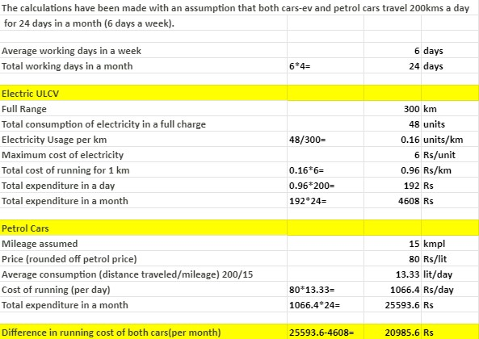
Selection of Vehicle Segment
Our Target : B2Bs - Faster adoption, Greater Impact
Economic Viability and durability
Ideal segment for Efficiency gains
Promising Market segment growth ; Nascent w.r.t. EVs
Modest Charging and Service infrastructure need
Notes:
We focussed on B2Bs - Cost justification B2B focussed -
EV is better suited for cities(urban and semi-urban) rather than highways.
Low maintanance.
Demand growth due to e-commerce.(Like Tata Ace ,Tata Magic have shown cosiderable growth).
B2B will usually involve fixed routes so charging can be scheduled and managed.
Environment.
Best target for early adoption - fuel consumption and distance travelled per day - biggest impact with minimum need for drastic measures/ market disruption
Untapped market potential - passenger, vehicles - big players involved, significant development, trucks, buses - still we see electric ones, but ulcvs - NO
Story ki atrah single para ki tarah bata
Market share B2b vehicles ka, ULCVs ka, percentage growth rojections for both
ex of popularity of autorickshaws, okinawa
Justification via image
Market growth till now, future projections
Normal photo / consumer vehicle ki charging infra per dependence dikha do
Avg life cycle improvement, maintenance cost reduction
Fuel, dist covered stats
Show no. of 2W/cars/buses/trucks, then show ulcvs launched in india
Torque graph comparison
Show map of registered ulcvs to show concentration in cities

Slide 15
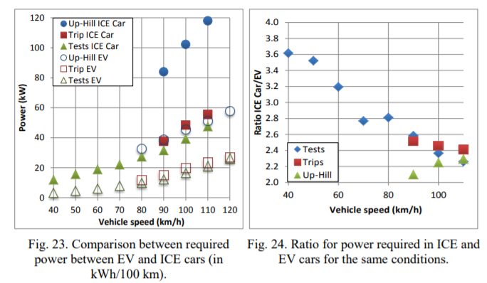
Selection of Vehicle Segment
Our Target : B2Bs - Faster adoption, Greater Impact
“EVs convert over 77% of the electrical energy from the grid to power at the wheels. Conventional gasoline vehicles only convert about 12% – 30% of the energy stored in gasoline to power at the wheels,”
US Department of Energy
Economic Viability and durability
Ideal segment for Efficiency gains
Promising Market segment growth ; Nascent w.r.t. EVs
Modest Charging and Service infrastructure need
Notes:
We focussed on B2Bs - Cost justification B2B focussed -
EV is better suited for cities(urban and semi-urban) rather than highways.
Low maintanance.
Demand growth due to e-commerce.(Like Tata Ace ,Tata Magic have shown cosiderable growth).
B2B will usually involve fixed routes so charging can be scheduled and managed.
Environment.
Best target for early adoption - fuel consumption and distance travelled per day - biggest impact with minimum need for drastic measures/ market disruption
Untapped market potential - passenger, vehicles - big players involved, significant development, trucks, buses - still we see electric ones, but ulcvs - NO
Story ki atrah single para ki tarah bata
Market share B2b vehicles ka, ULCVs ka, percentage growth rojections for both
ex of popularity of autorickshaws, okinawa
Justification via image
Market growth till now, future projections
Normal photo / consumer vehicle ki charging infra per dependence dikha do
Avg life cycle improvement, maintenance cost reduction
Fuel, dist covered stats
Show no. of 2W/cars/buses/trucks, then show ulcvs launched in india
Torque graph comparison
Show map of registered ulcvs to show concentration in cities

Slide 16
Selection of Vehicle Segment
Our Target : B2Bs - Faster adoption, Greater Impact
YEAR | TATA ACE CUMULATIVE SALES
2005 | 30,000
2006 | 1,00,000
2007 | 1,90,000
2008 | 2,70,000
2009 | 3,80,000
2010 | 5,40,000
2018 | 20,00,000
Economic Viability and durability
Ideal segment for Efficiency gains
Promising Market segment growth ; Nascent w.r.t. EVs
Modest Charging and Service infrastructure need
In vehicle units
Notes:
We focussed on B2Bs - Cost justification B2B focussed -
EV is better suited for cities(urban and semi-urban) rather than highways.
Low maintanance.
Demand growth due to e-commerce.(Like Tata Ace ,Tata Magic have shown cosiderable growth).
B2B will usually involve fixed routes so charging can be scheduled and managed.
Environment.
Best target for early adoption - fuel consumption and distance travelled per day - biggest impact with minimum need for drastic measures/ market disruption
Untapped market potential - passenger, vehicles - big players involved, significant development, trucks, buses - still we see electric ones, but ulcvs - NO
Story ki atrah single para ki tarah bata
Market share B2b vehicles ka, ULCVs ka, percentage growth rojections for both
ex of popularity of autorickshaws, okinawa
Justification via image
Market growth till now, future projections
Normal photo / consumer vehicle ki charging infra per dependence dikha do
Avg life cycle improvement, maintenance cost reduction
Fuel, dist covered stats
Show no. of 2W/cars/buses/trucks, then show ulcvs launched in india
Torque graph comparison
Show map of registered ulcvs to show concentration in cities

Slide 17
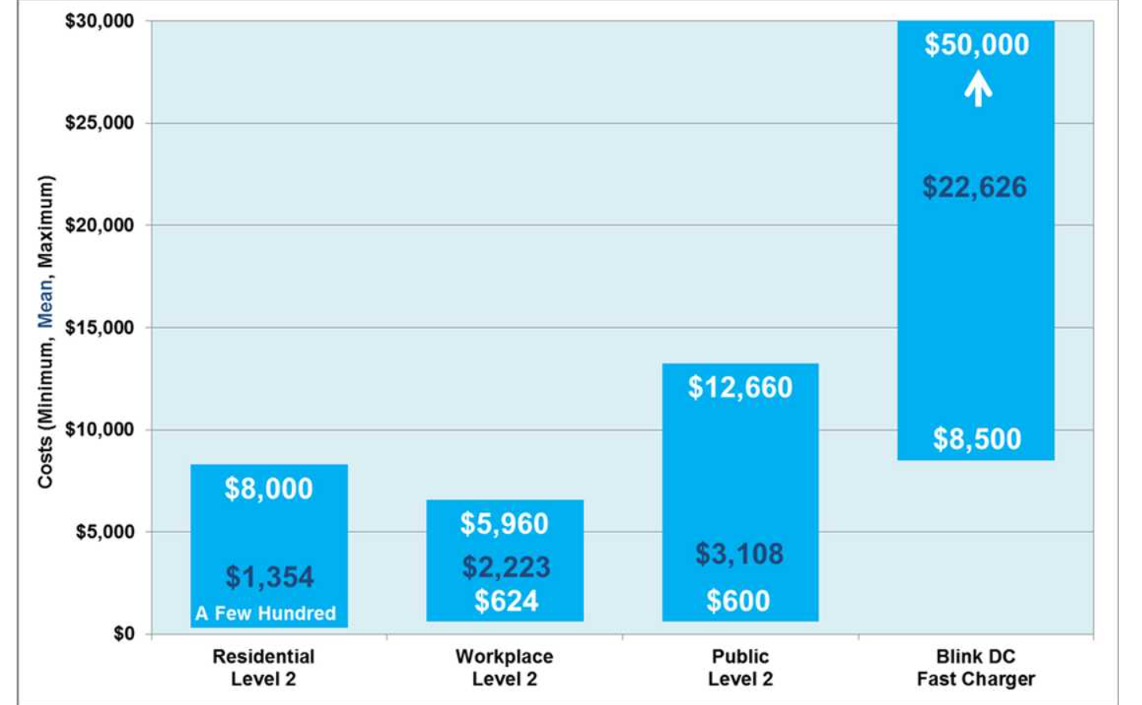
Selection of Vehicle Segment
Our Target : B2Bs - Faster adoption, Greater Impact
Charger Installation costs according to category
Economic Viability and durability
Ideal segment for Efficiency gains
Promising Market segment growth ; Nascent w.r.t. EVs
Modest Charging and Service infrastructure need
Notes:
We focussed on B2Bs - Cost justification B2B focussed -
EV is better suited for cities(urban and semi-urban) rather than highways.
Low maintanance.
Demand growth due to e-commerce.(Like Tata Ace ,Tata Magic have shown cosiderable growth).
B2B will usually involve fixed routes so charging can be scheduled and managed.
Environment.
Best target for early adoption - fuel consumption and distance travelled per day - biggest impact with minimum need for drastic measures/ market disruption
Untapped market potential - passenger, vehicles - big players involved, significant development, trucks, buses - still we see electric ones, but ulcvs - NO
Story ki atrah single para ki tarah bata
Market share B2b vehicles ka, ULCVs ka, percentage growth rojections for both
ex of popularity of autorickshaws, okinawa
Justification via image
Market growth till now, future projections
Normal photo / consumer vehicle ki charging infra per dependence dikha do
Avg life cycle improvement, maintenance cost reduction
Fuel, dist covered stats
Show no. of 2W/cars/buses/trucks, then show ulcvs launched in india
Torque graph comparison
Show map of registered ulcvs to show concentration in cities

Slide 18
Performance Baselining
USE CASE SCENARIOS OF A ULCV
Loaded / unloaded equal distance of travel
Flyovers / gradient roads - part of travel, but say only 10%
High Traffic operation -60 % of the time
High speed/highway cruise operation - 30% of the time
Notes:
Loaded / unloaded equal distance of travelto the eyes
Flyovers / gradient roads - part of travel, but say only 10%
High Traffic operation -60 % of the time
High speed/highway cruise operation - 30% of the time

Slide 19
Performance Baselining
S/N | Parameter | Baseline | Reasoning
1. | Load Capacity | 800 kg | Desired market segment ; from market comparison
2. | Top Speed | 75 km/h * | Matches the speed limit in most urban and semi-urban areas, for occasional highway cruising
3. | Target Gradeability | 21% (12 deg) * | For commercial applications and hilly roads
4. | Braking Distance | 50-0 km/h in 15m * | Identical to small passenger car braking distance
5. | Max Acceleration | > 1.5 m/s² * | Does 0-30 kmph in 5 seconds
6. | Range | 300 km * | For hassle-free complete day / shift operation
7. | HVAC & Motorized Loads | 1.5 kW | Recommended by the judges (Single cabin)
* All the values at maximum payload condition ( GVW = 1712 kg)
GVW : Gross Vehicle Weight = Car weight + Driver’s Weight + Max Payload Weight
Notes:
Braking dist - ps://www.consumerreports.org/car-safety/best-and-worst-braking-distances/
We did a study about the use case scenarios and specifications of existing ULCVs like TATA Ace to determine the baseline performance for our vehicle.
For example, Payload capacity was set to 800kg which is similar to TATA ACE’s 750kg capacity. Target Gradability was also set by taking the gradient of roads in consideration. Top Speed at loaded condition matches the max allowed speed for commercial vehicles on highways, and the range is set by considering a ULCV’s daily usage

Slide 20
Performance Baselining
Top speed
Baselined at 60 kmph for highway/open road cruising
Speed limit is usually 60 kmph in most city regions across India
Load Capacity
Current market segment comparison = 1000kg - what competitors are offering
Gradeability
Use case - in hilly regions, hilly patches in cities
Highways : 3-5 degrees is standard
City Flyovers : 5-7 degrees is standard
Requires high torque => bigger motor => translates into high acceleration - not relevant for ULCVs => compromise
Starting gradeability => 10 degrees at full load capacity

Slide 21
Performance Baselining
Braking Distance
60 mph to 0 - 120 ft - convert in km, m
Load Capacity
Current market segment comparison = 1000kg
Gradability - use case - in hilly regions, hilly patches in cities
Highways - 3-5 degrees is standard
City Flyovers - 5-7 degrees is standard
Requires high Torque =>bigger motor - translates into high acceleration - not relevant for ULCVs - > compromise
Starting gradability >= 10 degrees at full load capacity

Slide 22
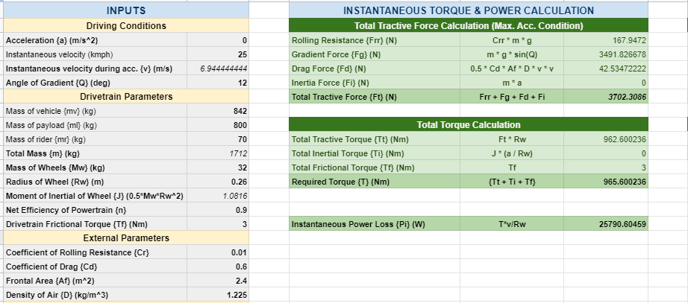
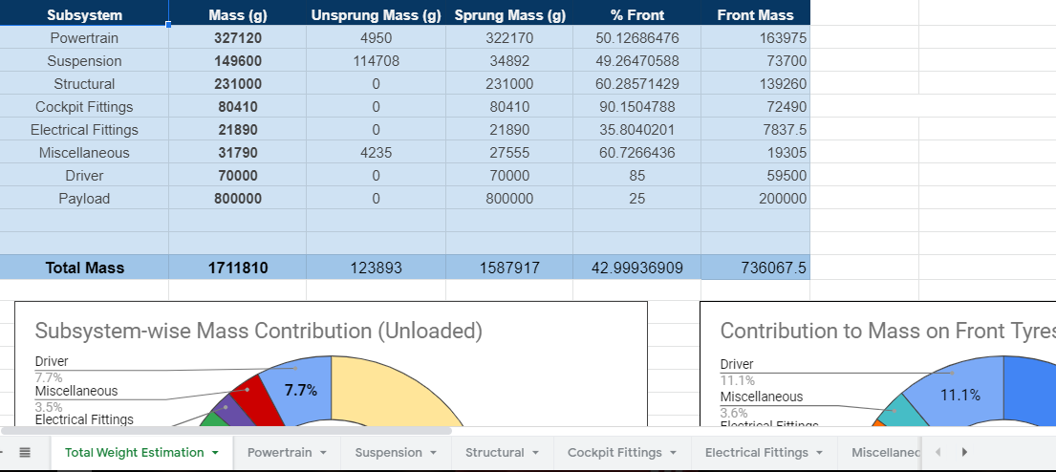
Mathematical Modeling & Analysis
PRELIMINARY MODELING
Torque & Power Calculator
This dynamic Google Sheet was made to perform preliminary motor sizing calculations. Any state can be defined by Acceleration, Velocity, & Gradient Angle, and the corresponding Torque & Power requirements can be calculated.
Mass & CG Estimation
This dynamic Google Sheet was made to perform preliminary mass & CG estimation for the proposed vehicle. Mass of components was approximated on Subsystem level to predict the final mass & CG location.
Notes:
To understand the Torque and Power requirement for our vehicle, we began the preliminary modelling by making dynamic spreadsheet which gives us the required Torque & Power for any given condition defined by the acceleration, velocity, and grade angle at any point. Vehicle parameters like the mass, drag coefficient, frontal area were given as inputs. This sheet was subsequently used for Motor sizing. We also made a dynamic spreadsheet for the Mass & CG Estimation of the vehicle

Slide 23
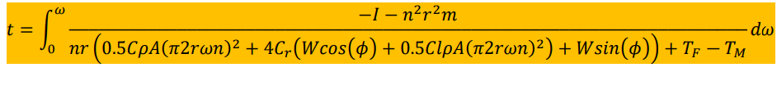
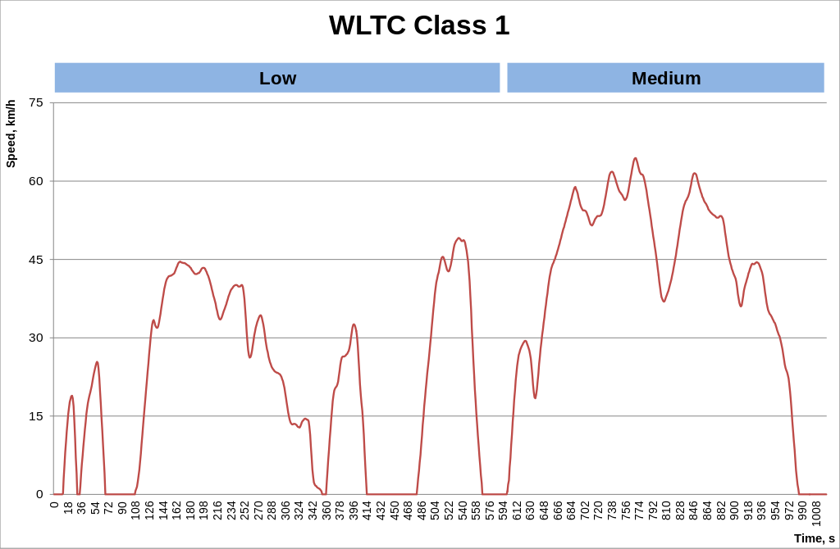
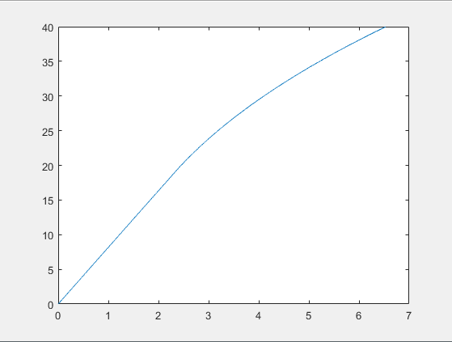
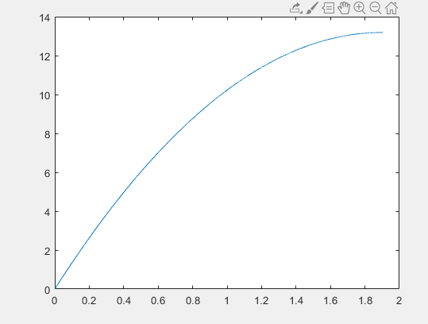
Mathematical Modeling & Analysis
PRELIMINARY MODELING
Longitudinal VD Differential Equation
Acceleration Time Calculation
Braking Distance Calculation
WLTP/WLTC Class 1 Low
WLTP is a global harmonized standard for determining the levels of pollutants, fuel consumption of IC cars, as well as the range of EVs. It offers different classes based on the Energy to Mass ratio.
We have used the WLTP Class 1 Low drive cycle for the consequent Integrated & Powertrain Sizing simulations
Full Throttle & Full Braking Simulations
MATLAB scripts were used to numerically solve the Longitudinal Differential Equation, as shown in the figure.
The values of acceleration time, overtaking time, and the braking distance were calculated using these scripts and the corresponding Drive Cycles were generated.
Notes:
For the range estimation, we used the WLTP Class 1 Low drive cycle. WLTP is the standard drivecycle used globally for the range estimation of EVs. Based on our Energy to mass ratio and our top speed we decided to use the ‘Class 1’ WLTP.
To calculate the acceleration time and the braking distance we created a MATLAB scripts which solve the shown differential equation numerically and give us results for varying vehicle parameters like gear ratio or the braking torque.

Slide 24
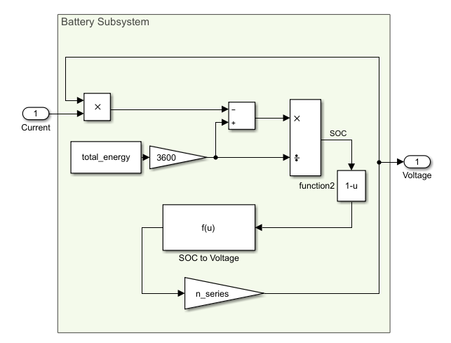
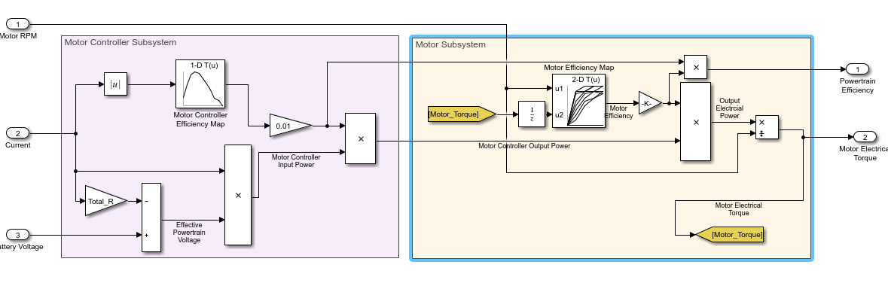
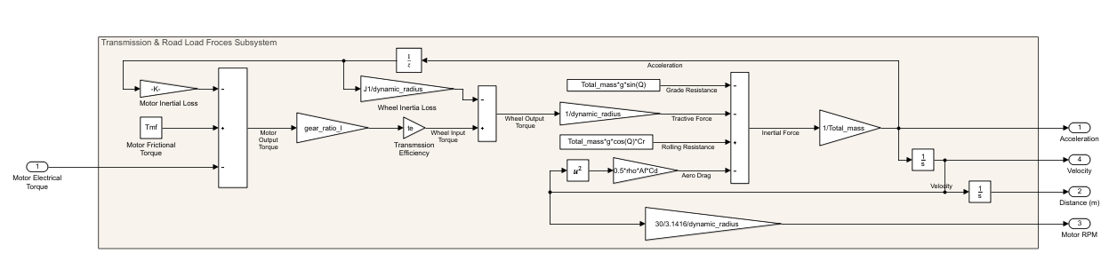
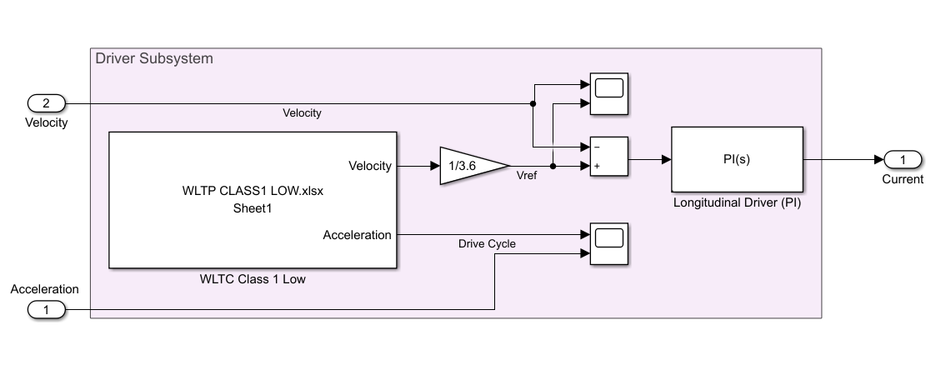
Mathematical Modeling & Analysis
SUBSYSTEM MODELING
Battery Subsystem
Motor & Motor Controller Subsystem
Transmission & Road Load Forces Subsystem
Longitudinal Driver (PI) Subsystem
Notes:
We then used the data from preliminary models, and the efficiency maps generated using motor & motor controller model to develop various sub-system level models like Battery subsystem, Longitudinal Driver (PI) subsystem, Motor & Motor Controller Subsystem, and the Transmission & Load Forces Subsystem.

Slide 25
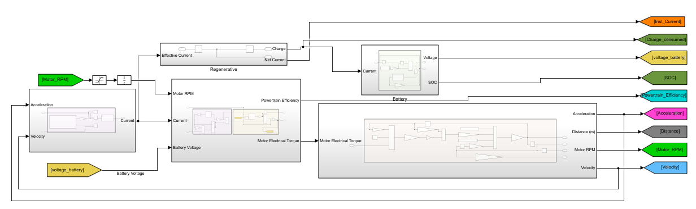
Mathematical Modeling & Analysis
INTEGRATED VEHICLE MODEL
Integrated Vehicle Model
Useful Results:
Motor Torque Profile
Motor Speed (RPM) Profile
Power Consumption Profile
Tractive & Regenerative Current Profiles
Powertrain Losses (Motor, Motor Controller, Batteries)
Battery SOC Profile
Notes:
All the subsystem models were then integrated to make the full vehicle model which uses drive cycle data to give the reference velocity to the PI Driver which then gives input signals to rest of the subsystems.This model provides various useful results like the Motor Torque Profile, Power Consumption Profile, Battery SOC profile etc.

Slide 26
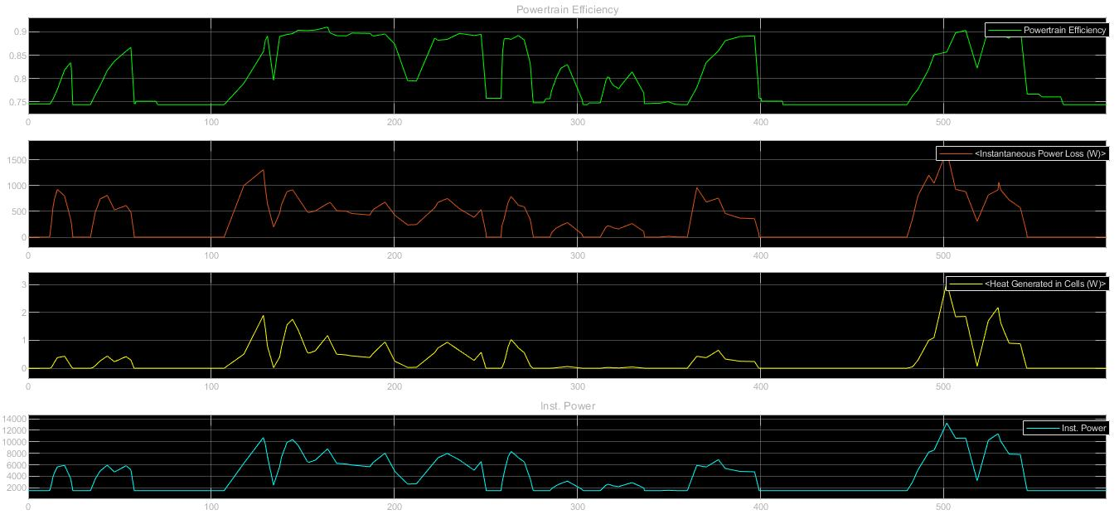
Mathematical Modeling & Analysis
VEHICLE MODEL - RESULTS
Tractive & Regenerative Current Profiles
Powertrain Losses (Motor, Motor Controller, Batteries)
Battery SOC Profile
Notes:
These are some of the results/plots that we received from our vehicle model

Slide 27
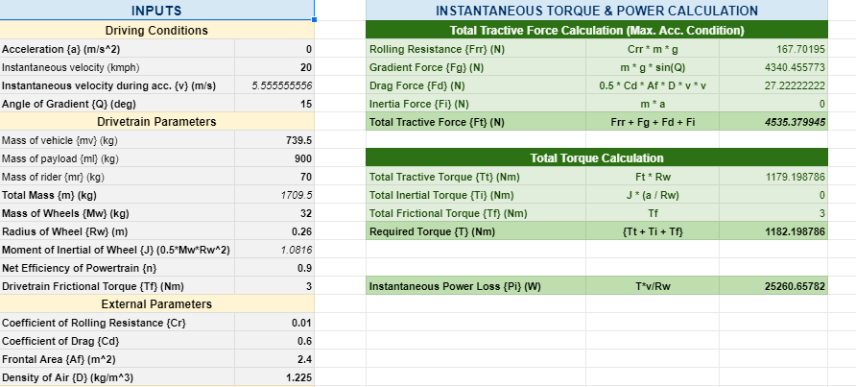
Electric Drive Dimensioning
MOTOR SIZING
Motor Sizing/Dimensioning Process:
Performance Baselining
Preliminary Modelling
Required Parameters
S/N | Velocity (km/h) | Acceleration (m/s²) | Gradient (degree) | Required Torque (Nm) | Motor Power (kW)
1. | 80 | 0 | 0 | 156 | 13.7
2. | 30 | 0.6 | 0 | 332 | 10.6
3. | 10 | 1 | 6 | 954 | 10.2
4. | 35 | 0 | 8 | 676 | 25.3
5. | 25 | 0 | 12 | 965 | 25.8
Notes:
We further utilized the results from the mathematical modelling shown in the previous slide to produce sizing values for our motor. We made a dynamic spreadsheet containing basic vehicle parameters and certain variables, allowing us to roughly examine the the extent to which they affect the sizing values, which include required torque and the motor output power. We followed this up by making a preliminary powertrain loss model in Simulink to back our claims. On plugging in reasonable values for the vehicle velocity, acceleration and gradient angle, we ended up obtaining the maximum motor output power required to be around 25.8 kW.

Slide 28
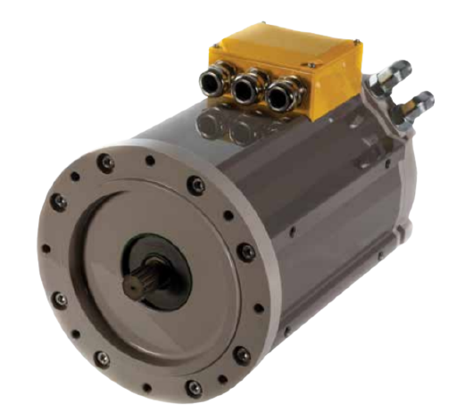
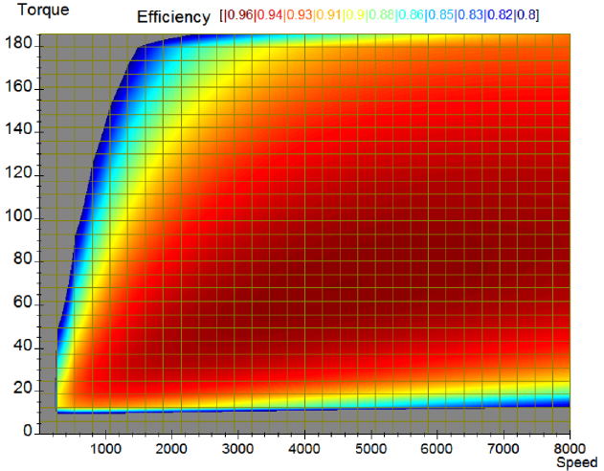
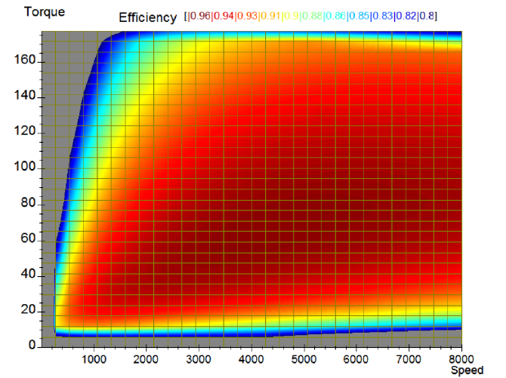
Electric Drive Dimensioning
MOTOR SELECTION
Metrics (@ 350V) | Peak | Rated
Motor Torque | 165 Nm | 77 Nm
Shaft Power | 26 kW | 18 kW
Motor Speed | 2964 RPM | 2248 RPM
Stall Current | 97 Amp RMS | 48 Amp RMS
Thermal Management | Liquid-Cooled
GVM 210-100D PMSM Traction Motor
High Efficiency (~96%)
Highly Reliable Vendor - Parker’s GVM
Detailed Datasheets with experimental data
Well-drawn efficiency curves for both generator and motor mode
Efficiency in generator operation mode
Efficiency in motor operation mode
Notes:
We decided to choose a commercially available motor instead of designing one from the scratch, simply owing to the lack of time. We decided to go with GVM210-100D PMSM Traction motor by ‘Parker’ as the motor choice for our vehicle. The motor peak output power for this model is 26kW, which is greater than the peak 25.8kW obtained from the motor sizing procedure followed as explained in the previous slide.

Slide 29
Electric Drive Dimensioning
MOTOR CONTROLLER DESIGN
- FoC of Motor
Less Noise
Less Harmonics in current
Better Efficiency
- Constant switching frequency
- Sinusoidal PWM
- Modelled switching and conduction losses
Notes:
So after finalizing the power rating we moved on to design our Motor Controller. After initial research we found out that FoC control of motor is more suitable for our higher power applications because it directly controls the current and hence less harmonics and noise in low speed conditions as compared to DTC. Also it has higher efficiency because of which we had planned to implement it in our model.
For the first version we decided to go with constant switching frequency as it was easier to implement and control
Modelled the conduction and switching losses of the IGBT’s which we have selected according to our requirements.
According to the simulation we were able to tune the PI controller such that the current follows the reference current with low error.

Slide 30
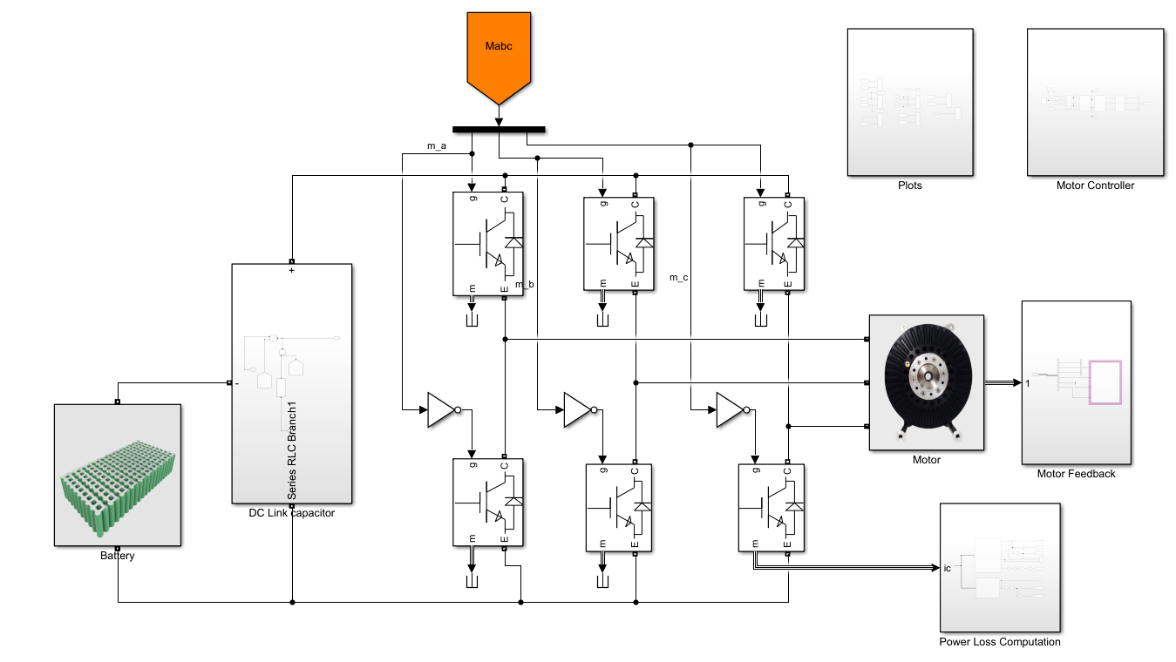
Electric Drive Dimensioning
MOTOR CONTROLLER DESIGN
Notes:
This is the image of outer section os simulink model which we made in matlab

Slide 31
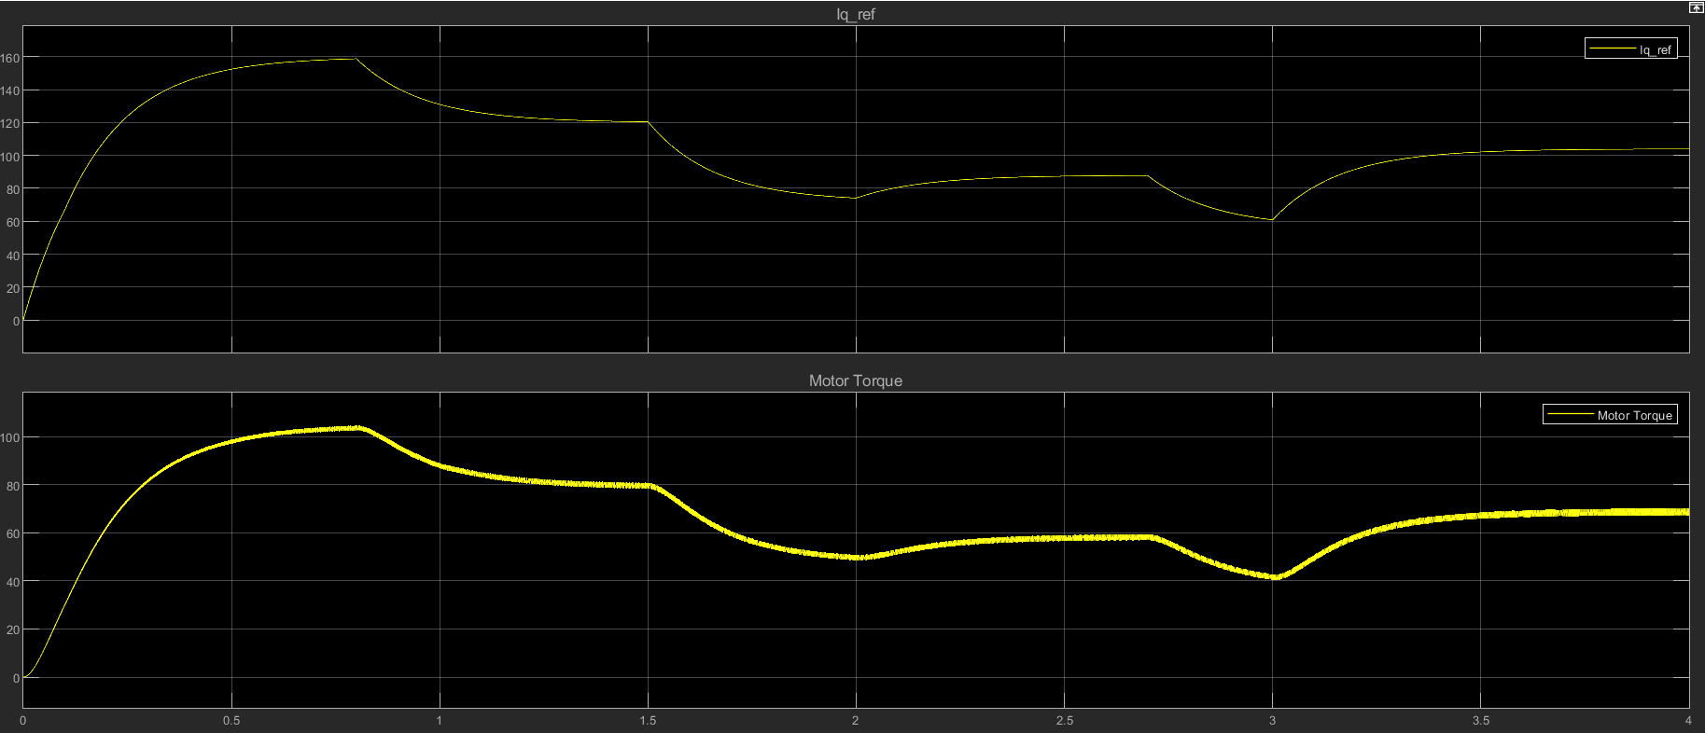
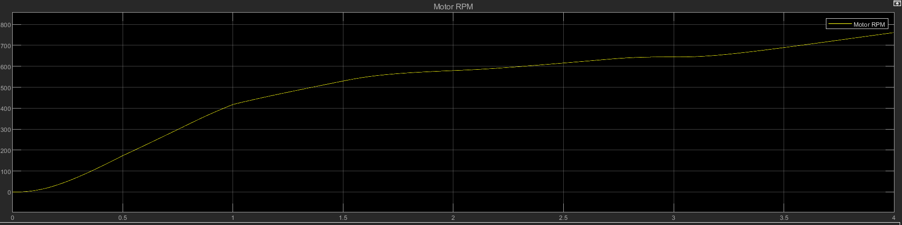
Electric Drive Dimensioning
MOTOR CONTROLLER RESULTS
Notes:
This is the image showing the electromagnetic torque with less ripples developed by the motor which we got from our simulations

Slide 32
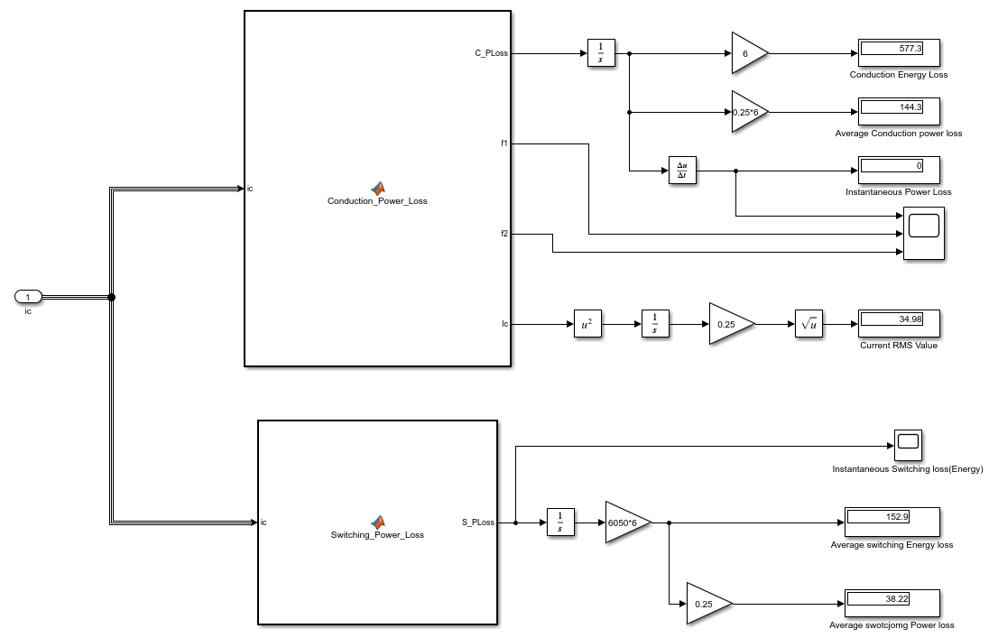
Electric Drive Dimensioning
MOTOR CONTROLLER RESULTS
Notes:
This is the power loss block where we confirmed the losses values with the official manufacturers power loss values and it fits the result with about and error of 3%

Slide 33
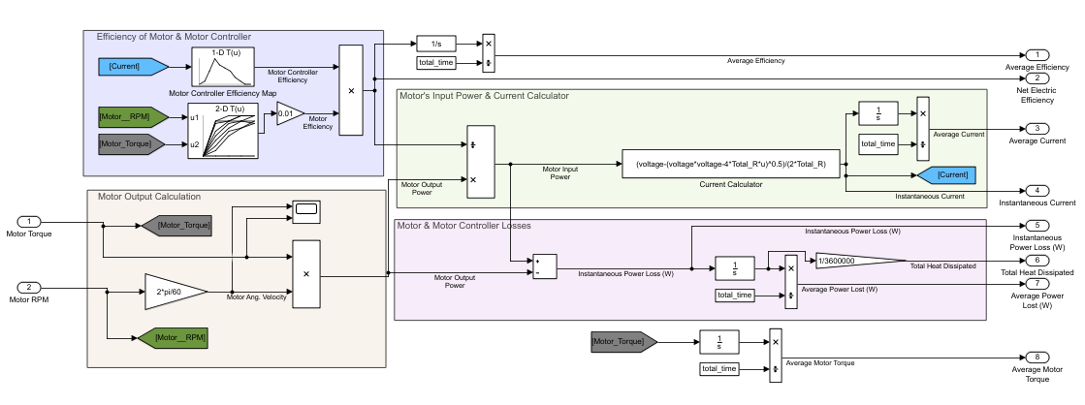
Battery Dimensioning
POWERTRAIN SIZING MODEL
Subsystem Level Models:
Motor & Motor Controller Subsystem
Notes:
Now, for the battery dimensioning, we used a separate Powertrain Sizing model to determine the battery size required to cover a given distance corresponding to the various drive cycles and values of vehicle parameters like the gear ratio, drag coefficient, payload mass, etc. We began the process by making subsystem level models of motor & motor controller which takes in Motor Torque & Motor RPM as the inputs to get the instantaneous motor & motor controller’s efficiency and gives powertrain current and power losses as output.

Slide 34
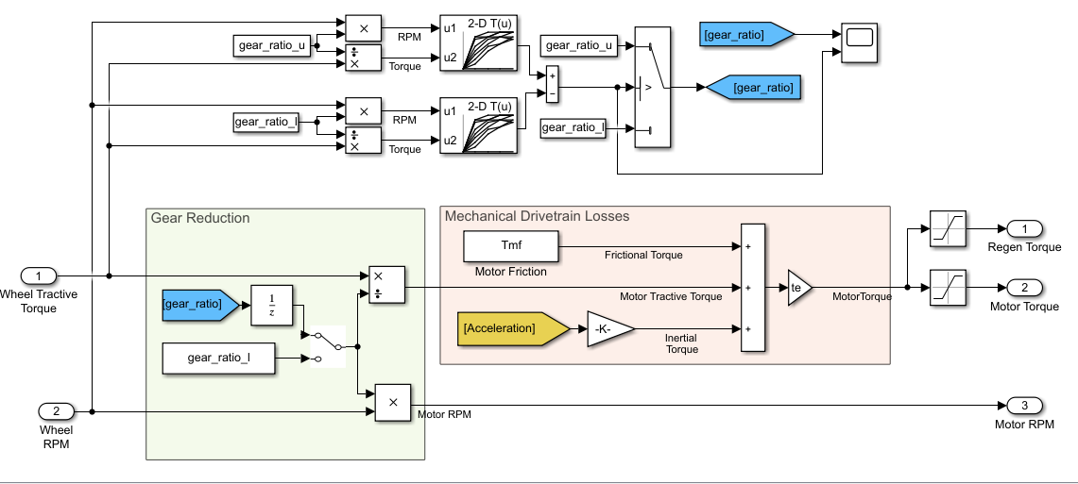
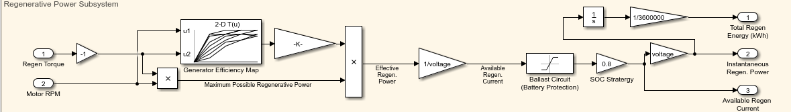
Battery Dimensioning
POWERTRAIN SIZING MODEL
Subsystem Level Models:
Transmission & Drivetrain Losses
Regenerative Power Calculations
Notes:
Other subsystems like the Transmission, Drive Train Losses, Road Load Forces Subsystem were also modelled to be used as a part of the integrated Powertrain Sizing Model. These subsystems convert the drive cycle data to Motor Torque & Motor RPM which can then be used by the motor & motor Controller subsystem.

Slide 35
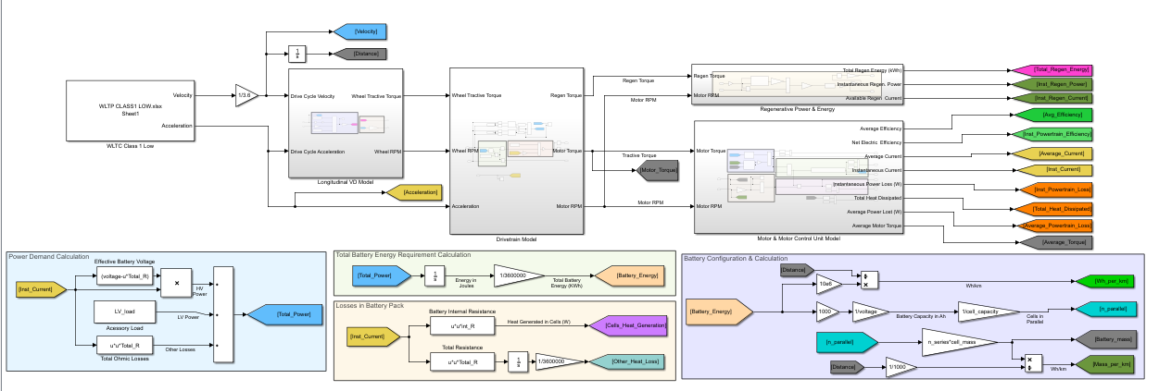
Battery Dimensioning
POWERTRAIN SIZING MODEL
Fully-Integrated Powertrain Sizing Model:
Notes:
All the subsystems mentioned in the previous slides are integrated to make the Powertrain Sizing Model as shown in this image. As mentioned before, this model can be used to determine the battery size for a given range with varying vehicle parameters.

Slide 36
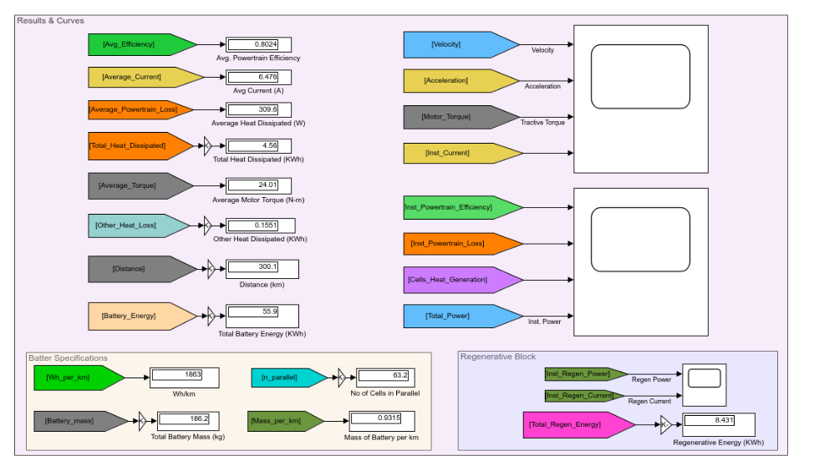
Battery Dimensioning
POWERTRAIN SIZING MODEL
Results of Powertrain Sizing Model:
Some Useful Results:
Total Battery Energy (kWh)
Total Regen Energy (kWh)
Power Consumption Profile
Powertrain Heat Losses
Average Motor Torque
Average Discharge Current
Mass of the Battery
Notes:
This Image contains the results from the powertrain sizing model. Some of the useful results that we can get from this model are: Total Battery Energy, Total Regen Energy, Mass of the cells, Powertrain Heat Losses, etc

Slide 37
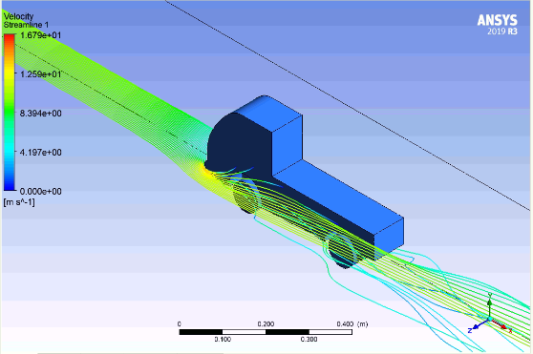
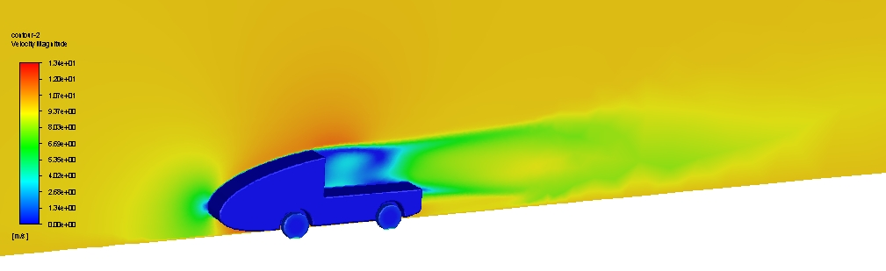
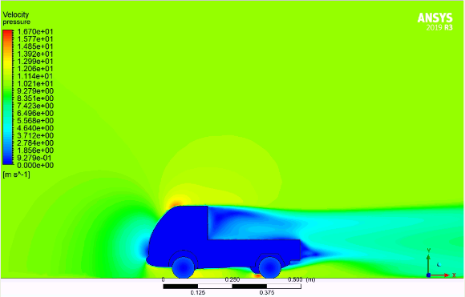
Battery Optimisation
OPTIMISATION METHODS
REDUCTION OF COEFFICIENT OF AERODYNAMIC DRAG:
Outcomes:
Aerodynamic Drag is the most significant Resistive Force at high speeds
Coefficient of Aerodynamic Drag can be reduced by changing:
- Front Profile of Vehicle - Ride Height -Bottom Profile of the Vehicle
Reducing the Coefficient from 0.86 to 0.52 can reduce the battery consumption by 3.9 kWh (6.4%)
Notes:
On the previous slides, we have shown in brief how the powertrain sizing model works, now in the Battery Optimisation section we will cover how this model can be used to reduce the battery size by varying certain parameters for the vehicle.
First method for battery optimisation is the reduction of drag coefficient of the vehicle. Aerodynamic Drag is the most significant Resistive Force on vehicle, especially at high speeds. By using CFD simulations we were able to reduce the Drag coefficient from 0.86, which is the drag coefficient for TATA ace, to 0.52 by changing the shape of the front of the vehicle. Corresponding to this design change we were able to reduce the battery size by 3.9 kWh

Slide 38
Battery Optimisation
OPTIMISATION METHODS
AUTOMATIC TRANSMISSION SYSTEM:
Specifications | Case 1* | Case 2 | Case 3 | Case 4**
No. of Gear Drives | 1 | 1 | 1 | 2
Gear Ratio | 4.9 | 6 | 3.6 | 6+3.6
Gradeability (%) | 17.6 | 21.2 | 12.6 | 21.2
Peak Velocity (km/h) | 59 | 48 | 80 | 80
Battery Size (300 km) | 60.9kWh | 62.2kWh | 60.1kWh | 59.2kWh
Wheel Torque
Motor Torque
Optimal Gear Ratio
Automatic Transmission System
Wheel RPM
Motor RPM
* Case 1 represents the best compromise b/w gradability & top speed.
** Case 4 represents the most efficient combination for an Automatic
Transmission 2-Gear Drive system.
Automatic Clutch & Actuator
Outcomes:
Multiple gear drives can be very useful in Commercial Vehicles which can have a highly varying Gross Vehicle Mass
Replacing a single gear drive with an Automatic 2-Gear drive increases Gradability, Top Speed, and even Efficiency of the powertrain
Optimising the Automatic Transmission for efficiency, we can reduce the battery size (300km) by 1.8 kWh (3%)
Notes:
Usually EVs have a single gear ratio as electric motors can have a high efficiency for a wide range of motor torque and RPM. But in case of a commercial vehicle with variable mass, using a multiple gear drive can not just increase the range of gradablity and top speed, but also the powertrain efficiency for a given motor .
As you can see in the table, Case 1 represents the best compromise for a single gear drive which gives as a gradability of 17.6% and top speed of 59 km/h fot the given motor. And, case 4 represents the configuration where the higher gear ratio gives as a higher gradablity of 21.2% and and the lower gear ratio gives us a top speed of 80km/h.
Also, using a transmission system which automatically changes the gear ratio to maximize the efficiency for any given configuration of torque & RPM, we can actually decrease the battery size by 1.8 kWh.

Slide 39
Battery Optimisation
OPTIMISATION METHODS
REGENERATIVE BRAKING SYSTEM:
Specifications | Case 1*
Peak Regen Torque | 90 Nm
Peak Regen Current (Ballast Circuit) | 40 A
SOC Strategy* | 0.65
Regenerative Energy (kWh) | 8.1
% Energy Regenerated | 13.3
Regen Torque
Generator Efficiency
Regenerated
Power
Ballast Circuit
Battery
Overcurrent Protection
Motor RPM
* SOC Strategy represents the decision to not store regenerated power to the battery at certain range of SOC (80-100 & 0-15)
Battery Voltage
Outcomes:
The maximum Regen Torque & Current have been limited to protect the Motor & the Li-ion batteries from damage
A very conservative SOC Strategy of 0.65 has been adopted to prevent the batteries to charge when the SOC is too high or too low
Using the specified configuration of Regenerative Braking system, we can reduce the required battery size by 8.1 kWh (13.3%)
Notes:
We have implemented regenerative braking in our model to increase the vehicle range. It has been ensured in the model that regenerative braking does not occur for a very high or very low SOC and at very high regen torque to prevent damage to the motor and the batteries. The excess current developed due to regen for the case of a high deceleration is to be dissipated through a ballast circuit, for overcurrent protection. Generator losses have also been modelled for calculating the generated power through regenerative braking.

Slide 40
Battery Optimisation
FINAL RESULTS
Specifications | Case 1* | Case 2 | Case 3 | Case 4 | Case 5**
No. of Gear Drives | 1 | 2 | 1 | 1 | 2
Gear Ratio | 4.9 | 6 + 3.6 | 4.9 | 4.9 | 6 + 3.6
Regenerative Braking | No | No | Conservative | No. | Conservative
Drag Coefficient | 0.86 | 0.86 | 0.86 | 0.5 | 0.5
Gradeability (%) | 17.6 | 21.2 | 17.6 | 17.6 | 21.2
Peak Velocity (km/h) | 60 | 80 | 60 | 60 | 80
Battery Size (for 300 km) | 60.9 kWh | 59.2 kWh | 52.8 kWh | 57.0 kWh | 47.5 kWh
% Reduction in Battery Size | N/A | 2.8 % | 13.3 % | 6.4 % | 22 %
* Case 1 is the unoptimised case, so it requires maximum energy (battery size) for completing 300 km
** Case 2 is the best optimised case, so it requires xx% less energy (battery size) than the Case 1 for completing 300 km
Other Useful Methods:
Reduction of Rolling Resistance from 0.01 to 0.008 by optimising tyre pressure
Reduction in Auxiliary load from 1.5kW to 0.5 kW by turning off HVAC system
Using Supercapacitors to be able to store more regenerative energy at high charging currents
Notes:
In this table, we are comparing the various cases to analyze the impacts changes mentioned in the previous slides have on the battery size. We can see by varying the drag coefficient, adding a 2-gear drive, and incorporating the regenerated energy, we can reduce the required battery size from 60.9 kWh to 47.5 kWh for a range of 300 km at fully loaded condition with 800 kg payload. This corresponds to a reduction of 22% in the battery size.
For the required nominal voltage of 350V, we need to put 98 Li-ion cells in series. So, for the optimal case, we need to use 53 cells in parallel with regen turned on which gives us a total capacity of 47.5 kWh. With regen turned off we need to use the 98s63p configuration of battery corresponding to 55.9 kWh of battery.

Slide 41
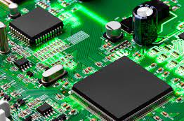
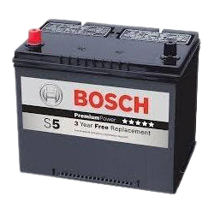
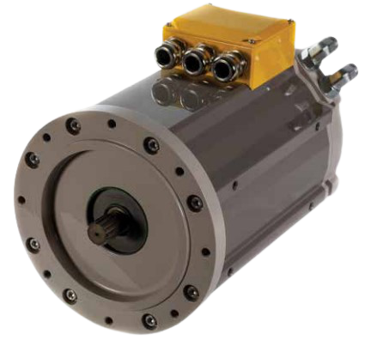
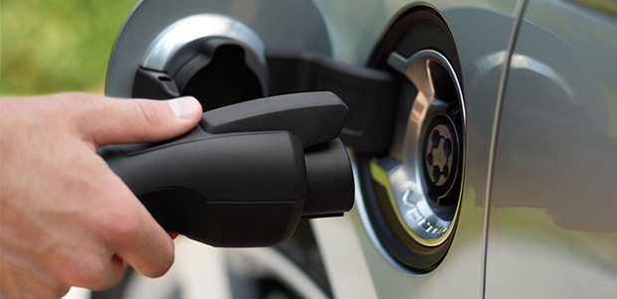
E/E Architecture
HV - - - -
BATTERY
MANAGEMENT
SYSTEM
BATTERY
BOX
High voltage power flow
Low voltage power flow
MOTOR
MOTOR
CONTROLLER

Slide 42
E/E Architecture
HV - - - -
DC-DC
CONVERTER
AUXILIARY
BATTERY
BATTERY
MANAGEMENT
SYSTEM
BATTERY
PACK
High voltage power flow
Low voltage power flow
MOTOR
OFF-BOARD
CHARGER
MOTOR
CONTROLLER
MOTOR

Slide 43
E/E Architecture
HV ARCHITECTURE
BATTERY AIR-COOLING SYSTEM
HVAC
System
DC DC CONVERTER
AUXILIARY BATTERY
BATTERY
PACK
POWER DISTRIBUTION DC BUS
MOTOR
CONTROLLER
MOTOR
BATTERY MANAGEMENT SYSTEM
DC
ON-BOARD CHARGER
TRACTION COOLING SYSTEM
AC
High voltage power flow
Low voltage power flow
Coolant flow
Air flow
Charging
Interface
AC OR DC EVSE
VEHICLE CONNECTOR
Notes:
These are the key components for our electric vehicle. We have 24V auxiliary battery for start up functions of the vehicles and can also serve as the backup for the Low Voltage Source.
Our DC to DC converter outputs 2 voltages :- 48V and 24V. 48V is used by the HVAC system which requires nearly 800W power for a typical single cabin vehicle and, 24V for rest of the low voltage systems.

Slide 44
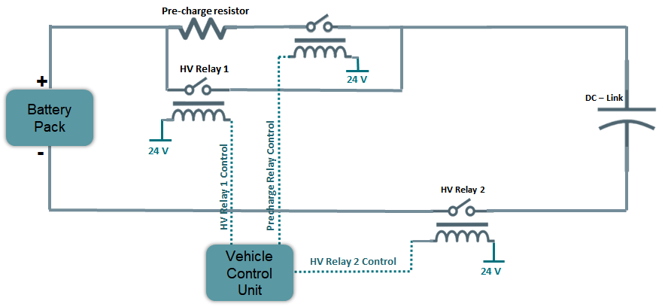
E/E Architecture
PRECHARGE CIRCUIT
Notes:
Motor Controller includes DC - Link capacitor which has to be put in parallel with the battery to maintain a constant DC bus voltage and filter out all the voltage spikes and ripples. So to interface our battery with the motor controller we have to charge the DC link capacitor which cannot be shorted directly to the battery and, for the purpose we need to charge the DC Link first just to prevent any kind of inrush currents.
This control is achieved by Vehicle Control Unit.

Slide 45
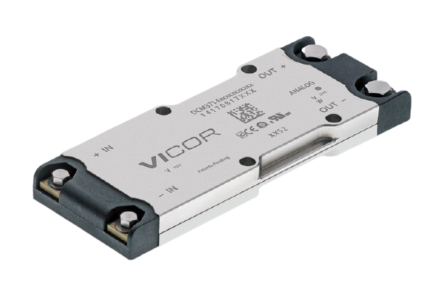
E/E Architecture
POWER DISTRIBUTION UNIT
Why DC - DC CONVERTER?
Power Delivery upto 96% efficiency
Lightweight Power System (1200W/in³ power density)
OV, UV, OC, Short circuit & Thermal protection
Notes:
For distributing power to the low voltage systems we decided to go with DC - DC converter as
It can operate at very high efficiency even at full load.
It is a lightweight system with high power density of 1200W/in3.
It can also be considered as safe as a battery against Over Voltage, Under Voltage, Open Circuit, Short Circuit & Thermal protection.

Slide 46
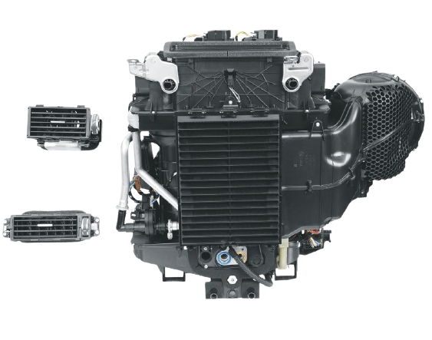

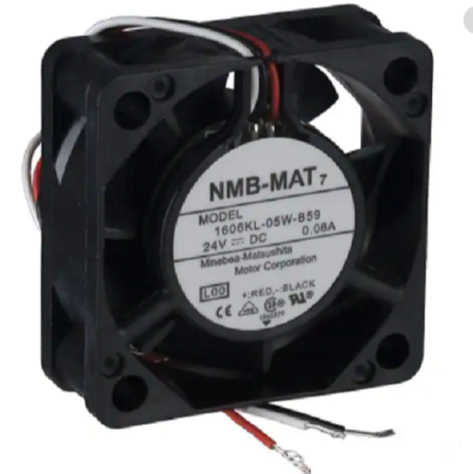
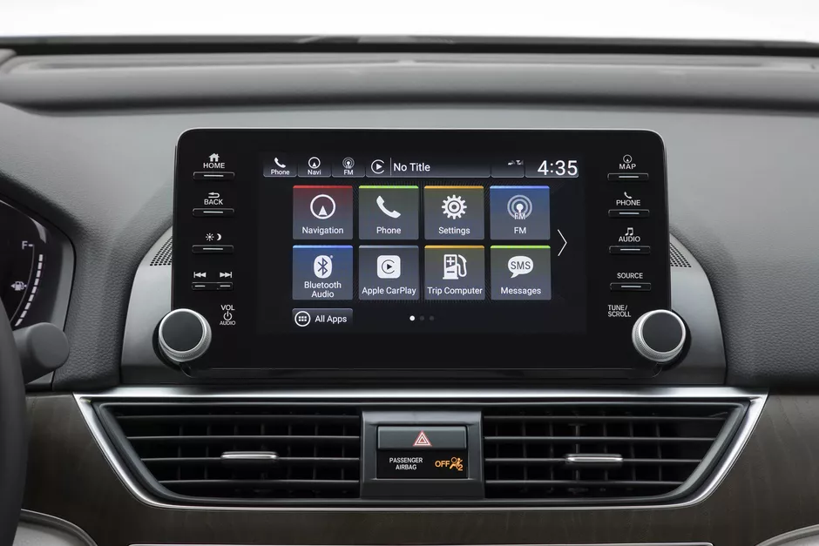
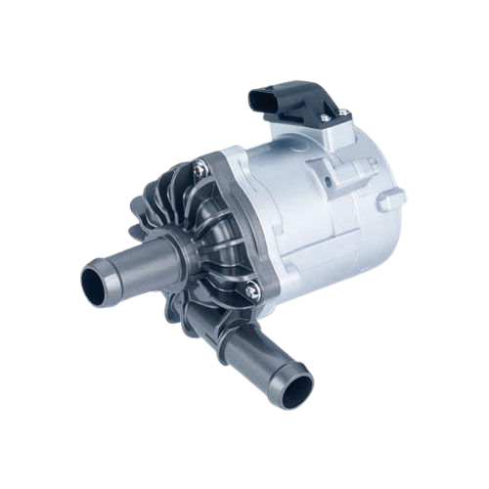
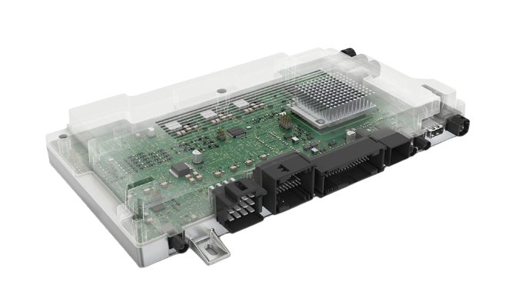
E/E Architecture
Infotainment
POWER DISTRIBUTION UNIT
HVAC System
Lighting & Other Systems
Infotainment
DC - DC
Battery Thermal Management
Pump
Vehicle Control Unit
Notes:
So according to our initial survey we have assumed the net power consumption of our Low Voltage system is nearly 1.5kW for which the DC DC converter cover the entire system.
So to connect these systems and all the sensors in our vehicle we are planning to use CAN communication for data transfer from one part of vehicle to another and LIN data transfer locally in each sections

Slide 47
Conclusion
Modelling can help reduce complicated physical systems, like Motor Controller or an EV, to Mathematical equations that can be solved to predict their behaviour
Modelling reduces testing cost and helps optimise parameters of various models
Concept design of an Electric Vehicle comes close and close to reality as models at subsystem level become more and more complex
Remarkable optimisations can be achieved by changing parameters like Aerodynamic Drag Coefficient, Gear Ratio, or Rolling Resistance, in a Mathematical Model
SCOPE OF IMPROVEMENT
Using variable Switching Frequency to improve efficiency of the inverter
Properly Modelling the Automatic Transmission System on Simscape to understand the associated Mechanical Losses and other Complexities
Implementation of Multi-level Converters for improved efficiency of inverter
Modelling variable Auxiliary Load accurately

Slide 48
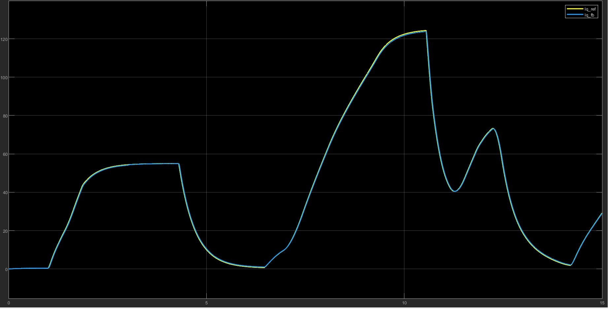
E/E Architecture
Notes:
Simulation result of the Motor controller showing the torque command (as the quadrature current) given to the motor as followed by the motor currents.

