Slide 1
OH FLAME ABSOTPION/EMISSION SPECTROSCOPY
ME498 Engineering Spectroscopy
Department of Mechanical Science and Engineering
Arjav Jain
Adviser: Professor Nick Glumac

Slide 2
Introduction
ME498 Engineering Spectroscopy

Slide 3
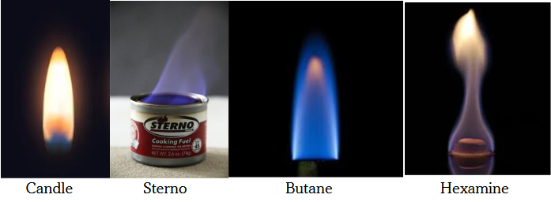
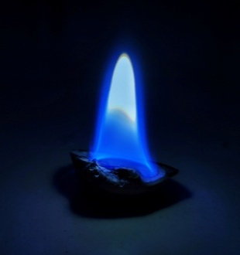
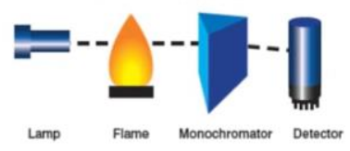
Introduction
Objective:
Using optical spectroscopy to understand the combustion behavior of several everyday fuels, specifically butane, candle wax, sterno gel, hexamine tablets, and propane
To develop a physics-informed spectroscopic framework for characterizing these combustion environments using
  UV broadband absorption spectroscopy (BAS) and
  Chemiluminescence emission measurements
OH radical - “God’s gift to the spectroscopist.” Most widely studied diatomic species in reacting systems
ME498 Engineering Spectroscopy

Slide 4
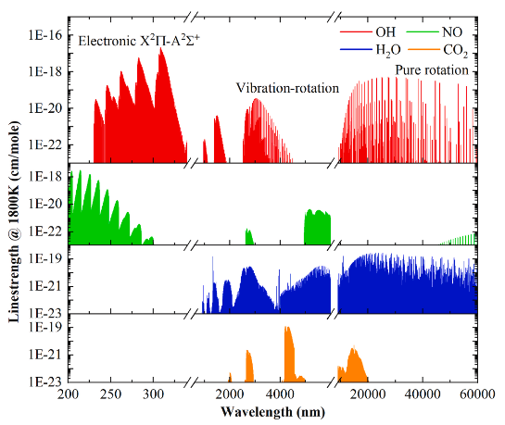
Introduction
UV BAS has low detection limits mainly due to strong absorption by electronic transitions in UV range by OH
OH UV transitions have very large line-strengths, more than two orders of magnitude larger than their IR transitions
Thus, the UV OH transitions can be used to detect low OH concentrations and provide high-SNR absorbance measurements for thermometry
UV transitions do not experience interference from other spectra
ME498 Engineering Spectroscopy

Slide 5
Literature Review
ME498 Engineering Spectroscopy

Slide 6
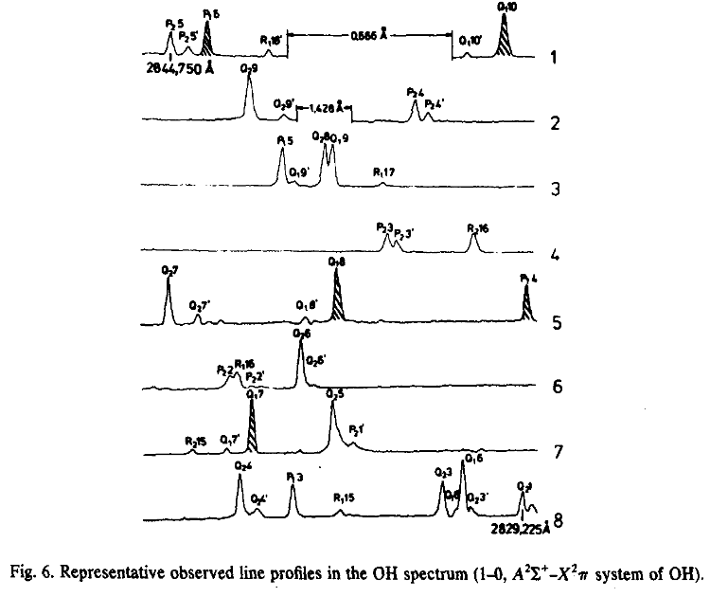
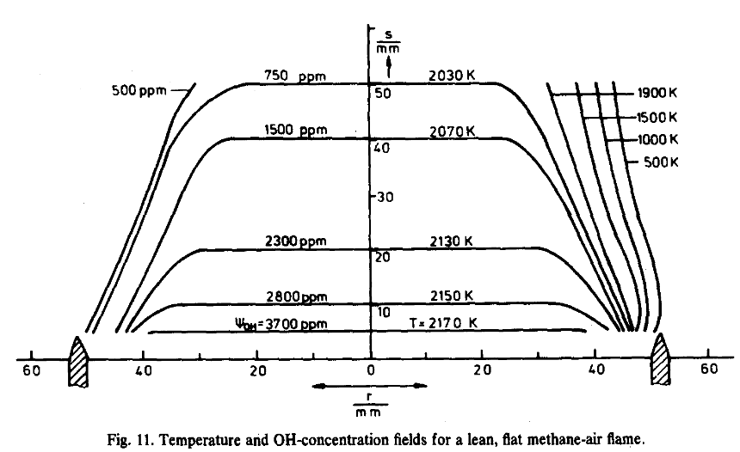
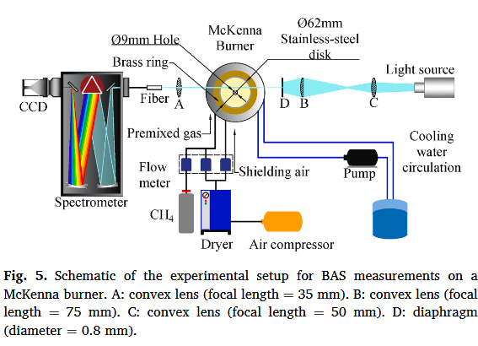
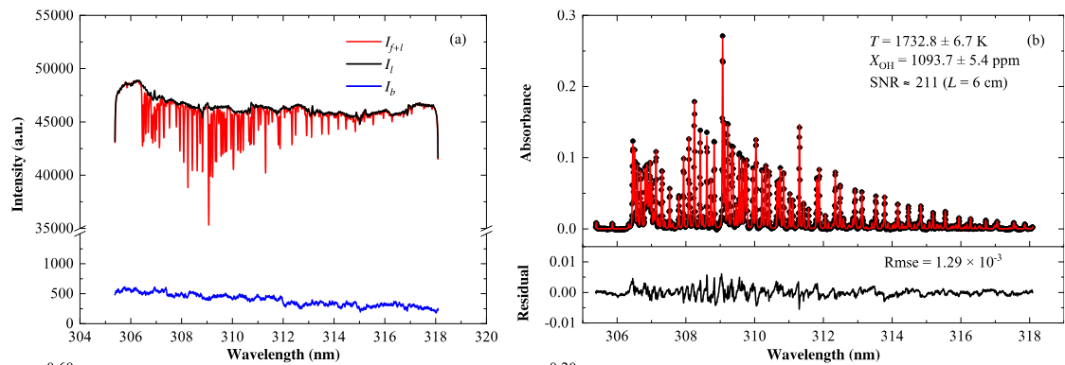
Literature Review
Luck et al. [1]
  Using a tunable, narrow-bandwidth dye laser, frequency-doubled using a KDP crystal, they targeted the UV spectral signature in the 1-0 band of the (X²Π-A²Σ⁺) system of OH, located near 2830 Å, inside a laminar, flat methane-air flame
  The concentration of the OH radical from the area under the Voigt profile
  The translational temperature from the full width at half maximum (FWHM) of the curve
  The rotational temperature, calculated from the ratio of the two local line-absorption coefficients
Yang at al. [2]
  The study examined 209 different OH absorption lines in the 0-0 band between 306 and 318 nm, all at once, inside a flat premixed flame at various equivalence ratios
  Results were benchmarked against two references: (1) 2D axisymmetric CFD simulations and (2) direct comparison with TDLAS measurements
  For stable flames. RMS error between observed temperature and CFD predictions was under 16K, and OH concentration error was below 150 ppm. The average error observed between UVBAS and TDLAS measurements was about 31.5 K
ME498 Engineering Spectroscopy

Slide 7
Numerical Method
ME498 Engineering Spectroscopy

Slide 8
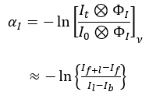





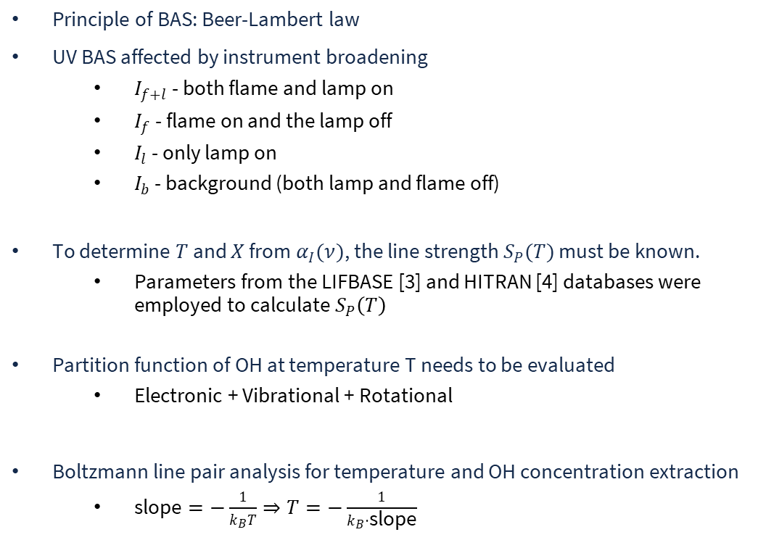
Numerical Method
Principle of BAS: Beer-Lambert law
UV BAS affected by instrument broadening
  $I_{f+l}$ - both flame and lamp on
  $I_{f}$ - flame on and the lamp off
  $I_{l}$ - only lamp on
  $I_{b}$ - background (both lamp and flame off)
To determine $T$ and $X$ from $α_{I}(ν)$, the line strength $S_{P}(T)$ must be known.
  Parameters from the LIFBASE [3] and HITRAN [4] databases were employed to calculate $S_{P}\left(T\right)$
Partition function of OH at temperature T needs to be evaluated
  Electronic + Vibrational + Rotational
Boltzmann line pair analysis for temperature and OH concentration extraction
  $\text{slope}=−\frac{1}{k_{B}T}⇒T=−\frac{1}{k_{B}⋅\text{slope}}$
Absorption
Emission
ME498 Engineering Spectroscopy

Slide 9
Experimental Setup
ME498 Engineering Spectroscopy

Slide 10
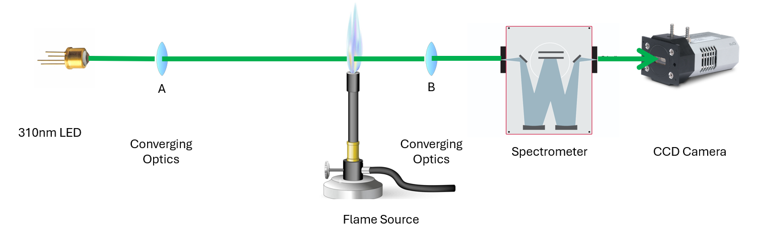
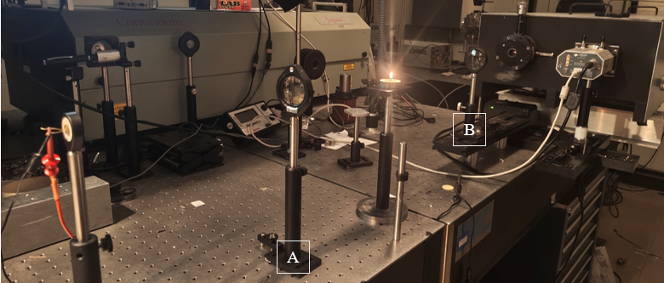
Experimental Setup
0-0 band of OH between 311 and 313.5 nm was chosen due to it having the strongest absorption among the OH transitions and minimal interference from other combustion radicals
The BAS measurement system consisted of
  Light source: Broadband radiation spanning 311-313.5 nm was produced by a 310nm LED
  Spectrometer: Grating spectrometer (1.54m Czerny-Turner spectrometer with 9-degree deviation angle) equipped with a 2400 grooves/mm grating
  CCD camera: (Andor iDus DU420 CCD detector featuring a 256 × 1024-pixel array with 25-micron square pixels
  Optical path arrangement: A and B were quartz-glass convex lenses with focal lengths of 29.21 cm and 24.13 cm, respectively
Wavelength calibration performed using an Hg lamp
Each spectral frame was accumulated over 100 ms, and 20 frames were averaged to reduce noise, requiring approximately 2 s per spectrum.
Spectra collected at 2 heights above the source – 0.25” & 0.5”
ME498 Engineering Spectroscopy

Slide 11
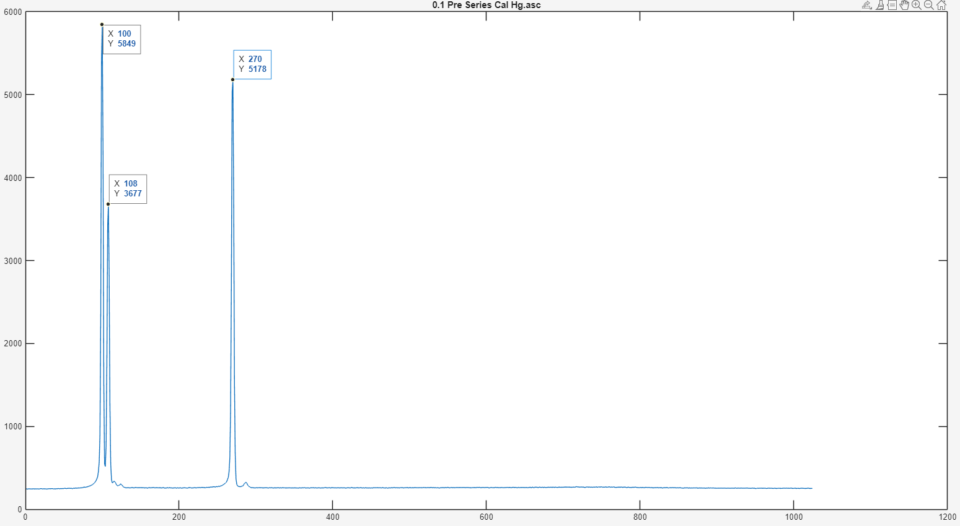
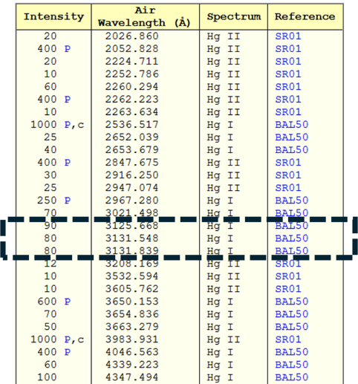
Experimental Setup
Spectra pre-processing
  Rolling-percentile masking method: To isolate the molecular absorption/emission features from the slowly varying broadband background
  Baseline estimation: 2nd order polynomial, then fitted to only the unmasked continuum points
  Spectra correction: Baseline removed from raw spectrum by division for absorption or subtraction for emission
Wavelength Calibration
  In the spectral region relevant to the OH A-X band, three distinct Hg emission peaks were observed
  Using the three pixel–wavelength pairs, a quadratic calibration curve was fitted to account for the small non-linearity inherent in the Czerny–Turner optical dispersion
ME498 Engineering Spectroscopy

Slide 12
Absorption – Results
ME498 Engineering Spectroscopy

Slide 13
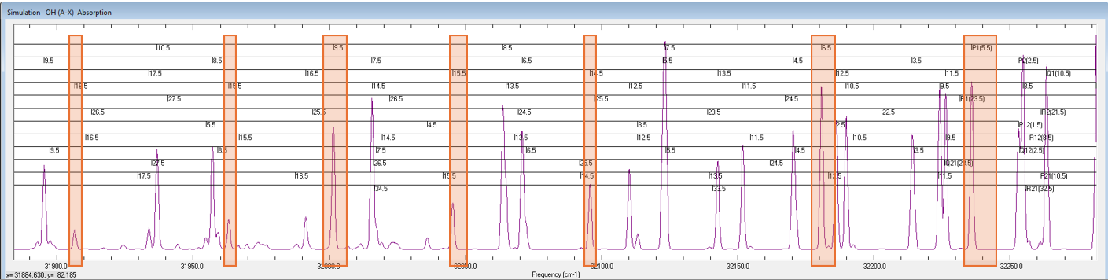
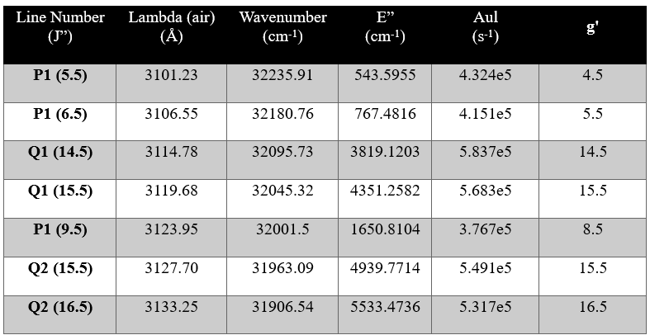
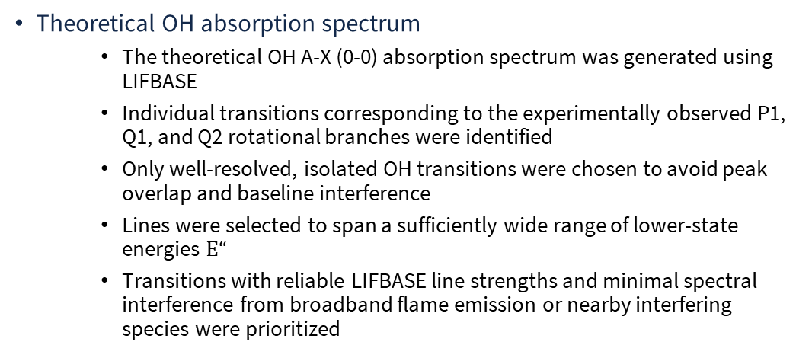
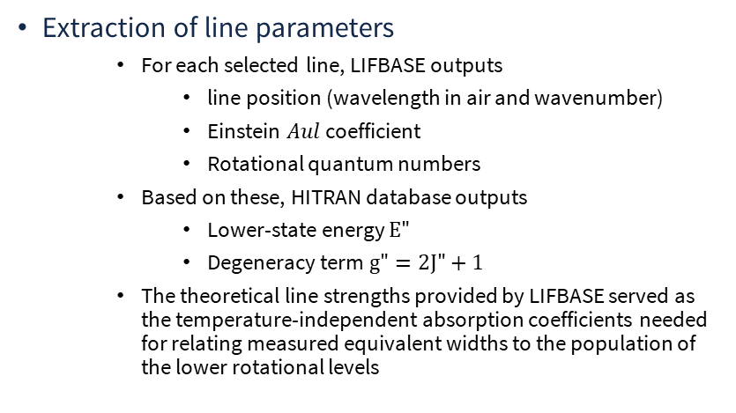
Absorption – Results
Theoretical OH absorption spectrum
  The theoretical OH A-X (0-0) absorption spectrum was generated using LIFBASE
  Individual transitions corresponding to the experimentally observed P1, Q1, and Q2 rotational branches were identified
  Only well-resolved, isolated OH transitions were chosen to avoid peak overlap and baseline interference
  Lines were selected to span a sufficiently wide range of lower-state energies $E“$
  Transitions with reliable LIFBASE line strengths and minimal spectral interference from broadband flame emission or nearby interfering species were prioritized
Extraction of line parameters
  For each selected line, LIFBASE outputs
    line position (wavelength in air and wavenumber)
    Einstein $Aul$ coefficient
    Rotational quantum numbers
  Based on these, HITRAN database outputs
    Lower-state energy $E"$
    Degeneracy term $g"=2J"+1$
  The theoretical line strengths provided by LIFBASE served as the temperature-independent absorption coefficients needed for relating measured equivalent widths to the population of the lower rotational levels
ME498 Engineering Spectroscopy

Slide 14
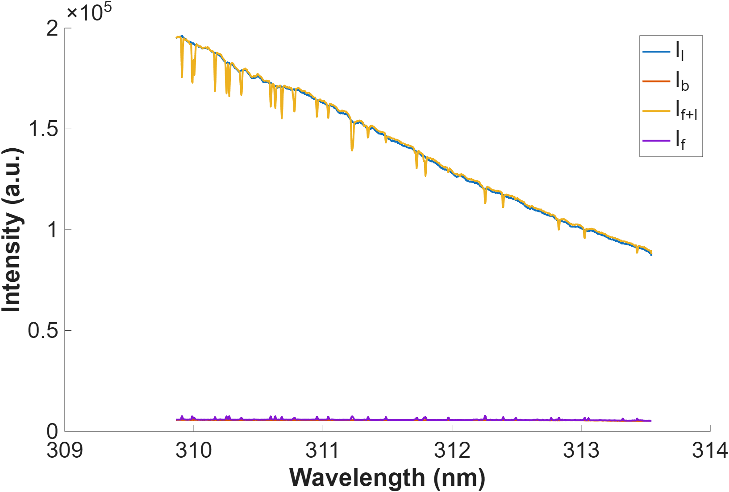
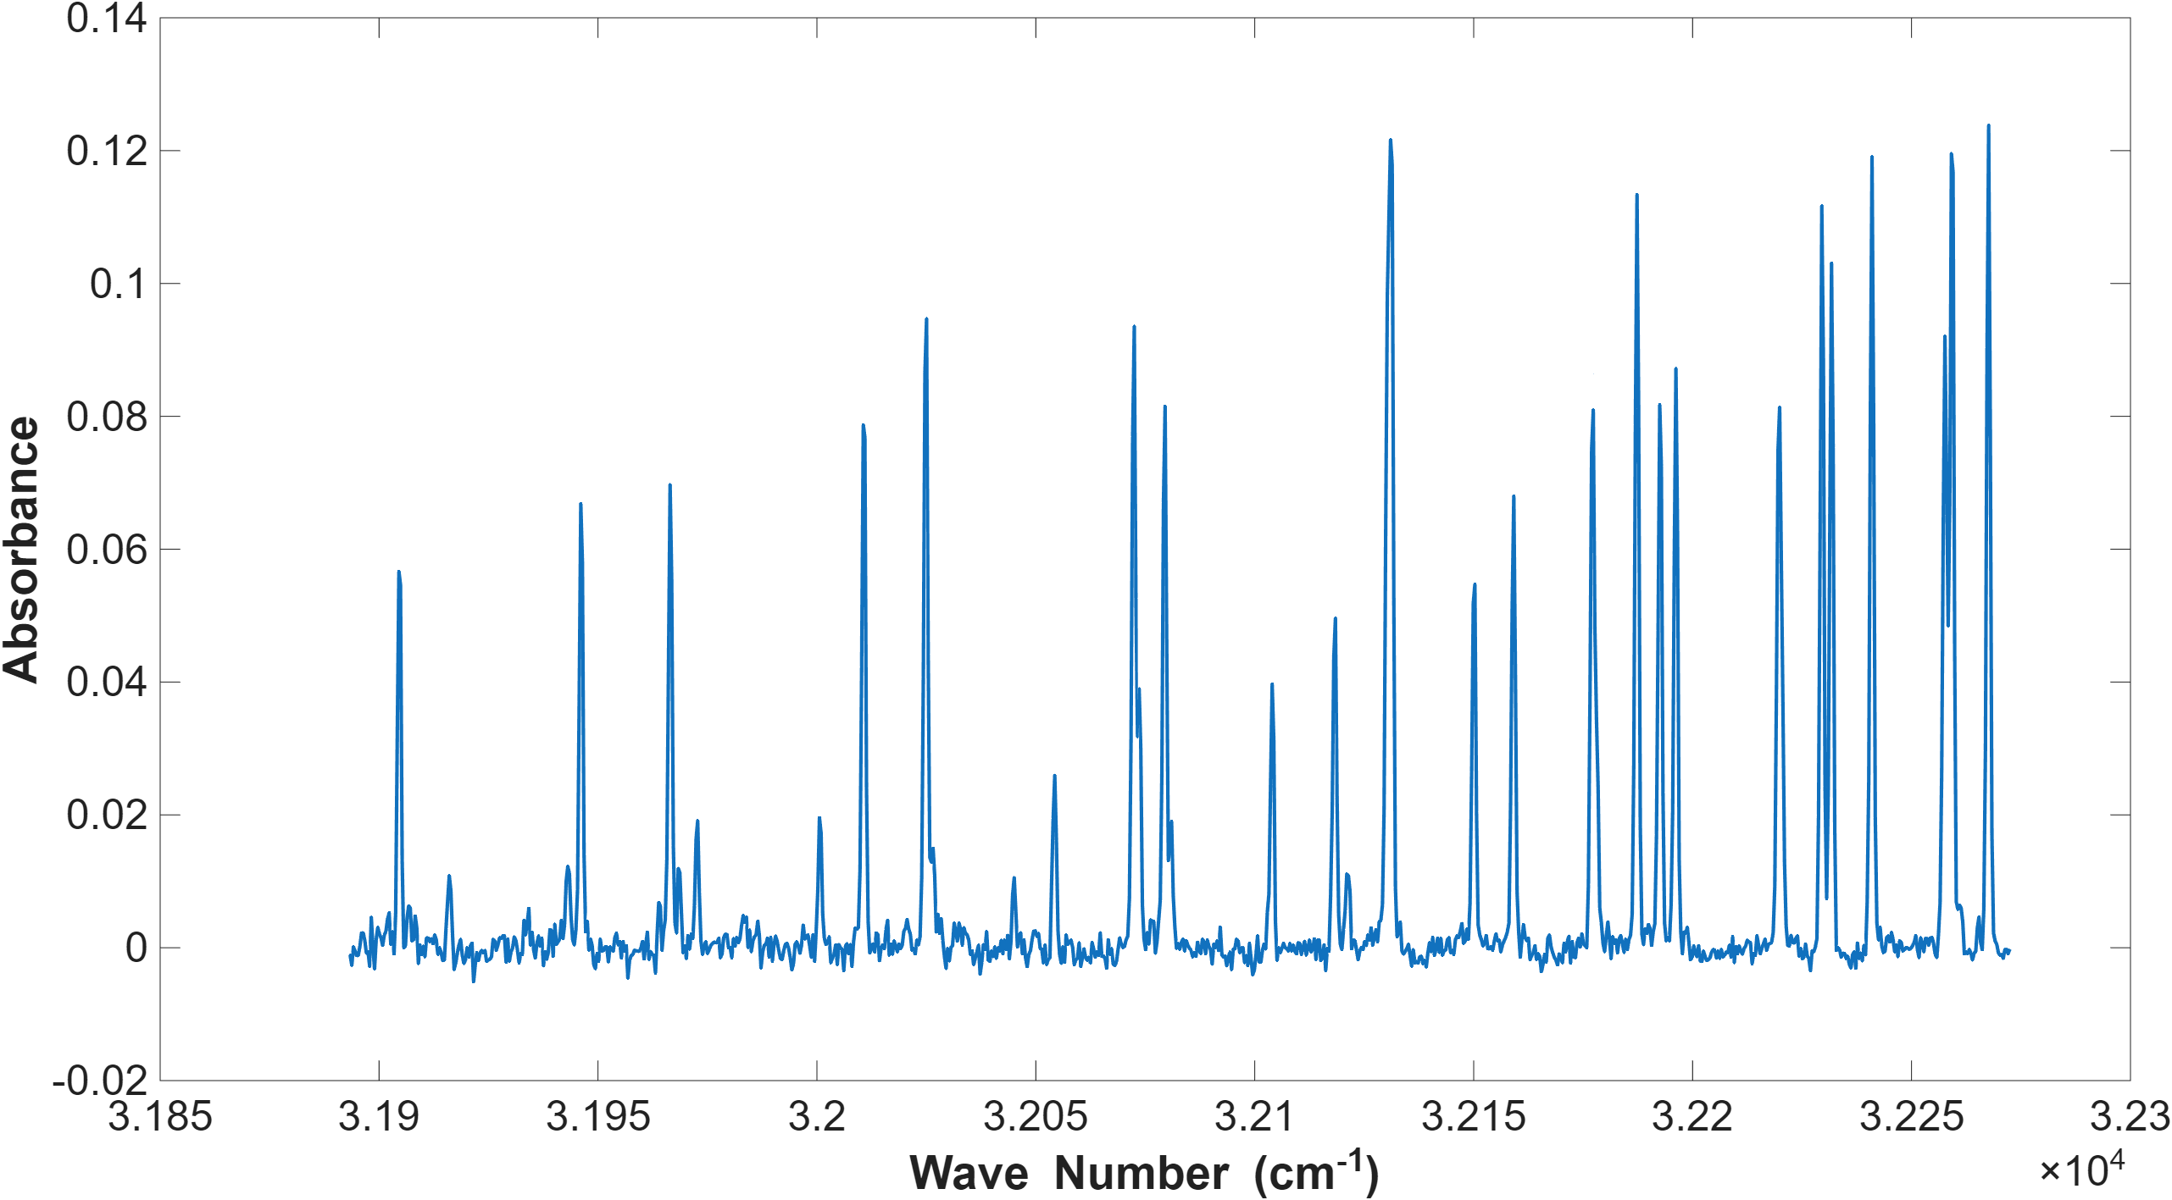
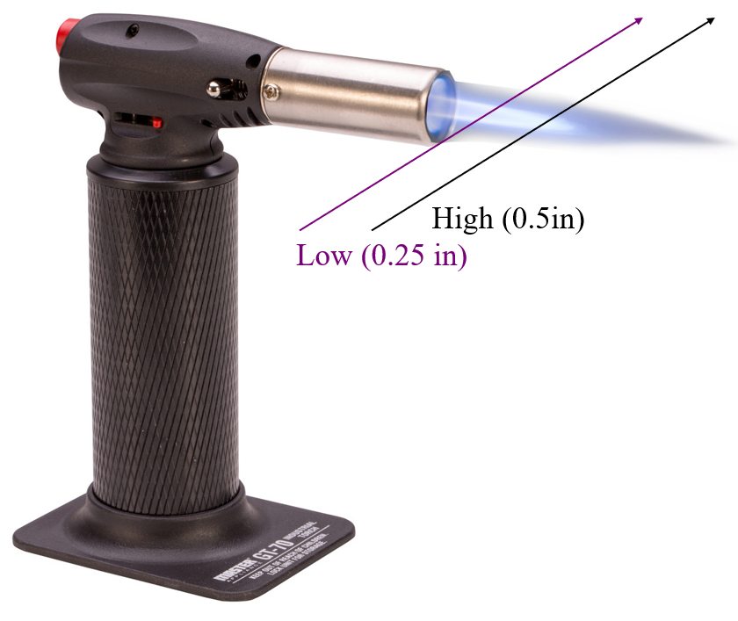
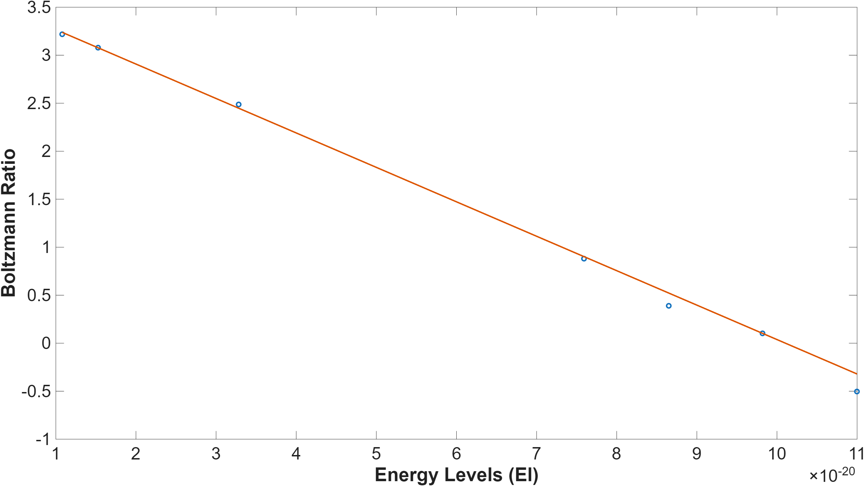
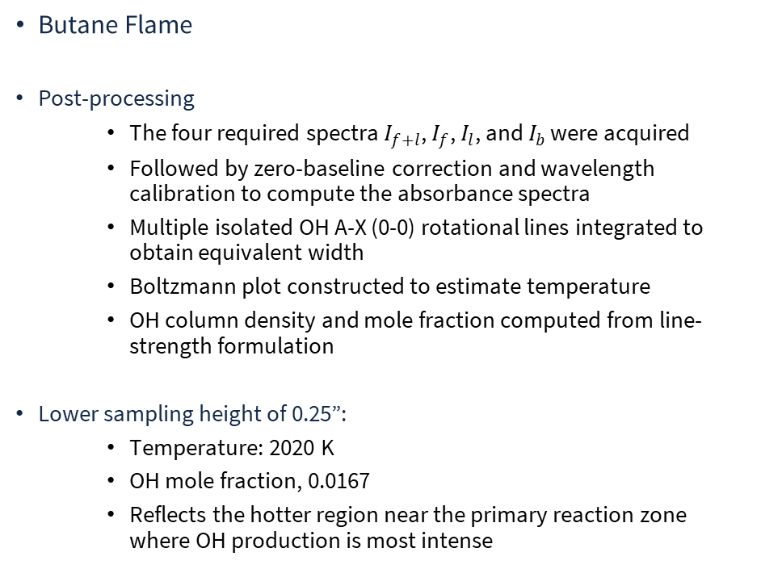
Absorption – Results
Butane Flame
Post-processing
  The four required spectra $I_{f+l}$, $I_{f}$, $I_{l}$, and $I_{b}$ were acquired
  Followed by zero-baseline correction and wavelength calibration to compute the absorbance spectra
  Multiple isolated OH A-X (0-0) rotational lines integrated to obtain equivalent width
  Boltzmann plot constructed to estimate temperature
  OH column density and mole fraction computed from line-strength formulation
Lower sampling height of 0.25”:
  Temperature: 2020 K
  OH mole fraction, 0.0167
  Reflects the hotter region near the primary reaction zone where OH production is most intense
ME498 Engineering Spectroscopy

Slide 15
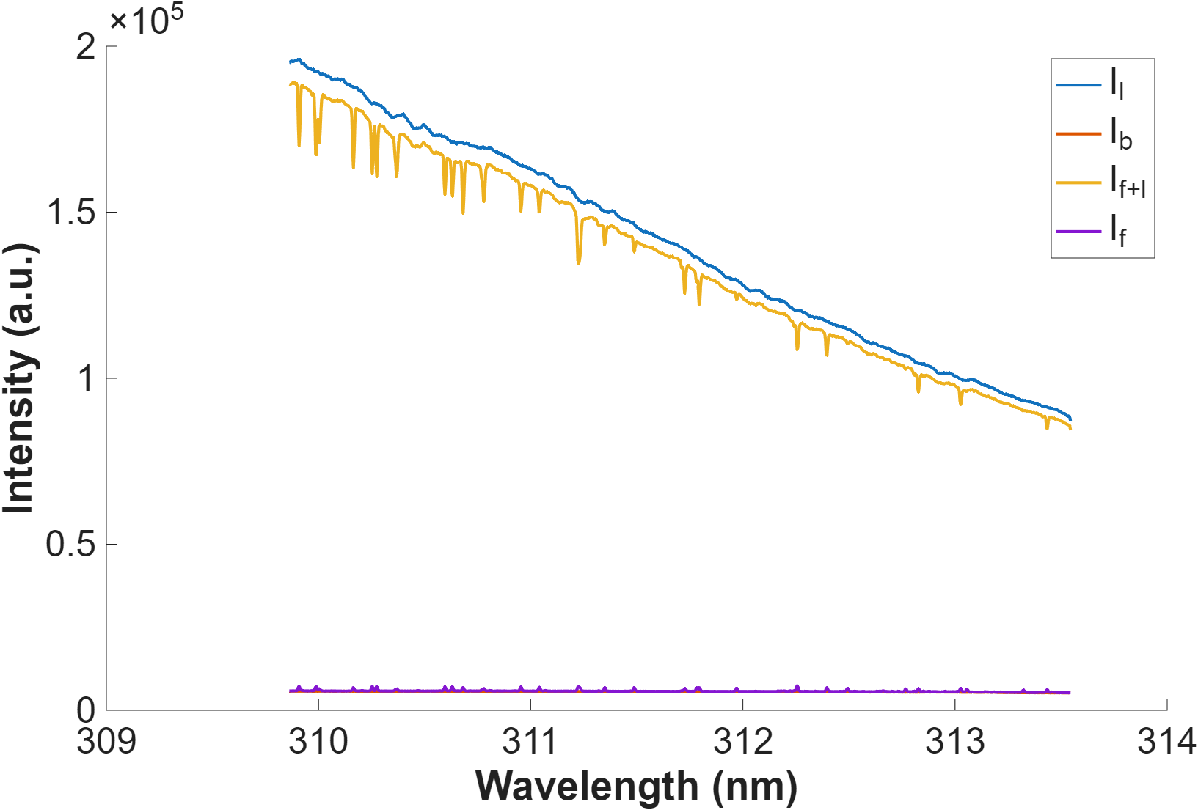
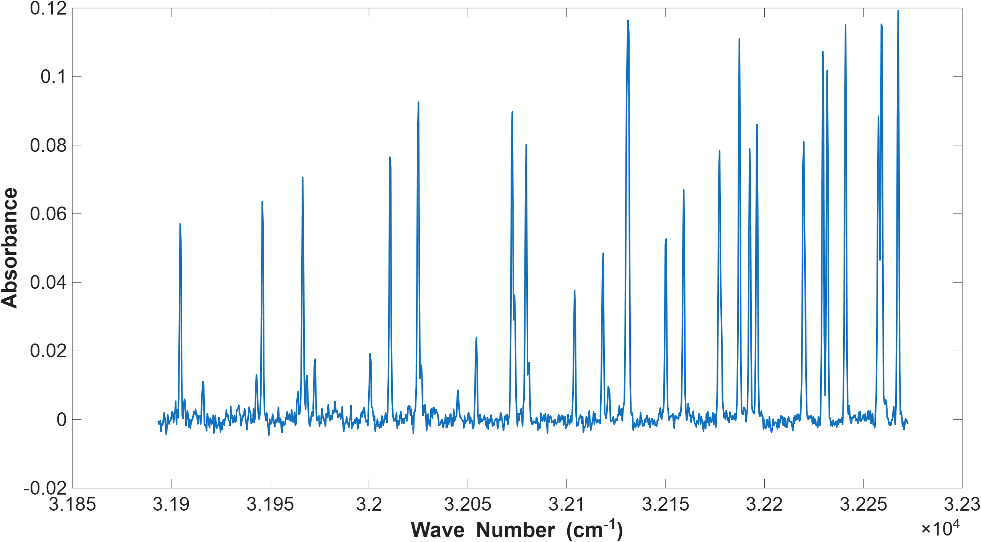
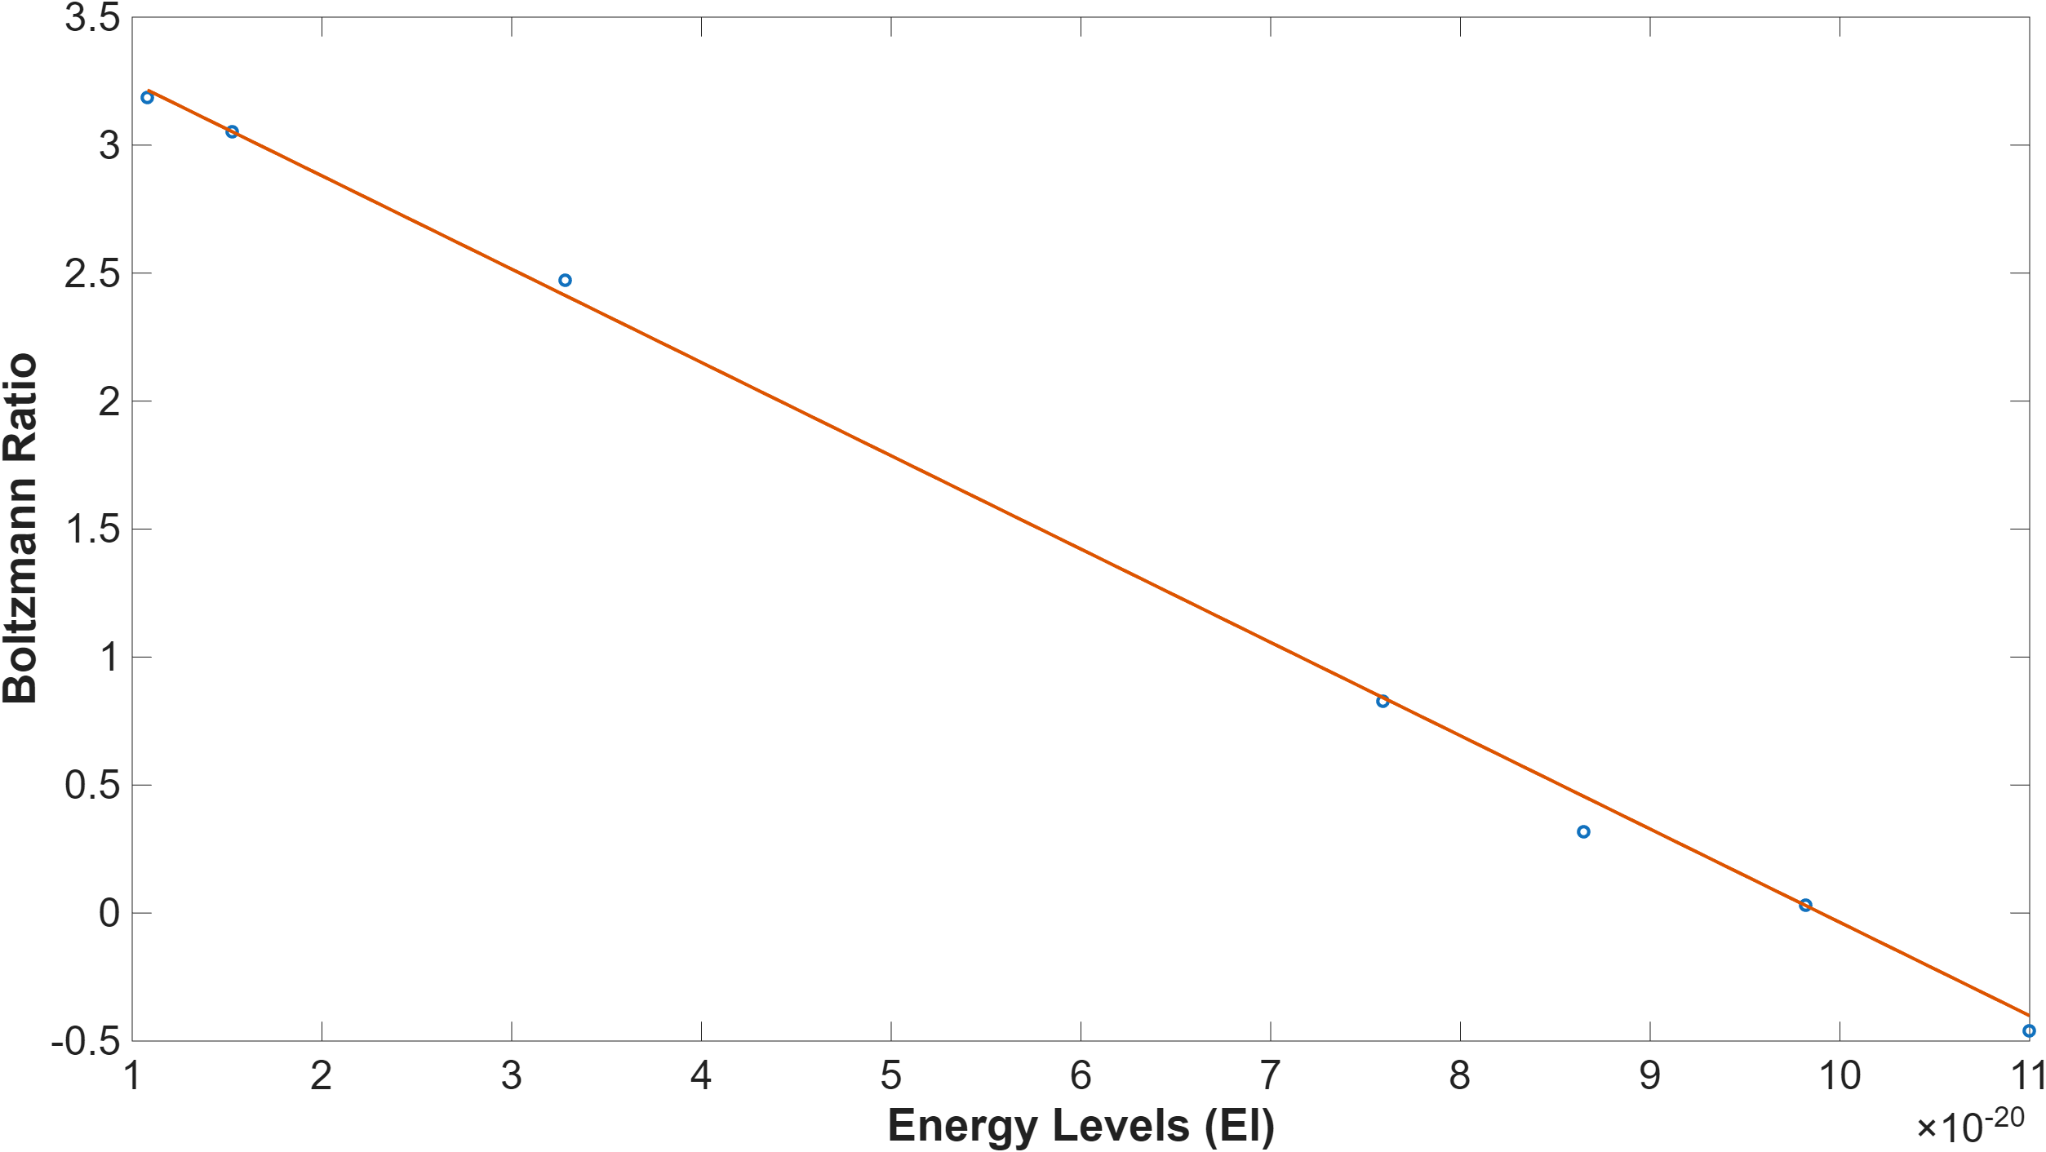
Absorption – Results
Butane Flame
Higher sampling height of 0.5”:
  Temperature: 1988 K
  OH mole fraction: 0.0162
  Both the temperature and mole fraction decreased, consistent with cooling and dilution as combustion products mix with the surrounding air
The linearity of the Boltzmann plots at both locations confirms that OH rotational populations remain near equilibrium, supporting the validity of the absorption-based method
ME498 Engineering Spectroscopy

Slide 16
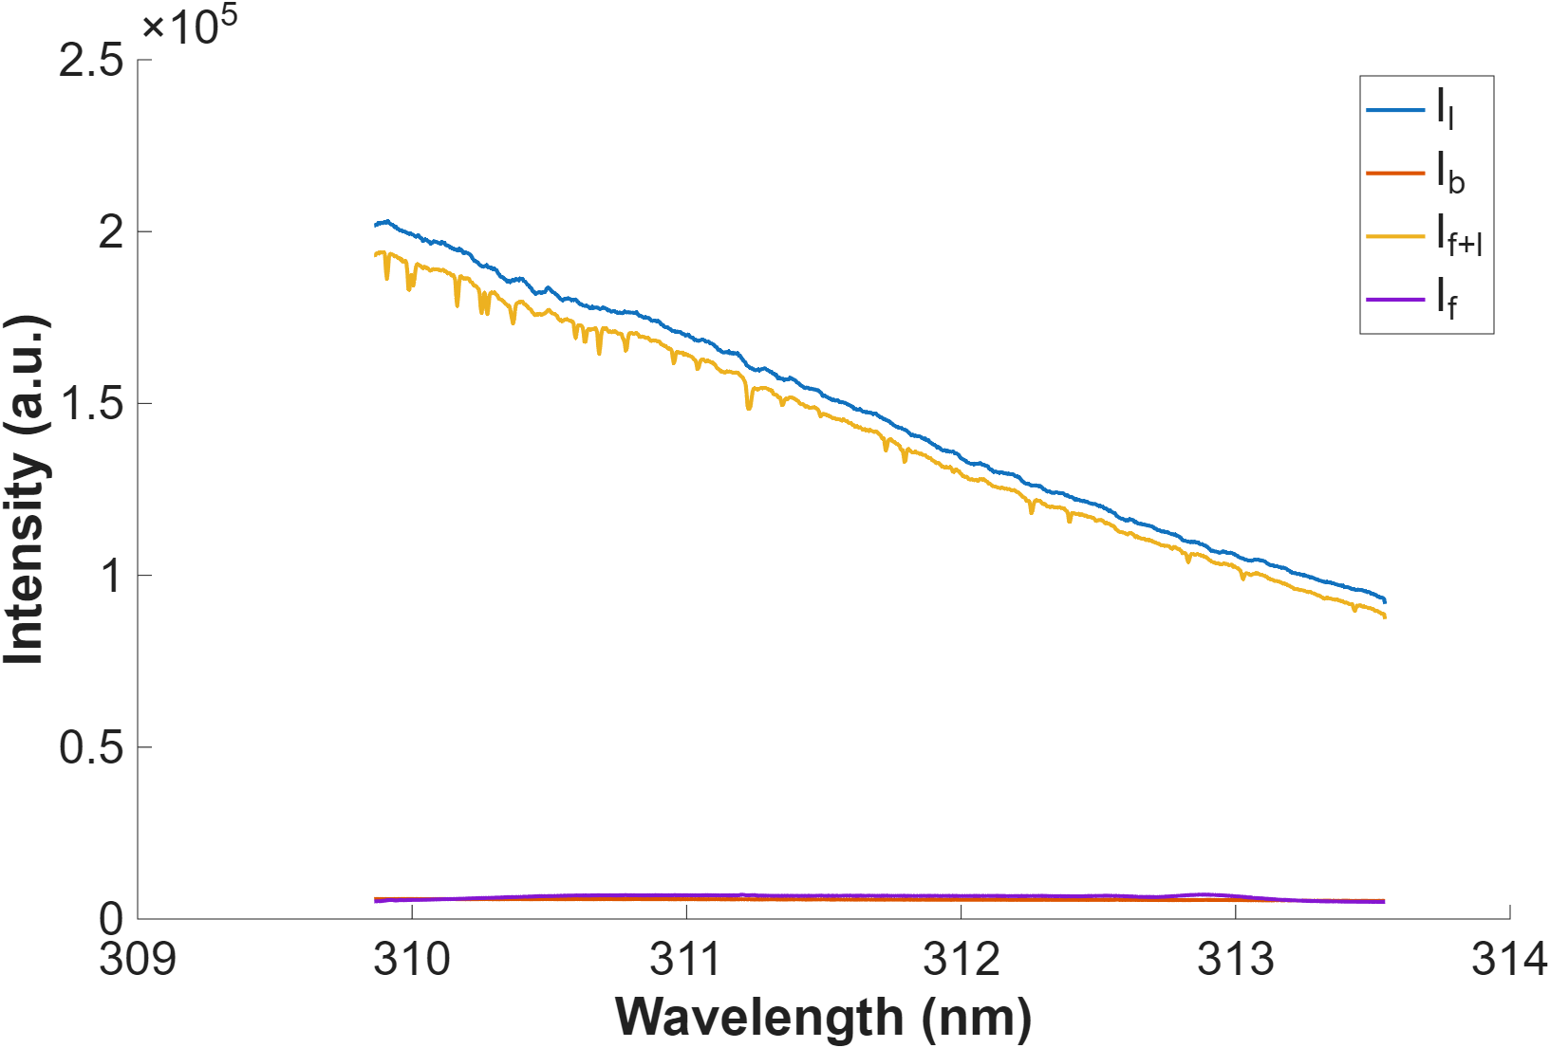
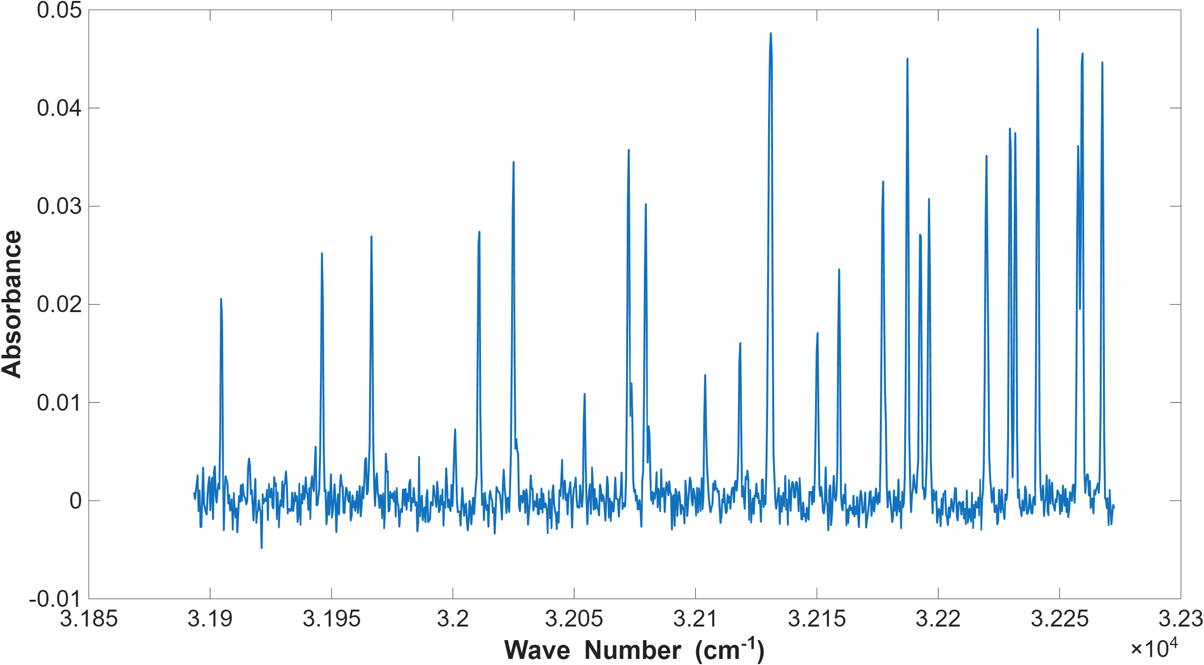
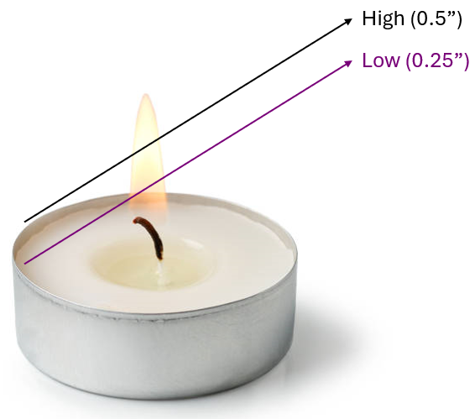
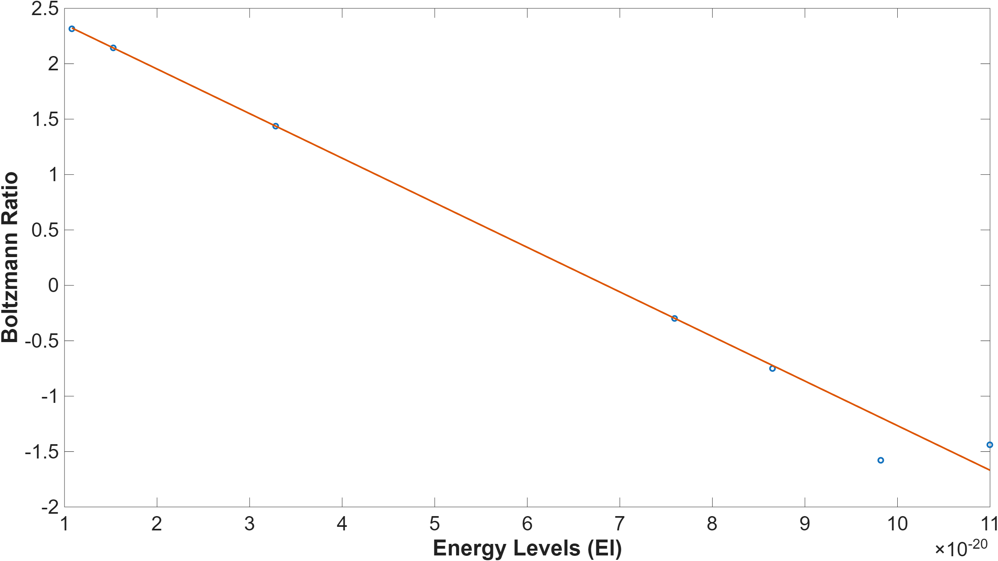
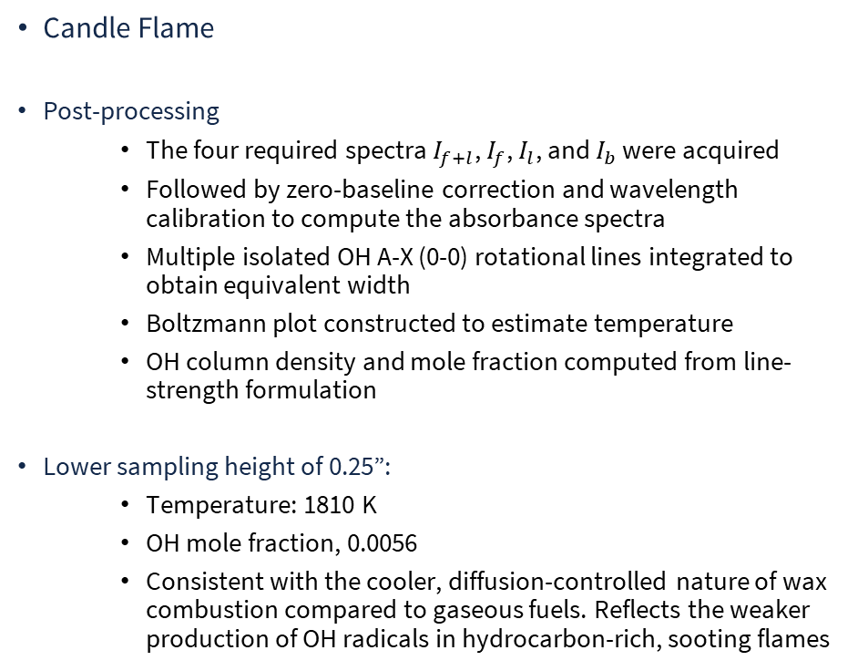
Absorption – Results
Candle Flame
Post-processing
  The four required spectra $I_{f+l}$, $I_{f}$, $I_{l}$, and $I_{b}$ were acquired
  Followed by zero-baseline correction and wavelength calibration to compute the absorbance spectra
  Multiple isolated OH A-X (0-0) rotational lines integrated to obtain equivalent width
  Boltzmann plot constructed to estimate temperature
  OH column density and mole fraction computed from line-strength formulation
Lower sampling height of 0.25”:
  Temperature: 1810 K
  OH mole fraction, 0.0056
  Consistent with the cooler, diffusion-controlled nature of wax combustion compared to gaseous fuels. Reflects the weaker production of OH radicals in hydrocarbon-rich, sooting flames
ME498 Engineering Spectroscopy

Slide 17
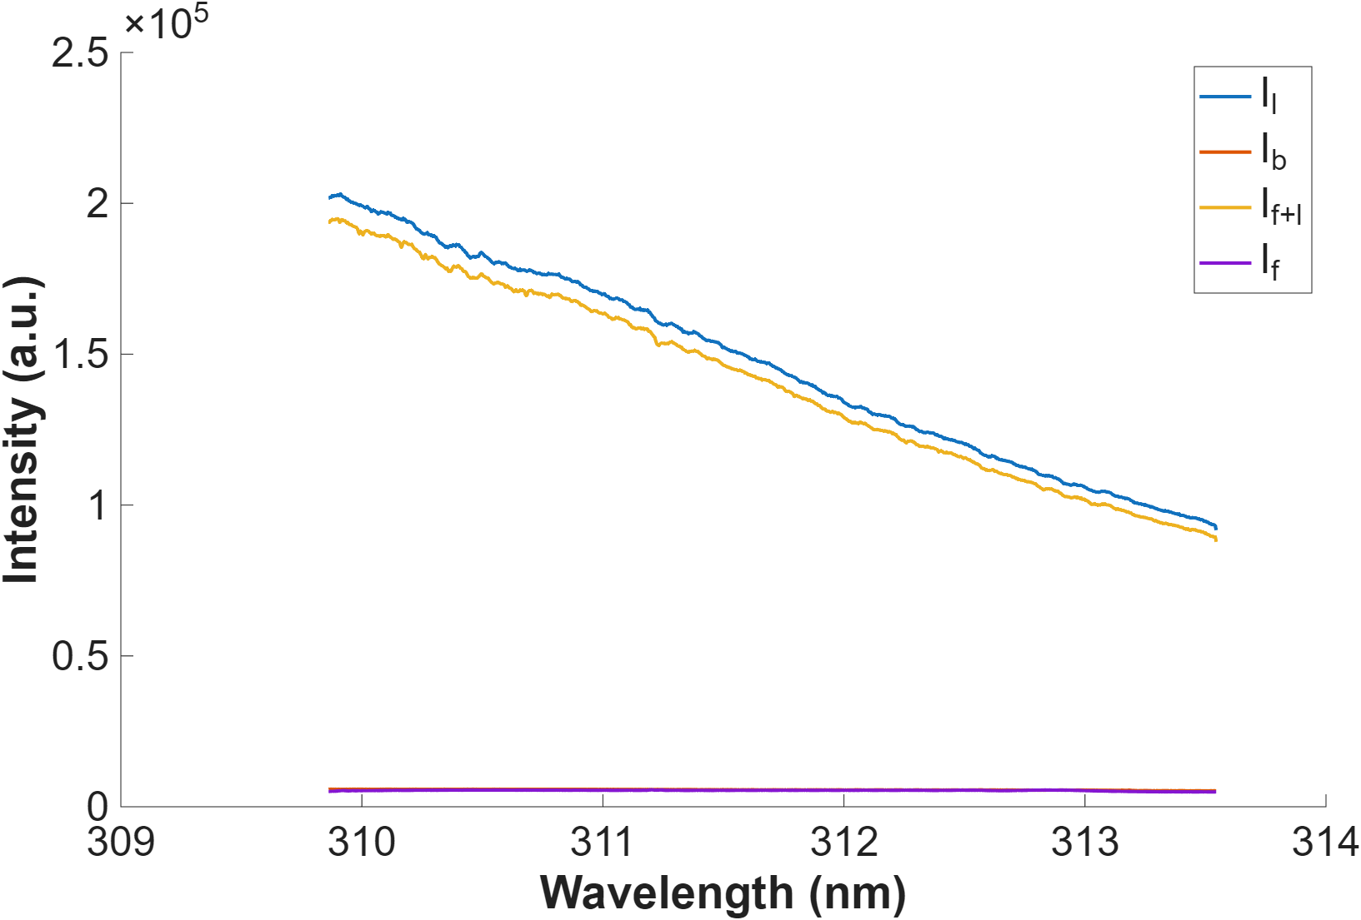
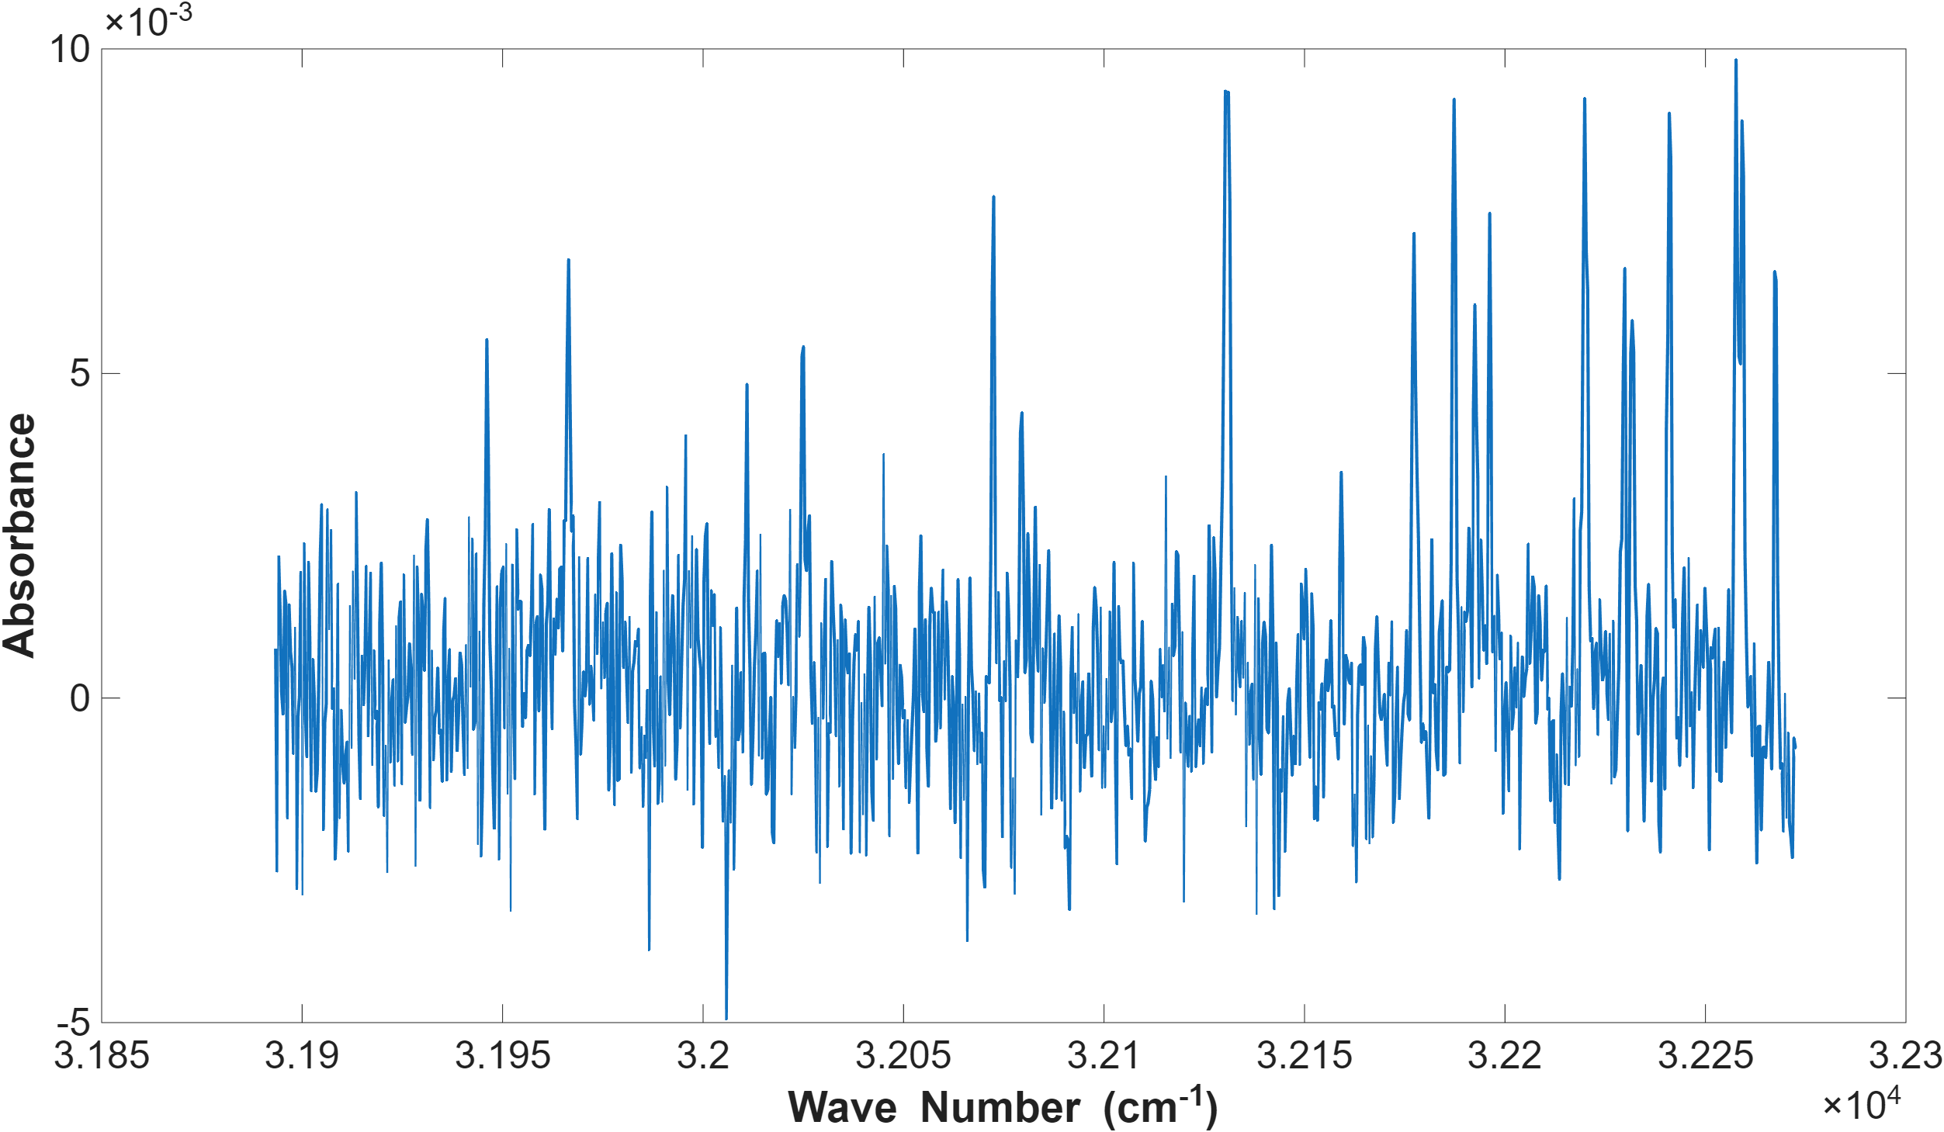
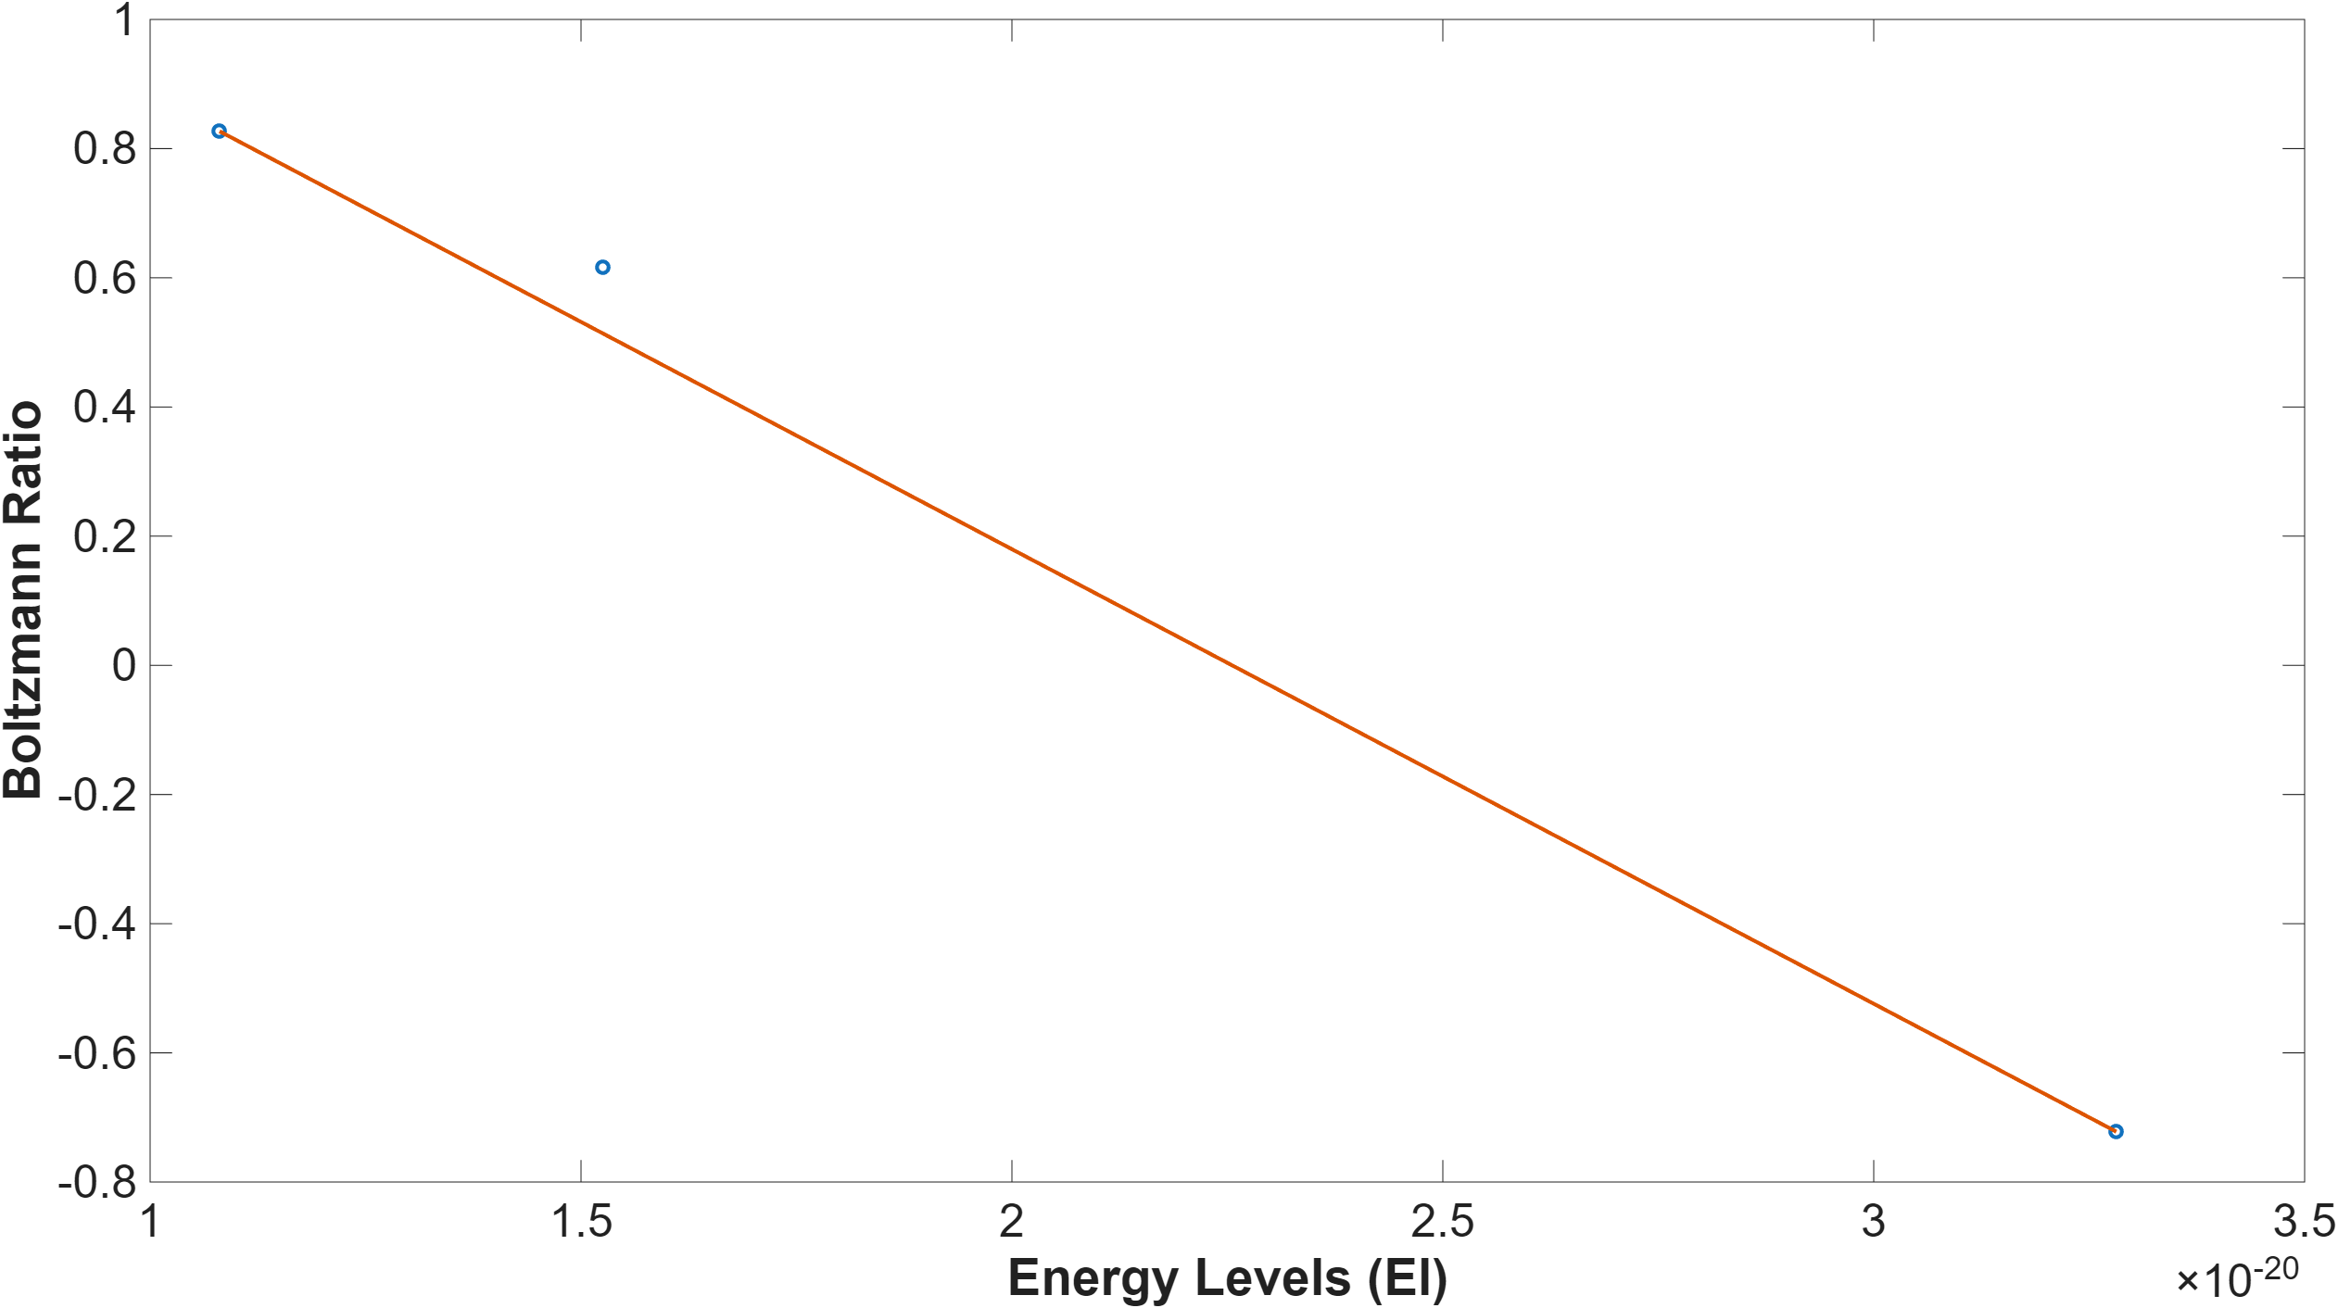
Absorption – Results
Candle Flame
Higher sampling height of 0.5”:
  Temperature: 1030 K
  OH mole fraction: 0.00056
  Both the temperature and mole fraction decreased, indicating dilution by entrained air and partial quenching of radicals as the plume cools
Unlike gaseous fuels, the candle flame exhibited a higher continuum background due to soot luminosity
Linearity of the Boltzmann plot remained adequate after baseline correction. This confirms that, despite weaker OH features, the rotational population is sufficiently close to equilibrium for reliable temperature and concentration extraction
ME498 Engineering Spectroscopy

Slide 18
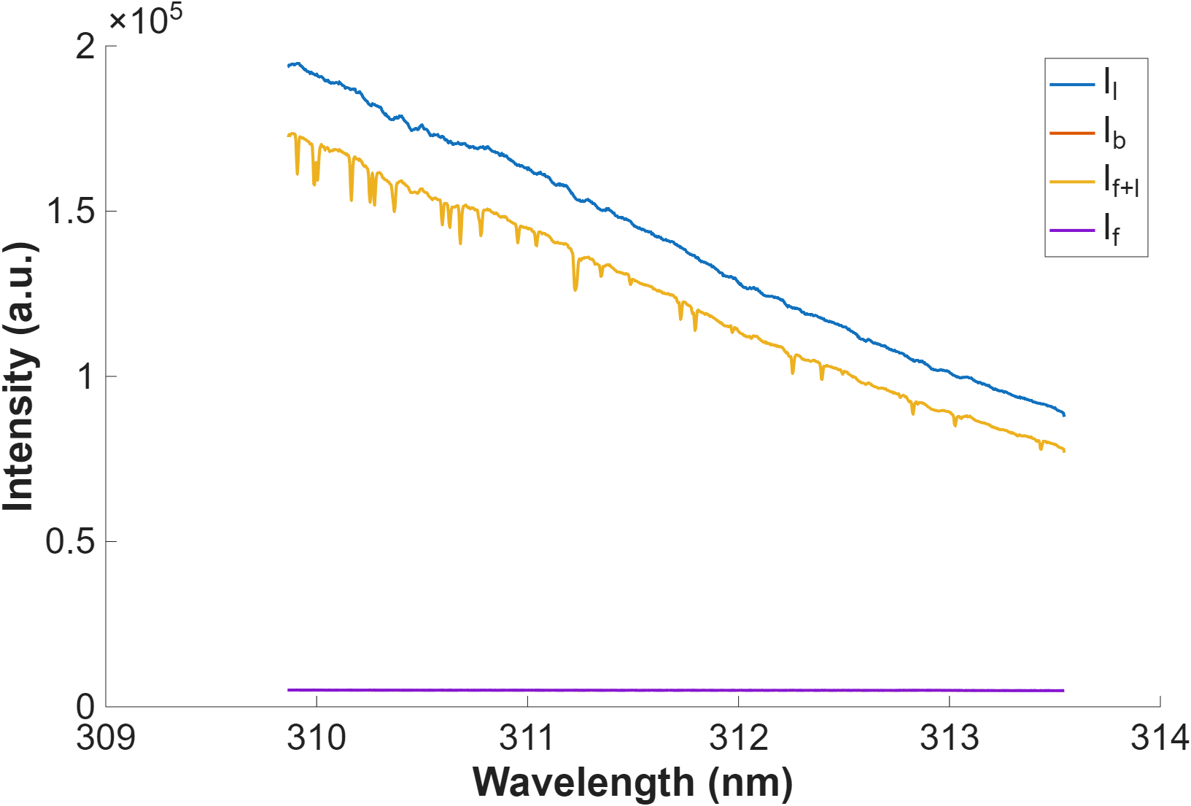
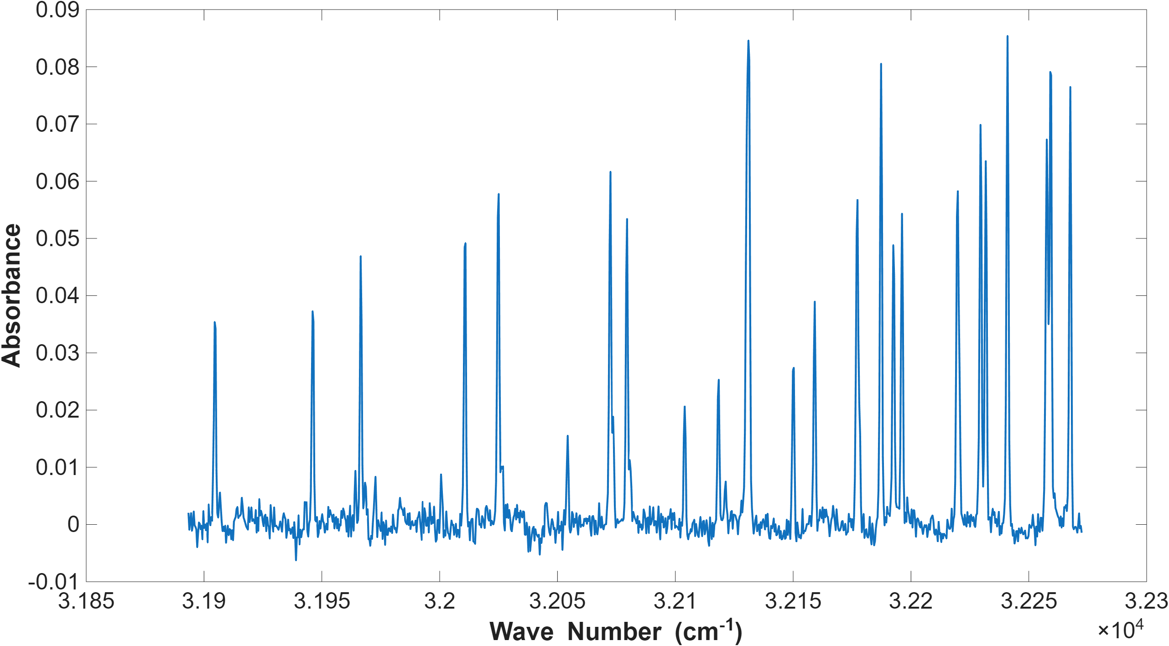
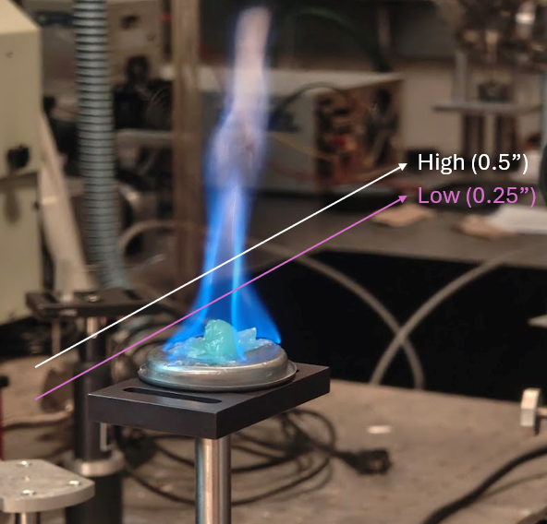
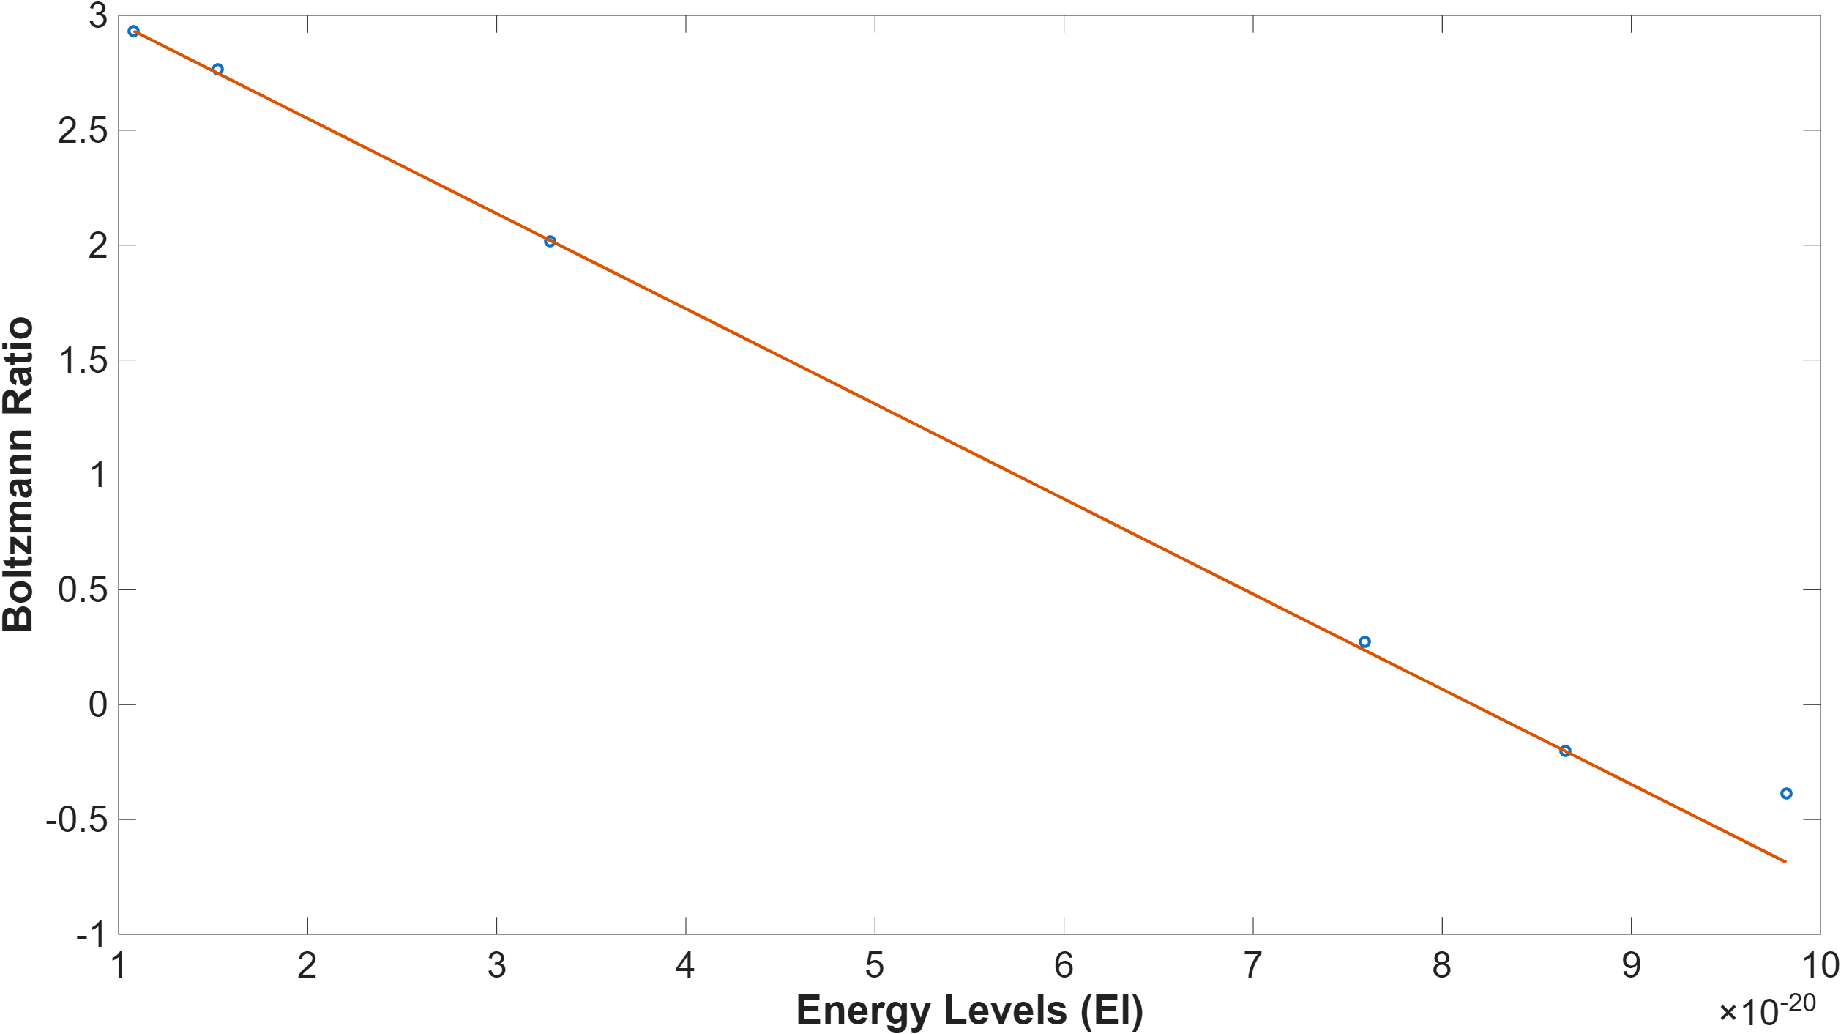
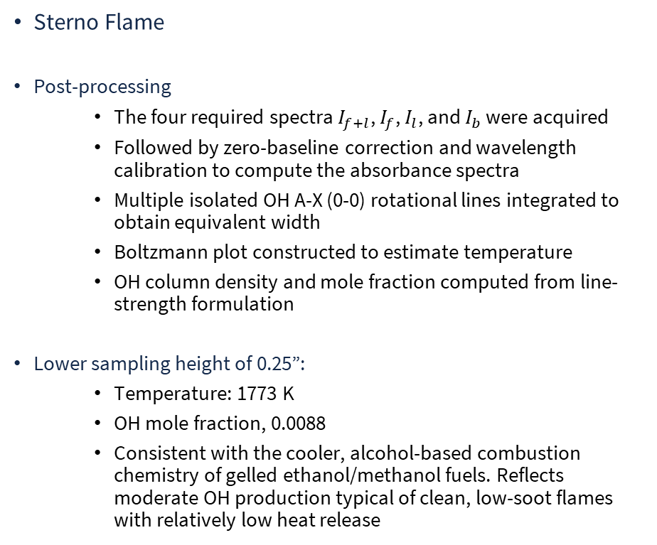
Absorption – Results
Sterno Flame
Post-processing
  The four required spectra $I_{f+l}$, $I_{f}$, $I_{l}$, and $I_{b}$ were acquired
  Followed by zero-baseline correction and wavelength calibration to compute the absorbance spectra
  Multiple isolated OH A-X (0-0) rotational lines integrated to obtain equivalent width
  Boltzmann plot constructed to estimate temperature
  OH column density and mole fraction computed from line-strength formulation
Lower sampling height of 0.25”:
  Temperature: 1773 K
  OH mole fraction, 0.0088
  Consistent with the cooler, alcohol-based combustion chemistry of gelled ethanol/methanol fuels. Reflects moderate OH production typical of clean, low-soot flames with relatively low heat release
ME498 Engineering Spectroscopy

Slide 19
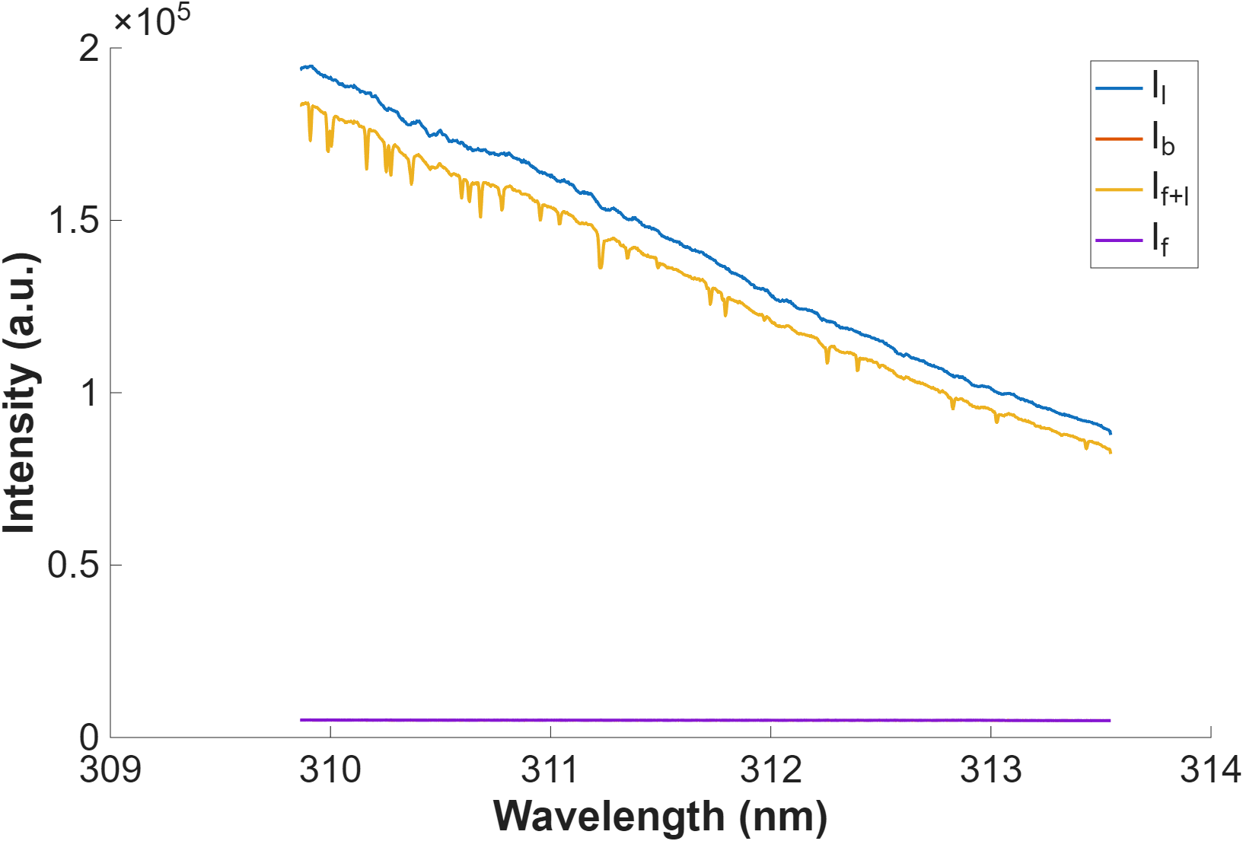
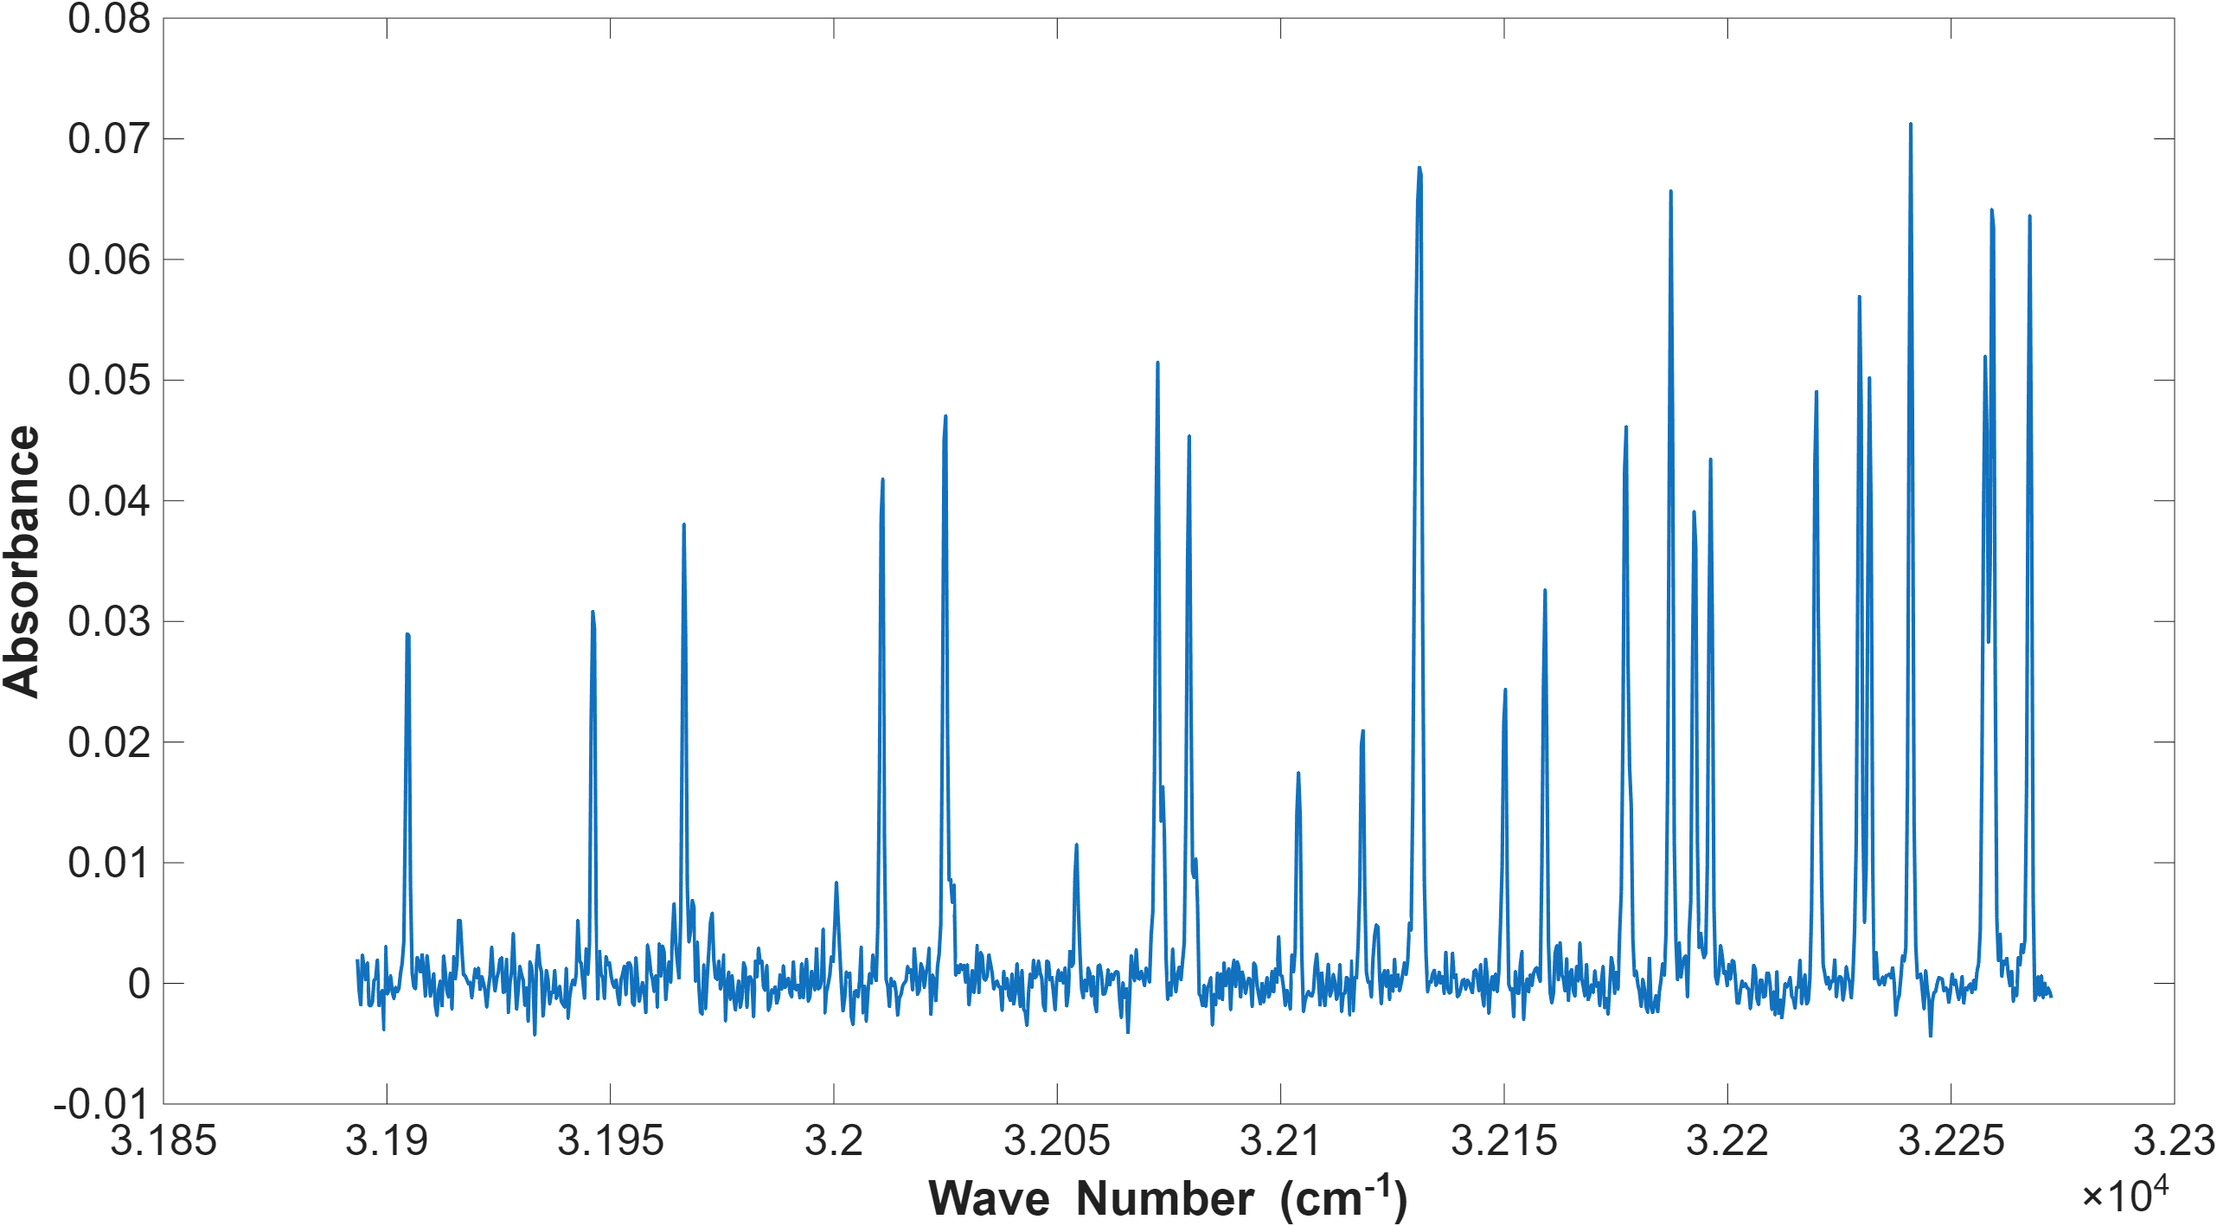
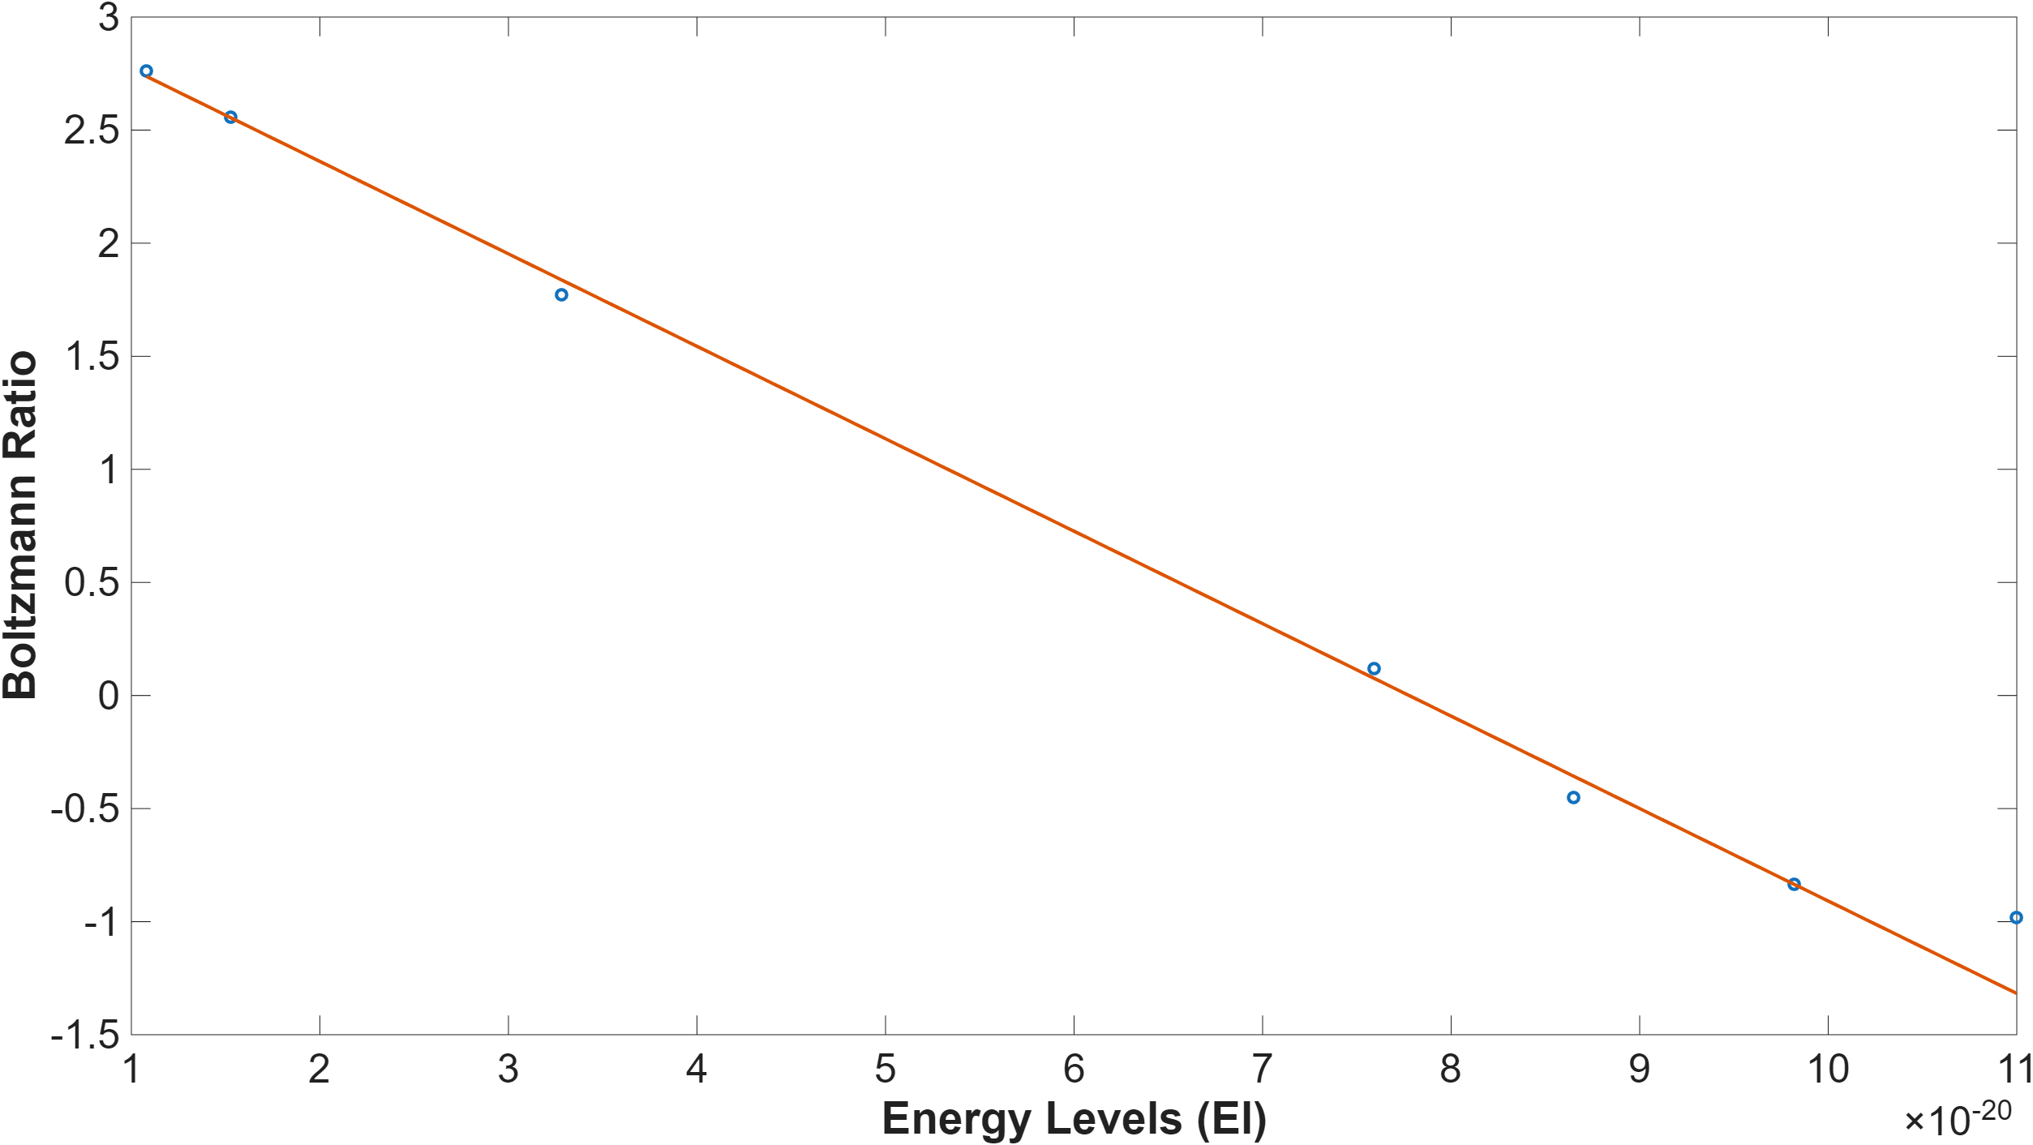
Absorption – Results
Sterno Flame
Higher sampling height of 0.5”:
  Temperature: 1746 K
  OH mole fraction: 0.0083
  Both the temperature and mole fraction decreased, driven by enhanced entrainment of ambient air and progressive radical recombination as the plume cools
Unlike hydrocarbon flames, the Sterno flame exhibited minimal continuum background because of its essentially soot-free combustion, improving the signal-to-noise ratio of the OH absorption features
After baseline correction, the Boltzmann plot retained strong linearity, confirming that the rotational population remains sufficiently equilibrated for reliable extraction of temperature and OH concentration across the sampled heights
ME498 Engineering Spectroscopy

Slide 20
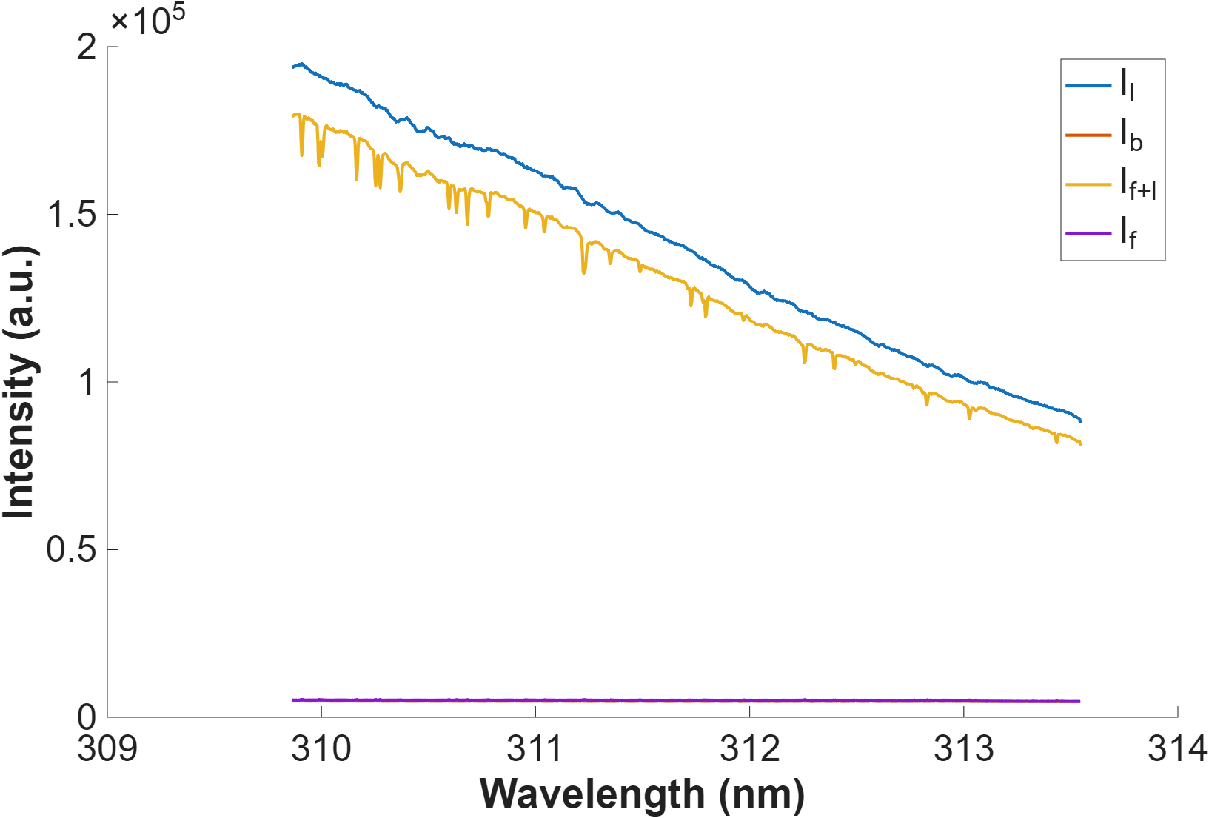
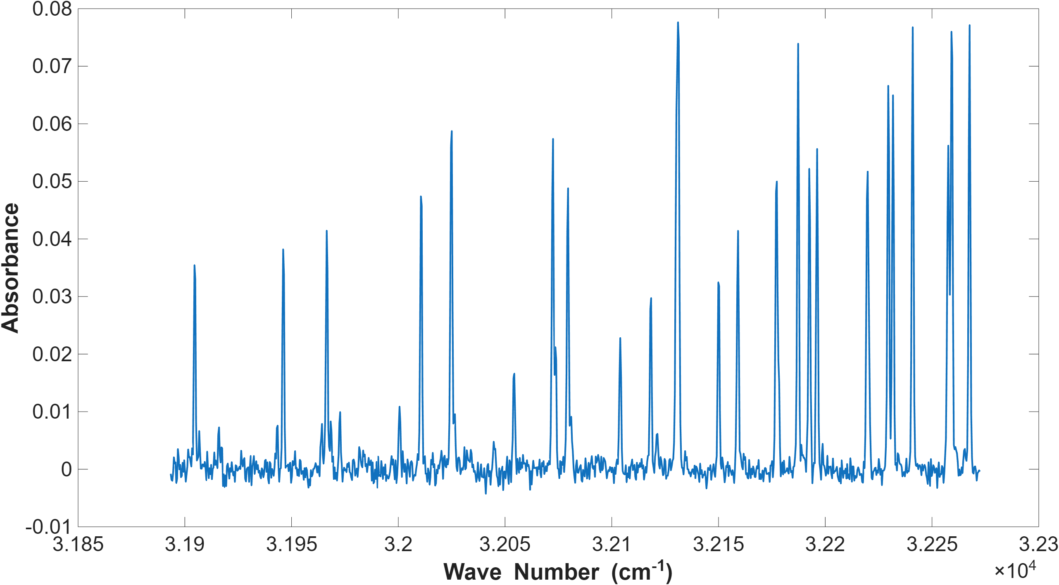
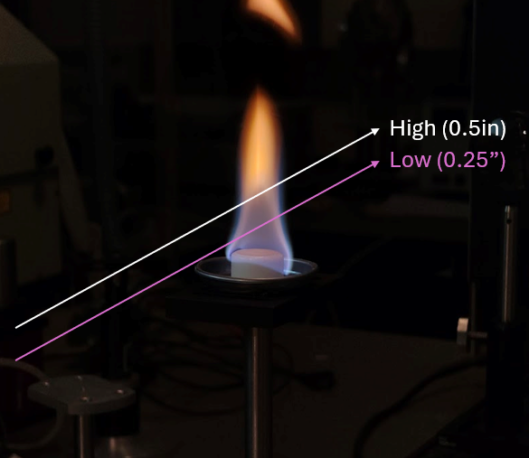
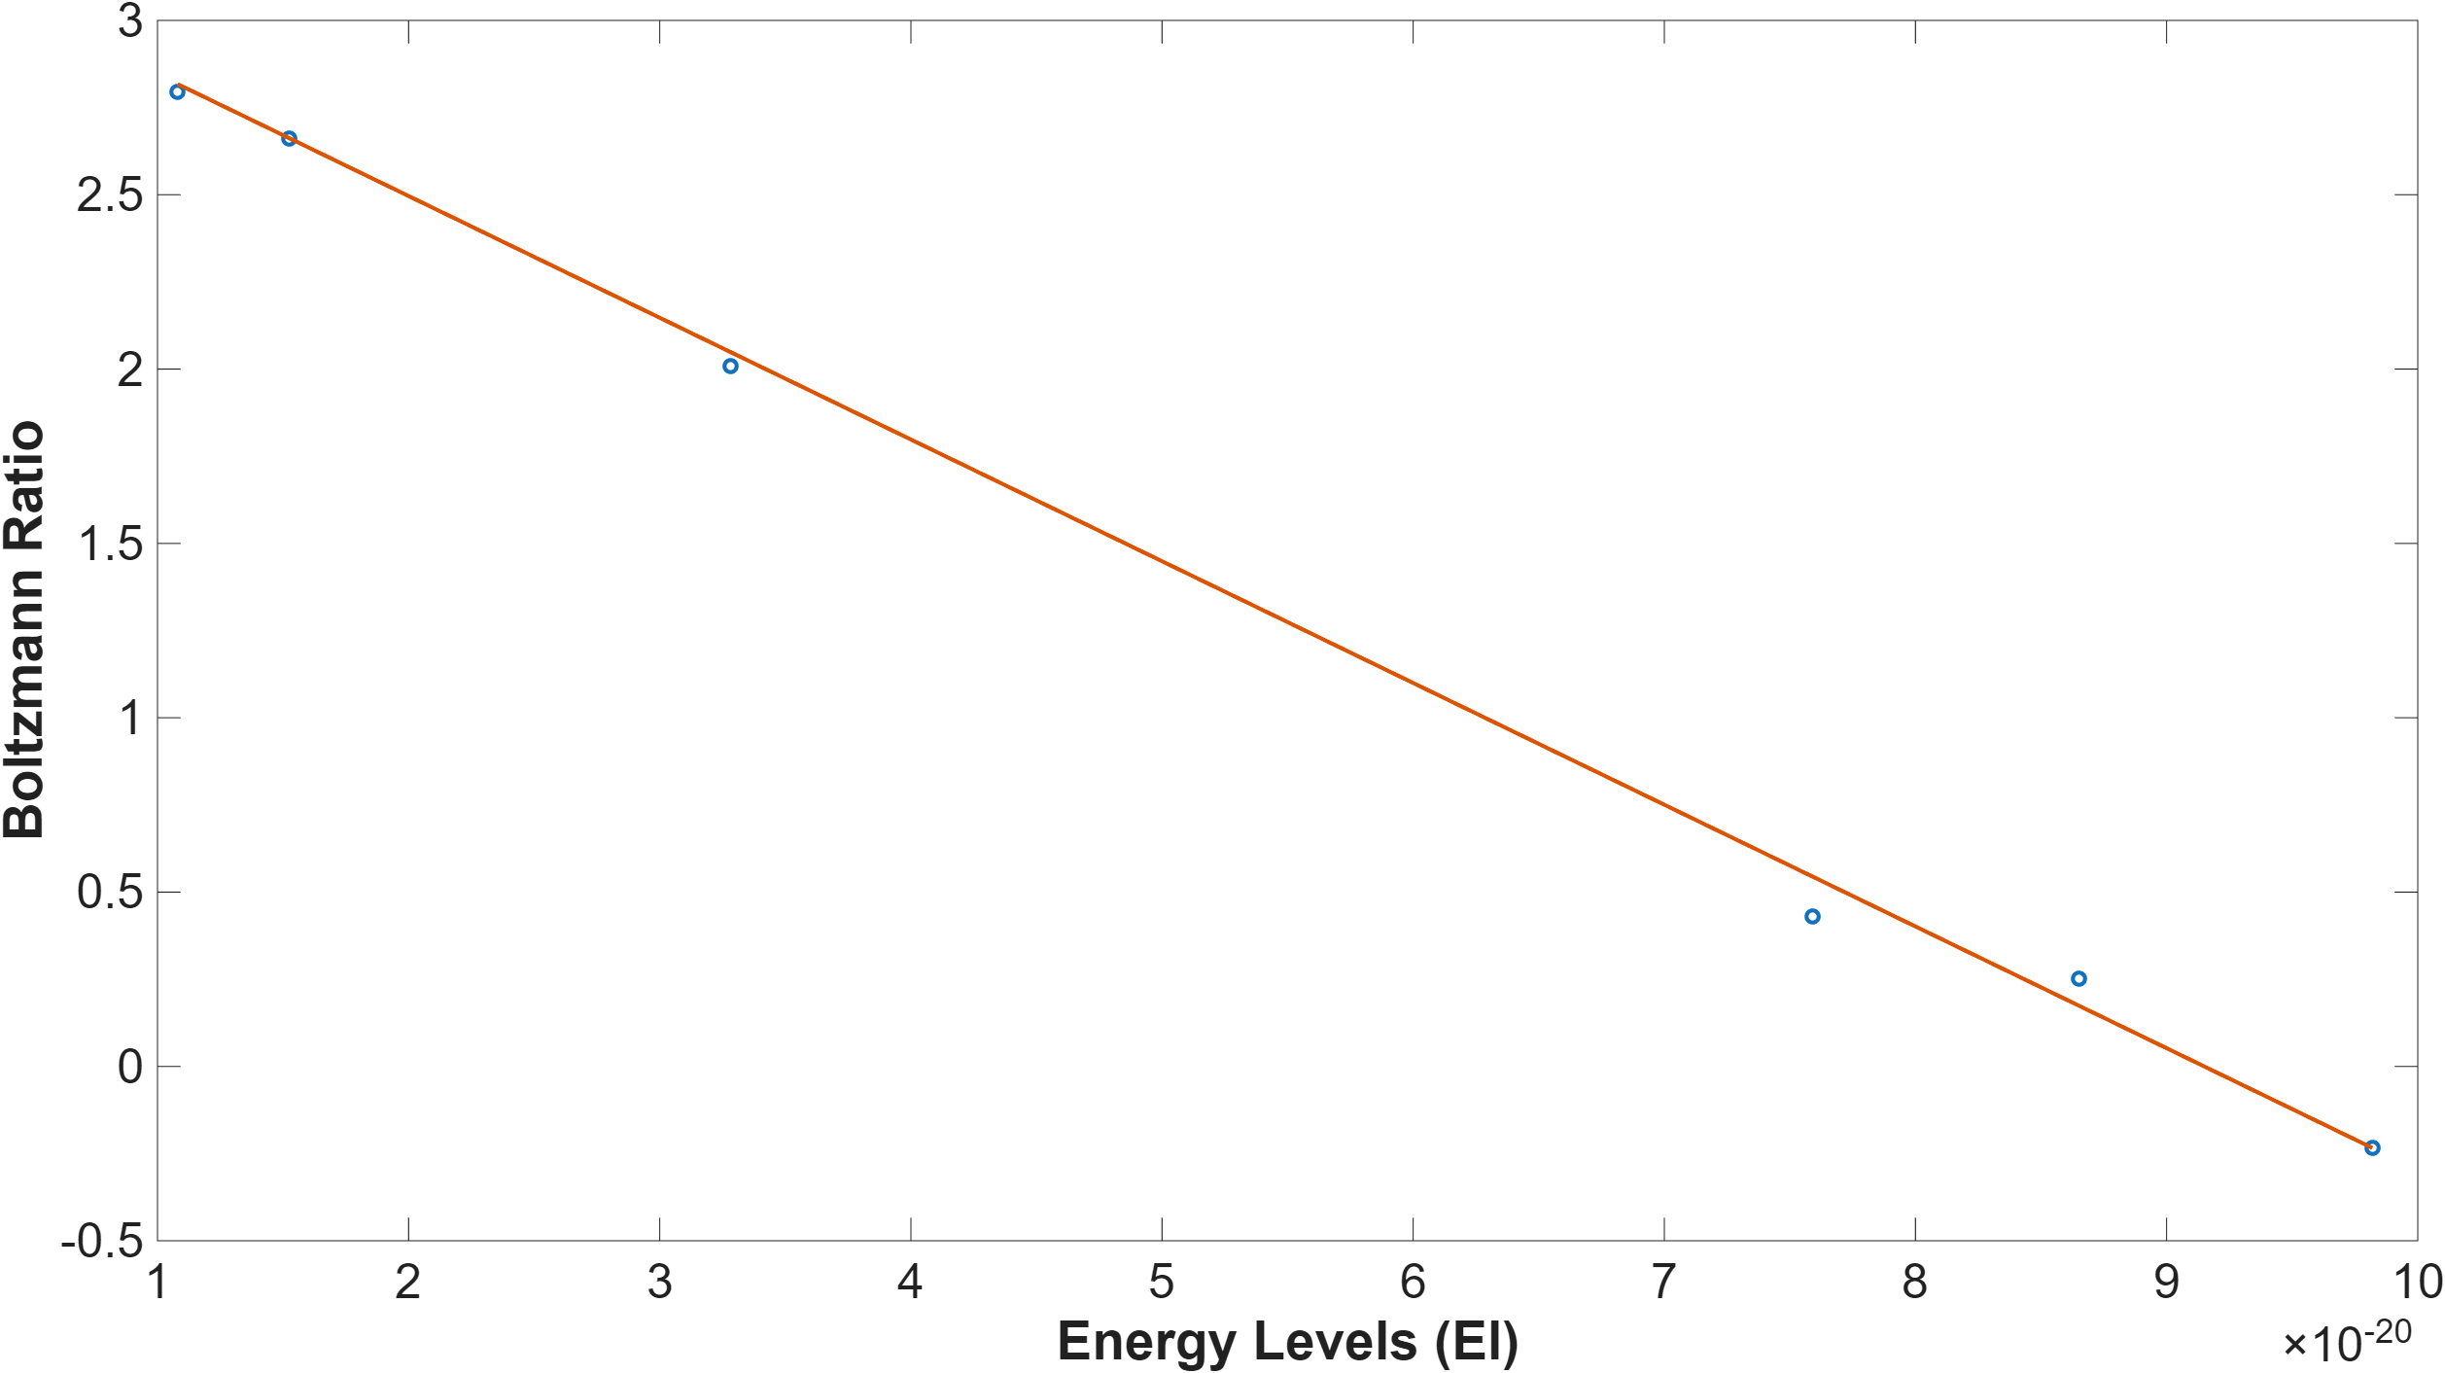
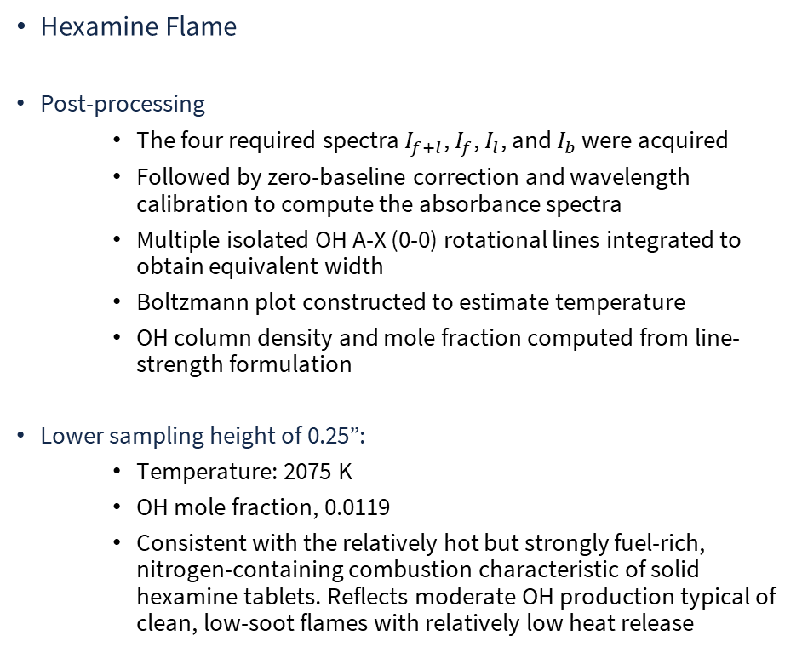
Absorption – Results
Hexamine Flame
Post-processing
  The four required spectra $I_{f+l}$, $I_{f}$, $I_{l}$, and $I_{b}$ were acquired
  Followed by zero-baseline correction and wavelength calibration to compute the absorbance spectra
  Multiple isolated OH A-X (0-0) rotational lines integrated to obtain equivalent width
  Boltzmann plot constructed to estimate temperature
  OH column density and mole fraction computed from line-strength formulation
Lower sampling height of 0.25”:
  Temperature: 2075 K
  OH mole fraction, 0.0119
  Consistent with the relatively hot but strongly fuel-rich, nitrogen-containing combustion characteristic of solid hexamine tablets. Reflects moderate OH production typical of clean, low-soot flames with relatively low heat release
ME498 Engineering Spectroscopy

Slide 21
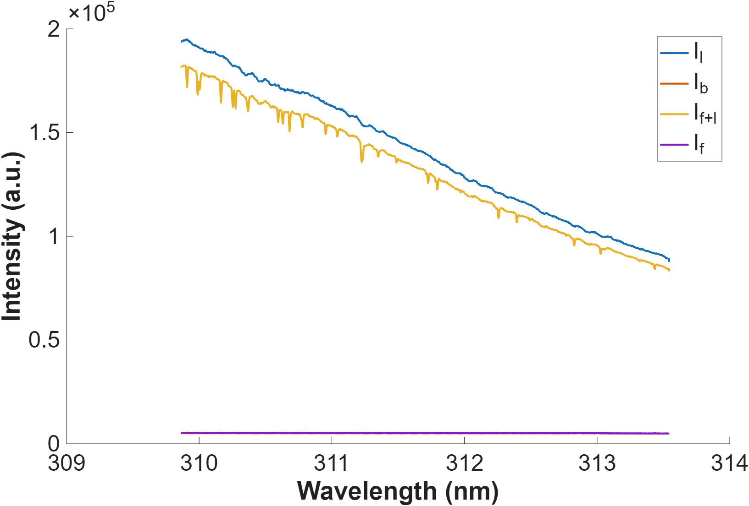
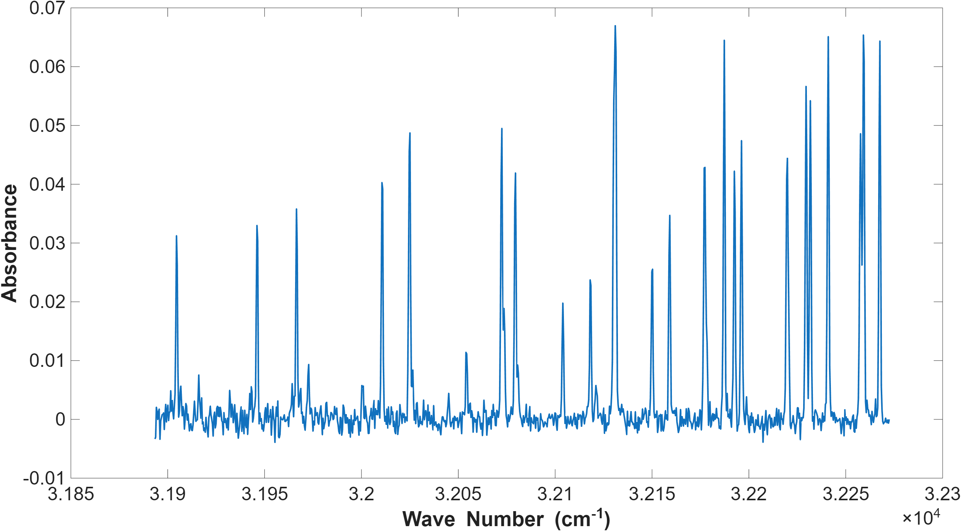
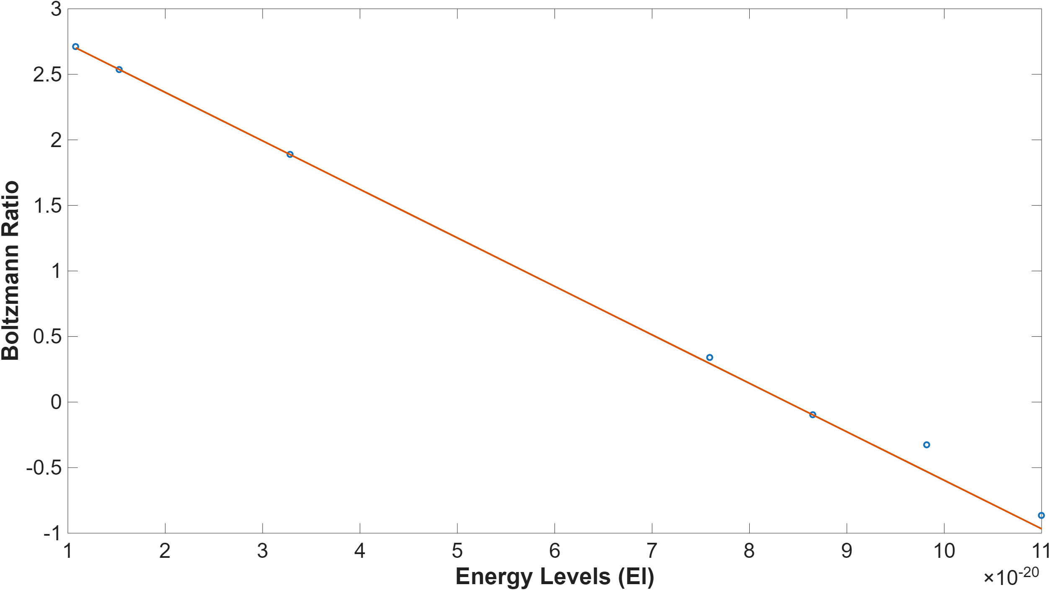
Absorption – Results
Hexamine Flame
Higher sampling height of 0.5”:
  Temperature: 1959 K
  OH mole fraction: 0.0102
  Both the temperature and mole fraction decreased, driven by entrainment-induced cooling and the recombination or conversion of OH as the plume transitions toward a diffusion-dominated post-flame region
The hexamine flame exhibited a noticeable broadband background due to soot and thermally excited CN/HCN chemiluminescence, requiring careful baseline correction before line selection and integration
After baseline correction, the Boltzmann plot maintained adequate linearity, confirming that the OH rotational population remained near equilibrium and permitting reliable extraction of temperature and local radical concentration
ME498 Engineering Spectroscopy

Slide 22





Absorption – Results
Propane Flame
Post-processing
  The four required spectra $I_{f+l}$, $I_{f}$, $I_{l}$, and $I_{b}$ were acquired
  Followed by zero-baseline correction and wavelength calibration to compute the absorbance spectra
  Multiple isolated OH A-X (0-0) rotational lines integrated to obtain equivalent width
  Boltzmann plot constructed to estimate temperature
  OH column density and mole fraction computed from line-strength formulation
Lower sampling height of 0.25”:
  Temperature: 2184 K
  OH mole fraction, 0.043
  Consistent with propane’s clean, gaseous, premixed-like combustion behavior that generates strong OH formation near the primary reaction zone. Reflects the high radical production typical of blue, low-soot hydrocarbon flames
ME498 Engineering Spectroscopy

Slide 23



Absorption – Results
Propane Flame
Higher sampling height of 0.5”:
  Temperature: 2122 K
  OH mole fraction: 0.02
  Both the temperature and mole fraction decreased, as expected from post-flame cooling and dilution with entrained ambient air
Propane exhibited minimal broadband luminosity compared to solid-fuel flames, resulting in a clean baseline with well-isolated OH A-X (0-0) lines and highly linear Boltzmann plots
This linearity confirms that OH rotational populations remained close to equilibrium across both heights, enabling reliable extraction of local temperature and radical concentration
ME498 Engineering Spectroscopy

Slide 24
Emission – Results
ME498 Engineering Spectroscopy

Slide 25



Emission – Results
Theoretical OH emission spectrum
  The theoretical OH A-X (0-0) emission spectrum was generated using LIFBASE
  Individual transitions corresponding to the experimentally observed P1, Q1, and Q2 rotational branches were identified
  Only well-resolved, isolated OH transitions were chosen to avoid peak overlap and baseline interference
  Lines were selected to span a sufficiently wide range of upper-state energies $E′$
  Transitions with reliable LIFBASE line strengths and minimal spectral interference from broadband flame emission or nearby interfering species were prioritized
Extraction of line parameters
  For each selected line, LIFBASE outputs
    line position (wavelength in air and wavenumber)
    Einstein $Aul$ coefficient
    Rotational quantum numbers
  Based on these, HITRAN database outputs
    Lower-state energy $E"$
    Degeneracy term $g′=2J′+1$
  From these, the upper-state energy E’ was extracted by adding the photon energy to the lower state energy
ME498 Engineering Spectroscopy

Slide 26




Emission – Results
Butane Flame
Post-processing
  The two required spectra $I_{f}$ and $I_{b}$ were acquired
  Followed by zero-baseline correction and wavelength calibration to compute the emission spectra
  Multiple isolated OH A-X (0-0) rotational lines integrated to obtain equivalent width
  Boltzmann plot constructed to estimate temperature
Lower sampling height of 0.25”:
  Temperature: 3902 K
ME498 Engineering Spectroscopy

Slide 27



Emission – Results
Butane Flame
Higher sampling height of 0.5”:
  Temperature: 3865 K
  The temperature decreased, consistent with cooling and dilution as combustion products mix with the surrounding air
ME498 Engineering Spectroscopy

Slide 28





Emission – Results
Candle Flame
Post-processing
  The two required spectra $I_{f}$ and $I_{b}$ were acquired
  Followed by zero-baseline correction and wavelength calibration to compute the emission spectra
The recorded spectrum shows indistinct rotational line features, which could be attributed to the low intensity of the OH signal and the strong continuum background from the soot
Candle flames are highly luminous diffusion flames characterized by high soot formation in the yellow/orange zone. This soot radiates as a near-perfect blackbody emitter due to its high temperature. The blackbody radiation creates a very strong, broad, continuous background signal that underlies the specific OH emission peaks.
The observed spectrum shows the intensity starting high (around 300-400 arbitrary units) even between the peaks, indicating a significant continuum signal
This high background drastically reduces the signal-to-noise ratio (SNR) and the contrast between the discrete OH rotational peaks and the baseline noise, making the individual OH lines look blurry or washed out
ME498 Engineering Spectroscopy

Slide 29





Emission – Results
Sterno Flame
Post-processing
  The two required spectra $I_{f}$ and $I_{b}$ were acquired
  Followed by zero-baseline correction and wavelength calibration to compute the emission spectra
The recorded spectrum shows extremely low intensity and a very poor signal-to-noise ratio, making the OH rotational features almost completely indistinguishable from the noise
The most significant factor suppressing the OH emission signal in a sterno flame is the high concentration of collisional quenchers in the burnt gas products
Sterno is typically composed of denatured alcohol (often ethanol or methanol). Alcohol fuels produce large amounts of H2O (water vapor) and CO2 as combustion products. Both H2O and CO2 are highly effective collisional quenchers. They rapidly collide with the excited OH radical and de-excite it (transferring the energy as heat) before the OH can emit a photon
This fast de-excitation drastically reduces the quantum efficiency of the OH emission process, leading to a much lower overall emission intensity compared to flames with cleaner products
ME498 Engineering Spectroscopy

Slide 30




Emission – Results
Hexamine Flame
Post-processing
  The two required spectra $I_{f}$ and $I_{b}$ were acquired
  Followed by zero-baseline correction and wavelength calibration to compute the emission spectra
  Multiple isolated OH A-X (0-0) rotational lines integrated to obtain equivalent width
  Boltzmann plot constructed to estimate temperature
Lower sampling height of 0.25”:
  Temperature: 3739 K
ME498 Engineering Spectroscopy

Slide 31



Emission – Results
Hexamine Flame
Higher sampling height of 0.5”:
  Temperature: 3008 K
  The temperature decreased, driven by entrainment-induced cooling and the recombination or conversion of OH as the plume transitions toward a diffusion-dominated post-flame region
ME498 Engineering Spectroscopy

Slide 32




Emission – Results
Propane Flame
Post-processing
  The two required spectra $I_{f}$ and $I_{b}$ were acquired
  Followed by zero-baseline correction and wavelength calibration to compute the emission spectra
  Multiple isolated OH A-X (0-0) rotational lines integrated to obtain equivalent width
  Boltzmann plot constructed to estimate temperature
Lower sampling height of 0.25”:
  Temperature: 3673 K
ME498 Engineering Spectroscopy

Slide 33



Emission – Results
Propane Flame
Higher sampling height of 0.5”:
  Temperature: 3378 K
  The temperature decreased, as expected from post-flame cooling and dilution with entrained ambient air
ME498 Engineering Spectroscopy

Slide 34
Conclusion
ME498 Engineering Spectroscopy

Slide 35
Conclusion
Absorption vs Emission
Aspect | Absorption Spectroscopy | Emission Spectroscopy
Temperature Interpretation | Gives true gas kinetic temperature because ground-state distribution follows Boltzmann equilibrium | Gives chemical excitation temperature, often much higher and not equal to gas temperature
Dependence on Chemical Reactions | Weak, only depends on absorption along the line of sight | Strong, OH* is formed through highly exothermic reactions (e.g., H + O + OH → H₂O + OH*)
Sensitivity to Soot / Background Light | Low, absorption ratio I/I₀ cancels luminosity effects | High, strong interference from soot luminosity and continuum background
OH Mole Fraction Measurement | Reliable, column density from absorption coefficient + known T → mole fraction via ideal gas law | Not reliable, emission intensity is nonlinear and strongly affected by quenching; cannot retrieve absolute concentrations without calibration
Robustness Across Fuels (candle, sterno, butane, propane, hexamine) | Very robust, works even when OH signals are weak or continuum is strong | Fuel-dependent, noisy for sooting flames (candle, sterno), strong signals for gaseous flames
ME498 Engineering Spectroscopy

Slide 36


Conclusion
Comparison of different flame characteristics:
Clear differences among the various flame types were also evident from the spectroscopic measurements
Gaseous fuels such as propane and butane produced strong, well-resolved OH A-X transitions with relatively low continuum background, enabling accurate Boltzmann fitting and consistent OH mole-fraction estimates. These flames showed moderate cooling with height, reflecting their clean, premixed-like reaction zones
In contrast, solid and gel fuels hexamine, candle, and sterno, displayed much weaker OH absorption signals and significantly stronger continuum emission arising from soot (candle), thermal glow (sterno), or fuel decomposition products (hexamine). These flames exhibited lower temperatures overall and a more pronounced reduction in both temperature and OH concentration with height due to their diffusion-controlled, oxygen-limited combustion
The combined observations emphasize that fuel chemistry and flame structure fundamentally influence the spectral signature, with gaseous fuels yielding clean, analyzable spectra and diffusion flames requiring more careful baseline correction but still producing meaningful rotational and concentration trends.
ME498 Engineering Spectroscopy

Slide 37
Conclusion
This study successfully applied both absorption and emission laser-spectroscopic methods to characterize OH rotational temperature and mole fraction across a range of flames, including
  gaseous (butane, propane) and
  diffusion-based solid/gel fuels (candle, sterno, hexamine)
Absorption spectroscopy proved to be a robust tool for quantitative diagnostics, yielding reliable Boltzmann temperatures and OH concentrations even in soot-laden or low-radical flames
While emission spectroscopy provided complementary insight into excited-state populations and local radiative behavior
Across all fuels, the measurements revealed consistent physical trends: higher temperatures and OH concentrations near the base of the flame, followed by cooling and radical decay with height
Differences between fuels were also clearly observed
  Clean-burning gaseous fuels produced strong, well-resolved OH features
  Whereas diffusion-controlled solid and gel fuels exhibited weaker OH transitions and stronger continuum backgrounds due to soot or thermal emissions
Overall, the combination of measurement techniques and multi-fuel comparison demonstrated not only the versatility of OH spectroscopy for combustion diagnostics but also the strong influence of fuel chemistry and flame structure on observed spectral behavior
This work provides a reliable framework for using spectroscopic tools to study real-world combustion systems and their underlying reactive-flow physics.
ME498 Engineering Spectroscopy

Slide 38
References
[1] Klaus C. Lück, Walter Thielen, “Measurements of temperatures and OH-concentrations in a lean methane-air flame using high-resolution laser-absorption spectroscopy”, Journal of Quantitative Spectroscopy and Radiative Transfer, Volume 20, Issue 1, July 1978, Pages 71-79
[2] Xinyu Yang, Zhimin Peng, Yanjun Ding, Yanjun Du, “Temperature and OH concentration measurements by ultraviolet broadband absorption of OH(X) in laminar methane/air premixed flames”, Fuel, Volume 288, 15 March 2021, 119666
[3] Luque J. Lifbase, database and spectral simulation for diatomic molecules, Sri Int Rep 99.
[4] I. E. Gordon, L. S. Rothman, R. J. Hargreaves, R. Hashemi, E. V. Karlovets, F. M. Skinner, et al., "The HITRAN2020 molecular spectroscopic database", J. Quant. Spectrosc. Radiat. Transfer 277, 107949 (2022)
[5] Lei He, Qinghua Guo, Yan Gong∗, Fuchen Wang, Guangsuo Yu, “Investigation of OH∗ chemiluminescence and heat release in laminar methane–oxygen co-flow diffusion flames”, Combustion and Flame 201 (2019) 12–22
[6] Gaydon, A. G. The Spectroscopy of Flames.
ME498 Engineering Spectroscopy

Slide 39
Thank You
Arjav Jain
NetID: Arjavj2
+1-217-800-2530
ME498 Engineering Spectroscopy

Slide 40

Illinois Blue

