Slide 1
ETE Evaluation
MIN-300 (Spring 2022)
‘Design and Development of a 14 DOF Full Vehicle Model’
Members
Advisor
Group Number: 14
Gautam Shetty (19117047)
Arjav Jain (19117017)
Ipsit Anand (19117053)
Parth Chhabra (19117082)
Harsiddh Desai (19117052)
Prof. S.H. Upadhyay
Notes:
A warm good morning to the panel present here. Today I, Gautam Shetty, along with my team members of group number 14 will present on the topic “Design and development of a 14 DOF full vehicle model”. But before going into the details of the project I will give an introduction of it.

Slide 2
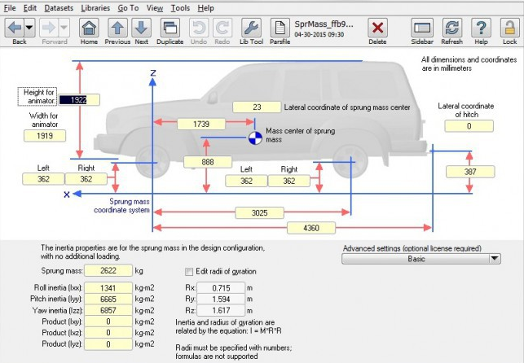
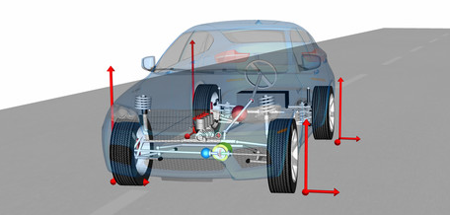
Motivation and Problem Definition
Interest in automotive engineering
Extensive modelling and simulation
Real-world implementation of physical equations
Myriad applications of our model
Desire to create a student friendly vehicle modeling software
https://www.carsim.com/
https://www.modelon.com/library/vehicle-dynamics-library/
Problem Definition
To build from the ground up a full vehicle model for analyzing the handling performance of a vehicle. The model will effectively and accurately simulate an electric powertrain, a moving chassis, a dynamic suspension and a full set of tyres. Additional prospects might involve development of various automotive control systems.
Notes:
Let me provide a brief overview of our motivation for working on this particular project. Most of our team has been part of an automotive technical group within this institute for the past two years. This means that we have a lot of experience and interest in the field of vehicle engineering and performance tuning. We are also quite adept at creating models for analyzing a system's behaviour, especially in software like MATLAB and Simulink. The large number of physical equations used in this project directly translate into real life. Various automobile manufacturers and performance sports teams depend on full vehicle models to test their cars' performance and handling. The image on the right presents the GUI of a vehicle dyanmics software like carSim. Even though several other commercial software like these are available for similar purposes, we aim to develop a student-friendly alternative where the underlying physical and mathematical models are clearly visible.
The project aims to build from the ground up a full vehicle model for analysing the handling performance of a vehicle. Torque and Efficiency maps will be used to create models for the motor, battery, and transmission to imitate an electric powertrain. The motion of the chassis will be simulated through a 6 DOF ride and handling model. Vertical movement of the unsprung masses, and force transfer through linkages will be effectively simulated using the suspension model. The tire model calculates each tire's friction forces, moments, and rotational speed. Extensive testing and validation would be our focus after creating the models. Finally, additional research topics will be identified to accentuate our project further.

Slide 3
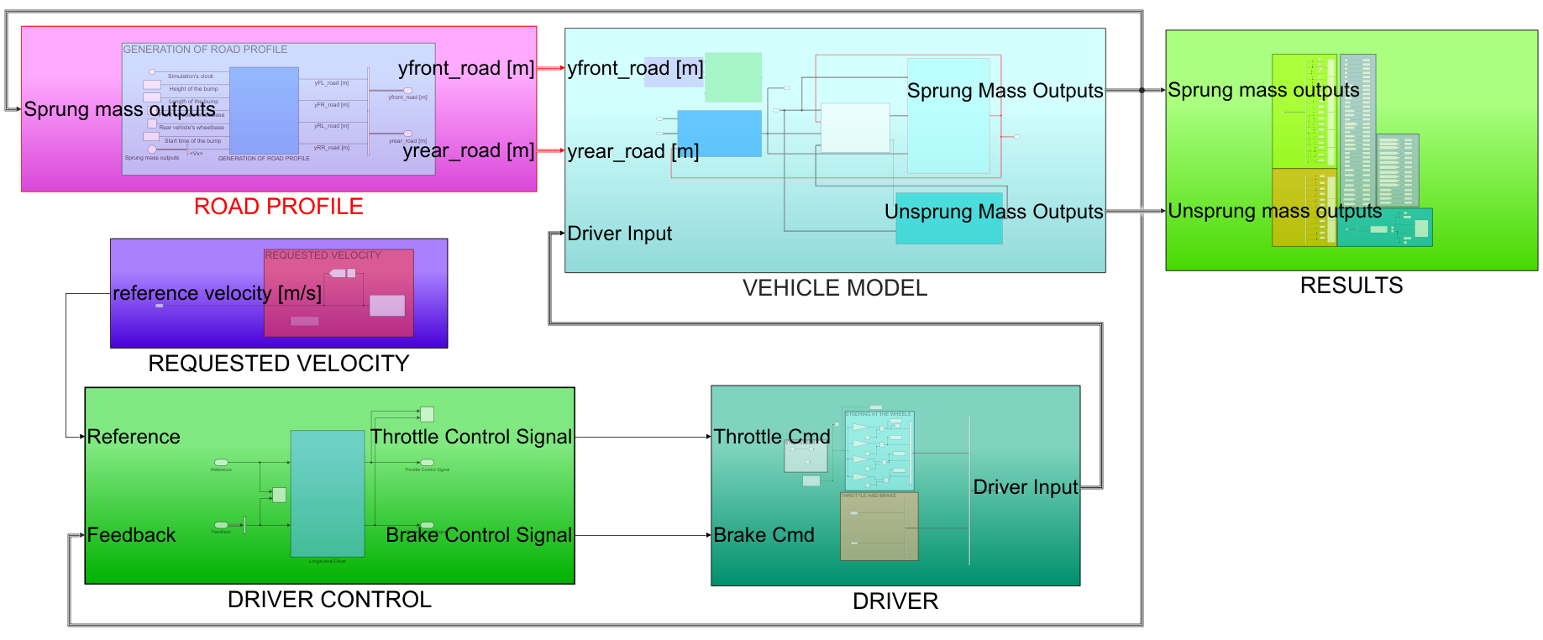
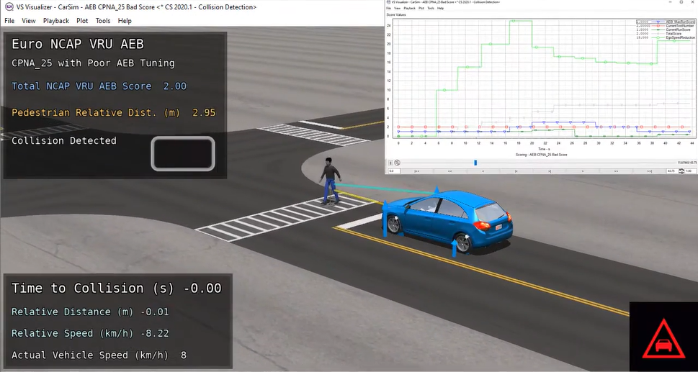
Methodology and Deliverables
Equations in MATLAB code
Research papers and books
Derived relevant equations
Testing and validation
ODE’s
modelled in Simulink blocks
Final Model
The Final Model
Reference: (1) Setiawan, Joga & Safarudin, Mochamad & Singh, Amrik. (2009). Modeling, simulation and validation of 14 DOF full vehicle model. 1 - 6. 10.1109/ICICI-BME.2009.5417285.
Deliverables
Tangible products
  14 DOF full vehicle model
Benefits
  Accurate monitoring for a large number of vehicle conditions
  Helpful in driver training in motorsport scenes
  Parameter tuning for optimal performance
  Can be used for vehicle safety design
https://www.carsim.com/publications/newsletter/2020_08_12.php

Slide 4
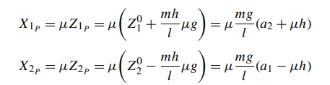
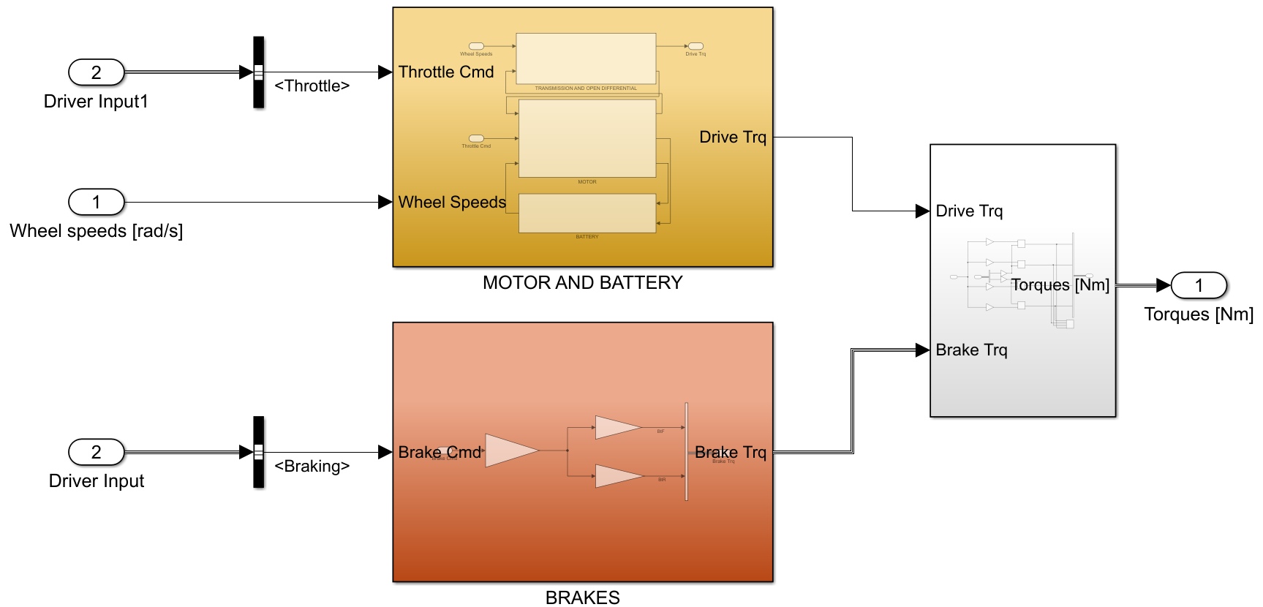
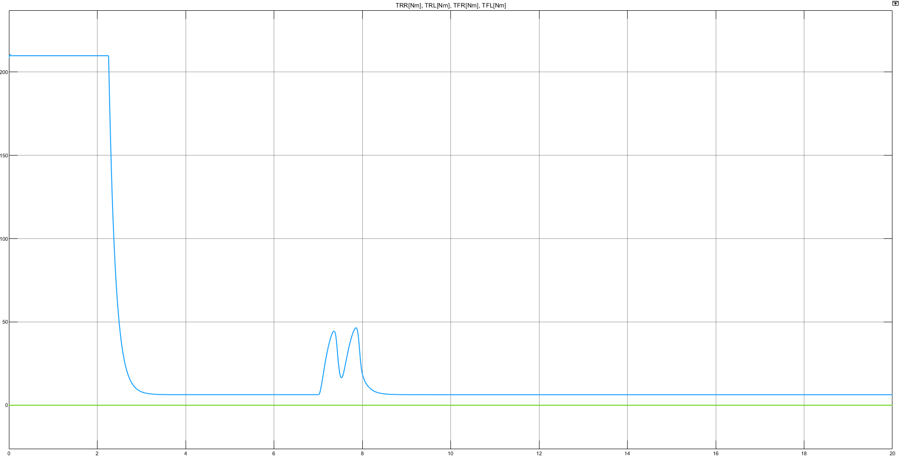
POWERTRAIN & BRAKING SUBSYSTEMS (Arjav Jain)
Developed subsystems to model the entire electric powertrain and hydraulic braking of the vehicle
Used blocks like 2D lookup table to plot the motor efficiency curve as a function of motor torque and RPM
Testing model with dummy inputs:
Constant velocity/Constant acceleration tests
Generates results like SOC of the battery, Output power of the motor, Total braking torque etc.
Equations to model longitudinal load transfer
INPUT: Driver Input (Throttle & Brake)/Wheel Speeds
OUTPUT: Wheel Torques
Powertrain & Braking Subsystems
Results:
Torque on each wheel (Nm)

Slide 5

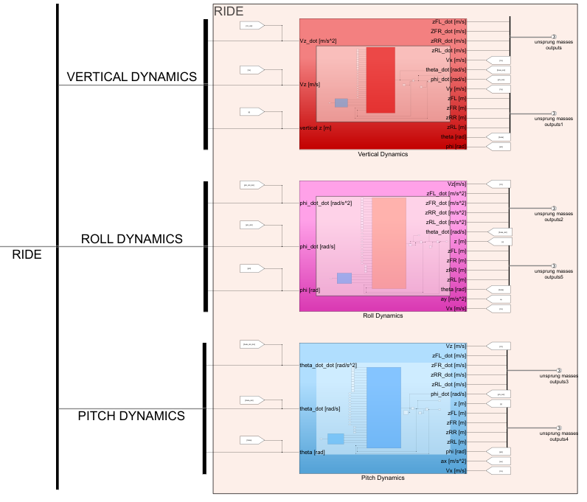
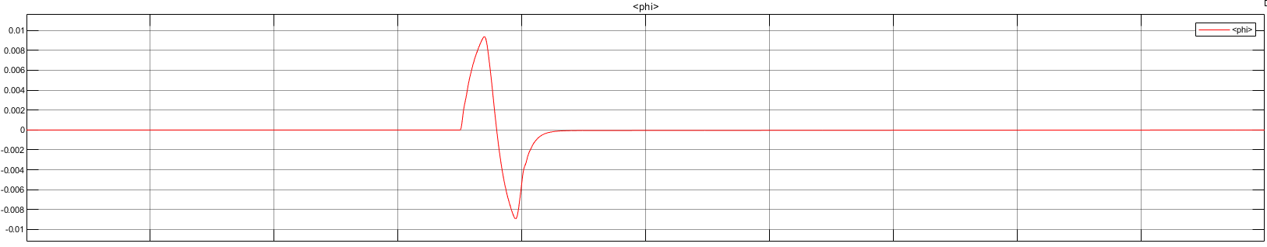
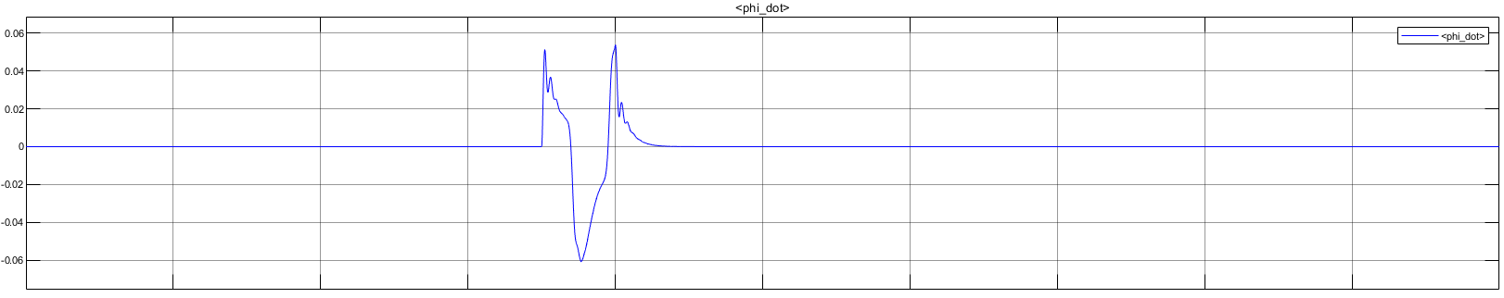
RIDE SUBSYSTEM (Parth Chhabra)
Modeled vertical, roll and pitch dynamics equations referring research papers using MATLAB functions
Obtained acceleration, velocity, displacement in vertical direction along with roll and pitch angles and their derivatives
Optimization of suspension geometry including roll centre, pitch centre height, vertical lifts and weight distribution can be decided based on equations that are modelled
Equations to model vertical dynamics
INPUT: Unsprung Mass Outputs
OUTPUT: Vertical Velocity CG/Roll & Pitch Angles/ Velocities/Accelerations
Powertrain & Braking Subsystems
Ride Subsystem: Vertical/Roll/Pitch Dynamics
Roll angle (rad)
Results:
Roll velocity (rad/s)

Slide 6
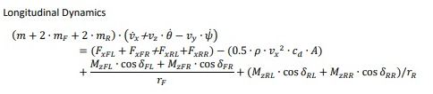
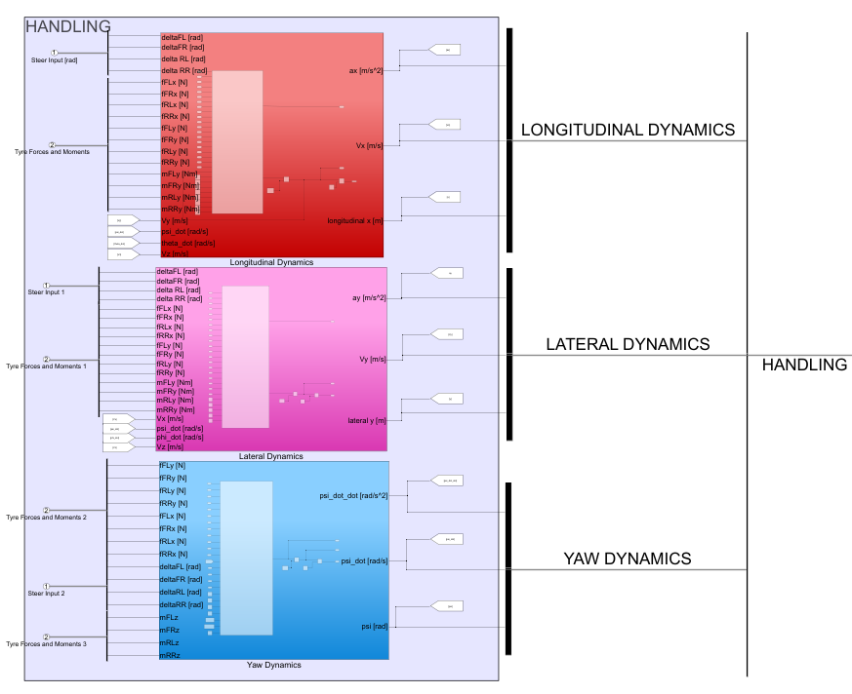
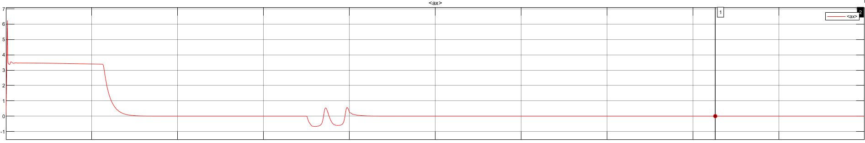
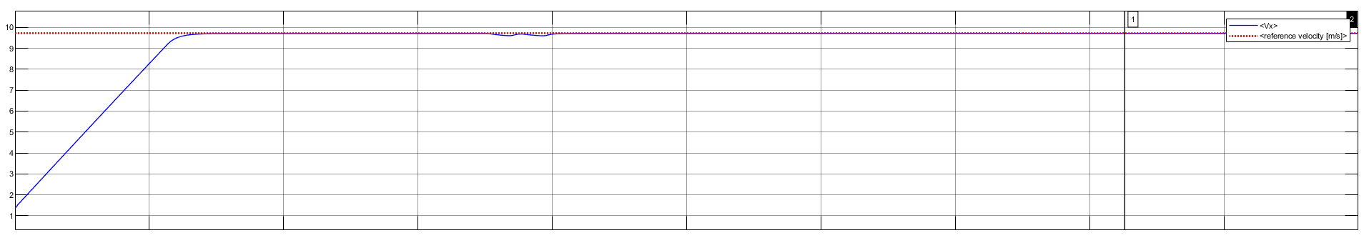
HANDLING SUBSYSTEM (Harsiddh Desai)
Designed chassis handling model of 14 DOF full vehicle model in Simulink
The equations shown here computes the longitudinal, lateral and yaw acceleration, velocities and displacement of the several dynamics which are shown in the results down below
This model allows us to simulate the sprung mass inputs and the Tyre forces and their moments
The outputs of this model can also be provided as inputs to other sub-systems like powertrain to analyze the overall performance
Equations to model longitudinal dynamics
INPUT: Driver Input (Steer)/Tyre Forces and Moments
OUTPUT: Longitudinal & Lateral Velocity CG/Yaw Angle
Powertrain & Braking Subsystems
Handling Subsystem: Longitudinal/Lateral/Yaw Dynamics
Longitudinal acceleration (m/s^2)
Results:
Longitudinal velocity (m/s)

Slide 7
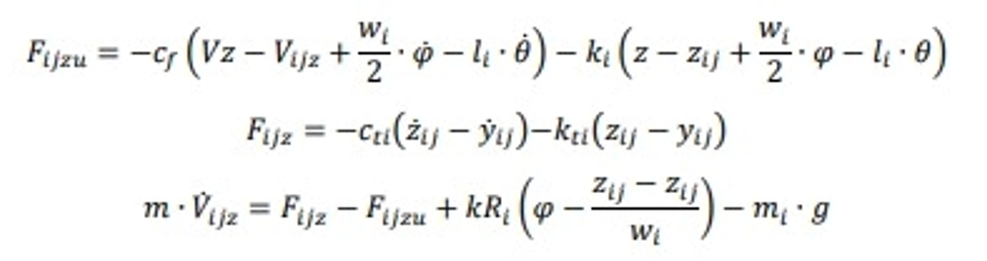
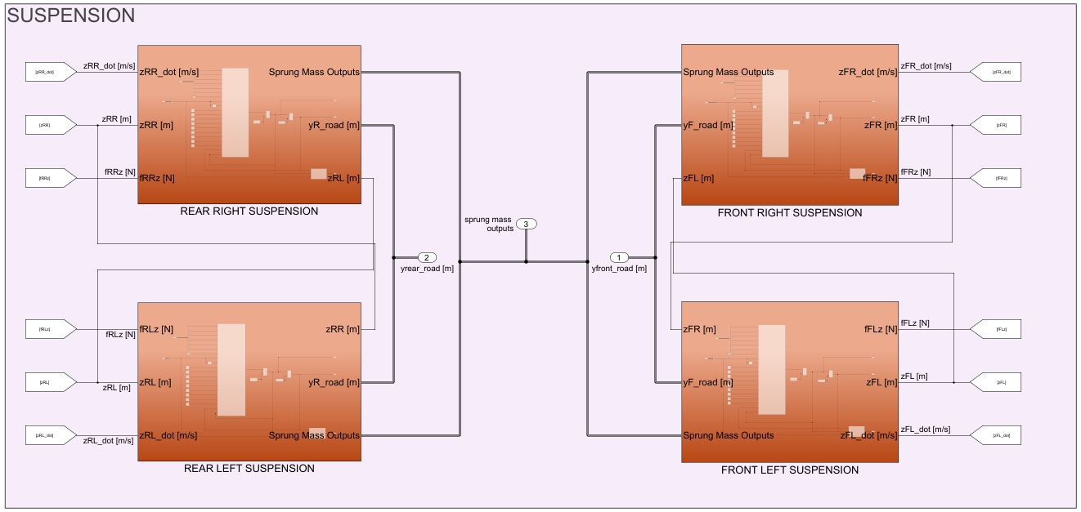
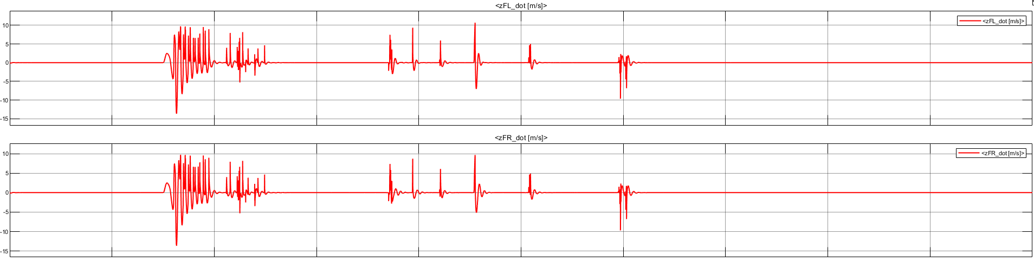
SUSPENSION SUBSYSTEM (Ipsit Anand)
Went through relevant research papers suggested by team leader
Designed suspension model of 14 DoF full vehicle model in Simulink
The equation shown computes the vertical sprung mass velocity with these four tyre equations
This model allows us to simulate the response of vehicle using different road profile inputs thus investigating the overall performance of vehicle by changing the damping and stiffness coefficient
Equations to model suspension vertical forces
INPUT: Sprung Mass Outputs/Road Profile
OUTPUT: Suspension Vertical Forces & Displacements
Suspension Subsystem
Results:
Vertical Velocity of Front Tyres (m/s)

Slide 8
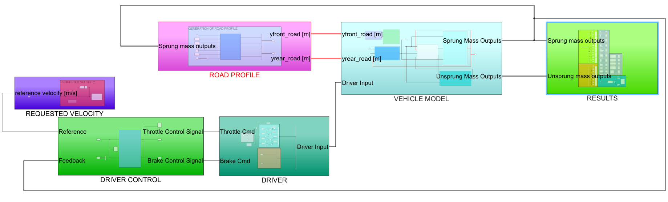
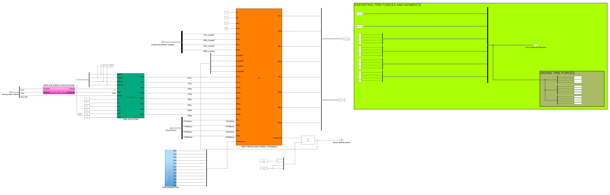
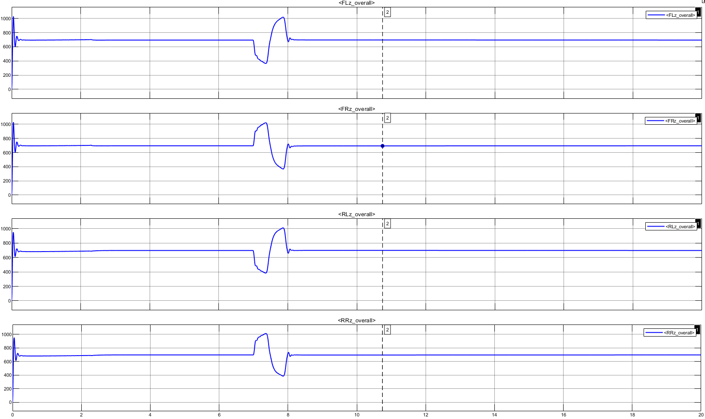
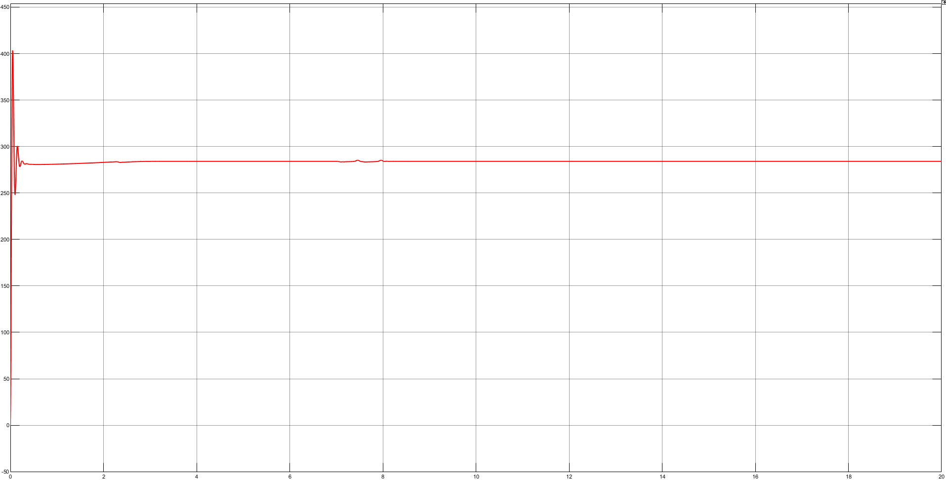
RESEARCH, WHEEL, INPUTS & TESTING (Gautam Shetty (Team leader))
Did preliminary research on the modelling and simulation of various automotive subsystems
Derived the necessary mathematical and physical equations for each working part of our vehicle
Tasked each member of our team to model these individual parts in MATLAB and Simulink
Developed the crucial wheel sub-block which outputs the tire forces, moments and wheel speeds
These values are integral to the functioning of our entire model
Subsidiary models for the input road profile, driver control and results were also developed
Connected all the individual components together to obtain the final system
Created several test cases for the final testing and thereby validated the entire working model
Final Integrated Model
Tyre Subsystem
Results:
Weight Validation (Kg)
Normal force on Each Tyre (N)

