Slide 1


Inter IIT Tech Meet 10.0
Team ID - 8
JLR’s Powered Bonnet for Electric Vehicles

Slide 2


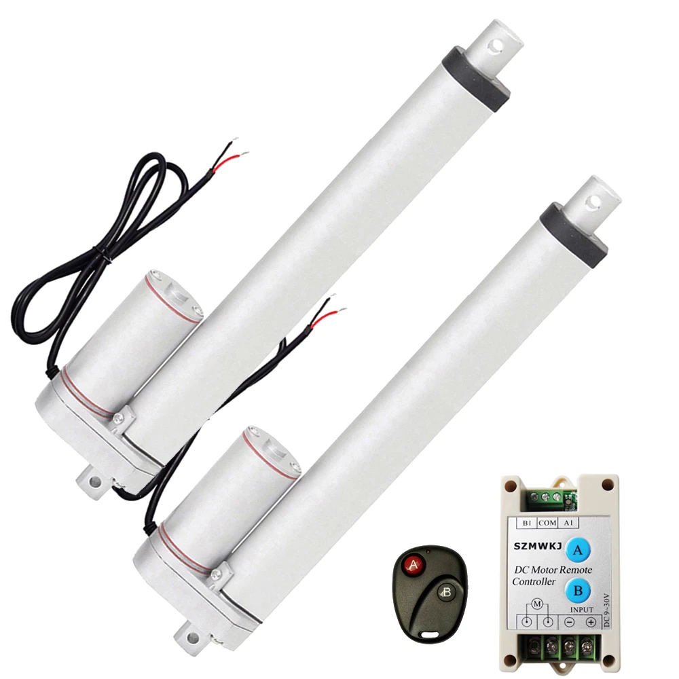
Background Research
Such automated lift mechanisms are already present in the form of powered tailgate systems in modern luxury automobiles.
Following existing systems were identified and examined.
Linear actuators-based solutions came out to be most optimum and easy to retrofit in existing vehicles.
Hyundai Tucson
Land Rover Discovery Sports
Linear Actuators

Slide 3
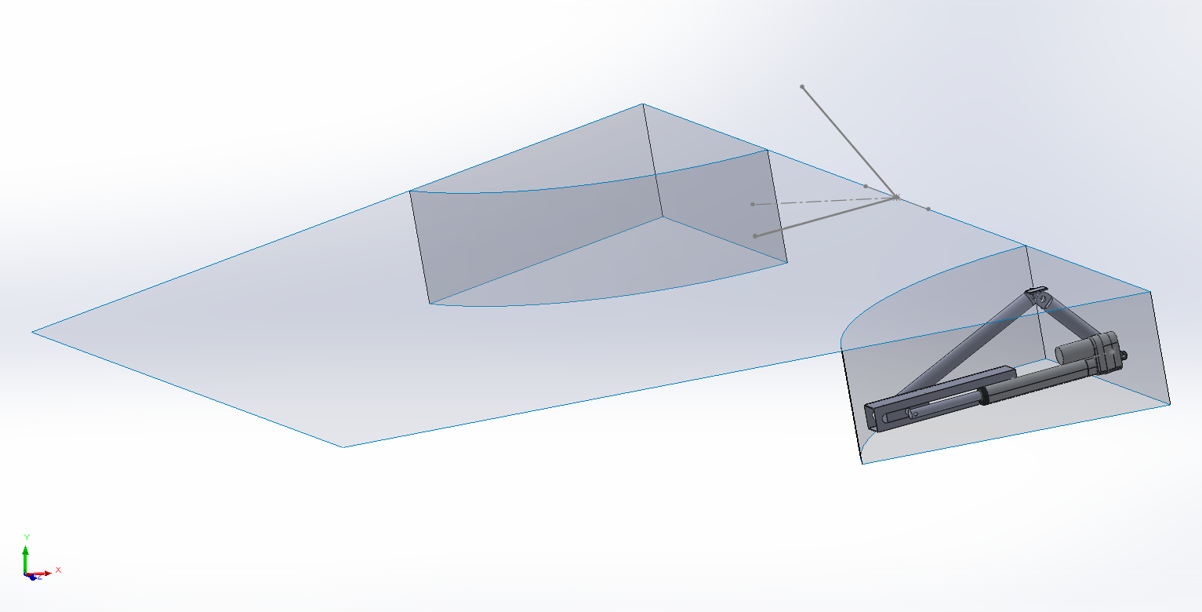
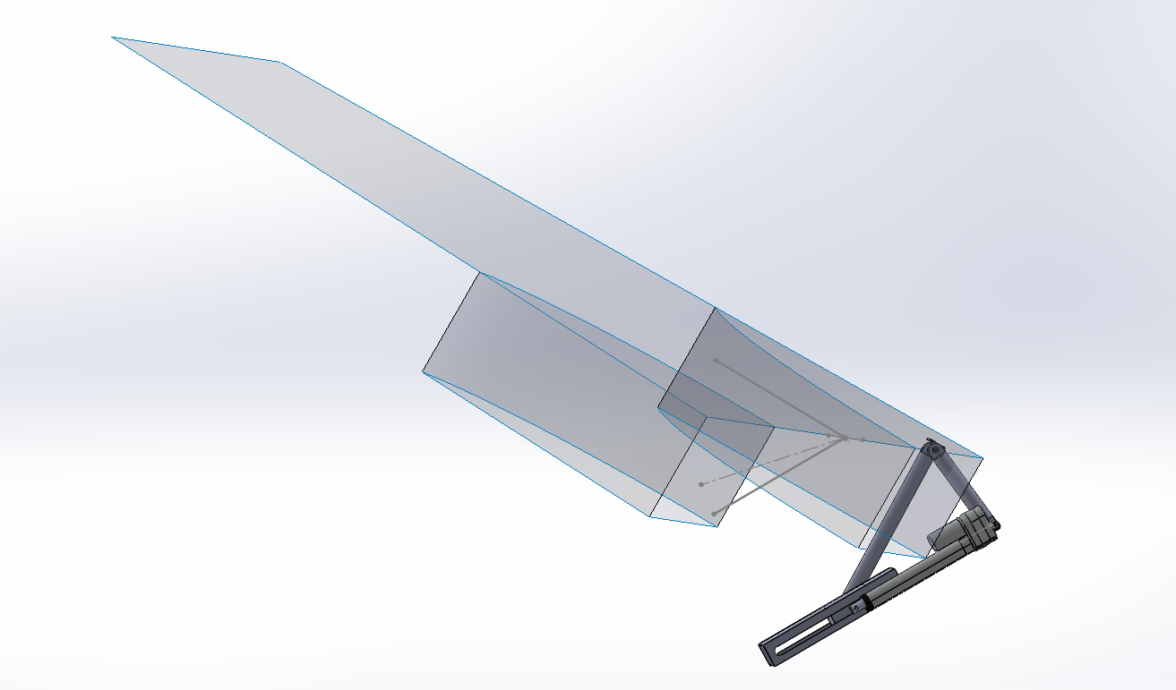
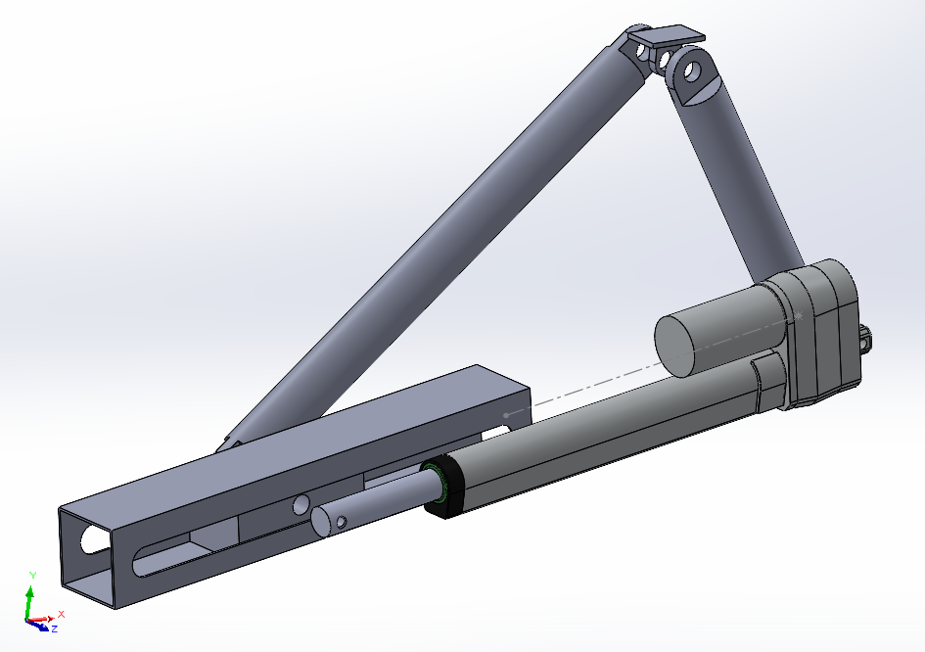
Mechanism Selection
Crank-Slider Coupled Linear Actuator (Rejected)
  A simple slider-crank mechanism is used to lift the bonnet.
  A linear actuator is coupled with the slider block to actuate the slider block.
  The mount connecting the bonnet and the crank is a sliding block.
Slider Crank Mechanism with Bonnet in Closed Position
Slider Crank Mechanism with Bonnet in Open Position
Closeup of the Slider Crank Assembly coupled with
Linear Actuator
Reasons for Rejection
  The mechanism consists of significantly greater number of parts, making it costlier to assemble.
  Multiple joints in the slider-crank mechanism would result in greater losses from friction hence greater power consumption.

Slide 4
Mechanism Selection
Direct Actuation (Selected)
  This mechanism consists of a linear actuator directly connected to the bonnet through mounting brackets.
  The actuator is extended from the retracted position at -12° to 48° from the horizontal.
  The bonnet is lifted through the direct application of force by the linear actuator.
  A linear actuator with feedback is selected to implement various control methodologies and safety features.
Reasons for selection
  Multiple design constraints are satisfied by this mechanism.
  Relatively lesser number of components ensures easy assembly.
  The setup consists of only 2 compact linear actuators and an Arduino board: making it very compact and lightweight.
  The required components are readily available in the Indian market.

Slide 5
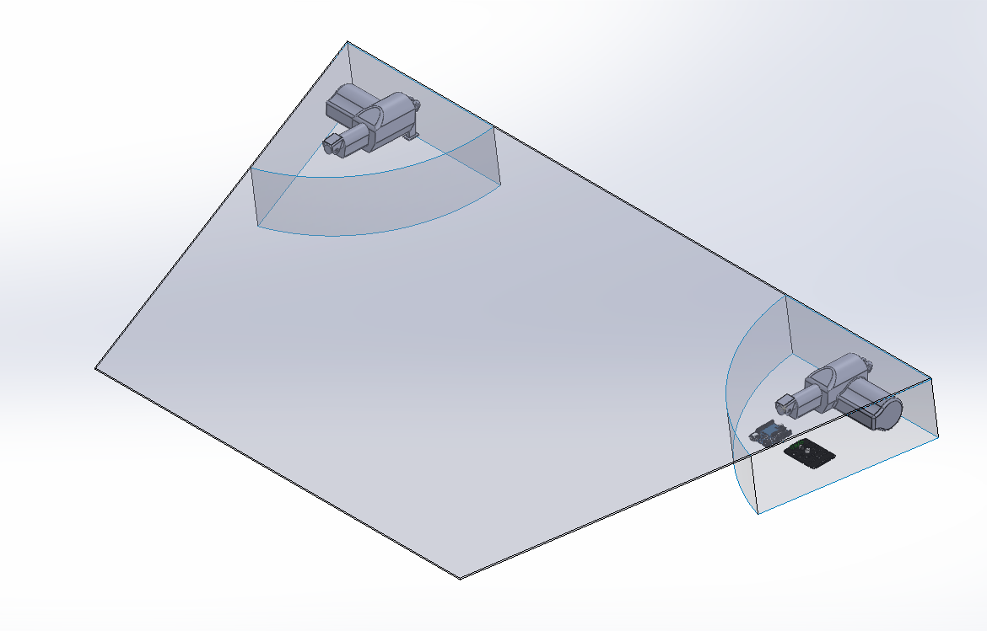
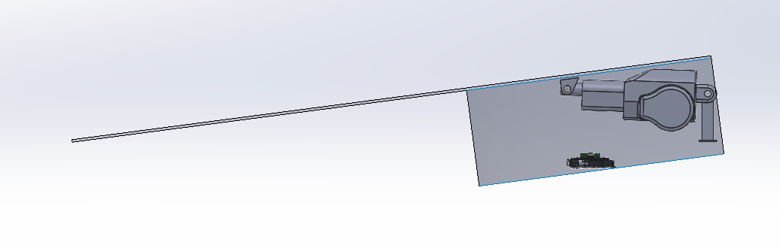
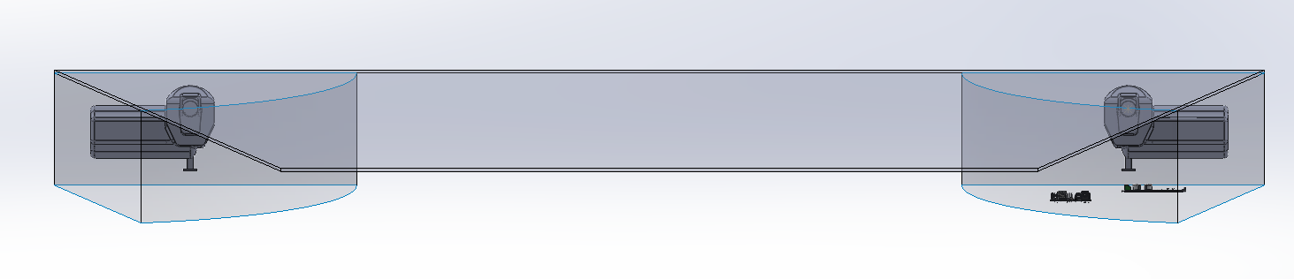
System Layout
Side-View of Bonnet Assembly
Isometric-View of Bonnet Assembly
Front-View of Bonnet Assembly
Direct Actuation Mechanism:
2x Ti Motion TA23 Linear Actuators with Feedback are used for actuation
U-mount: Attach actuator to bonnet, manufactured using Al-3003
T-mount: Attach actuator to chassis, manufactured using Al-3003

Slide 6
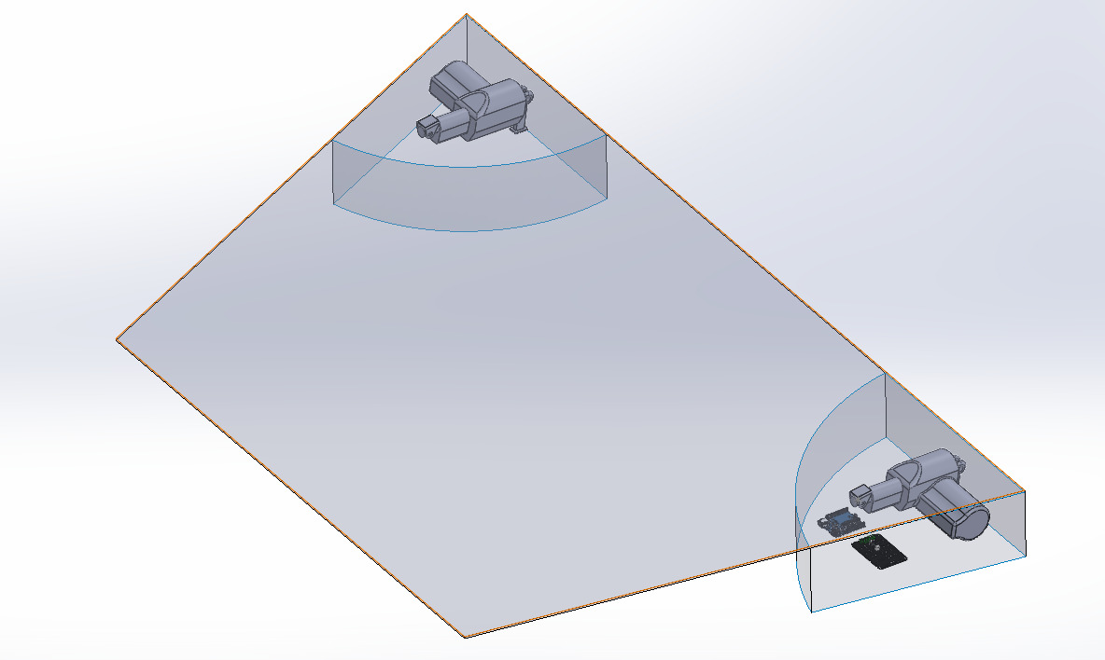
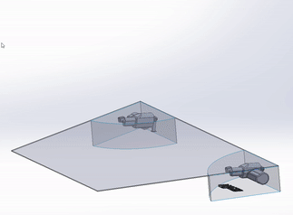
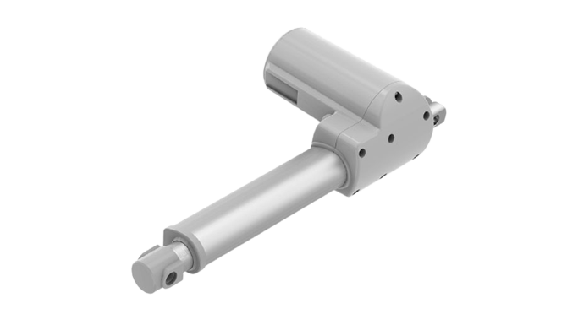
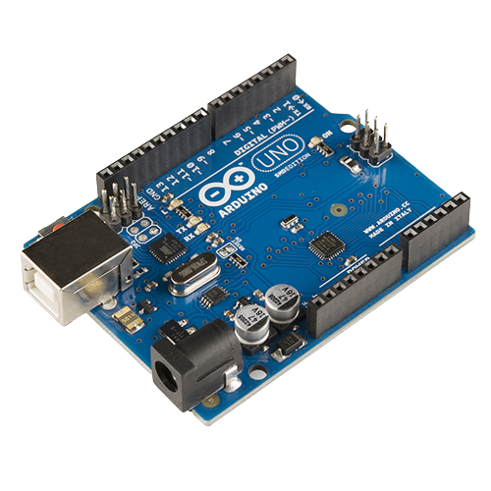
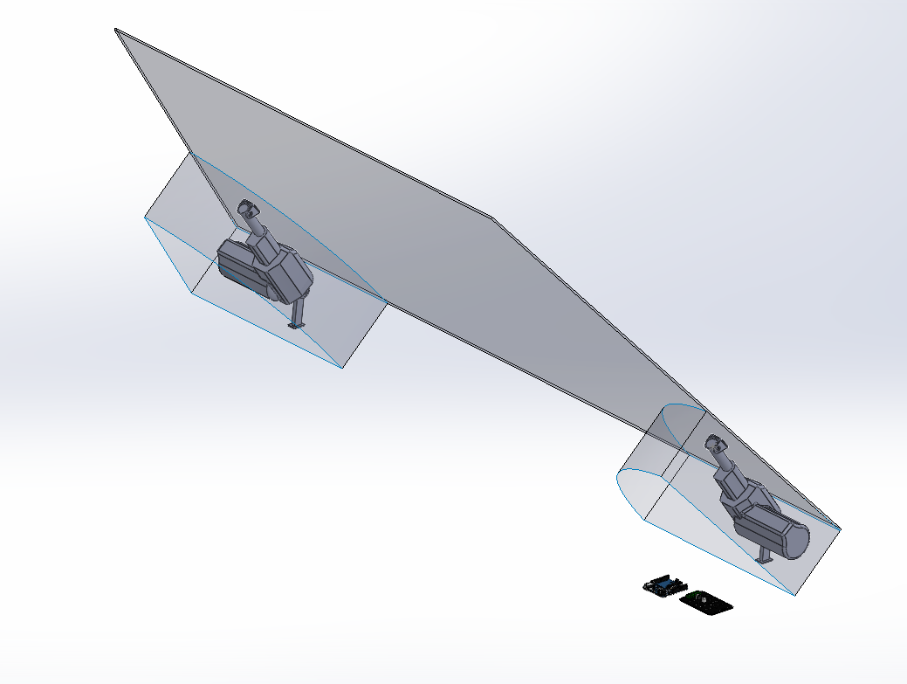
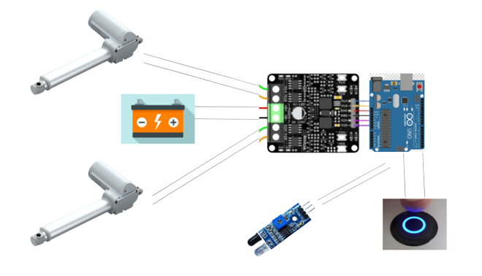
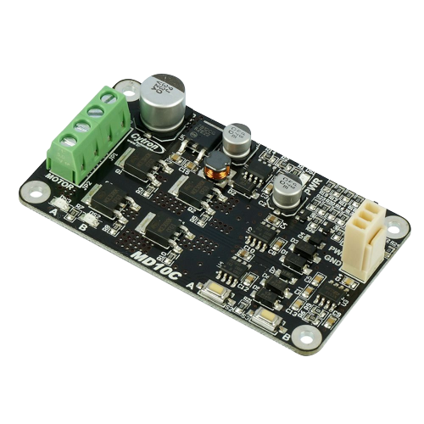
System Layout
Ti Motion TA23 Linear Actuator
Bonnet Assembly in the closed position with the actuators retracted
Simulation of Bonnet Assembly using Direct Actuation Mechanism
Arduino UNO
Electrical architecture of the system
Cytron Motor Driver
Bonnet Assembly in the open position with the actuators extended

Slide 7
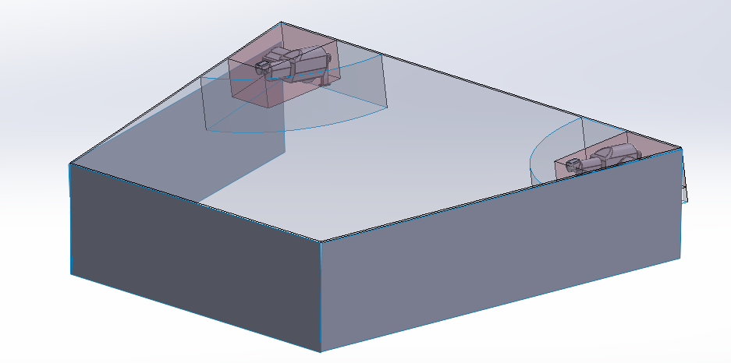

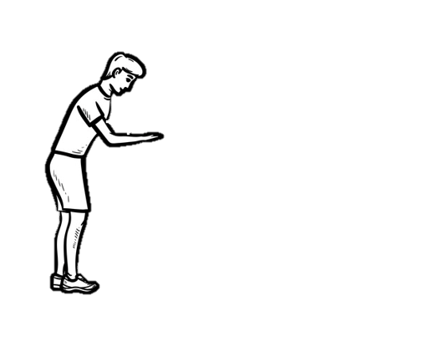
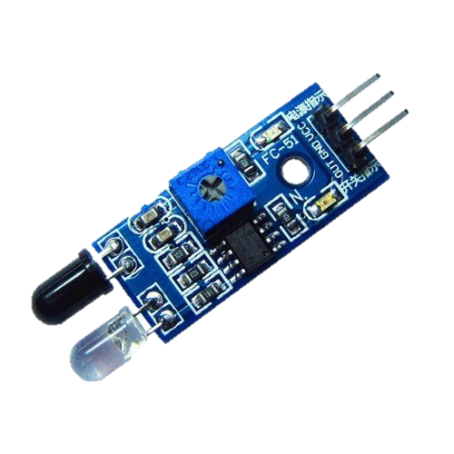
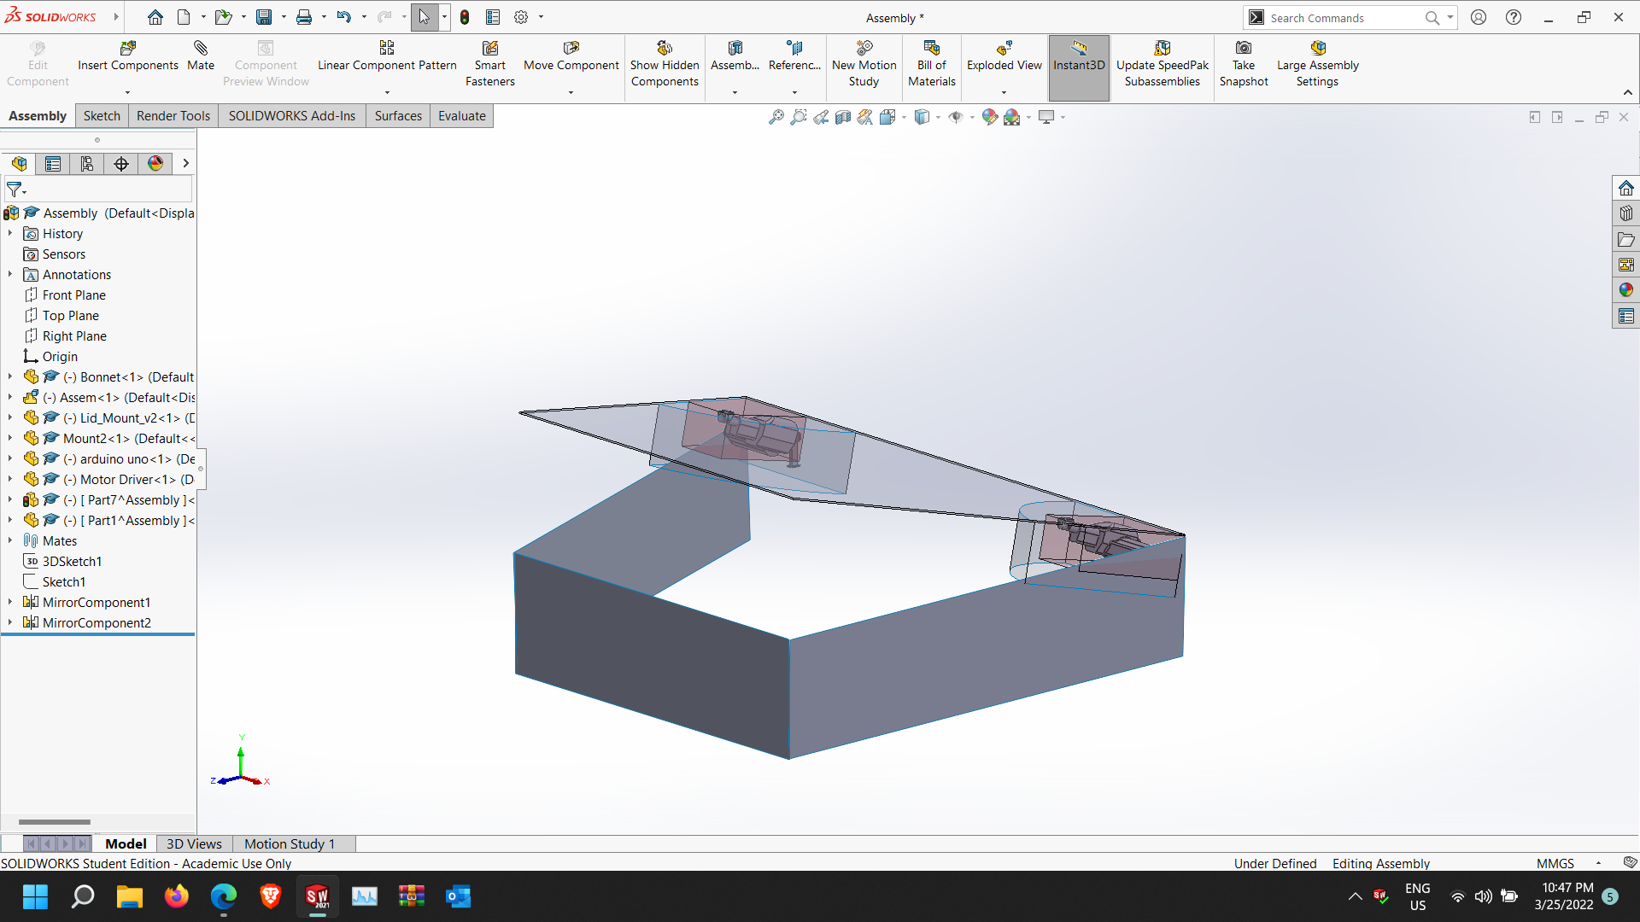

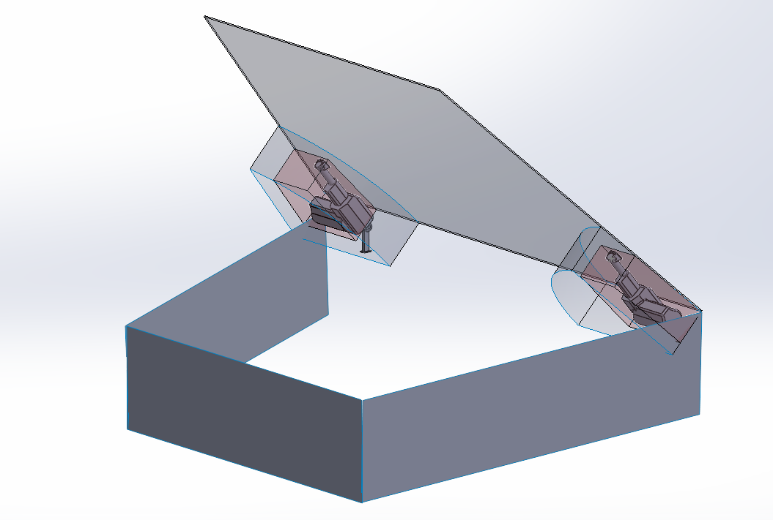


Ergonomics and Safety
Ergonomics
Safety Feature
The powered bonnet incorporates a safety feature which stops the closing of bonnet to prevent injury in case of accidental obstruction
The powered bonnet incorporates gesture-based sensor, which allows automatic opening, or closing of the powered bonnet by a kick motion

Slide 8
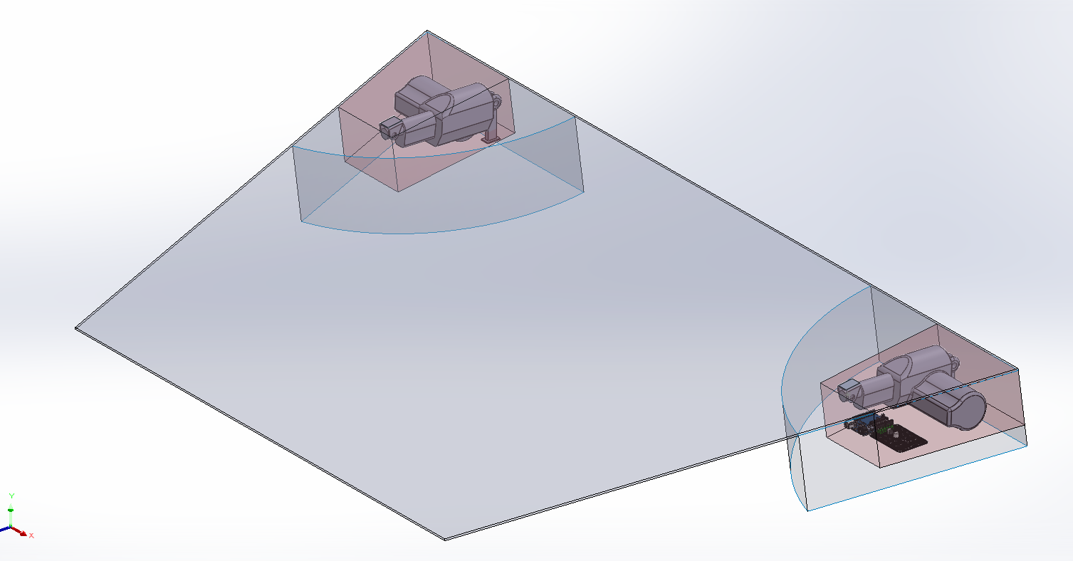
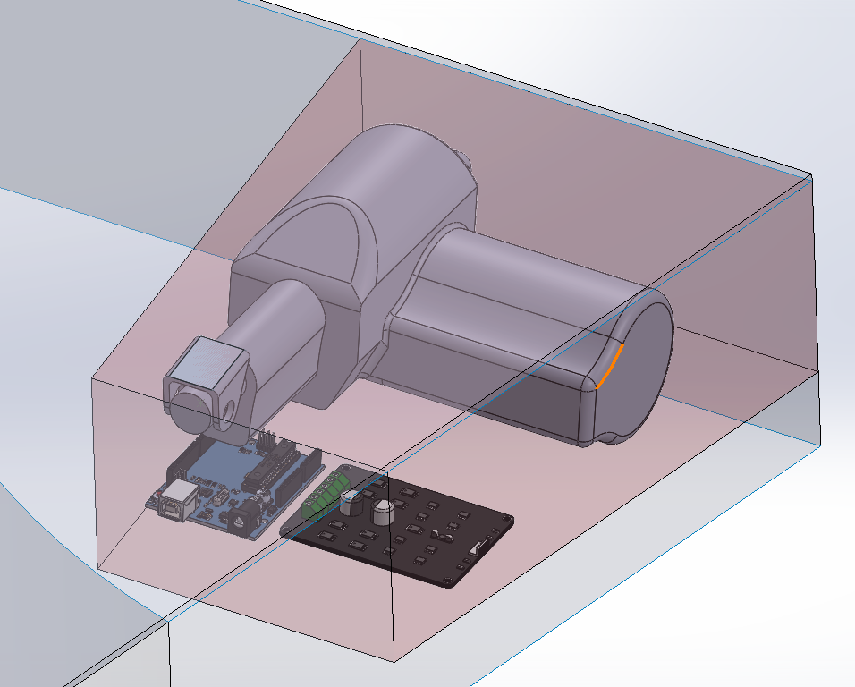
Packaging Data
The Volume covered by the red region denoted the volume used in our design
Closeup of one of the actuators, its attachments and the volume occupied.
Specifications | Value
Total Volume Available (cm³) | 30703.83
Total Volume Utilized (cm³) | 9940.24
Percentage Available Space Used (%) | 32.37
Note: The above volumes are calculated neglecting the wire harness.

Slide 9
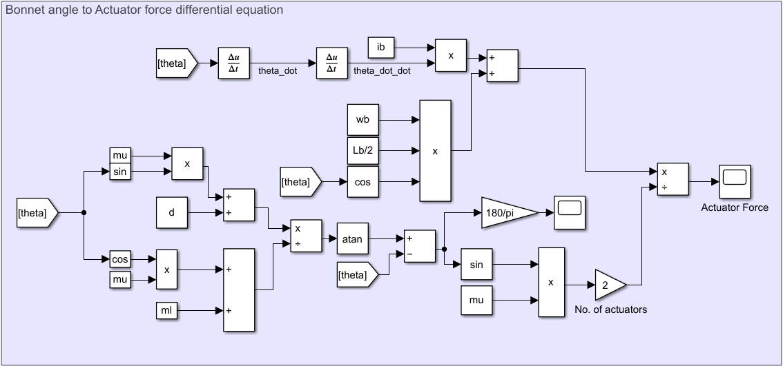
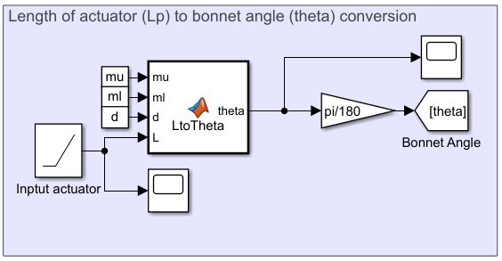
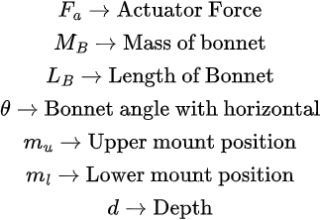
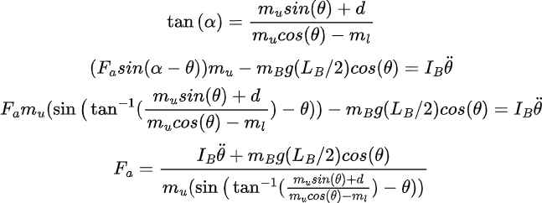
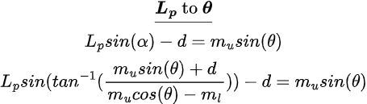
Governing Equations And Model
Mechanical Subsystem-1 (MS1)
Mechanical Subsystem-2 (MS2)
Outcomes:
Since the input from the electrical subsystem would be the length of the actuator, the bonnet angle and actuator length is written in a single equation which is further solved using MATLAB solvers. This is demonstrated in MS1.
The differential equation in the rotational plane in terms of actuator force, bonnet angle and other constants was derived. This is shown in MS2

Slide 10
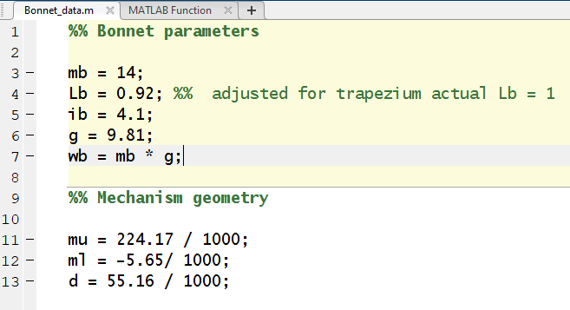
MATLAB Model
MATLAB Script 1 (MS1)
MATLAB Script 2 (MS2)
Outcomes:
All the Parameters for the bonnet/mechanism mentioned in script MS2
Altering the parameters will help in obtaining the required values for various orientations
The MS1 script contains the conversion equation (Lp to theta), solved numerically using the “fzero” solver present in MATLAB
Since multiple values are possible, the initial guesstimate of pi/4 is selected to find the correct ones

Slide 11
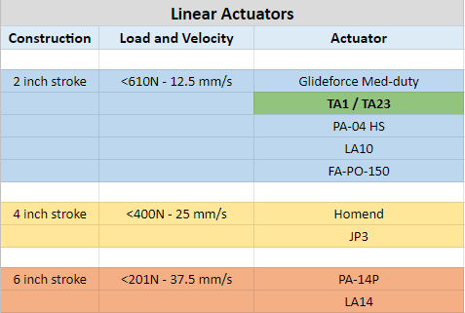
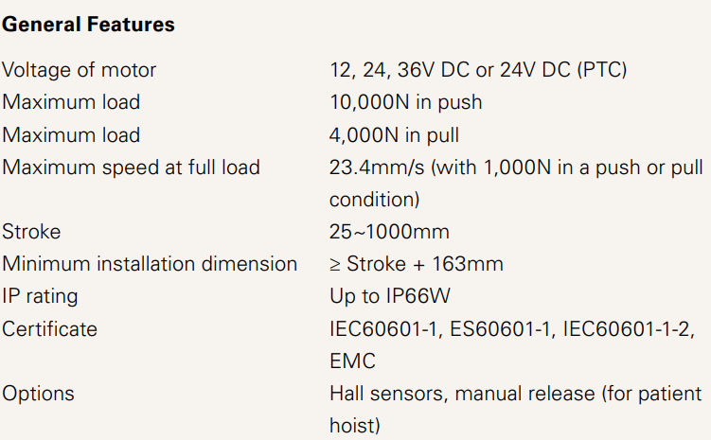
Linear Actuator Selection
Market Research
Selected Actuator
Outcomes:
TA1 Linear Actuator selected: Satisfies both our load and speed requirements
Seller Statement: TA1 linear actuator unavailable but TA23 linear actuator available with the exact same specifications
Final Selection: TA23 Linear Actuator

Slide 12
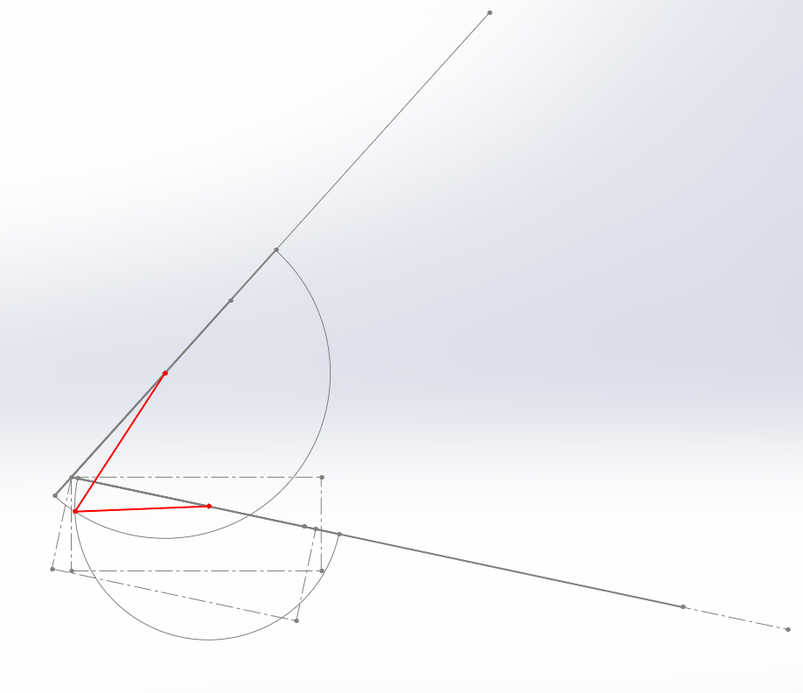
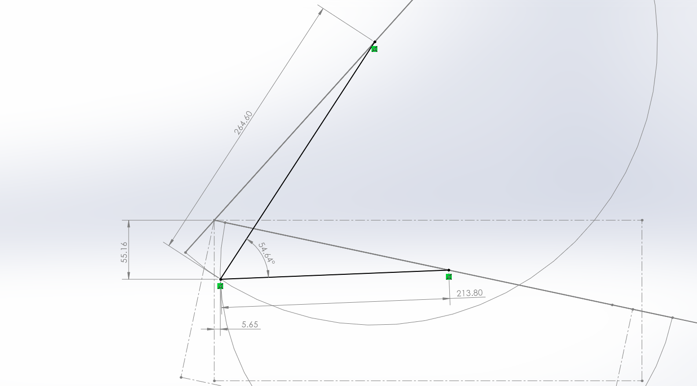
Position Calculation
Mount Position Estimation & Optimization
Mounting Points Estimation
Mounting Points Optimization
Outcomes:
2D SolidWorks sketch created to estimate the upper and lower mounting points
Allowable mounting points exist on the intersection of the two semicircles shown in the figure, their radii are equal to the actuator length in retracted and extended position
Mounting points were adjusted to obtain load profiles with minimum overall load

Slide 13
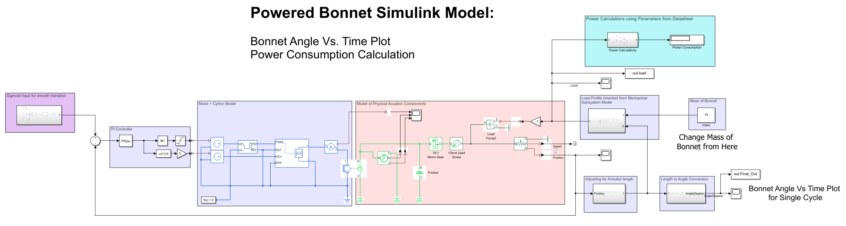
Complete Model
Outcomes:
Linear actuator modelled using Simscape Electrical & Mechanical blocks
Load profile, inherited as lookup table from previous Simulink model, used to determine force on actuator at different angles
PWM control strategy implemented with H-bridge for controlling the speed of linear actuator
PI Controller is used for jerk free control of linear actuator

Slide 14
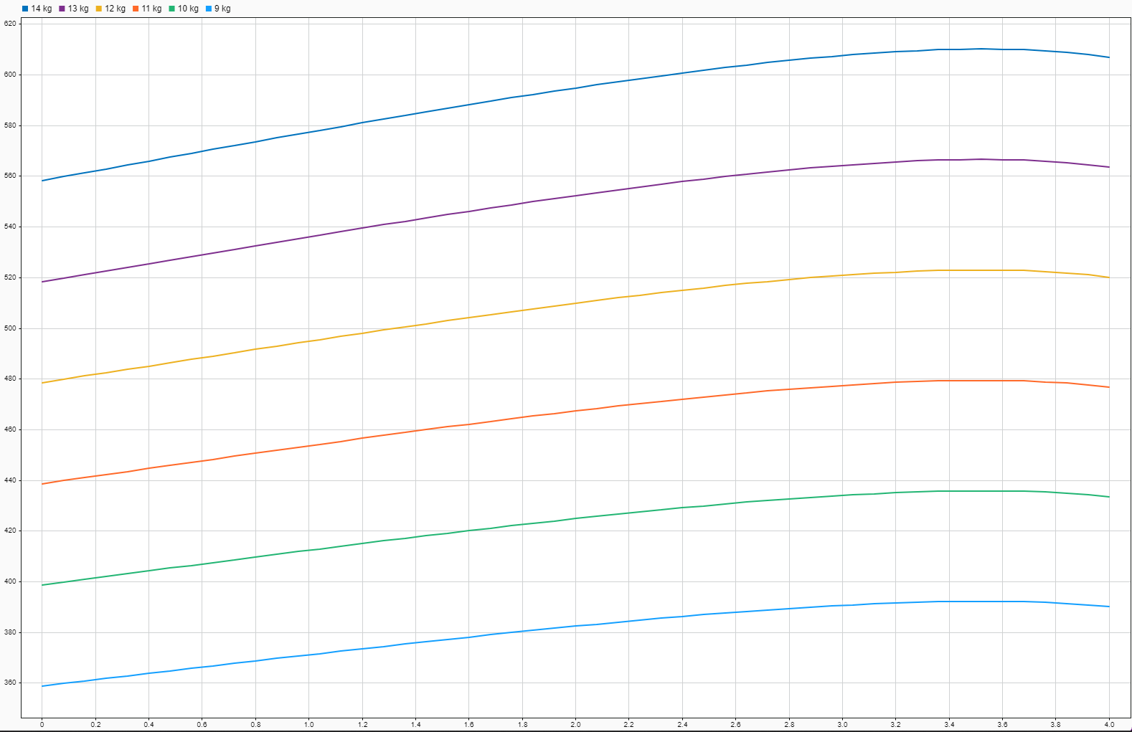
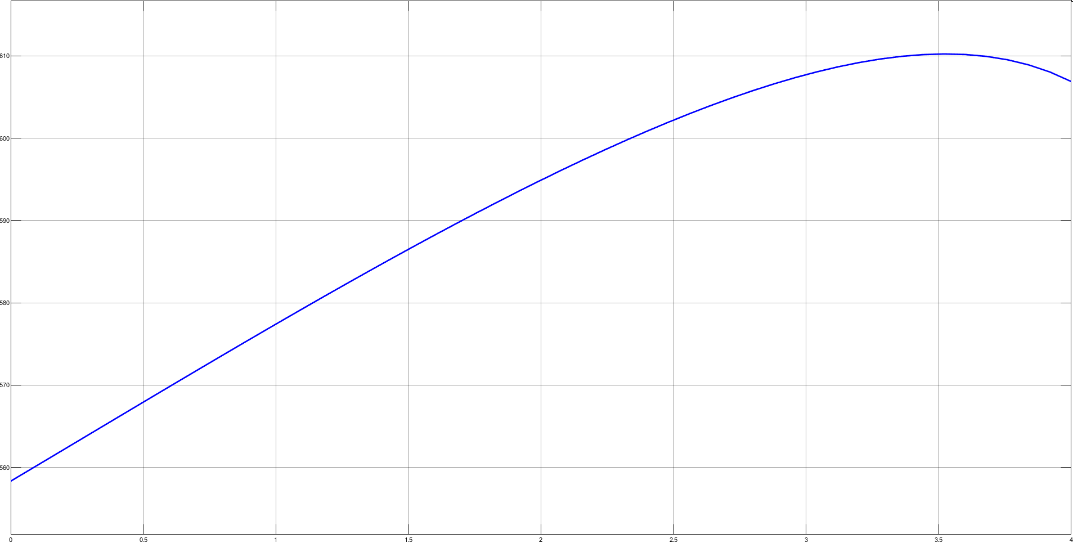
Simulation Results
Weight – 14 kg
Weight – 9 kg - 14 kg
Outcome:
Plots of the Actuator load vs time for a single cycle

Slide 15
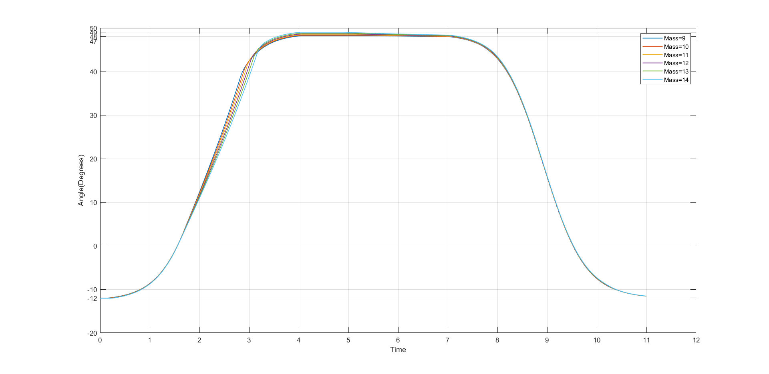
Simulation Results
Plots of the angle of opening of the Bonnet vs time for a single cycle
Outcomes:
After 4 seconds position of bonnet remains within ±1° of the final angle

Slide 16
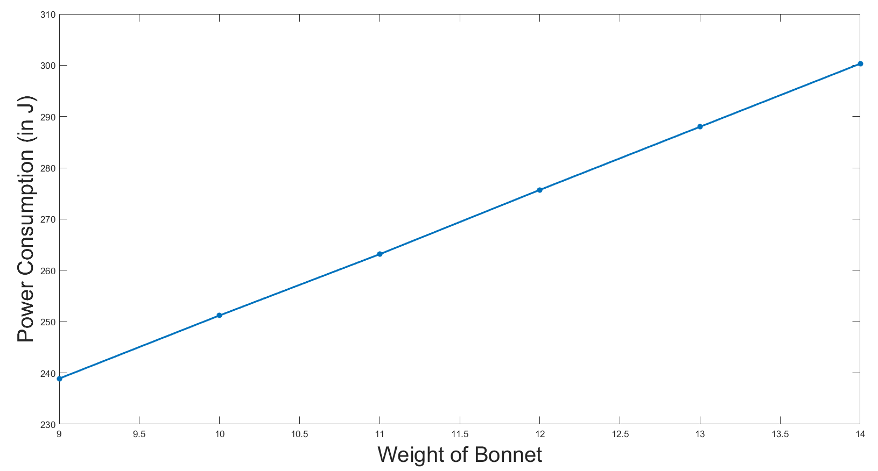
Simulation Results
Power Consumption for different Bonnet Weights
Outcomes:
Power consumption comes out be 300.3 J for 14 kg
Power Consumption comes out to be almost linear from mass = 9 kg to 14 kg

Slide 17
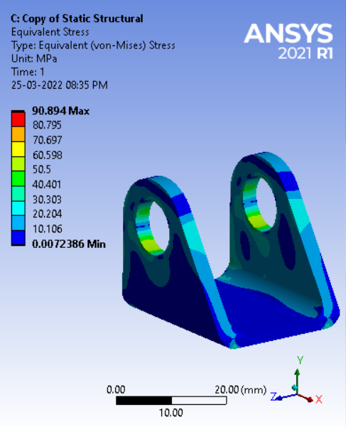
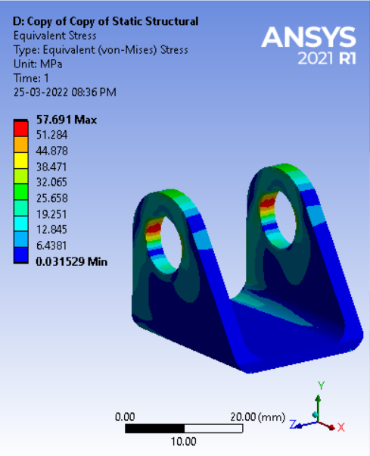
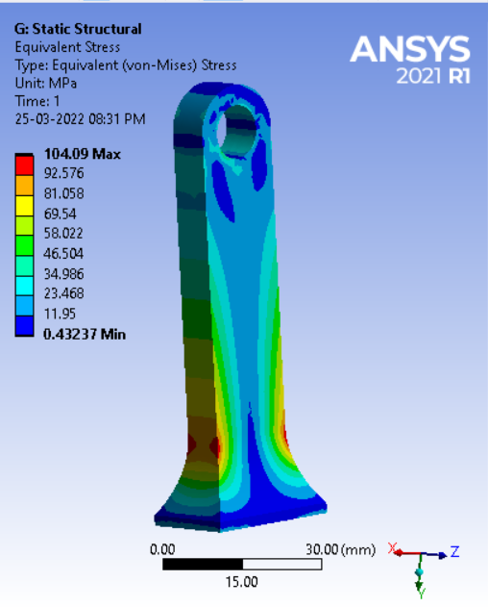
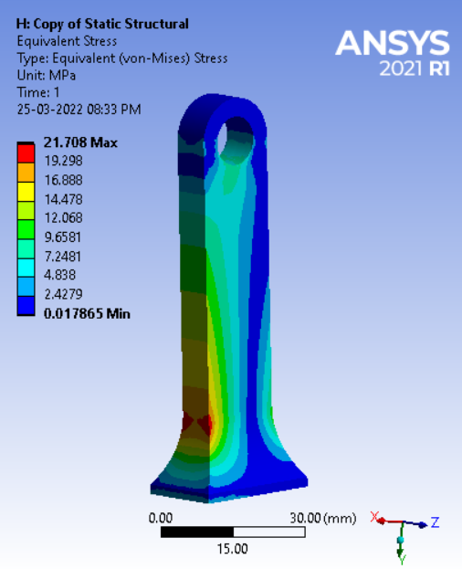
Simulation Results
Mount Simulations
  The Mounts are made of Al-3003 (S_{y} = 140 MPa).
  Manufactured using CNC machining.
  The maximum force transmitted to the linear actuator is around 650N.
Stress Distribution Longitudinal Loading
Stress Distribution
Vertical Loading
Stress Distribution Longitudinal Loading
Stress Distribution
Vertical Loading
Mount | Longitudinal Loading |  | Vertical Loading
 | Max Stress | Min FoS | Max Stress | Min FoS
U-Mount | 90.89 MPa | 1.54 | 57.69 Mpa | 2.43
T-Mount | 104.09 MPa | 1.34 | 21.71 MPa | 6.45

Slide 18
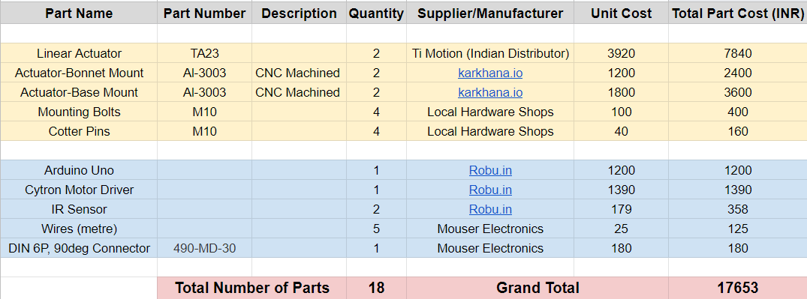
Bill of Materials
Outcomes:
All the parts are available readily in the Indian Market.
The Linear Actuator is available through a specific importer, whom we were able to connect with and confirm the price and availability
Minimum number of moving parts.
Total cost < INR 20,000

Slide 19
Claimed Points
Field | Claimed Points
Valid plots: Bonnet’s Opening Angle vs Time from MATLAB Model | 20/20
Simplicity & Versatility | 25/25
Ergonomics | 13/15
Power Consumption | 13/15
Packaging | 24/25
Generalized Model Equations | 10/10
Final Presentation | 37/40
Total | 142/150

Slide 20
References
Choi, K.-B.; Lee, J.; Kim, G.; Lim, H.; Kwon, S. Kinematic Analysis of a Parallel Manipulator Driven by Perpendicular Linear Actuators. Actuators 2021, 10, 262. https://doi.org/10.3390/act10100262
Automotive Electric Actuator Modelling And Design Methodologies, John Welford, School Of Electrical And Electronic Engineering, 2014
Modelling and Design of a Mechatronic Actuator Chain Application to a Motorized Tailgate,
E. D. Ruiz-Rojas, J. L. Vazquez-Gonzalez, R. Alejos-Palomares, A. Z. Escudero-Uribe and J. R. Mendoza-Vázquez, "Mathematical Model of a Linear Electric Actuator with Prosthesis Applications," 18th International Conference on Electronics, Communications and Computers (conielecomp 2008), 2008, pp. 182-186, doi: 10.1109/CONIELECOMP.2008.29.
Selected aspects of design and modelling of linear actuator based on PM BLDC motor.

Slide 21
Thank You!

