Slide 1
MIN-629: COURSE PROJECT
Rapid Tooling of Cast Magnesium Wheels for FSAE
Submitted By:- Under the guidance of-
Arjav Jain(19117017) Prof. Varun Sharma
Rohit Bade(19117027)
Ruthik K. Jadhav(19119030)
Shreyam Bansal(19119038)
Vaibhav Saini(19119046)

Slide 2
Introduction
IIT Roorkee Motorsports Formula SAE team
Reduce the unsprung rotating mass & inertia
The wheels were designed with the aid of 3D modeling software and finite element analysis, and cast out of magnesium using a sand-casting process. The tooling was made using rapid prototyping
The wheels currently used on the IITRMS FSAE car are a 13 inch diameter, three piece aluminum design consisting of a machined aluminum center and spun aluminum shells. The three sections are bolted together using twelve 3/16 inch bolts and cost roughly $120 2 a piece. The primary problem with these wheels is their weight
Many motorsports use magnesium for its high specific stiffness and low weight. Currently it is used to make Formula One wheels, Moto GP wheels. Other benefits of magnesium are its cost and versatility. Of the primary light alloy metals magnesium is one of the cheapest, and currently costs less to cast than aluminum
It is also applicable to many manufacturing processes. Unlike other metals, magnesium can be cast, machined, laser cut and welded. This makes it very appealing to any situation where several machining processes are required.

Slide 3
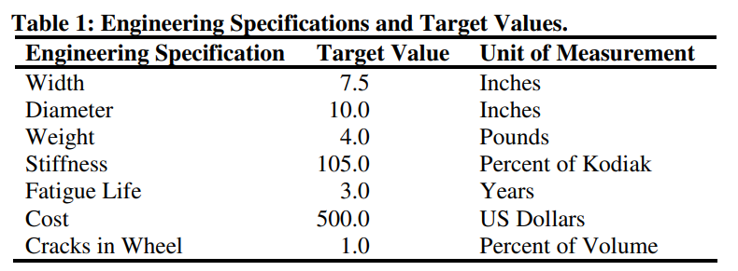
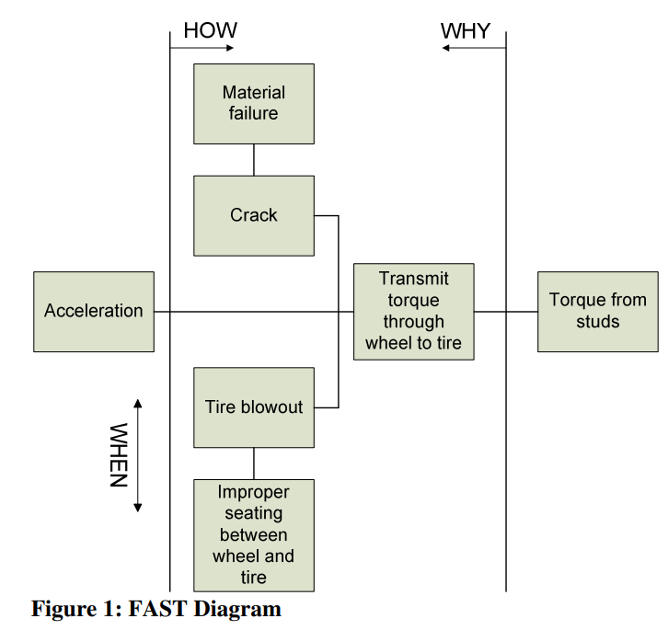
Concept Generation
We benchmarked the Kodiak wheels currently used on the car using FEA software
QFD was created. The QFD helped us determine which engineering specifications should be focused on in order to fulfill the customer’s specifications
The input to the wheel is torque from the studs, which is then transmitted through the wheel to the tire. As the torque is being transmitted through the wheel, three things can happen:
  the wheel can crack due to material failure
  the tire can blowout due to improper seating between the wheel and the tire
  or everything can function as designed and a force can be placed on the ground, leading to acceleration of the car.

Slide 4
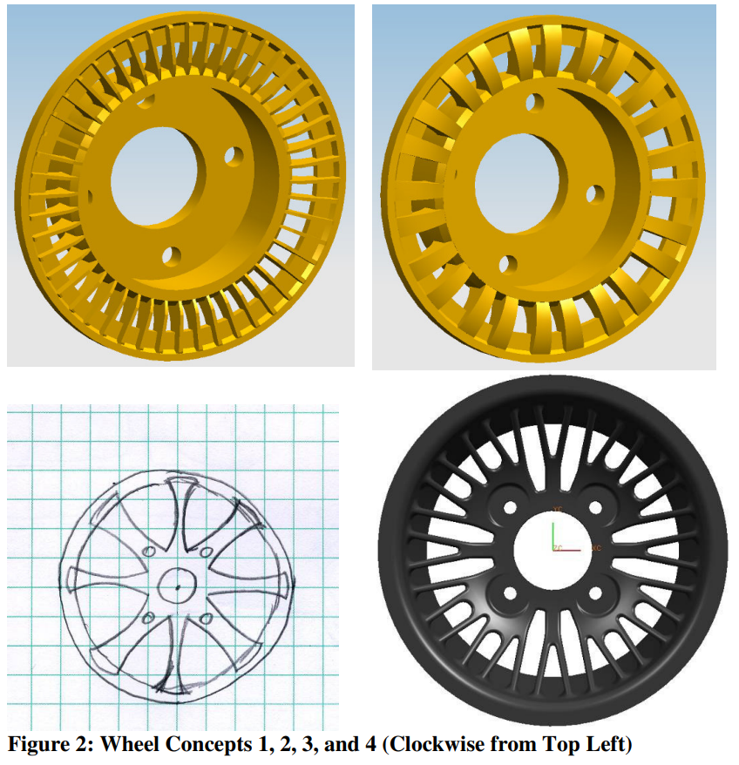
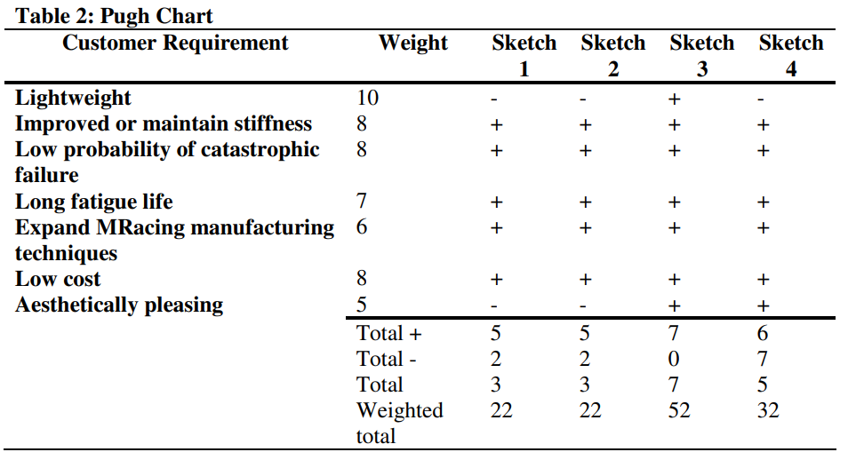
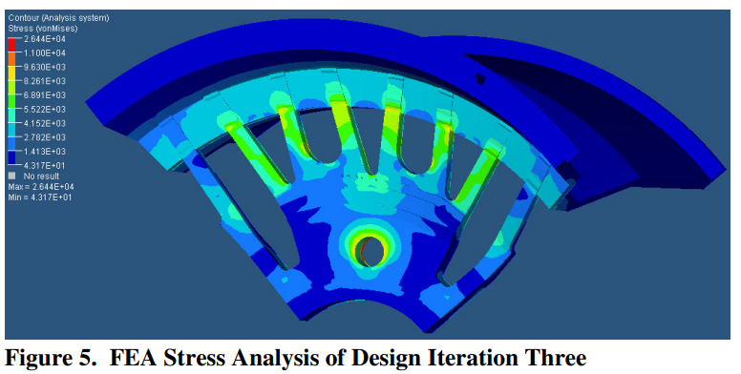
Concept Selection & FEM
Finite element analysis was used both to validate and optimize the design. Similar models were created for our design as well as the Kodiak wheel. Both models were then run with identical forces and constraints so the results could be directly compared. The models were run under four different loading conditions:
  1000 lb torsion load
  1000 lb lateral load
  1000 lb longitudinal load
  100 lb mounting load.
The relative strength and stiffness of our design was then compared to the Kodiak wheel. We calculated worst case loads for each loading condition

Slide 5
FDM vs SLA vs SLS
Criteria | FDM | SLA | SLS
Material | ABS, PLA, Nylon | Photosensitive Resins | Polyamide (Nylon), Polystyrenes, Thermoplastic Polyurethane, Metal
Layer Thickness | 0.5 to 0.127 mm | 0.05 to 0.015 mm | 0.05 to 0.01 mm
Surface Texture | Rough (can be post- processed for fine surface) | Smooth | Slightly rough
Support Structures | Required | Required | Not required
Post-Processing | Sanding, Polishing, Painting Smoothing (with acetone vapor) | Painting, Dyeing | Polishing, Varnishing, Dyeing, Painting
Cost | Cheapest | Medium Price | Costly
Ease of Use | Beginner Friendly | Beginner-Moderate | Highly Skilled

Slide 6
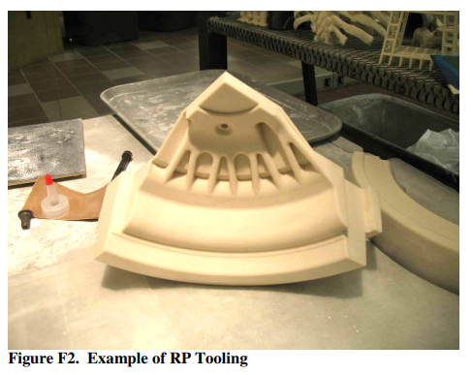
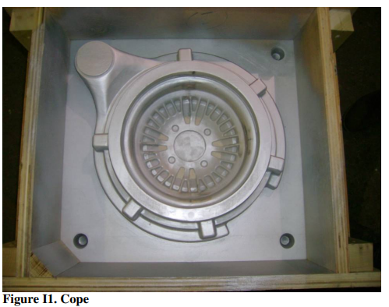
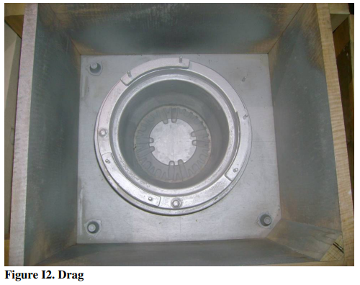
Tooling & Manufacturing
In addition to designing the wheels, we are also responsible for designing and manufacturing the tooling that will be used to create the sand molds for casting the wheels
We chose to use rapid prototyping to create the necessary tooling because of the huge savings in both time and cost over traditional tool making methods. One case study showed that using RP to create tooling resulted in a 54.0% time savings and 49.6% cost savings over traditional aluminum tooling. Specifically, we used an RP technique called 3D printing to create the tools. 3D printing is one of the fastest and most cost effective RP methods available
When creating the tooling for the wheels, several factors had to be taken into consideration. First, the tooling needed to be scaled larger than the wheels to account for shrinkage during cooling. In the case of the alloy the wheels will be cast in, AZ91C-T4, a 2% linear shrinkage was quoted from our foundry. The tooling also needed to provide extra material on surfaces which will be post-machined
Another consideration was that all of the tooling for the wheel is significantly larger than the 8” x 10” x 8” build volume of the ZCorp ZPrinter 310 we used. We therefore had to break up each section of the tooling into four parts to be joined later using epoxy.

Slide 7
Conclusion
The goal of our project was to design and manufacture a set of wheels lighter than those currently in use on the IITRMS Formula SAE car without sacrificing stiffness
To achieve our design goal, we intended to be the first FSAE team to design and manufacture a set of one piece cast magnesium wheels. The design needed to satisfy requirements in three areas: mechanics, manufacturing, and aesthetics
In considering the requirements in the areas of mechanics, manufacturing, and aesthetics, the chosen design concept has many smaller spokes, as opposed to the larger-spoke design of the wheels currently in use by the team. Using FEA software and the determined loads, the design was validated and optimized, netting a weight of approximately 4 lbs (25% reduction), and similar stiffness values
We also designed and manufactured the tooling for the casting process using rapid prototyping methods
The wheels were cast and need to be physically tested

Slide 8
Thank You

