Slide 1
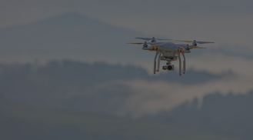
No Contact Delivery
Using
Autonomous Drone
Team Excelsior

Slide 2
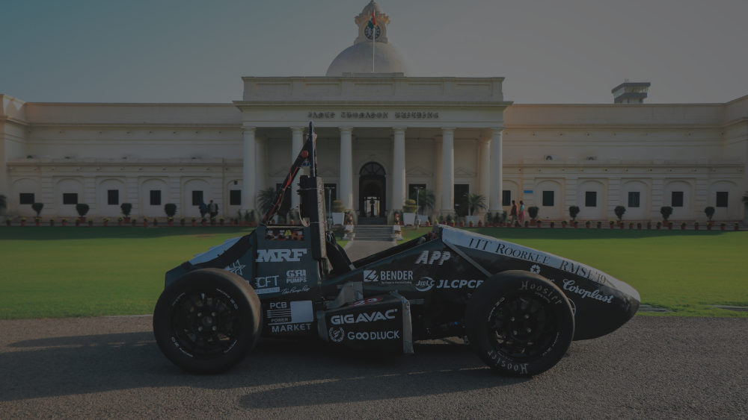
About Us
We are members of the FSAE team at IIT Roorkee. We have extensive experience in designing, simulating and manufacturing structural as well as functional parts.

Slide 3

Our Solution
The COVID-19 pandemic has fostered people to re-evaluate their primacies very quickly. The cash flow in the ecosystem hai slowed down due to increased risk of transmission in person to person communication. To make human intervention minimal in door to door delivery systems we aim at building autonomous drone capable of delivery items which weigh upto 2.5 kgs through a predefined path with capability to avoid unforeseen obstacles (like birds) and feature of real time data downlink

Slide 4
Drone Visualisation
Number of Rotors: 4
Dimensions: 75x75x20cm
Theoretical Weight (without payload): 2.3 kg
Max payload capacity : 3.5 kg
Propeller Size: 38.1cm
Battery Life:
  20 mins with 2kg payload
  35 mins without payload
Frame:
  Material: CFRP Sandwich Panel for central pod and 3D printed arms

Slide 5
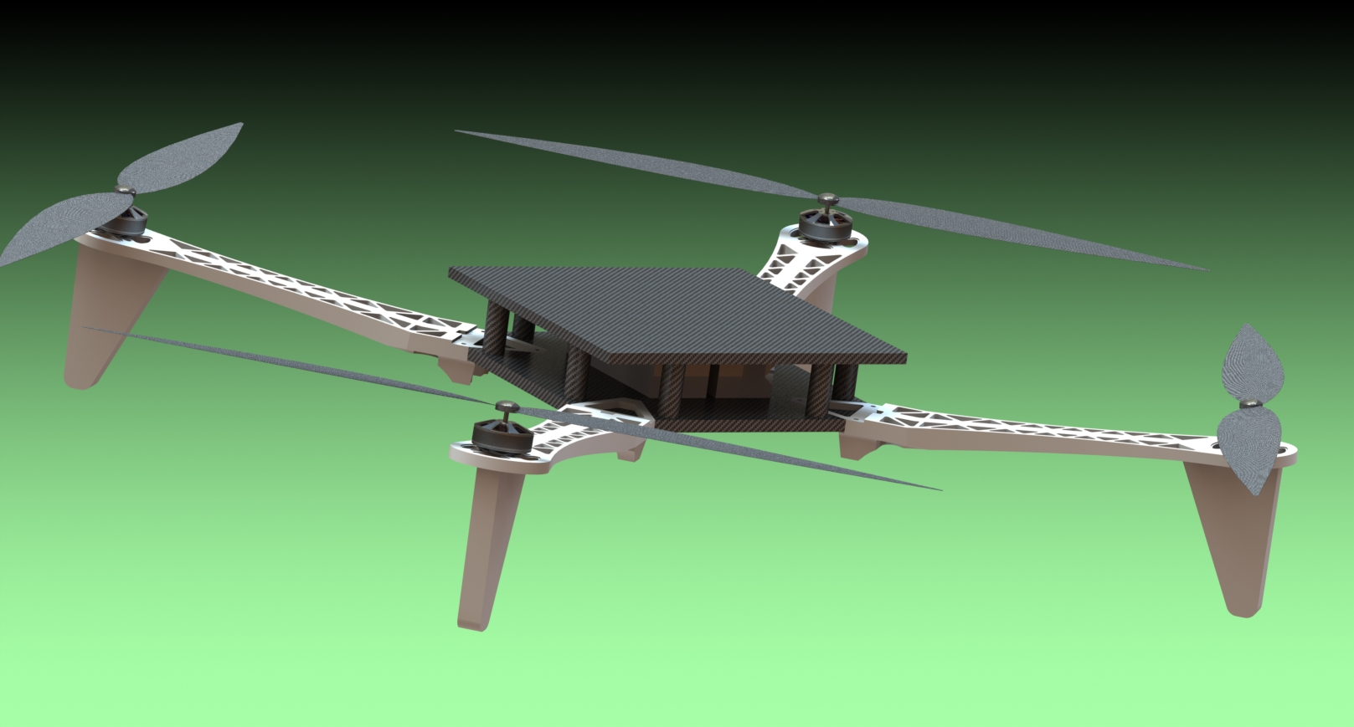

Slide 6
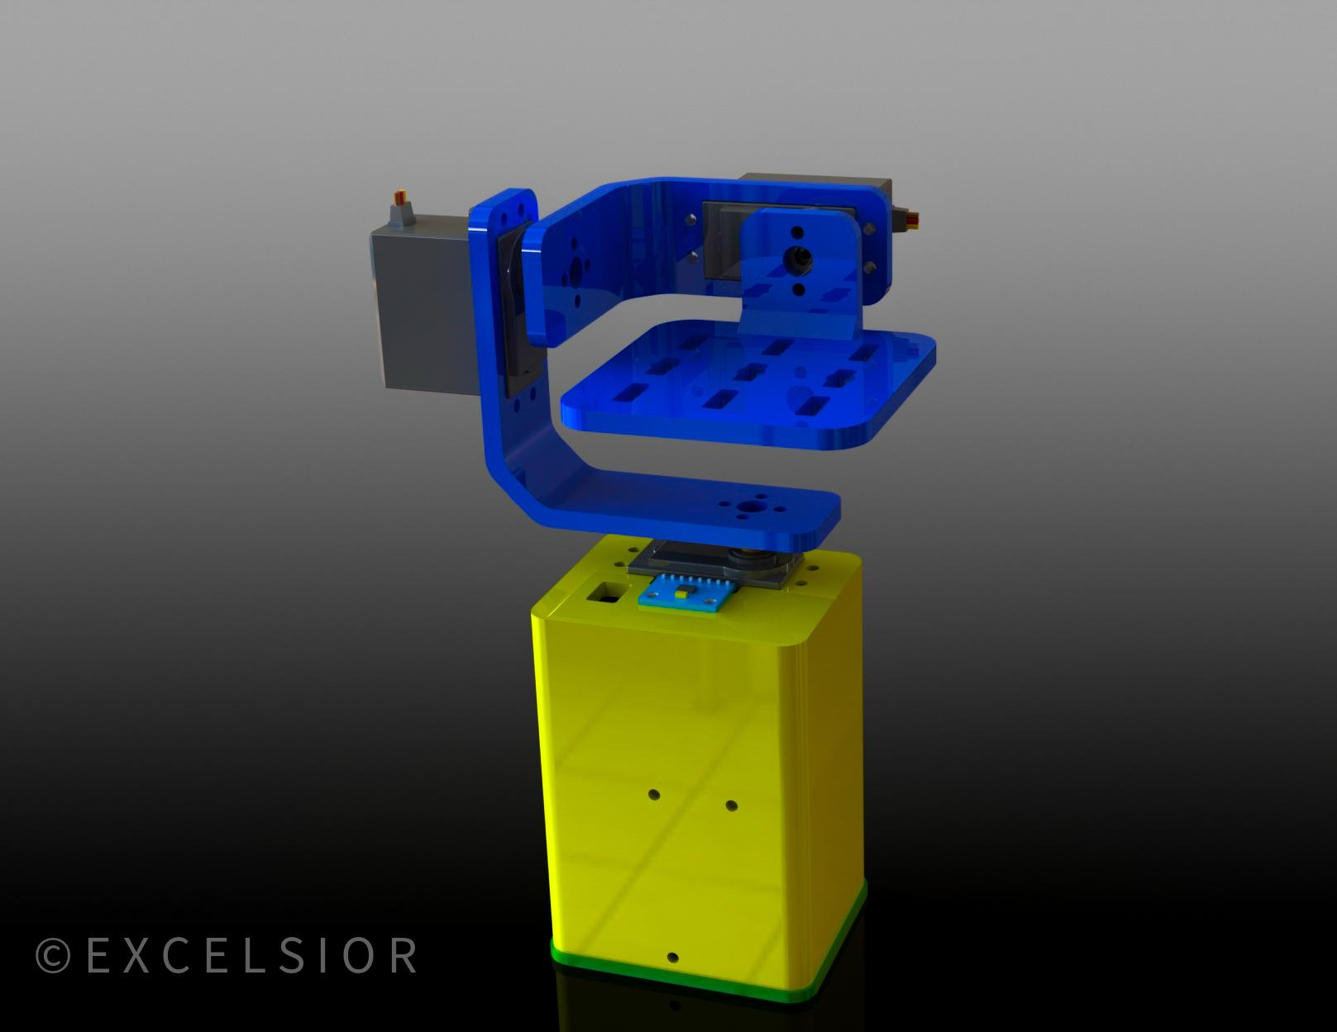
Mechanical Advancements
Gimbal
Instead of purchasing a readymade gimbal from the market, we decided to make a custom gimbal that suits our specific requirements. The gimbal is made using 3d printing techniques and employs servo motors controlled by Raspberry Pi using data from a gyroscope and accelerometer. This reduces cost and effort for adapting the gimbal to the frame.

Slide 7
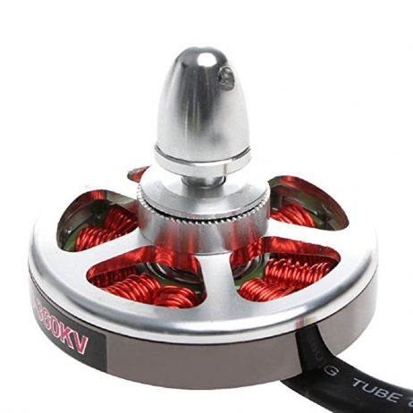
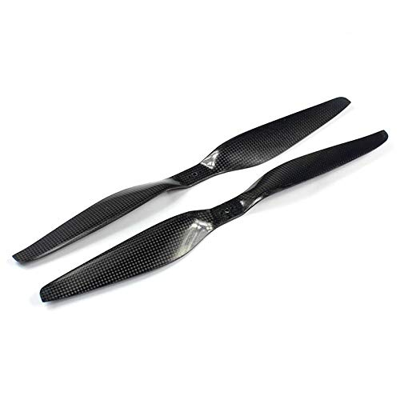
Mechanical Advancements
Motor and Propeller:
We have replaced the motors and propellers selected earlier with new ones that are cheaper and similar in thrust capabilities. This helps in reducing costs.

Slide 8
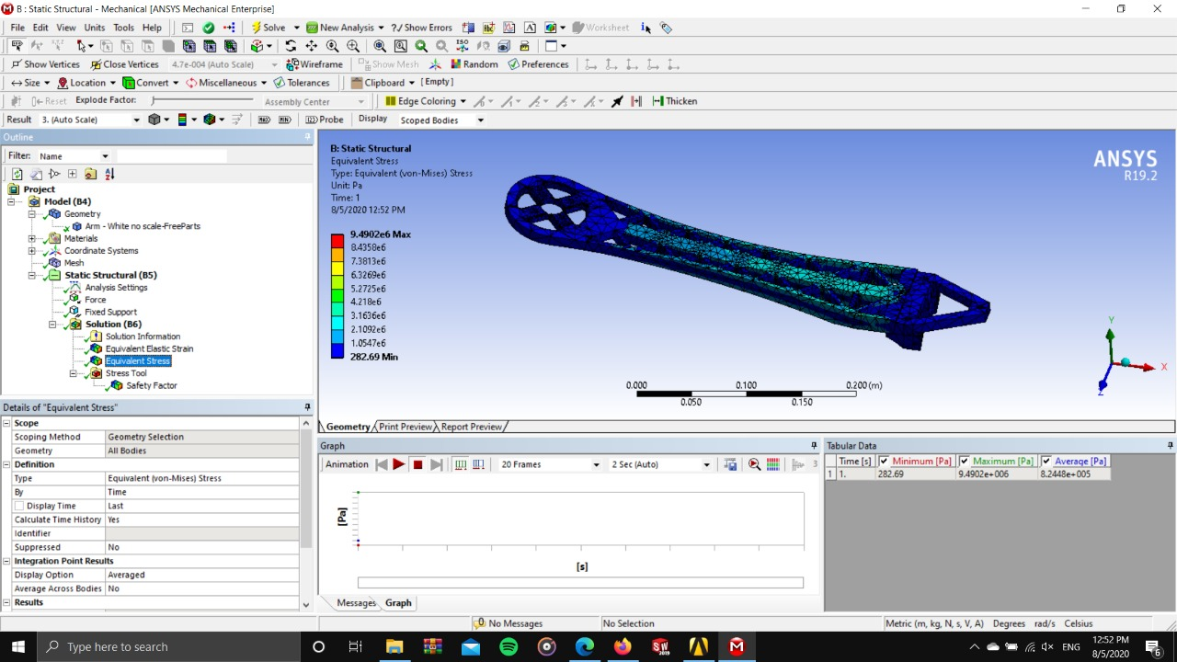
Structural Analysis

Slide 9

Structural Analysis

Slide 10
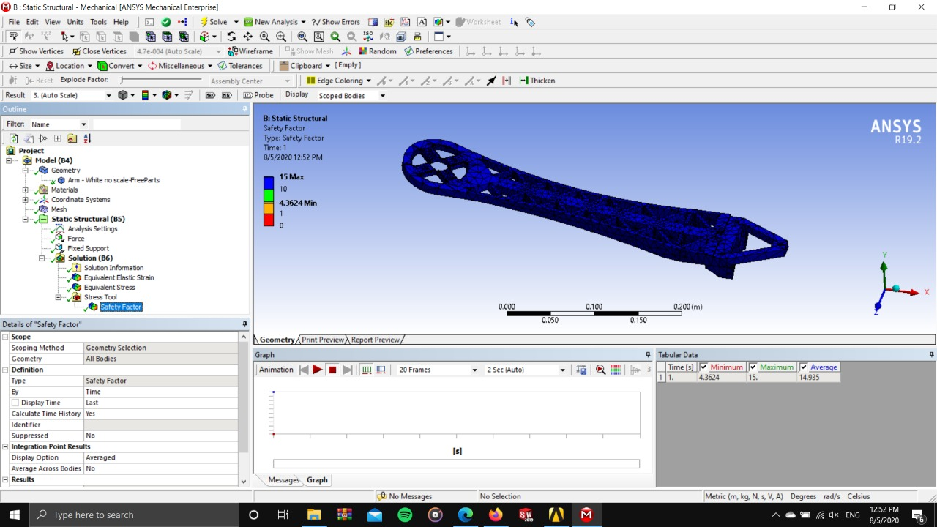
Structural Analysis

Slide 11
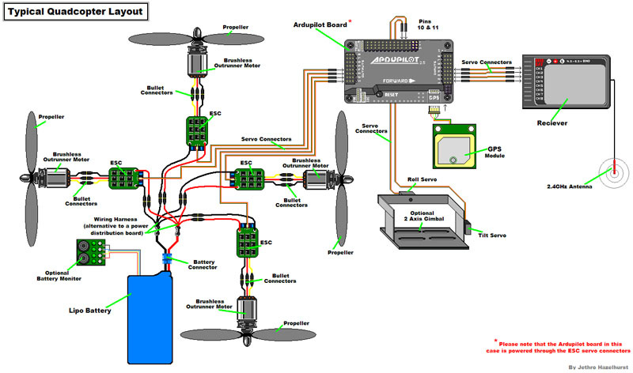
Hardware Architecture

Slide 12
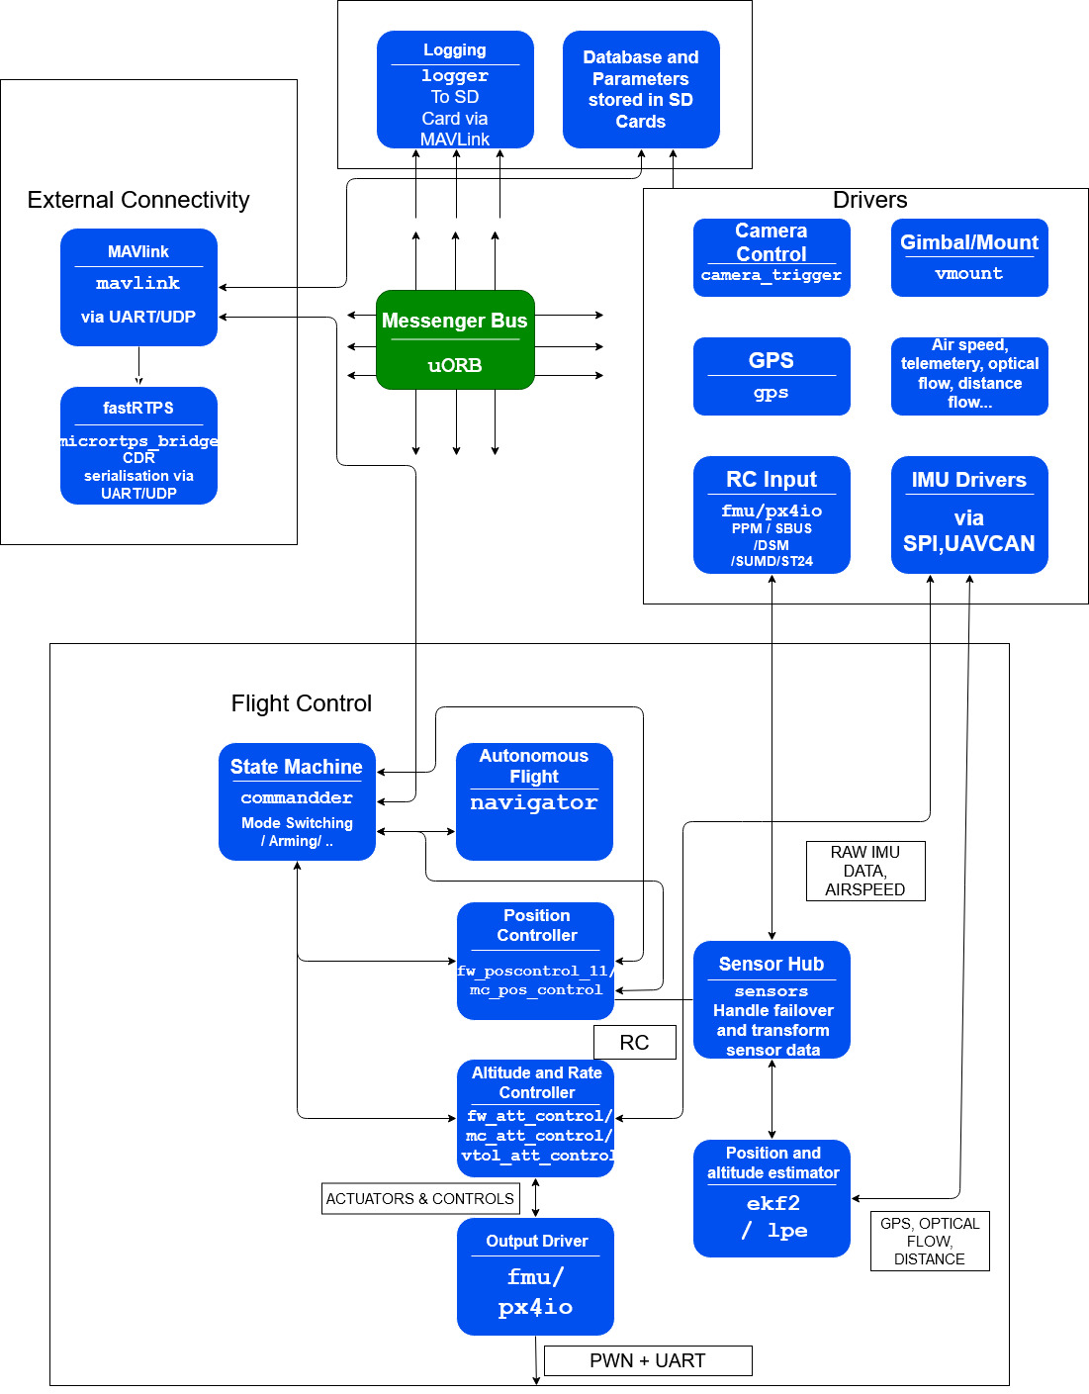
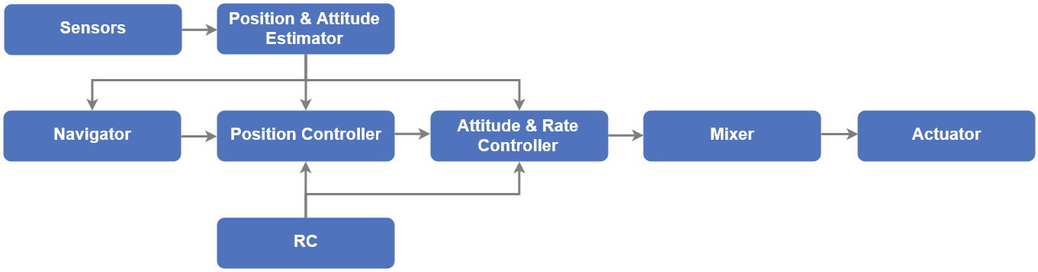
Software Architecture

Slide 13
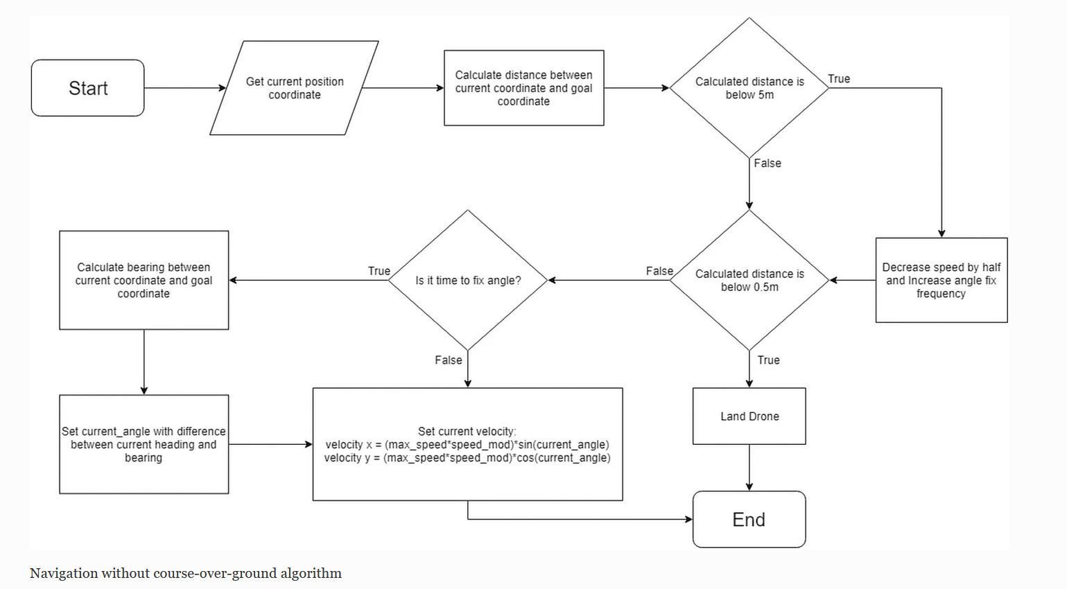
Navigation Control

Slide 14
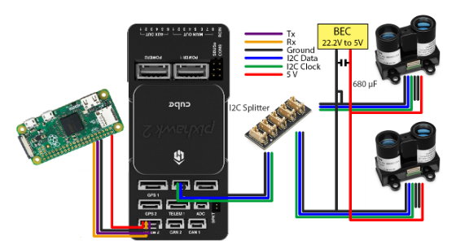
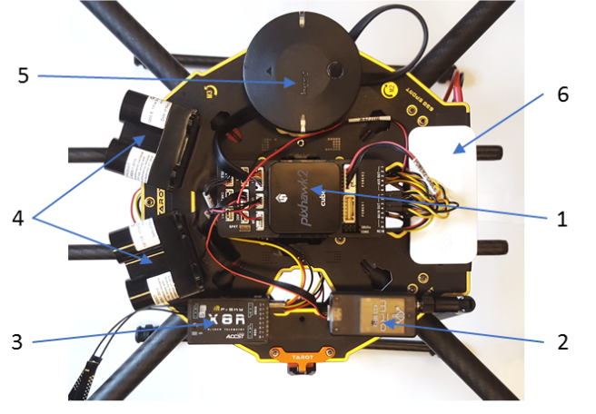
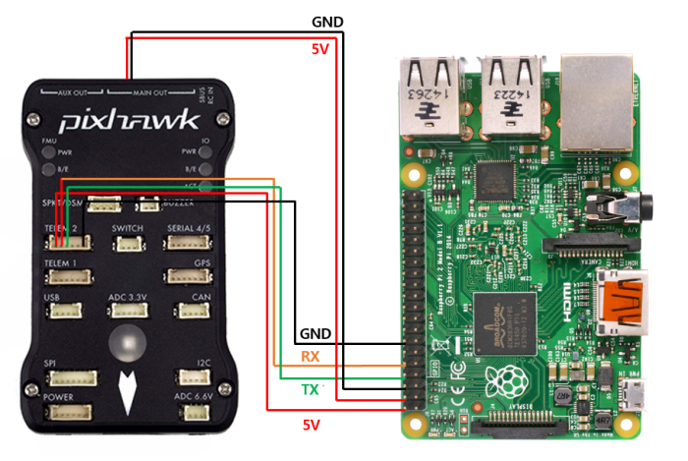
1 | Pixhawk
2 | Telemetry
3 | Receiver
4 | Lidar
5 | GPS
6 | Pi

Slide 15
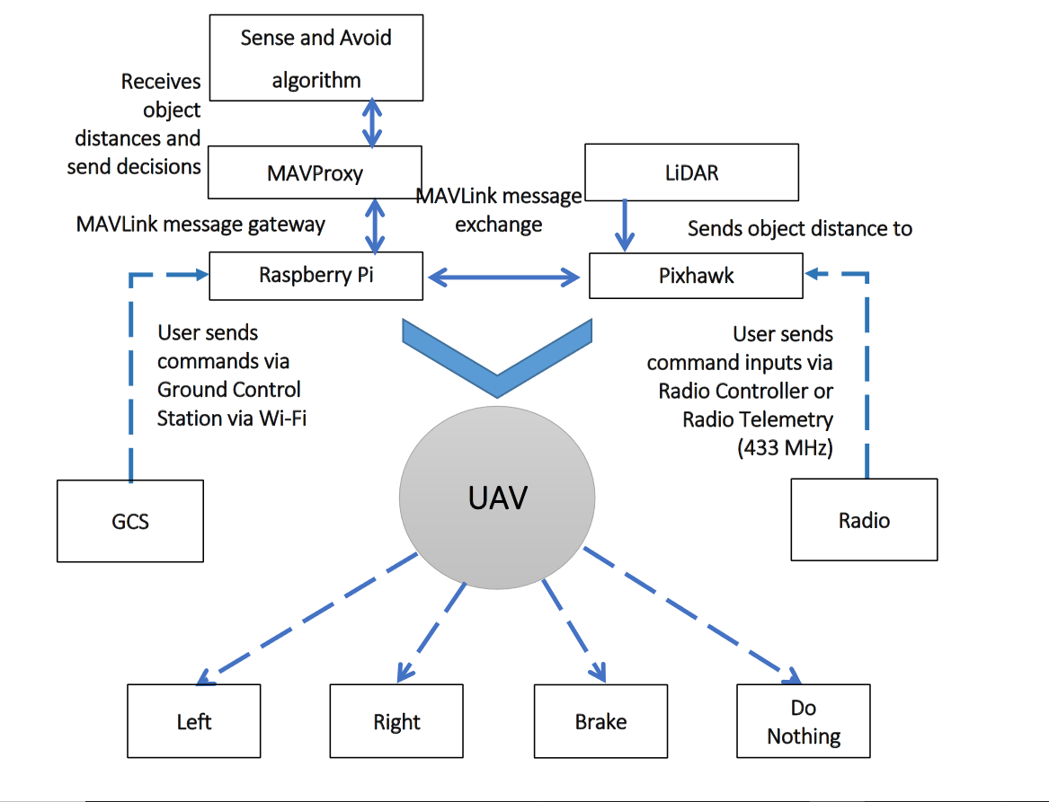
Obstacle Avoidance Overview

Slide 16

SWOT Analysis

Slide 17
Strengths
Weakness
- Lack of proper backup
systems for onboard failures
- Limited thrust when battery
is not fully charged
- Self mounting and
detachment of payload
not-available.
- Weather Constraints
-Very durable structure -Easy and cheap
maintenance
-Robust control
algorithms
-Cost effective
Opportunities
Threats
India’s e-commerce market is growing at exponential rates, accelerated even further because of the current covid-19 crisis. To deal with this, efficient delivery systems are required that have the least amount of human involvement. Can help in developing guidelines for delivery drones with the government which are non-existent as of now.
As the structure of the drone is quite rigid, it can cause minor injuries if it crashes into people (although it is very unlikely to happen). If the battery overheats too much, it can explode, causing damage to sensitive things in close proximity. Fire hazard.

Slide 18
Cost Structure
Item | Quantity | Cost
5010 360Kv Brushless Motor | 4 | 6000
1555 Propeller | 4 | 3000
6000 mAh 6S Battery | 2 | 9000
Raspberry Pi | 1 | 3000
Pixhawk Controller | 1 | 5000
Miscellaneous | x | 4000
Total | 1 | 30000

Slide 19
Market Analysis

Slide 20
Small drone market is estimated to reach USD 40.31 billion by 2025. Everyone from Walmart to Amazon, from Dominos to Mercedes is exploring drone delivery system as their options. It can avoid traffic to ensure on time delivery of time sensitive products like medicines.
With efficient delivery mechanisms and cost efficient design, our drone is best suited for a country like India. It can be trained to work flawlessly in diverse environment and lighting conditions. It would strengthen the ground-level operation of all the delivery associated industries.

Slide 21
STP ANALYSIS
Targeting
Positioning
Segmentation

Slide 22
Segmentation
Targeting
Positioning
We have focussed on e-commerce establishments, which can be generically segmented into various groups such as B2B, B2C, C2B, B2A, C2A etc.
We intend to target the last stage of B2C e-commerce solutions i.e the delivery of packages from last nodes of transit to the consumer itself. This element is currently solely dependent on manual delivery of goods, which increases human contact.
Current commercial payload carrying drones lack proper systems for efficient delivery of packages apart from other problems. Our drone makes use of the latest LiDAR Technology providing efficient Obstacle Avoidance and Collision Prevention features unlike the costly counterparts making use of High Resolution Cameras thus making it cost effective.

Slide 23
Future Improvements
- Overheating problems can be solved using appropriate cooling system.
- Battery performance can be optimized using Battery Management System.
- Self mounting and demounting mechanisms can be incorporated.
- IoT Based Devices used for data transfer between on-board components and
Ground Control Station can be modified.

