Slide 1

TEAM MEMBER DETAILS
Team Name | BLAZZE
Institute Name | INDIAN INSTITUTE OF TECHNOLOGY ROORKEE
Team Members > | 1 (Leader) | 2 | 3 | 4 | 5 | 6
Name | Shreyam Bansal | Arjav Jain | Priyangsi Dey | Arsh Jindal | Lakshya | Ayan Shree
Batch | 2023 | 2023 | 2024 | 2024 | 2024 | 2024
Area of expertise | Aero & Thermal Mgmt. | Powertrain | BMS | VCU | Accumulator | Vehicle Dynamics

Slide 2
Design Specifications (Summary)
S/N | Variable |  |  |  |  | Comments
1 | Vehicle Mass (kg) | 11 |  | 141 |  | -
2 | CG Height (mm) | 765 |  | 826 |  | -
3 | Mass Distribution (xxF-xxR) | 40F60R |  | 44F56R |  | -
4 | Wheelbase (mm) | 1150
5 | Gradeability (Percentage) | 17 |  | Hand Calculations |  | -
6 | Range (km) | 170 |  | Powertrain Sizing Model |  | -
7 | Suspension Type (Front & Rear) | - |  | - |  | Reasoning
8 | Brake System Type (Front & Rear) | Disc Brake |  | Disc Brake |  | Comfort and rider safety
9 | Frame Material | Al 6061 T6 |  |  |  | -
10 | Frame Type/Construction | Tubular Space Frame/Laser cutting, welding of tubes |  |  |  | Light weight, High strenth
11 | Drive Type (FWD/RWD/AWD) | RWD |  |  |  | Most effective due to longitudinal load transfer during acceleration
12 | Motor (Technology, Model Number) | BLDC |  | LEISON 57BLF047 |  | -
13 | Motor Power (kW) | 0.75 |  | 0.25 |  | -
14 | Battery Pack | Cylindrical | 14s4p |  | 0.4954 kWh
15 | Power Management / Control Features | Motor Controller, BMS, VCU and Shutdown
16 | IOT Features & Instrumentation | GPS Module, GSM Module, PIC Microcontroller, 8MHz Crystal, Hall Sensor
17 | Optional Information (if any)

Slide 3
Cost Breakup
S/N | Subsystem Name | Expected Cost (INR) | Comments (reasoning, if any)
1 | Frame | 5000 | -
2 | Suspension & Braking | 2000 | -
3 | Powertrain | 6080 | -
4 | Battery Pack | 53000 | -
5 | Electronics | 6150 | -
6 | Miscellaneous | 2770 | -
Total |  | 75000

Slide 4
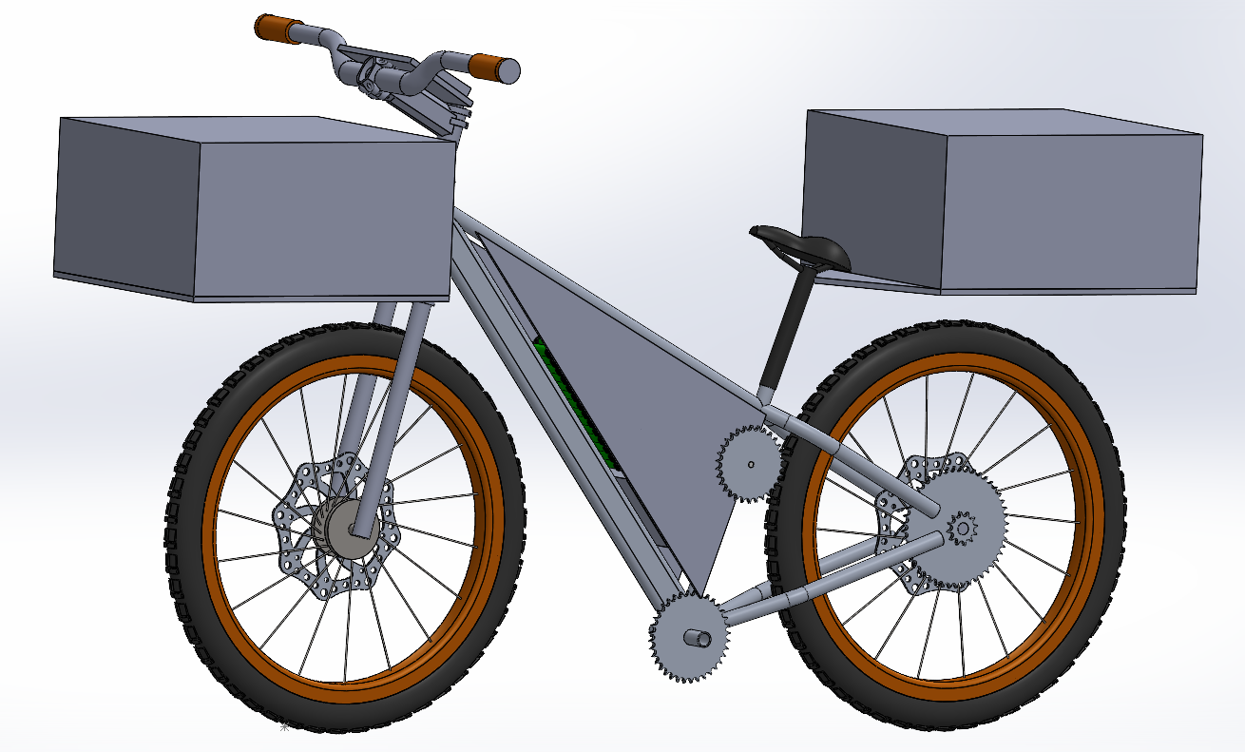
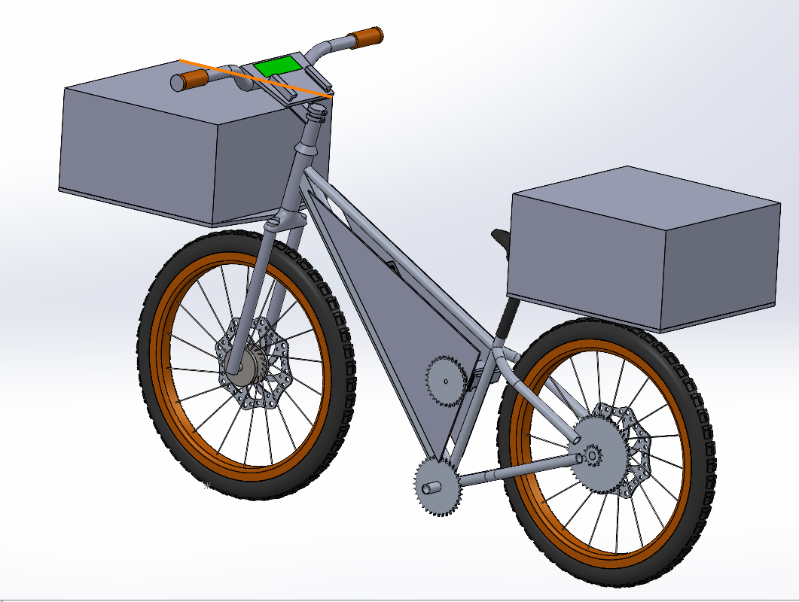
Overall Concept
Reliability
Features:
GPS enabled
Can travel 170km on single charge
Speed and distance monitored and displayed on dashboard
Manufacturability
User Comfort
Economic Viability

Slide 5


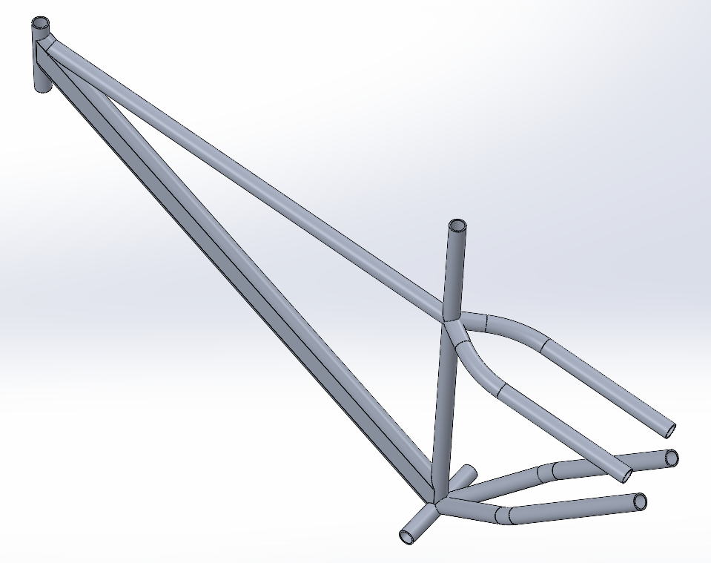



Frame Design & Packaging
Subsystem Level Goals
Frame Design
Accurate Manufacturing
Reliability
Model-Based Design for Validation
Manufacturability
Automated Machining of Tubes
User Comfort
Ergonomics Incorporated Design
Reduced # of Chassis Tubes
Economic Viability
Lesser Manufacturing Costs
Design Process
Component Selection
Preliminary Packaging
Frame Design Finalization
Outcomes:
Material used: Al 6061 T6 (Lightweight and durable with high yield strength)
Minimalistic unisex design with least possible number of tubes

Slide 6
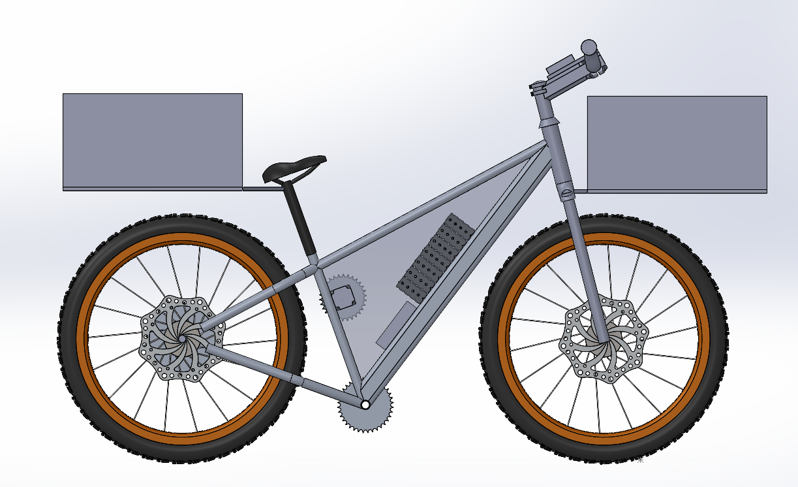
Frame Design & Packaging
Vehicle Packaging
Specifications | W/o Driver & Payload | With Driver & Payload
CG Height (mm) | 765 | 826
Weight Distribution | 40F60R | 44F56R
Total Payload Volume (litres) | 115
Outcomes:
The entire payload was divided into 2 storage boxes of 57.5 litres each for optimum weight distribution

Slide 7
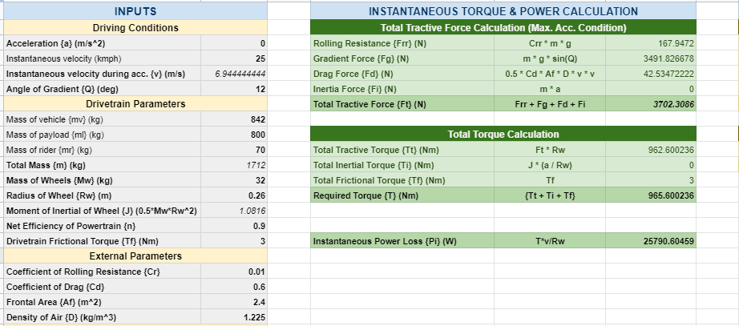
Powertrain Design
Subsystem Level Goals
Motor Sizing
High Quality Components
Reliability
Model-Based Design for Validation
Manufacturability
CNC Laser Cutting of Mounts
User Comfort
Smooth Operating Components
Cheaper Components
Economic Viability
Lesser Manufacturing Costs
Design Process
S/N | Velocity (km/h) | Acceleration (m/s²) | Gradient (degree) | Required Torque (Nm) | Motor Power (W)
1. | 30 | 0 | 0 | 10 | 238
2. | 0 | 1 | 0 | 54 | 0
3. | 6 | 0 | 10 | 89 | 447
4. | 0 | 0.5 | 10 | 113 | 0
Performance Baselining
Preliminary Modeling
Parameters Finalization

Slide 8
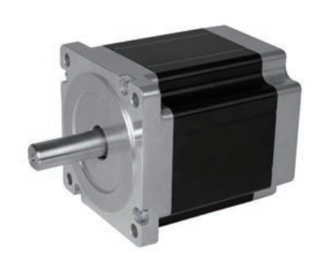
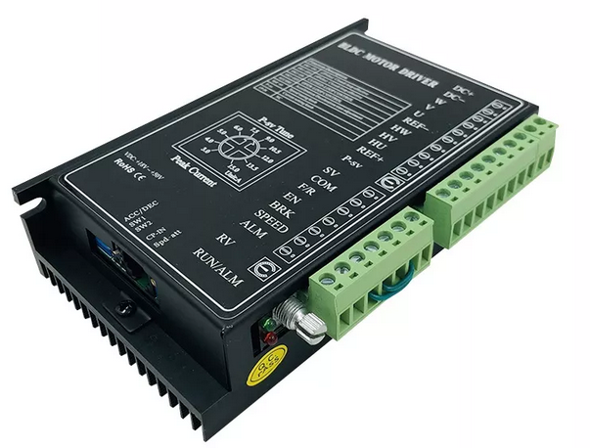
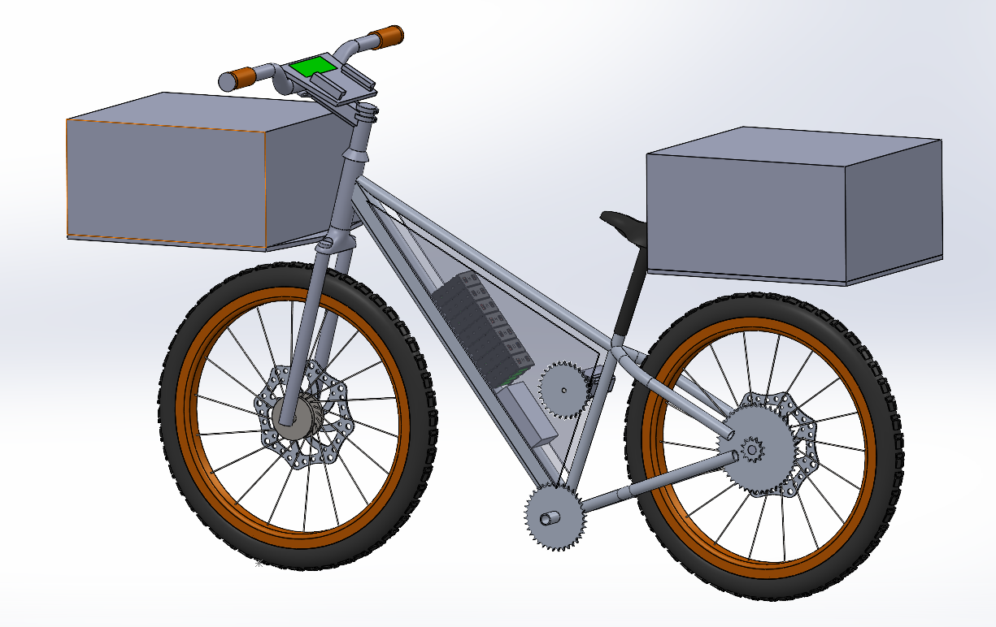
Powertrain Design
Market Research
LEISON 57BLF047
Best in class Power Density of 375 W/kg
Specifications | ROBU MY1016 | EMFi BL-IR-48-350-3000 | LEISON 57BLF047 | LEISON 57B06
Motor Type | BLDC | BLDC | BLDC | BLDC
Peak/Continuous Power (W) | 500/250 | 700/350 | 750/250 | 500/138
Weight (Kg) | 1.9 | 4.5 | 2 | 1.25
Efficiency (%) | 75 | 85 | 88 | 83
Cost (INR) | 3,300 | 8,000 | 2,200 | 1,722
Peak/Continuous Torque (Nm) | 7/1 | 11.5/1 | 2.4/0.8 | 1.6/0.44
Max. Operating Speed (RPM) | 3,000 | 3,500 | 3,700 | 3,700
Thermal Management | Air Cooled | Air Cooled | Air Cooled | Air Cooled
Nominal Battery Voltage (V) | 24 | 48 | 48 | 36
Best in class Efficiency of 88%
Peak Torque of 2.4 Nm
EMC Certified
EMC Certified
Drivetrain Design
BLD300 Controller
Priority | Weight
High | 25
Moderate | 15
Low | 10
Outcomes:
A 1:30 planteary gearbox was used for torque multiplication and speed reduction
Further 2 gear ratios of 0.4 & 1.6 were selected in order to drive the cycle
The final gear ratios were obtained as 48 and 12 to achieve the required value for gradeability and top speed respectivelty.

Slide 9
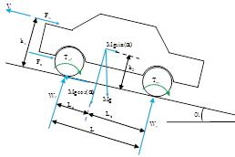
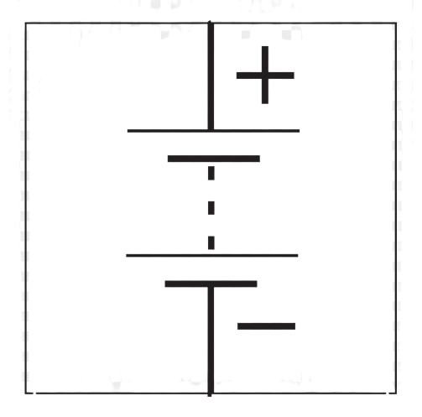
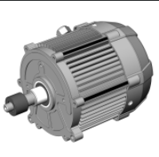
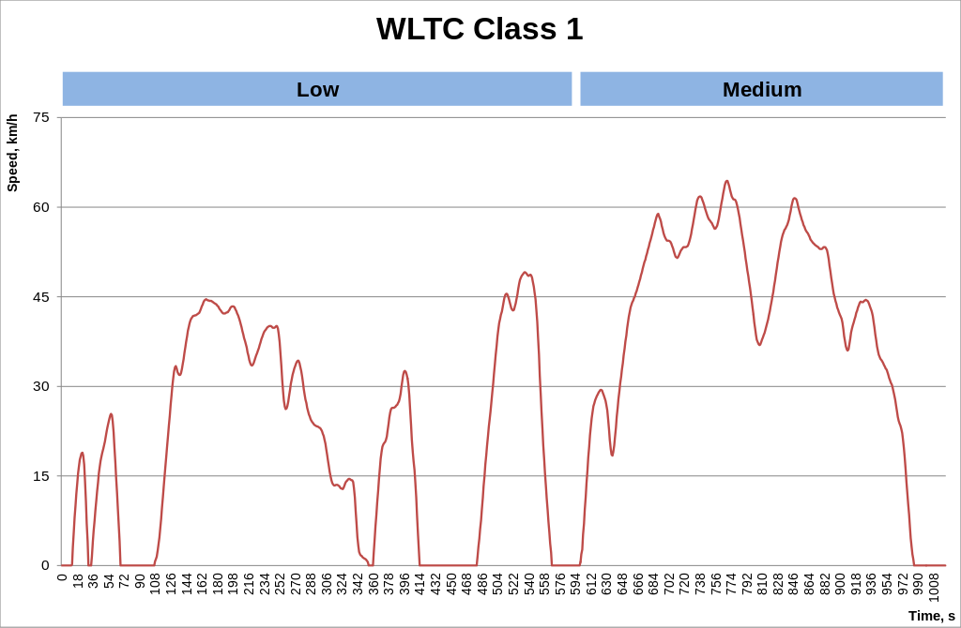
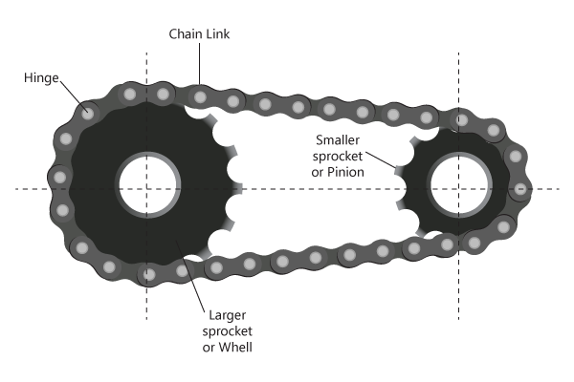
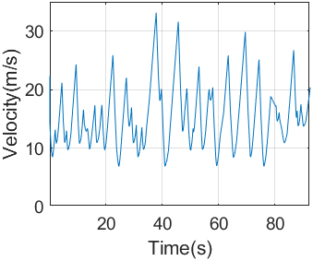
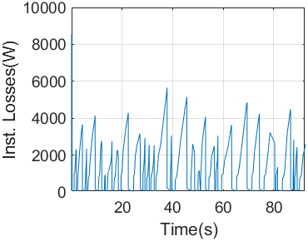
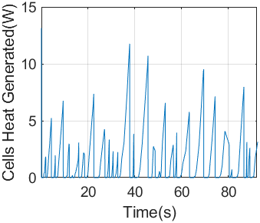
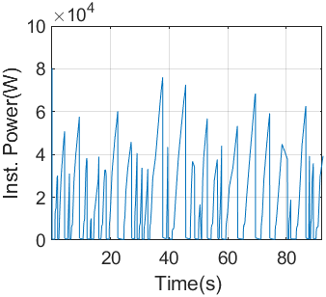
Battery Pack Design
Accumulator Sizing Model
Wheel to Well (Reverse) Model:
Road Load Forces
Motor & Controller
(Efficiencies & Current Calculation)
Battery
Current
Battery
Battery
Consumption
Drive Cycle
Drivetrain
(Gear Reduction & Drivetrain Losses)
Accel.
Total
Tractive
Force
Motor
Torque
Results
Power
Loss
Vehicle Speed
Motor
RPM
Efficiency
Outcomes:
Model predicted the Battery Consumption to be 2316 Wh for 170 km (w/o Regen)
Model predicted the Battery Consumption to be 495.4 Wh for 170 km (with Regen)
Current & Heat Generation profiles were also produced to design the Thermal Management System
Parameters | Model Output (w/o Regen) | Model Output (with Regen) | Adjusted Design Value
Battery Size | 2316 W-h | 495.4 W-h | 600 W-h
Avg. Power Loss | 7.515 W | 7.515 W | 8 W
Avg. Current | 2.508 A | 2.508 A | 2.75 A

Slide 10
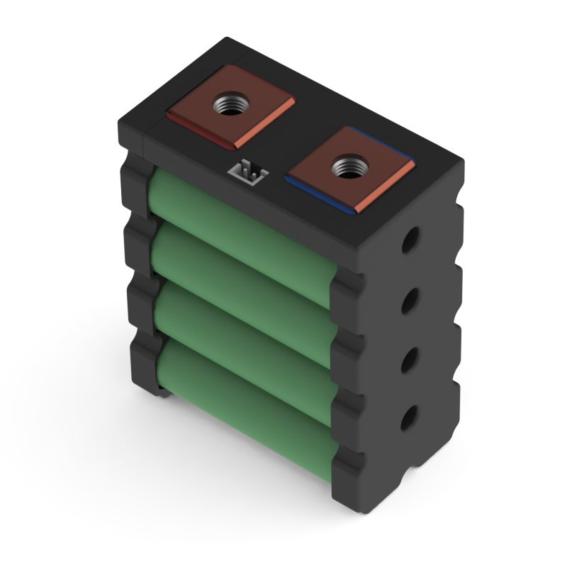
Battery Pack Design
Cell Selection
Cells Available at EnergusPS
Property | Melasta Pouch Cells | Melasta Prismatic Cells | Cylindrical Cells (Self Assembly) | Preassembled Cylindrical Modules
Manufacturabilty | Moderate | High | Low | Very High
Energy Density | High (190Wh/kg) | Low (100 Wh/kg) | Very High (~220Wh/kg) | High (~200 Wh/kg)
Electrical Safety | Low | Moderate | Low | Very High
Cost | Moderate (INR 7L+) | Low (INR 10L+) | High (INR 4L+) | Low (INR 10L+)
Peak Discharge Current | Very High (~500A) | Very High (~500A) | High (~300A) | High (~300A)
Int. Resistance | Very High (< 1mohm) | Very High (< 1mohm) | Moderate (2-3mohm) | Moderate (2-3mohm)
Thermal Mgmt. | Low | Low | High | Very High
Mech. Robustness | Very Low | Very High | Moderate | Very High
Sony-Murata VTC5
Pre-Assembled OEM Modules
Samsung 25R
In-Built Fuses & Temp. Sensors
Sony-Murata VTC6
Very Low Assembly Time
Samsung 30Q
UL94v-0 Rated Robust Frame
Cell Chemistry Selection
Property | Sony VTC5 | Samsung 25R | Sony VTC6 | Samsung 30Q
Chemistry | NMC | NCA | NMC | NCA
Voltage(Nom/Max) | 3.6/4.2 V | 3.6/4.2 V | 3.6/4.2 V | 3.6/4.2 V
Capacity | 2.6 Ah | 2.5 Ah | 3.0 Ah | 3 Ah
Mass | 44 | 45 | 46 | 46
Energy Density | 212 | 200 | 237 | 235
Cost (per cell) | Moderate | Moderate | High | High
Max. Discharge (Continuous/Peak) | 10C / 18C | 5C / 18C | 5C / 15C | 5C / 12C
Int. Resistance | 13m-ohm | 22 | 13 m-ohm | 20 m-ohm
Weighted Average | 3.38/5 | 3.44/5 | 3.38/5 | 3.94/5
Outcomes:
Due to moderate Energy Density, low Internal Resistance, less mass and low cost we went for Sony VTC5
Priority | Weight
High | 15
Moderate | 10
Low | 5

Slide 11
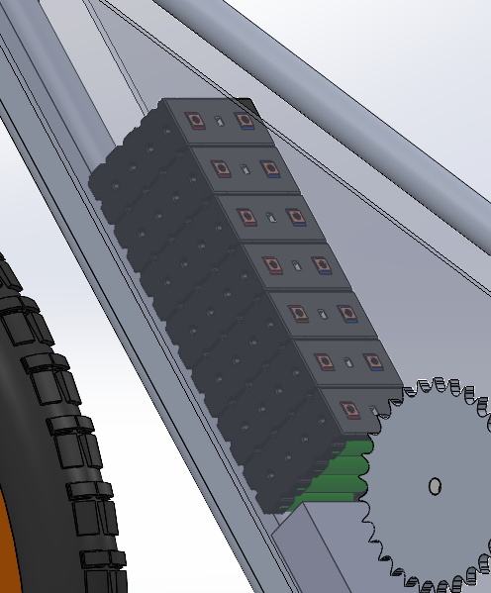
Battery Pack Design
Battery Pack Design
Specifications | Value
Mass of 1xBattery Module | 0.43 kg
No. of Battery Modules (2s4p) | 7
Total Mass of Accumulator | 3
Peak Discharge Current | 224.6 A (18C)
Nominal Voltage | 50.4 V
Total Capacity | 495.4 W-h
Outcomes:
Body panels with ducts and slots used to protect the cells from outside environment and perform necessary passive cooling respectively

Slide 12
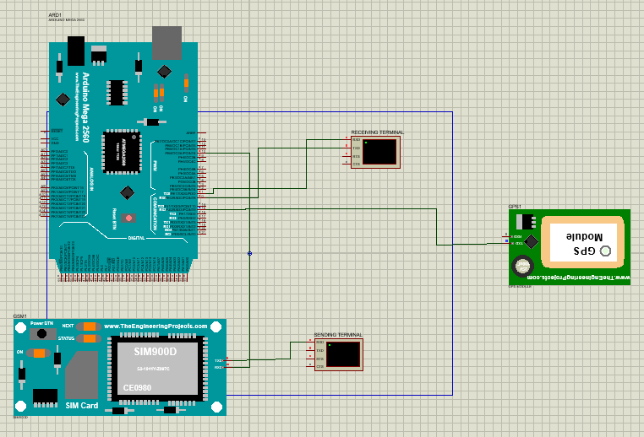
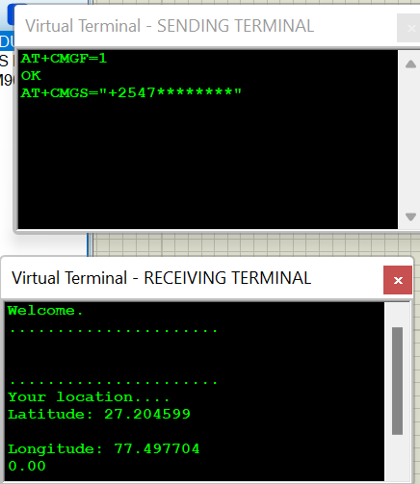
Electronics
IoT Features
Outcomes:
GPS Module used to fetch coordinates of vehicle, sent as text message to mobile number through Arduino and GSM Module SIM 900D
Simulated using Proteus software where location sent can be seen through Virtual Terminal

Slide 13



Electronics
Safety Features - BMS
1A
1A
1A
1A
1A
1A
250A
5V
Battery Management System Module
Current Sensing
Other Stacked AMS
Voltage sensing &
Cell Balancing
Temp Sensing
Differential Communication
T (°C)
Fault Generation Unit
(Isolated)
TX
RX
Isolator
UART
Micro-Controller
CAN BUS
Data collected
AMS AIR
Outcomes:
BMS will protect battery pack from overcharge and overdischarge by balancing the cells passively.
Extra charge in any cell is balanced by dissipating it through mosfet and resistor combination.
Temperature is also monitored through a thermistor. If any fault occurs the circuit sends signal to shut down the vehicle.

Slide 14
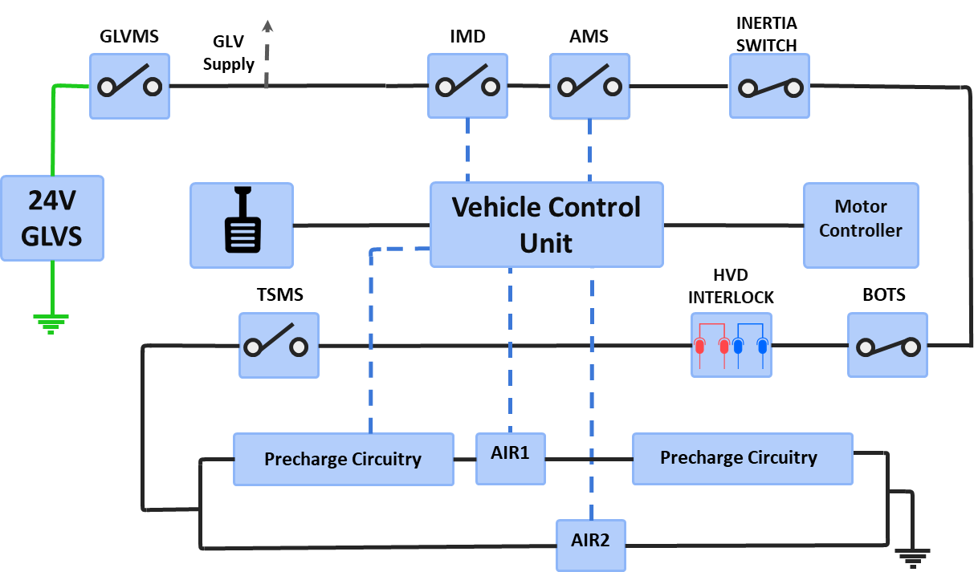
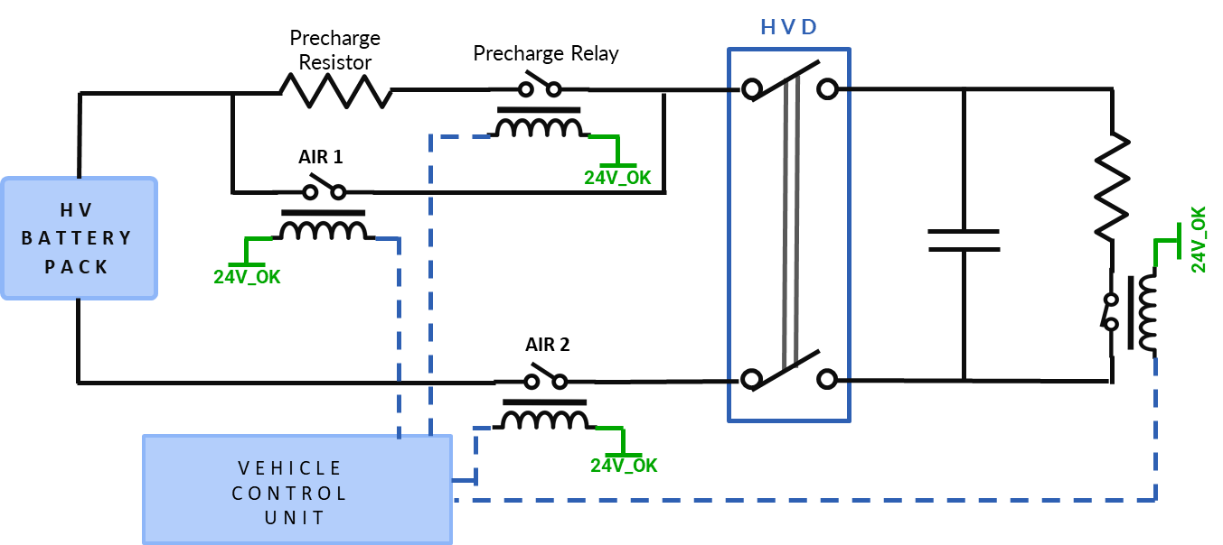
Electronics
Safety Features – Shut Down Circuit
Safety Features – Pre-Charge Circuit
Outcomes:
Provides a resistive path through the pre-charge relay till the voltage builds up across the motor
Once the voltage is in safe margin (90% or more), the pre-charge relay opens and AIR1 is closed to provide low resistance path to minimize power loss
Outcomes:
In case of any error, the corresponding switch opens the shutdown circuit and the AIRs (Accumulator Insulation Relay) disconnect the power supply to ensure safety of the driver and the vehicle

Slide 15
Electronics
Regenerative Braking System
Regen Torque
Specifications
Peak Regen Torque | 2.4 Nm
Peak Regen Current (Ballast Circuit) | 40 A
SOC Strategy* | 0.75
Regenerative Energy (Wh) | 495.4
% Energy Regenerated | 78.6
Generator Efficiency
Regenerated Power
Ballast Circuit
Battery
Motor RPM
Outcomes:
The maximum Regen Torque & Current have been limited to protect the Motor & the Li-ion batteries from damage
A very conservative SOC Strategy of 0.75 has been adopted to prevent the batteries to charge when the SOC is too high or too low
Using the specified configuration of Regenerative Braking system, we can reduce the required battery size by 1.82 kWh (78.6%)

Slide 16
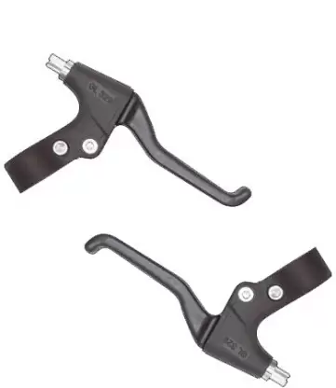
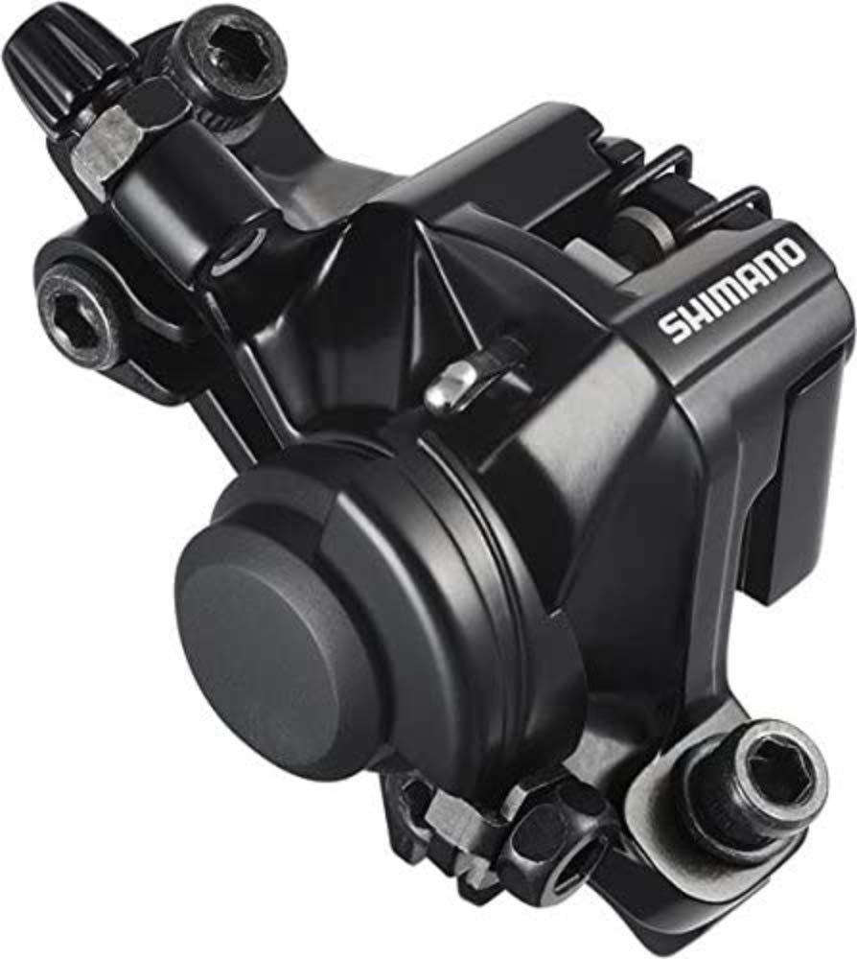
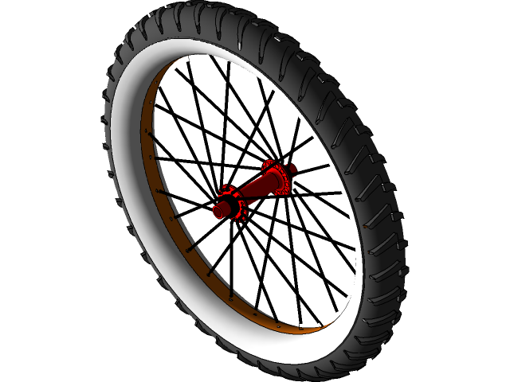
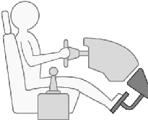
Suspensions & Braking
Stopping Distance Calculation
F. Line Tension
F. Braking Torque
Wheel Angular Velo.
Pedal
Brake Calipers
Tyres
Stopping Dist.
R. Line Tension
R. Braking Torque
Slip
Ratio
Pedal
Position
Results
Longitudinal Driver
Acc.
Vehicle State Calculator
Velocity
Frictional Force.
Outcome:
Disc Brake System used on the front and rear tyres
The Tyre-slip model has been used to finalize the Brake Bias to get maximum braking force before the traction is lost
The Stopping distance came out to be 205m with a max. retardation of 0.3 m/s2 achieved

Slide 17
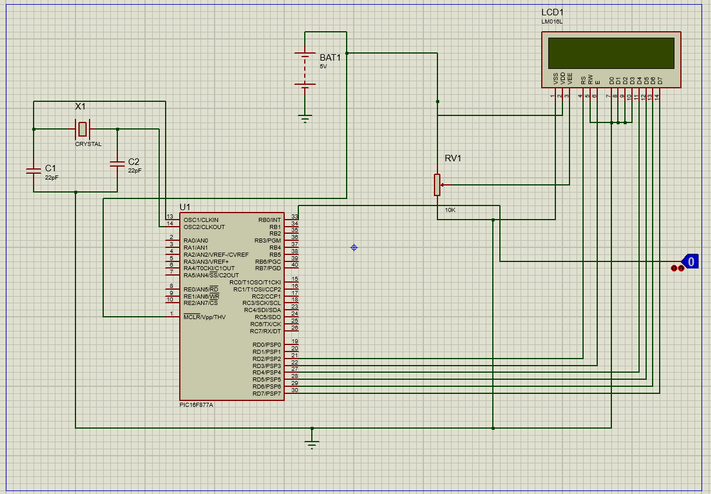
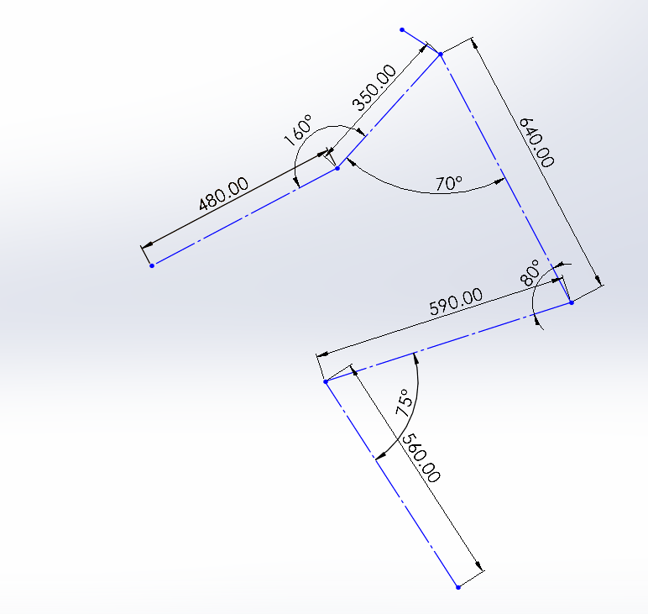
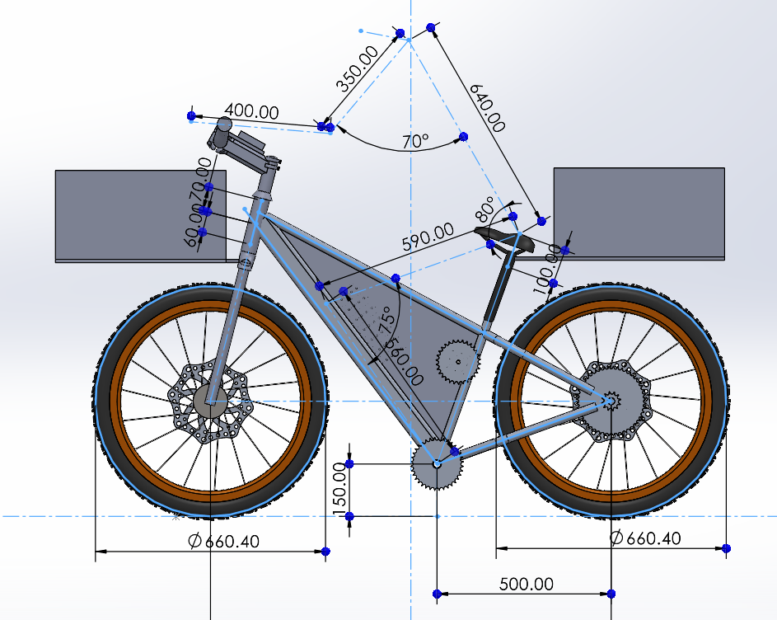
Driver Interface
Driver Ergonomics
Dashboard/Digital Features
Comfort to maximise performance
Maximum Mechanical Advantage
Optimal Field of View
Safety against all possible outcomes
Configured cockpit forces
We have used a piece of magnet and hall sensor to measure speed and distance.
Since it involves moving objects it is not possible to demonstrate the complete simulation so we have used logic state to interrupt the microcontroller.
Literature was intensively studied and ideal ranges along with test result were used to set design target ranges for angles

Slide 18
Thank You!

