Slide 1
Tech4Heritage
Sample Phase 1 Submission
Team128 Ancient_AI
Members:
Parth Chhabra (Team Captain)
Arjav Jain
Aryan Prasad
Kushagra Babbar

Slide 2
Dataset
The research and the the work behind nitpicking a proper dataset was worth the experience. Following are the precautionary measures and factors that we had the utmost concern of:
Since the competition revolves around rejuvenating Indias’ heritage, it became immensely necessary to include only the images having Indian significance. Western art differed from our requirements in terms of the the style of paintings, the historical choices of colour shades and most significantly, the age of the artwork. All of the images have been duly evaluated taking into account, its similarity to given sample data.
In order to extend the flexibility of the program in acceptance of varying resolutions of images, we ensured that we resize our images to 500 X 500 px and normalized the data on all pixels for maintaining mathematical uniformity.
With the plan of implementing a proper deep learning network, we have developed a function apply_distortion() which distorts the image in addition to the distortions already present. We have channelized various values for pixels in hsv mode which tints the accommodated images using one of our predefined mathematical models for each of them. This way, we eliminate the layman’s idea of imparting distortion through binary colours(B&W) which might possibly overfit the model only one of the infinite number of ways a painting could be patched.

Slide 3
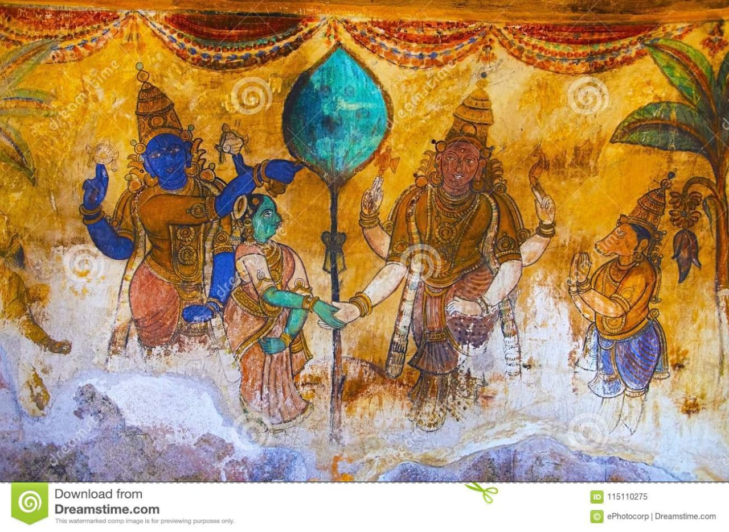
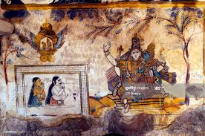
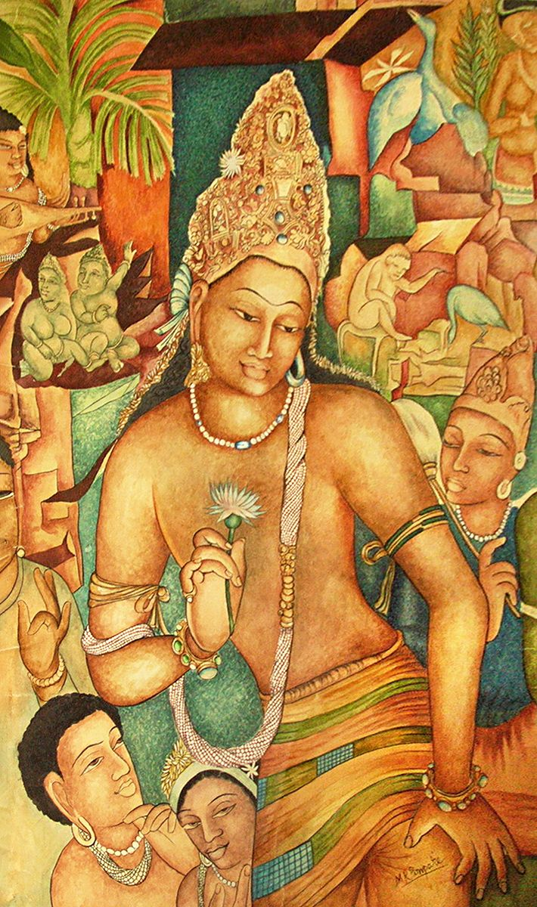
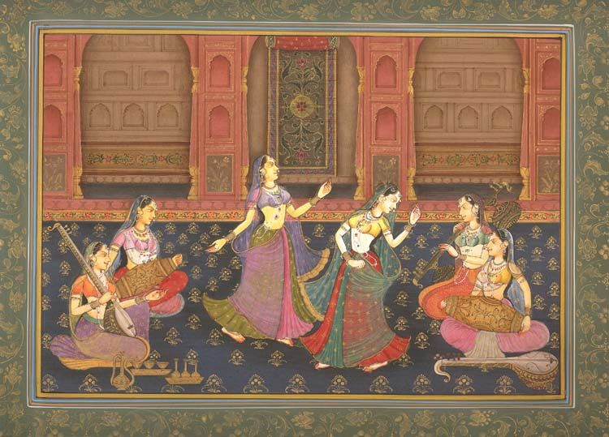
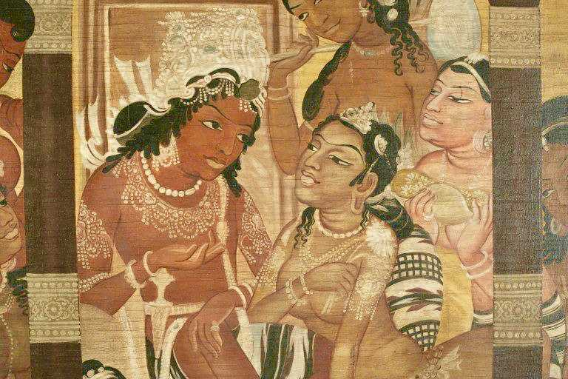

Slide 4
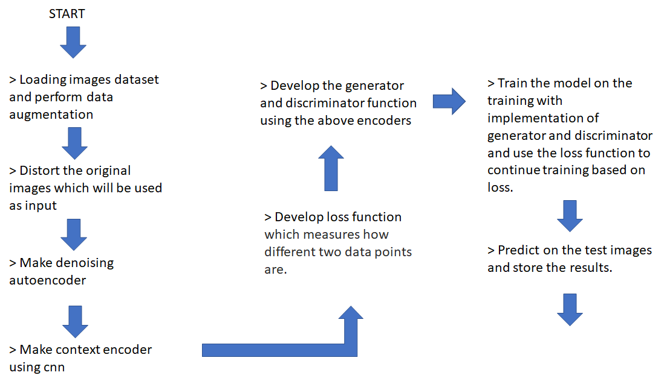

Roadmap

Slide 5
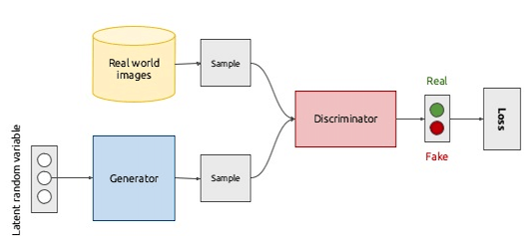
Generative Adversarial Networks:
GANs are an approach to generative modeling using deep learning methods, such as convolutional neural networks.
Generative modeling is an unsupervised learning task in machine learning that involves automatically discovering and learning the regularities or patterns in input data in such a way that the model can be used to generate or output new examples that plausibly could have been drawn from the original dataset.
GANs are a clever way of training a generative model by framing the problem as a supervised learning problem with two sub-models: the generator model that we train to generate new examples, and the discriminator model that tries to classify examples as either real (from the domain) or fake (generated). The two models are trained together in a zero-sum game, adversarial, until the discriminator model is fooled about half the time, meaning the generator model is generating plausible examples.

Slide 6
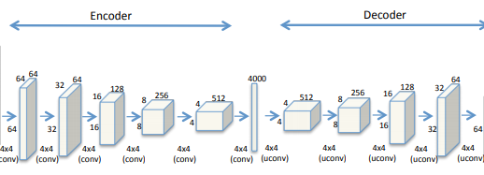
Denoising Autoencoder used in GAN :
An autoencoder is a type of neural network that attempts to replicate its input x on its output. It consists of two components, an encoder E and a decoder D.
Encoders output is a vector with a lower dimension, also called a latent space vector. There are some uses for a higher dimensional latent space, but we shall neglect the case for our purposes.
We do not want the network to learn an identity function, but rather make it produce an approximate copy, which still holds the same properties as original input. Consequently, the network is encouraged to learn the most important and potentially useful feature representations in the latent space.
A visual representation of an encoder-decoder is given below.

Slide 7
Loss Function L:
The training process minimizes a loss function L, which measures how different two data points are. Depending on the usage, different loss functions can be used in place for L. Some of the most popular are mean-squared error and cross-entropy.
Criteria:
A modification is presented over the autoencoders idea that enables us to recover partially damaged data by changing the criteria for reconstruction.
Instead of learning to replicate the input directly, the input is damaged beforehand, and the network’s output is trained to approximate the undamaged original image.
In order to create a deep architecture, we can stack multiple encoder/decoder pairs, by chaining multiple autoencoders so that each encoder’s output is the input to the next. The motivation behind this architecture is to have each latent layer represent more abstract features, like how most other deep neural networks work.
The process of denoising training together with the usage of deep layers enable the model to build a well-structured and robust hidden layer of features, from which it is possible to reconstruct the original image.

Slide 8
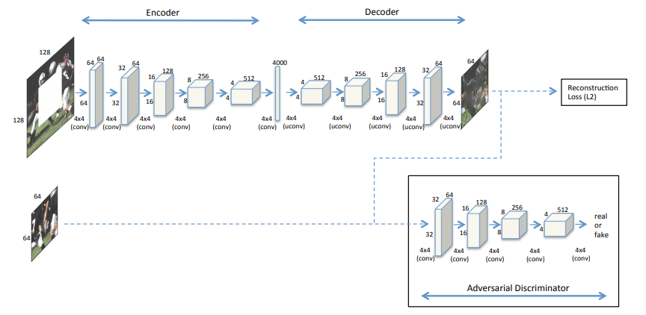
Context Encoder
The Context Encoder framework is based on an autoencoder architecture with an adversarial discriminator, while exclusively using convolutional layers with varying kernel sizes and channel counts. Like denoising autoencoders, we do not try to reconstruct the input image, but rather generate a patch to fill in the missing or damaged area of the input. This concept will be used while making the model.
Like vanilla autoencoders, all training is performed in an unsupervised manner, meaning no class label information is supplied to the model and there is no conditioning for the evaluation. Therefore, for significantly damaged images the model might perform successful inpainting, while differing in the class characteristic content.
Through the discriminator’s opinion, the generator is pushed to produce sharper results instead of uncertain averages. The adversarial loss is joined with reconstruction loss and both are weighed with the respective coefficients.

Slide 9
Interim Function :
Damaged Images
Damaged
Images
Generator
Clean
Images
Discriminator
GAN
Model
Generator
Feedback
Feedback
Restored
Images

Slide 10
Interim Function :
In this function we create our generator and discriminator models.
Then we build our final model by concating both of the above models with their respective losses as stated above in the road map .
The final GAN model is trained with our dataset with damaged images and clean images .
It learns to extract features from the generator elements and fill the missing elements in the damaged images .
Thus we get our restored images .

