Slide 1

Flow Analysis and Optimization of Supersonic
Turbojet Engine Intake and Nozzle
MIN-345 Compressible Flow
Group-2

Slide 2
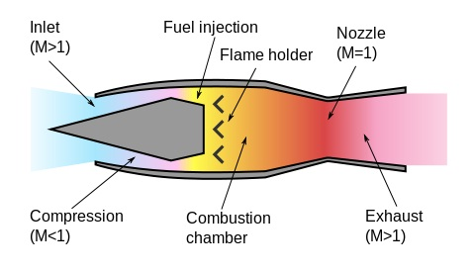
Supersonic Ramjet Design
Supersonic Inlet
Supersonic to Subsonic
Diffuser
Subsonic to Supersonic
C-D Nozzle
Supersonic Exhaust

Slide 3
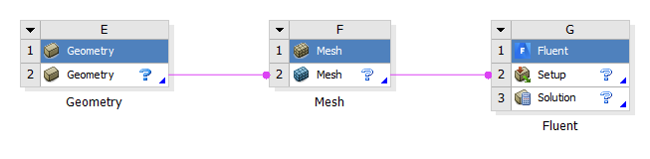
Compressible Flow CFD Simulations
Simulation Flow Diagram
Modeling
Meshing
Pre-Processing
Solver/Processing
Post Processing
Fig: Ansys Workbench Component Systems

Slide 4
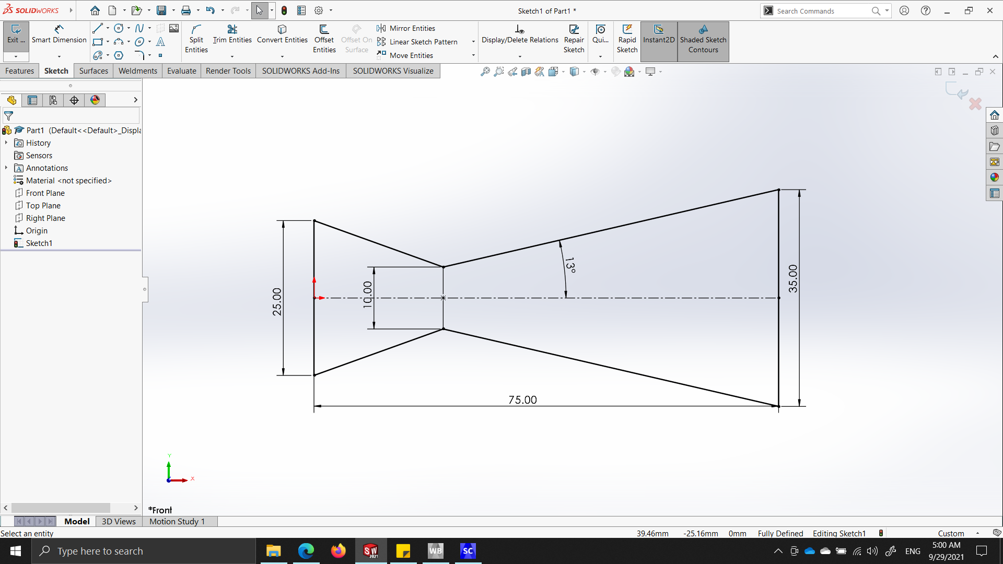
Converging-Diverging Nozzle
Initial Geometry
Parameter | Dimension
Total Length of Nozzle (mm) | 75
Inlet Diameter (mm) | 25
Outlet Diameter (mm) | 35
Throat Diameter (mm) | 10
Divergence Angle (degs) | 13
Convergence Angle (degs) | 20
Fig: 2D- Geometry
Table: Geometry Specifications
Outcomes:
Solidworks used for modelling
2-D Geometry due to axi-symmetricity

Slide 5
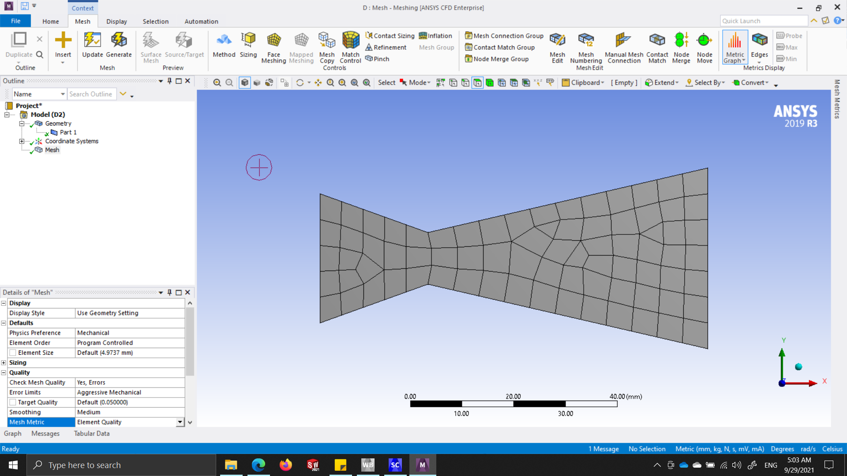
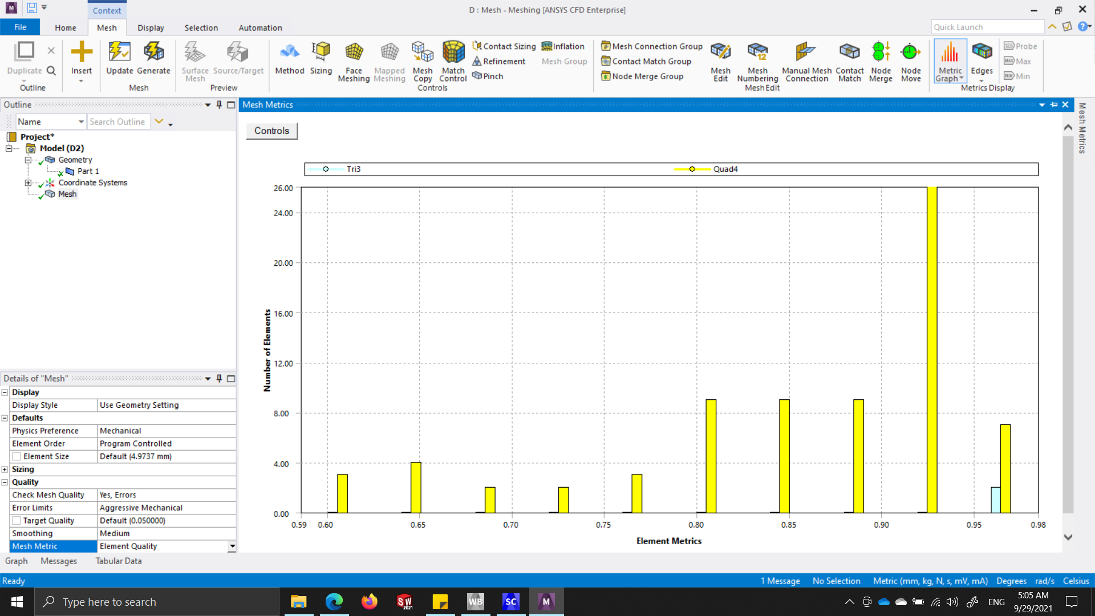
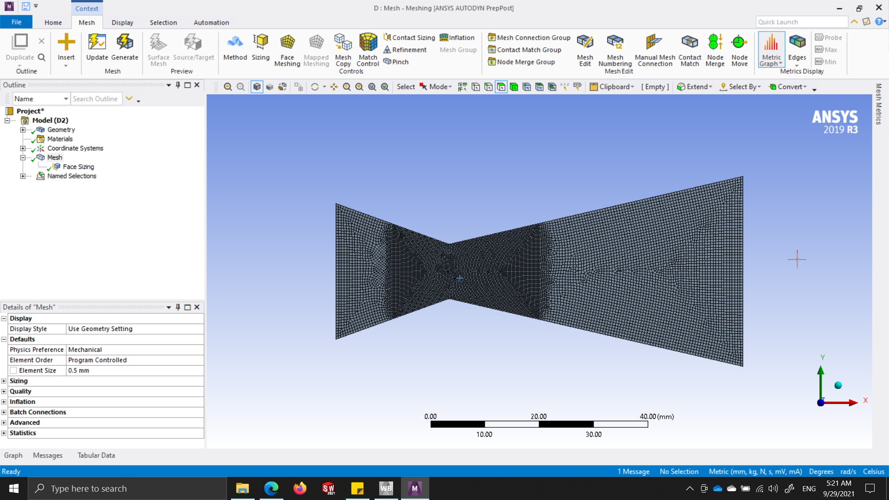
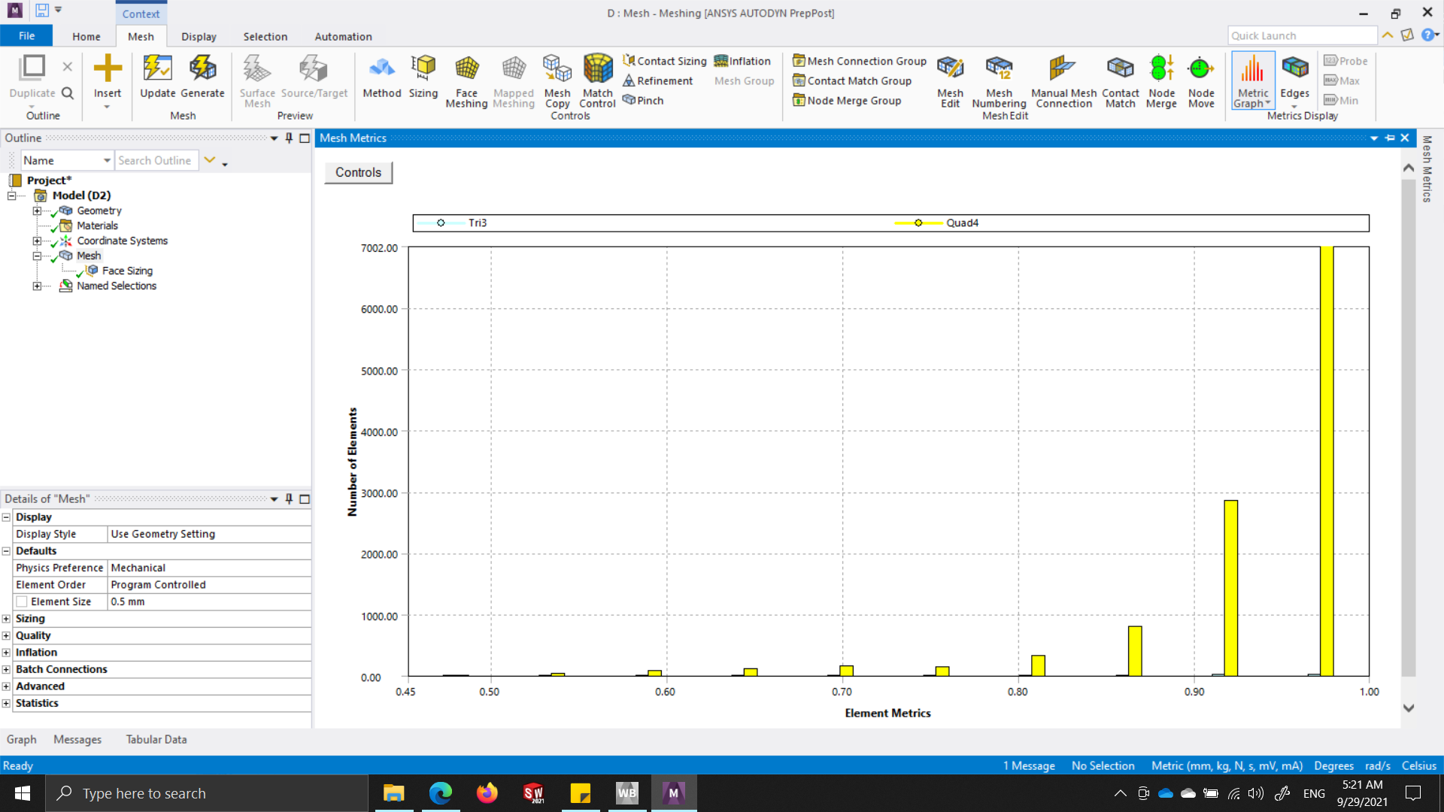
Converging-Diverging Nozzle
Meshing
Specifications | Element Size | Element Quality
Default Mesh | 5mm
Optimized Mesh | 0.1mm/0.5mm
Table: Mesh Specifications
Outcomes:
Hex-dominant meshing method used
Number of Nodes - 11770
Number of Elements - 11551

Slide 6
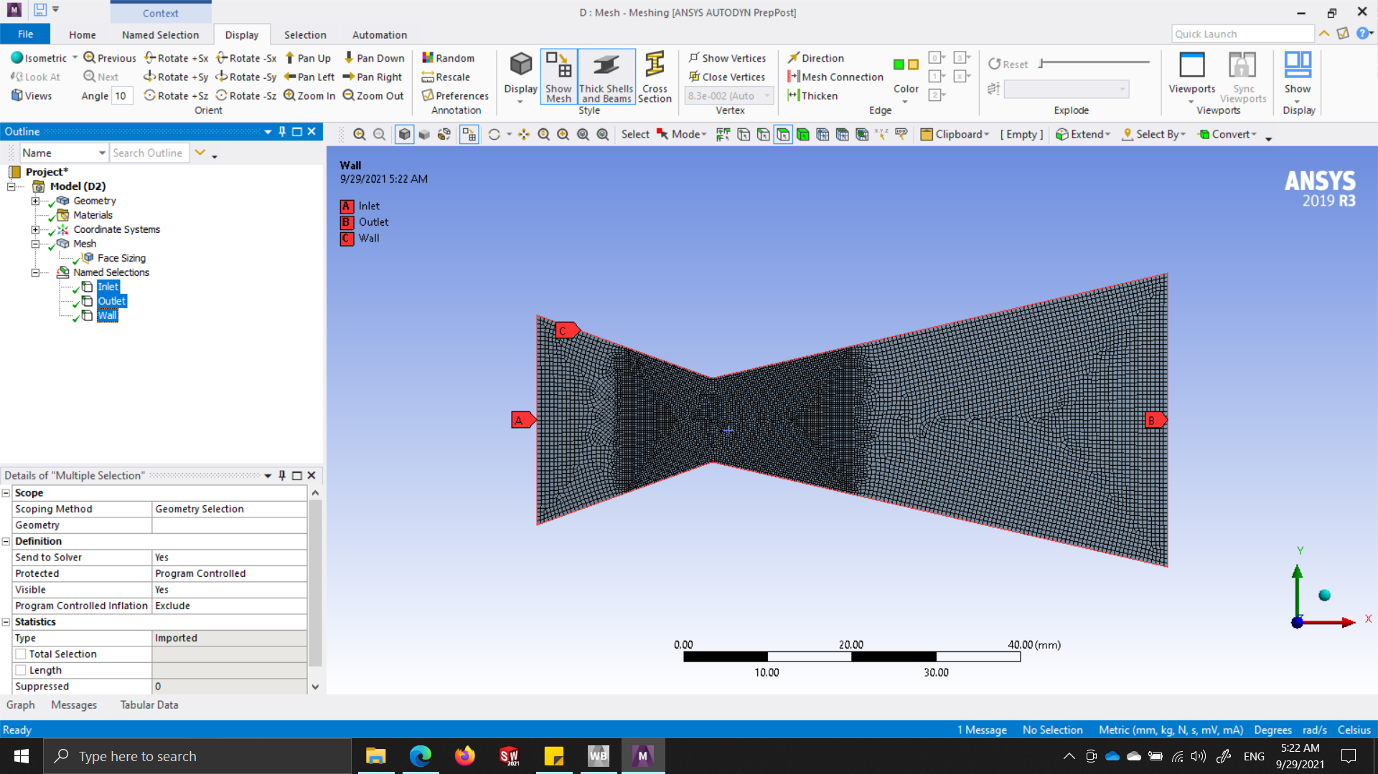
Converging-Diverging Nozzle
Pre-Processing
Boundary Conditions
Specifications | Details
Solver Type | Density Based
Time | Steady
2D Space | Planar
Model | Energy Eqn. (On)
 | Viscous (Inviscid)
Table: General Specifications
Specifications | Details
Inlet Gauge Pressure (Pa) | 3e5
Inlet Temperature (K) | 300
Outlet Gauge Pressure (Pa) | 1.7e5
Outlet Temperature (K) | 273
Specifications | Details
Density (kg/m³) | Ideal Gas
Cp (J/kg-K) | 1006.43
Molecular Weight (kg/kmol) | 28.966
Table: Material Specifications
Table: Boundary Conditions

Slide 7
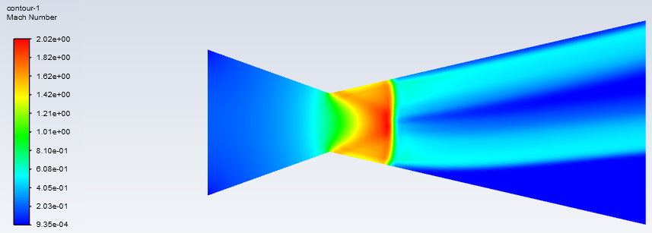
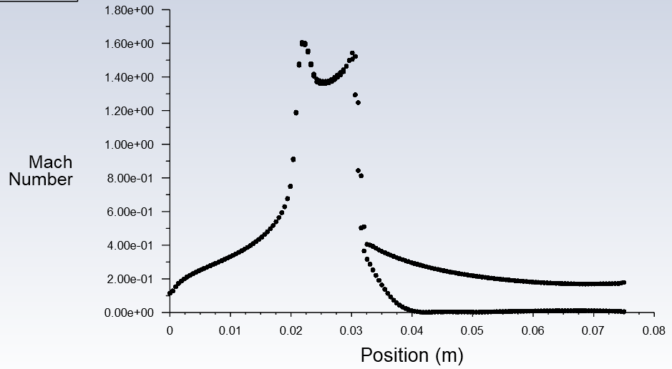
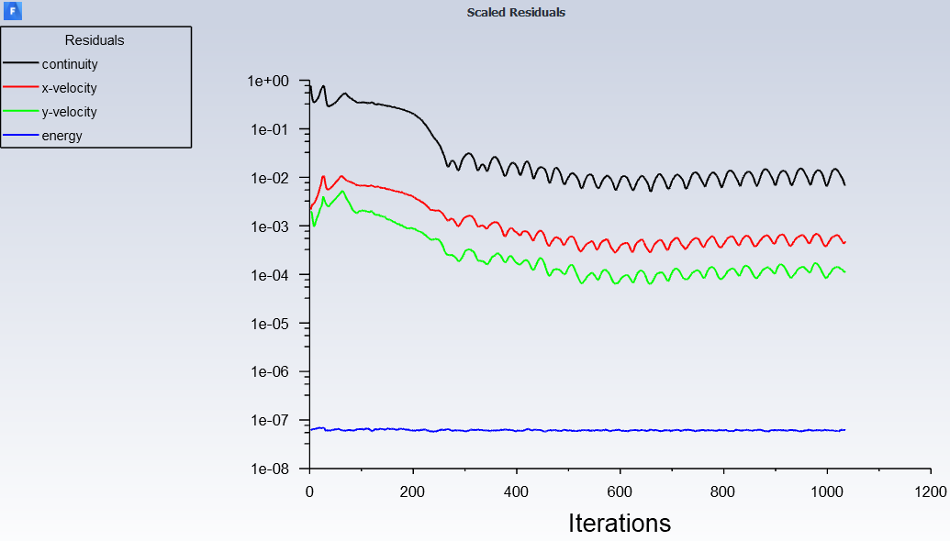
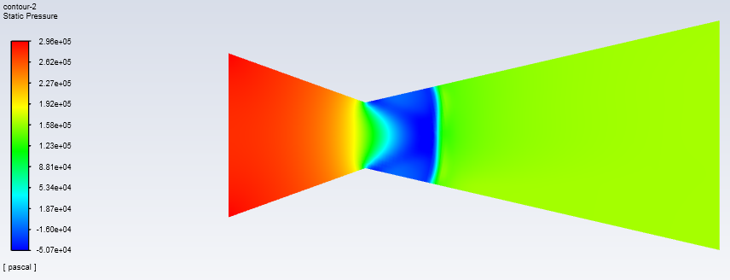
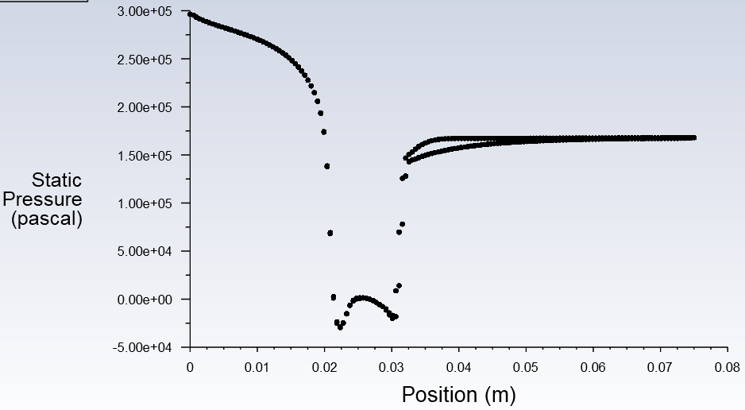
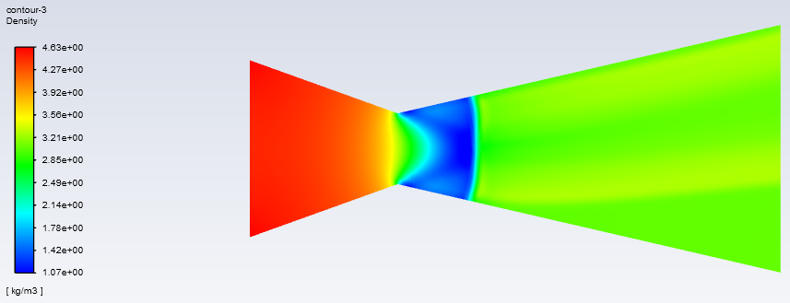
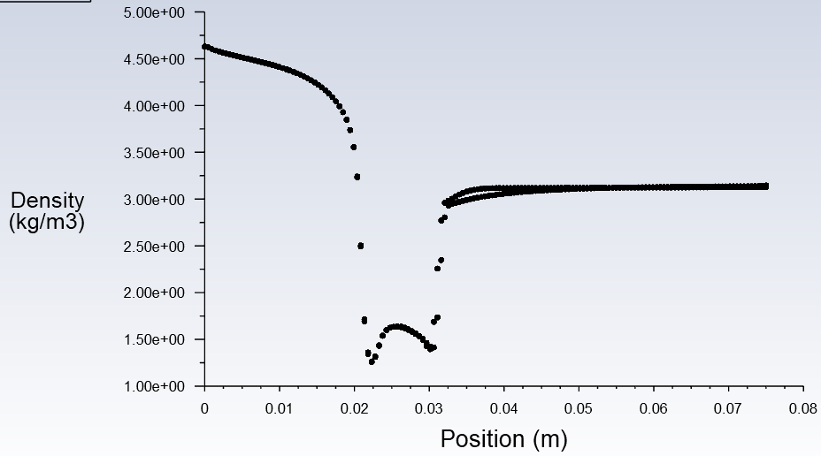
Converging-Diverging Nozzle
Post-Processing
Specifications | Contours | Plots
Mach Number
Static Pressure
Density
Residuals
Outcomes:
Shock observed at 30mm
Notes:
0.0225

Slide 8
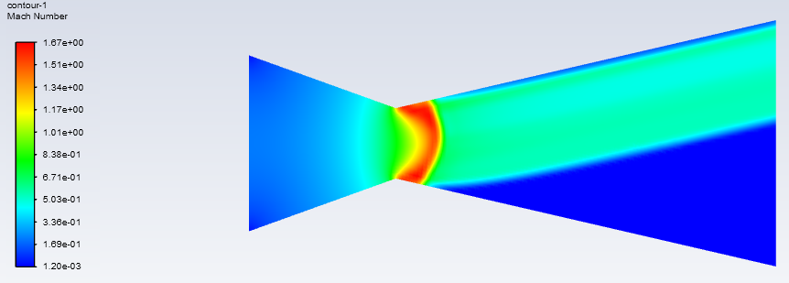
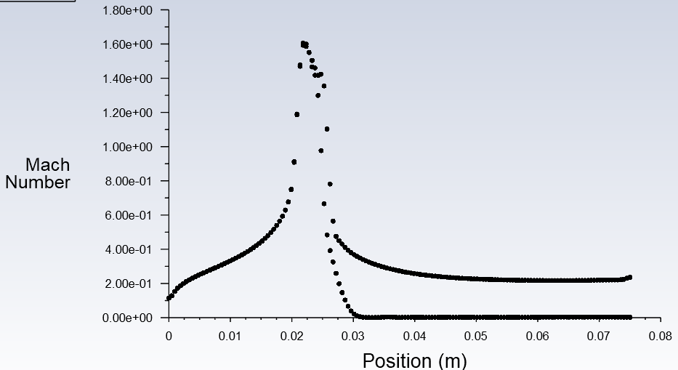
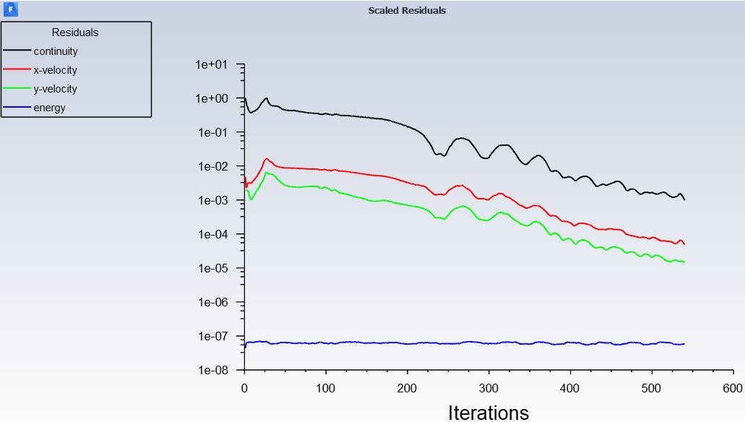
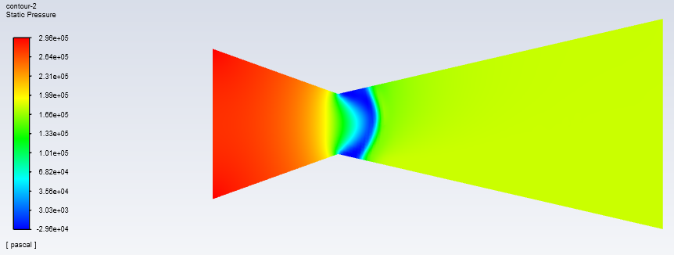
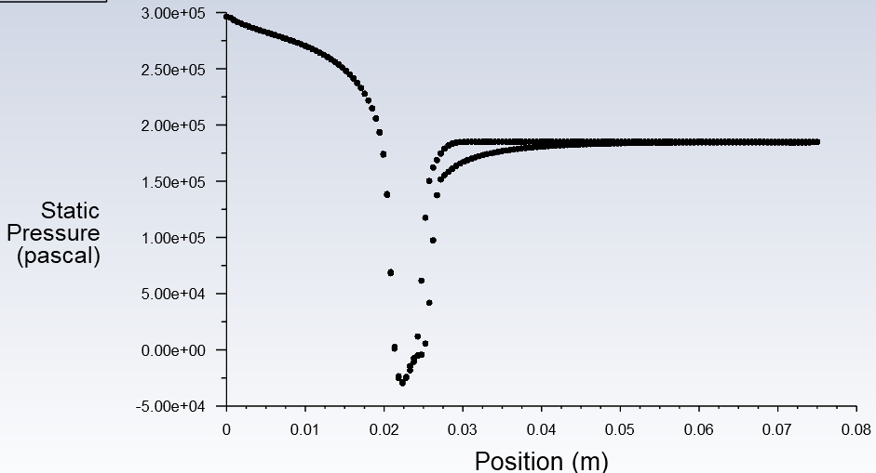
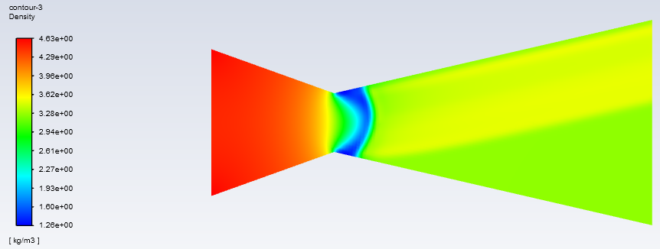
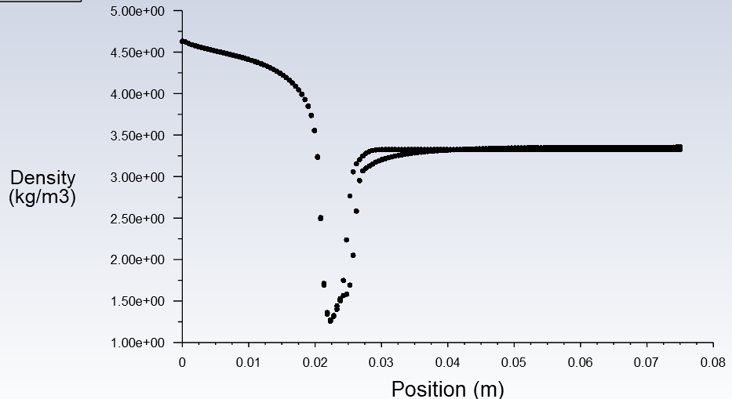
Converging-Diverging Nozzle
Post-Processing
Specifications | Contours | Plots
Mach Number
Static Pressure
Density
Residuals
Outcomes:
Outlet Pressure increased by 5e3
Shock observed at 25mm
Convergence at Step 540
Notes:
0.0225

Slide 9
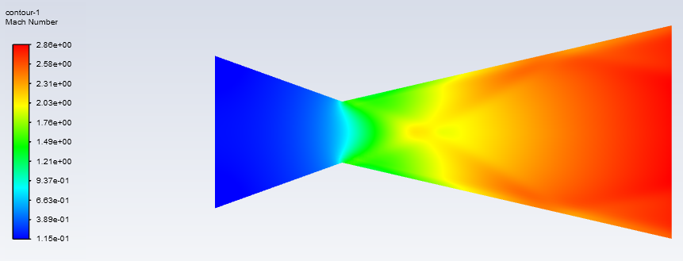
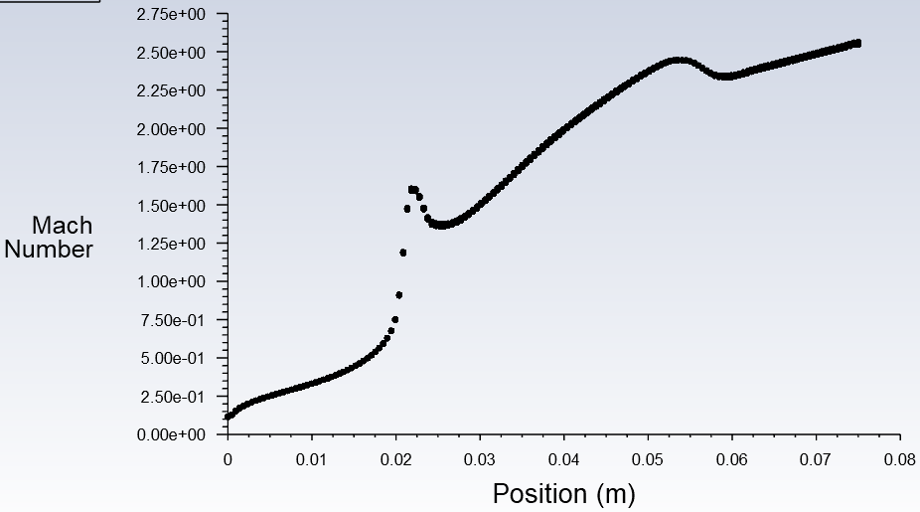
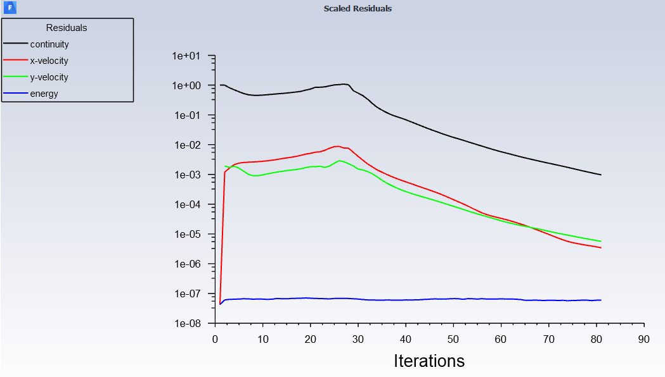
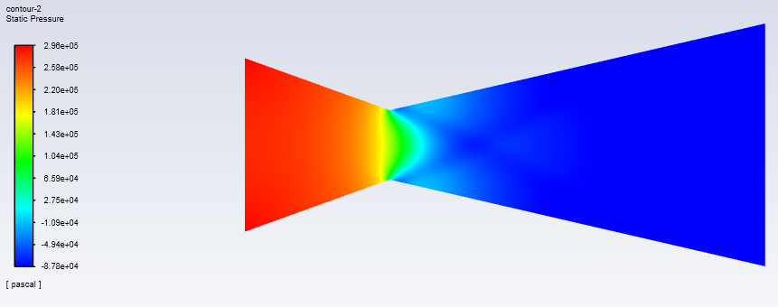
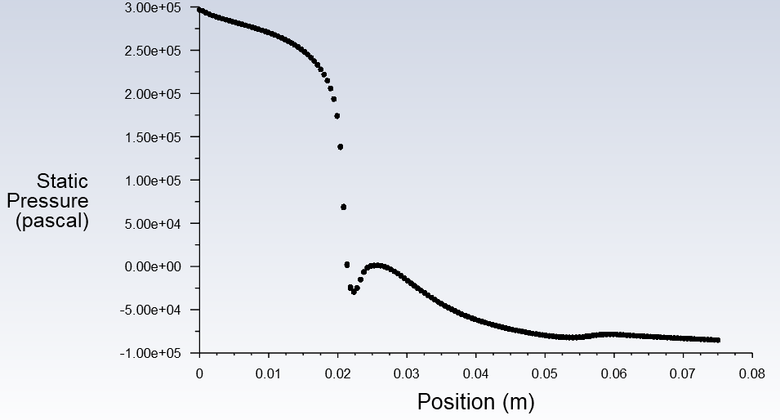
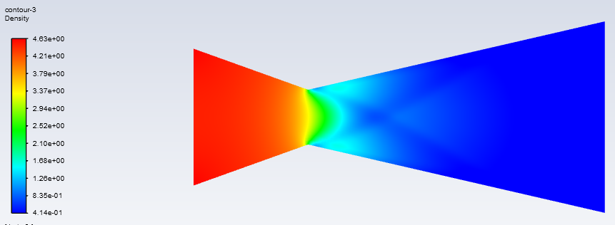
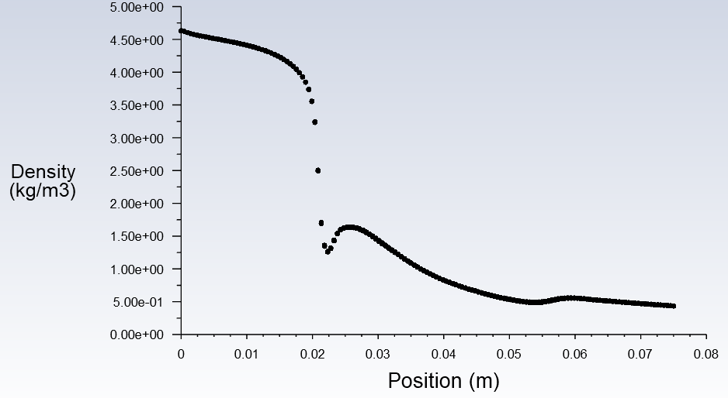
Converging-Diverging Nozzle
Post-Processing
Specifications | Contours | Plots
Mach Number
Static Pressure
Density
Residuals
Outcomes:
Outlet Gauge Pressure set to 0
Convergence at Step 81
No shock formed
Notes:
0.0225

Slide 10
Thank you

Slide 11
Flow Analysis and Optimization of Supersonic
Turbojet Engine Intake and Nozzle
MIN-345 Compressible Flow
Group-2
Part-2

Slide 12
Converging-Diverging Nozzle
Pre-Processing
Boundary Conditions
Specifications | Details
Solver Type | Density Based
Time | Steady
2D Space | Planar
Model | Energy Eqn. (On)
 | Viscous (Inviscid)
Table: General Specifications
Specifications | Details
Inlet Gauge Pressure (Pa) | 3e5
Inlet Temperature (K) | 300
Outlet Gauge Pressure (Pa) | 1.7e5
Outlet Temperature (K) | 273
Specifications | Details
Density (kg/m³) | Ideal Gas
Cp (J/kg-K) | 1006.43
Molecular Weight (kg/kmol) | 28.966
Table: Material Specifications
Table: Boundary Conditions

Slide 13
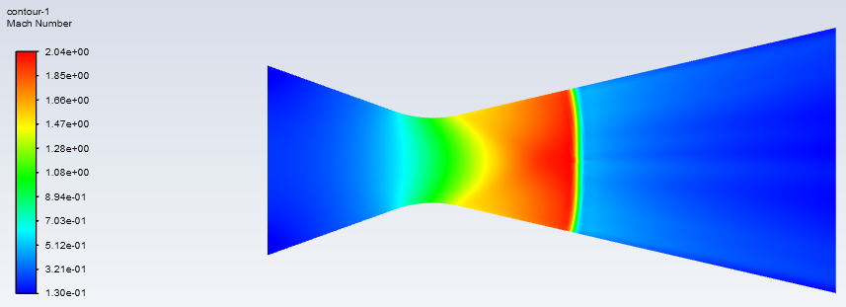
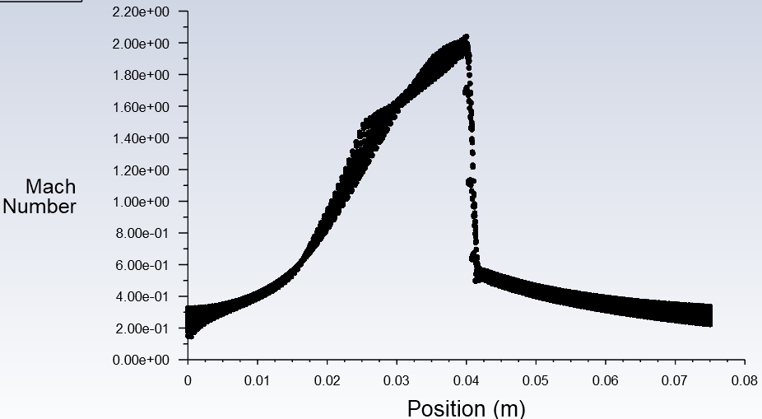
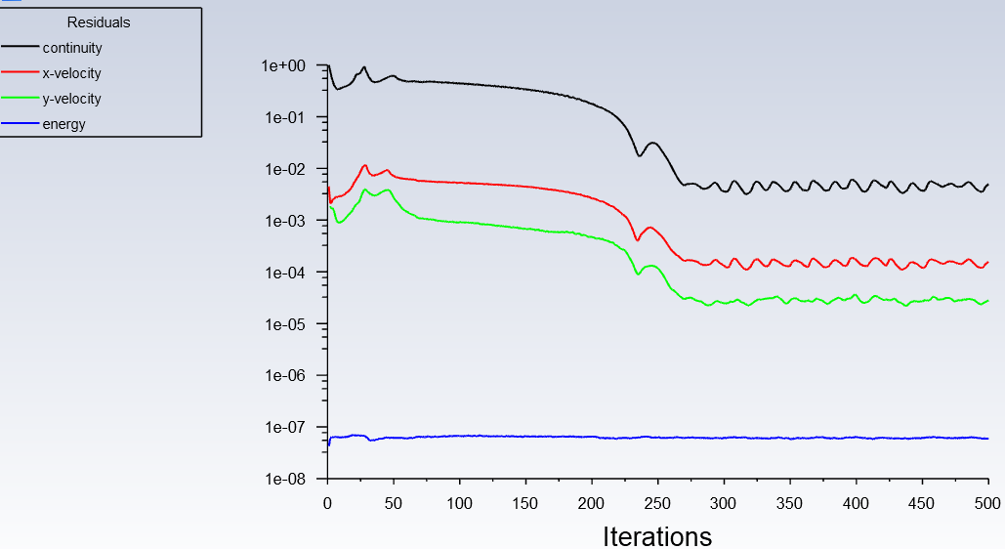
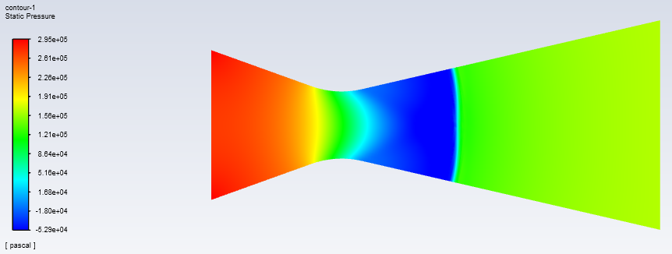
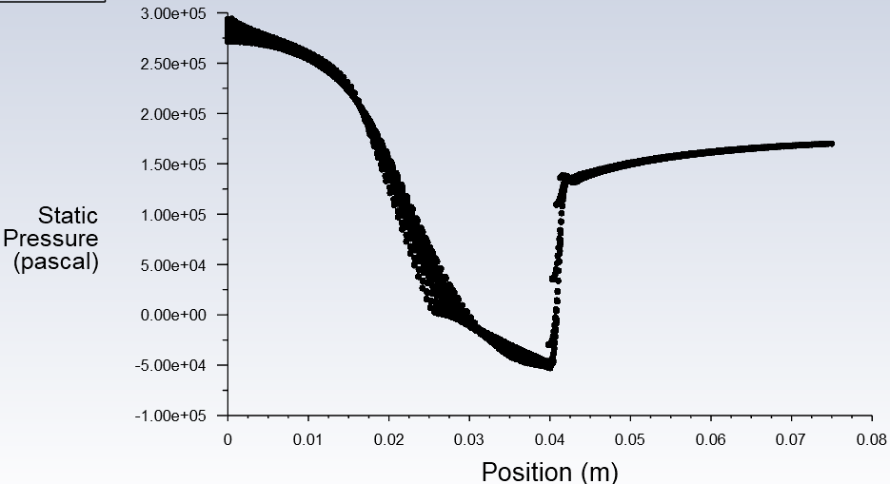

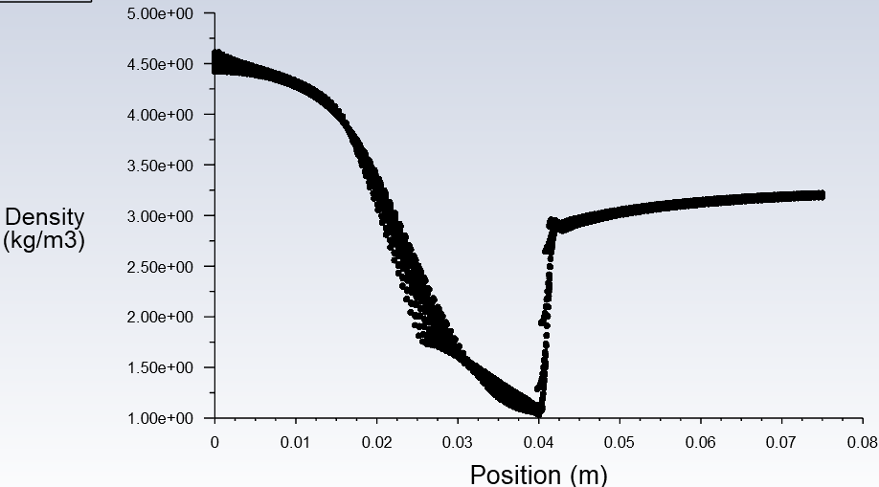
Converging-Diverging Nozzle
Post-Processing
Specifications | Contours | Plots
Mach Number
Static Pressure
Density
Residuals
Outcomes:
Shock observed at 0.04m
Notes:
0.0225

Slide 14
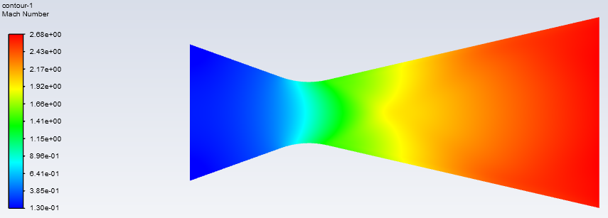
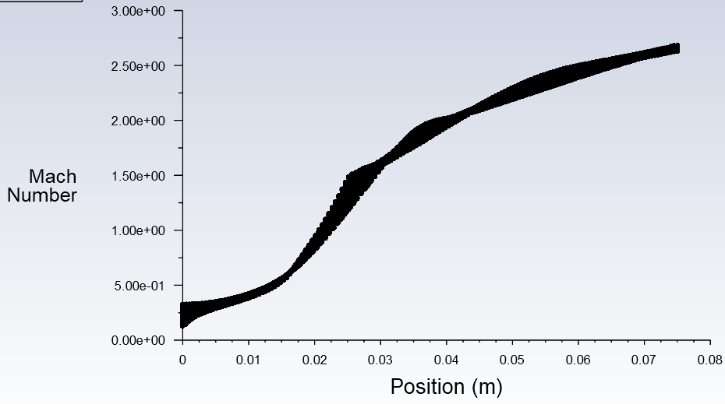
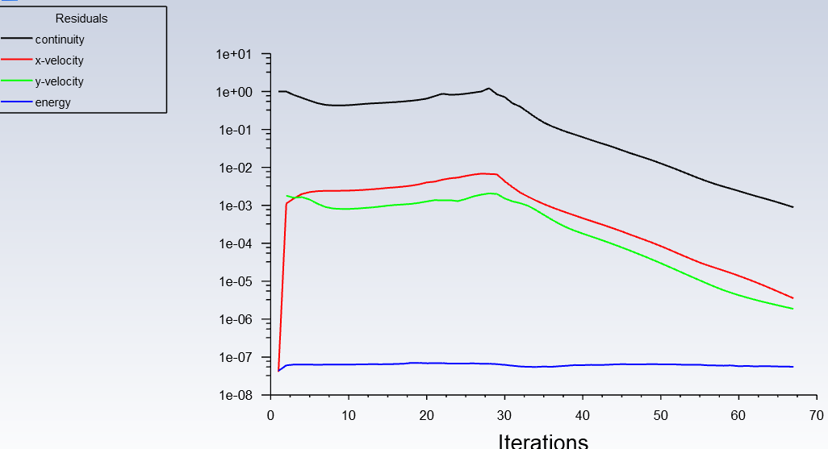
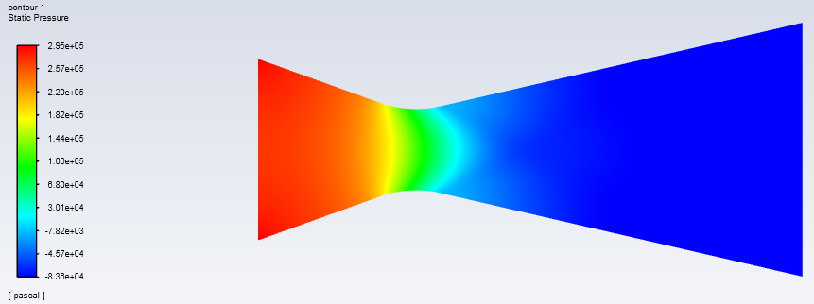
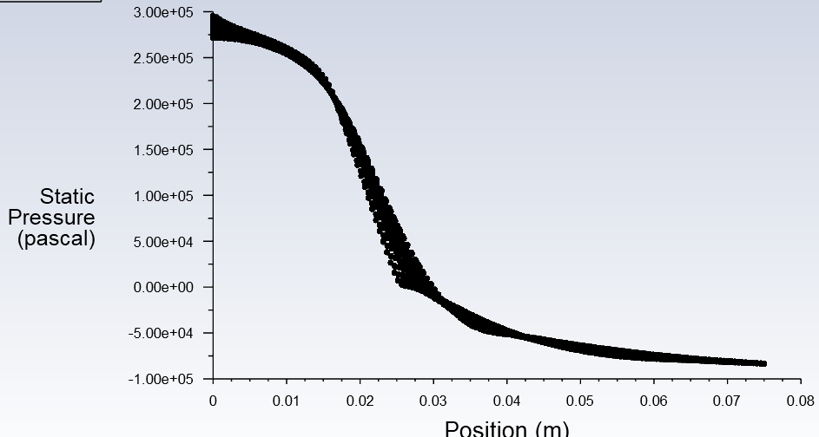
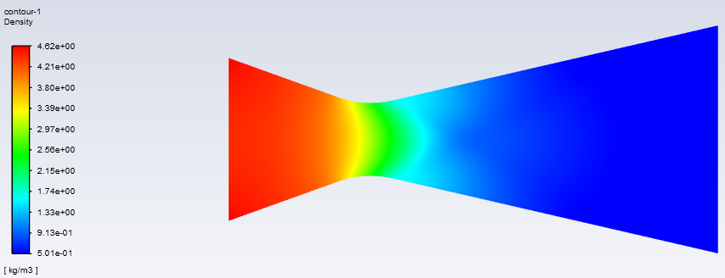
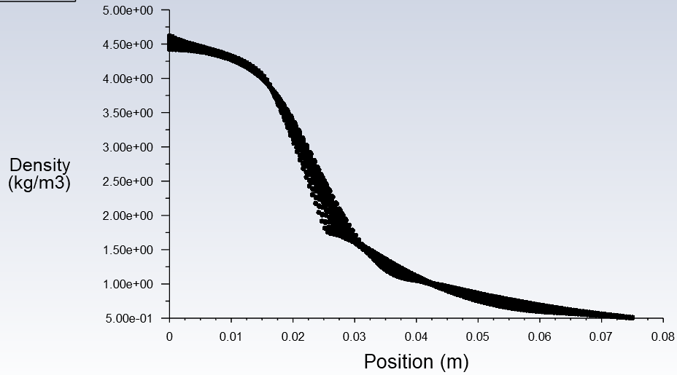
Converging-Diverging Nozzle
Post-Processing
Specifications | Contours | Plots
Mach Number
Static Pressure
Density
Residuals
Outcomes:
Outlet Gauge Pressure set to 0
Convergence at Step 67
No shock formed
Notes:
0.0225

Slide 15
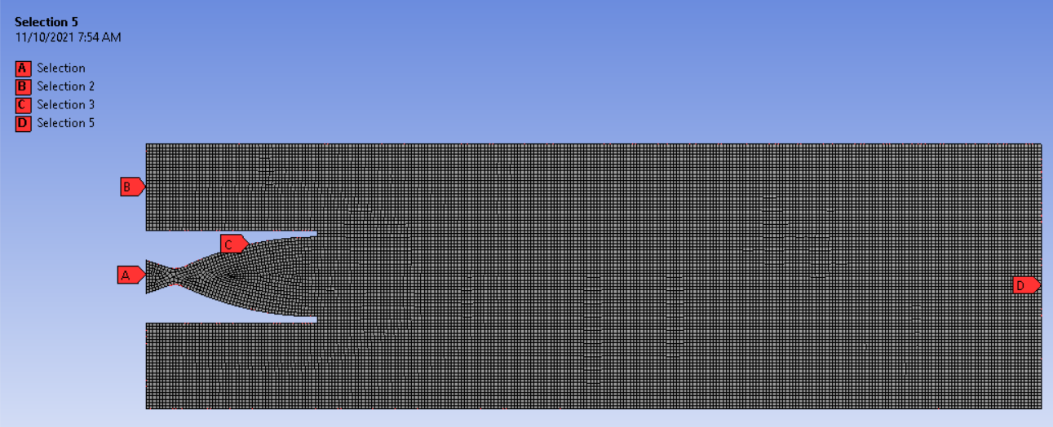
Converging-Diverging Nozzle - Nozzle Expansion
Pre-Processing
Boundary Conditions
Specifications | Details
Solver Type | Density Based
Time | Steady
2D Space | Planar
Model | Energy Eqn. (On)
 | Viscous (Inviscid)
Table: General Specifications
Specifications | Details
Inlet Gauge Pressure (Pa) | 7e6
Inlet Temperature (K) | 300
Outlet Gauge Pressure (Pa) | 0
Outlet Temperature (K) | 273
Specifications | Details
Density (kg/m³) | Ideal Gas
Cp (J/kg-K) | 1006.43
Molecular Weight (kg/kmol) | 28.966
Table: Material Specifications
Table: Boundary Conditions

Slide 16
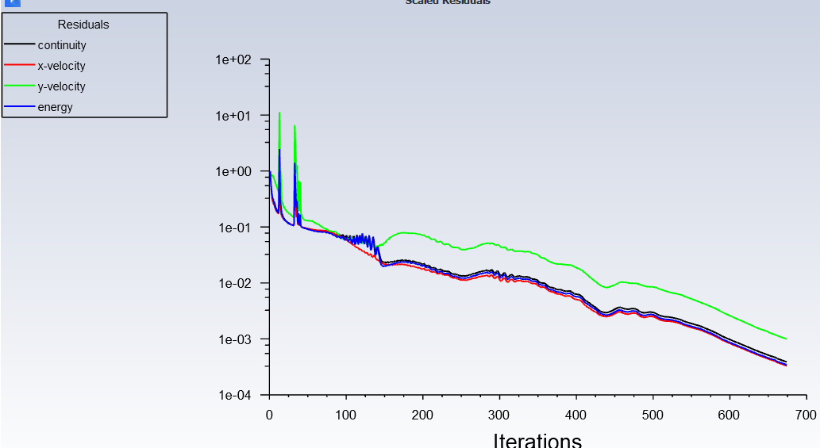
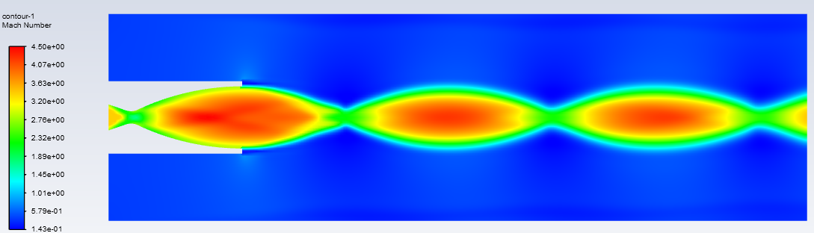
Converging-Diverging Nozzle - Nozzle Expansion
Post-Processing
Residuals
Specifications | Contours
Mach Number
Outcomes:
P<P_{atm}
Over-Expanded Nozzle
Convergence at Step 674
Shortcoming:
Couldn’t analyse other type of expansions
Notes:
0.0225

Slide 17
Supersonic Ramjet Design
Supersonic Inlet
Supersonic to Subsonic
Diffuser
Subsonic to Supersonic
C-D Nozzle
Supersonic Exhaust

Slide 18
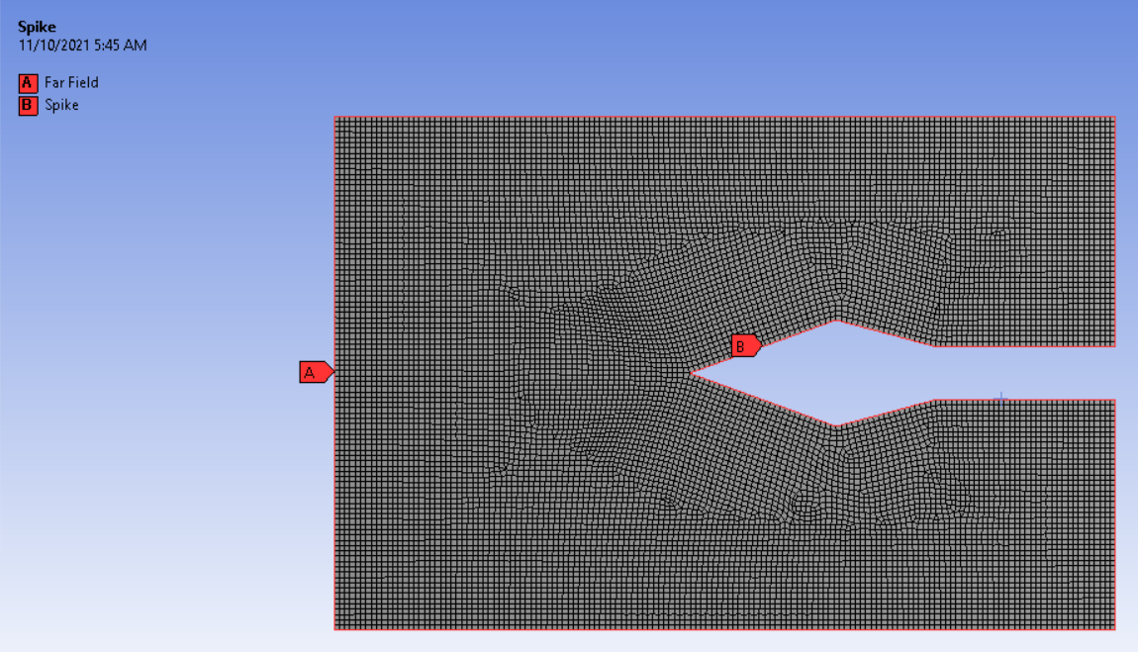
Supersonic Jet Engine - Spike Intake
Pre-Processing
Boundary Conditions
Specifications | Details
Solver Type | Density Based
Time | Steady
2D Space | Planar
Model | Energy Eqn. (On)
 | Viscous (Inviscid)
Table: General Specifications
Specifications | Details
Density (kg/m³) | Ideal Gas
Cp (J/kg-K) | 1006.43
Molecular Weight (kg/kmol) | 28.966
Specifications | Details
Pressure-Far Field
Gauge Pressure (Pa) | 0
Mach Number | 1
Table: Material Specifications
Table: Boundary Conditions

Slide 19
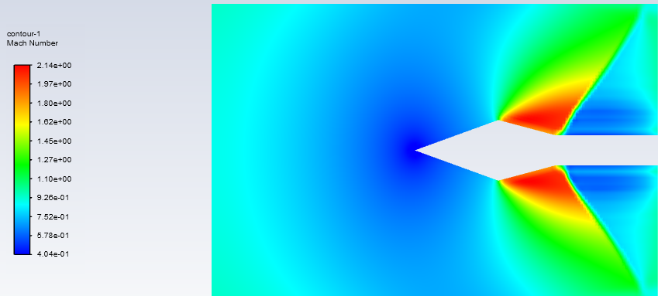
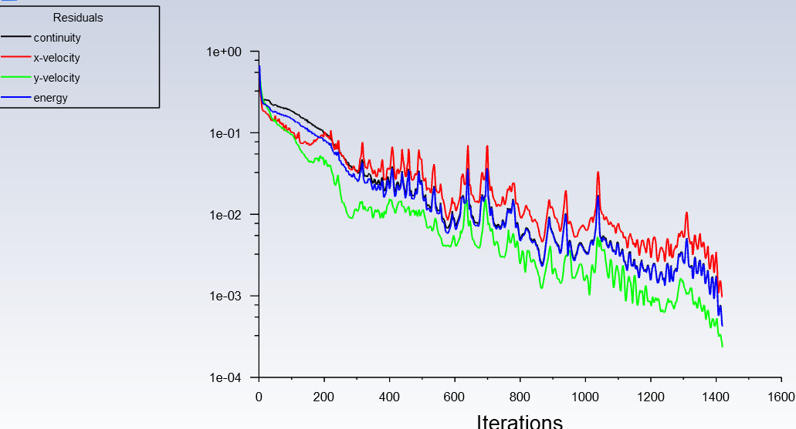
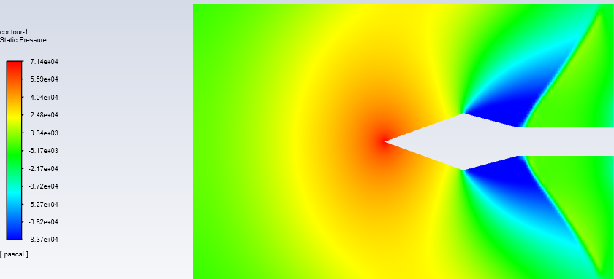
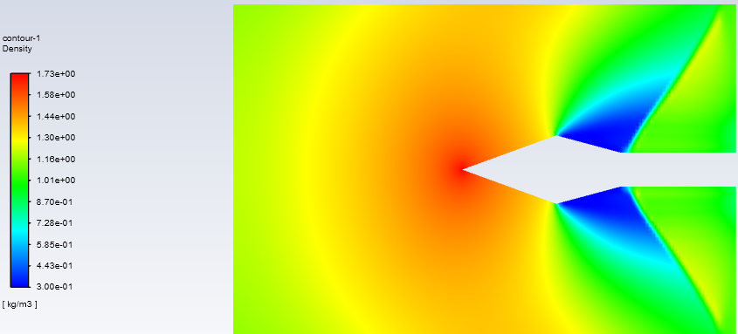
Supersonic Jet Engine - Spike Intake
Post-Processing
Specifications | Contours
Mach Number
Static Pressure
Density
Residuals
Outcomes:
Mach Number = 1
Convergence at Step 1418
Notes:
0.0225

Slide 20




Supersonic Jet Engine - Spike Intake
Post-Processing
Specifications | Contours
Mach Number
Static Pressure
Density
Residuals
Outcomes:
Mach Number = 2
Convergence at Step 212
Notes:
0.0225

Slide 21




Supersonic Jet Engine - Spike Intake
Post-Processing
Specifications | Contours
Mach Number
Static Pressure
Density
Residuals
Outcomes:
Mach Number = 3
Convergence at Step 115
Notes:
0.0225

Slide 22

Supersonic Jet Engine - Spike Intake
Pre-Processing
Boundary Conditions
Specifications | Details
Solver Type | Density Based
Time | Steady
2D Space | Planar
Model | Energy Eqn. (On)
 | Viscous (Inviscid)
Table: General Specifications
Specifications | Details
Density (kg/m³) | Ideal Gas
Cp (J/kg-K) | 1006.43
Molecular Weight (kg/kmol) | 28.966
Specifications | Details
Pressure-Far Field
Gauge Pressure (Pa) | 0
Mach Number | 2
Table: Material Specifications
Table: Boundary Conditions

Slide 23


Supersonic Jet Engine - Spike Intake
Post-Processing
Residuals
Specifications | Contours
Mach Number
Outcomes:
Convergence at Step 806
Notes:
0.0225

