Slide 1
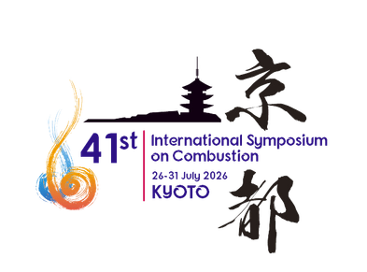


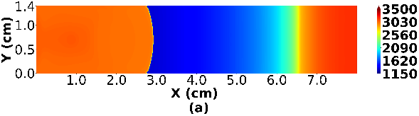
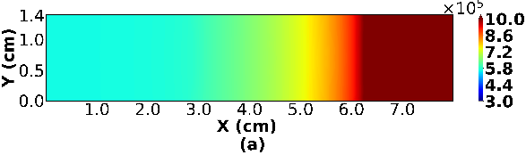
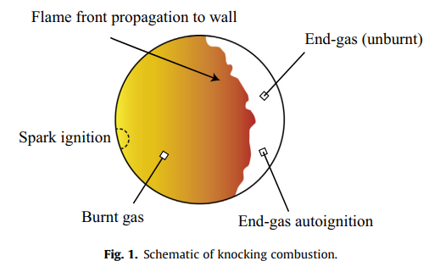
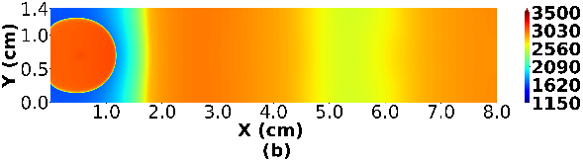
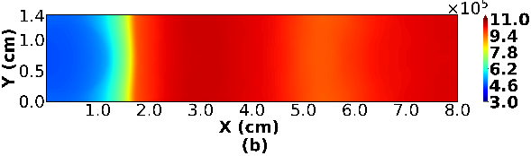
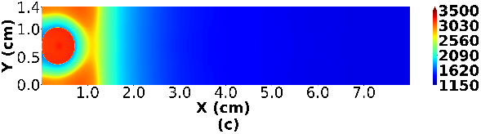
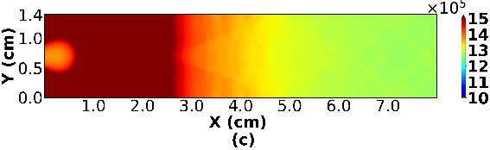
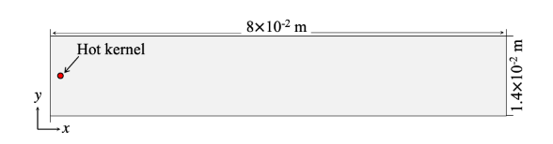
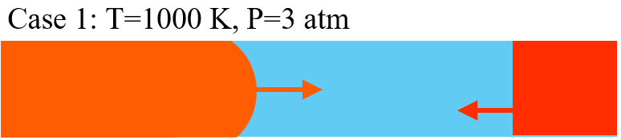
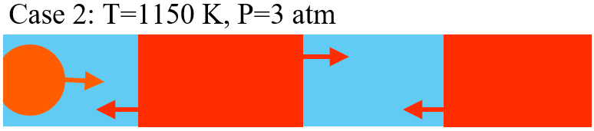
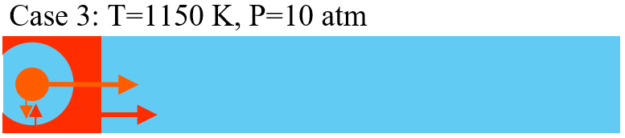




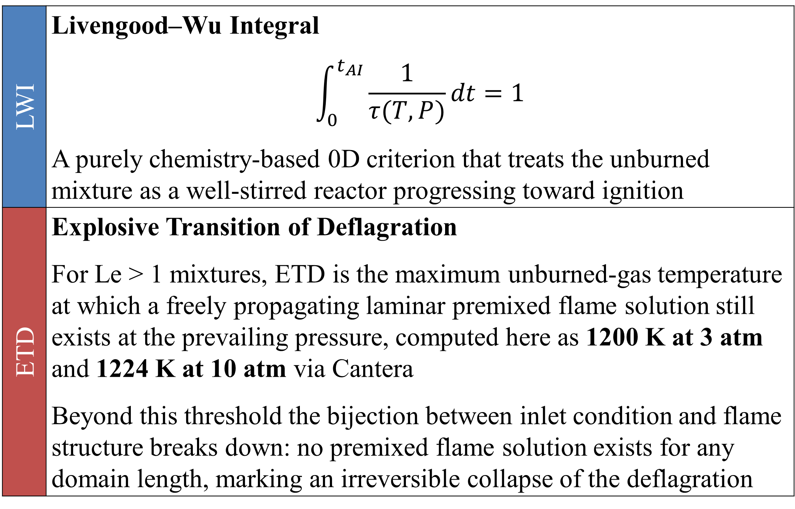




Evaluating Simple Models for AI Timing and Mode Prediction of n-heptane with 2D DNS
Arjav Jainª, Shreyam Bansalª, Arnab Gangulyª, Ajit Kumar Dubey^{a,*}, Youhi Morii^{b, †}, Kaoru Maruta^{b, †}
ªMechanical and Industrial Engineering Department, Indian Institute of Technology Roorkee, Uttarakhand, India, ^{b}Institute of Fluid Science, Tohoku University, Sendai, † Visiting Professor, CARES, University of Cambridge, Singapore
Paper # 2086
*ajit.Dubey@me.iitr.ac.in
Colloquium #2 - Fundamental Processes: Flame Dynamics & Transport Processes
Introduction & Objectives
Temperature (left) & Pressure (right) Profiles
$ξ$ vs AI Wave Speed
Introduction and Objectives
Classical Livengood–Wu Integral (LWI) [1] used to predict knock timing, monitors ignition chemistry progress alone and struggles with high-compression engines, NTC fuels, and multi-stage ignition
Zel’dovich [2] first showed that reactivity gradients can produce distinct autoignition modes through the propagation of AI fronts
Bradley and co-workers [3] proposed the detonation peninsula, which relates autoignition modes to the normalized temperature gradient ($ξ$) and the ratio of acoustic to excitation times (ϵ)
Prior 1D DNS [4] works captured knocking sequences but could not simulate flame wrinkling and multi-dimensional acoustic waves
This study investigates simple models for the prediction of knock timing and the characterization of autoignition modes using 2D-DNS of stoichiometric n-C7H16/O2/Ar mixtures
The most probable (mode) $ξ$ correlates well with observed AI wave speeds via a hyperbolic relationship. The zone-averaged $ξ$ fails: high- $ξ$ outliers (large T-gradient regions) skew the mean, giving inverse and physically incorrect trends
Engine knock occurs when end-gas auto-
ignites ahead of the spark-ignited (SI) flame,
causing reduced performance, increased
emissions, and potential engine damage
Zone 1
Zone 2
Zone 1
Zone 2
$ξ$ cannot reliably interpret (i) AI waves propagating through significant temperature gradients, or (ii) waves arising from merging
of initial AI fronts. In 3D scenarios, correlation may weaken further
Knock Onset Models: ETD vs LWI
LWI | Livengood–Wu Integral $$\int_{0}^{t_{AI}}{\frac{1}{τ(T,P)}dt=1}$$ A purely chemistry-based 0D criterion that treats the unburned mixture as a well-stirred reactor progressing toward ignition
ETD | Explosive Transition of Deflagration For Le > 1 mixtures, ETD is the maximum unburned-gas temperature at which a freely propagating laminar premixed flame solution still exists at the prevailing pressure, computed here as 1200 K at 3 atm and 1224 K at 10 atm via Cantera Beyond this threshold the bijection between inlet condition and flame structure breaks down: no premixed flame solution exists for any domain length, marking an irreversible collapse of the deflagration
Conclusion
ETD provides a physically meaningful transition criterion rooted in the flame-autoignition relationship, superior to chemistry-only LWI
The mode (most probable) $ξ$ evaluated at ETD or LWI timing correlates well with observed AI wave speeds via a hyperbolic relationship. Zone-averaged $ξ$ does not
The unified ETD- $ξ$ workflow enables swift analysis of massive SI-knock DNS, extensible toward SACI/SI knock-intensity prediction
$ξ$ limitations remain for AI waves in strong T-gradient regions or post-merging fronts. Extension to turbulent, 3D SI engine DNS is the next frontier
Research Gap :- 2D/3D DNS of knocking combustion generates vast data but lack a unified, physics-based workflow for swift knock-onset identification and autoignition mode classification
Numerical Method
ETD corresponds to the transition from flame dominated process to autoignition dominated process i.e. the point at which SI flame can no longer maintain classical premixed structure. In NTC fuels and high-CR engines, LWI degrades; ETD is physically grounded
The reactive compressible flow simulations were performed using the PeleC set of codes coupled with AMReX
The maximum AMR level was set to 3 i.e. the minimum mesh size of 3.90625 × 10⁻⁶ m. The timestep is controlled by a CFL number of 0.4
MACKS chemical kinetics solver was employed along with a reduced chemical mechanism derived from the SIP engine project in Japan
Proposed ETD- $ξ$ Workflow
Monitor T & P history in end-gas region
Phase 1: flame-dominated compression
Detect ETD (or LWI = 1) timing
Phase 1 → Phase 2 transition
Compute $ξ$ distribution in end-gas at ETD/LWI
PDF analysis: extract mode value
Compute ξ distribution in end-gas at ETD/LWI
PDF analysis: extract mode value
Mode $ξ$ → predict AI wave mode & speed
$ξ$ < 1: supersonic deflagration confirmed
Mode ξ → predict AI wave mode & speed
ξ < 1: supersonic deflagration confirmed
Auto-ignition Mode Prediction
Zel’dovich’s Spontaneous Ignition Front Speed
$$S_{sp}={\left|∇τ_{ig}\right|}^{−1}$$
Zel’dovich’s Spontaneous Ignition Front Speed
𝑆_𝑠𝑝=|∇𝜏_𝑖𝑔 |^(−1)
Normalized Temperature Gradient
$$ξ=\frac{a}{S_{sp}}$$
Normalized Temperature Gradient
𝜉=𝑎/𝑆_𝑠𝑝
$ξ=0$ : Homogenous ignition
𝜉=0 : Homogenous ignition
$ξ<1$ : Supersonic Deflagration
𝜉<1 : Supersonic Deflagration
Sankaran Number
$$Sa=β\frac{S_{L}}{S_{sp}}$$
Sankaran Number
𝑆𝑎=𝛽 𝑆_𝐿/𝑆_𝑠𝑝
$Sa<1$ : Strong ignition
𝑆𝑎<1 : Strong ignition
$Sa>1$ : Weak ignition/Deflagration
𝑆𝑎>1 : Weak ignition/Deflagration
$ξ≈O(1−10)$ : Detonation
𝜉≈𝑂(1−10) : Detonation
$ξ≈O(100)$ : Deflagration
𝜉≈𝑂(100) : Deflagration
Case 1: 1000 K, 3 atm | End-gas AI due to compression-wave reflection from the end-walls
Case 1: 1150 K, 3 atm | 2 AI zones due to pressure-wave reflections from end walls and side wall
Case 1: 1150 K, 10 atm | AI regions at corners near SI flame front due to transverse pressure waves
ξ evaluated across the entire end-gas region (excluding SI flame zone) at ETD timing. Mode (most probable) ξ < 1 for all cases → supersonic deflagration predicted throughout
Low Sa throughout the region (<<1), also indicates a predominance of strong, homogeneous ignition rather than a single localized hotspot early in the knocking process
Key References
Key Observation (vs 1D) :- In 2D DNS, pressure-wave effects are weaker than in 1D studies due to multidirectional propagation & interference. AI near flame front results from constructive wave interference rather than preheat-zone ignition
[1] J.C. Livengood, P.C. Wu, Correlation of auto-ignition phenomena in internal combustion engines and rapid compression machines, Proc. Combust. Inst. 5 (1955) 347–356.
[2] Y.B. Zeldovich, Regime classification of an exothermic reaction with nonuniform initial conditions, Combust. Flame 39 (1980) 211–214.
[3] X.J. Gu, D.R. Emerson, D. Bradley, Modes of reaction front propagation from hot spots, Combust. Flame 133 (2003) 63–74.
[4] J. Pan, H. Wei, G. Shu, R. Chen, Effect of pressure wave disturbance on auto-ignition mode transition and knocking intensity under enclosed conditions, Combust. Flame 185 (2017) 63–74.
[5] Y. Morii, A. K. Dubey, H. Nakamura, K. Maruta, Two-dimensional laboratory-scale DNS for knocking experiment using n-heptane at engine-like condition, Combust. Flame 223 (2021) 330–336.
[6] Y. Morii, A. Tsunoda, A. K. Dubey, K. Maruta, Analysis of knock onset based on two-dimensional direct numerical simulation and theory of explosive transition of deflagration, Phys. Fluids 35 (2023) 083604.
Indian Institute of Technology Roorkee
Tohoku University
This work was supported by a collaborative project between IFS, Tohoku University, and IIT Roorkee, with project code CX02SEP23. This research (with acronym HYCOMBS) is part of the CREATE Thematic Programme in Decarbonisation and is partially supported by the National Research Foundation, Prime Minister's Office, Singapore under its Campus for Research Excellence and Technological Enterprise (CREATE) programme

