Slide 1





The 41st International Symposium on Combustion
Kyoto, Japan 26-31 July 2026
Paper #2086
Evaluating Simple Models for Knock Timing and
Autoignition-Mode Prediction with 2D DNS of
n-Heptane in an Enclosure
A unified ETD–ξ diagnostic pathway connecting spark-ignited flame propagation,
end-gas compression and knock onset in spark-ignition engines
Arjav Jain ¹ • Shreyam Bansal ¹ • Arnab Ganguly ¹ • Ajit Kumar Dubey * ¹ • Youhi Morii ² • Kaoru Maruta ²
¹Department of mechanical & industrial engineering, Indian Institute Of Technology Roorkee, Roorkee India
²Institute of Fluid Science, Tohoku University, Sendai, Japan

Slide 2
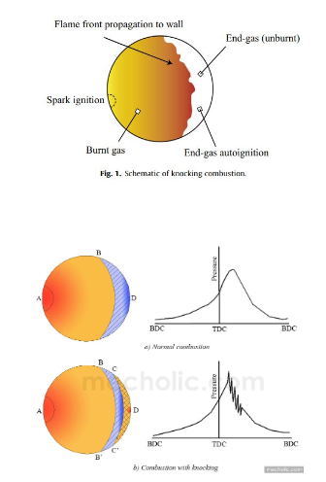
01 / MOTIVATION
Engine Knock: The Barrier to Efficient SI Engines
▸ Knock limits high-efficiency, downsized spark-ignition (SI) engines
  – End-gas autoignites before the spark flame arrives → high-amplitude pressure waves
  – Damage: piston-crown melting, bore scuffing, head erosion; loss of power & efficiency
▸ Existing predictive models are incomplete
  – Livengood–Wu Integral (LWI) tracks ignition chemistry only; fails for high compression, NTC fuels & two-stage ignition
  – Zel'dovich / Bradley diagrams classify autoignition modes but need a single well-defined hot-spot of known radius
▸ Why multi-dimensional DNS is needed
  – 1D DNS cannot capture flame wrinkling or oblique pressure-wave reflections that set the end-gas state
  – 2D/3D DNS is faithful but generates massive data → demands simple, physics-based post-processing metrics
End-Gas Autoignition in n-Heptane • ETD–ξ Framework for Knock in 2D DNS
2

Slide 3
02 / OBJECTIVES & NOVELTY
Research Goal and Key Contribution
Objectives
Novelty & Significance
▸ Perform 2D DNS of the complete knock sequence — spark ignition → end-gas compression → knock onset
▸ Capture the three canonical autoignition modes by varying initial temperature and pressure
▸ Test simple models for the phase-1→phase-2 transition (knock timing): LWI vs. ETD
▸ Use reactivity-gradient metrics (ξ, Sa) to predict autoignition modes & wave speeds
▸ Deliver a tractable analysis workflow that collapses huge DNS data to a few physical metrics
▸ Predicting knock requires the autoignition–flame relationship, not ignition progress alone
▸ First unified ETD–ξ framework to interpret BOTH knock timing AND autoignition modes from multi-dimensional SI-knock DNS
▸ ETD marks the physically-grounded transition from a flame-dominated to an autoignition-dominated regime
▸ The mode of the ξ-distribution (not the mean) predicts autoignition wave speed
End-Gas Autoignition in n-Heptane • ETD–ξ Framework for Knock in 2D DNS
3

Slide 4
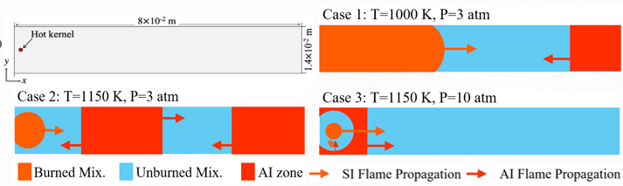
03 / NUMERICAL METHODOLOGY
2D DNS Setup, Solver and Test Matrix
▸ Configuration
  – Rectangular enclosure 8.0 × 1.4 cm; no-slip, adiabatic walls
  – Homogeneous stoichiometric n-C₇H₁₆ / O₂ / Ar (1.00 : 11.00 : 41.382)
  – Ignition kernel: 1400 K, Ø 0.1 cm at (x=0.25, y=0.7) cm; error-function profile
▸ Solver & chemistry
  – PeleC compressible reacting Navier–Stokes, finite-volume Godunov + HLLC Riemann solver (shock-capturing)
  – Adaptive mesh refinement (AMReX), 3 levels → Δxmin = 3.9 µm; CFL = 0.4
  – MACKS stiff-kinetics solver with reduced SIP gasoline-surrogate mechanism
▸ ETD & flame-speed inputs computed in Cantera
Test matrix — three thermochemical cases
Case
T₀ (K)
P₀ (atm)
Autoignition mode
1
1000
3
single zone,
near end wall
2
1150
3
two zones: end-wall
+ ahead of flame
3
1150
10
corner zones near
ignition kernel
Key computed inputs
• ETD limit: 1200 K @ 3 atm, 1224 K @ 10 atm
• Conditions chosen beyond NTC / low-T chemistry
• Argon dilution simplifies chemistry & raises flame speed to cut cost
End-Gas Autoignition in n-Heptane • ETD–ξ Framework for Knock in 2D DNS
4

Slide 5
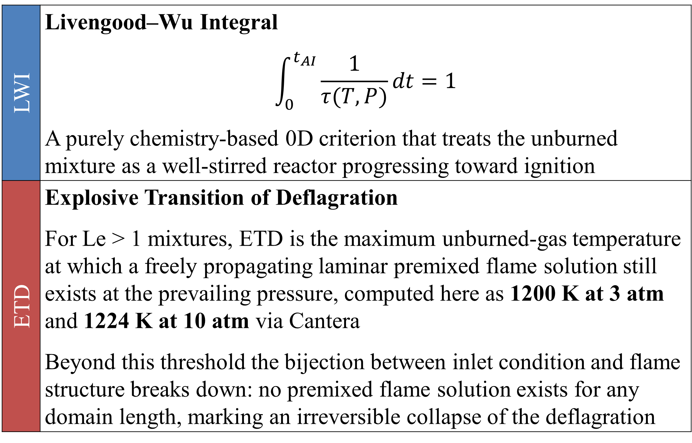
04 / KNOCK-TIMING CRITERIA
Two Models for the Flame → Autoignition Transition
▸ The transition matters
  – Phase 1: flame compresses end-gas (track T, P)
  – Phase 2: hot-spots → autoignition waves (track reactivity gradients)
  – Knock timing = peak of dP/dt in the DNS
▸ LWI — chemistry-only, 0D integral = 1 at ignition
  – No information on flame–autoignition coupling
▸ ETD — flame structure ceases to exist
  – Max. unburned-gas T sustaining a laminar premixed flame; for Le>1 the flame solution itself collapses
  – Rooted in the ignition-chemistry ↔ flame relationship → physically meaningful knock onset
End-Gas Autoignition in n-Heptane • ETD–ξ Framework for Knock in 2D DNS
5

Slide 6
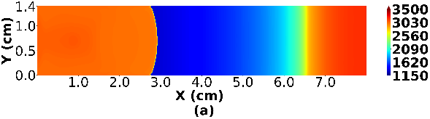
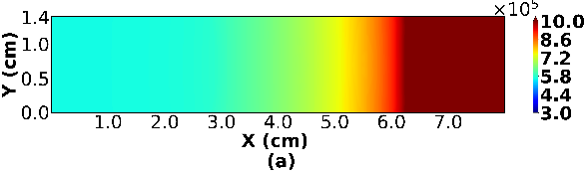
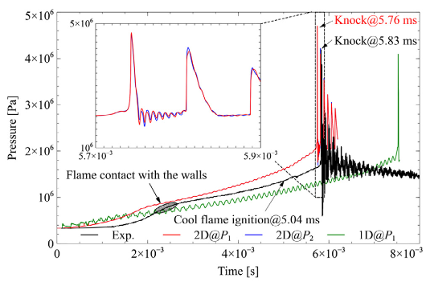
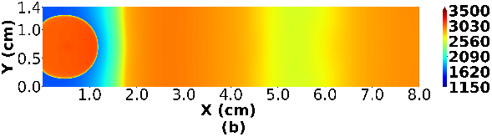
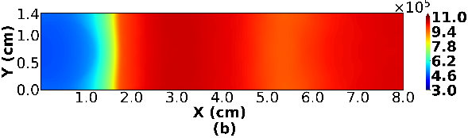
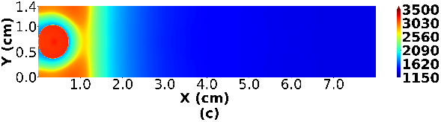
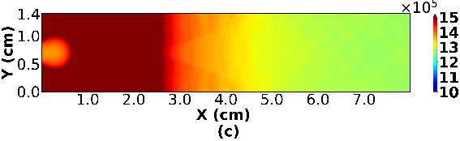
05 / RESULTS — PHYSICS
Three Autoignition Modes Set by Pressure-Wave Reflections
Zone 1
Zone 2
Zone 1
Zone 2
Fig. 4: Pressure history at end gas in one of the reference studies conducted by Morii et al [7] showcasing the difference between 1D, 2D and experimental observations
Fig. 2: Spatial distribution of temperature (left) and pressure (right) near auto-ignition timing for (a) Case 1:
T₀ = 1000K, P₀ = 3 atm, (b) Case 2: T₀ = 1150 K, P₀ = 3 atm, (c) Case 3: T₀ = 1150 K, P₀ = 10 atm. Distinct ignition zones for Case 2 are also shown.
▸ Location set by chamber geometry — pressure waves reflect off all walls
▸ Timing set by flame speed — controls end-gas compression rate
▸ 2D vs 1D differences:
  – oblique waves → weak P/T oscillations (smooth histories)
  – Case-2 zone-2 ignites ahead of — not within — the flame preheat zone
▸ No detonation develops; all cases → supersonic deflagration
Fig. 3: Temperature, pressure, and X-velocity along center lines for (a) Case 1: T₀ = 1000K, P₀ = 3 atm, (b) Case 2:
T₀ = 1150 K, P₀ = 3 atm, and along line connecting ignition kernel center to corner for (c) Case 3: T₀ = 1150 K, P₀ = 10 atm.
End-Gas Autoignition in n-Heptane • ETD–ξ Framework for Knock in 2D DNS
6

Slide 7
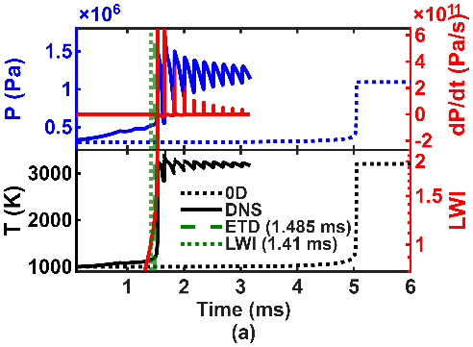
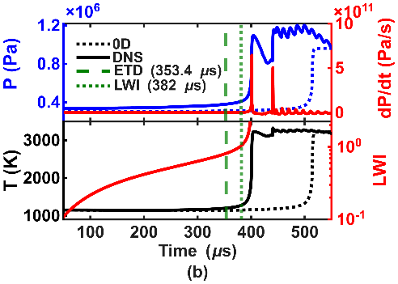
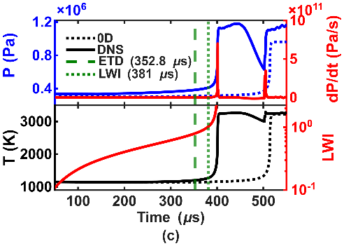
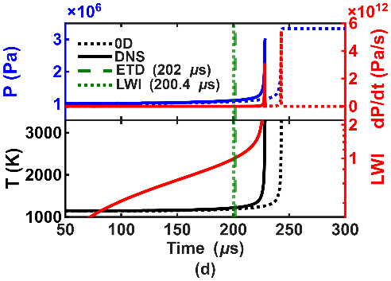
06 / RESULTS — KNOCK TIMING
ETD and LWI Both Bracket the DNS Knock Onset
▸ Autoignition occurs sooner in 2D DNS than in a 0D reactor → flow & pressure-wave effects
▸ Higher T (Case 1→2) and higher P (Case 2→3) advance end-gas autoignition
▸ ETD predicts closest for Cases 1 & 3; LWI closest for Case 2
▸ LWI's apparent accuracy here is conditional — high T₀ gives single-stage ignition & short delays, keeping the end-gas near its initial state
▸ In real engines (NTC, cool flames, long delays) LWI degrades; ETD tracks the actual flame-to-autoignition coupling
Fig. 4: Temporal evolution of pressure (blue), dP/dt (red) and temperature (black), LWI (red) from DNS (solid) and 0D constant-volume reactor (dashed) at the center point of the respective autoignition zones for (a) Case 1: T₀ = 1000K, P₀ = 3 atm, (b) Case 2: T₀ = 1150 K, P₀ = 3 atm, Zone 1, (c) Case 2: T₀ = 1150 K, P₀ = 3 atm, Zone 2, and (d) Case 3: T₀ = 1150 K, P₀ = 10 atm.
End-Gas Autoignition in n-Heptane • ETD–ξ Framework for Knock in 2D DNS
7

Slide 8
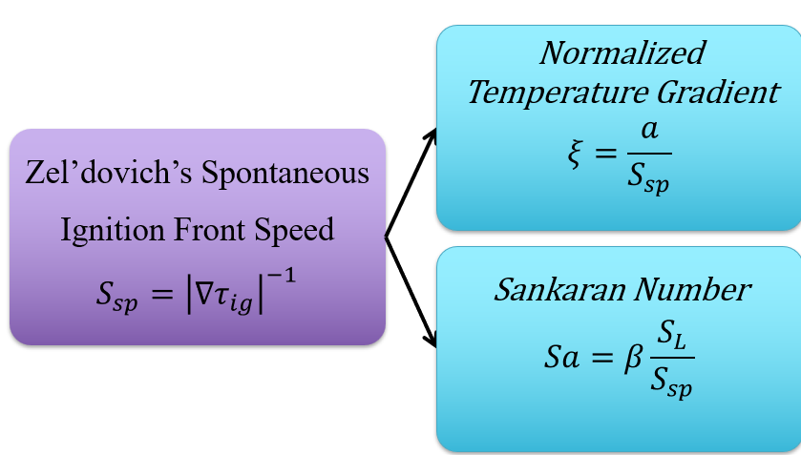
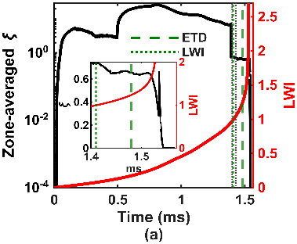
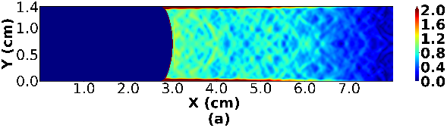
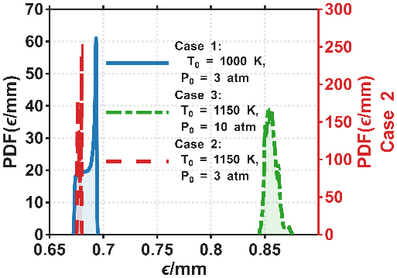
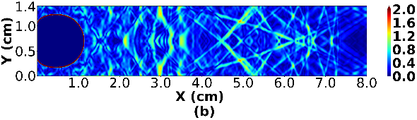
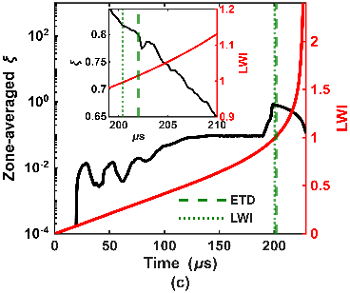
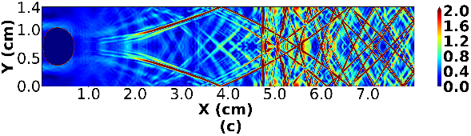
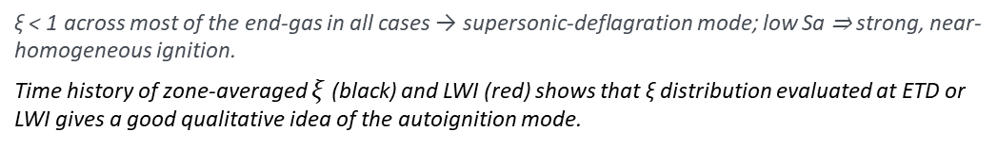
07 / RESULTS — MODE PREDICTION
Reactivity-Gradient (ξ) Distribution at the Transition
Case 1: 1000 K, 3 atm
Case 2: 1150 K, 3 atm
ξ ≈ 0 homogeneous ignition
ξ < 1 supersonic deflagration
ξ ~ O(1–10) detonation
ξ ~ O(100) deflagration
Sa < 1 Strong ignition
Sa > 1 Weak ignition/Deflagration
Evaluated at ETD (or LWI) — the
physically-defined transition time
PDF of energy-release strength ε/mm
Use the mode, not the mean
ξ-distribution is right-skewed; high-ξ outliers from large-T-gradient regions pull the average up
Case 3: 1150 K, 10 atm
ξ < 1 across most of the end-gas in all cases → supersonic-deflagration mode; low Sa ⇒ strong, near-homogeneous ignition.
Time history of zone-averaged $ξ$ (black) and LWI (red) shows that ξ distribution evaluated at ETD or LWI gives a good qualitative idea of the autoignition mode.
End-Gas Autoignition in n-Heptane • ETD–ξ Framework for Knock in 2D DNS
8

Slide 9
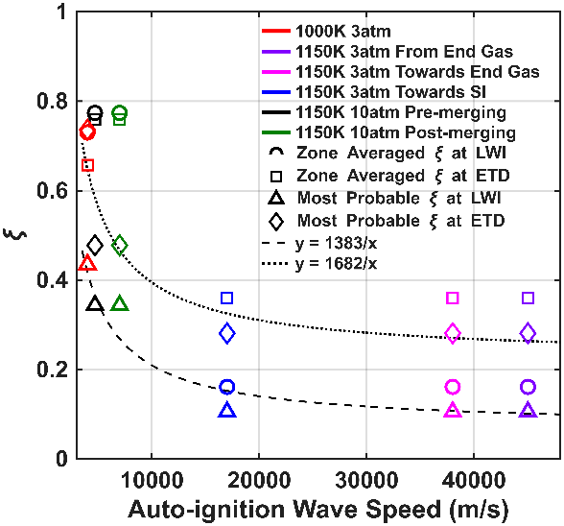
08 / KEY RESULT
Most-Probable ξ Predicts the Autoignition-Wave Speed
▸ AI wave speed increases as the most-probable ξ decreases — a clean hyperbolic correlation (ξ = C/S)
▸ Most-probable ξ ≫ zone-averaged ξ as a predictor; the mean gives inverted, unphysical trends (compare Cases 1 & 3)
▸ Holds whether ξ is read at ETD or LWI (fit marginally better at LWI for these cases)
▸ Limitations of a simple ξ metric:
  – waves crossing strong T-gradient regions, and post-merging waves, fall off the curve
  – expected — ξ is built for single hot-spots in an isothermal background
AI wave speed vs ξ at LWI & ETD timings, with hyperbolic fits ξ = C / S
End-Gas Autoignition in n-Heptane • ETD–ξ Framework for Knock in 2D DNS
9

Slide 10
09 / CONCLUSIONS
A Tractable ETD–ξ Workflow for Knocking-Combustion DNS
Conclusions
Future Work
▸ 2D DNS reproduced the full knock sequence — spark flame → end-gas compression → hot-spots → autoignition — for all three cases
▸ ETD gives a physically-grounded flame→autoignition transition criterion for knock onset, superior to chemistry-only LWI
▸ The mode of the ξ-distribution at ETD/LWI predicts the autoignition-wave speed; all cases evolve as supersonic deflagration
▸ Net result: high-fidelity 2D/3D knock DNS reduced to a few simple, physical metrics — ETD finds the transition, ξ predicts the mode
▸ Simplifications assumed: laminar flame, initial homogeneous mixture, no turbulence, no heat transfer from wall
▸ Extend to turbulent, 3D SI-engine DNS
▸ Test ξ on post-merging waves & strong-gradient regions
▸ Validate LWI–ξ correlation over wider, more complex conditions (NTC, cool flames)
▸ Link the workflow to knock-intensity & SACI prediction
Acknowledgements: IFS Tohoku University – IIT Roorkee collaboration (CX02SEP23); HYCOMBS / CREATE Thematic Programme in Decarbonisation,
NRF Singapore.
Tools: PeleC + AMReX • MACKS • Cantera • reduced SIP gasoline-surrogate mechanism.
End-Gas Autoignition in n-Heptane • ETD–ξ Framework for Knock in 2D DNS
10

