Slide 1
PITCHROOM AI
01 / 06
VOICE-FIRST PITCH REHEARSAL
Every answer,
from the deck.
Approved pitch
Recorded question
A source-grounded, voice-first pitch rehearsal assistant for founder-led startup teams.
Grounded response
Notes:
Source: backend/data/pitch.txt. Cover statement reflects the current prototype description.

Slide 2
PITCHROOM AI
02 / 06
Static decks break under live questions
Pitch decks set a prepared narrative. They do not help founders answer unexpected questions in the room
When a question arrives, founders often choose between:
A live question
Searching across slides
“What is the Series B
valuation?”
The room waits while the founder looks for the approved detail.
Improvising an answer
Pitchroom keeps the answer inside the approved source.
A claim can leave the approved pitch without anyone noticing.
The product declines when the source cannot support an answer.
Notes:
Source: backend/data/pitch.txt; backend/test_app.py. The Series B valuation example is an existing unsupported-answer test case.

Slide 3
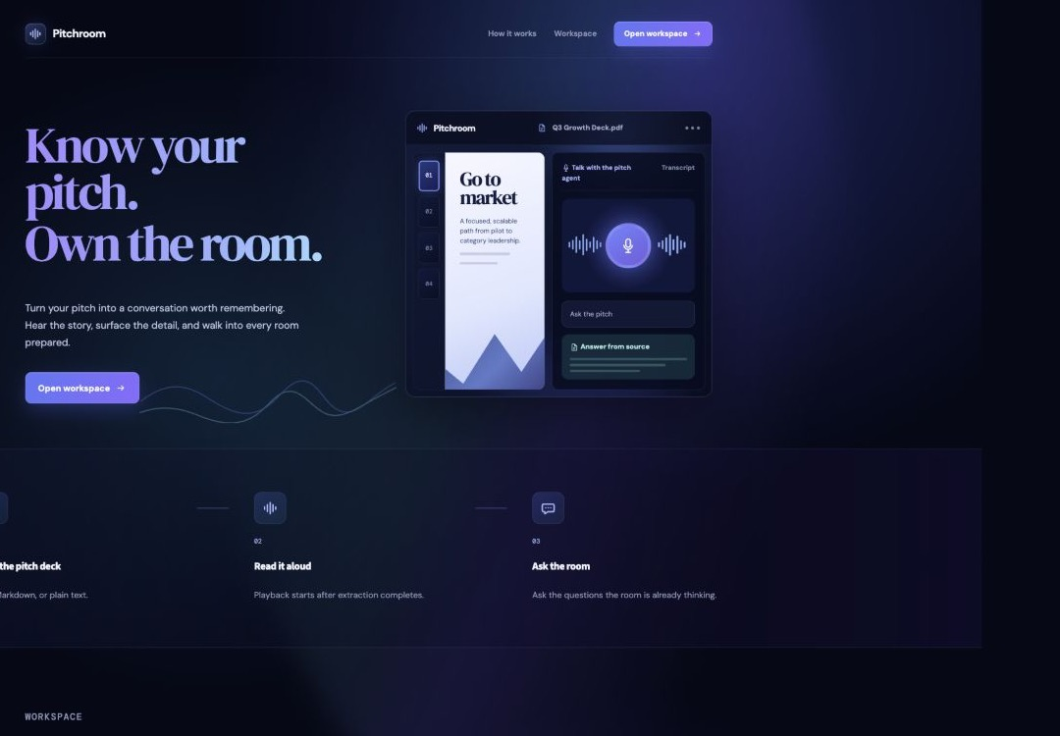
PITCHROOM AI
03 / 06
Recorded-turn voice workflow
Pitchroom turns an approved pitch into a controlled answer loop
01
Load
Use an approved text-based PDF, Markdown file, or plain-text brief.
02
Record
Capture one spoken question in the workspace.
03
Ground
Transcribe the question and select relevant source sections.
04
Speak
Return the source-grounded answer as audio.
Current UI
Document upload and microphone workspace
Current interaction: one recorded question per turn. It is not a continuous real-time conversation.
Notes:
Sources: frontend/app.py, backend/routes/pitch.py, docs/architecture.md, docs/audit/01-live-home.png. Screenshot is a local audit capture of the current UI.

Slide 4
PITCHROOM AI
04 / 06
Trust boundary and current scope
The prototype treats the approved pitch as the answer boundary
Answer behavior
Prototype scope
Relevant source sections
Supported source formats
The service selects matching source chunks before answering.
Selectable text in PDFs, plus Markdown and plain text.
Extractive by default
Demo storage
The current answer path returns source text instead of adding unsupported claims.
The active pitch stays in memory and resets when the service restarts.
Clear decline
Voice setup
When no relevant source supports the question, the response says so.
Transcription and speech need configured providers before a voice demo.
Not yet supported: image-only slides, charts, or scanned documents.
Notes:
Sources: backend/data/pitch.txt; backend/routes/pitch.py; docs/architecture.md; README.md. The slide distinguishes actual current behavior from scope limits.

Slide 5
PITCHROOM AI
05 / 06
A 90-second judge demo
Show the full speech-to-speech loop, then prove that the boundary holds
00:00
Load the demo source
Open the built-in fact sheet and show the transcript as the evidence base.
00:20
Ask the known question
Use: “What problem does Pitchroom AI solve?” Show the grounded answer.
00:45
Record the question
Show transcription, the source-grounded answer, and spoken playback.
01:10
Test the boundary
Ask: “What is the Series B valuation?”
Show the supported decline.
Before presenting: configure Hugging Face transcription and one speech provider.
Notes:
Sources: frontend/app.py, backend/routes/pitch.py, backend/test_app.py, README.md. This is a proposed demo sequence using existing demo controls and tested questions.

Slide 6
PITCHROOM AI
06 / 06
From prototype to trusted workspace
The next build turns one demo source into a durable pitch practice environment
Today
Proposed next build
A single active source
Turn-based voice workflow
Text-first document support
Authenticated workspaces
Versioned pitch sources
Encrypted storage
Visual document understanding
Pitchroom AI
Every answer, from the deck.
Notes:
Sources: backend/data/pitch.txt; docs/architecture.md. The right column is explicitly proposed roadmap work. Authenticated workspaces, versioning, and encrypted storage are named future extensions in the supplied brief; visual document understanding addresses documented current exclusions.

