Slide 1
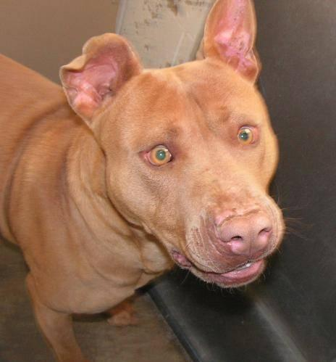
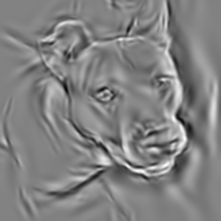
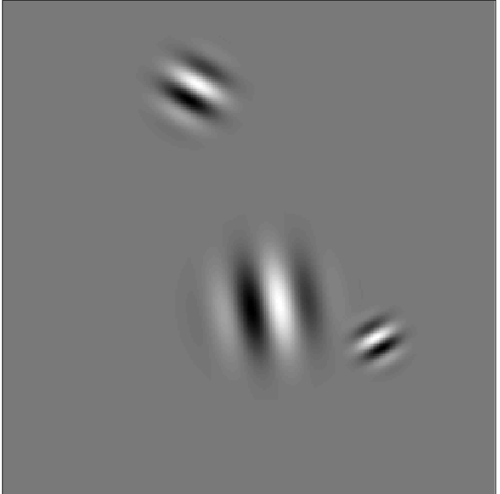
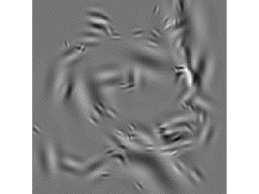
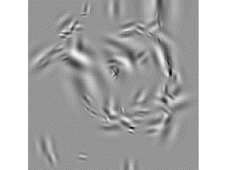
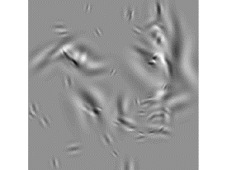
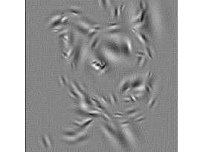
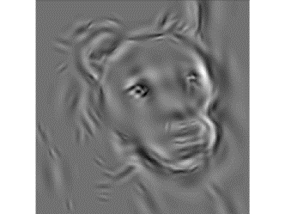
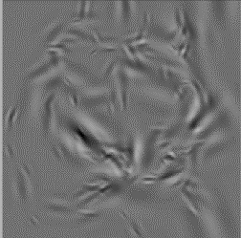
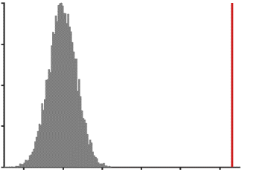
a
original image
1000 features
1 feature =
1 Gabor wavelet
feature presence [ =present]
…
stimuli: 90/1000 randomly selected features
trial 1
trial 2
trial 3
trial 4
recorded data
feature presence
…
…
…
…
behavioral data: image recognized?
yes
no
no
yes
feature diagnosticity index (FDi)
average z-transformed performance for trials containing the feature
b
c
FDi split-half replicability
400
300
null-
distribution
200
count
200
best features
200
worst features
100
observed
r = .086
0
-.02
0
.02
.04
.06
.08
Pearson r

Slide 2
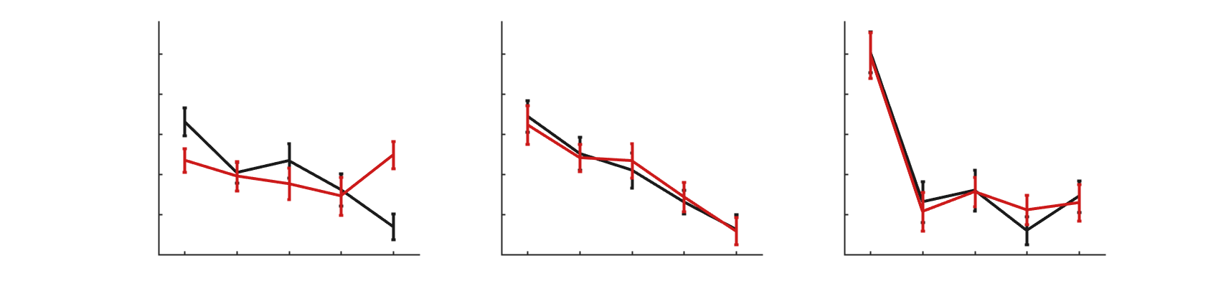
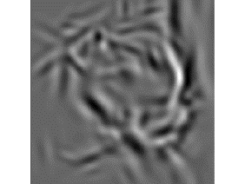
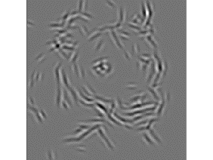
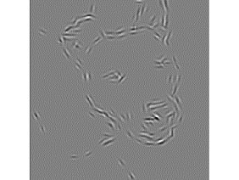
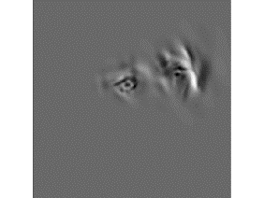
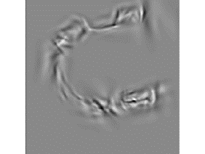
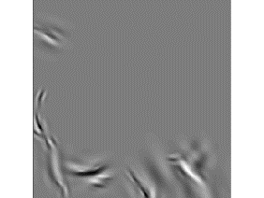
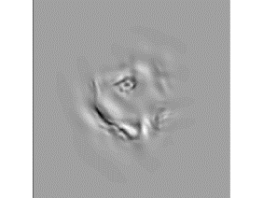
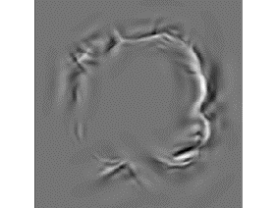
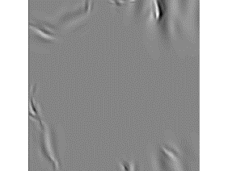
high AQ
low AQ
.03
.02
FDi
.01
0
-.01
-.02
0.24-0.60
0.89-1.21
1.52-2.07
spatial frequency [cycles/dva]
.03
.02
FDi
.01
0
-.01
-.02
0-2.9
5.3-7.3
9.8-18.4
distance from the eyes [dva]
.03
.02
FDi
.01
0
-.01
-.02
0.1-4.6
6.7-8.6
10.6-15.7
distance from image center [dva]

Slide 3
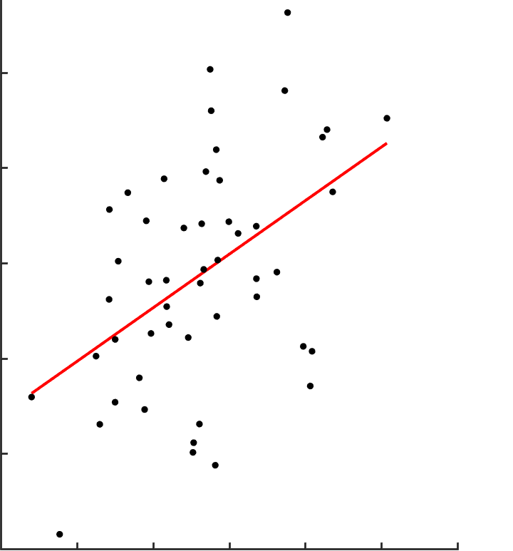
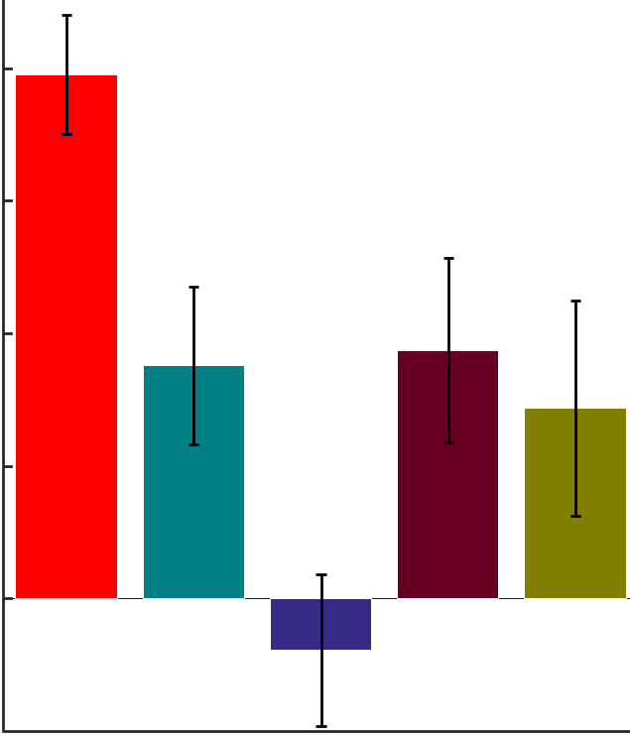
social skill
attention switching
attention to detail
communication
imagination
.004
.008
.003
.004
.002
.002
trait-related reliance on detail increase [linear slope difference]
0
.001
-.002
0
-.004
-.001
-.5
0
.5
1
1.5
2
2.5
trait clinical diagnosticity [log odds ratio]
trait type

