Slide 1
Jpowder Version 2

Slide 2
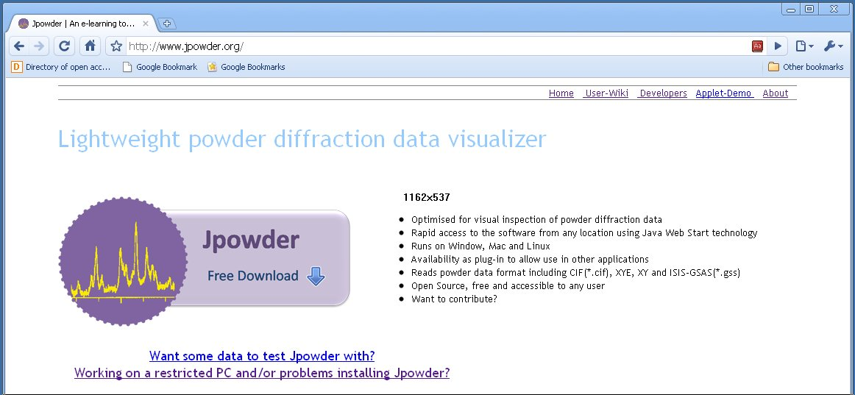
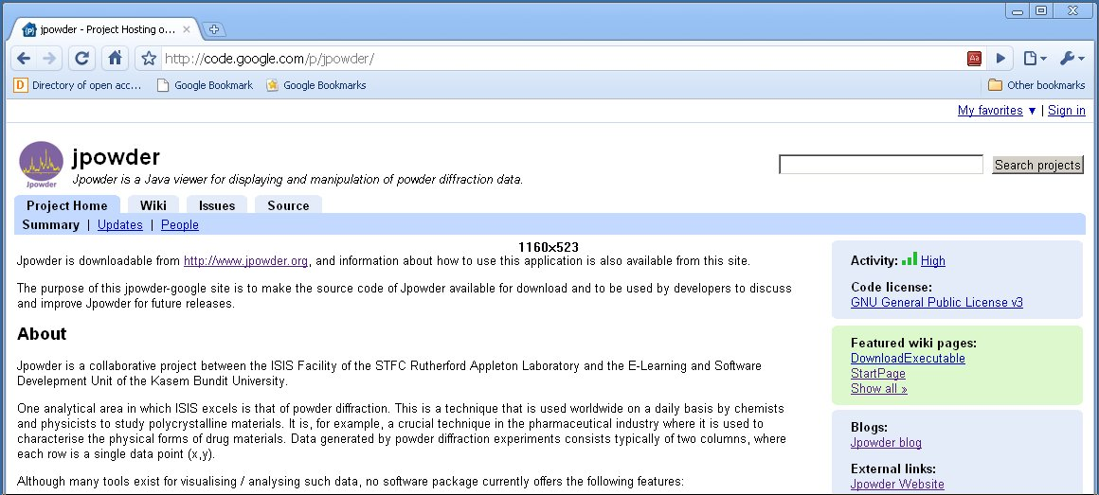

Slide 3
123456789012345678901234567890123456789012345678901234567890
INS BANK 5
INS FPATH1 13.1
INS FPATH2 13.2 DIFC DIFA ZERO
INS FPATH3 13.2
INS FPATH4 13.2
INS FPATH5 13.1
INS HTYPE PNTR
INS 1 ICONS 4680.56 0.36 3.52
INS 1BNKPAR 0.6030 90.00 0.00 .00000 .3000 1 1
INS 1I HEAD PRL10/1 Si (#68420-21) & CeO2 (#68422) 90deg bank
INS 1I ITYP 0 1.000 20.000 2
INS 1PRCF 3 14 0.001000
INS 1PRCF 1 0.221415E+00 0.245100E-01 0.239525E-01 0.000000E+00
INS 1PRCF 2 7.181850E+01 2.416800E+00 0.000000E+00 2.905420E+00
INS 1PRCF 3 0.000000E+00 0.000000E+00 0.000000E+00 0.000000E+00
INS 1PRCF 4 0.000000E+00 0.000000E+00 0.000000E+00 0.000000E+00
INS 2 ICONS 1712.77 4.23 -5.94
INS 2BNKPAR 0.6000 30.00 0.00 .00000 .3000 1 1
INS 2I HEAD PRL10/1 Y2O3 (#68432-35) - module #5
INS 2I ITYP 0 1.000 20.000 2
INS 2PRCF 3 14 0.001000
t = ZERO + DIFC*d + DIFA*d^2
2theta
L?
d = 1.977E-3 * t(micro-sec)/(L(m)*sin(theta))
DIFC = L*sin(theta)/1.977E-3 = 0.603*sin(45*pi/180)/1.977E-3 = 215.6729

Slide 4
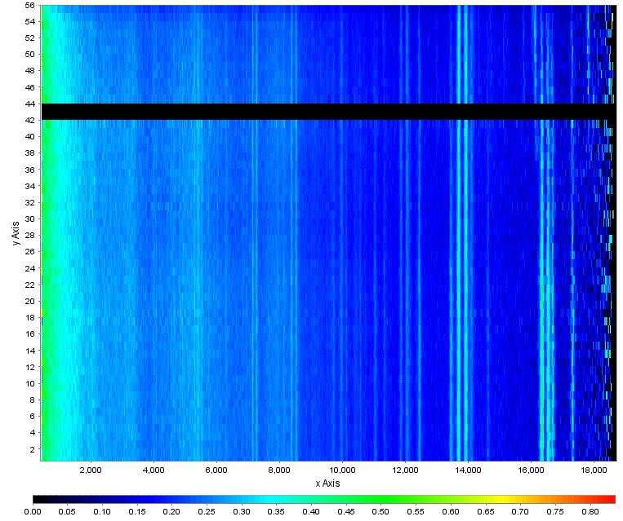

Slide 5
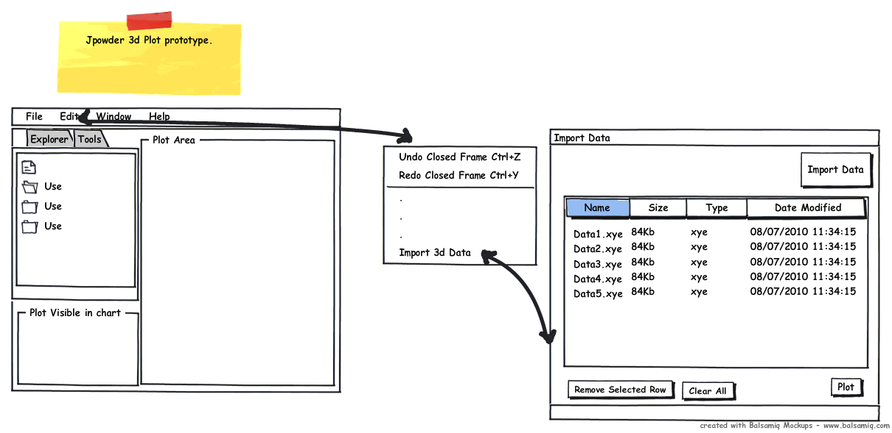
3D Design Layout
Importing Data into the a Table sorted and then get the plot.

Slide 6
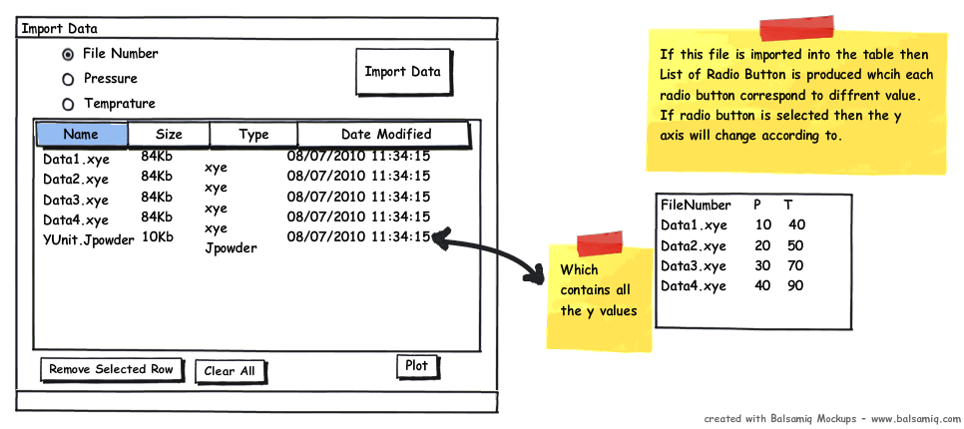
Reading Jpowder Meta-file
If meta-file is present then a list of radio buttons appears which enable user to change the Y axis’s Unit.

