Slide 1
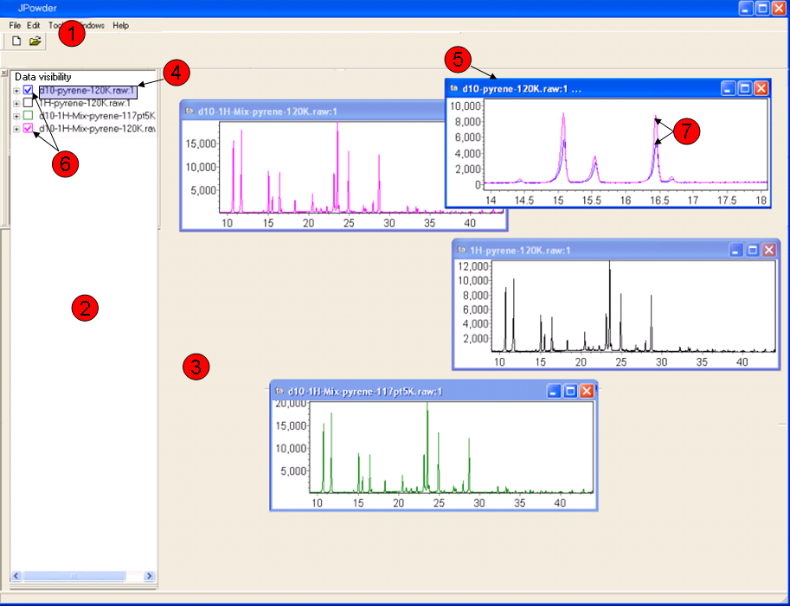
1
5
4
7
6
2
3

Slide 2
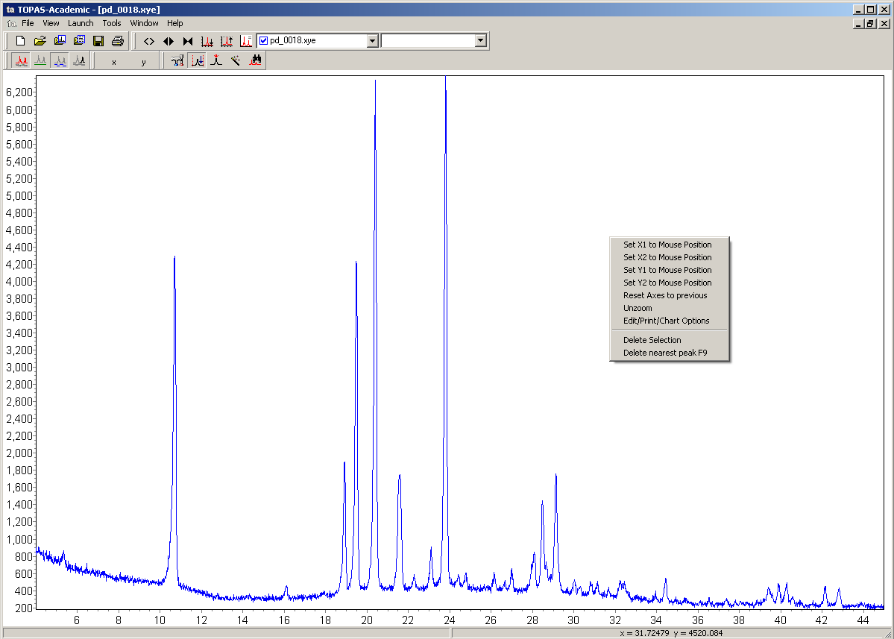
Screen shot of Topas illustrating the right-click menu.

Slide 3
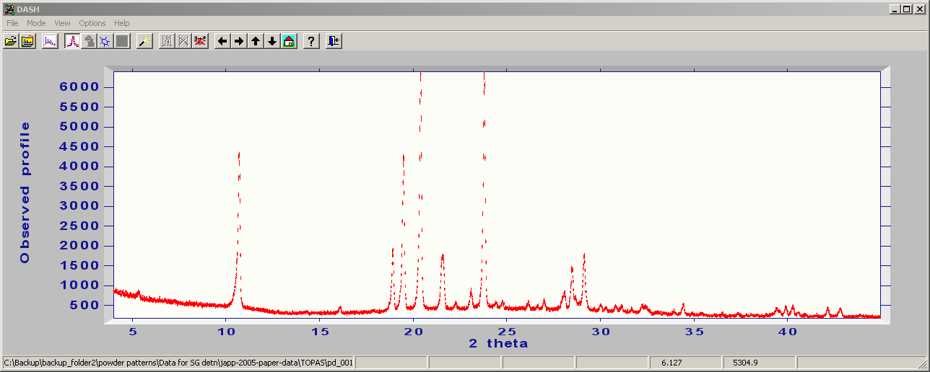
Screen shot of DASH. Notice DASH does not seem to have a
right-click menu.

Slide 4
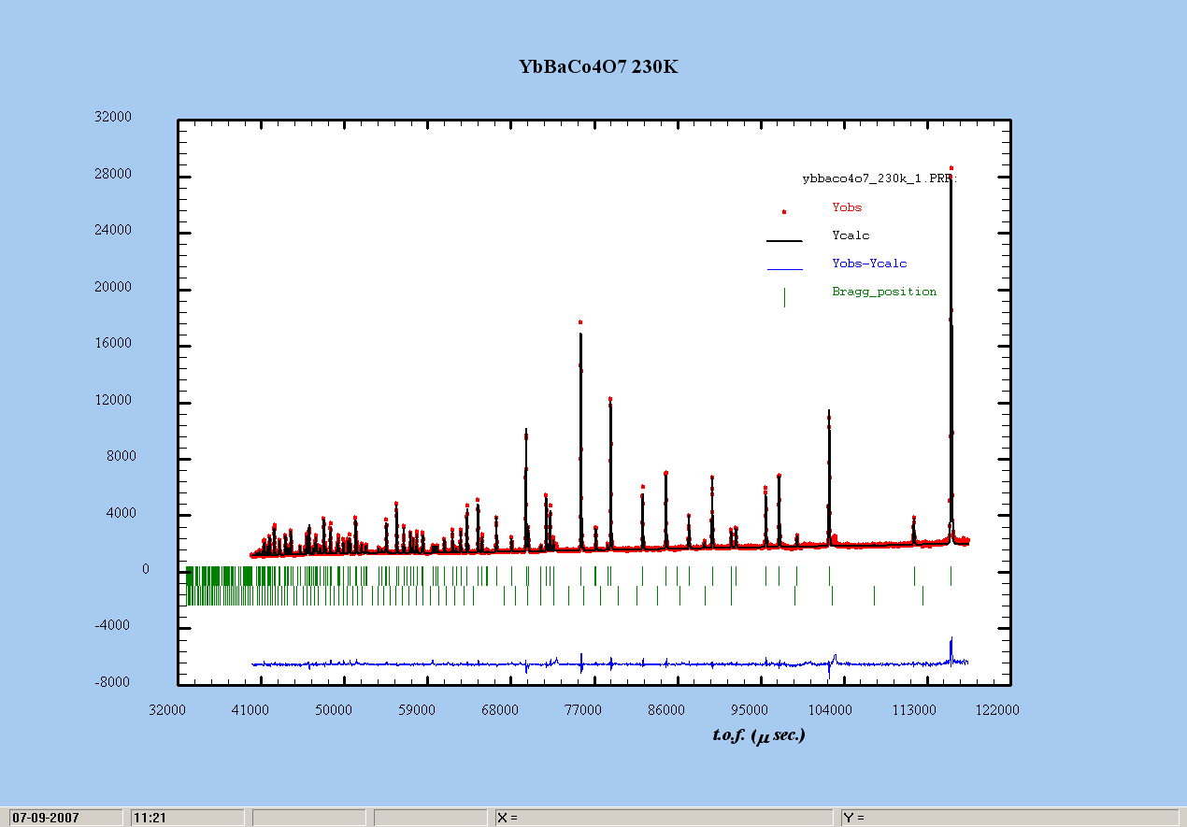
Screen shot of FullProf powder plot window. Notice FullProf does not
seem to have a right-click menu.

Slide 5
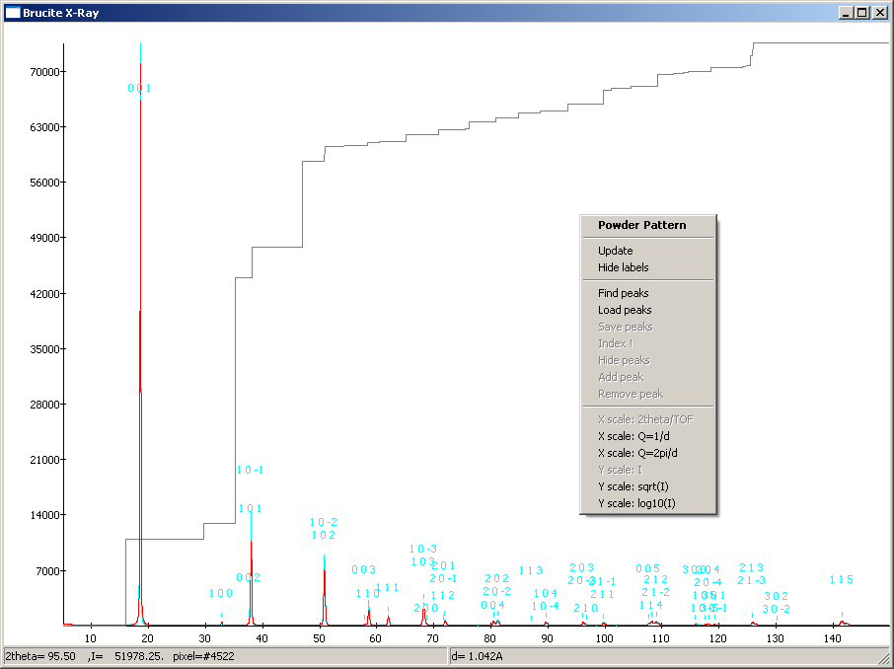
Screen shot of a Fox powder plot window illustrating the right-click menu.

Slide 6
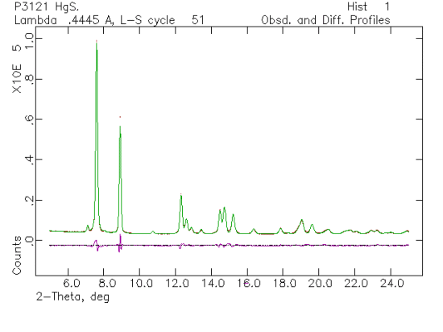
This is a GSAS plot – copied from the web.

Slide 7
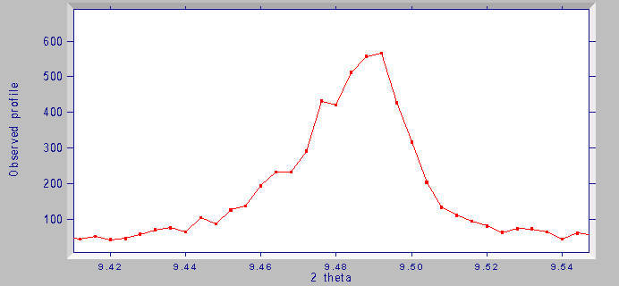
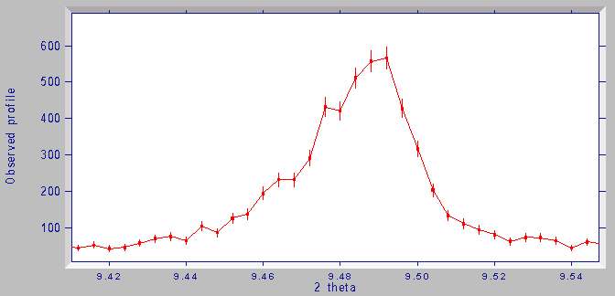
Close-up of DASH plot (no esds).
Close-up of DASH plot (with esds).

