Slide 1
Jpowder Version 2

Slide 2
Design constraint
Ordering is important

Slide 3
Design issues
Browse window
How and where to activate browse window
Meta files

Slide 4
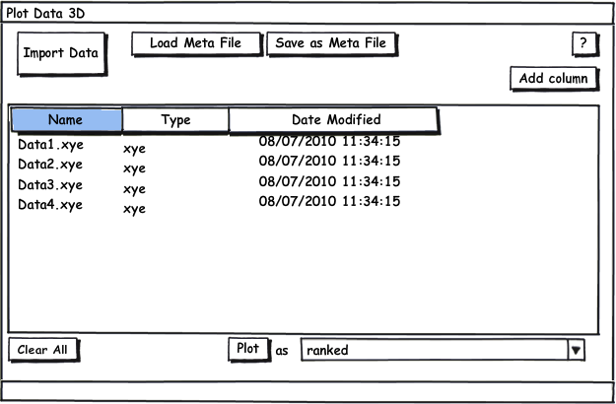
Browse Window

Slide 5
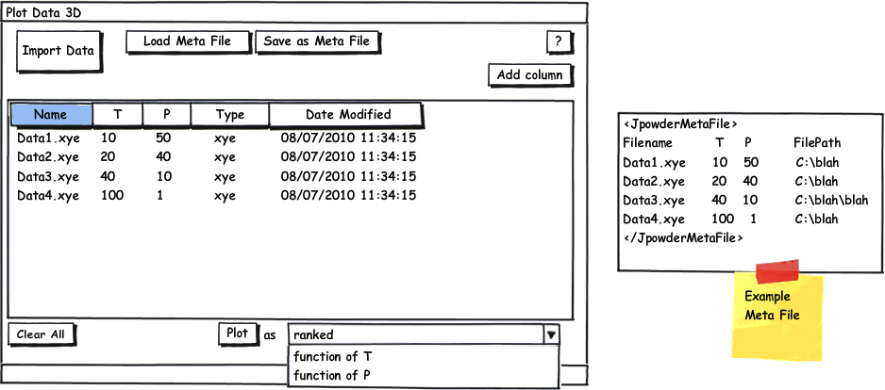
Browse Window

Slide 6
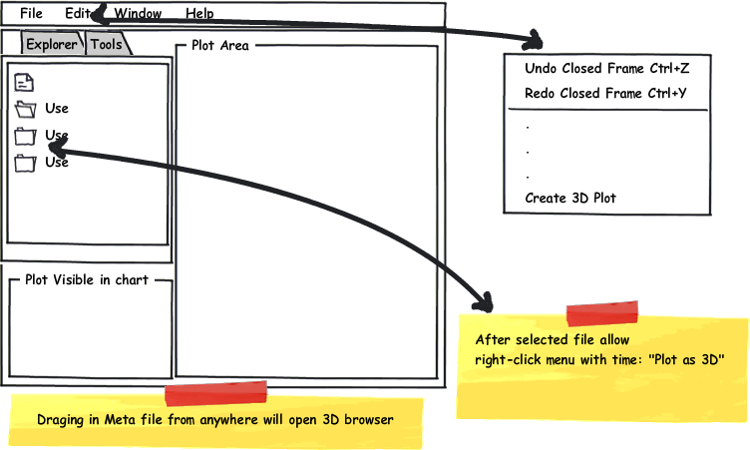
How to activate

Slide 7
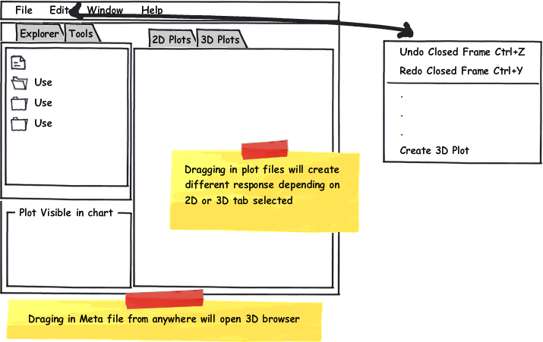
How to activate

Slide 8
Other questions
What is going to happen to ‘Plot(s) visible in chart when 3D? (Stay as it is)
JFreeChart for 2nd version

Slide 9
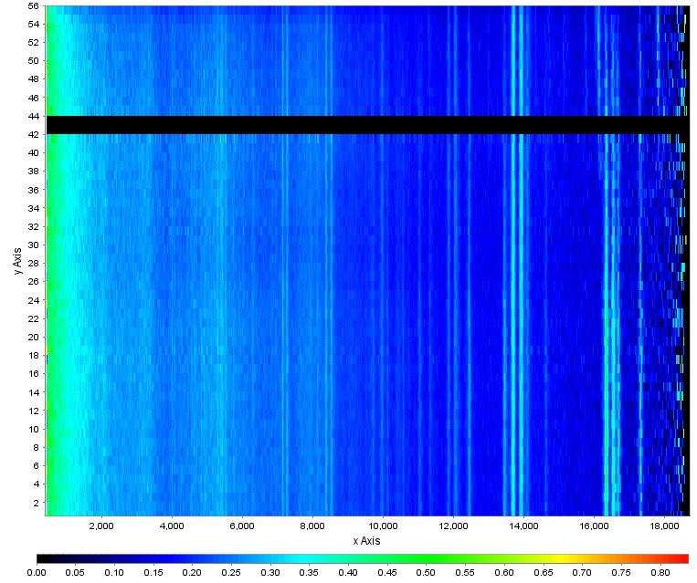
JFreeChart 3D plot

