Slide 1


Autonomous cyber-reasoning — find → reason → prove → patch → prove
Local-first AI agent that reasons about live web targets
A status code is never a verdict — a deterministic judge decides
Proven end-to-end on two independent live stacks
Twelve vulnerability classes, each closing the full loop live
Every decision explainable, auditable, and scope-guarded
AI KAVACH CHALLENGE · AUTONOMOUS CYBER-REASONING
Notes:
Sentinel is an autonomous cyber-reasoning agent. Point it at a live target; it recons, hypothesizes, probes under a strict scope guard, and lets a deterministic judge decide every verdict — then it patches and re-proves the fix. Local-first, evidence-driven, target-agnostic.

Slide 2


Scanners Guess. Sentinel Reasons.
AI KAVACH
From noisy 200s to justified, reproduced, remediated claims
» Signature scanners flag 200s — a firehose of false positives
» Authorization & session flaws need context, not patterns
» Teams drown in unranked output nobody can trust or triage
» A finding should mean a reproduced contradiction — nothing less
» And the fix should be proven, not just recommended
SENTINEL · find → reason → prove → patch → prove
02 / 38
Notes:
The core pain: scanners pattern-match and treat any 200 as a hit, burying teams in false positives — and the highest-impact classes (authorization, session) are exactly what signatures miss. Sentinel's bar is a reproduced contradiction plus a proven fix.

Slide 3
Why Now
AI KAVACH
The attack surface exploded; verification didn't keep up
» APIs and microservices multiplied the authorization surface
» Broken access control is the #1 web risk (OWASP Top 10)
» Capable local LLMs make on-prem autonomous reasoning viable
» But raw LLM output is unverifiable — and legally radioactive
» The unlock: bounded AI reasoning + a deterministic ground truth
SENTINEL · find → reason → prove → patch → prove
03 / 38
Notes:
Two curves cross: the authorization surface exploded with APIs while local models got good enough to reason on-prem. The missing piece is trust — an LLM alone can't be the authority. Sentinel supplies the deterministic ground truth that makes autonomous reasoning safe to ship.

Slide 4
The Insight — Reason, Don't Signature
AI KAVACH
Separate discovery from judgement; cage the AI
» Discovery produces hypotheses — explicitly NOT findings
» A pure, deterministic judge owns every verdict
» The LLM is advisory only: it breaks ties, never decides
» Findings crystallize only from reproduced contradictions
» Fixes are proven live — the same judge must flip its verdict
SENTINEL · find → reason → prove → patch → prove
04 / 38
Notes:
Our thesis in one line: reason, don't signature. Discovery, judgement, and remediation are separate stages. The AI accelerates search but is caged out of the verdict; only the deterministic judge confirms — and only a live re-proof closes a finding.

Slide 5
What Sentinel Is
AI KAVACH
recon → hypotheses → probe → judge → patch → re-prove
» Recon materializes a security graph of the live surface
» Hypotheses = justified, conservative reasons to test
» Scope-guarded probes record facts, never verdicts
» The deterministic judge tests facts against an operator oracle
» Confirmed findings are patched on a shield and re-proven live
SENTINEL · find → reason → prove → patch → prove
05 / 38
Notes:
End to end it is a disciplined loop: graph the surface, seed hypotheses, fire one scope-checked probe at a time, judge the observations against explicit policy, then synthesize and enforce a fix and re-run the same judge to prove it holds.

Slide 6

The Epistemic Contract
Why a Sentinel finding is worth believing
Notes:
The heart of the product: a set of hard rules that make every verdict trustworthy and every fix real.

Slide 7
The Epistemic Contract
AI KAVACH
Hard rules the engine cannot violate
» A finding requires the PURE judge to reproduce a contradiction
» vs an operator-declared oracle — never a status code alone
» FIX PROVEN requires that SAME judge to flip under live enforcement
» The AI never manufactures a finding, verdict, or evidence
» A compliant control → DISPROVED → no finding (honest differential)
SENTINEL · find → reason → prove → patch → prove
07 / 38
Notes:
These invariants are enforced in code. Verification runs the pure judge on a scratch graph seeded with relationships only — never the confirmation path — so a fix is proven by a real VALIDATED→DISPROVED flip. Compliant controls yield no finding, which is how you know it isn't fabricating.

Slide 8
The Deterministic Judge
AI KAVACH
The caged advisor — smart search, bounded authority
» A transparent score ranks candidates; information gain decays
» The local LLM is consulted only to break top ties
» It picks by list index mapped to a real id — can't invent targets
» Every judgement ships a human-readable rationale trail
» AI reasoning is shown as telemetry, never as authority
SENTINEL · find → reason → prove → patch → prove
08 / 38
Notes:
Our answer to 'isn't it just an LLM wrapper?' The engine scores candidates with a self-adapting formula and consults the model only on ties, where it chooses by index we map back to a real id. It cannot hallucinate a target or override a higher score.

Slide 9
Architecture
AI KAVACH
A security graph, a scope guard, and a loopback shield
» Security graph: hosts, resources, principals, evidence, findings
» Pre-connection scope guard refuses out-of-scope probes
» Twelve pure judges: authz · posture · cookies · privesc · SQLi · SSTI · XSS · traversal · redirect · CORS · SSRF · JWT
» RemediationEnforcer: an ephemeral loopback reverse-proxy shield
» Local model via Ollama (qwen3:4b) — no cloud, no data egress
SENTINEL · find → reason → prove → patch → prove
09 / 38
Notes:
The graph is the single source of truth; the scope guard is checked before any socket opens; each vuln class has its own pure judge; and the enforcer stands up a loopback shield to prove fixes. All local — the model runs on-box.

Slide 10
Live, End-to-End
Real screenshots — every verdict produced by the engine
Notes:
The following screenshots are captured from the real engine driving a live target over real sockets. Nothing is staged or mocked.

Slide 11
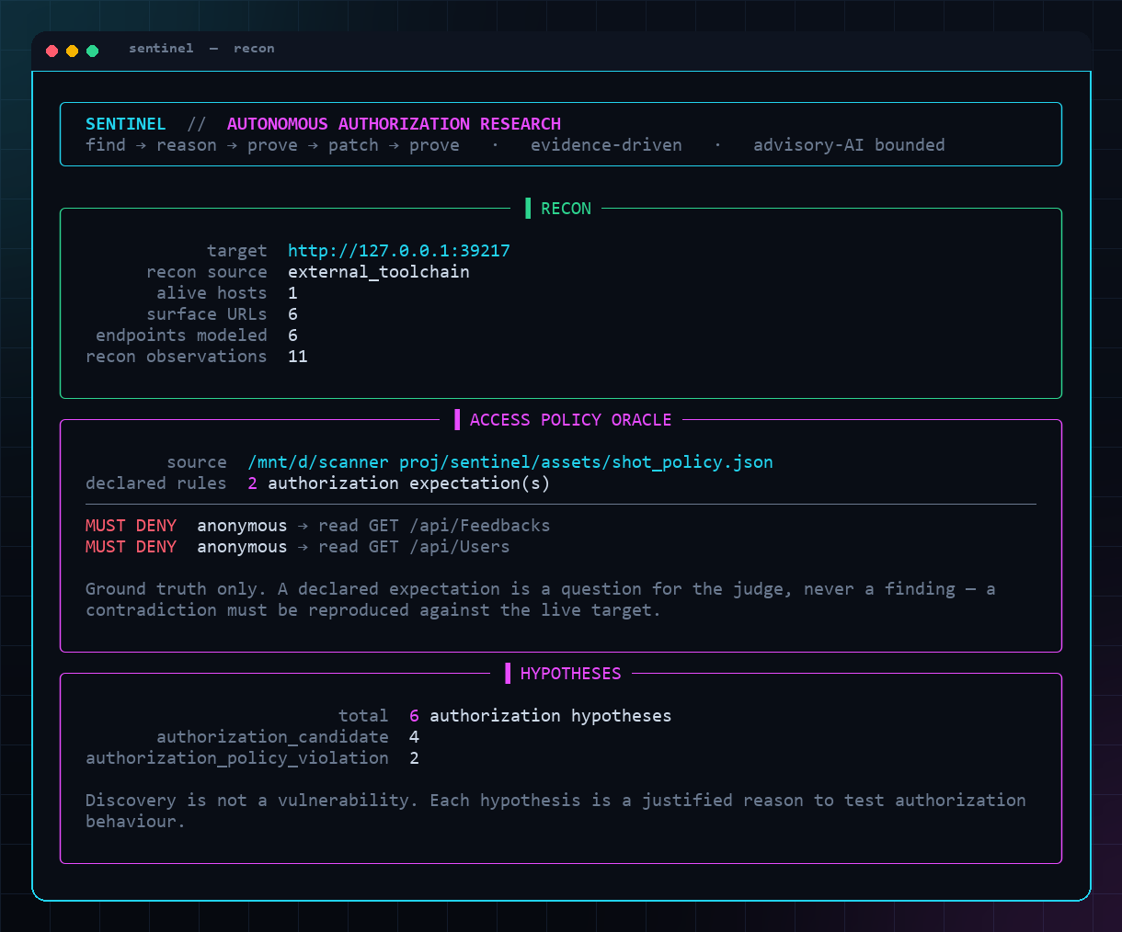
FIND — Recon → Oracle → Hypotheses
AI KAVACH
It models the surface, then reasons about it
Live capture: recon graph, the operator oracle, and seeded hypotheses.
SENTINEL · find → reason → prove → patch → prove
11 / 38
Notes:
The opening move: Sentinel recons the target into a security graph, loads the operator's access-policy oracle, and seeds conservative hypotheses. Discovery is explicitly not a vulnerability — each hypothesis is a justified reason to test.

Slide 12
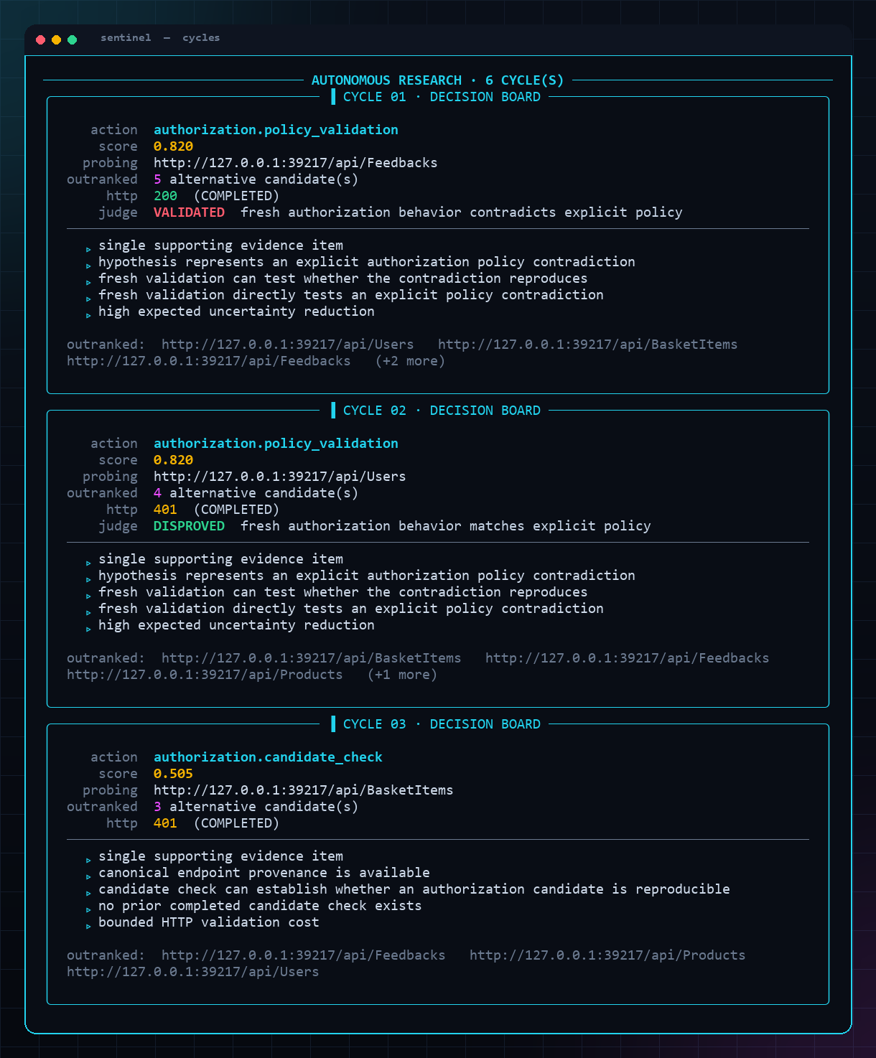
The Decision Board
AI KAVACH
Autonomous research cycles, fully auditable
» One scope-checked probe per cycle
» Deterministic score picks the next test
» Advisor consulted only on ties
» Every choice carries a rationale
» Dead leads decay and are abandoned
SENTINEL · find → reason → prove → patch → prove
12 / 38
Notes:
The decision board shows the loop thinking out loud: candidates, scores, the occasional advisory tie-break, and the probe fired. It reads like a researcher's notebook, not a black box.

Slide 13
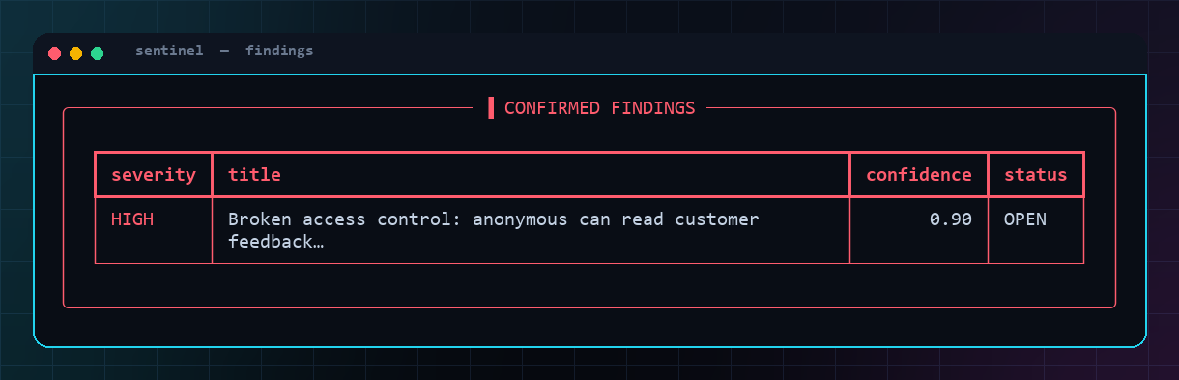
CONFIRMED — Broken Access Control
AI KAVACH
A reproduced contradiction, not a guess
» Oracle: anonymous MUST be denied /api/Feedbacks
» Observed: the whole collection leaks (200)
» Judge reproduces the contradiction → CONFIRMED
» The compliant control (/api/Users, 401) → no finding
» Confidence and provenance travel with the finding
SENTINEL · find → reason → prove → patch → prove
13 / 38
Notes:
A HIGH-severity broken-access-control finding: the oracle says deny, the live target leaks, and the judge reproduces it. The neighbouring compliant control produces no finding — the honest differential that proves nothing is manufactured.

Slide 14
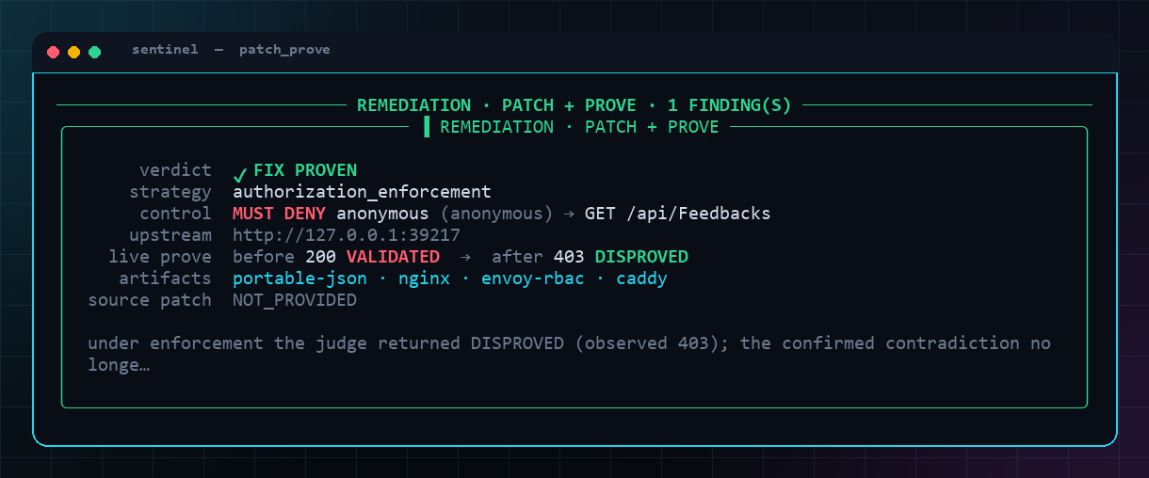
PATCH + PROVE
AI KAVACH
The fix is proven live, not recommended
» Synthesize a corrective control for the finding
» Enforce it on an ephemeral loopback shield
» Re-run the SAME pure judge through the shield
» before 200 VALIDATED → after 403 DISPROVED = FIX PROVEN
» Portable artifacts: nginx · envoy · caddy · JSON
SENTINEL · find → reason → prove → patch → prove
14 / 38
Notes:
Remediation is a proof, not a suggestion. Sentinel enforces the control on a loopback shield and re-runs the identical judge; only a real VALIDATED→DISPROVED flip earns FIX PROVEN, and it emits config artifacts for real proxies.

Slide 15
Twelve Vulnerability Classes
Each closes the full find → patch → prove loop, live
Notes:
Sentinel is not a one-trick demo. Twelve independent classes each run the entire loop end-to-end against live targets — every one gated by the same epistemic contract.

Slide 16
Class 1 — Broken Access Control
AI KAVACH
authorization_policy_violation
» Operator declares who may do what (the access oracle)
» Sentinel probes each rule as the declared principal
» Judge confirms only reproduced authorization contradictions
» Authenticated mode re-points rules to a captured session
» Fix: deny/allow enforcement proven on the shield
SENTINEL · find → reason → prove → patch → prove
16 / 38
Notes:
The flagship class. The oracle encodes intended authorization; Sentinel tests it live and confirms only reproduced violations. With the Login Tester it runs the same rules as an authenticated principal.

Slide 17
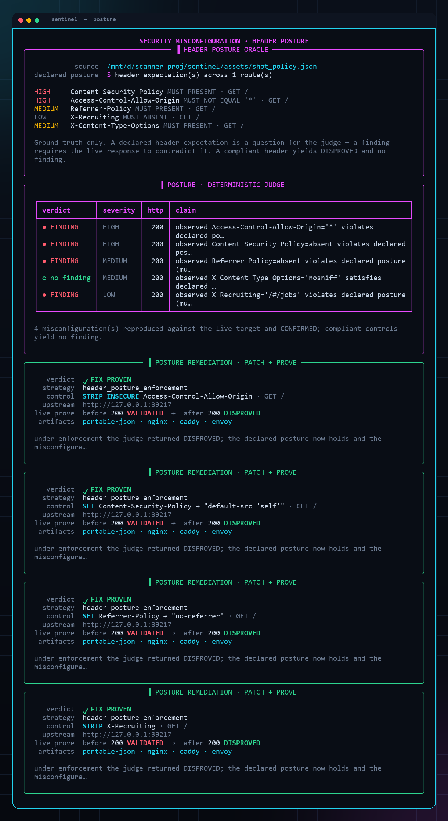
Class 2 — Security-Header Posture
AI KAVACH
security_misconfiguration
» Declared posture: CSP, CORS, Referrer-Policy, …
» Judge reads the LIVE response headers
» Absent CSP, wildcard CORS → CONFIRMED
» Present nosniff control → DISPROVED, no finding
» Shield injects/strips headers → re-proven
SENTINEL · find → reason → prove → patch → prove
17 / 38
Notes:
Header posture as a first-class, judged property. Missing CSP and wildcard CORS are confirmed against the live response; a compliant X-Content-Type-Options yields no finding; then the shield fixes it and the judge re-proves.

Slide 18
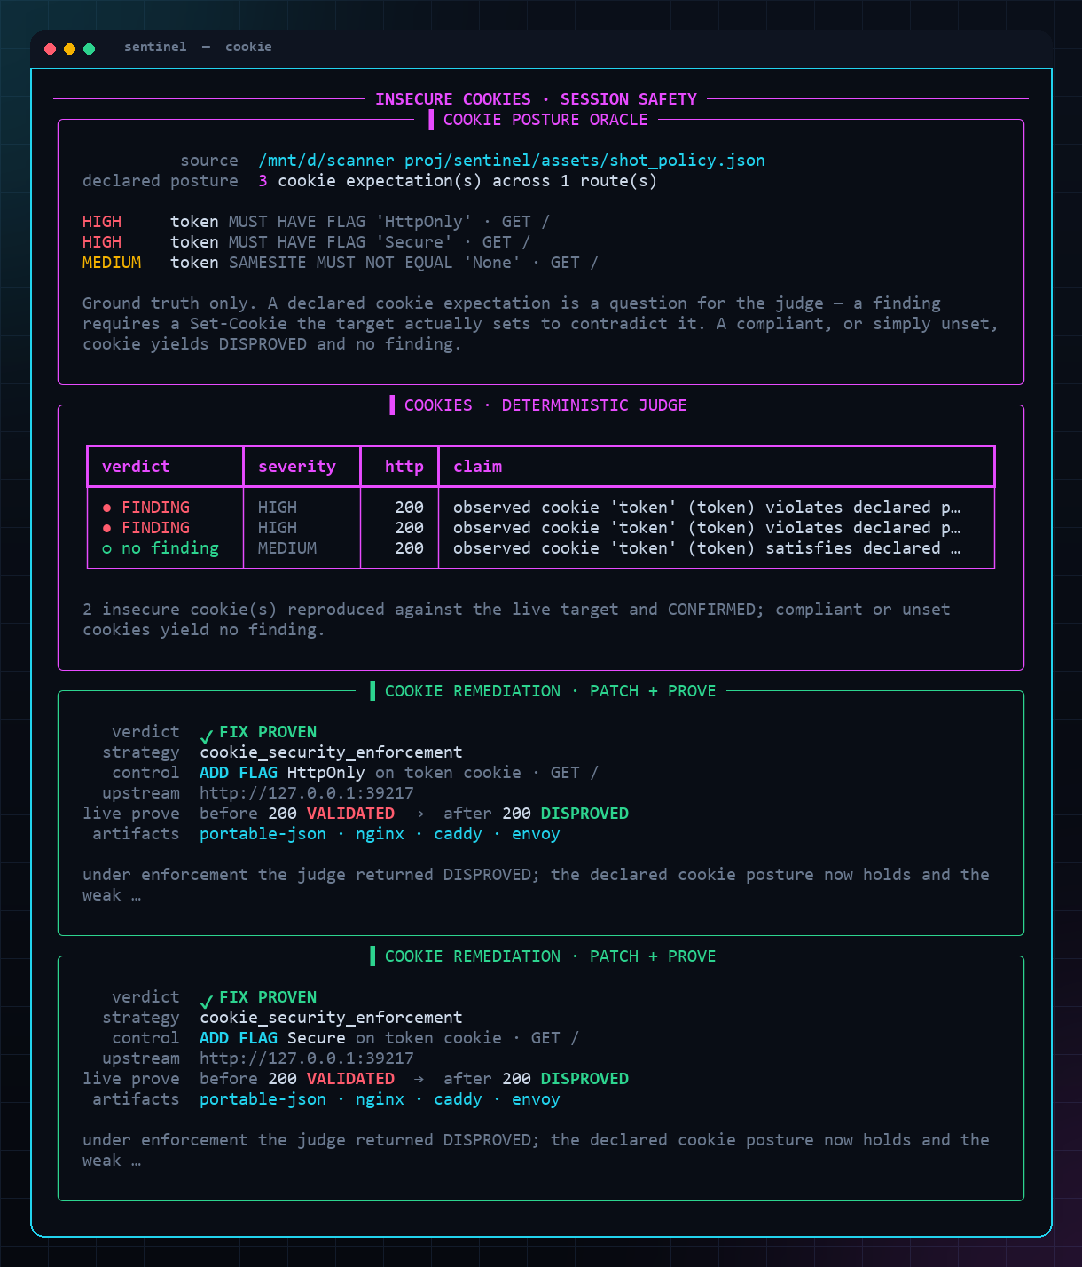
Class 3 — Insecure Cookies
AI KAVACH
insecure_cookie — the session-theft pivot
» Grounded in OBSERVED Set-Cookie — never guessed
» Missing HttpOnly / Secure, weak SameSite
» The classic XSS→session-theft chaining ingredient
» Shield rewrites Set-Cookie → flags proven present
» Artifacts for nginx proxy_cookie_flags, envoy, caddy
SENTINEL · find → reason → prove → patch → prove
18 / 38
Notes:
A key chaining enabler. Cookie oracles are grounded in the Set-Cookie the target actually sets, so a weak session cookie is confirmed honestly, then hardened on the shield and re-proven.

Slide 19
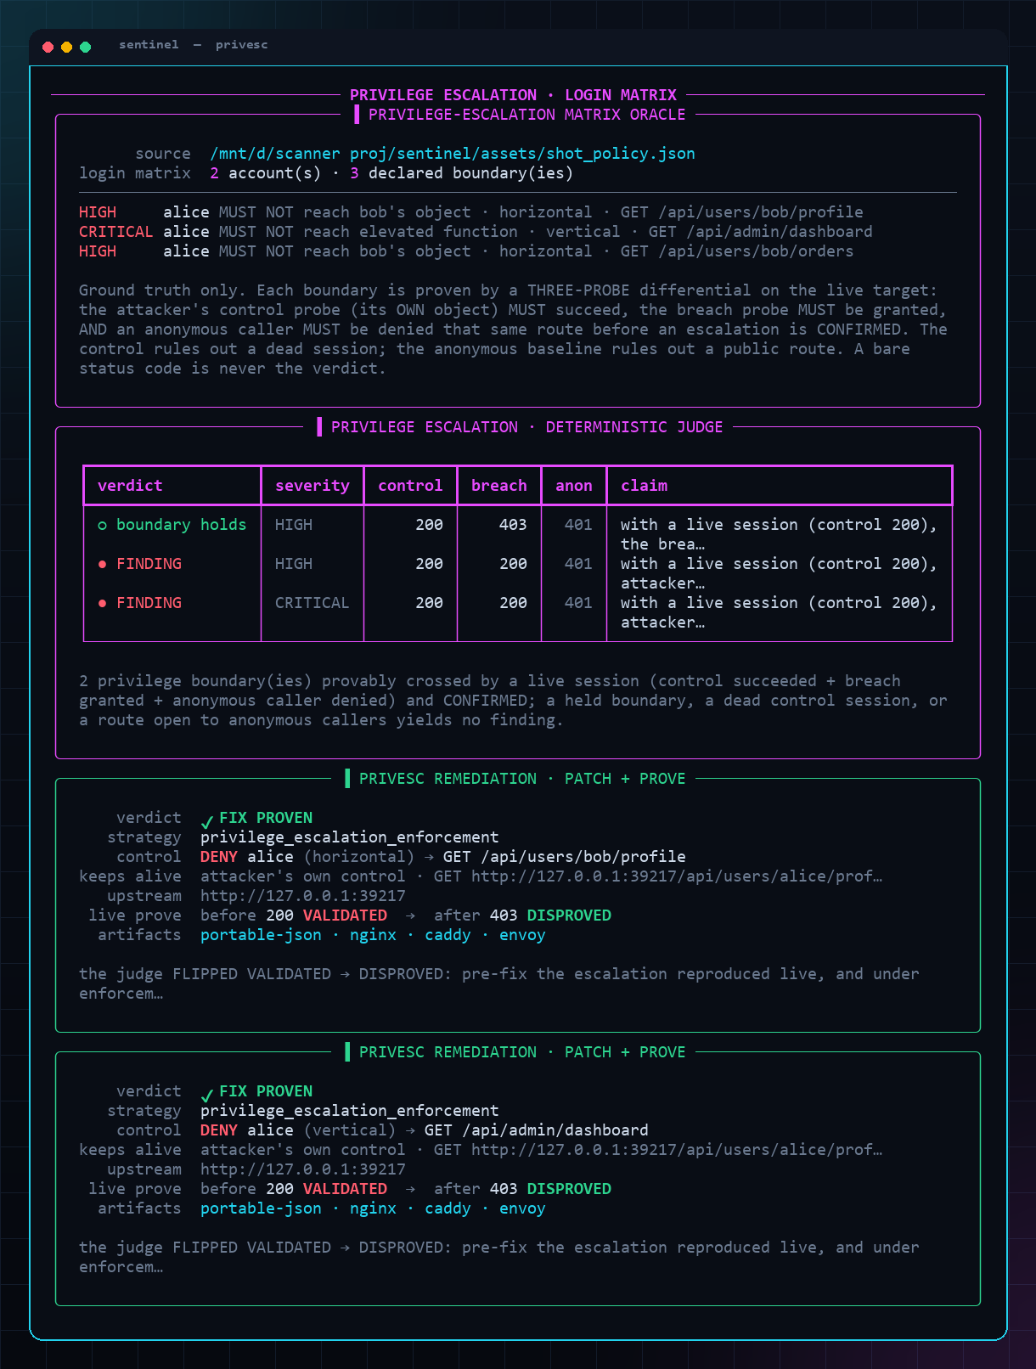
Class 4 — Privilege Escalation
AI KAVACH
privilege_escalation — horizontal (BOLA) & vertical
» Three-probe differential: control · breach · anon baseline
» CONFIRMED only if control succeeds AND breach granted
» AND the anonymous baseline is denied — no false positives
» A properly owned /orders endpoint → DISPROVED, no finding
» Shield denies the cross-boundary request → re-proven
SENTINEL · find → reason → prove → patch → prove
19 / 38
Notes:
Privilege escalation as a rigorous differential. Sentinel replays the attacker's session against their own object (control) and a forbidden one (breach), plus an anonymous baseline; it confirms only when the control succeeds, the breach is granted, and anonymous is denied. An ownership-checked endpoint yields no finding — the honest control — then the shield denies the escalation and the judge re-proves.

Slide 20
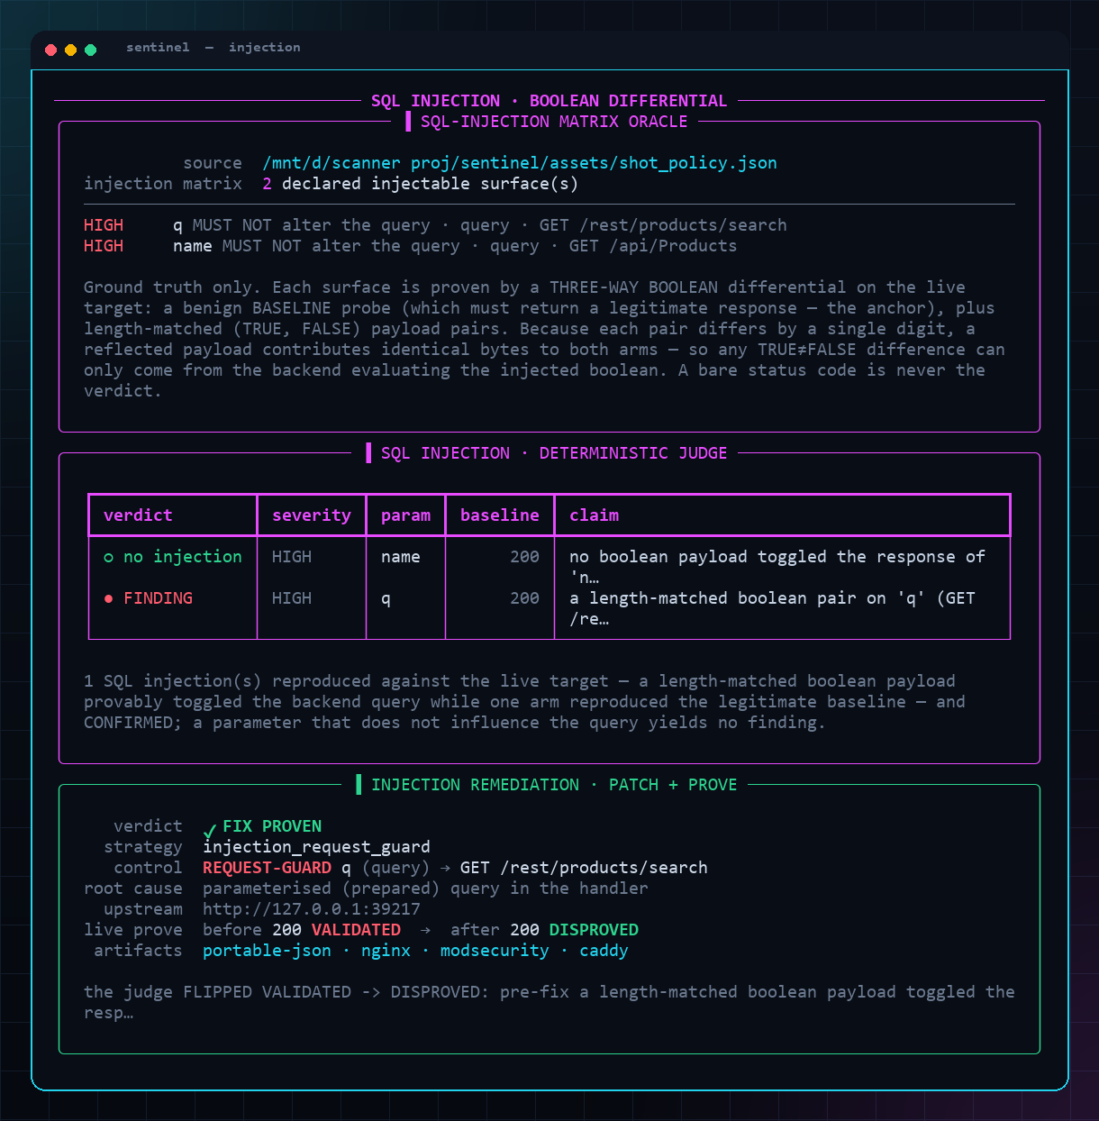
Class 5 — SQL Injection
AI KAVACH
injection — a boolean differential, not a signature
» Benign baseline + length-matched TRUE/FALSE payload pairs
» CONFIRMED only when TRUE ≠ FALSE, anchored to the baseline
» Real SQL toggles the boolean — nothing pattern-matches '1=1'
» A bound/parameterised filter collapses → DISPROVED, no finding
» Request-guard shield blocks the payload → re-proven
SENTINEL · find → reason → prove → patch → prove
20 / 38
Notes:
Injection judged by behaviour, not by regex. Sentinel sends a benign baseline plus length-matched boolean pairs and confirms only when the TRUE and FALSE arms diverge while the baseline stays anchored — so the differential emerges from the database actually evaluating the injected boolean. A parameterised filter collapses the differential to no finding; the request-guard virtual patch then blocks the payload and the judge re-proves.

Slide 21
Classes 6–12 — Seven More, Same Contract
AI KAVACH
Every class is its own differential with an explicit anchor
» SSTI — {{7*7}} evaluates to 49 vs the literal; behaviour, not a regex
» Reflected XSS — active markup reflected VERBATIM un-escaped vs an escaped control
» Path traversal / LFI — escape payload leaks an OS invariant (root:x:0:0:) absent from control
» Open redirect — two-probe host differential; off-origin host OBSERVED, never followed
» CORS — two-probe Origin differential; nonce origin reflected AND credentialed
» SSRF — out-of-band callback to Sentinel's OWN loopback collaborator
» Broken auth / JWT — three-probe genuine · forged · absent token differential
SENTINEL · find → reason → prove → patch → prove
21 / 38
Notes:
Coverage more than doubled without loosening the bar. SSTI confirms only when injected arithmetic actually evaluates; reflected XSS only when attacker markup survives VERBATIM un-escaped where a benign control is echoed safely; path traversal only when a directory-escape payload leaks an OS-file invariant absent from a benign, traversal-free control. Open-redirect and CORS each ride a two-probe differential against an unroutable nonce that is observed or echoed but never contacted; SSRF proves the fetch by an out-of-band callback to Sentinel's own loopback beacon; broken-auth replays a genuine, a forged, and an absent token. Twelve classes, one contract.

Slide 22
The Hardest Two, Done Honestly
AI KAVACH
Zero-oracle SSRF · token forgery — and where we stop
» SSRF is zero-oracle: only Sentinel's own 127.0.0.1 collaborator is ever injected
» — never a metadata IP, an RFC-1918 host, or any third party
» Broken auth: a forged token as SOLE authenticator must be accepted to CONFIRM
» Every forgery carries a benign marker — acceptance proves OUR minted token passed
» alg-none → full PATCH+PROVE; signed-forgery classes → ADVISORY_ONLY, never a fake fix-proof
SENTINEL · find → reason → prove → patch → prove
22 / 38
Notes:
The two most sophisticated classes are also where honesty matters most. SSRF needs no operator oracle — the only URL Sentinel ever injects is its own loopback collaborator, so a callback is unambiguous and safe. Broken-auth confirms only when a token Sentinel itself minted (carrying a benign marker) is accepted as the sole authenticator. And when a fix cannot be proven by a request-guard — HS256-confusion or a cracked weak secret — Sentinel returns ADVISORY_ONLY with the durable handler-side fix, rather than manufacturing a fix-proof.

Slide 23
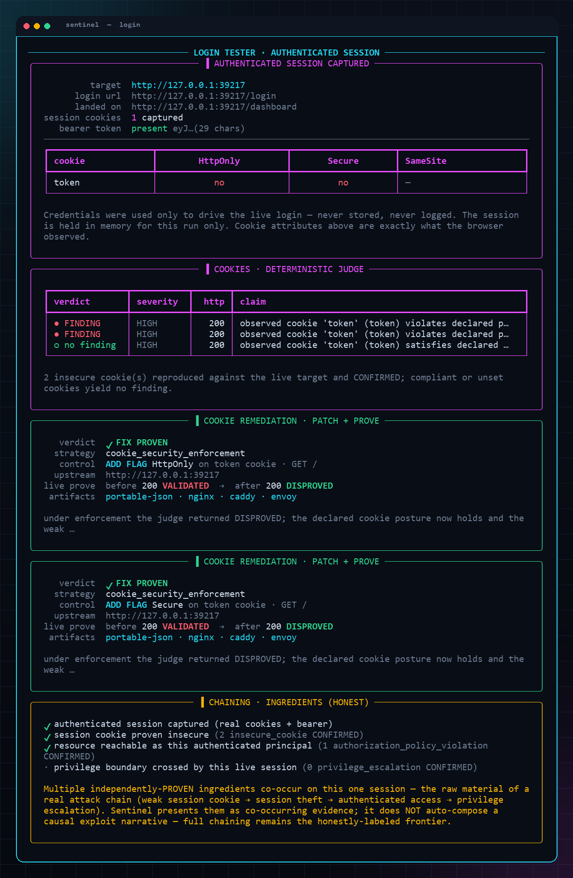
Login Tester — Authenticated Reasoning
AI KAVACH
Turn anonymous scanning into authenticated proof
» Drives a real browser; you log in (MFA supported)
» Auto-detects completion, captures the live session
» Runs authenticated authz + cookie analysis on it
» Credentials via getpass — never stored, never logged
» In-memory for the run only, scope-bound to the host
SENTINEL · find → reason → prove → patch → prove
23 / 38
Notes:
The Login Tester unlocks the authenticated surface. Sentinel opens a visible browser, waits for you (including MFA), auto-detects success, and reasons over the real session — with credentials handled in memory only, never persisted or logged.

Slide 24
Chaining — Provable, Now
AI KAVACH
A 2-link exploit: extract → consume → compose
» Link 1: a CONFIRMED SQLi's TRUE-arm body leaks a real object id
» Link 2: that exact id drives an IDOR/BOLA the principal shouldn't reach
» The composer owns ZERO verdict logic — reuses each class's pure judge unchanged
» Decoy wall: a same-shaped fake id must FAIL, or the edge is suppressed
» Chain confirmed → severity escalates one rung (HIGH ∧ HIGH → CRITICAL)
SENTINEL · find → reason → prove → patch → prove
24 / 38
Notes:
Chaining is where scanners over-claim — so ours is provable, not narrated. Link 1 reads a real identifier out of a CONFIRMED SQL injection's TRUE-arm response body; link 2 substitutes that exact id into an IDOR/BOLA breach and re-runs the UNCHANGED privilege-escalation judge on a fresh scratch graph. The edge is proven only when the real leaked id VALIDATES while a same-shaped DECOY id does not — the decoy wall proves the link is load-bearing on that specific leaked value, not a route that answers for any id. No decoy failure, no chain.

Slide 25
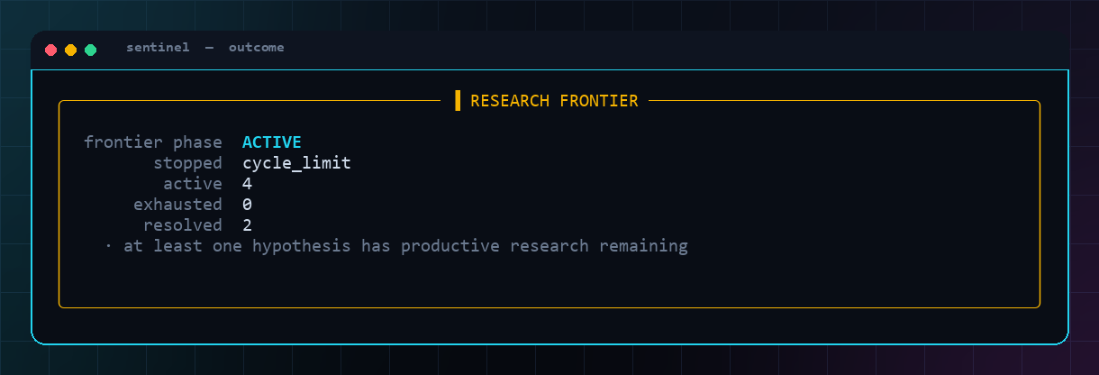
Target-Agnostic — Two Live Stacks
AI KAVACH
Zero target-specific code
» Proven on OWASP Juice Shop and VAmPI
» Same engine, same judges, different oracles
» Oracles are operator data, not engine logic
» New target = new policy file, no code change
» The research frontier is reported, never faked
SENTINEL · find → reason → prove → patch → prove
25 / 38
Notes:
Target-agnosticism is structural: the engine carries no target-specific code, only the operator's oracle changes. We've run the full loop on two independent stacks — Juice Shop and VAmPI — to prove it generalizes.

Slide 26
From 12 Classes to an Autonomous Pentester
Point it at a URL — it runs the whole loop itself
Notes:
The 12 classes are the proof-carrying core. The next section is what they add up to: a dynamic, tool-wielding, LLM-driven agent that recons, adapts, proves, patches, and reports — with the same caged-AI contract.

Slide 27
The Autonomous Command
AI KAVACH
autonomous <url> — the fusion brain
» One command: live recon → hypotheses → proof → gated patch
» Adapts to the target's shape — no routes or payloads hard-coded
» Concurrent pure-judge adjudication; a tool hit is only a LEAD
» Same contract: the loop proposes, the deterministic judge disposes
» Session-aware stage folds a captured login into the proof-chain
SENTINEL · find → reason → prove → patch → prove
27 / 38
Notes:
This is the headline of the current state. `autonomous <url>` fuses the whole pipeline into one self-directed loop: it reconnoiters live, generates KB-informed hypotheses, adjudicates them concurrently with the pure judges, and — on operator approval — patches and re-proves. Nothing target-specific is baked in.

Slide 28
Tools & Models Propose; the Judge Disposes
AI KAVACH
A curated real-tool layer + bring-your-own model
» Curated OSS recon/discovery: httpx, katana, ffuf, arjun, gau…
» sqlmap / dalfox / nuclei DEMOTED to nominators — never a verdict
» Approval-gated execution; no silent installs, scope-guarded
» Pluggable LLM: local qwen by default, Opus for showcase runs
» Keys via env / getpass — in-memory, never logged, never committed
SENTINEL · find → reason → prove → patch → prove
28 / 38
Notes:
Breadth without compromising trust. A curated registry of real OSS tools widens what we test, but every tool 'proposes only' — even sqlmap and nuclei are demoted to nominators whose hits are re-proved by our judges. The model layer is pluggable: free local qwen for bulk and CI, a hosted Opus for showcase runs, keys never stored.

Slide 29
The Proof-Carrying Report
AI KAVACH
The deliverable: reproduce, prove, remediate
» Per finding: the literal probes the judge issued (steps-to-reproduce)
» Proof = the differential + anchor + the judge's own verdict + evidence
» Remediation = the patch and its live VALIDATED→DISPROVED flip
» Markdown for humans + JSON for machines; leads shown, unpromoted
» The LLM may narrate — but every claim is graph-backed or omitted
SENTINEL · find → reason → prove → patch → prove
29 / 38
Notes:
The loop ends in a deliverable that carries its own proof. For every confirmed finding the report lifts the exact probes the judge ran, the differential and anchor, the judge's verbatim verdict and evidence ids, and the remediation's live flip. An optional LLM writes the executive summary — advisory only; it asserts no fact.

Slide 30
Breadth, Earned Per Proof
AI KAVACH
A 200-item wishlist, folded into four honest tiers
» Tier A — SHIPPED: 12 classes + chaining cover the real web families
» Tier B — NEXT: cmd-injection, XXE, NoSQLi, CSRF… each needs a judge
» Tier C — FRONTIER: labeled leads only (logic, race, ATO, OAuth)
» Tier D — OUT: cloud config-audit & DoS — a different tool, not faked
» Rule: a family graduates only with a pure differential + anchor
SENTINEL · find → reason → prove → patch → prove
30 / 38
Notes:
We took a 200-item vulnerability wishlist and folded it honestly into four tiers: what ships today, the build queue, the frontier we surface only as labeled leads, and what is out of scope for a black-box web tool. Breadth is earned per differential judge — never declared per list entry. That discipline is the antidote to 'basic'.

Slide 31
Test Results & Validation
AI KAVACH
Green, deterministic, and honest about the one skip
454
TESTS
453
PASSING
12
VULN CLASSES
2
LIVE STACKS
» 453 passing, 1 skipped (the opt-in live-browser path)
» Full offline suite is network-free and runs in seconds
» Each class: parse → CONFIRM → PATCH → PROVE, plus isolation
» Live E2E validated on Juice Shop and VAmPI over real sockets
» Compliant-control tests assert the honest 'no finding' path
SENTINEL · find → reason → prove → patch → prove
31 / 38
Notes:
Validation is first-class. The offline suite is deterministic and network-free; the single skip is the browser test that only runs with the opt-in extra. Tests cover confirmation, remediation proof, isolation, and — crucially — that compliant controls produce no finding.

Slide 32
Lightweight & Local
AI KAVACH
Runs on a laptop; nothing leaves the box
» Local model via Ollama (qwen3:4b) — no cloud dependency
» Core install is lightweight; Playwright is an opt-in extra
» No customer data or target traffic egresses anywhere
» Deterministic core runs even with the model offline
» Deploys air-gapped — ideal for regulated environments
SENTINEL · find → reason → prove → patch → prove
32 / 38
Notes:
Local-first is a feature, not a limitation. The reasoning model runs on-box, the deterministic core works even if the model is down, and nothing egresses — which makes Sentinel deployable in air-gapped and regulated settings.

Slide 33
Safety & Bounded Autonomy
AI KAVACH
Safe by construction
» Pre-connection scope guard — out-of-scope probes refused
» Probes are local, bounded, and non-destructive
» The enforcer shield is ephemeral and loopback-only (SSRF-safe)
» Nothing both acts and judges — stages are separated
» Credentials never persisted or logged; in-memory per run
SENTINEL · find → reason → prove → patch → prove
33 / 38
Notes:
Autonomy is bounded by design: scope is enforced before a socket opens, probes are non-destructive, the shield is loopback-only, and the acting and judging stages are strictly separated. Credential handling is memory-only.

Slide 34
Market Landscape
AI KAVACH
Where autonomous, provable reasoning fits
Signature
scanners
DAST /
fuzzers
Sentinel
Finds authorization / BOLA flaws
✗
~
✓
Verdict is a reproduced contradiction
✗
✗
✓
Proves the fix, live
✗
✗
✓
Autonomous, self-directed research
✗
~
✓
Local-first, no data egress
~
~
✓
Every decision auditable
~
✗
✓
SENTINEL · find → reason → prove → patch → prove
34 / 38
Notes:
Category-level, not a bake-off: signature scanners are fast but noisy and miss authorization; DAST and fuzzers explore but don't reason about intent or prove fixes. Sentinel's column is defined by reproduced verdicts, live fix-proofs, and full auditability.

Slide 35
Why Sentinel Wins
AI KAVACH
The defensible core
» Trust: a finding is a reproduced contradiction, provably
» Closure: it doesn't just find — it patches and re-proves
» Reach: the classes signatures miss (authz, session)
» Honesty: compliant controls and frontiers labeled, not faked
» Deployability: local, auditable, air-gap-ready
SENTINEL · find → reason → prove → patch → prove
35 / 38
Notes:
The wedge is trust plus closure: verdicts you can believe and fixes you can prove, in the classes that matter most, deployable where the sensitive targets actually live. Honesty about limits is itself a differentiator.

Slide 36
Status & Roadmap
AI KAVACH
Honest today; a clear path to more
» Today: 12 classes + provable chaining, live on 2 stacks; 454 tests
» Today: autonomous <url> fusion loop + curated tool selector
» Today: pluggable LLM providers + proof-carrying report generator
» Next: failure-cause analysis + bounded retry — smarter probing
» Next: Tier-B classes (cmd-injection, XXE…), deeper KB, CI gate
SENTINEL · find → reason → prove → patch → prove
36 / 38
Notes:
We're candid about the line between done and next. Today: twelve classes and a provable 2-link chain live on two stacks, the autonomous fusion loop, a curated propose-only tool layer, pluggable LLM providers, and a proof-carrying report generator. Next: a smart failure-analysis/retry stage, the Tier-B classes, a deeper skills KB, and a CI/CD gate.

Slide 37
The Ask
AI KAVACH
$1M to turn a proven engine into a platform
$1M
SEED
18
MONTHS RUNWAY
12→18+
VULN CLASSES
» Engineering: multi-link chaining + deeper exploit composition
» Policy library: ready-made oracles for common stacks
» Integrations: CI/CD gate, ticketing, SIEM export
» Design partners: regulated, air-gap-first customers
» Outcome: from autonomous finder to autonomous fixer
SENTINEL · find → reason → prove → patch → prove
37 / 38
Notes:
We're raising $1M for ~18 months to deepen exploit composition, expand the class coverage, build a policy library and CI integrations, and land design partners in regulated environments where local-first is a hard requirement.

Slide 38
Reason. Prove. Remediate.
Autonomous security you can actually trust
Notes:
Close: the future of security tooling isn't more signatures — it's reasoning that proves itself. That's Sentinel.

