Slide 1
Assignment #6 CS.1428.H01
Arjit Magar

Slide 2
Algorithm : Finding Happy Prime Numbers up to 1 Million
1)Start by setting the limit to 1 million and initialize happyPrime to 0
2)Check the numbers from i = 1 to 1000000 whether they are even and separate the numbers (except 2) as they cannot be prime
3)Check the primality of i
Firstly, initialize primeCount= 0
For every odd number i, check divisibility by all numbers j from 2 to the square root of i ( We start from 2 as every number is divisible by 1)
If any divisor is found increase the primeCount by 1 else keep it 0 and the value of i will be prime.

Slide 3
4)Check whether i is happy prime or not
Initialize the num to i and itr = 0 to track iteration
Repeat the process until the num == 1(happy prime) or itr < 20 (to avoid the infinite loop)
Initialize the sum to 0
Extract each digit of the num and compute the square of the digit and add the square to the sum
Update the num to the sum
Increment the itr
If num == 1 after the loop, then the number is happy number
5) Count the happy prime number
If i both prime and happy prime , increment the happyPrime
6)Output the results
Print the total number of happy prime numbers
Measure and display the execution time

Slide 4
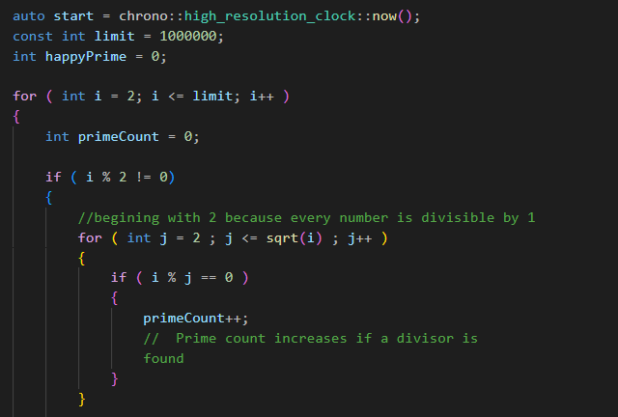
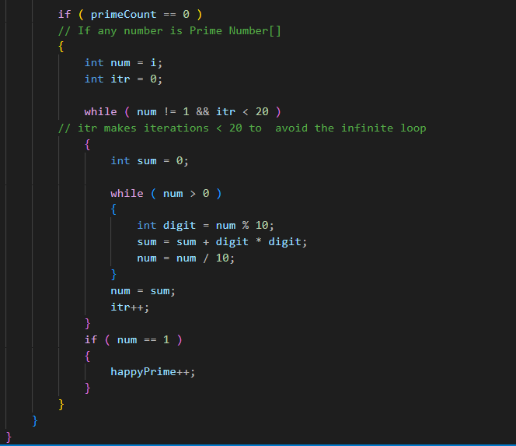

Slide 5
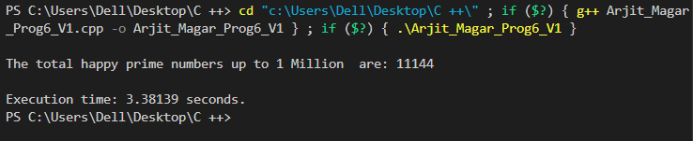
Version 1 Execution Time
3.381 Seconds

Slide 6
Parallelizing the version 1 using openMp
We use the data parallelism approach as the same task (checking if a number is a happy prime) is performed independently on different pieces of data (numbers from 2 to 1,000,000) across multiple threads.
We use OpenMP to parallelize the code from version 1 to version 2

Slide 7
Parallelization With open MP
1)Firstly, enable the Parallelization with OpenMP
Use the #include <omp.h> to include all access the openMP library
2)Secondly, start the parallelization with #pragma omp parallel for
The pragma omp for parallelizes the loop that iterates overs the number from 2 to 1 million (for (int i = 2; i <= limit; i++)).
OpenMP automatically divides the loop iterations into multiple threads allowing each thread to independently process a subset of numbers.
3)Using Reduction (+ : happyPrime)
The reduction (+ : happyPrime) ensures that happyPrime counter is safely updated across the threads
Each thread maintains a local copy of happyPrime to increment independently when it finds a happy prime number.

Slide 8
OpenMP sums up all thread-local copies at the end of the parallel region and combines (reduces) them into the global happyPrime variable
4). Time the Execution with omp_get_wtime()
The omp_get_wtime() function is used to measure the execution time of the parallelized computation.
start_time is recorded before the loop, and end_time is recorded after the loop.
The difference end_time - start_time gives the total execution time for the parallel computation.

Slide 9
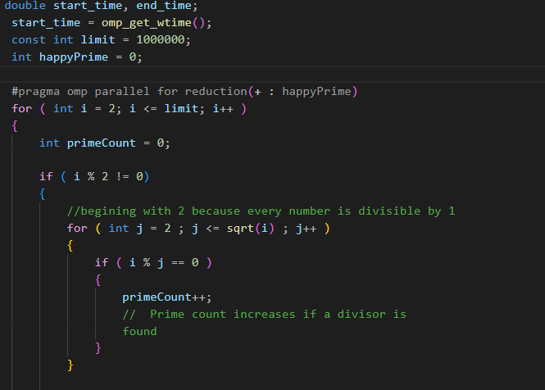
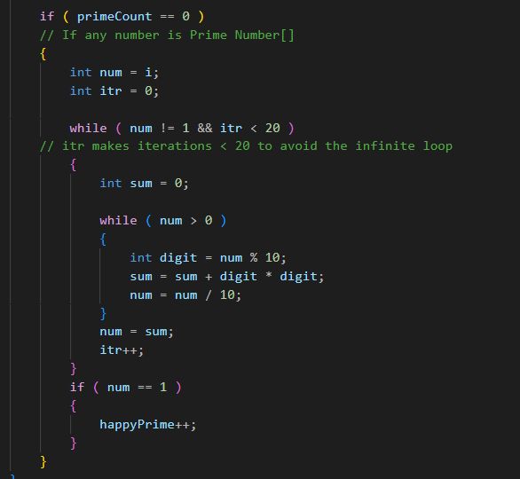

Slide 10
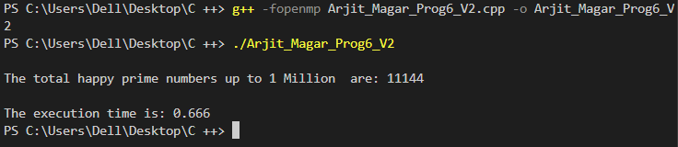
Version 2 Execution Time :
0.666 Seconds

Slide 11
Version 3 : Optimizing version 2
To optimize the execution speed of version 2, I changed the programming language from C++ to Fortran as it is well-suited for numerical and scientific computing.
Fortran is a natively parallel programming language with inbuilt array-like syntax to communicate data between CPUs.
Fortran is the dominant language of High-Performance Computing and is used to benchmark the fastest supercomputers in the world.
Write the same program in Fortran and parallelize the code.
Use omp_lib to enable OpenMP functionality in Fortran.
Parallelize the iterations of the loop across multiple threads using !$OMP PARALLEL DO.

Slide 12
We use REDUCTION(+: happy_prime_count) to makes sure that updates to the shared variable happy_prime_count are safe and thread-local. The partial outcomes from each thread are added together (summed) to create a single global value at the end of the loop.
Variables like i, j, count, num, iterations, sum, and digit are declared private using Private Clause: PRIVATE(...) , ensuring each thread has its own copy which prevents conflict or race problems.
Lastly, we calculate the execution time as we did in the version 2 and end the program.

Slide 13
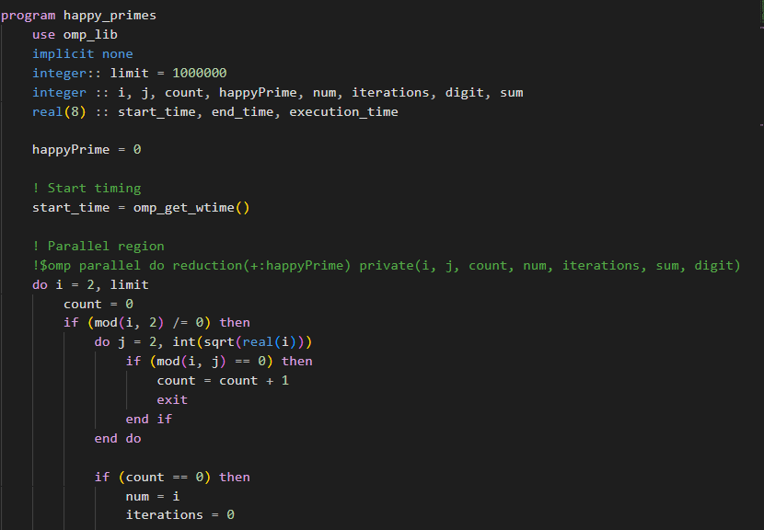
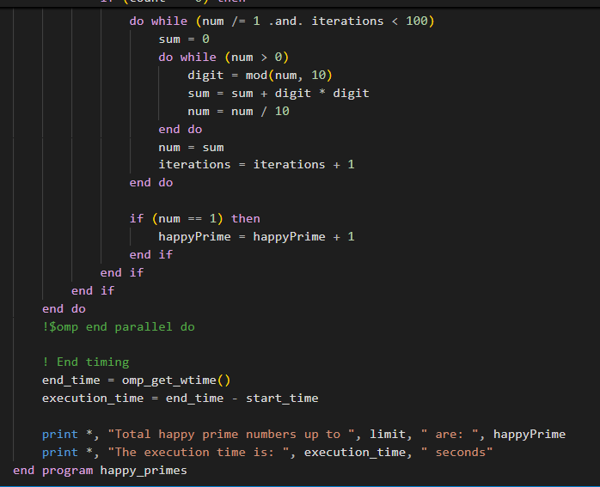

Slide 14
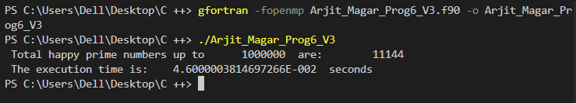
Version 3 Execution Time :
0.046 seconds.

Slide 15
Execution Time and Speedup Comparison
Version | Execution time (seconds) | Speedup Over Version 1
Version 1 | 3.381 | 1.00x
Version 2 | 0.666 | 5.08x
Version 3 | 0.046 | 73.50x

Slide 16
THE END
Thank you !!

