Slide 1
Ab initio Session 1
Introduction to
Ab Initio
Ab Initio Training
Notes:
CapGemini
Ab Initio Training

Slide 2
History of Ab Initio
Ab Initio Software Corporation was founded in the mid 1990's by Sheryl Handler, the former CEO at Thinking Machines Corporation, after TMC filed for bankruptcy. In addition to Handler, other former TMC people involved in the founding of Ab Initio included Cliff Lasser, Angela Lordi, and Craig Stanfill.
Ab Initio is known for being very secretive in the way that they run their business, but their software is widely regarded as top notch.
CapGemini
Ab Initio Training

Slide 3
History of Ab Initio
The Ab Initio software is a fourth generation data analysis, batch processing, data manipulation graphical user interface (GUI)-based parallel processing tool that is used mainly to extract, transform and load data.
The Ab Initio software is a suite of products that together provides platform for robust data processing applications. The Core Ab Initio Products are: The [Co>Operating System] The Component Library The Graphical Development Environment.
CapGemini
Ab Initio Training

Slide 4
What Does “Ab Initio” Mean?
Ab Initio is Latin for “From the Beginning.”
From the beginning Ab Initio was designed to support a complete range of business applications, from simple to the most complex. Crucial capabilities like parallelism and check pointing can’t be added after the fact.
The Graphical Development Environment and a powerful set of components allow our customers to get valuable results from the beginning.
CapGemini
Ab Initio Training
Notes:
CapGemini
Ab Initio Training
Ab Initio software helps you build large-scale data processing applications and run them in parallel environments.
Ab Initio software consists of two main programs:

Slide 5
Ab Initio’s focus
  “Moving Data”
    move small and large volumes of data in an efficient manner
    deal with the complexity associated with business data
  High Performance
    scalable solutions
  Better productivity
CapGemini
Ab Initio Training

Slide 6
Ab Initio’s Software
Ab Initio software is a general-purpose data processing platform for mission-critical applications such as:
    Data warehousing
    Batch processing
    Click-stream analysis
    Data movement
    Data transformation
CapGemini
Ab Initio Training

Slide 7
Applications of Ab Initio Software
Processing just about any form and volume of data.
Parallel sort/merge processing.
Data transformation.
Rehosting of corporate data.
Parallel execution of existing applications.
CapGemini
Ab Initio Training

Slide 8
Ab Initio Provides For:
Distribution - a platform for applications to execute across a collection of processors within the confines of a single machine or across multiple machines.
Reduced Run Time Complexity - the ability for applications to run in parallel on any combination of computers where the Ab Initio Co>Operating System is installed from a single point of control.
CapGemini
Ab Initio Training

Slide 9
Applications of Ab Initio Software in terms of Data Warehouse
Front end of Data Warehouse:
  Transformation of disparate sources
  Aggregation and other preprocessing
  Referential integrity checking
  Database loading
Back end of Data Warehouse:
  Extraction for external processing
  Aggregation and loading of Data Marts
CapGemini
Ab Initio Training

Slide 10
Ab Initio Product Architecture
User Applications
Ab Initio
EME
Development Environments
GDE Shell
Component Library
User-defined
Components
3rd Party
Components
The Ab Initio Co>Operating® System
Native Operating System (Unix, Windows, OS/390)
CapGemini
Ab Initio Training
Notes:
CapGemini
Ab Initio Training
GDE :

Slide 11
Ab Initio Architecture-Explanation
The Ab Initio Co operating system unites the network of computing resources-CPUs, storage disks , programs , datasets into a production quality data processing system with scalable performance and mainframe class reliability.
The Cooperating system is layered on the top of the native operating systems of the collection of servers .It provides a distributed model for process execution, file management ,debugging, process monitoring , checkpointing .A user may perform all these functions from a single point of control.
CapGemini
Ab Initio Training

Slide 12
Co>Operating System Services
Parallel and distributed application execution
  Control
  Data Transport
Transactional semantics at the application level.
Checkpointing.
Monitoring and debugging.
Parallel file management.
Metadata-driven components.
CapGemini
Ab Initio Training

Slide 13
Ab Initio: What We Do
Ab Initio software helps you build large-scale data processing applications and run them in parallel environments. Ab Initio software consists of two main programs:
Co>Operating System:
which your system administrator installs on a host Unix or Windows NT server, as well as on processing computers.
The Graphical Development Environment (GDE):
which you install on your PC (GDE Computer) and configure to communicate with the host.
CapGemini
Ab Initio Training

Slide 14
The Ab Initio Co>Operating® System
The Co>Operating System Runs across a variety of Operating Systems and Hardware Platforms including OS/390 on Mainframe, Unix, and Windows. Supports distributed and parallel execution. Can provide scalability proportional to the hardware resources provided. Supports platform independent data transport.
CapGemini
Ab Initio Training

Slide 15
The Ab Initio Co>Operating® System-Continued
The Ab Initio Co>Operating System
depends on parallelism to connect (i.e.,
cooperate with) diverse databases. It extracts,
transforms and loads data to and from
Teradata and other data sources.
CapGemini
Ab Initio Training

Slide 16
Co-Operating System Layer
GDE
Any OS
Solaris,
AIX, NT,
Linux,
NCR
Top Layer
GDE
Co-Op System
GDE
Same Co-Op Command
On any OS.
GDE
Graphs can be moved from
One OS to another w/o any
Changes.
CapGemini
Ab Initio Training

Slide 17
The Ab Initio Co>Operating System Runs on:
Sun Solaris
IBM AIX
Hewlett-Packard HP-UX
Siemens Pyramid Reliant UNIX
IBM DYNIX/ptx
Silicon Graphics IRIX
Red Hat Linux
Windows NT 4.0 (x86)
Windows NT 2000 (x86)
Compaq Tru64 UNIX
IBM OS/390
NCR MP-RAS
CapGemini
Ab Initio Training
Notes:
CapGemini
Ab Initio Training
Who is this aimed at? For a course held here, this might be useful. For a course held at a client site, they probably have a specific environment. Do we have a 1 page brochure that says all this?

Slide 18
Connectivity to Other Software
Common, high performance database interfaces:
  IBM DB2, DB2/PE, DB2EEE, UDB, IMS
  Oracle, Informix XPS, Sybase,Teradata,MS SQL Server 7
  OLE-DB
  ODBC
Other software packages:
  Connectors to many other third party products
  Trillium, ErWin, Siebel, etc.
CapGemini
Ab Initio Training
Notes:
CapGemini
Ab Initio Training
See comments on last notes page.

Slide 19
Ab Initio Cooperating System
Ab Initio Software Corporation, headquartered in Lexington, MA, develops software solutions that process vast amounts of data (well into the terabyte range) in a timely fashion by employing many (often hundreds) of server processors in parallel. Major corporations worldwide use Ab Initio software in mission critical, enterprise-wide, data processing systems. Together, Teradata and Ab Initio
deliver:
• End-to-end solutions for integrating and processing data throughout
the enterprise
• Software that is flexible, efficient, and robust, with unlimited scalability
• Professional and highly responsive support
The Co>Operating System executes your application by creating and managing the processes and data flows that the components and arrows represent.
CapGemini
Ab Initio Training

Slide 20
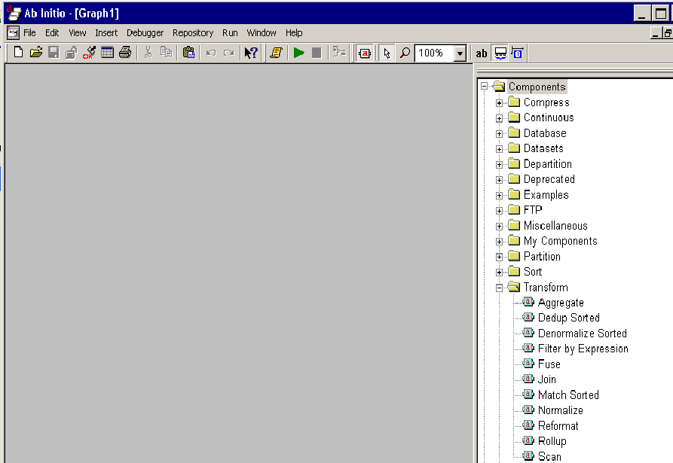
The GDE
Graphical Development
Environment GDE
CapGemini
Ab Initio Training

Slide 21
The GDE
The Graphical Development Environment (GDE) provides a graphical user interface into the services of the Co>Operating System. The Graphical Development Environment Enables you to create applications by dragging and dropping Components. Allows you to point and click operations on executable flow charts. The Co>Operating System can execute these flowcharts directly. Graphical monitoring of running applications allows you to quantify data volumes and execution times, helping spot opportunities for improving performance.
CapGemini
Ab Initio Training

Slide 22
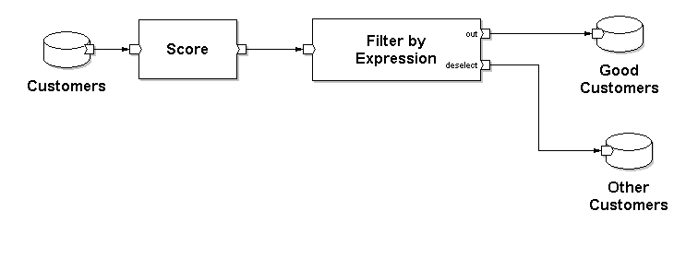
The Graph Model
CapGemini
Ab Initio Training

Slide 23
The Component Library:
The Component Library: Reusable software Modules for Sorting, Data Transformation, database Loading Etc. The components adapt at runtime to the record formats and business rules controlling their behavior.
Ab Initio products have helped reduce a project’s development and research time significantly.
CapGemini
Ab Initio Training

Slide 24
Components
Components may run on any computer running the Co>Operating System.
Different components do different jobs.
The particular work a component accomplishes depends upon its parameter settings.
Some parameters are data transformations, that is business rules to be applied to an input (s) to produce a required output.
CapGemini
Ab Initio Training

Slide 25
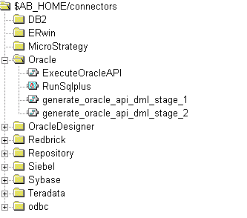
3rd Party Components
CapGemini
Ab Initio Training

Slide 26
EME
The Enterprise Meta>Environment (EME) is a high-performance object-oriented storage system that inventories and manages various kinds of information associated with Ab Initio applications. It provides storage for all aspects of your data processing system, from design information to operations data.
The EME also provides rich store for the applications themselves, including data formats and business rules. It acts as hub for data and definitions . Integrated metadata management provides the global and consolidated view of the structure and meaning of applications and data- information that is usually scattered throughout you business .
CapGemini
Ab Initio Training

Slide 27
Benefits of EME
The Enterprise Meta>Environment provides a rich store for applications and all of their associated information including :
Technical Metadata-Applications related business rules ,record formats and execution statistics
Business Metadata-User defined documentations of job functions ,roles and responsibilities.
Metadata is data about data and is critical to understanding and driving your business process and computational resources .Storing and using metadata is as important to your business as storing and using data.
CapGemini
Ab Initio Training

Slide 28
EME-Ab Initio Relevance
By integrating technical and business metadata ,you can grasp the entirety of your data processing – from operational to analytical systems.
The EME is completely integrated environment. The following figure shows how it fits in to the high level architecture of Ab Initio software.
CapGemini
Ab Initio Training

Slide 29
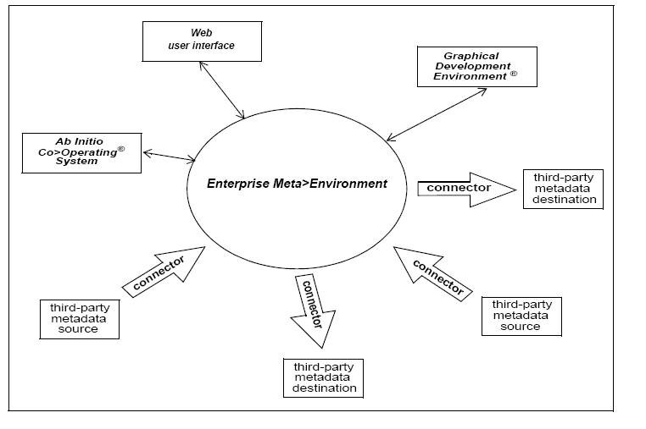
CapGemini
Ab Initio Training

Slide 30
Stepwise explanation of Ab Initio Architecture
You construct your application from the building blocks called components, manipulating them through the Graphical Development Environment (GDE).
You check in your applications to the EME.
The EME and GDE uses the underlining functionality of the Co>Operating System to perform many of their tasks. The Cooperating System units the distributed resources into a single “virtual computer” to run applications in parallel.
Ab Initio software runs on Unix ,Windows NT,MVS operating systems.
CapGemini
Ab Initio Training

Slide 31
Stepwise explanation of Ab Initio Architecture - continued
Ab Initio connector applications extract metadata from third part metadata sources into the EME or extract it from the EME into a third party destination.
You view the results of project and application dependency analysis through a Web user interface .You also view and edit your business metadata through a web user interface.
CapGemini
Ab Initio Training

Slide 32
EME :Various users constituency served
The EME addresses the metadata needs of three different constituencies:
Business Users
Developers
System Administrators
CapGemini
Ab Initio Training

Slide 33
EME :Various users constituency served
Business users are interested in exploiting data for analysis, in particular with regard to databases ,tables and columns.
Developers tend to be oriented towards applications ,needing to analyze the impact of potential program changes.
System Administrator and production personnel want job status information and run statistics.
CapGemini
Ab Initio Training

Slide 34
EME Interfaces
We can create and manage EME through 3 interfaces:
GDE
Web User Interface
Air Utility
CapGemini
Ab Initio Training

Slide 35
Thank You
End of Session 1
CapGemini
Ab Initio Training

