Slide 1
Ab initio Session 2
Building a simple
graph
Ab Initio Training
Notes:
CapGemini
Ab Initio Training

Slide 2
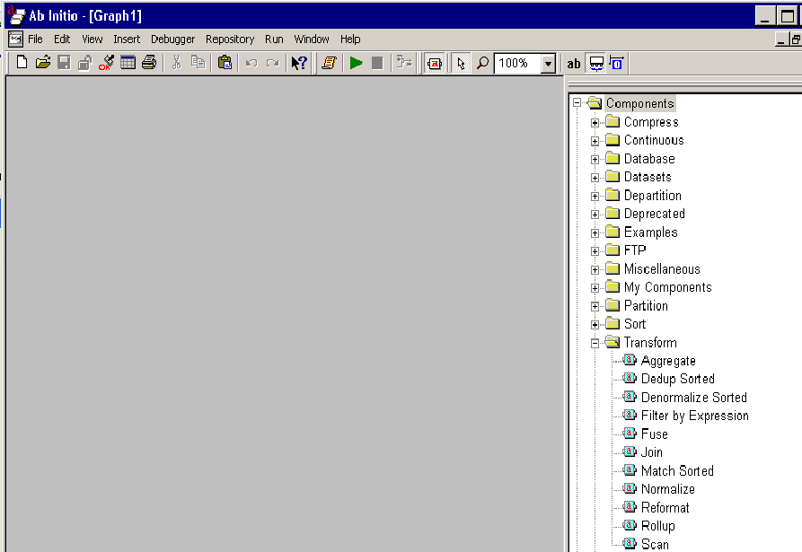
Graphical Development
Environment GDE
CapGemini
Ab Initio Training

Slide 3
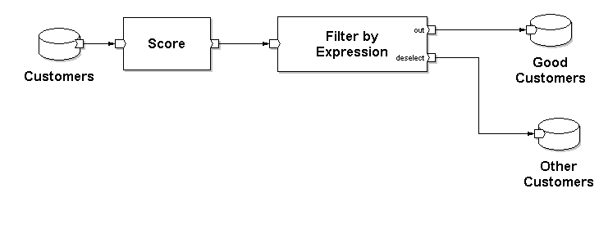
The Graph Model
CapGemini
Ab Initio Training

Slide 4
The Graph Model: Naming the Pieces
Components
Datasets
Dataset
Flows
CapGemini
Ab Initio Training
Notes:
CapGemini
Ab Initio Training

Slide 5
Components
Components may run on any computer running the Co>Operating System.
Different components do different jobs.
The particular work a component accomplishes depends upon its parameter settings.
Some parameters are data transformations, that is business rules to be applied to an input(s) to produce a required output.
CapGemini
Ab Initio Training

Slide 6
Categories of Components
  Compress Components
  Continuous Components
  Database Components
  Dataset Components
  Departition Components
  FTP Components
  Miscellaneous Components
  Partition Components
  Sort Components
  Transform Components
  Translate Components
  Validate Components
CapGemini
Ab Initio Training

Slide 7
Datasets
A dataset is a source or destination of data. It can be a simple file, a database table, a SAS dataset, ...
Datasets may reside on any machine running the Co>Operating System.
Datasets may reside on other machines if connected by FTP or database middleware.
Data is always described by record format metadata (termed “dml”).
CapGemini
Ab Initio Training

Slide 8
Locating Files with URLs
Ab Initio software uses Universal Resource Locator(URLs) to locate files.You enter URLs for datasets,record formats,input and output files,and so on in component’s properties dialog.Enter files and multifiles on the description tab,transforms on the parameters tab,and the DML record formats on the ports tab.The Ab Initio URL fomat is:
[file|mfile]://hostname/directory1/directory2…/filename
CapGemini
Ab Initio Training

Slide 9
More on URLs
Argument And Description
File:Specifies a serial file.
Mfile:Specifies a multifile.
Hostname:Specifies the name of the computer containing the file you want.
Directory1…:Specifies the directory path of the file.
Filename:Specifies the filename.
CapGemini
Ab Initio Training

Slide 10
Examples on URLs
This file specifies a file named input.dat,located in the tmp directory on the computer named revkalt.abinito.com:
file://revkalt.abinito.com/tmp/input.dat
This example specifies a multifile named customer.dat,located in the tmp/mfs subdirectory on a computer named mycomputer:
mfile://mycomputer.abinito.com/tmp/mfs/customer.dat
CapGemini
Ab Initio Training

Slide 11
What is a Record Format
record
decimal(6) cust_id;
string (18) last_name;
string (16) first_name;
string (26) street_addr;
string (2) state;
decimal (5) zip;
string (1) gender;
decimal (7) income;
newline (1) string;
end
Name of
the Field
Data Type
Length
In what format will the source data be read from the source data set or
written to a target data set
CapGemini
Ab Initio Training
Notes:
CapGemini
Ab Initio Training
Notes

Slide 12
About Record Formats :
A record format is a description of data.
For example, you might have a database of employees where each record contains four fields: Six characters for the employee's first name, followed by ten characters for the employee's last name, followed by three characters for the employee's age, and six characters for the employee's date of hire.
One employee's record might look like this (where each square represents one character, or byte in the record):
You can enter or edit a record format using the Record Format Editor.
CapGemini
Ab Initio Training

Slide 13
Text Record Format Representation:
record
decimal(4) id;
string(6) first_name;
string(6) last_name;
date("YYYY-DD-MM") newfield;
end;
CapGemini
Ab Initio Training

Slide 14
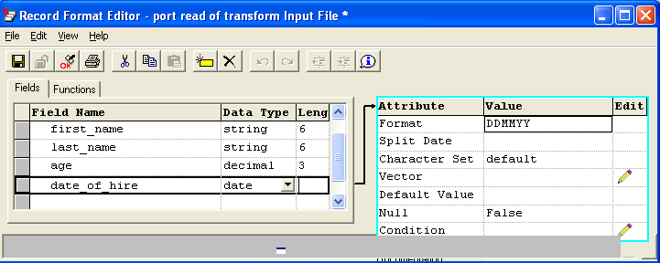
Specifying the Record Format of a Port
Record Format Editor
CapGemini
Ab Initio Training

Slide 15
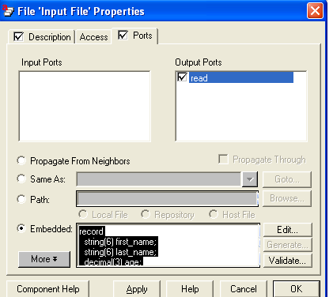
Specifying the Record Format of a Port
You can assign a record format to a dataset component or program component by viewing the component's properties dialog, and specifying the record format on the Ports tab.
CapGemini
Ab Initio Training

Slide 16
Specifying the Record Format of a Port
On this tab, you specify the record format of a component port using one of the following:
A record type specifier.
A reference to a file containing a collection of type specifiers.
Using a type specifier other than record. Although this is not commonly done, it is perfectly legal. For example, the following type specifier indicates that the record format is simply a five-character string: string (5)
Record formats are usually comprised of multiple fields (called columns in a database table). You define a field by using a keyword that represents a DML base or compound type, followed by additional information that the DML type needs (such as the size of the field), and/or by optional information.
CapGemini
Ab Initio Training

Slide 17
Introduction to DML
DML is an acronym for Data Manipulation Language. It is the Ab Initio programming language you can use to define record formats, expressions, transform functions, and key specifiers. Components in the Ab Initio Co>Operating System use DML to describe, interpret, and manipulate data.
CapGemini
Ab Initio Training

Slide 18
What Data Can Be Described?
There are both fixed-size and variable-length types.
ASCII, EBCDIC, UNICODE character sets are supported.
Supported types can represent strings, numbers, binary numbers, packed decimals, dates …
Complex data formats can consist of nested records, vectors, ...
CapGemini
Ab Initio Training

Slide 19
About Records
In general, a record is one complete entry in a file or in a database table. A record about a customer might contain individual fields for account number, account type, name, address, and telephone number.
In Ab Initio products, a record is a DML object that contains a sequence of named fields (called columns in a database table), each of which can be a different DML base or compound type. Most record types are fairly simple, containing only data fields.
CapGemini
Ab Initio Training

Slide 20
To Do Cues
When you create a graph, you will see yellow highlights in certain areas. These To-do cues prompt you for additional information the GDE needs before it can run the graph, as follows:
?? :When a layout indicator is colored yellow, the component has no layout. For program components, layout is set either by propagation or manually. Double-click the layout indicator and select the desired layout.
When a component has a square yellow box, its required parameters lack values. Double-click the square box and fill in the missing parameters.
CapGemini
Ab Initio Training

Slide 21
out* :When the name of a port is accented with yellow, the record format for the port is not set. Record formats are usually propagated, but are sometimes set manually. Connect the port to another port with known record format, or double-click the port and add the new record format.
When a port is highlighted with yellow, the port needs at least one flow. Connect one or more flows to the port.
CapGemini
Ab Initio Training

Slide 22
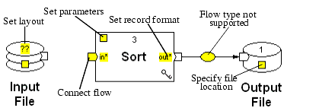
More To Do Cues
To-do cues are yellow highlighted areas that require action.
CapGemini
Ab Initio Training

Slide 23
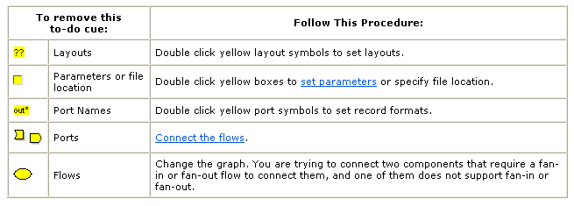
Eliminating To Do Cues
Double click a component with to-do cues to reach the Properties dialog for that component.
CapGemini
Ab Initio Training

Slide 24
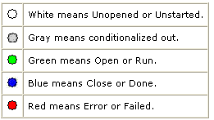
LED status indicators
For quick diagnosis of the pass/fail state of components and graphs, the GDE displays status indicators when you run an graph. The status is depicted with colored LEDs, as follows:
CapGemini
Ab Initio Training

Slide 25
More on LED status indicators
Files normally start in an Unopened state, progress to Open, and end in a Closed state. Components, flows, and graphs normally begin in an Unstarted state, progress to Run, and end in a Done state. When abnormal events occur, components change to an Error or Failed state.
If you let your mouse pointer hover over a red status indicator, the GDE displays the error message associated with the failure. If you double-click the red status indicator, the Application Job Output Window opens with the complete error message in it.
CapGemini
Ab Initio Training

Slide 26
Thank You
End of Session 2
CapGemini
Ab Initio Training

