Slide 1
Ab initio Session 6
Introduction to
Ab Initio
Ab Initio Training
Notes:
CapGemini
Ab Initio Training

Slide 2
DATASETS COMPONENTS
Dataset components represent data records or act upon data records as follows:
Input File
Intermediate File
Lookup File
Output File
Read Multiple Files
Write Multiple Files
CapGemini
Ab Initio Training

Slide 3
Input File
Input File represents records read as input to a graph from one or more serial files or from a multifile.
INPUT FILE is not a phased component. The phase number it displays in the GDE refers to the phase number of the component that reads from it. (If the INPUT FILE is read in more than one phase, the phases are shown as a range of phase numbers.)
CapGemini
Ab Initio Training

Slide 4
Parameters : Input File
The Input File Properties dialog does not have a prominent Parameters tab. However, you can specify values for parameters on the Description, Access, and Ports tabs of the Input File Properties dialog. This includes parameters such as input file location, file handling behavior and permissions, and the intermediate record format.
CapGemini
Ab Initio Training

Slide 5
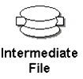
Intermediate File
Intermediate File represents one or multiple serial files or a multifile of intermediate results that a graph writes during execution, and saves for your review after execution.
CapGemini
Ab Initio Training

Slide 6
Parameters : Intermediate File
The Intermediate File Properties dialog does not have a Parameters tab. However, you can specify values for parameters on the Description, Access, and Ports tabs of the Intermediate File Properties dialog. This includes parameters such as intermediate file location, file handling behavior and permissions, and the intermediate record format.
CapGemini
Ab Initio Training

Slide 7
Runtime Behavior
The upstream component writes to Intermediate File through Intermediate File's write port. After the flow of data records into the write port is complete, the downstream component reads from Intermediate File's read port. This guarantees that the writing and reading processes are in two separate phases
CapGemini
Ab Initio Training

Slide 8
Lookup File
Lookup File represents one or multiple serial files or a multifile of data records small enough to be held in main memory, letting a transform function retrieve records much more quickly than it could retrieve them if they were stored on disk.
Lookup File associates key values with corresponding data values to index records and retrieve them.
CapGemini
Ab Initio Training

Slide 9
Parameters for Lookup File
key : (key specifier, required)
Name(s) of the key field(s) against which Lookup File matches its arguments.
RecordFormat : (record format, required)
The record format you want Lookup File to use when returning data records.
CapGemini
Ab Initio Training

Slide 10
How to Use Lookup File
Unlike other dataset components, Lookup File is not connected to other components in graphs. In other words, it has no ports. However, its contents are accessible from other components in the same or later phases.
You use the Lookup File in other components by calling one of the following DML functions in any transform function or expression parameter: lookup, lookup_count, or lookup_next.
The first argument to these lookup functions is the name of the Lookup File. The remaining arguments are values to be matched against the fields named by the key parameter. The lookup functions return a record that matches the key values and has the format given by the RecordFormat parameter.
CapGemini
Ab Initio Training

Slide 11
How to Use Lookup File
A file you want to use as a Lookup File must fit into memory. If a file is too large to fit into memory, use Input File followed by Match Sorted or Join instead.
Information about Lookup Files is stored in a catalog, which allows you to share them with other graphs
CapGemini
Ab Initio Training

Slide 12
Converting an Output File to a Lookup File
You can convert an Output File generated in one phase of a graph to a Lookup File used in a later phase. To do this:
Create an Output File to contain the data records you want to use as a Lookup File.
On the Description tab of the File Properties dialog box for that Output File, check Add to Catalog.
CapGemini
Ab Initio Training

Slide 13
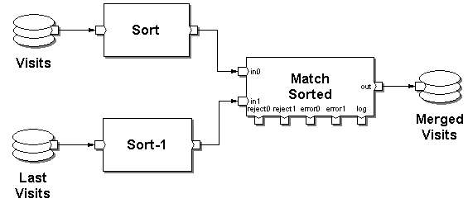
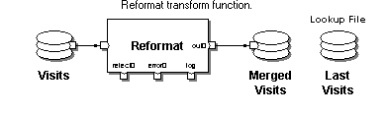
CapGemini
Ab Initio Training

Slide 14
Output File
Output File represents records written as output from a graph into one or more serial files or a multifile.
When the target of an Output File component is a special file such as /dev/null, NUL, a named pipe, or some other special file, the Co>Operating System never deletes and re-creates that file, nor does it ever truncate it.
OUTPUT FILE is not a phased component. The phase number it displays in the GDE refers to the phase number of the component that writes to it.
CapGemini
Ab Initio Training

Slide 15
Read Multiple Files
Read Multiple Files is useful for reading records from a number of different target files. It extracts the filenames of these files from the component's input flow. Then it reads the records from each target file and writes the records to the output port. (You can set optional parameters to control how many records Read Multiple Files skips before starting to read records, and the maximum number of records to read.) An optional transform function allows you to manipulate the records or change their formats before they are written as output.
CapGemini
Ab Initio Training

Slide 16
Runtime Behaviour
Read Multiple Files does the following:
Reads an input record from the in port.
Passes the input record to the get_filename transform function.
If the get_filename function returns a string that does not contain a valid filename, or if the file derived from the string is empty or missing, Read Multiple Files proceeds according to what is specified in the filename-error, file-empty, and file-missing parameters.
If the get_filename function returns a string containing a valid filename, Read Multiple Files retrieves the target file.
NOTE: The target file specified in the string must be local to the machine where Read Multiple Files is running. Note also that in multifile layouts, different instances of Read Multiple Files can be running on different computers, so target filenames referring to directories that exist only on particular computers must be partitioned carefully. To use relative paths, use t he DML function this_partition_path.
CapGemini
Ab Initio Training

Slide 17
Runtime Behavior(contd..)
Opens the target file and reads records from it:
  If an input_type data type is defined in the transform package, Read Multiple Files uses this type to read records from the file. If you omit input_type, Read Multiple Files uses the record type defined on the out port.
  If the filter parameter was set to Range, and the skip-count parameter is non-0, Read Multiple Files skips the specified number of records before reading subsequent records from the file.
  If the filter parameter was set to Range, and the read-count parameter is non-0, Read Multiple Files reads up to this maximum number of records from the file. If read_count is less than or equal to zero, Read Multiple Files reads the remainder of the file.
  If a repair_input function is defined in the transform package, Read Multiple Files attempts to repair any malformed records. If the record is successfully repaired, the new record is used instead of the original malformed record. Otherwise, the malformed record is logged and discarded.
CapGemini
Ab Initio Training

Slide 18
Runtime Behavior(contd..)
Read Multiple Files writes records to the out port.
  If a reformat function is defined in the transform package, the component passes each record read from the target file to the reformat function, along with the filename and the original input file record. The output of the reformat function is written to the out port. If you omit a reformat function but provide an input_type data type in the package, the component behaves like a Reformat component with no transform package, reading records from the target file using the input_type, and performing any conversion necessary to match the record format on the out port.
  If the reject and error ports are connected to flows and the reformat transform function returns NULL, Read Multiple Files writes an error message to the error port and the current record to the reject port.
  Read Multiple Files stops execution of the graph when the number of reject events exceeds the value given by the following formula:
limit + (ramp * number_of_records_processed_so_far)
CapGemini
Ab Initio Training

Slide 19
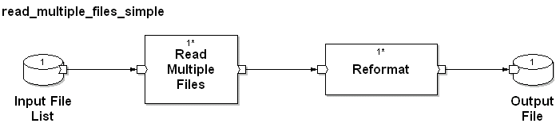
CapGemini
Ab Initio Training

Slide 20
Write Multiple Files
Write Multiple Files does the following:
Reads input records
Derives a local filename from each input record
Passes the record through an optional transform function
Writes a designated local file
CapGemini
Ab Initio Training

Slide 21
Runtime Behavior
Write Multiple Files does the following:
Reads records from the in port.
Passes each input record to the get_filename function. This function returns a string containing a filename.
NOTE: The output file specified in the string must be located on the machine here Write Multiple Files is running. Note also that in multifile layouts, different instances of Write Multiple Files can be running on different computers; so output filenames referring to directories that exist only on particular computers must be formulated carefully. To use relative paths, use the this_partition_path function.
CapGemini
Ab Initio Training

Slide 22
Runtime Behavior(contd..)
For each record, Write Multiple Files:
  Opens the designated output file, if it is not already open. If the transform package includes an output_type data type, the component uses this type to write data to the output file. Otherwise, it uses the record type specified on the in port.
  If the number of open files is limited and opening a new output file would make the number of open files the exceed the limit of open files,the component closes the output file least recently opened before opening the new file.
  If the package includes a reformat function, the component passes the input record to that function and writes a resulting record to the output file. Otherwise, it writes the input record to the output file. In this case, data transformations still take place as appropriate to the input and output record formats, as happens in a Reformat component with no transform.
  If either the get_filename function or the reformat function returns NULL, the component writes the current input record to the reject port and writes an error message to the error port.
  The component stops execution of the graph when the number of reject events exceeds the result of the following formula:
  limit + (ramp * number_of_records_processed_so_far)
CapGemini
Ab Initio Training

Slide 23
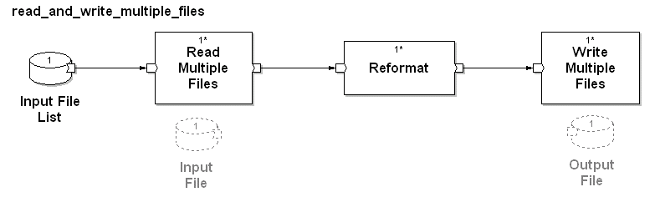
CapGemini
Ab Initio Training

Slide 24
Exercise 6
CapGemini
Ab Initio Training

Slide 25
Exercise 7
CapGemini
Ab Initio Training

Slide 26
Thank You
End of Session 6
CapGemini
Ab Initio Training

