Slide 1
Ab initio Session 7
Introduction to
Ab Initio
Ab Initio Training
Notes:
CapGemini
Ab Initio Training

Slide 2
DATABASE COMPONENTS
Input Table
Output Table
Update Table
Run SQL
CapGemini
Ab Initio Training

Slide 3
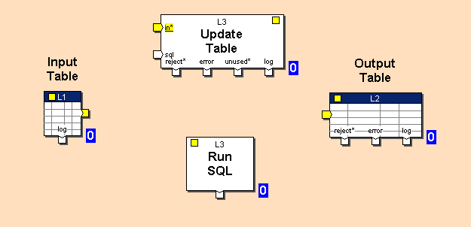
CapGemini
Ab Initio Training

Slide 4
Input Table
Input Table unloads data records from a database into an Ab Initio graph, allowing you to specify as the source either a database table, or an SQL statement that selects data records from one or more tables.
CapGemini
Ab Initio Training

Slide 5
Output Table
Output Table loads data records from a graph into a database, letting you specify the records' destination either directly as a single database table, or through an SQL statement that inserts data records into one or more tables.
CapGemini
Ab Initio Training

Slide 6
Update Table
Update Table executes UPDATE, INSERT, and DELETE statements in embedded SQL format (or a stored procedure) to modify a table in a database, and writes status information to the log port.
CapGemini
Ab Initio Training

Slide 7
How the SQL’s are executed
Update Table executes SQL UPDATE, INSERT, and DELETE statements (or a stored procedure) located in the files (or embedded statements) referenced by the updateSqlFile and (if specified) insertSqlFile parameters.
There should be only one SQL statement each per updateSqlFile and insertSqlFile. The updateSqlFile statement need not be UPDATE, and the insertSqlFile need not be INSERT; however, only UPDATE, INSERT, and DELETE statements (or a stored procedure call) should be used (except for Teradata in non-api mode).
CapGemini
Ab Initio Training

Slide 8
How the SQL’s are executed(contd..)
Note that updateSqlFile and insertSqlFile need not be files: the SQL statements can be embedded in Update Table (select Embedded on the Parameters tab and type the statement in the adjacent box). An advantage of coding this way is that embedded statements can contain references to other graph parameters. The parameters must be specified with the ${} syntax — for example, ${table_name}.
The SQL statements referenced by the updateSqlFile and (if specified) insertSqlFile parameters are not checked by the GDE validate operation.
CapGemini
Ab Initio Training

Slide 9
Runtime Behavior
The statement referenced by updateSqlFile is tried first. If the statement can be successfully applied to the current record, it is executed; and the statement referenced by insertSqlFile is skipped.
If the updateSqlFile statement cannot be applied to the current record, the component attempts to execute the statement referenced by insertSqlFile.
CapGemini
Ab Initio Training

Slide 10
Run SQL Component
Run SQL executes SQL statements in a database and writes confirmation messages to the log port. You can use Run SQL to perform database operations such as table or index creation.
CapGemini
Ab Initio Training

Slide 11
Run SQL Component
DBConfigFile (filename, required)
Name of the database table configuration file.
SQLFile (filename, required)
Name of the file containing SQL statements to be executed against the database.
Note that the SQL statements, instead of being located in a file, can be embedded in the component. For more information, see "Specifying the source of the SQL for RUN SQL".
Interface (choice, optional)
api or utility.
Default is api.
ignore_drop_table_errors (boolean, optional)
True — Suppress and ignore errors generated by the database when the SQL attempts to drop a nonexistent table.
False — Do not ignore such errors.
CapGemini
Ab Initio Training

Slide 12
Executing SQL for Run SQL
If interface is api, the appropriate routines in the database's runtime library (called through the database's API) are invoked.
If interface is utility, Run SQL invokes a database-specific utility to execute the SQL statements referenced by the SqlFile parameter. If the utility successfully executes the statements, it exits with status 0.
In api mode the component automatically issues a COMMIT after executing your SQL statements.
In utility mode, whether you do or do not need explicitly to issue a COMMIT at the end of your SQL statements depends on the vendor-specific behavior of the utility the component is using. For example, sqlplus (utility-mode Oracle) implicitly performs a COMMIT when you issue an EXIT.
CapGemini
Ab Initio Training

Slide 13
api mode versus utility mode
When choosing whether to use api or utility mode with Run SQL, you should keep the following considerations in mind:
  Usually, api mode (the default) gives better diagnostics with Run SQL.
  utility mode allows you to access all language extensions that the database vendors build into their utilities. For example, to use PL/SQL (with Oracle), you must be in utility mode.
  utility mode is recommended if you are executing stored procedures; you get better diagnostics (if you need them) with stored procedures in utility mode than in api mode.
CapGemini
Ab Initio Training

Slide 14
Exercise 8
CapGemini
Ab Initio Training

Slide 15
Thank You
End of Session 7
CapGemini
Ab Initio Training

