Slide 1
Ab inito Session 8
Introduction to
Ab Initio
Ab Initio Training
Notes:
CapGemini
Ab Initio Training

Slide 2
Normalize
(Vector Creation)
CapGemini
Ab Initio Training

Slide 3
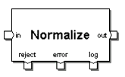
Normalize
Normalize generates multiple output data records from each of its input records. You can directly specify the number of output records for each input record, or the number of output records can depend on some calculation.
CapGemini
Ab Initio Training

Slide 4
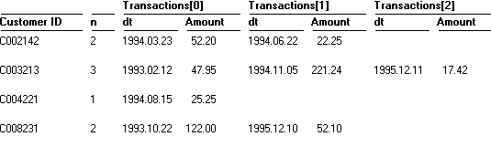
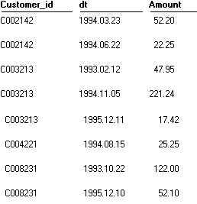
CapGemini
Ab Initio Training

Slide 5
Vector creation expressions
The following example produces a vector of three integers: 1, 2, and 3:
[vector 1, 2, 3]
The following example produces a vector of two records, each with fields id and name.
[vector
[record
id 123343
name "John Smith"],
[record
id 123344
name "Mary Jones"]]
CapGemini
Ab Initio Training

Slide 6
Parameters for Normalize
Limit
Log
Ramp
Reject Threshold
Transform
Either the name of the file containing the types and transform functions, or a transform string.
CapGemini
Ab Initio Training

Slide 7
Diagnostic Ports: Reject, Error
Reject: Input records that caused errors.
Error: Error messages.
CapGemini
Ab Initio Training

Slide 8
About Normalize Transform Functions
input_select
initialize
length
normalize
(if you have not defined temporary_type)
finalize
output_select
CapGemini
Ab Initio Training

Slide 9
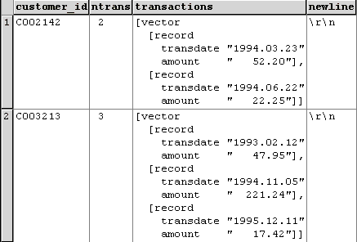
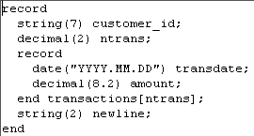
Normalization : Input
Input Record
Structure
Input Data
CapGemini
Ab Initio Training

Slide 10

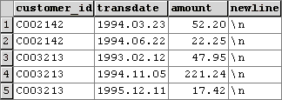
Normalization : Output
Output Record
Structure
Output Data
CapGemini
Ab Initio Training

Slide 11
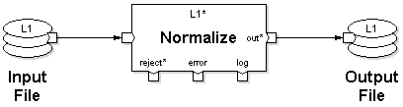
Normalization : Input & Output
Output
Input
CapGemini
Ab Initio Training

Slide 12
Explanation of transform functions
Following is an explanation, section-by-section, of the transform functions in the Normalize example above:
length - The length transform function takes the input record as an argument, and from the value of the n field, determines how many times to call the normalize transform function:
out :: length(in) =
begin
out :: in.n;
end;
CapGemini
Ab Initio Training

Slide 13
Explanation of transform functions - normalize
normalize - The normalize transform function takes the following arguments:
The input record
An index value which increases by one - starting from 0 -each time Normalize calls the normalize transform function with another record
out :: normalize(in, index) =
begin
out.customer_id :: in.customer_id;
out.dt :: in.transactions[index].dt;
out.amount :: in.transactions[index].amount;
end;
The normalize transform function produces an output record containing customer_id, dt, and the corresponding amount for each transaction in the input records.
CapGemini
Ab Initio Training

Slide 14
Explanation of Other transform functions - finalize
finalize - The finalize transform function performs the last step in a multistage transform:
out :: finalize(temp, in) =
begin
out.key :: in.key;
out.count :: temp.count;
out.average :: temp.sum / temp.count;
end;
The finalize transform function takes the temporary storage record and the input record as arguments, and produces a record that has the record format of the out port.
CapGemini
Ab Initio Training

Slide 15
Explanation of Other transform functions - initialize
initialize - The initialize transform function initializes temporary storage. This transform function takes a single argument - the input record - and returns a single record with type temporary_type:
temp :: initialize(in) =
begin
temp.count :: 0;
temp.sum :: 0;
end;
CapGemini
Ab Initio Training

Slide 16
Explanation of Other transform functions – temporary_type
temporary_type - If you want Normalize to use temporary storage, define this storage as a record with a type named temporary_type:
type temporary_type =
record
int count;
int sum;
end;
CapGemini
Ab Initio Training

Slide 17
Runtime behaviour
Normalize generates a series of output data records for each input data record by calling a transform function repeatedly. At runtime, Normalize executes the following steps:
Input selection
If you have defined input_select, it filters the input records. If the expression evaluates to 0 for a particular record , Normalize does not process the record (i.e., the record does not appear on any output port).
If the expression produces NULL for a particular record , Normalize :
Writes the record to the reject port
CapGemini
Ab Initio Training

Slide 18
Input selection
Writes a descriptive error message to the error port
Discards the information if you do not connect flows to the reject or error ports
If the expression evaluates to anything other than 0 or NULL for a particular record, Normalize processes the record.
If you have not defined input_select, Normalize processes all records.
CapGemini
Ab Initio Training

Slide 19
Temporary initialization
Normalize passes the input record to the initialize transform function, which creates a temporary record.
This temporary record has the record type temporary_type.
Typically, Normalize does not need temporary storage. If you have not defined temporary_type, Normalize does not call the initialize transform function.
CapGemini
Ab Initio Training

Slide 20
Computation
Normalize passes the input record to the length transform function which determines n: the number of times to call the normalize transform function.
If you have defined temporary_type, Normalize calls the normalize transform function n times with three arguments: the temporary record, the input record, and an index value increasing from 0 to n-1. Each time it calls the transform function it produces a new temporary record.
If you have not defined temporary_type, Normalize calls the normalize transform function n times with only two arguments: the input record and the index value. Each time it calls the transform function it produces an output record.
CapGemini
Ab Initio Training

Slide 21
Finalization
If you have defined temporary_type, Normalize calls the finalize transform function with the temporary record and the input record as arguments every time it calls the normalize transform function.
The finalize transform function produces an output record.
Typically, Normalize does not need temporary storage. If you have not defined temporary_type, Normalize does not call the finalize transform function.
CapGemini
Ab Initio Training

Slide 22
Output selection
If you have defined the output_select transform function, it filters the output records.
Normalize ignores records for which output_select returns 0; it writes all others to the out port.
If you have not defined the output_select transform function, Normalize writes all records to the out port.
CapGemini
Ab Initio Training

Slide 23
Exercise 9
CapGemini
Ab Initio Training

Slide 24
Thank You
End of Session 6
CapGemini
Ab Initio Training

