Slide 1
Ab inito Session 9
Introduction to Ab Initio
Ab Initio Training
Notes:
CapGemini
Ab Initio Training

Slide 2
Denormalize (including vector creation)
CapGemini
Ab Initio Training

Slide 3
Introduction Of Denormalize
Denormalize Sorted consolidates groups of related data records into a single output record with a vector field for each group, and optionally computes summary fields in the output record for each group .
For example, if you have records with people and the households to which they belong, Denormalize Sorted can consolidate those records into records of households, each with a variable number of people.
Denormalize Sorted requires grouped input.
CapGemini
Ab Initio Training

Slide 4
Denormalize generates one output record for a group of input records. In that respect it is similar to Rollup, but the output can more easily include a vector (array) field.
Denormalize has these stages:
  Input Selection input_select
  Initialization initialize
  Initialization initial_denormalization
  Rollup rollup
  Denormalize denormalize
  Finalization finalize
  Output Selection output_select
CapGemini
Ab Initio Training

Slide 5

Diagnostic Ports: Reject, Error
Reject: Input records that caused errors.
Error: Error messages.
CapGemini
Ab Initio Training

Slide 6
Parameters for Denormalize
key :- Optional Key specifier
Name(s) of the key field(s) Denormalize Sorted can use to define groups of data records.
key-method:- Optional Choice
Method by which the component groups records.
Use key specifier :-written as a series of fields and modifiers that apply to those fields, separated by semicolons, contained in braces:
{ field1 modifier1 modifier2 ... ; field2 modifier3 ... }
Use key_change function :-Denormalize Sorted considers records as belonging to the same group if they have the same key value, or if the key_change transform function returns 0 (false).
CapGemini
Ab Initio Training

Slide 7
limit
log
ramp
reject-threshold
transform
CapGemini
Ab Initio Training

Slide 8
Denormalization
Jane Smith
Bill Smith
Thom Smith
Andy Jones
Elle Jones
Lori Lee
Eric Ruben
Anne Ruben
Smith 3 Jane Bill Thom
Jones 2 Andy Elle
Lee 1 Lori
Ruben 2 Eric Anne
CapGemini
Ab Initio Training

Slide 9
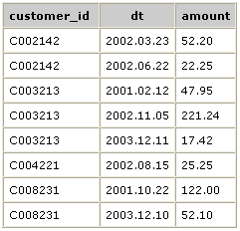
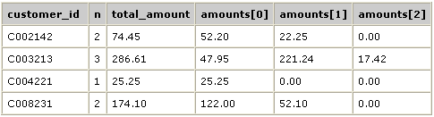
Denormalization of Data
Output Data
Input Data
CapGemini
Ab Initio Training

Slide 10
To accomplish the task:
1. Group the input data records by customer_id and dt.
2. Use a Denormalize Sorted component with a transform file containing both a rollup and a denormalize transform function.
CapGemini
Ab Initio Training

Slide 11
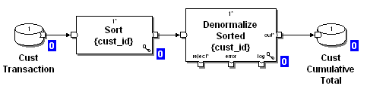
Denormalize Sorted
CapGemini
Ab Initio Training

Slide 12
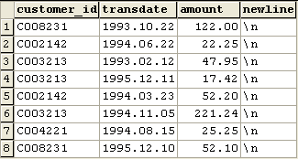
Denormalized Sorted Input Data and Record Format
record
string(7) customer_id;
date("YYYY.MM.DD") transdate;
decimal(8.2) amount;
string(1) newline = "\n";
end
Input Record Format
Input Data
CapGemini
Ab Initio Training

Slide 13
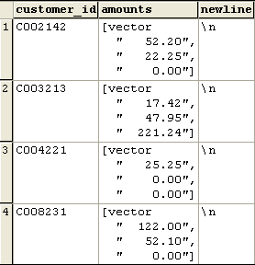
Denormalized Sorted Output Data
and Record Format
record
string(7) customer_id;
decimal(8.2) amounts[3];
string(1) newline = "\n";
end
Output Record Format
Output Data
CapGemini
Ab Initio Training

Slide 14
The result is a combination of Rollup Sorted and Denormalize Sorted, as shown in the following example:
type denormalization_type = decimal(8.2)[3];
out :: initial_denormalization() =
begin
out :: 0;
end;
type temporary_type =
record
decimal(8.2) total_amount;
decimal(4) count;
end;
out :: initialize(in) =
begin
out.total_amount :: 0;
out. count :: 0;
end;
CapGemini
Ab Initio Training

Slide 15
out :: rollup(temp, in) =
begin
out.total_amount :: temp.total_amount + in.total_amount;
out.count :: temp.count + 1;
end;
out :: denormalize(temp, denormalization, in, count) =
begin
out. index :: count;
out.elt :: in. amount;
out. update :: count < 3;
end;
out :: finalize(temp, denormalization, in) =
begin
out.customer_id :: in.customer_id;
out.n :: temp.count;
out.total_amount :: temp.total_amount;
out. amounts :: denormalization;
end;
CapGemini
Ab Initio Training

Slide 16
Explanation of types and transform functions
denormalization_type - The first line declares the denormalization vector:
initial_denormalization - The initial_denormalization transform function sets all the elements of the denormalization vector to 0.
temporary_type -defines the temp. storage as a record with a type named temporary_type:
initialize - At the start of each group, the initialize transform function sets the values of the count and total_amount fields of the temporary record to 0.
CapGemini
Ab Initio Training

Slide 17
rollup - The rollup transform function accumulates for the group the sum of the values from the total_amount fields and the number of records processed.
denormalize - The denormalize transform function saves the value of the amount field from each input record of the group in the appropriate place in the denormalization vector.
finalize - This function gathers the value of the customer_id field from the last input record of the group, the values of the count and total_amount fields from the temporary record for the group, and the values in the denormalization vector, and produces the output record:
CapGemini
Ab Initio Training

Slide 18
Other transform functions
input_select - If you define the input_select transform function, it performs selection of input records.
out :: input_select(in) =
begin
out :: amount > 25.00;
end;
key_change - to define grouping as an alternative to using the key parameter
out :: key_change(prev, curr) =
begin
out :: curr.customer_id != prev.customer_id;
end;
CapGemini
Ab Initio Training

Slide 19
output_select - If you define output_select, it performs selection of output records
out :: output_select(final) =
begin
out :: total_amount > 5.00;
end;
CapGemini
Ab Initio Training

Slide 20
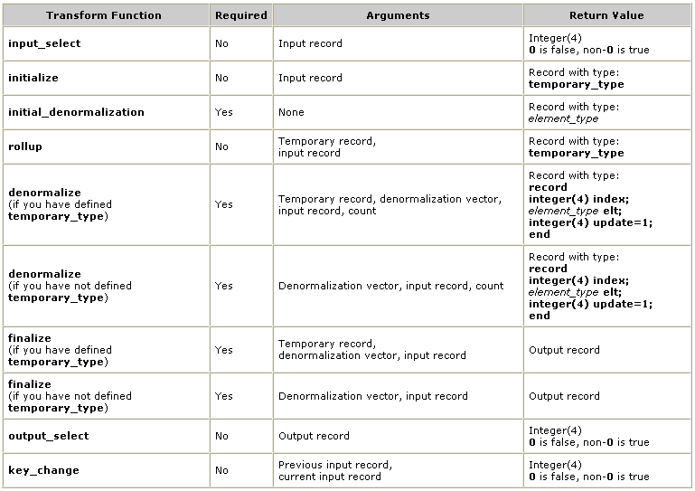
Transform Functions of Denormalize
CapGemini
Ab Initio Training

Slide 21
Runtime behavior/ Input selection
If you have defined input_select, it filters the input records.
If the expression evaluates to 0 for a particular record , Denormalize Sorted does not process the record (i.e., the record does not appear on any output port).
If the expression produces NULL for a particular record , Denormalize Sorted :
Writes the record to the reject port
Writes a descriptive error message to the error port .
Denormalize Sorted discards the information if you do not connect flows to the reject or error ports.
If the expression evaluates to anything other than 0 or NULL for a particular record, Denormalize Sorted processes the record.
If you have not defined input_select, Denormalize Sorted processes all records.
CapGemini
Ab Initio Training

Slide 22
2. Temporary initialization
Denormalize Sorted passes the first record in each group to the initialize transform function, which creates a temporary record.
This temporary record has the record type temporary_type.
If you have not defined temporary_type, Denormalize Sorted does not call the initialize transform function.
Also at the beginning of the group, Denormalize Sorted calls the initial_denormalization transform function to set the initial value of each element in the denormalize vector.
The denormalize vector has DML type denormalization_type.
CapGemini
Ab Initio Training

Slide 23
Computation
If you have defined a transform function named rollup, Denormalize Sorted calls it with the temporary record and the input record to produce a new temporary record. This option lets you combine Rollup Sorted and Denormalize Sorted. See "Examples" .
If you have defined temporary_type in order to use rollup, Denormalize Sorted calls the denormalize transform function with four arguments: the temporary record, the denormalize vector, the input record, and the running count of records in the group.
If you have not defined temporary_type, Denormalize Sorted calls the denormalize transform function with only three arguments: the denormalize vector, the input record, and the running count of records in the group.
CapGemini
Ab Initio Training

Slide 24
The running count of the first record in a group is 0.
The denormalize transform function returns three values: an index (int index), a vector element (elt), and an update flag (int update).
The vector element replaces the corresponding index element of the denormalize vector, unless the update flag is 0.
CapGemini
Ab Initio Training

Slide 25
4. Finalization
When all the input records in a group have been processed, Denormalize Sorted calls the finalize transform function.
If you have defined temporary_type, Denormalize Sorted passes three arguments to the finalize transform function: the temporary record, the denormalize vector, and the last input record of each group.
If you have not defined temporary_type, Denormalize Sorted calls finalize with only two arguments: the denormalize vector and the last input record of the group.
The finalize transform function produces an output record.
5. Output selection
If you have defined the output_select transform function, it filters the output records.
The output_select transform function takes a single argument - the record produced by finalization - and returns a value of 0 (false) or non-0 (true).
Denormalize Sorted ignores records for which output_select returns 0; it writes all others to the out port.
If you have not defined the output_select transform function, Denormalize Sorted writes all records to the out port.
CapGemini
Ab Initio Training

Slide 26
5. Output selection
If you have defined the output_select transform function, it filters the output records.
The output_select transform function takes a single argument - the record produced by finalization - and returns a value of 0 (false) or non-0 (true).
Denormalize Sorted ignores records for which output_select returns 0; it writes all others to the out port.
If you have not defined the output_select transform function, Denormalize Sorted writes all records to the out port.
CapGemini
Ab Initio Training

Slide 27
If any of the transform functions returns NULL , Denormalize Sorted writes:
The current input record to the reject port.
The component stops the execution of the graph when the number of reject events exceeds the result of the following formula:
limit + (ramp * number_of_records_processed_so_far)
A descriptive error message to the error port.
If you do not connect flows to the reject or error ports, Denormalize Sorted discards the information.
CapGemini
Ab Initio Training

Slide 28
Exercise 10
CapGemini
Ab Initio Training

Slide 29
Thank You
End of Session 9
CapGemini
Ab Initio Training

