Slide 1
Ab inito Session 12
Introduction to Ab Initio
Ab Initio Training
Notes:
CapGemini
Ab Initio Training

Slide 2
De-Partitioning Components
Gather
Merge
Concatenate
Interleave
CapGemini
Ab Initio Training

Slide 3
De-Partitioning
Departition components combine multiple streams of input. Usually a Departition component is preceded by a fan-in flow.
To reverse the effect of a Departition component, use a Partition component.
Departitioning combines many flows of data to
produce one flow.
Each departition component combines flows in a
different manner.
CapGemini
Ab Initio Training

Slide 4
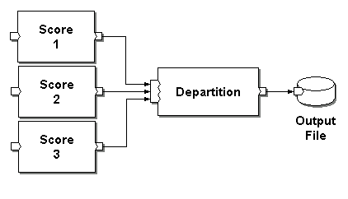
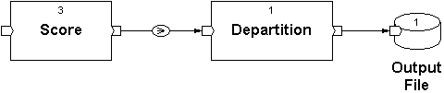
Departitioning
Expanded View:
Global View:
*
*
CapGemini
Ab Initio Training

Slide 5

Departitioning
For the various departitioning components:
  Key-based?
  Result ordering?
  Effect on parallelism?
  Uses?
Fan-in Flow
CapGemini
Ab Initio Training

Slide 6
Gather
Gather combines data records from multiple flow partitions (mfs) arbitrarily and make the flow serial and collect from different serial flow of same type (of same dml) to make it single flow.
CapGemini
Ab Initio Training

Slide 7
Gather
Round-robin partitioned and scored:
42John 02116 30A
45Sue 02241 92A
48Mary 02116 38A
43Mark 02114 9C
46Rick 02116 23B
49Jane 02241 2C
44Bob 02116 8C
47Bill 02114 14B
Scored dataset in random order, following gather:
43Mark 02114 9C
46Rick 02116 23B
42John 02116 30A
45Sue 02241 92A
48Mary 02116 38A
44Bob 02116 8C
47Bill 02114 14B
49Jane 02241 2C
CapGemini
Ab Initio Training
7

Slide 8
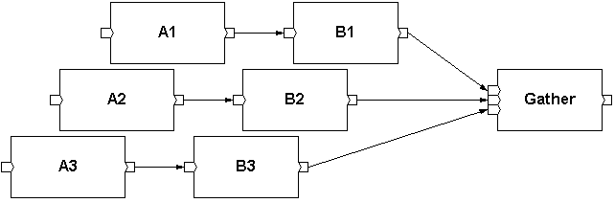
Gather: Performance
Reading flows as
data is available
Note that the Gather will not affect upstream
processing
CapGemini
Ab Initio Training
8

Slide 9
Gather
Not key-based.
Result ordering is unpredictable.
Has no affect on the upstream processing.
Most useful method for efficient collection of data from multiple partitions and for repartitioning.
Used most frequently
CapGemini
9

Slide 10
Merge
Merge combines data records from multiple flow partitions that have been sorted according to the same key specifier ( for reference see yellow mark in parameter box), and maintains the sort order.
CAUTION: While using merge component use flow buffering.
CapGemini
Ab Initio Training

Slide 11
Merge
Round-robin partitioned and sorted by amount:
42John 02116 30
48Mary 02116 38
45Sue 02241 92
49Jane 02241 2
43Mark 02114 9
46Rick 02116 23
44Bob 02116 8
47Bill 02114 14
Sorted data, following merge on amount:
49Jane 02241 2
44Bob 02116 8
43Mark 02114 9
47Bill 02114 14
46Rick 02116 23
42John 02116 30
48Mary 02116 38
45Sue 02241 92
CapGemini
Ab Initio Training
11

Slide 12
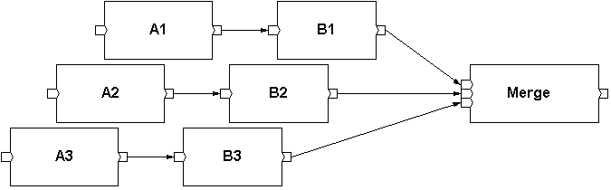
Merge: Performance
If keys evenly distributed:
Reading flows
roughly evenly
Components running roughly in lock-step, thus
computation becomes synchronized across partitions
CapGemini
Ab Initio Training
12

Slide 13
Merge: Performance
If keys globally sorted or near globally sorted:
Reading single flow
in its entirety
Blocked components, thus
computation becomes serialized across partitions
CapGemini
Ab Initio Training
13

Slide 14
Merge
Key-based.
Result ordering is sorted if each input is sorted.
Possibly synchronizes pipelined computation; may even serialize.
Useful for creating ordered data flows.
Other than the ‘Gather’, the Merge is the other ‘departitioner’ of choice
CapGemini
Ab Initio Training
14

Slide 15
Concatenate
Concatenate appends multiple flow partitions of data records one after another.
Example : If the requirement is to generate and output file containing header, body and trailer part ( all parts are from different flow)
CapGemini
Ab Initio Training

Slide 16
Concatenate
Globally ordered, partitioned data:
49Jane 02241 2
44Bob 02116 8
43Mark 02114 9
47Bill 02114 14
46Rick 02116 23
42John 02116 30
48Mary 02116 38
45Sue 02241 92
Sorted data:
49Jane 02241 2
44Bob 02116 8
43Mark 02114 9
47Bill 02114 14
46Rick 02116 23
42John 02116 30
48Mary 02116 38
45Sue 02241 92
CapGemini
Ab Initio Training
1<number>

Slide 17
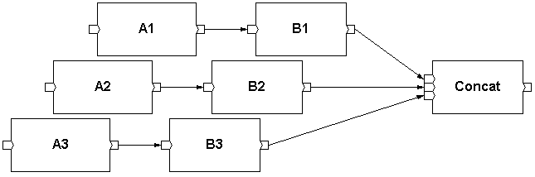
Concatenate: Performance
Running components
Reading single flow
in its entirety
Blocked components, computation is
serialized across partitions
CapGemini
Ab Initio Training
17

Slide 18
Concatenate
Not key-based.
Result ordering is by partition.
Serializes pipelined computation.
Useful for:
  appending headers and trailers
  creating serial flow from partitioned data
Used very infrequently
CapGemini
Ab Initio Training
18

Slide 19
Interleave
Globally ordered, partitioned data:
49Jane 02241 2
44Bob 02116 8
43Mark 02114 9
47Bill 02114 14
46Rick 02116 23
42John 02116 30
48Mary 02116 38
45Sue 02241 92
Departioned data:
49Jane 02241 2
47Bill 02114 14
42John 02116 30
44BOb 02116 8
46Rick 02116 23
48Mary 02116 38
43Mark 02114 9
45Sue 02241 92
CapGemini
Ab Initio Training

Slide 20
INTERLEAVE Cont.
PARAMETERS
Blocksize:-Number of data records interleave reads from each flow before reading the same number of data records from the next flow.
CapGemini
Ab Initio Training

Slide 21
The Interleave component:
Reads the number of data records specified in the blocksize parameter from the first flow connected to the in port
Then reads the number of data records specified in the blocksize parameter from the next flow, and so on
Writes the records to the out port
CapGemini
Ab Initio Training

Slide 22
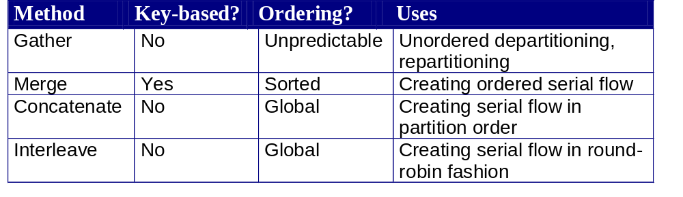
Summary of Departitioning Methods
CapGemini
Ab Initio Training

Slide 23
Differences between DePartitioning Components
There are some basic difference of concatenate, gather and merge which are mentioned as below
Concatenate: Append different flows of same types ( same dml) in order in a single flow.
In the example, concatenate will always take header record, then detail and then trailer.
Gather: Collect different flow arbitrarily.
Merge: Collect different flows and maintain the sorted order.
But the gather will do this arbitrarily
CapGemini
Ab Initio Training

Slide 24
Thank You
End of Session 12
CapGemini
Ab Initio Training

