Slide 1
Ab inito Session 13
Introduction to Ab Initio
Ab Initio Training
Notes:
CapGemini
Ab Initio Training

Slide 2
Miscellaneous Components
Redefine format
Generate Records
Trash
Gather logs
Run Program
Leading Records
CapGemini
Ab Initio Training

Slide 3

Redefine format
Redefine Format copies data records from its input to its output without changing the values in the data records. You can use Redefine Format to change or rename fields in a record format without changing the values in the records.
CapGemini
Ab Initio Training

Slide 4
Redefine format
Parameters
None.
CapGemini
Ab Initio Training

Slide 5
Runtime Behavior of Redefine Format
Redefine Format intentionally does not support using default record assignment, so you can use it to change the record format associated with a particular flow. To do this, assign a record format to the out port different from the record format on the in port.
If you use Redefine Format to change a record format, make sure you specify an output record format compatible with the input record format. For example, if you combine several fields into one, that one field must have the same number of bytes as the total of the original several fields.
CapGemini
Ab Initio Training

Slide 6
Runtime Behavior of Redefine Format
The Redefine Format component:
Reads the data records arriving at the in port
Writes the data records to the out port with the fields renamed according to the record format of the out port Redefine Format appears as mp copy in the Generated Script produced by the GDE.
CapGemini
Ab Initio Training

Slide 7
Exercise : Example of Using Redefine Format
This example shows how to reduce the number of fields in an input record by renaming the fields with Redefine Format. This improves the performance of the graph.
Suppose the input record format is:
record
string(10) first_name;
string(10) last_name;
string(30) address;
decimal(5) zipcode;
decimal(8.2) salary;
end;
CapGemini
Ab Initio Training

Slide 8
Example of Using Redefine Format
You can reduce the number of fields by specifying an output record format of:
record
string(55) personal_info;
decimal(8.2) salary;
end;
CapGemini
Ab Initio Training

Slide 9
Validate
Components
Validate components test, debug, and check data records, and produce data for testing Ab Initio graphs, as follows:
Check Order
Compare Checksums
Compare Records
Compute Checksum
Generate Random Bytes
Generate Records
Validate Records
CapGemini
Ab Initio Training

Slide 10

Generate Records
Generate Records generates a specified number of data records with fields of specified lengths and types.
You can let Generate Records generate random values within the specified length and type for each field, or you can control various aspects of the generated values. Typically, the output of Generate Records is used for testing a graph.
CapGemini
Ab Initio Training

Slide 11
Parameters for Generate Records
num_records
(integer, required) : Number of records to generate.
command_line
(unquoted string, optional) : Options that modify the values generated for particular fields. More than one option can apply to a field.
CapGemini
Ab Initio Training

Slide 12
Runtime Behavior of Generate Records
The Generate Records component:
Generates the number of data records specified in the num_records parameter. The values of the records depend on the record format of the out port, and the optional command_line parameter.
Writes the records to its out port.
CapGemini
Ab Initio Training

Slide 13
Example of Generate Records
Suppose you define the record format for the out port of Generate Records as follows:
record
decimal(10) cust_id;
string(20) cust_name;
integer(4) state_code;
string(1) preferred = "Y";
end;
CapGemini
Ab Initio Training

Slide 14
Example of Generate Records
Then suppose you specify the following in the command_line parameter:
-sequential cust_id 350000
-minimum state_code 1
-maximum state_code 50
-default preferred
Generate Records creates the number of records specified in the num_records parameter.
CapGemini
Ab Initio Training

Slide 15
Example of Generate Records
In these records, Generate Records inserts the following values:
350000 in the cust_id field for the first record, 350001 in the cust_id field for the next record, and so on
20 random alphanumeric characters in the cust_name field
A random number between 1 and 50, inclusive, in the state_code field
The default value, Y, in the preferred field
CapGemini
Ab Initio Training

Slide 16

Trash
Trash ends a flow by accepting all the data records in it and discarding them.
CapGemini
Ab Initio Training

Slide 17
Trash
Parameters
None
CapGemini
Ab Initio Training

Slide 18
Runtime Behavior of Trash
Trash is a Broadcast component without an out port.
The Trash component:
Reads records from the in port
Discards the records
CapGemini
Ab Initio Training

Slide 19
Trash Command-line Syntax
To call the Trash component from the command line, use the mp broadcast command, and do not attach a flow to the out port.
Following is the command syntax:
mp broadcast label
-layout layout_name
Following is a list of the arguments to the command, with a brief description of each:
CapGemini
Ab Initio Training

Slide 20

CapGemini
Ab Initio Training

Slide 21
Gather Logs
Gather Logs collects the output from the log ports of components for analysis of a graph after execution.
CapGemini
Ab Initio Training

Slide 22
Parameters for Gather Logs
LogFile
(path, required) : Path to the file you want to use as your log file. Specify a path that is valid on all nodes where Gather Logs runs. A relative path is relative to the host directory in the Run Settings dialog box.
StartText
(string, required) : Text to include in the start record.
EndText
(string, required) :Text to include in the end record.
CapGemini
Ab Initio Training

Slide 23
Runtime Behavior for Gather Logs
The Gather Logs component:
Collects log records generated by components through their log ports
Writes a record containing the text from the StartText parameter to the file specified in the LogFile parameter
Writes any log records from its in port to the file specified in the LogFile parameter
Writes a record containing the text from the EndText parameter to the file specified in the LogFile parameter
CapGemini
Ab Initio Training

Slide 24
Controlling Type and Frequency of Log Records
The transform components, Validate Records, and some other components have logging parameters that control the output of their log ports. You can determine how frequently you want input, output, reject, and intermediate records logged
CapGemini
Ab Initio Training

Slide 25
Generating Log Records for Events
The transform components and some other components have a logging parameter. This parameter specifies whether or not you want the component to generate log records for certain events. The value of the logging parameter is True or False. The default is False.
If you set the logging parameter to True, you must also connect the component's log port to a component that collects the log records, for example, a Gather Logs component. If you do not connect the log port to a component, the component discards any log records.
CapGemini
Ab Initio Training

Slide 26
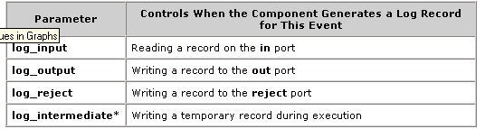
Generating Log Records for Events
When you set the logging parameter to True, the following parameters become available:
CapGemini
Ab Initio Training

Slide 27

Run Program
The RUN PROGRAM component is used to run any executable program through a graph.
CapGemini
Ab Initio Training

Slide 28
Parameters for Run Program
commandline
(string, required)
Path to an executable program and the arguments to that program is required in the commandline parameter.
CapGemini
Ab Initio Training

Slide 29
Runtime Behavior for Run Program
RUN PROGRAM runs the program specified by the commandline parameter.
We must explicitly pass any parameters or environment variables that the invoked program or script needs in order to run as intended.
CapGemini
Ab Initio Training

Slide 30

Leading Records
LEADING RECORDS copies a specified number of records from its in to its out port, counting from the first record in the input file.
CapGemini
Ab Initio Training

Slide 31
Parameters for Leading Records
num_records
(integer, required)
The number of records to copy from in port to out port is specified in this parameter.
CapGemini
Ab Initio Training

Slide 32
Runtime Behavior for Leading Records
LEADING RECORDS does not have a port to which to send unused records as it is specifically designed to stop reading when the specified number of records have been read. If it did, it would need to read the entire input dataset to the end, hence reducing the performance of the component.
CapGemini
Ab Initio Training

Slide 33
Generic Graphs
A generic graph has input parameters that affect the runtime behavior of the graph in some important way.
In a generic graph, different input parameter values can change the graph's behavior to such a degree that the graph becomes fundamentally different, with a different function, for each distinct set of input values it receives.
CapGemini
Ab Initio Training

Slide 34
How to Create Generic Graphs
Ab-initio graphs use a parameter called AB_JOB. This parameter specifies the base name of the job file for the current job.
For running multiple instances of a graph in the same working directory, we must produce a unique value for AB_JOB for each instance of the graph. Such situations typically involve a different set of parameter values for each instance of the generic graph being executed.
CapGemini
Ab Initio Training

Slide 35

How to Create Generic Graphs - Continued
The value of AB_JOB for a graph can be based on the values of the set of parameters to which it belongs.
The AB_JOB parameter has to exported to the environment for the generic graph to function properly.
Eg for exporting the parameter in the start script of a generic graph :
CapGemini
Ab Initio Training

Slide 36
User Defined Functions
User defined functions can be used for any project specific purpose that is not already handled in Ab-initio.
Any computation that is required to be performed repeatedly can be embedded into a user defined function that can be called with the specific parameters as and when required.
CapGemini
Ab Initio Training

Slide 37
PSETS
The definitions for an input parameter set can be saved in an input values or input parameters set file. By default these files have an extension of .pset, and are sometimes called “pset files”.
There can be as many different such input values sets for an object (such as a graph or a plan) as you want.
Every .pset file contains information linking it back to the original graph or plan it was created from.
CapGemini
Ab Initio Training

Slide 38
Example
OLD:
→ 2050 P D findb/wp ${RUN}/findb.wp_load_data.ksh -ORIG_SRC_CD findb -TABLE stg_fin_trm_fct -EXEC_PATH findb/wp
USING PSETS:
→2050 P D findb/wp $PROJECT_DIR/ pset/ findb.wp_load_data.tablename.pset
All generic graphs can have one and more pset files associated with it.
CapGemini
Ab Initio Training

Slide 39
HOW TO CREATE PSETS
Open the generic graph
Go to run and select “INPUT VALUES” and the input values needed to run the graph.
Save the pset file in the Pset directory of the project you are working upon.
Whenever you check-in a Pset make sure you Turn Off the Dependency Analysis .
CapGemini
Ab Initio Training

Slide 40
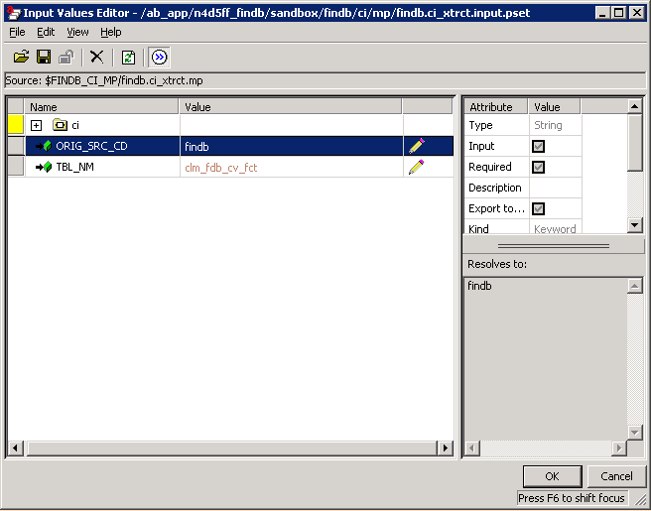
Parameters Passed
PSET’s
CapGemini
Ab Initio Training

Slide 41
Sample PSET file
Here is what a pset file looks like on disk
!prototype|P|||$PLW_IMAGE_MP/unload_tbl_sql_w_deflate.mp
SQL_FILE_NAME|$|||${AI_SQL}/incidents.sql
DML_FILE_NAME|$|||${AI_DML}/incidents_plw.dml
OUTPUT_FILE_NAME|$|||${AI_SERIAL}/incidents_plw.gz
This example calls a graph in the plw image project with 3 arguments
CapGemini
Ab Initio Training

Slide 42
How to Create User Defined Functions
The definition of all such functions have to be defined in a transform first. The definition specifies the parameters required by the function to do the computation and the output information to be returned by the function.
The function can be called from any component of Ab-initio then by passing the required parameters and the output of the desired computation can be obtained as the result.
CapGemini
Ab Initio Training

Slide 43
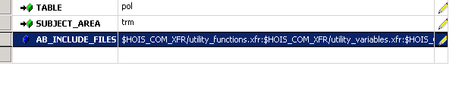
How to Create User Defined Functions - Continued
The complete path of the transform in which the function is defined must be specified in a graph parameter called AB_INCLUDE_FILES.
Eg for defining AB_INCLUDE_FILES :
CapGemini
Ab Initio Training

Slide 44
Thank You
End of Session 13
CapGemini
Ab Initio Training

