Slide 1
Ab inito Session 14
Introduction to Ab Initio
Ab Initio Training
Notes:
CapGemini
Ab Initio Training

Slide 2
Sandboxes
Concepts of Projects
EME (Covering Checkin and Checkout procedures)
CapGemini
Ab Initio Training

Slide 3
Ab Initio Environment
The Ab Initio Environment is a collection of functionality that allows you to set up a framework in which to organize your Ab Initio development, testing, and production work. It uses EME projects, common projects, and common data areas to build an open-ended hierarchy that can be as simple or complex as you require.
Note that the term "Ab Initio Environment" can be a little ambiguous in certain contexts. It can be used to refer to an instance of an organizational framework that you have created, or to the set of Ab Initio executables that you use to create it. In these paragraphs, "Ab Initio Environment" signifies the things you create with the software: the collection of projects and sandboxes, the common data areas that are associated with them, and so on.
CapGemini
Ab Initio Training

Slide 4
Main Characteristics of Ab Initio Environment
Every sandbox (and project) in an Ab Initio Environment has by default an expanded set of subdirectories In an Ab Initio Environment, you must create new projects either by running the install-environment script (when you create the new environment), or by running the create-project script.
Every Ab Initio Environment is by default set up with ready-to-use data areas for serial and multifile data, as well as logs, error reporting, and the like Each of these areas is common to all projects in that environment, although each project has its own separate sub-section of it; these can be further subdivided into user-specific sub-areas.
CapGemini
Ab Initio Training

Slide 5
Main Characteristics of Ab Initio Environment
You create an Ab Initio Environment by running the install-environment script.
Every Ab Initio Environment has a single central common project (called the "environment project") whose parameter definitions are included in all other projects in that environment; these values allow the individual projects to access the data areas and any other values common to the environment The environment project is created automatically by install-environment.
Including a given environment project is what puts a given project "in" a specific Ab Initio Environment.
CapGemini
Ab Initio Training

Slide 6
What is a Sandbox?
A "sandbox" is a special directory (folder) containing a certain minimum number of specific subdirectories for holding Ab Initio graphs and related files. These subdirectories have standard names that indicate their function. The sandbox directory itself can have any name; its sandbox properties are recorded in various special and hidden files that lie at its top level (the my_project directory, in the following illustration):
CapGemini
Ab Initio Training

Slide 7
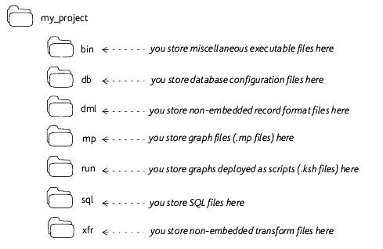
CapGemini
Ab Initio Training

Slide 8
More on Subdirectories of Sandbox
bin — for executable files Usually this directory is used only in public projects, where it is used to hold macro scripts and third-party executables for Run Program components. A "public project" is an Ab Initio Environment concept: it is a common project, intended to be accessible to other projects. Public projects are the Ab Initio environment's mechanism for sharing data among projects.
sql — for SQL files Used to hold .sql files used by database components, in particular by the Run SQL component.
CapGemini
Ab Initio Training

Slide 9
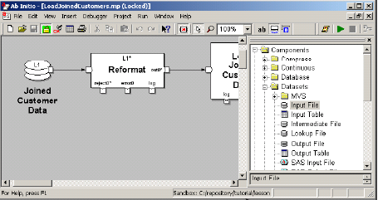
Identifying the Sandbox in the GDE
The name of your sandbox is shown on the status bar at the bottom of the window in which the graph appears:
CapGemini
Ab Initio Training

Slide 10
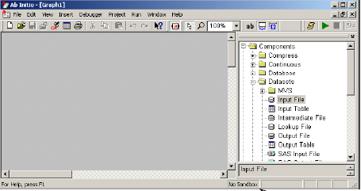
Identifying the Sandbox in the GDE
Otherwise, if the graph is not there in the sandbox the status bar reads ‘No Sandbox’
CapGemini
Ab Initio Training

Slide 11
Saving your Graphs in the Sandbox
New graphs that have not yet been saved in your sandbox do not recognize the project parameters until after they have been saved.
If you have to save the graph generated script produced when you ran the graph), check the Save Script When Graph Saved To Sandbox option in the EME Datastore Settings dialog box. The script will be saved whenever you save the graph in your sandbox.
CapGemini
Ab Initio Training

Slide 12
What is a Project
In EME,Project is a collection of graphs and related files that are stored in a single directory tree in EME data store and are treated as a group for purposes of version control, navigation and migration. Logically a project is a self contained and largely independent content area that accomplishes a simple business goal. Projects are checked out to sandboxes.
CapGemini
Ab Initio Training

Slide 13
Projects
Every EME is grouped into projects.
Physically, each project in the database is a collection of graphs and related files that are stored in the single directory tree and are treated as a group for purposes of source control, navigation and migration.
Logically a project is fairly a self contained and largely independent content area, a suite of graphs and associated files that accomplishes a business goals.
To work on a project you check it, out into a sandbox, which is a filesystem directory structure that mirrors the projects datastore structure.
A project has attributes that describe its behavior ,including parameters ,import list, directory list and an extension list.
Projects can include other projects so as to share common files and settings.
CapGemini
Ab Initio Training

Slide 14
Sandbox with Project
A sandbox that is associated with a project is by definition under source control in an Enterprise Meta>Environment datastore. The project is the "master copy" of the sandbox contents; you check out copies of files in the project to work on in your sandbox, and check in the altered files to update the project copies under source control. The directory structure of the project in the datastore is exactly the same as the sandbox directory structure in your filesystem.
The sandbox now contains only some set of particular versions (usually the latest) of the files that make up its contents. The project contains all the versions of the files.
CapGemini
Ab Initio Training

Slide 15
Sandboxes and Projects
A project and a sandbox are thus essentially the same thing, seen from different points of view. A sandbox is a copy of a project. There can be (and usually are) many such copies. Multiple users can set up sandboxes based on the same project, thus creating multiple copies of it.
Each sandbox can be associated with only one project, but a project can be (and usually is) associated with multiple sandboxes.
Any user working on the project will have his or her own sandbox in which to work.
When you check a sandbox in to the EME, the contents of the sandbox are copied into the EME datastore project area. When you check the project out, the filesystem copies of the project contents are updated in your sandbox.
CapGemini
Ab Initio Training

Slide 16
Sandbox Parameters and Graph Parameters
A Parameter is a name-value pair, with a number of additional associated attributes that describe when and how to interpret or resolve the value. Parameter are used to change the behavior of graphs and projects in controlled and uniform way. Both graphs and projects have parameters.
Graph Parameters: These are associated with individual graphs and are private to them. They affect the execution only of the graph for which they are defined.
Graph Parameters are part of graph they are associated with and are checked in or out along with the graph.
CapGemini
Ab Initio Training

Slide 17
Project Parameters and Sandbox Environment Variables
A project.ksh file is located in the root directory of the sandbox for each checked out project. It contains settings that define the sandbox environment and consequently the runtime values of all the environment variables corresponding to the project parameters.
Each project’s .project.ksh script first invokes the .project.ksh scripts of any common projects included in the checked out projects .Those common projects invoke the .project.ksh of any common projects to which they refer. The net effect is that the most deeply nested common projects are invoked first, the local client project last.
CapGemini
Ab Initio Training

Slide 18
Project Parameters
Project Parameters, unlike graph Parameters, have an effect that is project wide. A project's parameters and values are inherited by all graphs in that project.
Project Parameters are checked in or out with the project. You can lock them in your sandbox, they can be (and often are) called sandbox parameters, but they are properly called Project Parameters.
CapGemini
Ab Initio Training

Slide 19
Order of evaluation of graph and project parameters
When you run the graph, parameters are evaluated in the following order:
The host setup script is run
Common (i.e. included) project parameters are evaluated.
Project Parameters are evaluated
The project start.ksh script is run
Graph parameters are evaluated
The graph start script is run.
CapGemini
Ab Initio Training

Slide 20
Types of Project Parameters
There are 4 types of project parameters:
Standard Parameters
Switch Parameters
Dependent Parameters
Common Project Parameters
CapGemini
Ab Initio Training

Slide 21
Types of Project Parameters
Standard Parameters :
Standard parameters consist of single name value pairs. Their data type is typically string.
Switch Parameters:
A switch parameter has fixed set of string values which you define when you create the parameter. The purpose of the switch parameter is to allow you change your sandbox context. Its values determines the values of various other parameters that you make dependent on that switch. For each switch value ,each of the dependent parameters has a dependent value.
CapGemini
Ab Initio Training

Slide 22
Types of Project Parameters
Dependent Parameters :
Dependent parameters are those whose values depends on the value of the switch parameter.
The values of the dependent parameters are set when the user in one of these groups checks out the sandbox for the first time. The appropriate value is chosen from the drop down list box in the sandbox parameters editor. After this, the checkout wizard will retain the value chosen by the user for that sandbox.
CapGemini
Ab Initio Training

Slide 23
Types of Project Parameters
Common project parameters:
These allow you to include other shared or common project values within the current project. The result of defining such a parameter is that you can refer to the parameters of the common project as if they were defined to the current project. In addition you can even refer to the record formats and transformations in the common project from the project that includes it, called the client project. The common project must exist prior to the adding it to the current project.
CapGemini
Ab Initio Training

Slide 24
Default Project Parameters
Every project is created with a set of default parameters. You can view these in the sandbox parameters editor.
Each predefined parameter has a value. The value of XFR ,for example is the path to the XFR Subdirectory in both your file system directory tree and in your EME datastore hierarchy. These default parameters are required, but you can define additional parameters for your project.
CapGemini
Ab Initio Training

Slide 25
Project Parameters and Sandbox Environment Variables
Similarly, a script called ab_project_setup.ksh(located at the sandbox’s root directory) sets up an environment with all the parameter values or a given sandbox (including values for all common projects).
For example assume a sandbox is located at your-path/your-project. Doing the following form a Korn shell command line:
cd your-path/your-project; .ab_project_setup.ksh $PWD
Will set the values of all of your projects parameters, such as $DML,$RUN, and so on, environment variables) in the shell. This script is used by the GDE.
CapGemini
Ab Initio Training

Slide 26
Project Directory Tree in a datastore
The directory tree of the project contains subdirectories for the transforms, record formats ,graphs and so on. The project structure in the datastore is mirrored by the structure of your file system sandbox directory.
The following table shows the structure of a typical EME datastore project.
CapGemini
Ab Initio Training

Slide 27
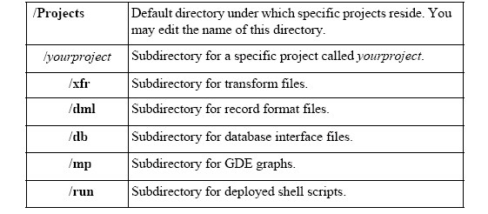
CapGemini
Ab Initio Training

Slide 28
More on Project
Migration: A project can be parameterized so that you can migrate projects or individual graphs through different work stages from development through test, to production without having to make changes to the graph.
Source Control: The EME assigns a version number to the project and all the files it contains .Because files are versioned to an earlier state or earlier time .
Common Projects: A common project is a directory tree containing information that is shared among multiple projects. When information is shared among multiple Ab Initio applications projects then this information should be placed into a common project, which can be included in other projects.
CapGemini
Ab Initio Training

Slide 29
Project Organization
Projects are organized in the EME Datastore as subdirectories under the projects root directory.
Project directories cannot contain other projects but you can easily set up a hierarchical project organization by creating subdirectory structures under /projects and locating projects in them.
A relatively simple organization could have all projects located at the same level with respect to the datastore root directory,/projects. In general common projects should be located at the same level as the project(s) that include them. You can create as many non-project sub directories within a project as you wish)
CapGemini
Ab Initio Training

Slide 30
Example of simple Project Organization
Suppose you are trying to create a data warehouse which comprises three main projects-Marketing ,Billing , Finance. All of these projects make use of same data; therefore you include the shared data through the common project called common.
Now if a single team at your company is responsible for the information in one of the constituent projects and responsibility for the common projects is shared by all, then a good way to organize our client projects and common project is shown by following diagram.
CapGemini
Ab Initio Training

Slide 31
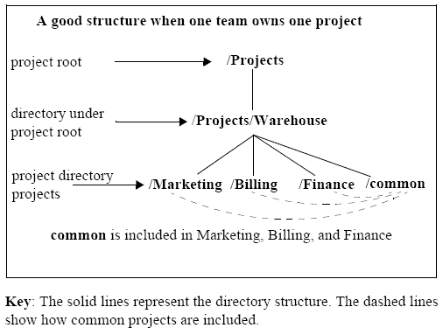
CapGemini
Ab Initio Training

Slide 32
Which Variables should be defined as Parameters
You must use your own judgment in deciding whether or not to define all environment variables as project parameters, but you should keep the following guidelines in mind:
Any variable in your Ab Initio application that determines the location of the file must be defined as the parameter. Typically this includes the default parameters automatically created in a new project.
Any variable that specifies the name of an input or output dataset-the URL of the file or the name of the database table-should also be defined as the project parameter.
Application Parameters that do not involve defining the location or the contents of parts of the graph need not be define as project parameters. For example, standard UNIX or Ab Initio environment variables that change something about how the environment works but do not affect the processing logic of the graph such as $PATH and $AB WORK DIR,fll into this category.
CapGemini
Ab Initio Training

Slide 33
EME
The Enterprise Meta>Environment (EME) is a high-performance object-oriented storage system that inventories and manages various kinds of information associated with Ab Initio applications. It provides storage for all aspects of your data processing system, from design information to operations data.
The EME also provides rich store for the applications themselves, including data formats and business rules. It acts as hub for data and definitions . Integrated metadata management provides the global and consolidated view of the structure and meaning of applications and data- information that is usually scattered throughout you business .
CapGemini
Ab Initio Training

Slide 34
Benefits of EME
The Enterprise Meta>Environment provides a rich store for applications and all of their associated information including :
Technical Metadata-Applications related business rules ,record formats and execution statistics
Business Metadata -User defined documentations of job functions ,roles and responsibilities.
Metadata is data about data and is critical to understanding and driving your business process and computational resources .Storing and using metadata is as important to your business as storing and using data.
CapGemini
Ab Initio Training

Slide 35
EME-Ab Initio Relevance
By integrating technical and business metadata ,you can grasp the entirety of your data processing – from operational to analytical systems.
The EME is completely integrated environment. The following figure shows how it fits in to the high level architecture of Ab Initio software.
CapGemini
Ab Initio Training

Slide 36
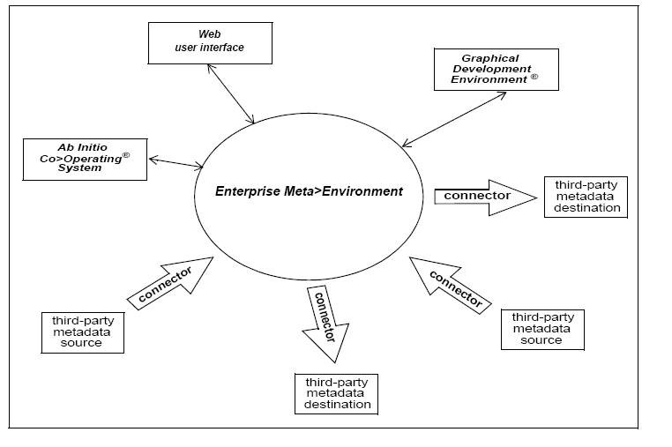
CapGemini
Ab Initio Training

Slide 37
Stepwise explanation of Ab Initio Architecture
You construct your application from the building blocks called components, manipulating them through the Graphical Development Environment (GDE).
You check in your applications to the EME.
The EME and GDE uses the underlining functionality of the Co>Operating System to perform many of their tasks. The Cooperating System units the distributed resources into a single “virtual computer” to run applications in parallel.
Ab Initio software runs on Unix ,Windows NT,MVS operating systems.
CapGemini
Ab Initio Training

Slide 38
Stepwise explanation of Ab Initio Architecture - continued
Ab Initio connector applications extract metadata from third part metadata sources into the EME or extract it from the EME into a third party destination.
You view the results of project and application dependency analysis through a Web user interface .You also view and edit your business metadata through a web user interface.
CapGemini
Ab Initio Training

Slide 39
EME :Various users constituency served
The EME addresses the metadata needs of three different constituencies:
Business Users
Developers
System Administrators
CapGemini
Ab Initio Training

Slide 40
EME :Various users constituency served
Business users are interested in exploiting data for analysis, in particular with regard to databases ,tables and columns.
Developers tend to be oriented towards applications ,needing to analyze the impact of potential program changes.
System Administrator and production personnel want job status information and run statistics.
CapGemini
Ab Initio Training

Slide 41
EME-Technical and Business Metadata are Integrated
The EME makes it possible to answer wide range of questions because it integrates both business metadata and technical metadata.
The EME holds the active elements that compose your applications. This means that the business concepts (such as organizational structure or business roles) can be directly linked to associated technical entities (such as database instances or record formats).
CapGemini
Ab Initio Training

Slide 42
EME-In depth Analysis Across the Enterprise
The EME enables deep analysis of applications and the relationships between them. Dependence analysis answers questions of data lineage :Where did a given value come from? How was the output value computed? Which applications produce and depend on this data? Impact analysis lets developers understand the consequences of proposed modifications. If this piece changes, which applications will be affected? In addition to this all objects stored in the EME are versioned, making it possible to examine the state of things as of last week, last month or last year and to compare it with the state of things today.
CapGemini
Ab Initio Training

Slide 43
EME-In depth Analysis Across the Enterprise
Impact Analysis lets developers understand the consequences of proposed modifications. If this piece changes what else will be affected? If this source format changes, which applications will be affected?
In addition, all objects stored in the EME ar versioned, making it possible to examine the state of things as of last week; last month or last year and to compare it with the state of things today.
The EME collects job tracking, or execution, information which enable trend analysis How fast is our data growing?) and capacity planning How long did that application take to run? How much data did it process, and at what rate?)
CapGemini
Ab Initio Training

Slide 44
EME-In depth Analysis Across the Enterprise
Because the EME holds both the technical metadata and business metadata in an integrated store, the EME can also provide the answers to the questions like :Which groups are responsible for producing and using this data? Who changed this application last?
And what changes did they make?
CapGemini
Ab Initio Training

Slide 45
More on EME
Special EME software, often called connectors, pull metadata from and deliver metadata to a wide variety of third party products, including design tools an OLAP Systems. This makes it possible to maintain the flow of metadata to a wide variety of third party products.
CapGemini
Ab Initio Training

Slide 46
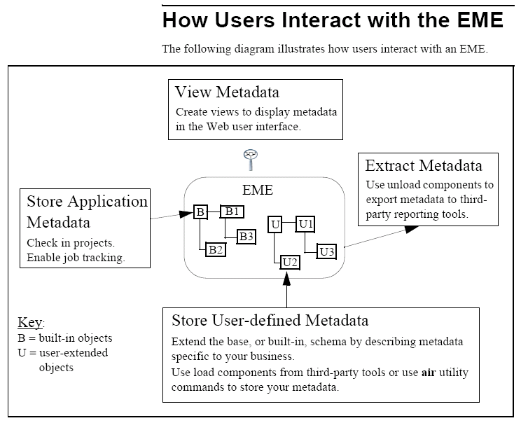
CapGemini
Ab Initio Training

Slide 47
More on EME
Application specific objects- like graphs,components,record formats and transformation are stored automatically whenever a user checks-in a project or graph. Job tracking information will also be stored automatically if a user selects Save Tracking Data to EME Datastore in the run settings dialog prior to running the application.
CapGemini
Ab Initio Training

Slide 48
Working with EME
The basic situation when you work with EME is that you have files in two kinds of location:
A personal work area which you specify, located in some filesystem.
A filesystem storage area
This is the EME system area where every version that you save of the files you work on its permanently preserved, organized in projects. Its general name is EME Datastore.
You have indirect access to this area through the GDE.
CapGemini
Ab Initio Training

Slide 49
Features of EME
The EME provides mechanisms for versioned storage of Ab Initio application metadata, source control, dependency and
performance analysis of applications and web access to analysis results.
CapGemini
Ab Initio Training

Slide 50
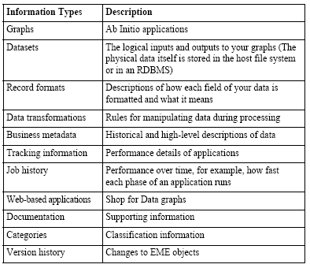
Features of EME-1
The EME stores all your metadata including:
CapGemini
Ab Initio Training

Slide 51
Features of EME-2
Versioning:
The EME logs all changes made to the objects stored in it so that you can compare different versions of your graphs for revision history or access earlier versions of your applications. The version control system allows you to:
Navigate to earlier version of the object
Navigate it to the version of the graph used in the particular run of the job.
View the state of the entire EME datastore at a particular point in time.
Find the differences between the 2 versions of a graph, data transformation, or record format definition.
CapGemini
Ab Initio Training

Slide 52
Features of EME-3
Source Code Control:
The EME controls access to objects stored in it, preventing users from interfering with each other as they work on the project. EME source controls allows you to:
Check in/check out files from a working area (sandbox)
Apply tags to specific graph and file versions in the datastore
Migrate versions from one datastore to another.
CapGemini
Ab Initio Training

Slide 53
Features of EME-4
Dependency Analysis:
The EME performs dependency analysis, a process by which it determines the dependencies and relationships among objects stored in the EME.
With dependency analysis you can quickly:
Find the origin of the data item by locating all the data transformations and data elements used in its production. These comprise the upstream dependencies of the object.
Determine the possible impact of the program changes by locating the parts of an application that depend on the object being changed – the downstream dependencies of the object.
CapGemini
Ab Initio Training

Slide 54
Features of EME-4
Dependency Analysis:
Locate all applications that help produce a dataset or data element.
Locate all applications that make use of a dataset or data element.
Locate all places where a given data transformation rule, record format or program component is used.
CapGemini
Ab Initio Training

Slide 55
Features of EME-5
Performance Analysis:
The EME stores extensive information Ab Initio environment, including which application ran, when they ran, and how long they took.
Universal Data Access through the Web Interface
All the information in the EME is available at any desktop computer that connects to your internal web server.
CapGemini
Ab Initio Training

Slide 56
EME Interfaces
You create and manage an EME through three interfaces:
Use the GDE (Graphical Development Environment) to do major tasks:
Create an EME project.
Edit a project’s parameters and attributes
Edit graphs, transformations and record formats
Check out graphs, files and entire projects from the EME
Check in to the EME modified graphs, files and projects
Perform Dependency Analysis.
CapGemini
Ab Initio Training
Notes:
CapGemini
Ab Initio Training
Out

Slide 57
EME Interfaces
Web User Interface (AIW) to:
Navigate the EME : View graphs, components and datasets
Examine dependencies among objects
View and compare the performance of various graph runs
View differences between versions
CapGemini
Ab Initio Training

Slide 58
EME Interfaces
Use the Air Utility, a command-line or shell-script interface to:
Revert to an earlier version of the project.
Migrate the project from one EME to another.
Copy a project in order to make a new project
Change permissions and ownerships of the object
Reparse certain files
View a list of graphs on the translation and the analysis queue
Remove objects from the EME
Backup the EME everyday
Restore the EME from the saved image file
Erase an EME
Display the structure of the EME OBJECT
Perform consistency checks of EME structures
CapGemini
Ab Initio Training

Slide 59
Checking out Projects, Graphs and Files
In order to work on the project, you must :
setup a sandbox
Checking the project out into your sandbox and locking the files you wish to work on.
The main effect of checking an object out from the EME datastore is that your sandbox is updated with the latest datastore version of that object. In order to edit the checked-out object in your sandbox, you must first lock it. While you possess the object’s lock, no one else can edit your sandbox’s version of the object. When you check the object in the GDE release the lock. Or even you can release the lock explicitly yourself any time. Note that checking an object does not lock the object, it merely allows you to view the object in your sandbox.
CapGemini
Ab Initio Training

Slide 60
Checking out Projects, Graphs and Files
If the target sandbox does not exist, the Checkout wizard creates and configures the sandbox according to the project parameters, to the sandbox parameters.
You can check out graphs and files as well as entire projects. When you check out a graph, the wizard also checks out the graphs project’s parameters as well as the graphs associated record format ,transform ,and configuration files.
You must first check out the common projects before you check out the projects that include them.
CapGemini
Ab Initio Training

Slide 61
Locking
You can open any graph in the usual fashion (by selecting file>open). However
If the graph or file has been checked in, then it is a datastore object and you must first lock it before you can edit it.
Locking the graph prevents other users from changing it at the same time as you are working on it. Otherwise conflicts will occur between the sandbox and the datastore versions of the files.
CapGemini
Ab Initio Training

Slide 62

The Lock Button
The Lock button’s appearance tells you that what the locking status of the object you are viewing is.
When a graph or file is unlocked, the lock button on its tool bar appears as an open yellow lock symbol.
CapGemini
Ab Initio Training

Slide 63


The Lock Button
If an object has never been checked in, there is no lock associated with it. The lock button on the toolbar appears as an open gray lock symbol.
When the object has been locked by other user then it looks like second diagram.
CapGemini
Ab Initio Training

Slide 64
Checking in Projects, Graphs and Files
Once you have successfully edited the project files you wish to work on you have to check them in order to put new versions under source control in the EME datastore ,and make them available to other users.
CapGemini
Ab Initio Training

Slide 65
IMP: More on Sandbox and Projects
A big difference between the contents of a sandbox and its corresponding project in the EME is that the latter will contain, for each file, each and every version that has ever been checked in by anybody. The sandbox, on the other hand, will contain only the latest version of each file checked out into that sandbox.
CapGemini
Ab Initio Training

Slide 66
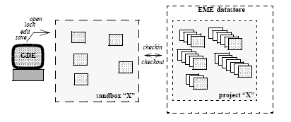
IMP: More on Sandbox and Projects
Sandbox Files and Datastore File Versions:
CapGemini
Ab Initio Training

Slide 67
IMP: More on Sandbox and Projects
In the EME datastore ,graphs and files are grouped in projects .The datastore at its highest level contains a Project directory. Each of its immediate contents represents a separate project, or a subdirectory containing projects.
As a practical matter, a project consists of whatever files you want to put in it. Formally defined a project is a collection of Ab Initio graphs and files that have some close working association with each other: taken together they make up a single application (graph or group of graphs) or a coherent discreet piece of an application. They share DML and transforms and prhaps other data as well.
CapGemini
Ab Initio Training

Slide 68
IMP: More on Sandbox and Projects
Projects are held in the EME datastore and you cannot directly manipulate them. To work on a project, you must set up a working area for it on your machine. Once this area has been properly set up, files can be checked out into it, or checked in from it. This working area is called Sandbox. It is physically accessible representation of the project.
CapGemini
Ab Initio Training

Slide 69
Thank You
End of Session 14
CapGemini
Ab Initio Training

