Slide 1
Ab inito Session 15
Introduction to Ab Initio
Ab Initio Training
Notes:
CapGemini
Ab Initio Training

Slide 2
Remaining Concepts like
Replicate
What is a Phase?
What is a Checkpoint?
What Is a Subgraph?
CapGemini
Ab Initio Training

Slide 3

Replicate
Replicate arbitrarily combines all the data records it receives into a single flow and writes a copy of that flow to each of its output flows.
CapGemini
Ab Initio Training

Slide 4
Runtime Behavior :Replicate
Replicate does not support using default record assignment. As a result, make the record format of the in and out ports identical. If you do not, execution of the graph stops when it reaches Replicate. The Replicate component:
Arbitrarily combines the data records from all the flows on the in port into a single flow
Copies that flow to all the flows connected to the out port Use Replicate to support component parallelism — for example, when you want to perform more than one operation on a flow of data records coming from an active component.
CapGemini
Ab Initio Training

Slide 5
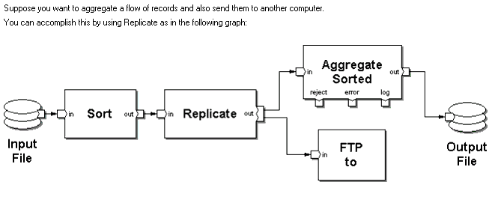
CapGemini
Ab Initio Training

Slide 6
What is a Phase?
A phase is a stage of a graph that runs to completion before the start of the next stage. By dividing a graph into phases, you can save resources, avoid deadlock, and safeguard against failures. To protect a graph, all phases are checkpoints by default.
CapGemini
Ab Initio Training

Slide 7
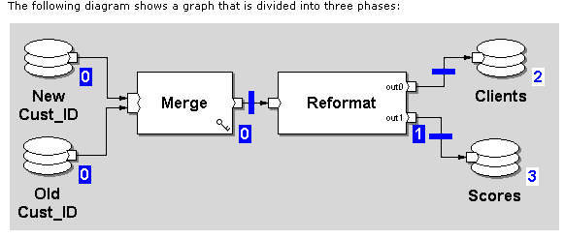
CapGemini
Ab Initio Training

Slide 8
Phase-Description
Phase numbers are assigned to each component.
White phase numbers inside blue boxes denote phases that are checkpoints.
CapGemini
Ab Initio Training

Slide 9
Phase-Description
Blue phase numbers against a white background denote phases that are not checkpoints. Phases with checkpoints save temporary files until the next checkpoint completes; phases without checkpoints delete all temporary files at the end of the phase.
CapGemini
Ab Initio Training

Slide 10
Phase-Description
When there are phase breaks inside a subgraph, the phase number shows the range of phases that occur inside.
When you insert an Intermediate File component into a graph, it automatically creates a phase break.
CapGemini
Ab Initio Training

Slide 11

Phase-Description
Blue bars across flows indicate phase breaks that are checkpoints, unfilled blue bars across flows indicate phase breaks that are not checkpoints.
CapGemini
Ab Initio Training

Slide 12
What is a Checkpoint
A checkpoint is a phase that acts as an intermediate stopping point in a graph and saves status information to allow you to recover from failures. By assigning phases with checkpoints to a graph, you can recover completed stages of the graph if failure occurs.
CapGemini
Ab Initio Training

Slide 13
Setting Phases and Checkpoints
In the graph, select all the components you want to place in phase 1.
Click the Increment Phase button.
CapGemini
Ab Initio Training

Slide 14
Setting Phases and Checkpoints
The phase number beside each selected component, and all downstream components, becomes 1. Phase breaks appear on the flows between phases
CapGemini
Ab Initio Training

Slide 15
Recovery
When you encounter a graph that fails (for example, one phase of a graph encounters an error or an operator aborts the program during execution), you do not need to rerun checkpointed phases that completed prior to failure. When you run the job again, the graph recovers from the last checkpoint. For the failed phases, all processes will be terminated, all temporary files will be deleted, and all nodes and their respective files will be rolled back to their initial state unless you select Don't roll back file if job fails on the File Properties: Access tab.
If you find a hardware failure, (for example, one or more nodes loses power or any of the UNIX operating systems crash), rerun the job to recover it.
CapGemini
Ab Initio Training

Slide 16
What Is a Subgraph?
A subgraph is a graph fragment.
Just like graphs, subgraphs contain components and flows.
A subgraph groups together components that perform a subtask in a graph. The subgraph creates a reusable component that performs the subtask.
CapGemini
Ab Initio Training

Slide 17
When to Use a Subgraph ?
If you can construct the solution to the task from Ab Initio pre-built components, and you can keep the number and arrangement of components static from one run of the graph to another, you can use a subgraph. Of the three facilities, a subgraph is the easiest to use.
When you use a subgraph, you can define the component parameters at runtime. You can change the value of the parameters from one run of the graph to another, but the number and arrangement of the components themselves remain static.
CapGemini
Ab Initio Training

Slide 18
Thank You
End of Session 15
CapGemini
Ab Initio Training

