Slide 1
Ab initio Session 16
Introduction to Ab
Initio
Ab Initio Training
Notes:
CapGemini
Ab Initio Training

Slide 2
Concepts of Parallelism
Explanation of Data partitioning
Concept of Repartitioning
CapGemini
Ab Initio Training

Slide 3
Forms of Parallelism
Component parallelism
Pipeline parallelism
Data parallelism
CapGemini
Ab Initio Training
Notes:
CapGemini
Ab Initio Training

Slide 4
Component parallelism
A graph with multiple processes running simultaneously on separate data uses component parallelism
In this two or more components process the records in parallel.
CapGemini
Ab Initio Training

Slide 5
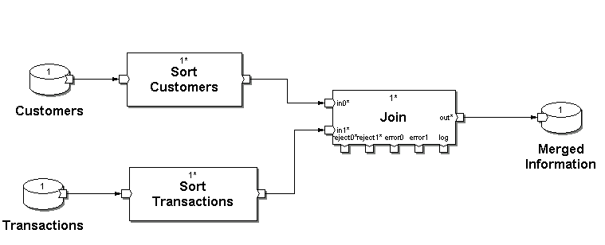
Component Parallelism
Sorting Customers
Sorting Transactions
CapGemini
Ab Initio Training

Slide 6
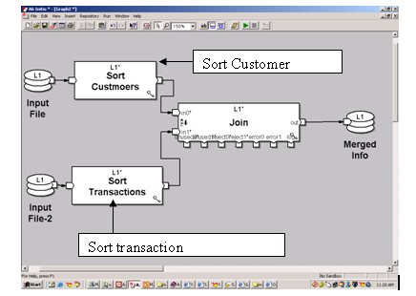
CapGemini
Ab Initio Training

Slide 7
Pipeline Parallelism
- A graph with multiple components running simultaneously on the same data uses pipeline parallelism. Each component in the pipeline continuously reads from upstream components, processes data, and writes to downstream components. Since a downstream component can process records previously written by an upstream component, both components can operate in parallel. NOTE: To limit the number of components running simultaneously,set phases in the graph.
CapGemini
Ab Initio Training

Slide 8
Pipeline Parallelism-cont.
Each component in the pipeline continuously reads from upstream components, processes data, and writes to downstream components. Since a downstream component can process records previously written by an upstream component, both components can operate in parallel.
NOTE: To limit the number of components running simultaneously, set phases in the graph.
CapGemini
Ab Initio Training

Slide 9
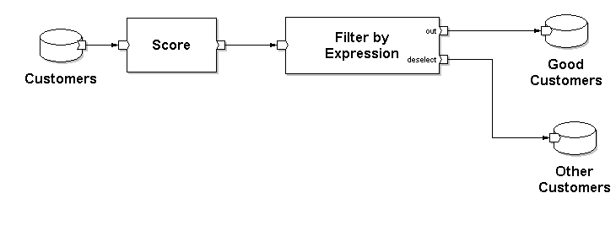
Pipeline Parallelism
Processing Record: 100
Processing Record: 99
CapGemini
Ab Initio Training

Slide 10
Pipeline Parallelism-cont.
In this the records are processed in pipeline, i.e. the components do not have to wait for all the records to be processed. The records that got processed are passed to next component in pipeline.
CapGemini
Ab Initio Training

Slide 11
Data Parallelism
A graph that deals with data divided into segments and operates on each segment simultaneously uses data parallelism. Nearly all commercial data processing tasks can use data parallelism. To support this form of parallelism, Ab Initio provides Partition components to segment data, and Departition components to merge segmented data back together.
Partitioning is an example of data parallelism.
CapGemini
Ab Initio Training

Slide 12
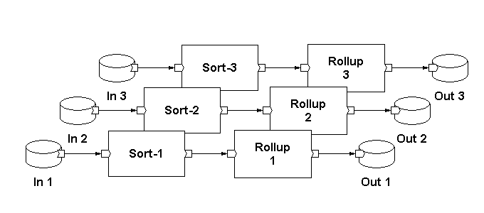
Data Parallelism
Partitions
CapGemini
Ab Initio Training

Slide 13
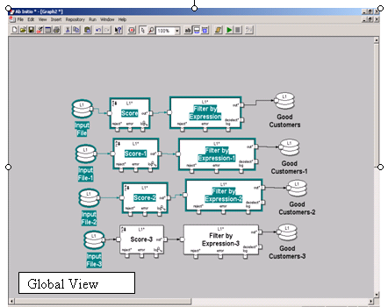
CapGemini
Ab Initio Training

Slide 14
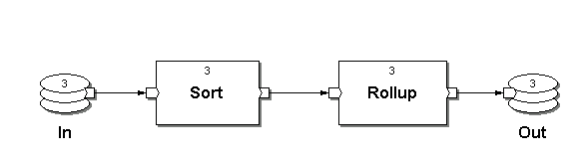
Two Ways of Looking at Data Parallelism
Expanded View:
Global View:
*
*
CapGemini
Ab Initio Training

Slide 15
Data Parallelism
Scales with data.
Requires data partitioning.
Dependent upon the application, different partitioning methods are available.
CapGemini
Ab Initio Training
Notes:
CapGemini
Ab Initio Training

Slide 16
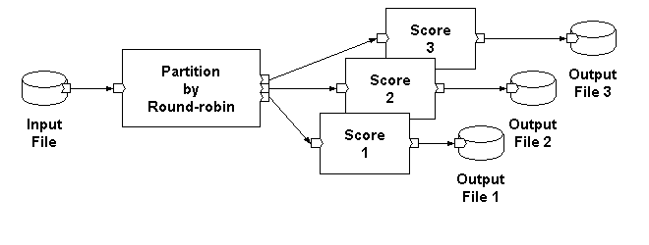
A Data Parallel Application: The Expanded View
CapGemini
Ab Initio Training

Slide 17
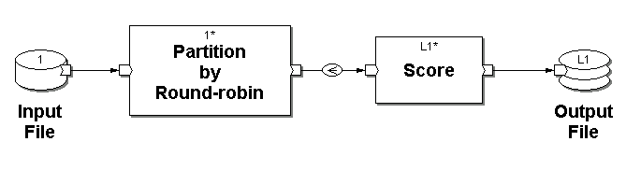
A Data Parallel Application: The Global View
Degree of Parallelism
(Abstract)
Fan-out Flow
Multifile
CapGemini
Ab Initio Training

Slide 18
Thank You
CapGemini
Ab Initio Training

