Slide 1
JUKEBOX PROJECT
By
Arjit Kumar Singh

Slide 2
Objective
Display the list of all songs.
Display the list of all podcast.
Display the list of user specific playlist.
User should be able to create a new playlist.
User should be able to add the items in the playlist.
User should be able search for a song or podcast on different criteria like title, artist, album, genre etc.

Slide 3
Classes and Packages used in the project
Connection and DriverManager class for connecting to database.
Javax.sound.sampled package for loading and playing the audio file.
File class for file handling.
IOException class for handling the i/o exceptions of file.
PreparedStatement class for running the query on the database.
ResultSet class for temporarily storing the data from the database.
SQLException class for handling the exception related to the database.
ArrayList class for storing the data from database in the list.
List class for processing different type of list.
Scanner class for taking input from the user.
Stream API for processing the list.

Slide 4
Features
User registration and login.
User validation while logging into account.
Play songs and podcast.
Search for a specific song or podcast based on a different search criteria like title, artist, album, genre, released date, celebrity.
Create multiple user specific playlist.
Edit the playlist(add items, remove items, delete playlist).
Can’t add duplicate items in the playlist.
Can’t add non existing items in the playlist.
Can go back to previous menu at every level.
Tabular output in the console window.

Slide 5
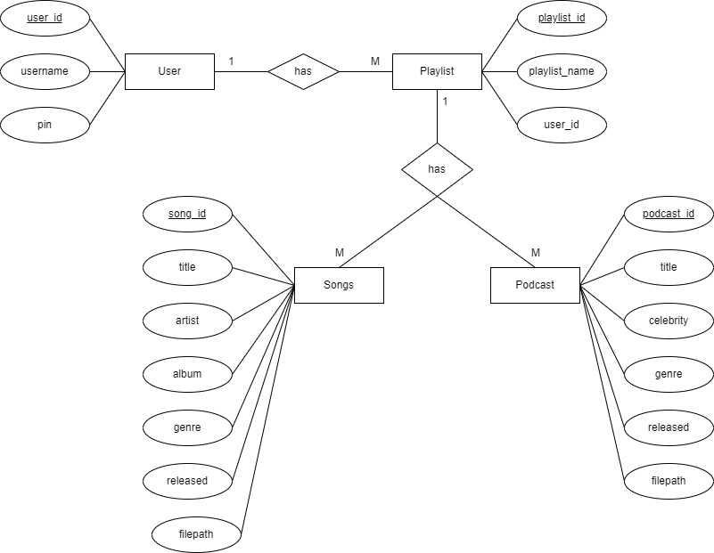
Entity and Relationship Diagram

Slide 6
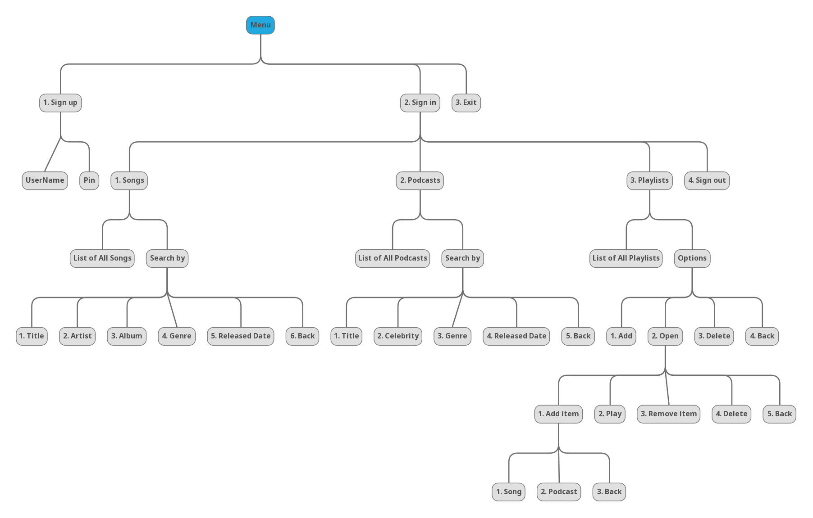
Jukebox Menu

Slide 7
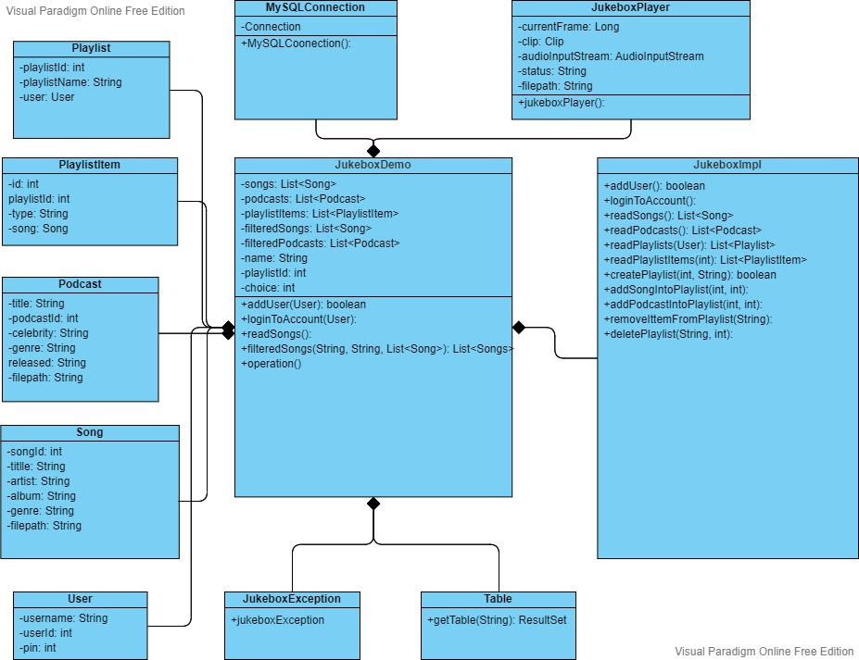
Class Diagram

Slide 8
Thank
You

