Slide 1
Python
Ease of Learning and Use
Python is known for its simple and readable syntax
Versatility – Python is versatile language.
Web development
Data Science
Machine Learning
Data Processing
AI
Rich Libraries
Pandas, Numpy
Django
Airflow
Druid
Nifi
Installation
Python Virtual Environment
Python IDE (PyCharm/Visual Studio)-Full scale development
Jupyter notebook(for development and testing)
Anaconda Navigator
Python shell
Databricks
Google Colab

Slide 2
Data Types
int
float
binary
string
tuple
lists
dictionary
sets
Variables
Variables hold references to objects.
Objects live in concrete memory positions.
All the variable are objects
>>> 42
42
>>> isinstance(42, int)
True
Objects and Attributes
Value
Identity
Type

Slide 3
>>> id(42)
4343440904
>>> type(42)
<class 'int'>
>>> type("Hello, World!")
<class 'str'>
>>> type([1, 2, 3])
<class 'list’>
Note: You can also determine the type of an object by accessing its .__class__ attribute directly.
Here’s how you’d do that:
>>> (42).__class__
<class 'int'>

Slide 4
Python is interpreted language
Mutable/Immutable
Sequence/Non Sequence
Python First Program
Function
Arguments(named parameters, positional parameters and dynamic parameters)
Collection Variables usage
Class & Object
Functional Programming
Python files read & write
Python Pandas
Exception Handling

Slide 5
Functional Programming
To take another function as an argument
To return another function to its caller

Slide 6
Lists
====================
Python lists are a classic example of a mutable data type. Like tuples, lists are sequences of arbitrary objects. In a list, however, you can change the value of any item without altering the list’s identity. In other words, you can change the value of a list object in place.
Because lists are sequences, you can use indexing and slicing operations to access individual data items:
>>> digits = [0, 1, 2, 3, 4, 5, 6, 7, 8, 9]
>>> digits[0]
0
>>> digits[9]
9
>>> digits[3:7]
[3, 4, 5, 6]
>>> digits[2::2]
[2, 4, 6, 8]
>>> digits[1::2]
[1, 3, 5, 7, 9]

Slide 7
List Operations
Mutation | Description | Syntax
Item assignment | Replaces the data item stored at a given index with a new data item, new_value | a_list[index] = new_value
Slice assignment | Replaces the data items within a given slice of the list | a_list[start:stop:step] = new_values
Item deletion | Deletes the data item at a given index | del a_list[index]
Slice deletion | Deletes the data items within a slice of the list | del a_list[start:stop:step]

Slide 8
List Operations
Method | Description
a_list.append(item) | Appends item to the end of a_list.
a_list.clear() | Removes all items from a_list.
a_list.extend(iterable) | Extends a_list with the contents of iterable.
a_list.insert(index, item) | Inserts item into a_list at index.
a_list.pop(index) | Returns and removes the item at index. With no argument, it returns the last item.
a_list.remove(item) | Removes the first occurrence of item from a_list.
a_list.reverse() | Reverses the items of a_list in place.
a_list.sort(key=None, reverse=False) | Sorts the items of a_list in place.

Slide 9
Spark is an In-memory and distributed Computing It can understand four languages Scala Java Python R
Distributed Processing
Low latency for disk read and write
Disk Read -> Comp. In Memory ->comp. In Memory -> comp. In memory -> Disk Write
How to install the spark ?
Java JDE 1.8 and above
Cluster(only for production)
Pyspark from Apache spark website

Slide 10
Distributed Files System (DFS)
Large volume will be divided into small blocks(128 MB default size in hdfs) and will be stored into across the data nodes. The default block size will be varying based on the storage types such as aws s3, azure blob and google GCP storage or any other distributed file system.
One Blocks will be stored into multiple data nodes to ensure the data integrity is called fault tolerance
Big data support file system
Column oriented file system( Parquet & orc)
Row Based file system (Avro)

Slide 11
Components in the Spark Architecture Cluster Resource Manager(Standalone, Meosys, YARN, Kubernetes) Driver Executor
Spark Libraries Spark RDD
Spark SQL
Spark Graph
Spark Streaming
Spark Machine Learning
Execution Mode Client Mode (Driver and Executors will run in same machine)
Server Mode(Driver and Executors will run in different machines in the cluster)

Slide 12
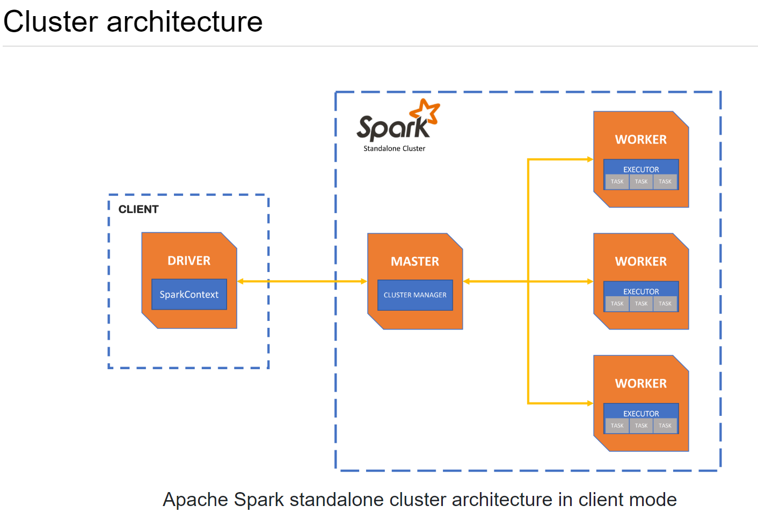
https://spark.apache.org/docs/latest/cluster-overview.html

Slide 13
RDD
The basic unit which holds the data in spark is called RDD
Resilient Distributed Dataset
It will support to read both structure and non-structured data
from pyspark import SparkConf, SparkContext
# Create a SparkConf object to configure the Spark application
conf = SparkConf().setAppName("SparkRDDExample").setMaster("local[*]")
# Create a SparkContext to interact with Spark
sc = SparkContext(conf=conf)
# Define a collection of data
data = [1, 2, 3, 4, 5]
# Create an RDD from the collection
rdd = sc.parallelize(data)
# Perform a transformation: map each element to its square
squared_rdd = rdd.map(lambda x: x * x)
# Perform an action: collect the results back to the driver
result = squared_rdd.collect()
# Print the result
print("Squared numbers:", ", ".join(map(str, result)))
# Stop the SparkContext
sc.stop()

Slide 14
Spark has two operations
1. Transformations – It is Lazy
2. Actions – It is not lazy
Example
----------------
day_list = ["monday","tuesday","wednesday"] - Transformations
B = list(map(lambda s : s.upper(),day_list)) - Transformations
Print(B) - Action
Execution Engine workflow
1. Create a DAG – Direct Acyclic Graph (by Driver)
2. Prepare the multiple Execution Plan and find optimized one(by Driver)
3. Execute the optimized plan
4. Create the Jobs/stages/tasks (by driver)
5. Execute the Tasks (by executor)

Slide 15
Datasets & DataFrames RDD + Schema Spark SQL Libraries will provide the DataFrame units Data Frame will support to do the all kind of transformations and actions Spark code can be done using either Integrated methods or native SQL Spark UI – http://localhost:4040 Spark web Server : http://<hostaddress>:18080

Slide 16
Shuffling
It involves moving data between executors or nodes in the cluster to ensure that related data ends up on the same partition
Narrow Transformations
Narrow transformations are operations where each partition of the parent RDD is used by at most one partition of the child RDD.
They operate on a single partition of the RDD without shuffling or moving data across partitions.
Examples of narrow transformations include map, filter, flatMap, mapPartitions, union, intersection, sample, etc.
Narrow transformations are typically more efficient since they can be executed within a single partition without needing data movement across the cluster.
Wide Transformations
Wide transformations are operations where each partition of the parent RDD can be used by multiple partitions of the child RDD, often requiring data to be shuffled across partitions.
They involve data shuffling or redistribution across partitions, which may require communication between nodes in the cluster.
Examples of wide transformations include groupBy, reduceByKey, sortByKey, join, intersection, distinct, sortBy, etc.
Wide transformations are relatively more expensive in terms of computational resources and time due to the data shuffling overhead. They may involve network communication and disk I/O.
Stages – New Stage will be created for each wide transformation.
Tasks – Each stage will be consisted of multiple tasks (Based on no of executors and the no of cores per executors) and will get it executed by executors
Spark Job – Separate Job will be created for each Stage. Hence, no of jobs = no of stages

Slide 17
Memory Persist =>
MEMORY_ONLY:
This is the default storage level used by cache().
Data is stored in memory as deserialized Java objects.
This is the fastest storage level but offers no fault tolerance against executor failures.
Use this level if recomputation of lost data is acceptable.
MEMORY_ONLY_SER (or MEMORY_ONLY_2):
Data is stored in memory as serialized Java objects (byte arrays).
This saves memory compared to MEMORY_ONLY because objects take up less space when serialized.
However, deserialization overhead is incurred when accessing the data.
Suitable when memory is constrained but CPU is not.
MEMORY_AND_DISK:
Data is stored in memory, and any excess spills to disk.
Offers fault tolerance by spilling data to disk when memory is full.
Slower than MEMORY_ONLY due to disk I/O for spilled partitions.
Suitable when the dataset is larger than available memory but can still fit in a reasonable amount of disk space.
MEMORY_AND_DISK_SER (or MEMORY_AND_DISK_2):
DISK_ONLY:
Data is stored only on disk, not in memory.
Slowest storage level but offers full fault tolerance against executor failures.
Suitable for large datasets that cannot fit into memory.

Slide 18
Broadcast Join
joined_df = df_large.join(broadcast(df_small), "join_column")
Spark-submit
https://spark.apache.org/docs/latest/submitting-applications.html
./bin/spark-submit \
--master local[*] \
/home/myunix/testpyspark/pyfiles/tr_pyspark_04.py
Spark Thrift Server
https://spark.apache.org/docs/latest/sql-distributed-sql-engine.html
Have to config hive-site.xml
spark-submit --class org.apache.spark.sql.hive.thriftserver.HiveThriftServer2 --master local[2] --deploy-mode client --executor-memory 1g --total-executor-cores 2 --jars D:\spark\spark-3.4.0-bin-hadoop3\jars\spark-hive_2.12-3.4.0.jar --conf hive.metastore.warehouse.dir="D:\spark-warehouse“
pyspark.sql module for reference
https://spark.apache.org/docs/2.4.0/api/python/pyspark.sql.html

Slide 19

Thank you

