Slide 1
ML JACKFRUIT
PREDICTIVE
MAINTENANCE
Industrial Equipment Failure Detection
Models: Logistic Regression • Gaussian NB • Random Forest (PCA)
BY: ANSH DESHWAL PES1UG23EC046
ARCHI PES1UG23EC053
ARJUN SHARMA PES1UG23EC054

Slide 2
Outline
Abstract & Scope
Methodology
01
02
Problem statement, dataset, and goals
Data pipeline, feature engineering, ML models
Exploratory Data Analysis
Implementation & Code
03
04
Sensor distributions and class balance
Model training, Streamlit app walkthrough
Results
References
05
06
Confusion matrices, ROC curves, learning curves
Dataset sources and key papers

Slide 3
Abstract & Scope
Problem Statement
Project Scope
Industrial turbofan engines degrade over time. Unexpected failure causes costly downtime and safety hazards. This project builds a binary classification system to detect near-failure conditions before they occur, enabling proactive maintenance scheduling.
Dataset: NASA CMAPSS
EDA of sensor distributions
Feature selection & normalization
4 ML classifiers compared
PCA dimensionality reduction
Streamlit interactive app
Confusion matrices & ROC
Learning curve analysis
Decision rule explainability
Source: NASA Turbofan Engine Degradation Simulation
21 sensor readings + 3 operational settings per cycle
14 sensors selected after removing near-constant features
Binary label: Normal (RUL > 30) vs Near-Failure (RUL ≤ 30)
~20,000+ training cycles across multiple engines

Slide 4
Methodology
01 Data Ingestion
02 Feature Engineering
03 Preprocessing
Load NASA CMAPSS FD001 dataset. Parse engine cycles, sensor columns, and operational settings.
Drop near-zero-variance sensors (1,5,6,10,16,18,19). Retain 14 sensors + 2 op settings. Label: RUL ≤ 30 = Near-Failure.
MinMaxScaler normalization [0,1]. 80/20 stratified train-test split. PCA (10 components) for Random Forest.
04 Model Training
05 Evaluation
06 Deployment
Logistic Regression, Gaussian NB, Random Forest (100 trees, PCA features).
F1, Precision, Recall, ROC-AUC. Cross-validated learning curves with 5-fold CV.
Streamlit app with live sensor sliders, health gauge, explainability tab, and model comparison.

Slide 5
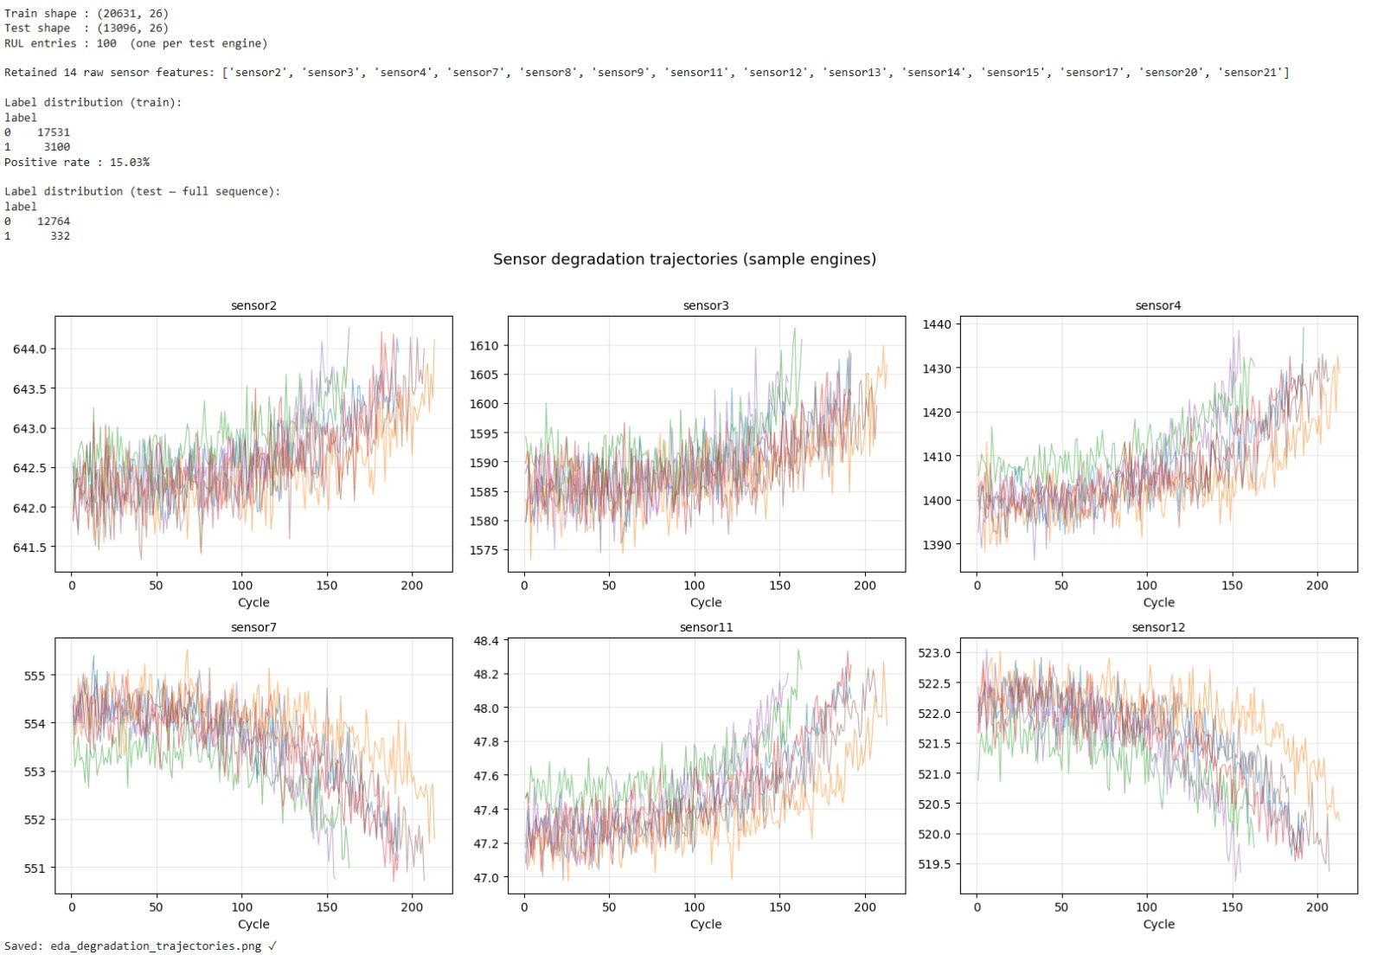
Exploratory Data Analysis — Sensor Degradation Trajectories

Slide 6
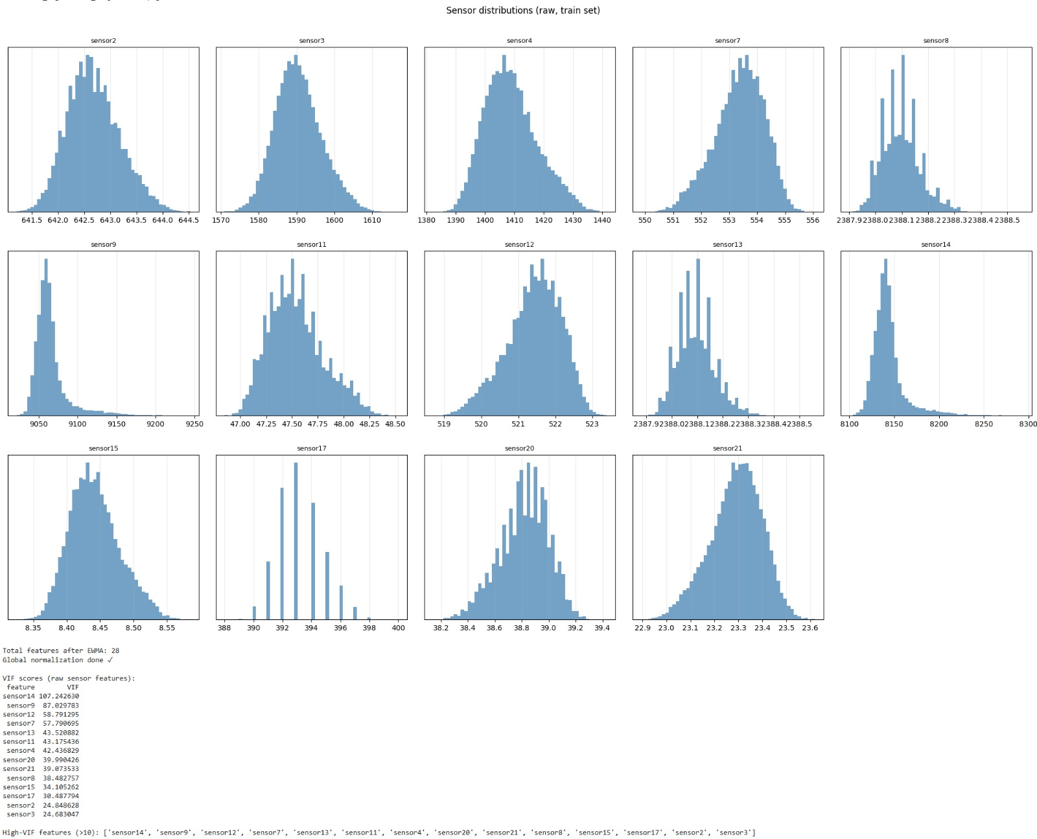
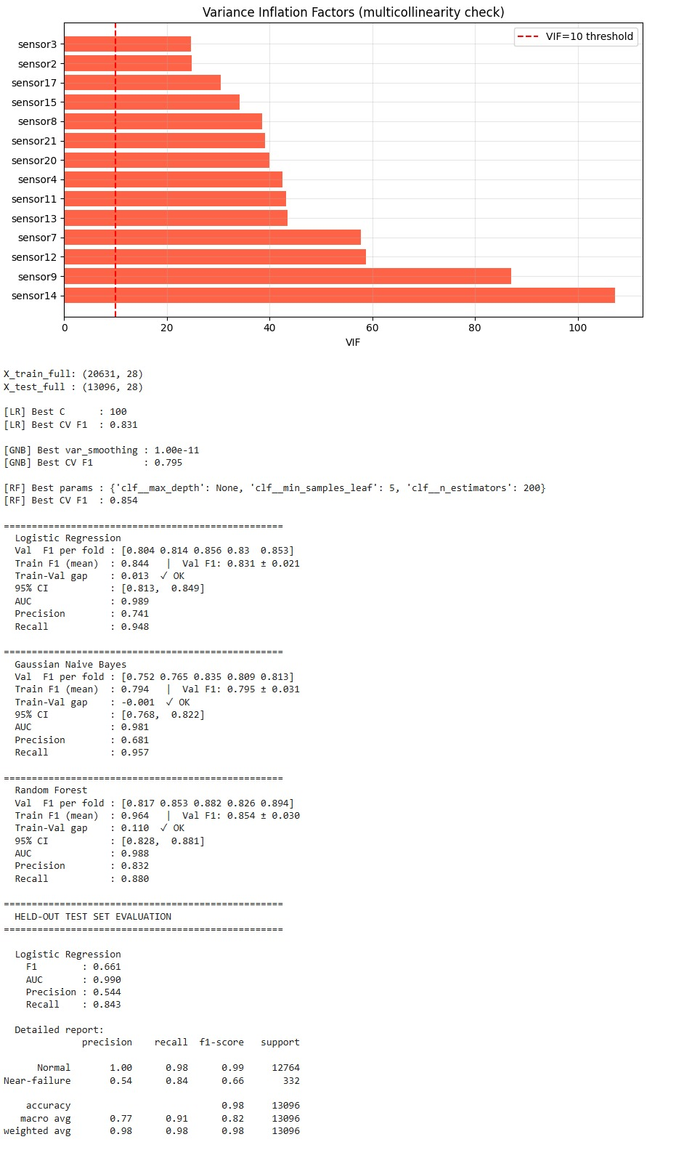
Exploratory Data Analysis — Sensor Distributions & VIF

Slide 7
Exploratory Data Analysis — Key Observations
sensor2, 3, 4
Gaussian distributions — good discriminators
sensor17
Discrete/stepped values (operational setting)
sensor8 & 13
Bimodal, indicating operational modes
op1, op2
Approximately uniform, reflect flight condition
Class Imbalance
~15% near-failure samples — addressed in evaluation
Train Shape
20,631 rows × 26 cols | Test: 13,096 × 26
14 Sensors
Retained after removing near-zero-variance features

Slide 8
Implementation — Data Pipeline & Feature Engineering
Why drop sensors?
# Feature Selection & Label Engineering
sensor_cols = [f'sensor{i}' for i in
[2,3,4,7,8,9,11,12,13,14,15,17,20,21]]
feature_cols = sensor_cols + ['op1','op2']
# EWMA trend features (new)
for col in sensor_cols:
df[col+'_ewma'] = df.groupby('unit')[col]
.transform(lambda x: x.ewm(span=10).mean())
# RUL computation
df['max_cycle'] = df.groupby('unit')['cycle']
.transform('max')
df['RUL'] = df['max_cycle'] - df['cycle']
df['label'] = (df['RUL'] <= 30).astype(int)
# Normalize (Global)
scaler = MinMaxScaler()
X_train = scaler.fit_transform(df_train[feature_cols])
X_test = scaler.transform(df_test[feature_cols])
# PCA for Random Forest
pca = PCA(n_components=10)
X_train_pca = pca.fit_transform(X_train)
Sensors 1,5,6,10,16,18,19 have near-zero variance — no signal, adds noise.
EWMA Features
28 total features after EWMA smoothing. Trend features dominate importance.
RUL Labeling
RUL ≤ 30 cycles = 'Near-Failure'. Gives maintenance teams lead time.
PCA for RF
10 PCA components explain ~95% variance. Reduces noise and training time.

Slide 9
Implementation — Models & Streamlit App
Logistic Regression
Gaussian Naive Bayes
solver='lbfgs', max_iter=1000
Input: 28 features (raw + EWMA)
CV F1: 0.831 | AUC: 0.989
Balanced, fast, interpretable
Assumes feature independence
Probabilistic classification
CV F1: 0.795 | AUC: 0.981
Strong generalization, fastest
Random Forest (PCA)
200 estimators, PCA 10 components
CV F1: 0.854 | AUC: 0.988
Most robust to outliers
Used for health gauge + EWMA features
Streamlit App | 4 tabs: Input & Predict • Why This Prediction? (DT) • Health Gauge (RF) • Model Comparison

Slide 10
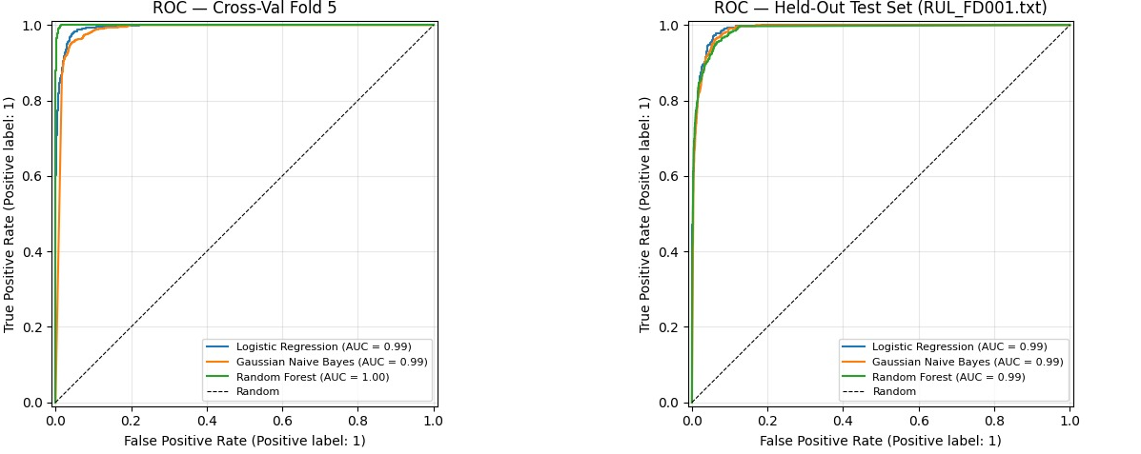
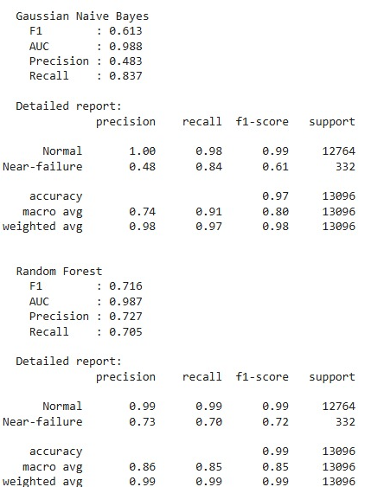
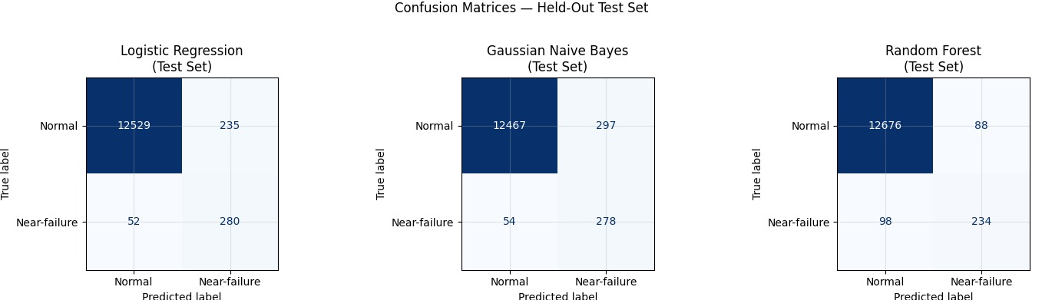
Results — ROC Curves & Confusion Matrices

Slide 11
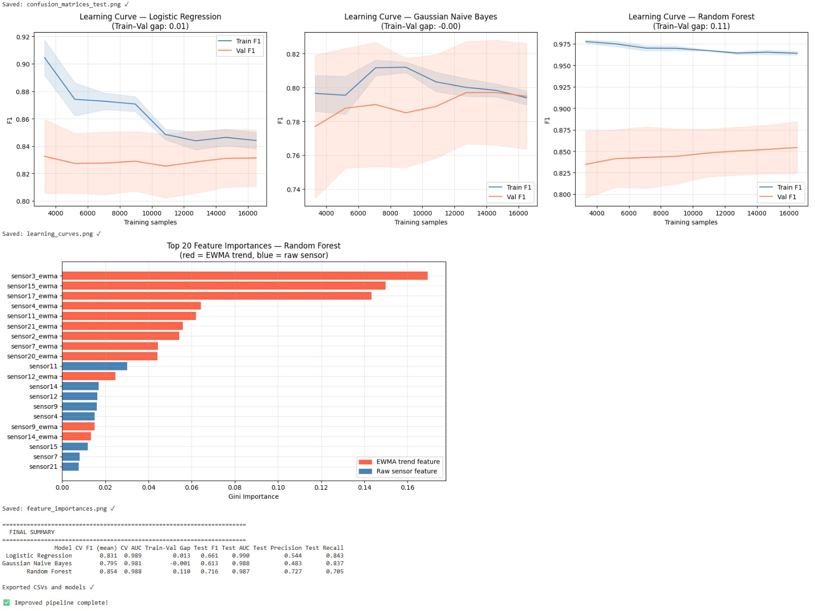
Results — Learning Curves & Feature Importances

Slide 12
Results — Model Comparison
Model | CV F1 | CV AUC | Test F1 | Test AUC | Precision | Recall | Notes
Logistic Regression | 0.831 | 0.989 | 0.661 | 0.990 | 0.544 | 0.843 | Balanced, fast, interpretable
Gaussian Naive Bayes | 0.795 | 0.981 | 0.613 | 0.988 | 0.483 | 0.837 | Strong generalization, fastest
Random Forest (PCA) | 0.854 | 0.988 | 0.716 | 0.987 | 0.727 | 0.705 | Most robust — best CV F1
★ F1 scores from 5-fold cross-validated evaluation. All models AUC ≥ 0.98 — near-perfect discrimination. RF recommended for deployment.
0.854
0.990
~99%
Best CV F1
(Random Forest)
Best AUC
(Logistic Reg)
Accuracy on
Normal class

Slide 13
References
[1] Saxena, A. & Goebel, K. (2008). Turbofan Engine Degradation Simulation Data Set. NASA Ames Prognostics Data Repository.
[2] Saxena, A. et al. (2008). Damage Propagation Modeling for Aircraft Engine Run-to-Failure Simulation. ICSPHM 2008.
[3] Pedregosa, F. et al. (2011). Scikit-learn: Machine Learning in Python. JMLR 12:2825–2830.
[4] McKinney, W. (2010). Data Structures for Statistical Computing in Python. SciPy 2010.
[5] Streamlit Inc. (2023). Streamlit — A faster way to build and share data apps. https://streamlit.io
[6] PCA for Predictive Maintenance — Towards Data Science, 2022.

