Slide 1

SHITHEAD
ONLINE
Play with your mates, anywhere.
No downloads. No sign-up. Just cards.

Slide 2


HOW IT WORKS
1
2
3
Create a Room
Share the Code
Play!
One person creates a game room and gets a 4-letter code
Send the room code to your mates via text, WhatsApp, wherever
Everyone joins in their browser. No downloads, no accounts needed

Slide 3
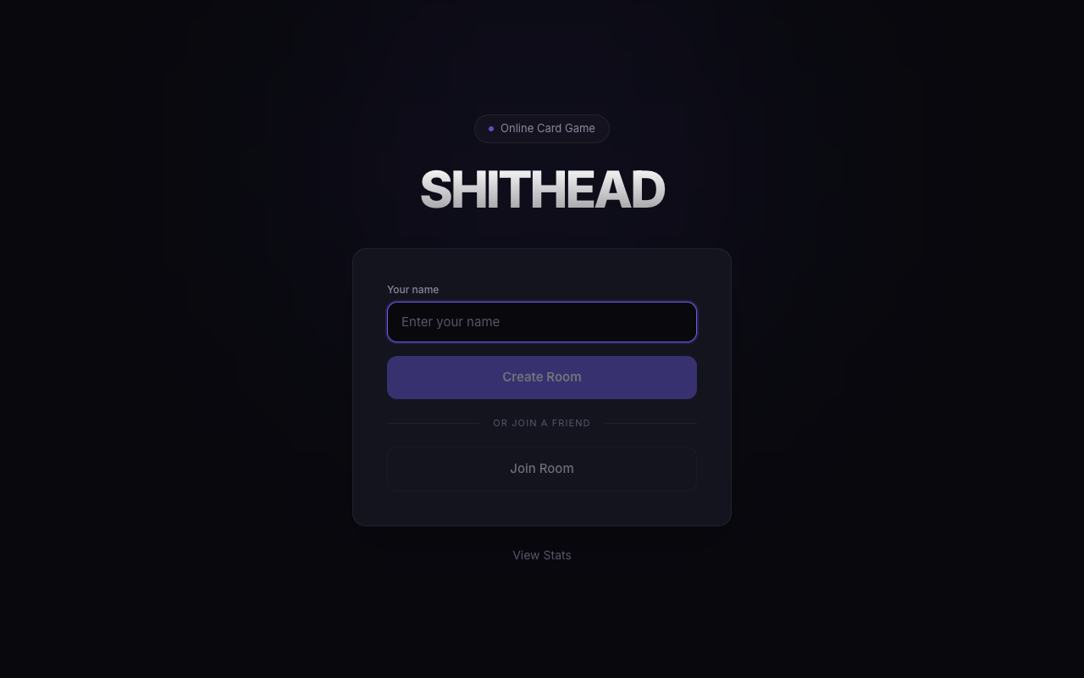
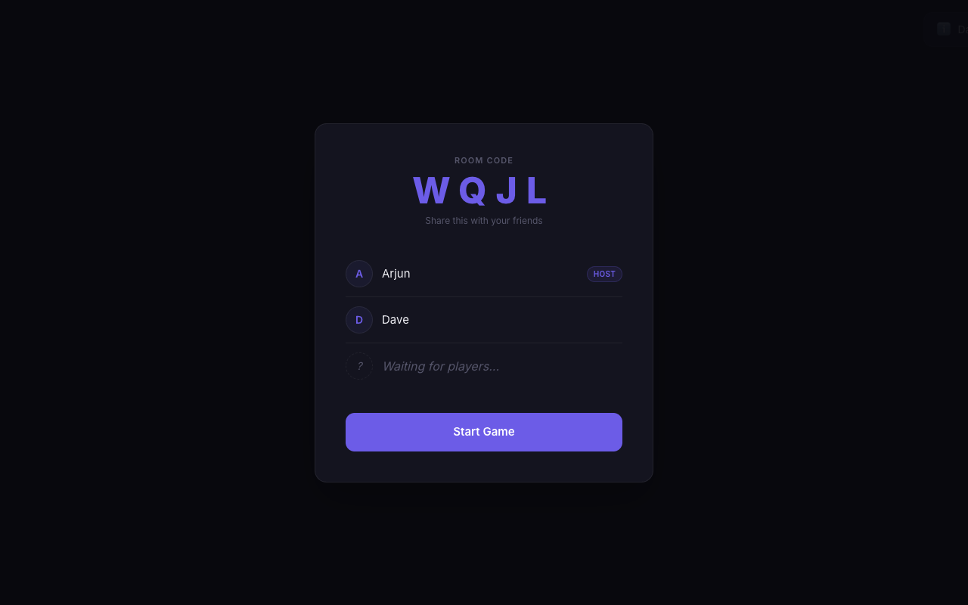
SEE IT IN ACTION
Home Screen
Waiting Room
Enter your name and create or join a room
Share the room code — friends join instantly

Slide 4
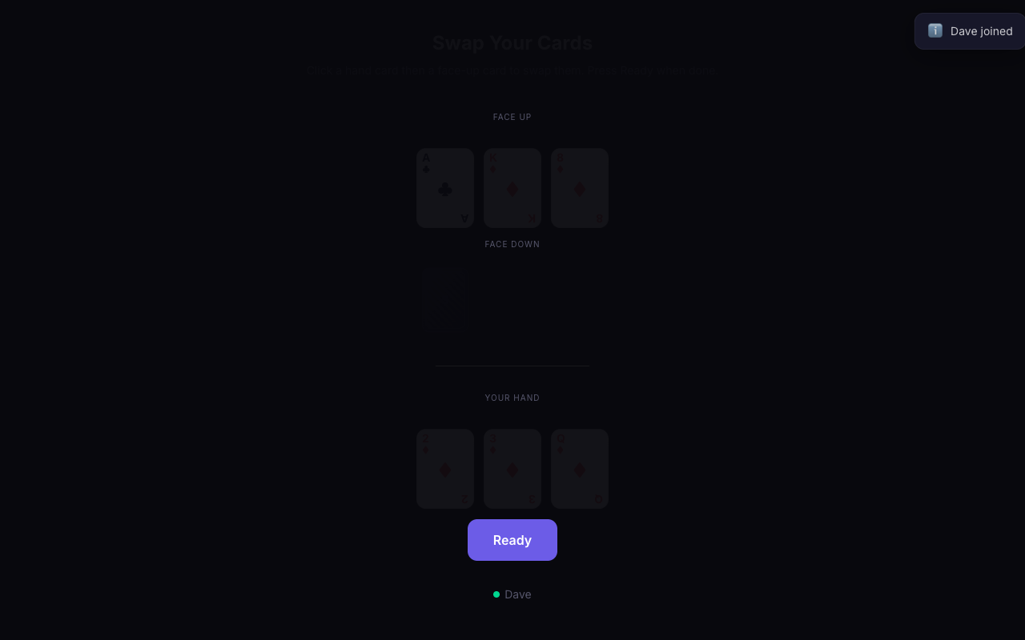
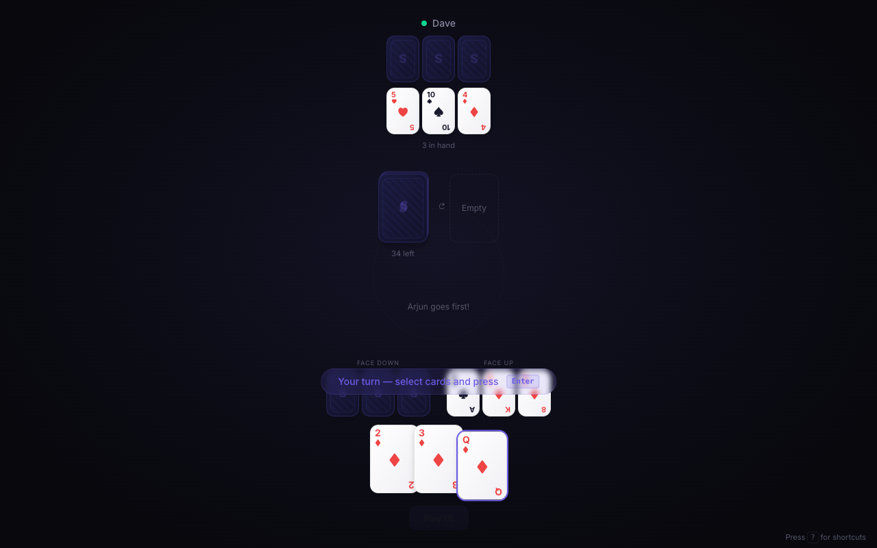
GAMEPLAY
Swap Phase
In-Game
Choose which cards to keep face-up before play begins
Select cards, play them, and watch the pile grow

Slide 5
THE CARDS
2
Reset
3
Invisible
7
Play Lower
8
Skip
Play on anything, resets the pile
Beat the card underneath
Next player goes lower (not on Ace)
Skips the next player
The great equaliser
Sneaky and invisible
Can also play a 7 on a 7
Sorry, not sorry
10
Burn
J
Reverse
4x
Auto Burn
A
Highest
Removes the entire pile
Reverses play direction
Four of a kind burns the pile
The highest card in the game
Boom! Pile gone
Change things up
Stack 'em up and watch it burn
Top dog, untouchable

Slide 6


THE RED 6 RULE
Red 6
Forces the next player to pick up the ENTIRE pile
Black 6
Deflects the red 6 to the next player
THE CATCH
The next player picks up EVERYTHING — including the black 6!

Slide 7






FEATURES
Real-time Multiplayer
Room Codes
Instant updates via WebSockets — no lag, no refreshing
Share a 4-letter code and your mates join in seconds
Card Swap Phase
Auto-Sorted Hand
Swap cards between hand and face-up before the game starts
Cards sorted worst to best, left to right — always tidy
Pile Peek
Stats Tracking
When a 3 is played, see the card underneath you need to beat
Wins, losses, streaks, and head-to-head records
Keyboard Shortcuts
Number keys to select, Enter to play, Space to pick up

Slide 8
READY?
Ask me for the link and let's go!
LET'S PLAY
2–6 players · Browser only · No sign-up required

