Slide 1
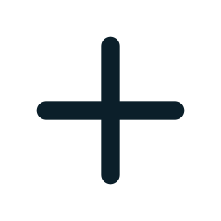
From a laptop to a monitored Kubernetes cluster on AWS
ClinicFlow
DEVOPS FINAL CAPSTONE · SESSION 21
A clinic appointment system, shipped through a complete, automated delivery pipeline.
Arjun Aggarwal
github.com/arju-prog/clinicflow
Notes:
Hello everyone. I'm presenting ClinicFlow, my DevOps final capstone. The application itself is a clinic appointment scheduler, but the real point of this project is the journey: how a single code commit travels all the way to a running, autoscaling, monitored Kubernetes cluster on AWS, with every step automated. I'll walk through each stage of that pipeline.

Slide 2



What ClinicFlow does
THE APPLICATION
A clinic front-desk system. Receptionists register patients, manage doctors and book appointments, and the backend refuses any double-booking.
Appointments
Doctors & patients
Live dashboard
Book, check in, complete or cancel. A doctor or patient is never in two places at once.
Full CRUD across three resources, validated input and a searchable patient register.
KPI cards, today’s schedule and doctor workload, all from the API’s stats endpoint.
React + Vite
FastAPI
PostgreSQL
SQLAlchemy + Alembic
36 pytest tests
Notes:
I deliberately chose my own domain rather than cloning the reference TaskBoard app, because the rubric gives zero for a direct clone. ClinicFlow is a clinic front desk. The headline feature is that the backend enforces real business rules — it rejects double-bookings for both doctors and patients, with a 409 response. The stack is React and Vite on the front, FastAPI and PostgreSQL on the back, with Alembic managing the database schema, and 36 automated tests.

Slide 3
One commit, thirteen stages
THE JOURNEY
This is the sequence I’ll demonstrate. Each box is a stage, and every stage is automated: pushing code to GitHub sets the whole chain in motion.
01
02
03
04
05
06
07
Application
Git commit
CI pipeline
Docker image
Security scan
Registry
Terraform
08
09
10
11
12
13
Kubernetes
Helm
Ingress
Autoscaling
Monitoring
Troubleshooting
Commit → test → build → scan → publish → deploy → observe
Notes:
Here is the full map, straight from the course outline. Thirteen stages, from the application all the way to live troubleshooting. The key idea is traceability and automation: I make one commit, and GitHub Actions runs the tests, builds and scans the images, pushes them to a registry, and deploys them with Helm to a Kubernetes cluster that Terraform built on AWS. Then Prometheus and Grafana watch it. I'll take each box in turn.

Slide 4

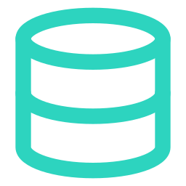
The working app
STAGE 01 · APPLICATION
Without a working application, no DevOps layer means anything. This is the foundation everything else carries.
WHY TWO HEALTH ENDPOINTS?
FastAPI backend, 8+ REST endpoints across doctors, patients and appointments
PostgreSQL with Alembic migrations: schema as versioned code
/health, /ready and /metrics endpoints
Responsive React UI: a real dashboard, not a blank page
/health · liveness
“Is the process up?” No database call, so a database blip never restarts every pod at once.
/ready · readiness
“Can it serve traffic now?” Checks the database first and returns 503 until it answers.
Notes:
Stage one: the application. The point I want to make is that the DevOps layer is only worth anything if the app underneath actually works. ClinicFlow has a FastAPI backend with more than eight REST endpoints, a PostgreSQL database whose schema is managed as versioned code through Alembic migrations, and three operational endpoints. The panel on the right is a question an examiner often asks: why have both health and ready? Liveness says the process is up, and deliberately does not touch the database, so a brief database problem does not cause Kubernetes to restart every pod simultaneously. Readiness does check the database, so traffic only goes to pods that can actually serve it.

Slide 5
Version control
STAGE 02 · GIT COMMIT
Every change is an immutable checkpoint. The commit is where the whole pipeline starts.
$ git log --oneline
3702b1a Trust GitHub's ID-based OIDC subject
30e7766 Use Free Tier m7i-flex.large nodes
6147414 Add Helm chart with Ingress, HPA, PDBs
65e43e2 Provision AWS VPC and EKS (Terraform)
c8ab632 Add CI/CD pipeline: tests, Trivy, GHCR
867a739 Add REST API with double-booking checks
... 20+ commits
Public repository with a clean, feature-by-feature history
Meaningful commit messages, never “update” or “fix”
.gitignore keeps .env, secrets and caches out of Git
20+ commits, each doing one logical thing
Notes:
Stage two is Git. Version control is non-negotiable in a professional team. My repository is public, with a clean history built feature by feature — each commit does one logical thing and has a descriptive message, never a vague "fix" or "update". And crucially, my gitignore keeps secrets out: the dot-env file, Terraform variable files and caches are never committed. The grading team rejects any submission with secrets in the history, so this matters.

Slide 6


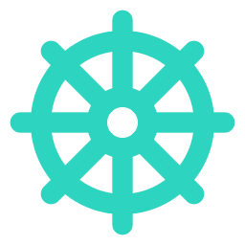

GitHub Actions: the automation backbone
STAGE 03 · CI PIPELINE
Runs on every push to main. Tests are the first quality gate: if they fail, no image is ever built or deployed.
1 · TEST
2 · BUILD + SCAN + PUSH
3 · DEPLOY
ruff + 36 pytest tests, Vitest, helm lint, terraform validate, secret scan
Build both images, scan with Trivy, push to GHCR tagged with the Git SHA
helm upgrade --install to EKS, keyless through GitHub OIDC
Quality gate: a failing test exits non-zero, the build stops, and no broken image is ever promoted to production.
Notes:
Stage three, the CI pipeline, is the automation backbone and it carries the most marks. It runs on every push to main, in three conceptual stages. First, test: linting, my 36 pytest tests, the frontend tests, Helm and Terraform validation, and a secret scan. Second, build, scan and push the images. Third, deploy with Helm. The arrows matter — they're dependencies. If the tests fail, the job exits non-zero, and because the later jobs depend on it, nothing gets built and nothing gets deployed. That's the first quality gate: a bad commit stops here, before it can ever become a running container.

Slide 7
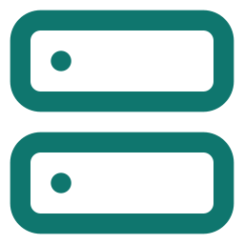

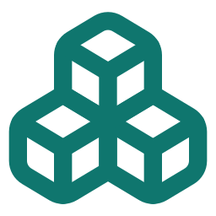
Containerised and portable
STAGE 04 · DOCKER IMAGE
The whole stack runs with one command. Each image ships only what it needs to run.
Backend image
python:3.12-slim · runs as uid 10001
Multi-stage builds: Node build, then an Nginx runtime; no build tools in the final image
Both images run as a non-root user
docker compose up --build starts all three services
Frontend image
nginx-unprivileged · runs as uid 101
3 services: frontend, backend and postgres, started together with health checks
Notes:
Stage four: Docker. The goal is that anyone can run the entire stack with a single command. I use multi-stage builds — for the frontend, one stage builds the React app with Node, and a second, clean stage serves the static files with Nginx, so the build tools never end up in the shipped image. Both images run as non-root users, which is a security requirement and a grading criterion. And docker compose up build brings up all three services — frontend, backend and Postgres — together, with health checks so they start in the right order.

Slide 8


Trivy: a gate, not a guarantee
STAGE 05 · SECURITY SCAN
The pipeline scans both images and fails the build on any fixable HIGH or CRITICAL vulnerability. A vulnerable image is never pushed.
THE PROBLEM IT CAUGHT
THE FIX
First scan failed with 4 HIGH CVEs (urllib3, msgpack, setuptools), all bundled inside pip, which ClinicFlow never uses.
Removed pip from the runtime image. All four CVEs gone, smaller attack surface. Result: 0 HIGH / CRITICAL.
Secret scanning
Dependency scanning
Container scanning
IaC misconfig scanning
Results in GitHub Security tab
Notes:
Stage five, security. I run Trivy on both images, and the gate fails the build on any HIGH or CRITICAL vulnerability that has a fix available. This is the example I most want to highlight, because it's a real finding. My first scan failed with four HIGH CVEs — in urllib3, msgpack and setuptools. The interesting part: ClinicFlow never imports any of them. They were there only because pip, and the libraries pip bundles, shipped inside the image. Pip is only needed at build time, so I removed it from the runtime stage. All four findings disappeared and the image got smaller. The lesson is that the best fix is often removing what you don't need, not upgrading it. A scanner isn't a guarantee of security — it's one automated control among several layers.

Slide 9
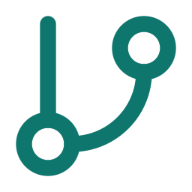
Published to GHCR
STAGE 06 · REGISTRY
The pipeline pushes both images to the GitHub Container Registry, tagged with the exact Git commit SHA, never latest.
commit A -> image A
commit B -> image B
ghcr.io/arju-prog/
clinicflow-backend:3702b1a...
ghcr.io/arju-prog/
clinicflow-frontend:3702b1a...
both packages public
Why the SHA and not “latest”?
Full traceability: any running pod points back to the exact commit that built it. Rolling back means redeploying an older SHA.
Notes:
Stage six is the registry. After the scan passes, the pipeline pushes both images to GitHub's Container Registry, GHCR. The important detail is the tag: I use the full Git commit SHA, never the latest tag. Latest is ambiguous — you can't tell which code is actually running. With a SHA tag, every running pod traces straight back to the exact commit that produced it, so I get full traceability from production back to source, and rolling back is just redeploying an older SHA.

Slide 10
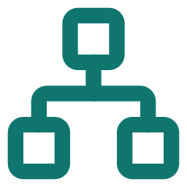
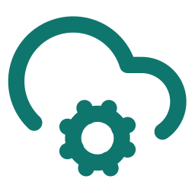
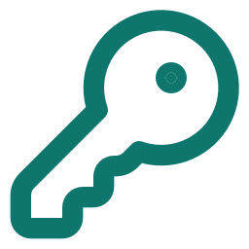
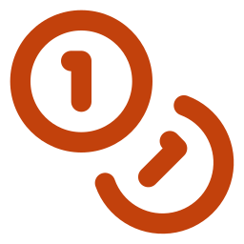
Infrastructure as Code
STAGE 07 · TERRAFORM
Instead of clicking through the AWS console, the network and cluster are described in code. Terraform builds them to match, and tears them all down with one command.
VPC
EKS cluster
IAM + OIDC
10.30.0.0/16, 2 public and 2 private subnets across 2 availability zones, NAT gateway
Kubernetes 1.34, managed node group, 2 worker nodes in Mumbai (ap-south-1)
Keyless deploy role: GitHub authenticates to AWS with no stored keys
Cost discipline: a real EKS cluster bills by the hour. terraform destroy removed all 65 resources, verified 0 left.
Notes:
Stage seven, Terraform. Kubernetes manages workloads, but it doesn't create the AWS network or the cluster itself — that's Terraform's job. Everything is described in code: a VPC with public and private subnets across two availability zones, the EKS cluster with a managed node group, and the IAM roles. I provisioned this for real in the Mumbai region. One thing I'm proud of is the keyless deploy: GitHub authenticates to AWS through OIDC, so there are no AWS access keys stored anywhere. And because a live cluster costs money by the hour, terraform destroy is just as important as apply — I tore down all 65 resources and verified nothing was left billing.

Slide 11
Running in the cluster
STAGE 08 · KUBERNETES
Deployments keep pods alive. Services give them stable networking even as pods come and go.
$ kubectl get pods -n clinicflow
clinicflow-backend-...mwtzl Running
clinicflow-backend-...ss26r Running
clinicflow-frontend-...hrxfl Running
clinicflow-frontend-...rnvf7 Running
clinicflow-postgres-0 Running
across 2 nodes, all 1/1 Ready
Backend and frontend, 2 replicas each, spread across nodes
ClusterIP Services for stable internal routing
PostgreSQL as a StatefulSet on an EBS volume
Hardened pods: non-root, read-only filesystem, dropped capabilities
Notes:
Stage eight: Kubernetes. Pods are ephemeral — they get killed and replaced. A Deployment makes sure the right number are always running; if one dies, it creates a replacement. A Service gives those pods a stable network address even as individual pods change. In my cluster the backend and frontend each run two replicas, spread across both nodes so a single node failure doesn't take anything down, Postgres runs as a StatefulSet with a persistent EBS volume, and every pod is hardened — non-root, read-only filesystem, all Linux capabilities dropped.

Slide 12


Packaged deployment
STAGE 09 · HELM
Instead of editing dozens of YAML files by hand, Helm turns the whole deployment into one reusable, versioned package.
$ helm upgrade --install clinicflow ...
Release "clinicflow" deployed · revision 1
Chart
values
templates
release
One chart configures it all
rollback
Deployments, Services, Ingress, HPA, PodDisruptionBudgets, NetworkPolicy and ServiceMonitor.
A values-dev.yaml for the local kind cluster and a values-prod.yaml for EKS: one chart, two environments.
A failed upgrade rolls itself back, so production stays on the last good release.
Notes:
Stage nine, Helm. A real Kubernetes deployment is dozens of YAML files. Helm packages them into a single chart with variables, so I describe the deployment once and configure it per environment — I have a dev values file for my local cluster and a prod values file for EKS. One command, helm upgrade install, deploys or updates everything: the Deployments, Services, Ingress, autoscaler, network policy and monitoring hooks. And because it's a release with history, a bad deploy can roll back to the previous version — I actually configured the pipeline to roll back automatically if the new pods never become healthy.

Slide 13

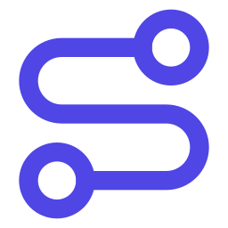
One door, two routes
STAGE 10 · INGRESS
The Ingress routes external traffic by path, so the browser never needs to know the internal service names.
/
React frontend
/api
FastAPI backend
A key distinction
An Ingress is only configuration. An Ingress Controller (Traefik) actually implements it.
Note: I used Traefik, not ingress-nginx, because the ingress-nginx project was retired in March 2026. Same standard Ingress API.
Notes:
Stage ten, Ingress. The application has two logical routes from the outside world: slash goes to the React frontend, and slash-api goes to the FastAPI backend. The browser just talks to one hostname and the Ingress handles the routing, so the frontend never needs to know the backend's internal address. An important teaching point an examiner may probe: the Ingress resource is only configuration — it does nothing on its own. You also need an Ingress Controller to actually implement it. I used Traefik, because the older ingress-nginx project was retired in early 2026, but it speaks the same standard Ingress API.

Slide 14
The HPA scales under load
STAGE 11 · AUTOSCALING
The Horizontal Pod Autoscaler watches CPU and adds pods when the app gets busy. Measured live on EKS during a load test:
340%
peak CPU, as a share of the request
2 → 6
backend pods (min → max)
~90 s
from idle to full scale-out
Requires CPU requests + metrics-server.
Notes:
Stage eleven, autoscaling. The Horizontal Pod Autoscaler watches the backend's CPU usage and adds pods when it gets busy, then removes them when things calm down. I didn't just configure it — I demonstrated it live. I ran a load generator inside the cluster, the CPU shot up to well over three times the requested amount, and the HPA scaled the backend from two pods up to its maximum of six, in about 90 seconds. The thing to remember is what the HPA depends on: the pods must declare CPU resource requests, and the cluster needs a metrics provider — metrics-server — to tell the HPA what the CPU actually is.

Slide 15



Prometheus + Grafana
STAGE 12 · MONITORING
The backend exposes metrics, a ServiceMonitor tells Prometheus to scrape them, and Grafana turns them into a live dashboard. Live figures during the EKS load test:
391
0.00%
95 ms
6 / 6
requests / second
error rate (5xx)
p95 latency
backend targets UP
/metrics
Prometheus
Grafana
HTTP rate and latency, plus custom counters: bookings and blocked double-bookings
Scrapes every backend pod via a ServiceMonitor; alert rules on errors and latency
Auto-provisioned dashboard: traffic, errors, p95, per-pod load and HPA replicas
Notes:
Stage twelve, monitoring. A system you can't observe is a system you can't operate. My backend exposes a metrics endpoint in Prometheus format — the standard HTTP metrics plus some custom business counters I added, like how many appointments were booked and how many double-bookings were blocked. A ServiceMonitor tells Prometheus to scrape every backend pod, and during my load test all six showed as UP. Grafana then visualises it in a dashboard I auto-provision with the app, showing request rate, error rate, latency percentiles, how traffic is balanced across pods, and the HPA scaling in real time. It answers the questions an on-call engineer actually asks.

Slide 16

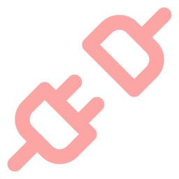

Breaking it on purpose
STAGE 13 · TROUBLESHOOTING
Deliberately broken manifests, each teaching one failure mode and how to diagnose it with kubectl.
ImagePullBackOff
Wrong image tag
kubectl describe pod → read the Events
Service, no endpoints
Selector typo: no Pod has that label, so no traffic
kubectl get endpointslices · --show-labels
CrashLoopBackOff
Wrong database password in the config
kubectl logs → readiness never passes
Notes:
Stage thirteen, the troubleshooting lab. Real operations isn't just deploying — it's diagnosing failures. I built a set of deliberately broken manifests, each teaching one classic failure mode. First, a wrong image tag gives an ImagePullBackOff, which you diagnose by reading the pod's Events with kubectl describe. Second, a Service with a typo in its label selector: it has an IP but zero endpoints, because labels are the only thing linking a Service to its pods — no matching labels, no traffic. Third, a bad database config that puts the pod in CrashLoopBackOff, where you read the logs and see the readiness probe never passing. In the live demo I'll break the Service, show it has no endpoints, find the typo, and fix it.

Slide 17

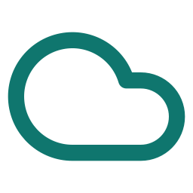

Not a tutorial: real engineering
REAL PROBLEMS I SOLVED
Supply-chain awareness
AWS Free plan limits
Pinned the Trivy action to a commit SHA, because its version tags were hijacked in a March 2026 attack.
t3.medium nodes were blocked, so I switched the node group to the Free Tier m7i-flex.large.
OIDC trust debugging
Removing beats upgrading
GitHub’s new ID-based tokens broke the deploy role. I fixed the IAM trust policy to accept them.
Dropping pip from the runtime image cleared 4 HIGH CVEs and shrank the attack surface.
Notes:
Before I close, I want to call out that this wasn't a tutorial I followed step by step — I hit real problems and solved them. I pinned the Trivy GitHub Action to a specific commit, not a version tag, because those tags were actually hijacked in a supply-chain attack earlier this year. My AWS account is on the Free plan, which blocked the standard instance type, so I had to find and switch to a Free-Tier eligible one. GitHub changed how it formats its identity tokens, which broke my AWS deploy role, and I had to debug the IAM trust policy. And the pip removal I mentioned earlier taught me that sometimes the best security fix is deleting something, not patching it. These are the kinds of problems you actually face in the job.

Slide 18
THE OBJECTIVE OF SESSION 21
Every running pod traces back to a commit
One commit sets off tests, a security scan, an image build, a registry push and a Helm deploy to an autoscaling, monitored cluster. All of it automated.
App + DB + tests
CI/CD + Trivy + GHCR
Terraform + EKS
Helm + Ingress + HPA
Prometheus + Grafana
Thank you. Questions?
github.com/arju-prog/clinicflow
Arjun Aggarwal · ClinicFlow DevOps Capstone
Notes:
To close: that is the actual objective of Session 21. I built a real application, but the deliverable is the journey around it — a single commit that flows, automatically, through testing, security scanning, image building, a registry, and a Helm deploy onto an autoscaling, monitored Kubernetes cluster that Terraform provisioned on AWS. Every running pod traces back to the exact commit that created it. Thank you — I'm happy to take questions, and to show any part of this running live.

