Slide 1
CAREFLOW
Clinical Pathway
Process Mining
Healthcare Operations & Process Analytics
Project Presentation
[Agnijita De] | [Internship / Infotact Solutions] | [5 November 2026 ]
Exploratory analysis using a synthetic patient-event dataset

Slide 2
1. Problem & Motivation
Why look beyond a single average duration?
A single average pathway duration can hide different activity sequences.
Repeated activities and uncommon transitions may be difficult to spot in summary KPIs.
Activity-level elapsed intervals can help identify patterns worth investigating.
CareFlow uses process mining and Power BI to make these patterns easier to explore.
500
Synthetic patient visits
3,744
Recorded events
CareFlow | Clinical Pathway Process Mining | Synthetic data
2

Slide 3
2. Project Objectives
From event data to an interactive process view
Generate and prepare a timestamped synthetic event log.
Discover and summarize activity sequences and transition frequencies.
Measure pathway duration and identify repeated activities and long pathways.
Check cases against a defined set of pathway sequence rules.
Export analysis outputs to Excel and communicate findings in Power BI.
CareFlow | Clinical Pathway Process Mining | Synthetic data
3

Slide 4
3. Dataset & Technology Workflow
Synthetic event log prepared for exploratory process mining
500
Patient visits
3,744
Recorded events
7.49
Average events / visit
7
Workbook sheets
Google Colab + Python: event-log preparation and analysis
PM4Py: process-mining analysis and process-flow exploration
Excel: seven-sheet analysis workbook
Power BI Desktop: KPI cards, transition charts, elapsed-time comparisons and slicers
CareFlow | Clinical Pathway Process Mining | Synthetic data
4

Slide 5
4. Methodology
How the analysis was performed
1
Prepare event log
2
Explore process
3
Measure transitions
Case ID, activity and timestamp
Activity sequence and process flow
Directly-following activity counts
4
Review time patterns
5
Validate configured rules
6
Present results
Average, median and maximum elapsed intervals
Four rule-based sequence checks
Excel workbook and Power BI dashboard
CareFlow | Clinical Pathway Process Mining | Synthetic data
5

Slide 6
5. Key Performance Indicators
Headline results from the supplied analysis workbook
131.61 min
Average pathway duration
131 min
Median pathway duration
216 min
Maximum pathway duration
38.80%
Visits with repeat Triage
100%
Rule-based conformance
23
Long pathways flagged
All values describe the synthetic dataset and the project's configured analysis rules.
CareFlow | Clinical Pathway Process Mining | Synthetic data
6

Slide 7
6. Activity Transition Findings
Most frequent directly-following activity pairs
From activity | To activity | Count
Triage | Doctor Consultation | 694
Registration | Triage | 500
Doctor Consultation | Treatment | 500
Treatment | Discharge | 500
Doctor Consultation | X-Ray | 335
X-Ray | Laboratory Test | 147
Laboratory Test | Doctor Consultation | 134
X-Ray | Doctor Consultation | 115
Laboratory Test | Triage | 81
X-Ray | Triage | 73
Triage → Doctor Consultation is the most frequent transition (694).
Counts can exceed 500 visits because some simulated pathways repeat activities.
Transition frequency describes how often a pair occurs, not how long it takes.
CareFlow | Clinical Pathway Process Mining | Synthetic data
7

Slide 8
7. Elapsed-Time Patterns
Highest average intervals in the Time Bottlenecks sheet
Transition | Count | Avg (min) | Median | Max
Doctor Consultation → Triage | 40 | 21.88 | 22 | 35
X-Ray → Triage | 73 | 21.67 | 24 | 35
Doctor Consultation → X-Ray | 335 | 21.41 | 23 | 35
Doctor Consultation → Doctor Consultation | 57 | 20.89 | 20 | 35
Treatment → Discharge | 500 | 20.58 | 21 | 35
Doctor Consultation → Triage has the highest average elapsed interval: 21.88 minutes.
X-Ray → Triage follows at 21.67 minutes.
These are elapsed intervals between recorded events—not verified queue waiting times.
CareFlow | Clinical Pathway Process Mining | Synthetic data
8

Slide 9
8. Repetition & Rule-Based Conformance
What the configured checks show
38.80%
Visits with repeat Triage
100%
Cases passing four rules
23
Long pathways flagged
Repeated activities are useful signals for further case-level investigation.
100% conformance means all cases passed the four configured sequence checks only.
It does not prove clinical quality, safety, or compliance with a complete hospital protocol.
CareFlow | Clinical Pathway Process Mining | Synthetic data
9

Slide 10
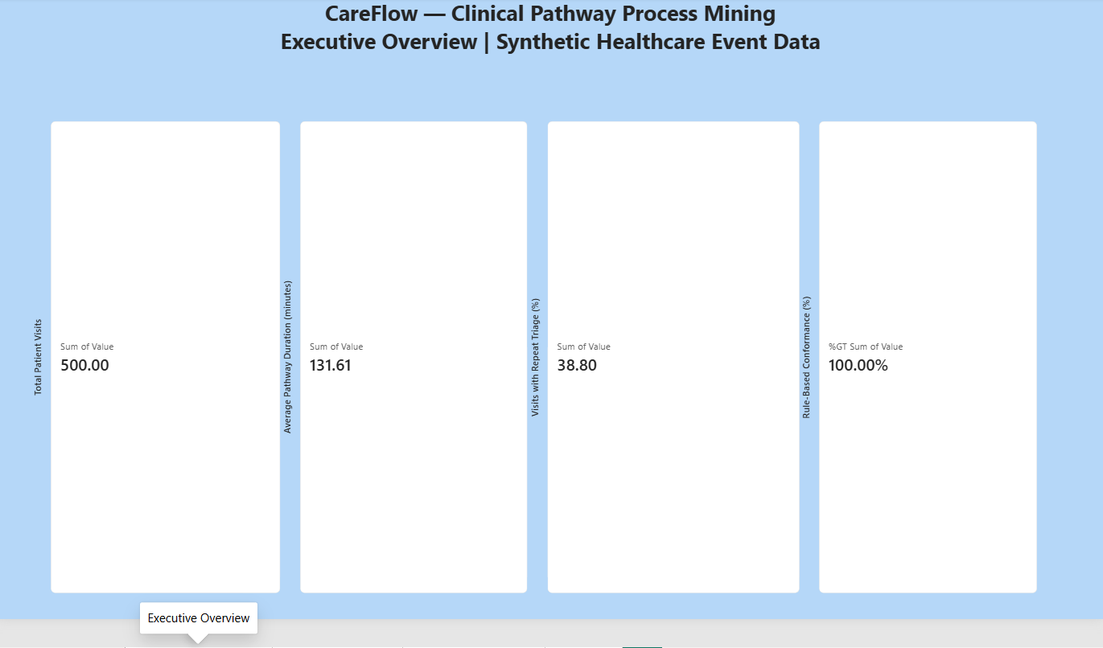
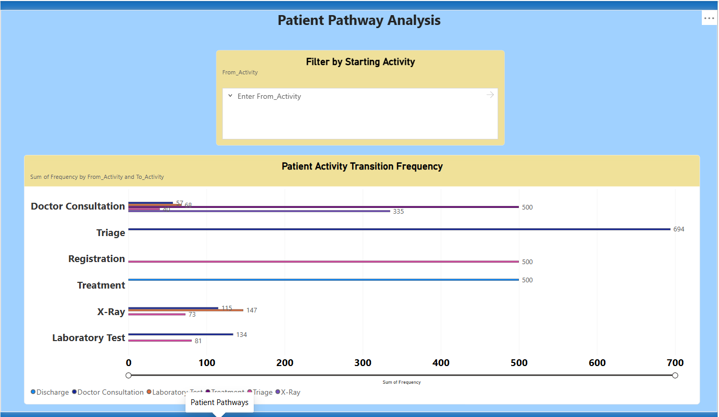
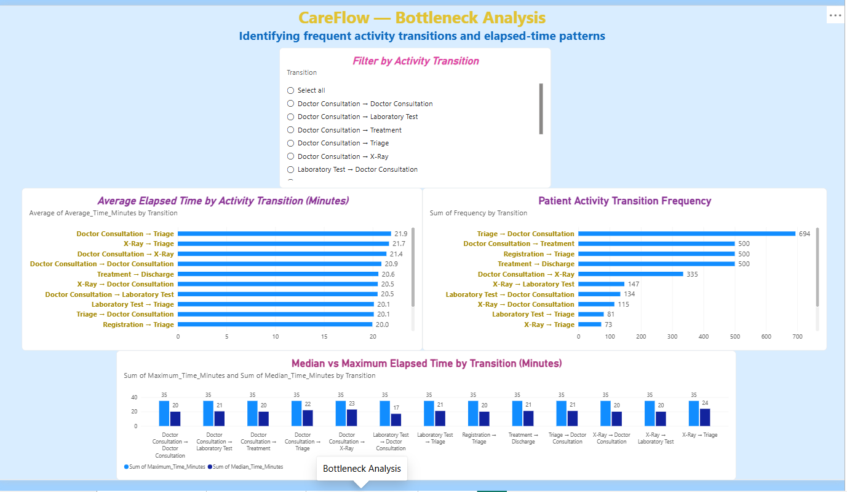
9. Power BI Dashboard
Insert your actual exported screenshots in the three placeholders
Executive Overview
Patient Pathways
Bottleneck Analysis
[Insert screenshot
here]
[Insert screenshot
here]
[Insert screenshot
here]
The report contains KPI cards, activity-transition analysis, elapsed-time comparisons and interactive slicers.
CareFlow | Clinical Pathway Process Mining | Synthetic data
10

Slide 11
10. Limitations & Interpretation
Important boundaries on what can be concluded
The event log is synthetic; results are illustrative and cannot be generalized to a real hospital.
Elapsed time between activities is not automatically queue waiting time or service time.
The four conformance rules are simplified sequence checks, not a full clinical protocol.
The analysis does not establish causes for repeated activities or longer pathways.
The configured long-pathway threshold should be documented from the source notebook before submission.
CareFlow | Clinical Pathway Process Mining | Synthetic data
11

Slide 12
11. Conclusion
CareFlow demonstrates an exploratory process-mining workflow: transforming a synthetic event log into pathway, transition, elapsed-time, repetition and conformance insights, then communicating selected results through an interactive Power BI dashboard.
Next step: validate the workflow and rules with real, governed operational data before drawing conclusions about actual hospital performance.
Thank you
CareFlow | Clinical Pathway Process Mining | Synthetic data
12

