Slide 1

-A APACHE HADOOP PROJECT

Slide 2
outline
History
Why use Hbase?
Hbase vs. HDFS
What is Hbase?
Hbase Data Model
Hbase Architecture
Acid properties in hbase
Accessing hbase
Hbase API
Hbase vs. RDBMS
Installation
References

Slide 3
introduction
HBase is developed as part of Apache Software Foundation's Apache Hadoop project and runs on top of HDFS (Hadoop Distributed Filesystem) providing BigTable-like capabilities for Hadoop.
Apache HBase began as a project by the company Powerset out of a need to process massive amounts of data for the purposes of natural language search.

Slide 4
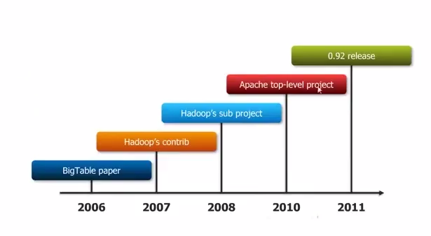
HISTORY
Notes:
2006: BigTable paper published by Google.
2006 (end of year): HBase development starts.
2008: HBase becomes Hadoop sub-project.
2010: HBase becomes Apache top-level project.

Slide 5
Why use hbase?
Storing large amounts of data.
High throughput for a large number of requests.
Storing unstructured or variable column data.
Big data with random read writes.

Slide 6
HBase vs. HDFS
Both are distributed systems that scale to hundreds or thousands of nodes
HDFS is good for batch processing (scans over big files)
Not good for record lookup
Not good for incremental addition of small batches
Not good for updates

Slide 7
HBase vs. HDFS
HBase is designed to efficiently address the below points
Fast record lookup
Support for record-level insertion
Support for updates
HBase updates are done by creating new versions of values

Slide 8
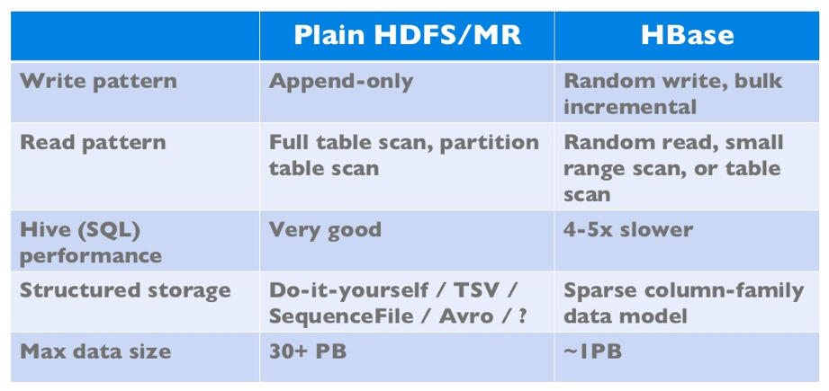
HBase vs. HDFS

Slide 9
WHAT IS HBASE?
HBase is a Java implementation of Google’s BigTable.
Google defines BigTable as a “sparse, distributed, persistent multidimensional sorted map.”

Slide 10
Open source
Committers and contributors from diverse organizations like
Facebook, Cloudera, StumbleUpon,
TrendMicro, Intel, Horton works, Continuity etc.

Slide 11
sparse
Sparse means that fields in rows can be empty or NULL but that doesn’t bring HBase to a screeching halt.
HBase can handle the fact that we don’t (yet) know that information.
Sparse data is supported with no waste of costly storage space.

Slide 12
sparse
We can not only skip fields at no cost also dynamically add fields (or columns in terms of HBase) over time without having to redesign the schema or disrupt operations.
HBase as a schema-less data store; that is, it’s fluid — we can add to, subtract from or modify the schema as you go along.

Slide 13
Distributed and persistent
Persistent simply means that the data you store in HBase will persist or remain after our program or session ends.
Just as HBase is an open source implementation of BigTable, HDFS is an open source implementation of GFS.
HBase leverages HDFS to persist its data to disk storage.
By storing data in HDFS, HBase offers reliability, availability, seamless scalability and high performance — all on cost effective distributed servers.

Slide 14
multidimensional sorted map
A map (also known as an associative array) is an abstract collection of key-value pairs, where the key is unique.
The keys are stored in HBase and sorted in byte lexicographical order.
Each value can have multiple versions, which makes the data model multidimensional. By default, data versions are implemented with a timestamp.

Slide 15
HBase Data Model
HBase data stores consist of one or more tables, which are indexed by row keys.
Data is stored in rows with columns, and rows can have multiple versions. By default, data versioning for rows is implemented with time stamps.
Columns are grouped into column families, which must be defined up front during table creation.
Column families are grouped together on disk, so grouping data with similar access patterns reduces overall disk access and increases performance.

Slide 16
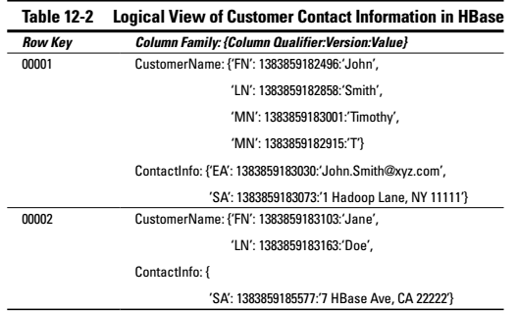
HBASE data model

Slide 17
Hbase data model
Column qualifiers are specific names assigned to our data values.
Unlike column families, column qualifiers can be virtually unlimited in content, length and number.
Because the number of column qualifiers is variable new data can be added to column families on the fly, making HBase flexible and highly scalable.

Slide 18
Hbase data model
HBase stores the column qualifier with our value, and since HBase doesn’t limit the number of column qualifiers we can have, creating long column qualifiers can be quite costly in terms of storage.
Values stored in HBase are time stamped by default, which means we have a way to identify different versions of our data right out of the box.
The versioned data is stored in decreasing order, so that the most recent value is returned by default unless a query specifies a particular timestamp.

Slide 19
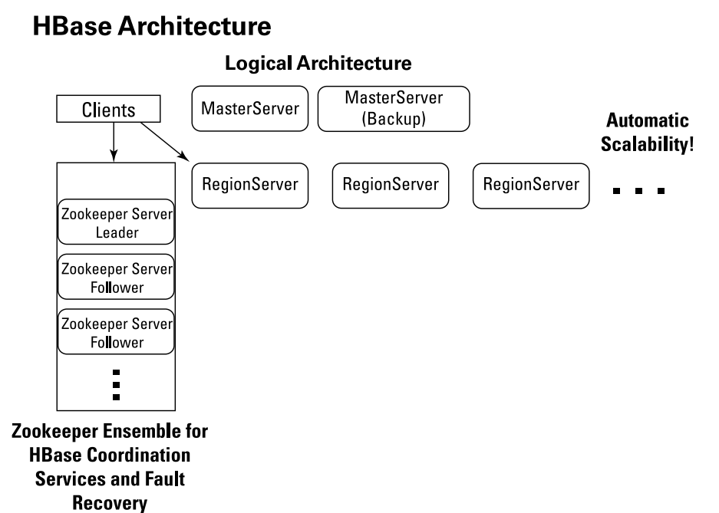
Hbase architecture

Slide 20
Hbase architecture: region servers
RegionServers are the software processes (often called daemons) we activate to store and retrieve data in HBase. In production environments, each RegionServer is deployed on its own dedicated compute node.
When a table grows beyond a configurable limit HBase system automatically splits the table and distributes the load to another RegionServer. This is called auto-sharding.
As tables are split, the splits become regions. Regions store a range of key-value pairs, and each RegionServer manages a configurable number of regions.

Slide 21
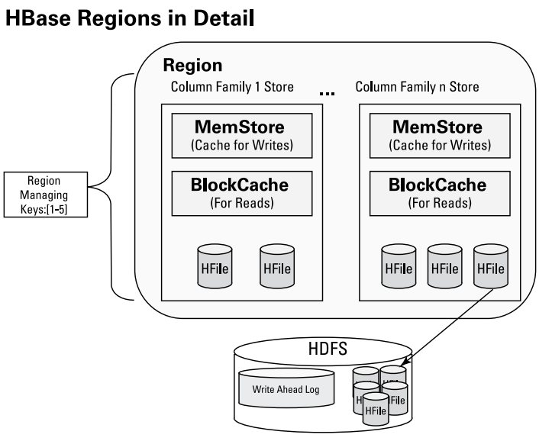
Hbase architecture

Slide 22
Hbase architecture: region servers
Each column family store object has a read cache called the BlockCache and a write cache called the MemStore.
The BlockCache helps with random read performance.
The Write Ahead Log (WAL, for short) ensures that our Hbase writes are reliable.
The design of HBase is to flush column family data stored in the MemStore to one HFile per flush. Then at configurable intervals HFiles are combined into larger HFiles.

Slide 23
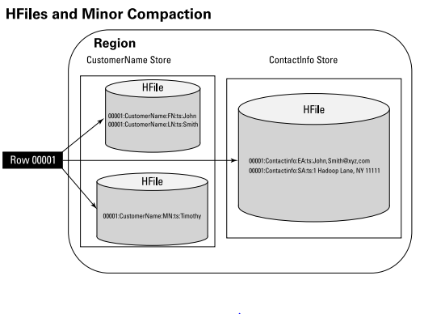
Hbase architecture: Compactions
Compaction, the process by which HBase cleans up after itself, comes in two flavors: major and minor.

Slide 24
Hbase architecture: compactions
Minor compactions combine a configurable number of smaller HFiles into one larger HFile.
Minor compactions are important because without them, reading a particular row can require many disk reads and cause slow overall performance.
A major compaction seeks to combine all HFiles into one large HFile. In addition, a major compaction does the cleanup work after a user deletes a record.

Slide 25
Hbase architecture: master server
Responsibilities of a Master Server:
Monitor the region servers in the Hbase clusters.
Handle metadata operations.
Assign regions.
Manage region server failover.

Slide 26
Hbase architecture: master server
Oversee load balancing of regions across all available region servers.
Manage and clean catalog tables.
Clear the WAL.
Provide a coprocessor framework for observing master operations.
There should always be a backup MasterServer in any HBase cluster incase of failover of the actual MasterServer.

Slide 27
Hbase architecture: zookeeper
HBase clusters can be huge and coordinating the operations of the MasterServers, RegionServers, and clients can be a daunting task, but that’s where Zookeeper enters the picture.
Zookeeper is a distributed cluster of servers that collectively provides reliable coordination and synchronization services for clustered applications.

Slide 28
Hbase architecture: CAP theorem
HBase provides a high degree of reliability. HBase can tolerate any failure and still function properly.
HBase provides “Consistency” and “Partition Tolerance” but is not always “Available.”

Slide 29
Acid properties in hbase
When compared to an RDBMS, HBase isn’t considered an ACID-compliant database.
However it guarantees the following aspects-
Atomic
Consistency
Durability

Slide 30
Accessing hbase
Java API
REST/HTTP
Apache Thrift
Hive/Pig for analytics

Slide 31
Hbase api
Types of access:
Gets: Gets a row’s data based on the row key.
Puts: Inserts a row with data based on the row key.
Scans: Finding all matching rows based on the row key.
Scan logic can be increased by using filters.

Slide 32
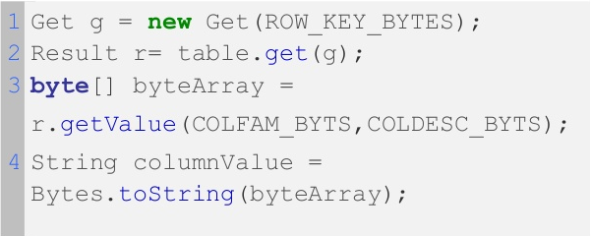
gets

Slide 33
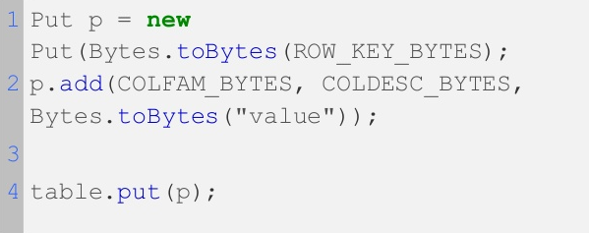
puts

Slide 34
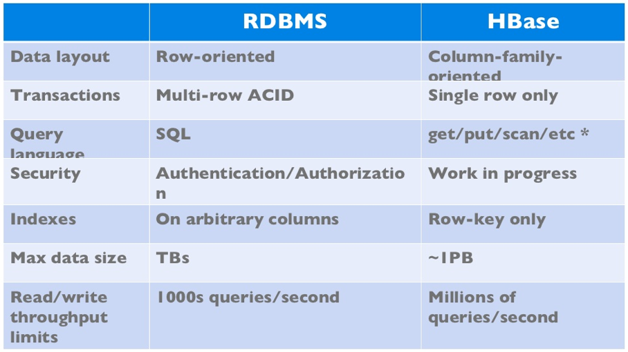
HBase vs. RDBMS

Slide 35
installation
HBase requires that a JDK be installed.
http://java.com/en/download/index.jsp
Choose a download site from the list of Apache Download Mirrors given in the Apache website.
http://www.apache.org/dyn/closer.cgi/hbase/
Extract the downloaded file, and change to a newly-created directory.
For HBase 0.98.5 and later, we are required to set the JAVA_HOME environment variable before starting Hbase using conf/hbase-env.sh.

Slide 36
installation
The JAVA_HOME variable should be set to a directory which contains the executable file bin/java.
Edit conf/hbase-site.xml, which is the main HBase configuration file.
The bin/start-hbase.sh script is provided as a convenient way to start HBase.
$ ./bin/hbase shell
hbase(main):001:0>

Slide 37
installation
Connect to your running instance of HBase using the hbase shell command.
Use the create command to create a new table. You must specify the table name and the ColumnFamily name.
hbase> create 'test', 'cf'
0 row(s) in 1.2200 seconds
Use the list command to see the List Information About your Table.
hbase> list 'test'
TABLE
test
1 row(s) in 0.0350 seconds
=> ["test"]

Slide 38
installation
To put data into your table, use the put command.
hbase> put 'test', 'row1', 'cf:a', 'value1'
0 row(s) in 0.1770 seconds
Use the scan command to scan the table for data.
hbase> scan 'test'
ROW COLUMN+CELL
row1 column=cf:a, timestamp=1403759475114, value=value1
1 row(s) in 0.0440 seconds

Slide 39
installation
To get a single row of data at a time, use the get command.
hbase> get 'test','row1'
COLUMN CELL
cf:a timestamp=1403759475114, value=value1
1 row(s) in 0.0230 seconds
If you want to delete a table or change its settings, you need to disable the table first, using the disable command. You can re-enable it using the enable command.
hbase> disable 'test‘
0 row(s) in 1.6270 seconds
hbase> enable 'test'
0 row(s) in 0.4500 seconds

Slide 40
installation
To drop (delete) a table, use the drop command.
hbase> drop 'test'
0 row(s) in 0.2900 seconds
To exit the HBase Shell use bin/stop-hbase.sh script.
$ ./bin/stop-hbase.sh
stopping hbase.................... $
For the detailed installation procedure look at,
http://hbase.apache.org/cygwin.html

Slide 41

Powered by hbase

Slide 42
references
https://www.usenix.org/system/files/conference/fast14/fast14-paper_harter.pdf
http://www.manning.com/dimidukkhurana/HBiAsample_ch1.pdf
https://research.facebook.com/publications/1420502254864214/analysis-of-hdfs-under-hbase-a-facebook-messages-case-study/
http://blog.cloudera.com/blog/2012/09/the-action-on-hbase-in-action/
http://www.informationweek.com/big-data/software-platforms/big-data-debate-will-hbase-dominate-nosql/d/d-id/1111048
http://hbasecon.com/archive.html
http://jimbojw.com/wiki/index.php?title=Understanding_Hbase_and_BigTable
ftp://61.135.158.199/pub/books/HBase%20The%20Definitive%20Guide.pdf

Slide 43
Questions?

Slide 44
Thank you

