Slide 1

DATA-DRIVEN TOURISM INTELLIGENCE PLATFORM
Kerala Tourism
Intelligence
Unlocking High-Yield Hospitality & Investment Opportunities
An end-to-end data analytics and machine learning platform analyzing 25 major destinations across Kerala. Synthesizing 2022–2024 footfall growth, Google Trends India demand (2021–2026), unsupervised K-Means segmentation, infrastructure deficit scoring, and 5-year venture ROI forecasting.
25
Destinations Audited • All 14 Districts Covered
3 Clusters
Machine Learning Segments • Standard & Robust Scaling
29,585
Cleaned Search Points • Google Trends India (2021-2026)
14 Corridors
High Gap Opportunities • Surging Footfall & Supply Deficits

Slide 2
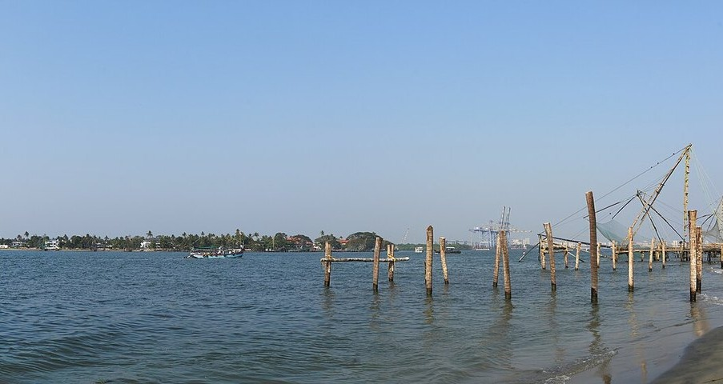
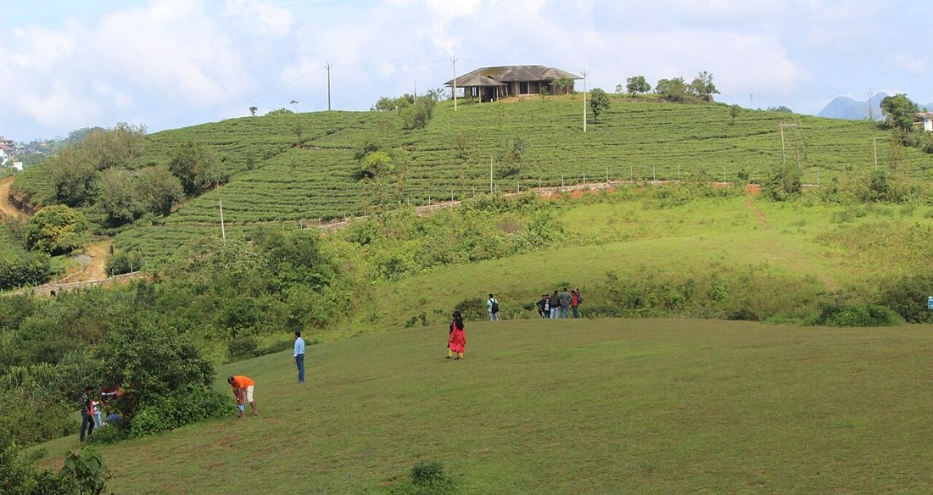
STRATEGIC CONTEXT & PROBLEM STATEMENT
Resolving the Kerala Tourism Investment Paradox
Balancing overtourism in legacy hubs with uncapitalized surge in emerging eco-corridors.
THE SOLUTION
Data Science Decision Engine
✔ Integrates multi-source data: official footfall records, Google Maps POIs, transport hubs, and 5-year Google Trends.
✔ Evaluates cluster-relative supply deficits (Overall Gap Score) rather than generic statewide averages.
✔ Maps 25 destinations onto an actionable 2×2 Opportunity Matrix (Growth vs. Gap).
✔ Provides dynamic 5-year cash flow and ROI simulator to derisk hospitality investments.
1. SATURATED CLASSIC HUBS
• Legacy nodes (Fort Kochi, Kovalam) face severe land price inflation, margin compression, and seasonal crowding.
• High baseline accommodation supply creates intense price wars for independent homestays and hotels.
• Uninformed entrepreneurs over-invest in crowded nodes due to lack of granular regional intelligence.
2. EMERGING ECO-CORRIDORS
• Rising nature and adventure corridors (Vagamon, Kumarakom, Bekal) exhibit footfall growth up to +109%.
• Critical deficits in quality dining, experiential stays, and branded homestays constrain tourist spend.
• Lack of structured feasibility metrics prevents institutional debt and capital from entering rural zones.

Slide 3
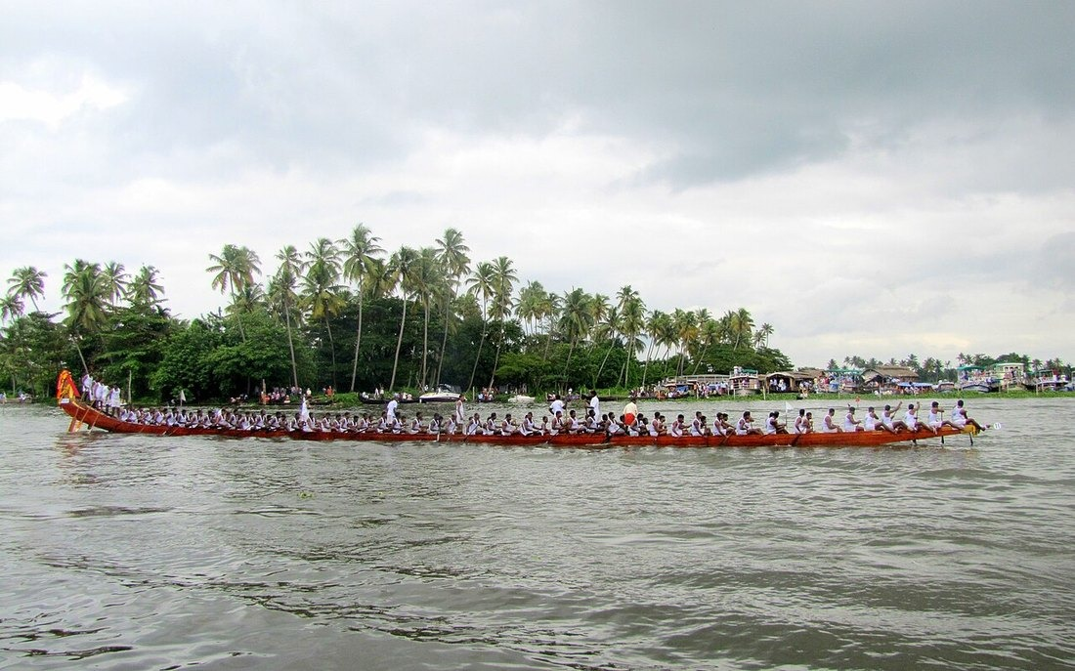
ARCHITECTURE & PIPELINE
Full-Stack Data Science & Engineering Pipeline
Modular Python data pipeline with production-grade separation of concerns and Flask dashboard.
PHASE 01
Data Acquisition & Audit
• Official Kerala Tourism annual statistics (2022–2024 calendar visits).
• Scraped Google Maps POIs: Hotels, Resorts, Homestays, Restaurants, Attractions.
• Accessibility metrics: distance to nearest airports & primary/alternative railway terminals.
PHASE 02
Cleaning & Imputation
• Zero-supply handling: replaced unrecorded counts with median SimpleImputer for ML.
• Isolated 5 duplicate-key search terms (610 records) to clean Google Trends dataset.
• Audited data quality notes: 16 destinations flagged with estimates; 9 official.
PHASE 03
Machine Learning & Scoring
• Benchmarked StandardScaler vs RobustScaler vs PCA(2) for K-Means (k=3).
• Calculated cluster-relative supply deficits (Overall Gap Score).
• Mapped 25 destinations into 2×2 Growth vs. Infrastructure Gap quadrants.
PHASE 04
Frontend & Interactive API
• Modern Flask web application with Jinja2 modular templates.
• REST JSON endpoints for real-time trend querying & financial calculations.
• Chart.js interactive visualizations for demand cycles and cash-flow curves.
MODULAR DESIGN & 100% REPRODUCIBILITY
• Production Pipeline: All stages in 05_Source_Code execute end-to-end via python run_pipeline.py with dry-run & persistent --save flags.
• Technology Stack: Python 3.11, Pandas, Scikit-Learn, Plotly, Flask, Jinja2, Chart.js — fully decoupled, zero vendor lock-in.
• Governance & Safety: Data quality flags guarantee that official statistics and provisional projections are never conflated.

Slide 4
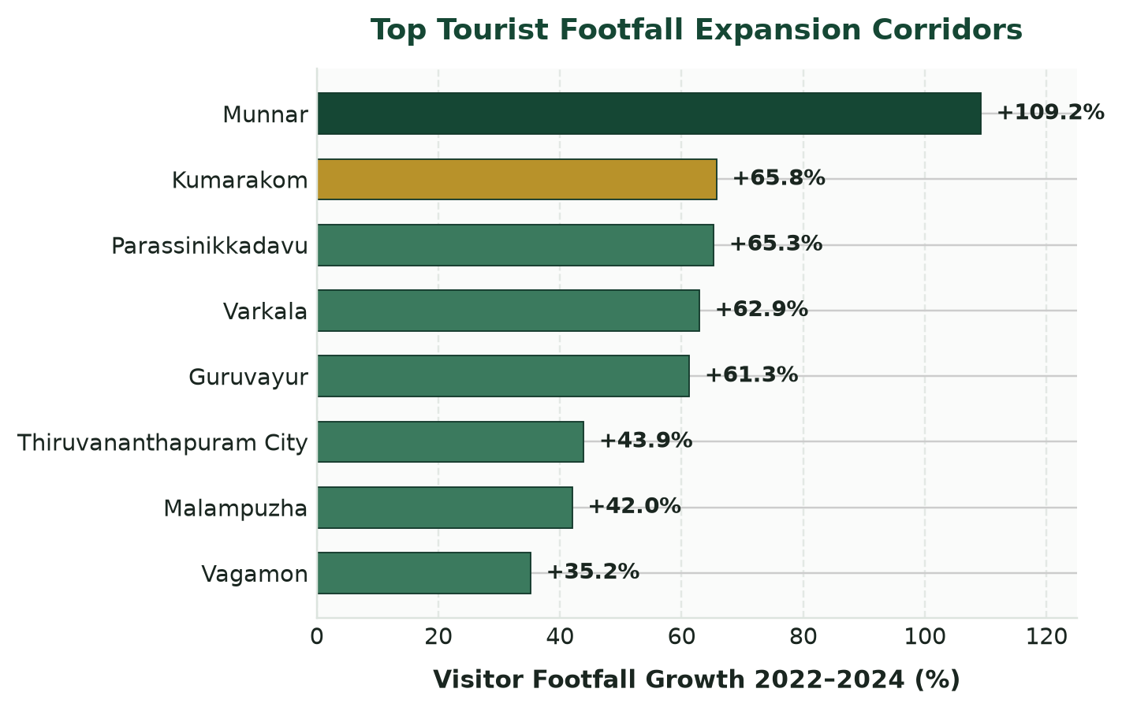
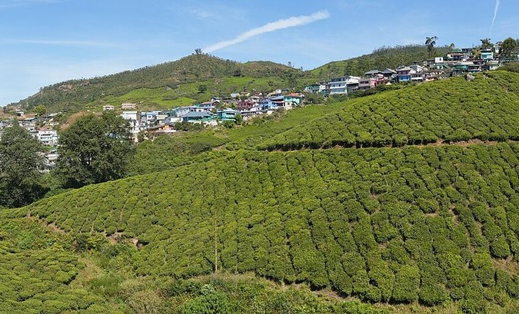
VISITOR FOOTFALL DYNAMICS
Visitor Growth Surge & Data Transparency (2022–2024)
Accelerated recovery across leisure destinations paired with rigorous estimation audit.
MUNNAR LEADS SURGE: +109.2% (1.08M → 2.26M Visits)
DATA TRANSPARENCY AUDIT
16 of 25 Destinations Contain Estimates
• Official data published by Kerala Tourism contains derived or provisional estimates for emerging rural sites.
• 9 Destinations (e.g. Munnar, Kumarakom, Kochi) are strictly official with no estimation notes.
• 16 Destinations are explicitly flagged as 'Contains estimates' in our pipeline, protecting investors from spurious correlations.

Slide 5
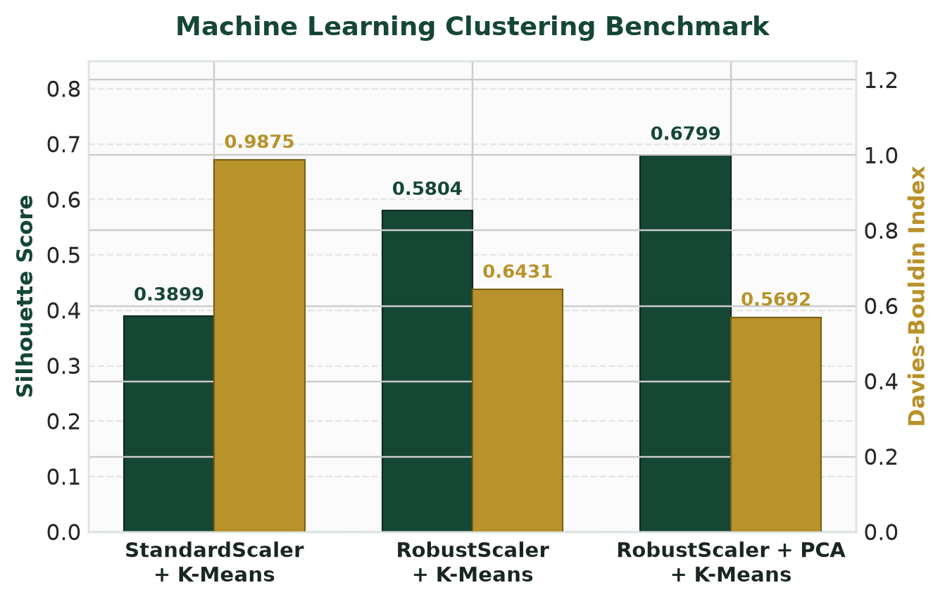
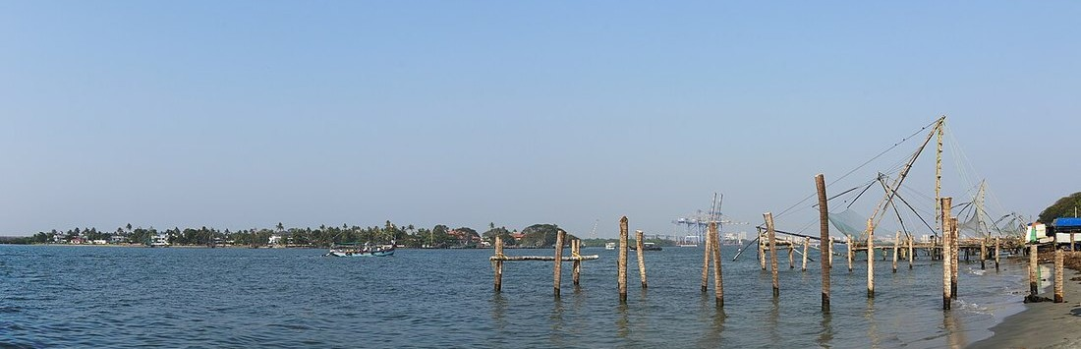

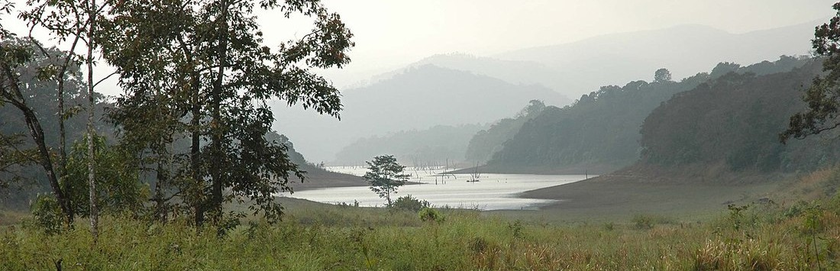
CLUSTERING & MACHINE LEARNING
Destination Segmentation via K-Means Clustering
Evaluating 8 structural features across StandardScaler, RobustScaler, and 2D PCA projection.
Cluster 0: Urban Hubs (3 Destinations)
Kochi City, Kozhikode, Thiruvananthapuram
Avg Hotels: 346.0 | Avg Restaurants: 912.7 | 22.3 km to Airport. Dense corporate & transit gateways.
Cluster 1: Developing & Nature (14 Destinations)
Vagamon, Silent Valley, Ponmudi, Bekal, etc.
Avg Hotels: 39.2 | Avg Homestays: 88.0 | 70.7 km to Airport. Rural eco-travel, severe dining deficits.
Cluster 2: Established Leisure (8 Destinations)
Munnar, Kumarakom, Varkala, Thekkady, etc.
Avg Resorts: 164.3 | Avg Homestays: 401.3 | Resort Rating: 4.44/5. High brand equity & leisure spend.

Slide 6
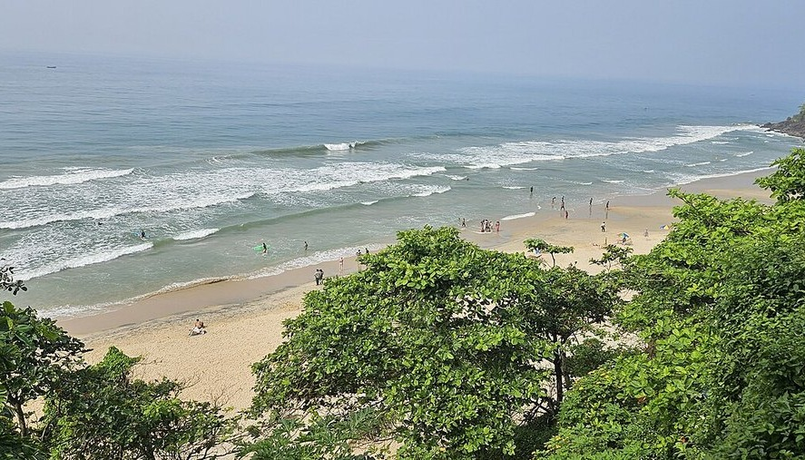
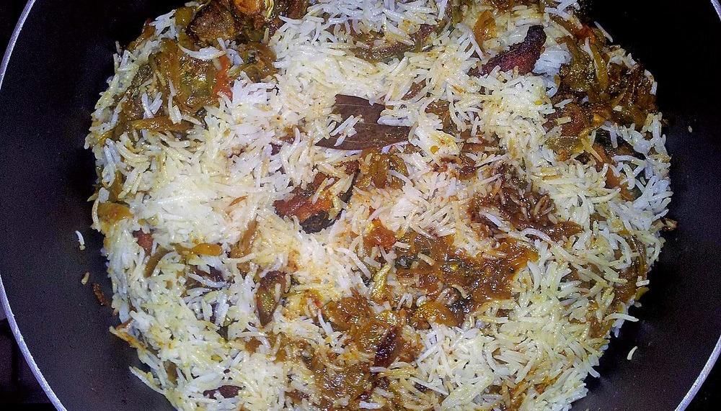
DIGITAL CONSUMER DEMAND
Decoding Traveler Intent via Google Trends India (2021–2026)
Standardized multi-pillar time series across 29,585 cleaned monthly observation points.
PILLAR 01
Destination Interest
Munnar, Wayanad & Kochi lead gross Indian travel queries. Macro awareness peaks during winter holidays.
PILLAR 02
Accommodation Queries
Surging demand for 'cliffside stays', 'private pool villas', and 'luxury houseboats'. Premium willingness to pay.
ACCOMMODATION SURGE
Varkala Cliffside Stays
Search interest for cliff villas has grown 4x faster than traditional beach resorts since 2022.
PILLAR 03
Tourism Activities
Accelerating query growth for trekking, bamboo rafting, tea trails, and kayaking over passive sightseeing.
PILLAR 04
Food & Dining Intent
Hyper-local search demand for Malabar Biryani, Thalassery snacks, and Toddy Shop duck roast outpaces generic dining.
CULINARY TOURISM
Regional Food Identity
Queries for Malabar snacks and seafood cuisine reveal massive uncapitalized culinary market opportunities.

Slide 7
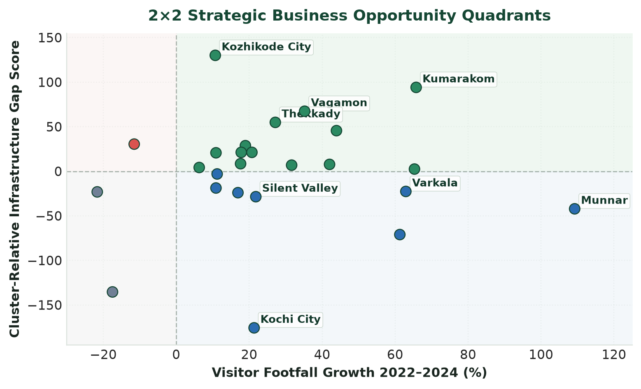
BUSINESS OPPORTUNITY EVALUATION
Infrastructure Deficit Scoring & 2×2 Opportunity Matrix
Evaluating cluster-relative supply gaps against footfall momentum to classify 25 destinations.
HIGH GAP + POSITIVE GROWTH (14 DESTS)
Primary Greenfield Targets: Kumarakom (Gap +94.1), Vagamon (Gap +67.4), Thekkady (Gap +54.9). Aggressive rollout of eco-resorts & dining.
LOW GAP + POSITIVE GROWTH (8 DESTS)
Quality / Niche Upgrades: Munnar (+109.2% growth, Gap -42.1), Varkala (+62.9%). Focus on experiential dining and premium service differentiation.
HIGH GAP + NEGATIVE GROWTH (1 DEST)
Cautionary Turnaround: Meenkunnu–Payyambalam (Kannur coast: -11.5% growth). Requires public infrastructure stimulus before private capital scale.
LOW GAP + NEGATIVE GROWTH (2 DESTS)
Consolidation & Asset Yield: Konni, Palaruvi. Saturated relative to footfall; focus strictly on optimizing existing yields.

Slide 8
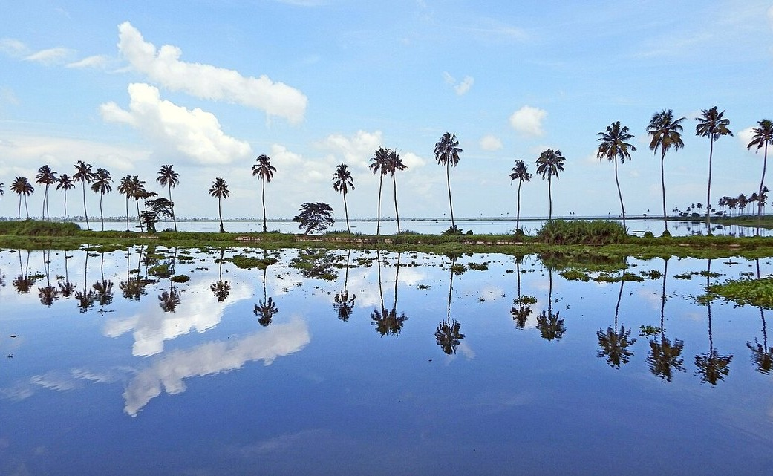
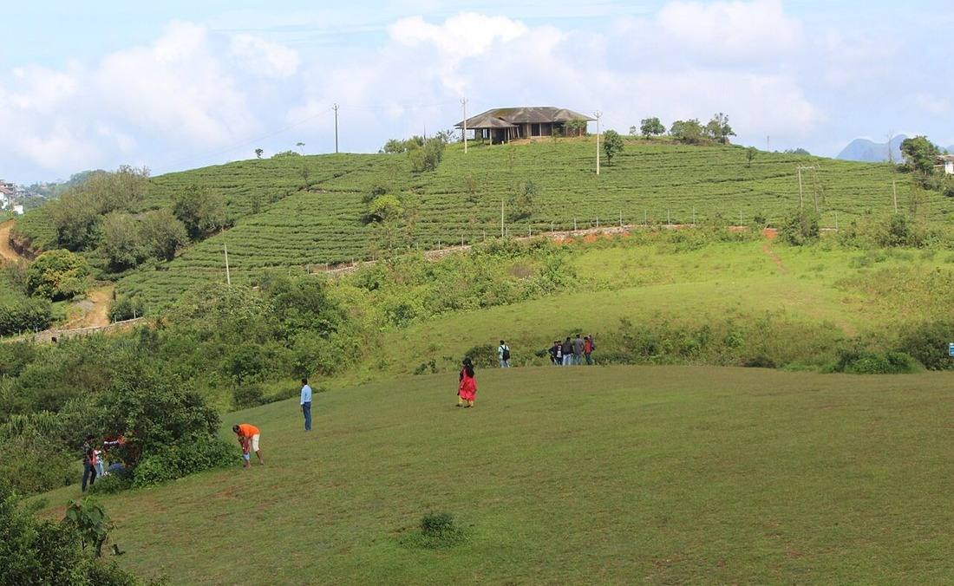
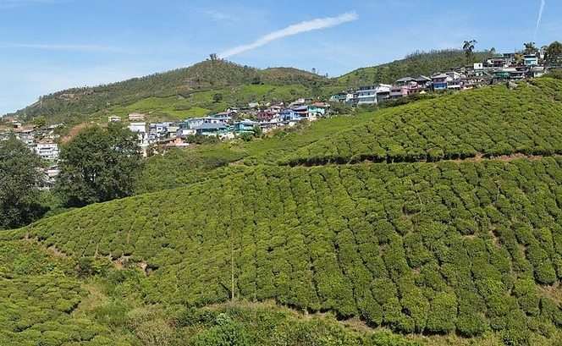
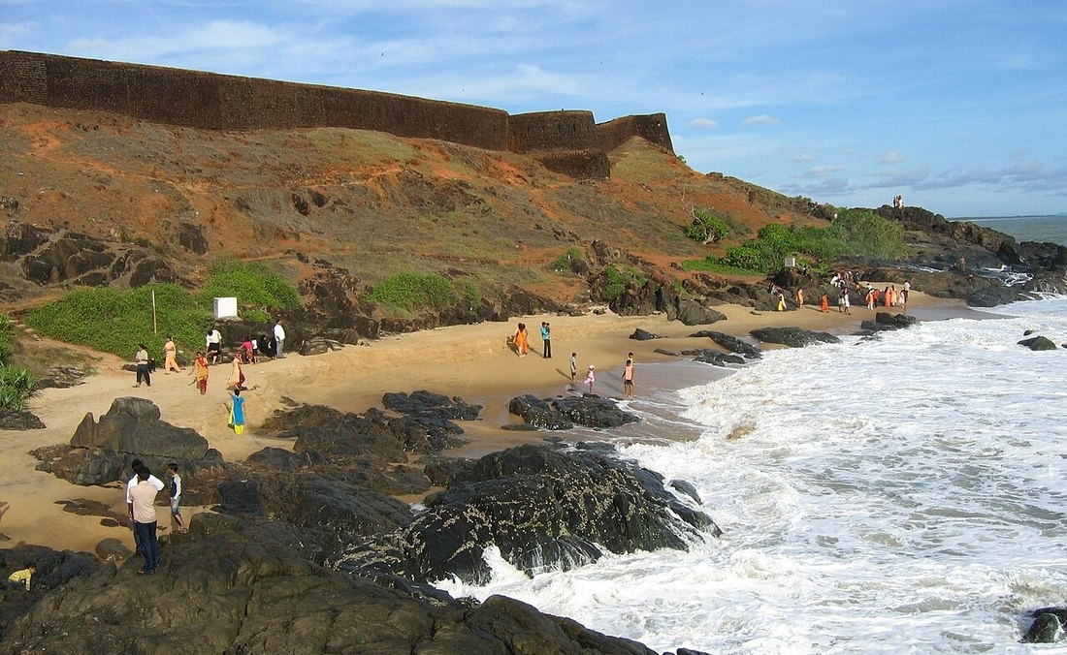
VENTURE BLUEPRINTS
High-Conviction Investment Blueprints by Regional Corridor
Detailed case studies translating data intelligence into commercial hospitality concepts.
BACKWATER LUXURY
Kumarakom
Gap: +94.1 | Footfall: +65.8%
Concept: Waterfront Dining & Eco-Villas
High deficit in dining & luxury villas. Surging footfall (+65.8%) creates ripe demand for independent experiential dining outside resorts.
ECO-ADVENTURE
Vagamon
Gap: +67.4 | Footfall: +35.2%
Concept: Glamping & Activity Lodges
High search demand for trekking & paragliding contrasts with severe homestay shortage. Ideal for off-grid eco-stays and adventure cafes.
QUALITY UPGRADE
Munnar
Footfall: +109.2% | Rating: 3.9/5
Concept: Farm-to-Table Dining & Cafes
Massive footfall surge (2.26M visits) but restaurants lag at 3.9/5 average rating. High pricing power for artisanal culinary experiences.
HERITAGE CIRCUIT
North Malabar
Bekal Gap: +147.5 | Kannur Airport
Concept: Heritage Homestay Circuit
Driven by Kannur airport connectivity and Theyyam festivals. Severe homestay deficit (>150 units below state mean) offers network opportunity.

Slide 9
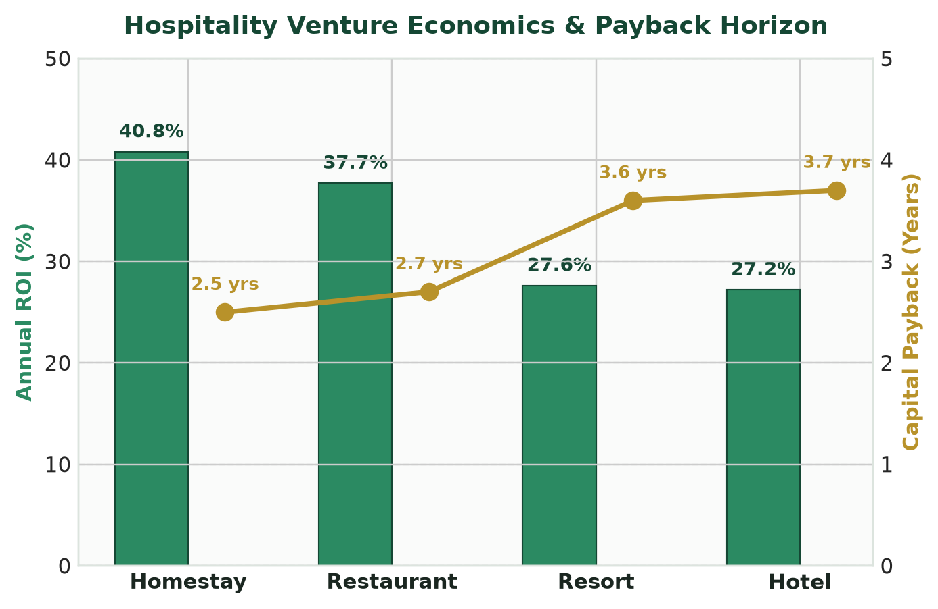
FINANCIAL SIMULATION & MODELING
Tourism Venture Feasibility & ROI Simulator
Ground-truthed financial modeling across 4 standardized hospitality business archetypes.
Hospitality Venture Archetypes & Economics
Venture | Capex | Monthly | ROI % | Payback
Homestay | ₹25.0 L | ₹85,000 | 40.8% | 2.5 Yrs
Restaurant | ₹35.0 L | ₹1,10,000 | 37.7% | 2.7 Yrs
Resort | ₹1.00 Cr | ₹2,30,000 | 27.6% | 3.6 Yrs
Hotel | ₹75.0 L | ₹1,70,000 | 27.2% | 3.7 Yrs
STRATEGIC FINANCIAL TAKEAWAYS
• Homestays deliver the quickest capital recovery (2.5 years) with minimal regulatory overhead.
• Experiential Dining captures immediate day-tripper cash flows without requiring heavy room capex.
• 5-Year Cash Flow simulator built into platform provides institutional stress-testing for bank loans.

Slide 10

STRATEGIC IMPACT & NEXT STEPS
Empowering Sustainable Tourism Growth in Kerala
Immediate Value
• De-risking private capital investments for local MSMEs and hospitality operators.
• Directing development toward underserved corridors to curb overtourism in saturated hubs.
• Providing evidence-based validation for bank loans and tourism state subsidy programs.
Technical Roadmap
• Real-time OTA pricing API integration (MakeMyTrip, Booking.com, Airbnb).
• NLP sentiment extraction across thousands of Google & TripAdvisor traveler reviews.
• Predictive seasonality forecasting using Prophet & ARIMA machine learning models.
Call to Action
• Engage Kerala Tourism Department for policy integration and real-time census data sharing.
• Establish sandbox pilots with regional entrepreneur networks in Kumarakom and Vagamon.
• Deploy white-label intelligence portals for district tourism promotion councils (DTPCs).

