Slide 1
MYSQL → EXCEL
Retail Sales
Performance Analysis
From MySQL Database to Excel Dashboard
Presented by: Arjun Aji
Junior Data Analyst
ARJUN AJI / RETAIL SALES ANALYSIS
01
Notes:
Source: User-provided retail sales analysis outline, 11 September 2026. Figures have not been independently verified. This editable draft uses only supplied figures; missing full chart series and dashboard screenshot are labeled.

Slide 2
BUSINESS PROBLEM AND OBJECTIVES
Turn retail data into business decisions
BUSINESS PROBLEM
ANALYSIS OBJECTIVES
Management needs a clear view of sales performance, customer behaviour, products, regions, and order fulfilment.
01
Measure revenue, orders, customers, quantity, and average order value.
02
Identify strong and weak products, regions, customer segments, and periods.
03
Analyse order status and delivery performance.
04
Recommend actions using the Excel dashboard.
ARJUN AJI / RETAIL SALES ANALYSIS
02
Notes:
Source: User-provided retail sales analysis outline, 11 September 2026. Figures have not been independently verified. This editable draft uses only supplied figures; missing full chart series and dashboard screenshot are labeled.

Slide 3
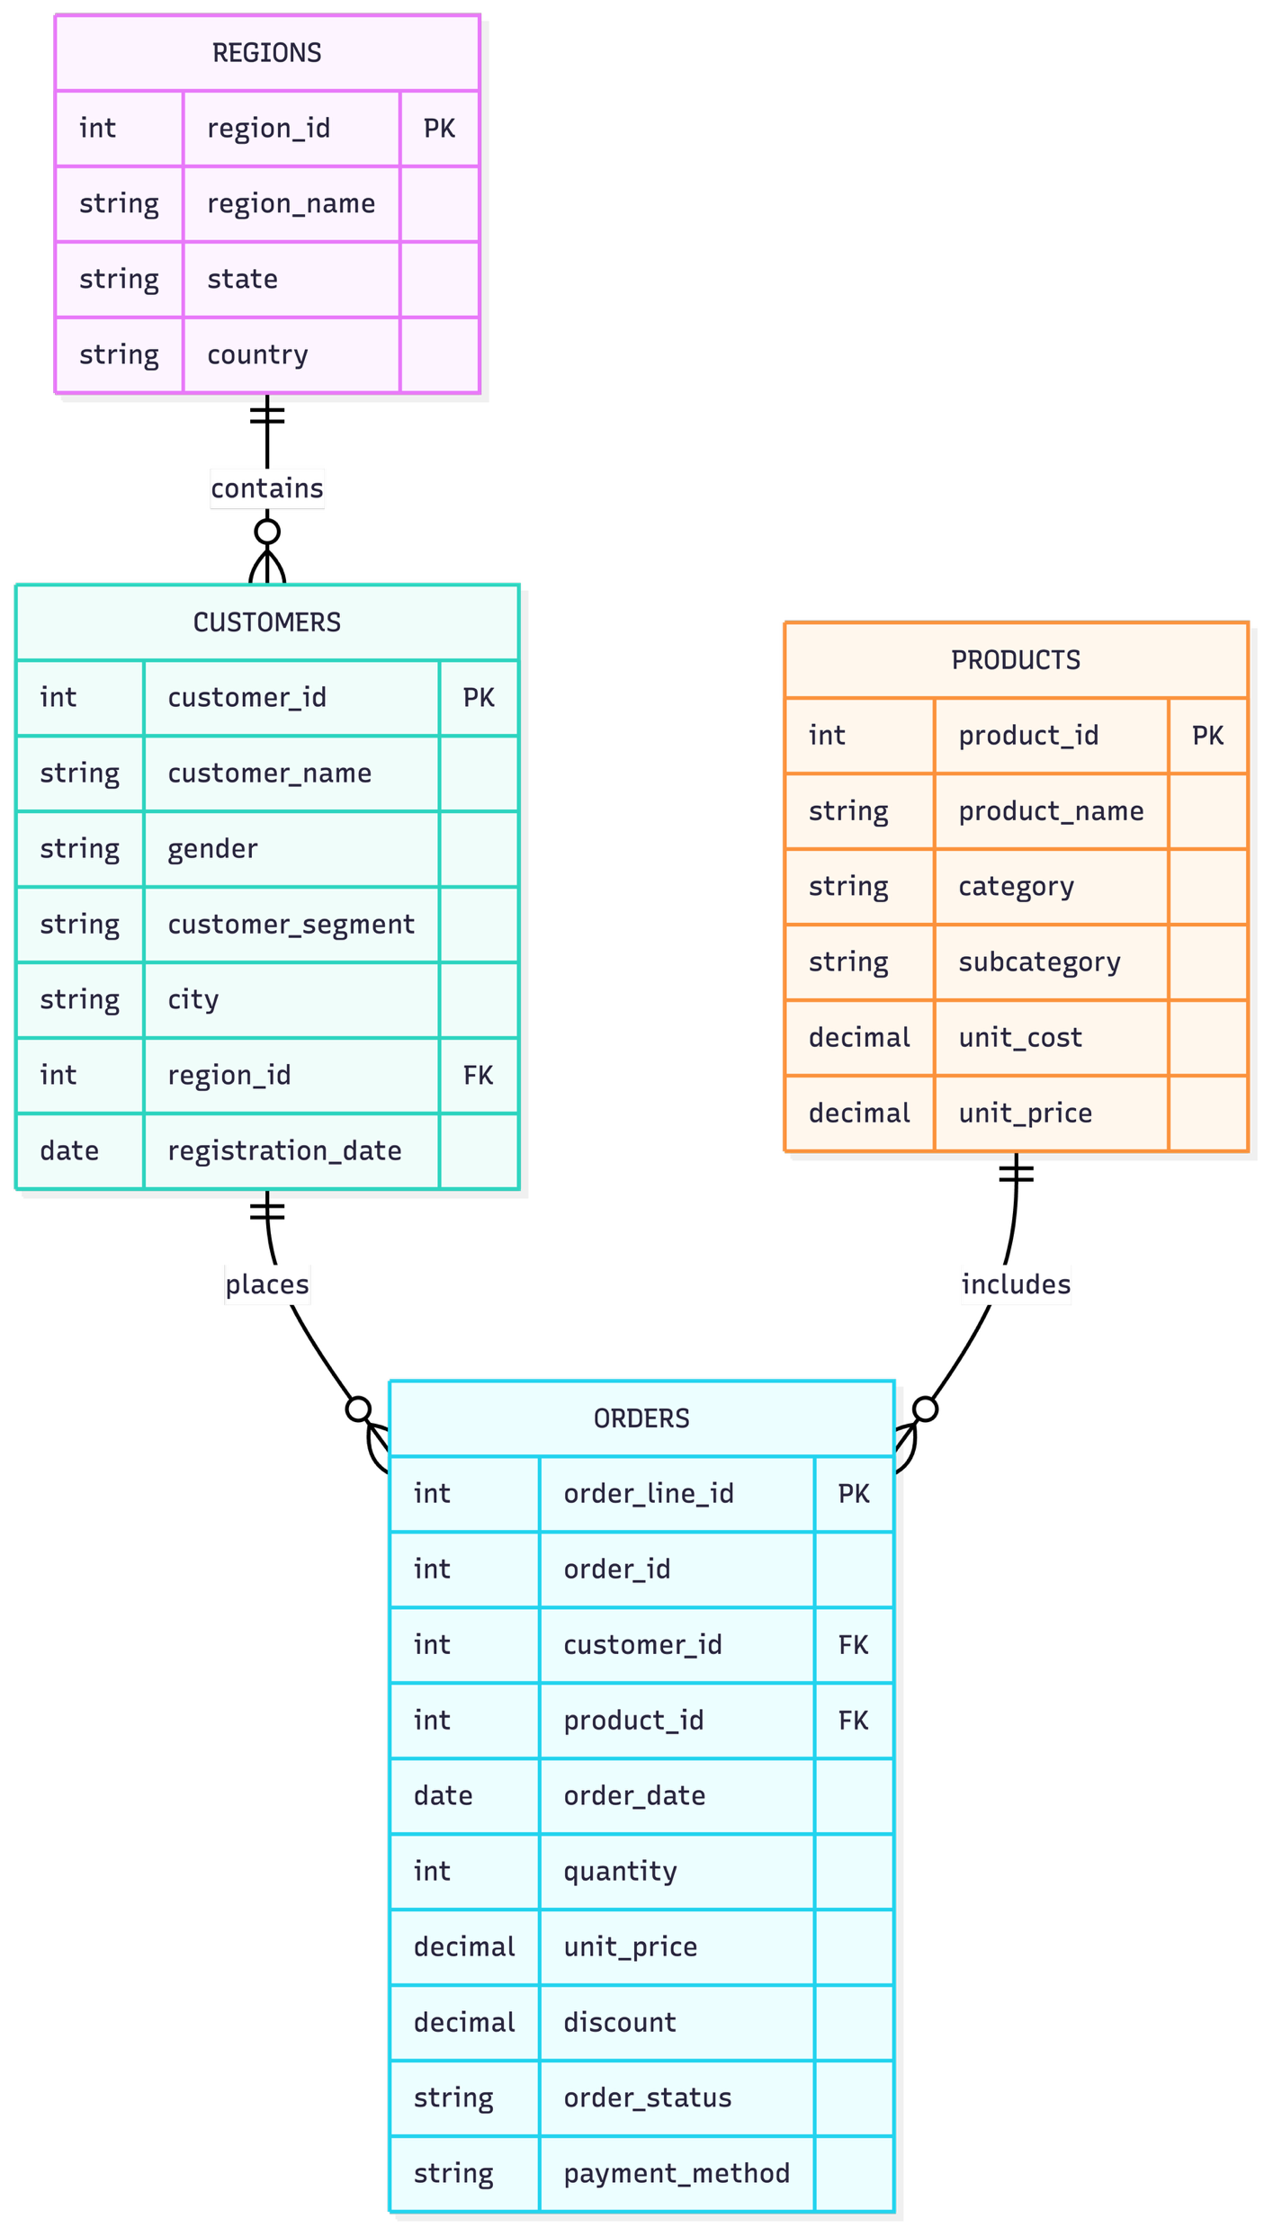
DATA PROVIDED AND ER DIAGRAM
Four MySQL tables form the analysis model
RELATIONSHIPS AT ORDER-LINE LEVEL
REGIONS
Region, state, country
region_id (PK)
CUSTOMERS
Customer details, segment, city, region
customer_id (PK) • region_id (FK)
ORDERS
Transactions, quantity, discount, status, payment method
order_line_id (PK) • order_id • customer_id (FK) • product_id (FK)
PRODUCTS
Product, category, subcategory, price
product_id (PK)
One order can contain multiple products, so one Order ID may appear in multiple order lines.
ARJUN AJI / RETAIL SALES ANALYSIS
03
Notes:
Source: User-provided retail sales analysis outline, 11 September 2026. Figures have not been independently verified. This editable draft uses only supplied figures; missing full chart series and dashboard screenshot are labeled.
Diagram source: user-provided Order Payment Ecosystem Flow image, 11 September 2026. Inserted as supplied; diagram text is part of the image.
Editable key labels restored from supplied ER diagram: regions.region_id PK; customers.customer_id PK and region_id FK; orders.order_line_id PK, customer_id and product_id FK, order_id order reference; products.product_id PK. PK means primary key; FK means foreign key.

Slide 4
SQL ANALYSIS AND ANALYSIS-READY DATASET
SQL turns source tables into analysis-ready data
REVENUE = QUANTITY × UNIT PRICE × (1 − DISCOUNT)
SQL WORK PERFORMED
FINAL DATASET FOR EXCEL
•
Calculated revenue, total orders, quantity sold, and average order value.
•
Order and customer details
•
Product and category details
•
Analysed months, categories, products, customers, regions, states, payments, and statuses.
•
Region, state, and city
INNER JOIN • LEFT JOIN • SUM • COUNT • AVG
GROUP BY • HAVING • ORDER BY
Date functions • Top-10 analysis
•
Quantity, price, discount, calculated revenue
•
Order status and payment method
ARJUN AJI / RETAIL SALES ANALYSIS
04
Notes:
Source: User-provided retail sales analysis outline, 11 September 2026. Figures have not been independently verified. This editable draft uses only supplied figures; missing full chart series and dashboard screenshot are labeled.

Slide 5
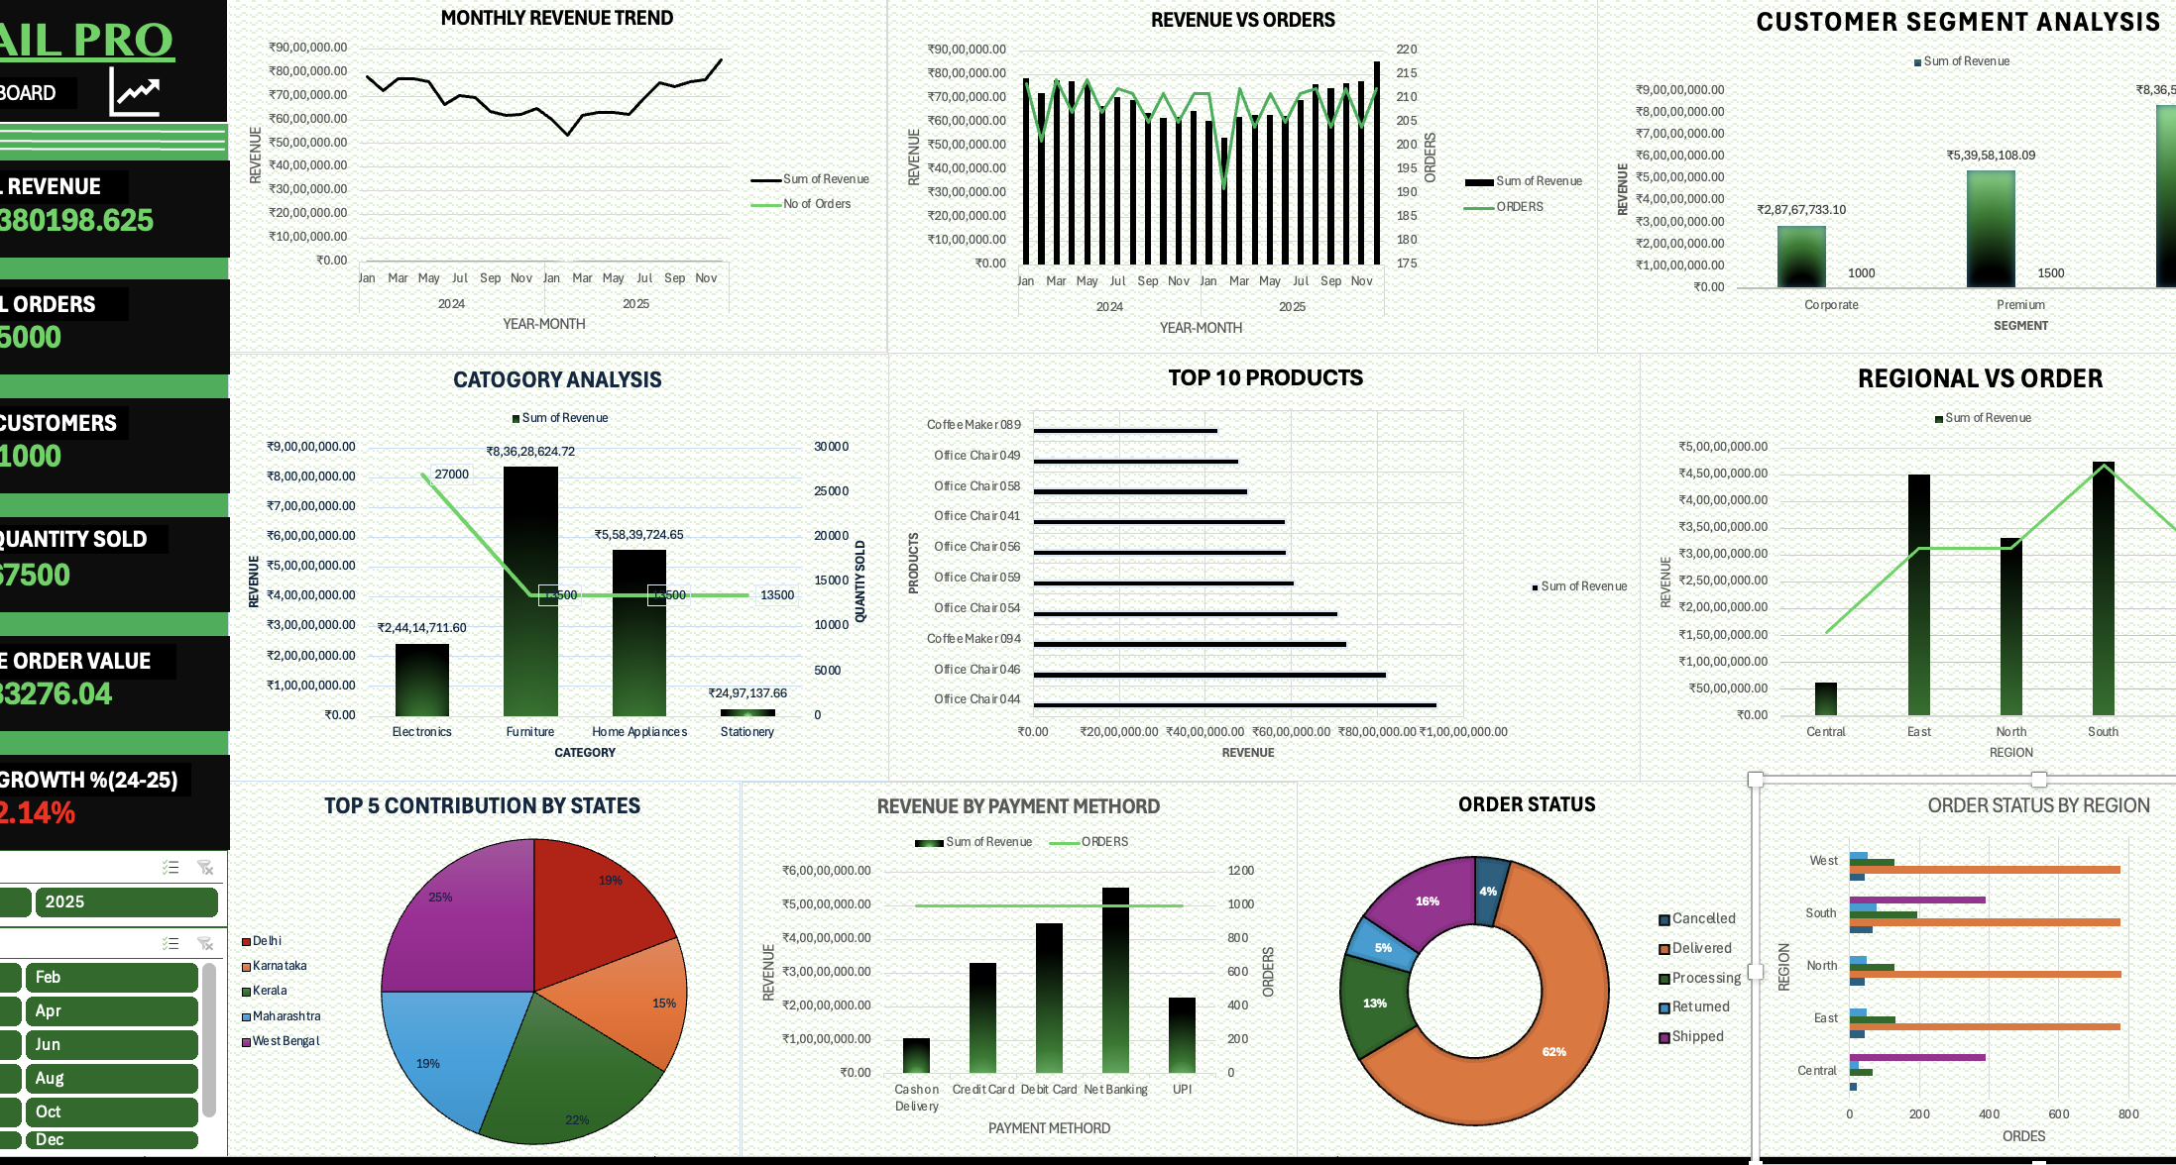
EXCEL PREPARATION, KPIS, AND DASHBOARD
₹166.38M revenue across 5,000 orders
SQL output → Excel Table → KPIs, PivotTables, PivotCharts, slicers, and dashboard visuals
₹166.38M
5,000
DASHBOARD SCREENSHOT
Total Revenue
Total Orders
1,000
67,500
Total Customers
Total Quantity Sold
₹33,276
−2.14%
Average Order Value
Revenue Growth, 2024–2025
Note: Total revenue is unconfirmed; it includes undelivered, cancelled and returned orders.
ARJUN AJI / RETAIL SALES ANALYSIS
05
Notes:
Source: User-provided retail sales analysis outline, 11 September 2026. Figures have not been independently verified. This editable draft uses only supplied figures; missing full chart series and dashboard screenshot are labeled.

Slide 6
ORDER VALUE DISTRIBUTION BY STATUS
Delivered orders account for ₹122.72M
Value after discount • January 2024–December 2025 • Total: ₹166.38M
OBSERVATION
INTERPRETATION
RECOMMENDATION
Delivered: ₹122.72M (73.8%). Shipped + Processing: ₹28.11M (16.9%). Cancelled + Returned: ₹15.55M (9.3%).
₹43.66M relates to orders not marked Delivered. These are status-based order values, not confirmed accounting revenue.
Validate pending shipments and resolve confirmed issues. Analyse cancellations and returns to complete more sales and reduce avoidable costs.
Source: ARJUNAJI_Retail_Data • All-status order value after discount; not recognised revenue
06

Slide 7
MONTHLY REVENUE TREND
Year-end demand offers a sales opportunity
Monthly revenue • 2024–2025
OBSERVATION
INTERPRETATION
RECOMMENDATION
December 2025 peaked at ₹8.53M; February 2025 was lowest at ₹5.36M.
Revenue recovered during the second half of 2025, but the annual total still fell 2.14% versus 2024.
Stock up before year-end peaks and target weak months with margin-safe offers to capture demand without over-discounting.
ARJUN AJI / RETAIL SALES ANALYSIS
07
Notes:
Source: Native chart values in the current retail sales presentation, 11 September 2026. Superseded draft charts removed; replacement chart series and values preserved. Revenue shown in ₹ millions to 2 decimals; order counts rounded to integers to remove floating-point noise. Ratios are derived from the chart values. Recommendations are proposed actions, not measured or guaranteed profit gains.
Observation: December 2025 peaked at ₹8.53M; February 2025 was lowest at ₹5.36M.
Interpretation: Revenue recovered during the second half of 2025, but the annual total still fell 2.14% versus 2024.
Recommendation: Stock up before year-end peaks and target weak months with margin-safe offers to capture demand without over-discounting.

Slide 8
REVENUE VS ORDERS
Grow the value of each order
Annual revenue: 2024 ₹84.09M → 2025 ₹82.29M (−2.14%)
OBSERVATION
INTERPRETATION
RECOMMENDATION
February 2025: ₹5.36M from 191 orders. December 2025: ₹8.53M from 212 orders.
Average order value rose from ₹28,040 in February to ₹40,238 in December; revenue growth outpaced order growth.
Bundle complementary products and cross-sell higher-value items to raise revenue per order; check margins before pricing offers.
ARJUN AJI / RETAIL SALES ANALYSIS
08
Notes:
Source: Native chart values in the current retail sales presentation, 11 September 2026. Superseded draft charts removed; replacement chart series and values preserved. Revenue shown in ₹ millions to 2 decimals; order counts rounded to integers to remove floating-point noise. Ratios are derived from the chart values. Recommendations are proposed actions, not measured or guaranteed profit gains.
Observation: February 2025: ₹5.36M from 191 orders. December 2025: ₹8.53M from 212 orders.
Interpretation: Average order value rose from ₹28,040 in February to ₹40,238 in December; revenue growth outpaced order growth.
Recommendation: Bundle complementary products and cross-sell higher-value items to raise revenue per order; check margins before pricing offers.

Slide 9
CATEGORY PERFORMANCE
Furniture leads value; Electronics leads volume
Category analysis • Revenue and quantity
OBSERVATION
INTERPRETATION
RECOMMENDATION
Furniture generates the highest revenue at ₹83.63M. Electronics leads quantity with 27,000 units.
Furniture supplies 50.3% of revenue; Electronics supplies 40.0% of quantity. Revenue and volume leaders are not necessarily profit leaders.
Keep Furniture stock available and move slow stock toward stronger demand to avoid missed sales and reduce holding costs.
ARJUN AJI / RETAIL SALES ANALYSIS
09
Notes:
Source: Native chart values in the current retail sales presentation, 11 September 2026. Superseded draft charts removed; replacement chart series and values preserved. Revenue shown in ₹ millions to 2 decimals; order counts rounded to integers to remove floating-point noise. Ratios are derived from the chart values. Recommendations are proposed actions, not measured or guaranteed profit gains.
Observation: Furniture generates the highest revenue at ₹83.63M. Electronics leads quantity with 27,000 units.
Interpretation: Furniture supplies 50.3% of revenue; Electronics supplies 40.0% of quantity. Revenue and volume leaders are not necessarily profit leaders.
Recommendation: Keep Furniture stock available and move slow stock toward stronger demand to avoid missed sales and reduce holding costs.

Slide 10
TOP 10 PRODUCTS
Protect sales of Office Chair 044
Top products • Revenue
OBSERVATION
INTERPRETATION
RECOMMENDATION
Office Chair 044 leads at ₹9.40M, followed by Office Chair 046 at ₹8.21M.
Eight of the top ten products are office chairs. Protecting their availability supports this important revenue base.
Replenish Office Chair 044 and cross-sell related office products to capture more sales per purchase; price bundles to protect margin.
ARJUN AJI / RETAIL SALES ANALYSIS
10
Notes:
Source: Native chart values in the current retail sales presentation, 11 September 2026. Superseded draft charts removed; replacement chart series and values preserved. Revenue shown in ₹ millions to 2 decimals; order counts rounded to integers to remove floating-point noise. Ratios are derived from the chart values. Recommendations are proposed actions, not measured or guaranteed profit gains.
Observation: Office Chair 044 leads at ₹9.40M, followed by Office Chair 046 at ₹8.21M.
Interpretation: Eight of the top ten products are office chairs. Protecting their availability supports this important revenue base.
Recommendation: Replenish Office Chair 044 and cross-sell related office products to capture more sales per purchase; price bundles to protect margin.

Slide 11
REGIONAL REVENUE VS ORDERS
South leads sales; East leads order value
Regional analysis • Revenue and orders
OBSERVATION
INTERPRETATION
RECOMMENDATION
South: ₹47.46M and 1,500 orders. East: ₹45.17M and 1,000 orders.
South leads revenue and volume, but East earns more per order: ₹45,168 versus South’s ₹31,639.
Keep South well stocked and study East’s higher-value sales mix. Test suitable bundles elsewhere to lift order value while protecting margins.
ARJUN AJI / RETAIL SALES ANALYSIS
11
Notes:
Source: Native chart values in the current retail sales presentation, 11 September 2026. Superseded draft charts removed; replacement chart series and values preserved. Revenue shown in ₹ millions to 2 decimals; order counts rounded to integers to remove floating-point noise. Ratios are derived from the chart values. Recommendations are proposed actions, not measured or guaranteed profit gains.
Observation: South: ₹47.46M and 1,500 orders. East: ₹45.17M and 1,000 orders.
Interpretation: South leads revenue and volume, but East earns more per order: ₹45,168 versus South’s ₹31,639.
Recommendation: Keep South well stocked and study East’s higher-value sales mix. Test suitable bundles elsewhere to lift order value while protecting margins.

Slide 12
TOP 5 STATES
West Bengal leads the displayed states
State contribution • Revenue
OBSERVATION
INTERPRETATION
RECOMMENDATION
West Bengal leads the displayed states at ₹29.38M; Kerala follows at ₹26.05M.
West Bengal and Kerala contribute 47.2% of the revenue shown across these five states—not 47.2% of total business revenue.
Prioritise stock for high-demand states and test targeted promotions to win sales; track fulfilment costs and margins before scaling.
ARJUN AJI / RETAIL SALES ANALYSIS
12
Notes:
Source: Native chart values in the current retail sales presentation, 11 September 2026. Superseded draft charts removed; replacement chart series and values preserved. Revenue shown in ₹ millions to 2 decimals; order counts rounded to integers to remove floating-point noise. Ratios are derived from the chart values. Recommendations are proposed actions, not measured or guaranteed profit gains.
Observation: West Bengal leads the displayed states at ₹29.38M; Kerala follows at ₹26.05M.
Interpretation: West Bengal and Kerala contribute 47.2% of the revenue shown across these five states—not 47.2% of total business revenue.
Recommendation: Prioritise stock for high-demand states and test targeted promotions to win sales; track fulfilment costs and margins before scaling.

Slide 13
CUSTOMER SEGMENT ANALYSIS
Retain Regular customers; grow Premium value
Customer analysis • Revenue, orders and value per order
OBSERVATION
INTERPRETATION
RECOMMENDATION
Regular customers: ₹83.65M from 2,500 orders. Premium has the highest revenue per order at ₹35,972.
Regular is the largest revenue base. Premium averages ₹35,972 per order versus Regular’s ₹33,462, supporting higher-value offers.
Use loyalty rewards for Regular customers and exclusive Premium bundles to encourage repeat and higher-value purchases; cap discounts to protect profit.
ARJUN AJI / RETAIL SALES ANALYSIS
13
Notes:
Source: Native chart values in the current retail sales presentation, 11 September 2026. Superseded draft charts removed; replacement chart series and values preserved. Revenue shown in ₹ millions to 2 decimals; order counts rounded to integers to remove floating-point noise. Ratios are derived from the chart values. Recommendations are proposed actions, not measured or guaranteed profit gains.
Observation: Regular customers: ₹83.65M from 2,500 orders. Premium has the highest revenue per order at ₹35,972.
Interpretation: Regular is the largest revenue base. Premium averages ₹35,972 per order versus Regular’s ₹33,462, supporting higher-value offers.
Recommendation: Use loyalty rewards for Regular customers and exclusive Premium bundles to encourage repeat and higher-value purchases; cap discounts to protect profit.

Slide 14
REVENUE BY PAYMENT METHOD
Payment revenue varies despite equal order counts
Payment method analysis • Revenue and orders
OBSERVATION
INTERPRETATION
RECOMMENDATION
Each method has 1,000 orders. Net Banking leads revenue at ₹55.43M; Cash on Delivery is lowest at ₹10.49M.
Revenue differs because order values differ, not order counts. Net Banking’s lead does not prove lower fees or higher profitability.
Keep Net Banking reliable and test higher-value bundles for lower-value baskets. Review fees and margins rather than pushing a method on revenue alone.
ARJUN AJI / RETAIL SALES ANALYSIS
14
Notes:
Source: Native chart values in the current retail sales presentation, 11 September 2026. Superseded draft charts removed; replacement chart series and values preserved. Revenue shown in ₹ millions to 2 decimals; order counts rounded to integers to remove floating-point noise. Ratios are derived from the chart values. Recommendations are proposed actions, not measured or guaranteed profit gains.
Observation: Each method has 1,000 orders. Net Banking leads revenue at ₹55.43M; Cash on Delivery is lowest at ₹10.49M.
Interpretation: Revenue differs because order values differ, not order counts. Net Banking’s lead does not prove lower fees or higher profitability.
Recommendation: Keep Net Banking reliable and test higher-value bundles for lower-value baskets. Review fees and margins rather than pushing a method on revenue alone.

Slide 15
ORDER STATUS
Turn more orders into successful deliveries
Delivered 3,106 • Shipped 778 • Processing 647 • Returned 252 • Cancelled 217
OBSERVATION
INTERPRETATION
RECOMMENDATION
3,106 of 5,000 orders were delivered, equal to 62.1%; the remainder have other statuses.
28.5% are shipped or processing; 9.4% are returned or cancelled. Separate pending deliveries from failed or reversed orders.
Speed up processing and investigate return and cancellation causes to complete more sales and reduce avoidable handling costs.
ARJUN AJI / RETAIL SALES ANALYSIS
15
Notes:
Source: Native chart values in the current retail sales presentation, 11 September 2026. Superseded draft charts removed; replacement chart series and values preserved. Revenue shown in ₹ millions to 2 decimals; order counts rounded to integers to remove floating-point noise. Ratios are derived from the chart values. Recommendations are proposed actions, not measured or guaranteed profit gains.
Observation: 3,106 of 5,000 orders were delivered, equal to 62.1%; the remainder have other statuses.
Interpretation: 28.5% are shipped or processing; 9.4% are returned or cancelled. Separate pending deliveries from failed or reversed orders.
Recommendation: Speed up processing and investigate return and cancellation causes to complete more sales and reduce avoidable handling costs.

Slide 16
ORDER STATUS BY REGION
Investigate Central-region fulfilment now
Regional order status • Central: 500 orders; South: 1,500 orders
OBSERVATION
INTERPRETATION
RECOMMENDATION
Central records no delivered count; 389 of 500 orders are shipped. South also has 389 shipped orders.
Central’s Delivered cell is blank, not an explicit zero. Verify it; South’s delivered rate is only 51.7% (776 of 1,500).
Verify Central’s blank status and trace its shipments first; review South’s backlog next to complete more sales and reduce avoidable support costs.
ARJUN AJI / RETAIL SALES ANALYSIS
16
Notes:
Source: Native chart values in the current retail sales presentation, 11 September 2026. Superseded draft charts removed; replacement chart series and values preserved. Revenue shown in ₹ millions to 2 decimals; order counts rounded to integers to remove floating-point noise. Ratios are derived from the chart values. Recommendations are proposed actions, not measured or guaranteed profit gains.
Observation: Central records no delivered count; 389 of 500 orders are shipped. South also has 389 shipped orders.
Interpretation: Central’s Delivered cell is blank, not an explicit zero. Verify it; South’s delivered rate is only 51.7% (776 of 1,500).
Recommendation: Verify Central’s blank status and trace its shipments first; review South’s backlog next to complete more sales and reduce avoidable support costs.

Slide 17
BUSINESS INSIGHTS
Eight insights to guide business action
# | Business area | Observation | Interpretation | Recommendation
1 | Revenue growth | Revenue fell 2.14% from 2024 to 2025. | A slight decline versus the previous year. | Identify weak products, regions and periods; increase sales efforts there to recover revenue.
2 | Regional performance | South leads revenue and order volume. | South is the strongest- performing region. | Maintain South’s stock. Apply its successful sales strategies in weaker regions such as Central.
3 | Category performance | Furniture leads revenue; Electronics leads quantity. | Furniture drives value; Electronics drives volume. | Keep Furniture stock updated to avoid stock-outs. Shift excess slow-moving stock to higher-demand areas.
4 | Customer segment | Regular customers generate the most revenue. | Regular customers support continuous revenue. | Offer loyalty benefits and special offers to encourage more repeat purchases.
5 | Monthly revenue | December 2025 had the highest monthly revenue. | Demand was particularly high in this period. | Prepare inventory before similar peaks and use promotions to maximise sales.
6 | Order fulfilment | 62% delivered; remaining orders have other statuses. | Most complete; others cancelled, processing, returned or shipped. | Reduce processing delays and investigate cancelled and returned orders to improve deliveries.
7 | Order status by region | Central has no recorded Delivered count | Possible fulfilment or order-status data issue. | Verify Central’s blank Delivered status, trace shipments and resolve confirmed delivery delays.
8 | Revenue vs orders | Revenue and order volumes fluctuate at different rates. | More orders need not mean proportionally more revenue. | Promote higher-value products, bundles and cross-selling to increase revenue per order.
ARJUN AJI / RETAIL SALES ANALYSIS
17
Notes:
Source: User-provided eight-row Business Insights table, 11 September 2026. Wording condensed for one-slide readability; no external content added. Order fulfilment observation uses the supplied rounded 62%. Other statuses specified by the source: cancelled, processing, returned and shipped.
Chart reconciliation: Central Delivered is blank in the native chart. Other Central statuses sum to 500; no delivered count is recorded, but a blank is not itself proof of a delivery failure.
Chart reconciliation: Central Delivered is blank in the native chart. Other Central statuses sum to 500; no delivered count is recorded, but a blank is not itself proof of a delivery failure.
Chart reconciliation: Central Delivered is blank in the native chart. Other Central statuses sum to 500; no delivered count is recorded, but a blank is not itself proof of a delivery failure.
Chart reconciliation: Central Delivered is blank in the native chart. Other Central statuses sum to 500; no delivered count is recorded, but a blank is not itself proof of a delivery failure.
Chart reconciliation: Central Delivered is blank in the native chart. Other Central statuses sum to 500; no delivered count is recorded, but a blank is not itself proof of a delivery failure.
Chart reconciliation: Central Delivered is blank in the native chart. Other Central statuses sum to 500; no delivered count is recorded, but a blank is not itself proof of a delivery failure.

Slide 18
CONSOLIDATED BUSINESS INSIGHTS
Six findings shape the business priorities
AREA | FINDING | BUSINESS MEANING
Revenue | Revenue declined 2.14% in 2025 | Sales recovery actions are needed
Region | South leads revenue and orders | South is the strongest market
Category | Furniture leads revenue | Furniture inventory is important
Customers | Regular customers lead revenue | Retention is essential
Time | December 2025 was the peak month | Prepare for year-end demand
Fulfilment | Central has no recorded Delivered count | Immediate investigation needed
ARJUN AJI / RETAIL SALES ANALYSIS
18
Notes:
Source: User-provided retail sales analysis outline, 11 September 2026. Figures have not been independently verified. This editable draft uses only supplied figures; missing full chart series and dashboard screenshot are labeled.
Chart reconciliation: Central Delivered is blank in the native chart. Other Central statuses sum to 500; no delivered count is recorded, but a blank is not itself proof of a delivery failure.
Chart reconciliation: Central Delivered is blank in the native chart. Other Central statuses sum to 500; no delivered count is recorded, but a blank is not itself proof of a delivery failure.
Chart reconciliation: Central Delivered is blank in the native chart. Other Central statuses sum to 500; no delivered count is recorded, but a blank is not itself proof of a delivery failure.
Chart reconciliation: Central Delivered is blank in the native chart. Other Central statuses sum to 500; no delivered count is recorded, but a blank is not itself proof of a delivery failure.
Chart reconciliation: Central Delivered is blank in the native chart. Other Central statuses sum to 500; no delivered count is recorded, but a blank is not itself proof of a delivery failure.
Chart reconciliation: Central Delivered is blank in the native chart. Other Central statuses sum to 500; no delivered count is recorded, but a blank is not itself proof of a delivery failure.

Slide 19
RECOMMENDATIONS AND NEXT STEPS
Prioritise fulfilment, retention, and recovery
IMMEDIATE PRIORITIES
NEXT STEPS
01
Investigate the Central-region delivery problem.
Refresh
02
Maintain Furniture stock and monitor Office Chair 044.
Update the dashboard regularly with new data.
03
Improve processing, cancellations, and return management.
Track
04
Use loyalty offers for Regular customers.
Monitor revenue per order and delivery rates by region.
05
Build Premium offers for higher-value purchases.
Review
06
Prepare stock and promotions for year-end demand.
Recheck Central status after corrective action.
ARJUN AJI / RETAIL SALES ANALYSIS
19
Notes:
Source: User-provided retail sales analysis outline, 11 September 2026. Figures have not been independently verified. This editable draft uses only supplied figures; missing full chart series and dashboard screenshot are labeled.

Slide 20
Thank You
Questions and Discussion
Arjun Aji | Junior Data Analyst
ARJUN AJI / RETAIL SALES ANALYSIS
20
Notes:
Source: User-provided retail sales analysis outline, 11 September 2026. Figures have not been independently verified. This editable draft uses only supplied figures; missing full chart series and dashboard screenshot are labeled.

