Slide 1
adaptive mail :a flexible email client App

Slide 2
Adaptive Mail:
A Flexible Email Client App
Feature team
Arjun M
Hari Prasath D
Somasundharam A
Abishek Prabhu P

Slide 3
Introduction
What is Adaptive Mail?
A modern, flexible email client app designed to streamline email management with user-centric features.
Why Adaptive Mail?
The app addresses the limitations of traditional email clients by offering enhanced adaptability, usability, and efficiency.

Slide 4
Problem Statement
Users face challenges with traditional email clients:
Limited customization options.Difficulty managing multiple accounts.
Lack of advanced features for power users.
Insufficient accessibility for diverse user needs.

Slide 5
Solution
Adaptive Mail:
A flexible and customizable email client that simplifies email organization and supports multiple user needs.
Provides intuitive design and robust features to improve productivity and user satisfaction.

Slide 6
Key Features
Multi-account support with easy switching.
Customizable interface (themes, layouts, font sizes).
Advanced search and filtering options.
Smart notifications and categorization.Offline access and email drafting.
Secure email encryption.Cross-platform compatibility.

Slide 7
Technology Stack
Frontend: kottlin (for cross-platform mobile app development).
Backend: Node.js/PHP (for API management).
Database: MySQL/MongoDB (for storing user data securely).

Slide 8
Conclusion
Adaptive Mail is the future of email management—offering adaptability, enhanced productivity, and user-centric design.

Slide 9
CODE:
<?xml version="1.0" encoding="utf-8"?>
<manifest xmlns:android="http://schemas.android.com/
apk/res/android“
xmlns:tools="http://schemas.android.com/tools" >
<application android:allowBackup="true“
android:dataExtractionRules="@xml/
data_extraction_rules" android:fullBackupContent="@xml/backup_rules" android:icon="@mipmap/ic_launcher“
android:label="@string/app_name"
android:supportsRtl="true“
android:theme="@style/Theme.EmailApplication
" tools:targetApi="31" >
<activity
android:name=".RegisterActivity"
android:exported="false“
android:label="@string/title_activity_register“
android:theme="@style/Theme.EmailApplication" />
<activity android:name=".
MainActivity" android:exported="false" android:label=
"MainActivity" android:theme="@style/Theme.EmailApplication" /> <activity android:name=".ViewMailActivity" android:exported="false" android:label="@string/title_activity_view_mail" android:theme="@style/Theme.EmailApplication" /> <activity android:name=".SendMailActivity" android:exported="false" android:label="@string/title_activity_send_mail" android:theme="@style/Theme.EmailApplication" /> <activity android:name=".LoginActivity" android:exported="true" android:label="@string/app_name" android:theme="@style/Theme.EmailApplication" > <intent-filter> <action android:name="android.intent.action.MAIN" /> <category android:name="android.intent.category.LAUNCHER" /> </intent-filter> </activity> </application> </manifest>

Slide 10
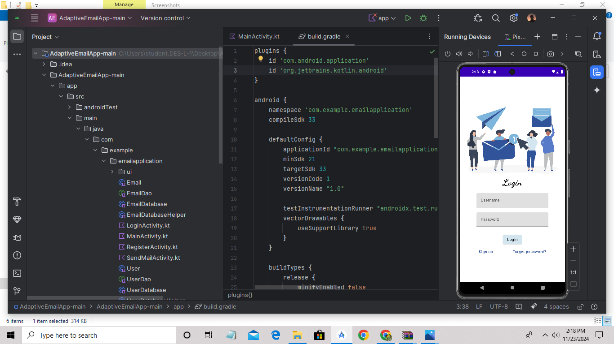
Output:

Slide 11
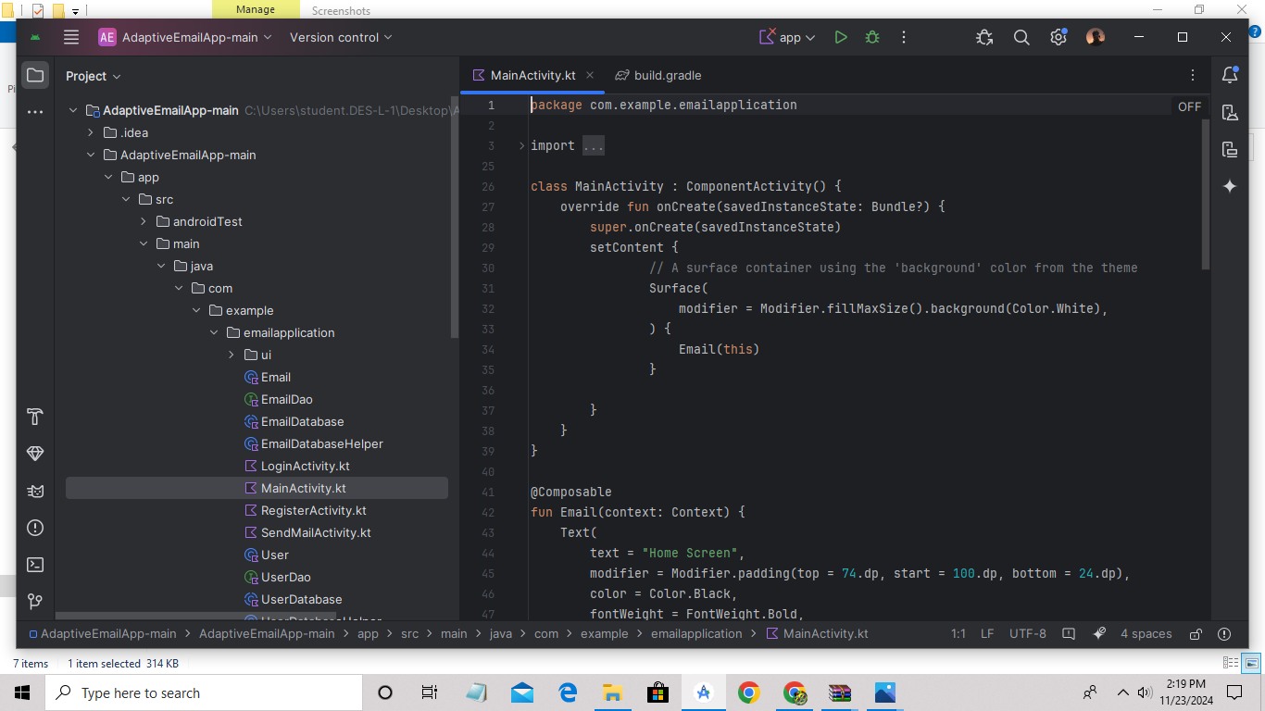
Demo

Slide 12
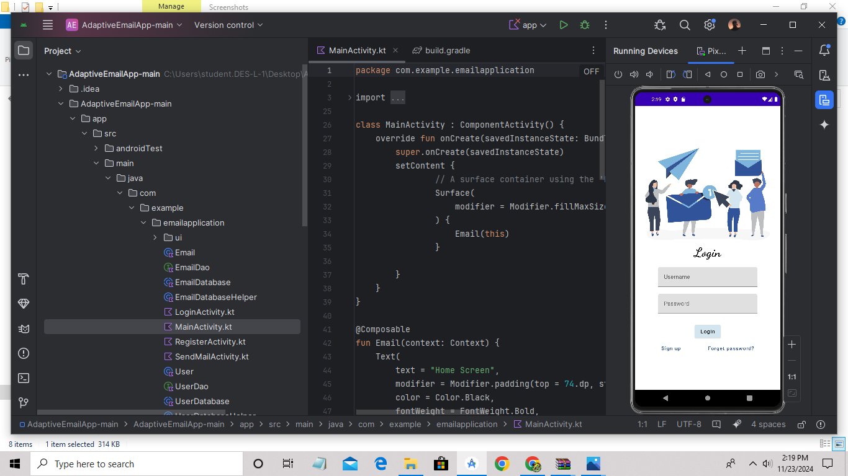
Output:

