Slide 1
WhenBus
A crowd-sourced bus timing application
Code and Reports @ https://github.com/arjun-krishna/WhenBus

Slide 2
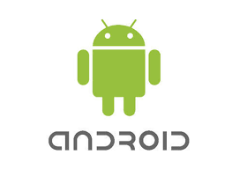
WhenBus [ System Architecture ]
get_suggestion
get_information
NodeJS
backend
Mongo
database
send_feedback

Slide 3
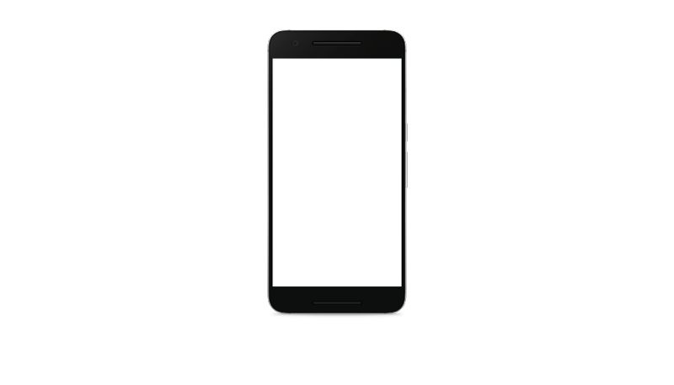
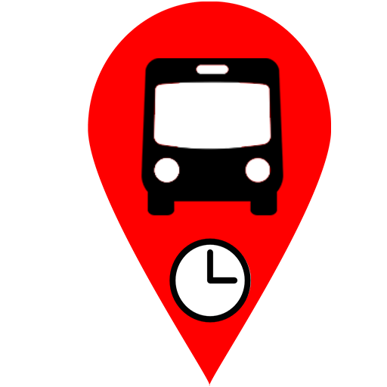
WhenBus [ User Interface ]
This is the first Activity launched as the user opens our
application.
WhenBus

Slide 4
WhenBus [ User Interface ]
This is the activity where we obtain the
Query from the user.
User has two options
(i) Enter bus number
(ii) Enter source and destination.
Bus number
submit
Source
Destination
submit

Slide 5
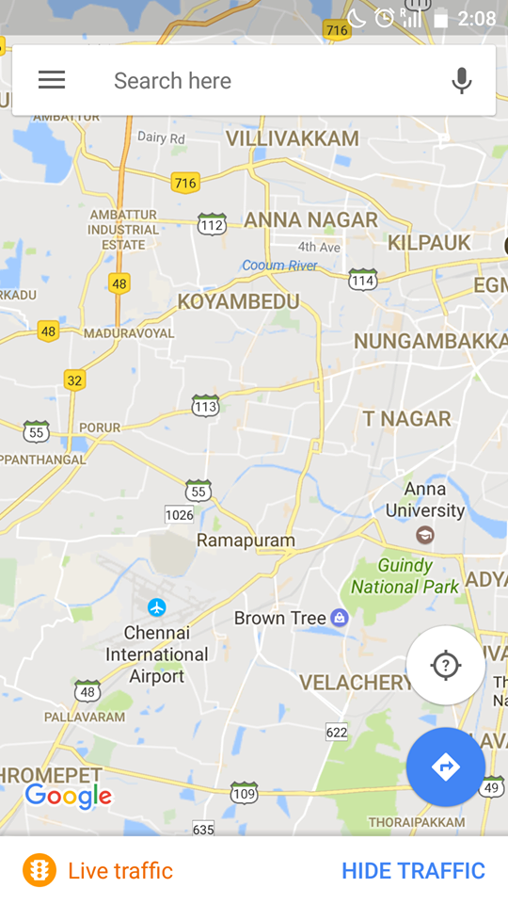
WhenBus [ User Interface ]
This activity is obtained, using the API get_information.
The user reaches this activity when a particular bus number is picked.
This interface displays expected bus location and expected arrival time.
BUS : 5C
Expected arrival : 10:30 a.m
time
Stop : BROADWAY

Slide 6
WhenBus [ User Interface ]
This activity is displayed when the user enters the source and destination. It uses the get_suggestion API.
It displays best five possible direct buses for a particular pair of source and destination.
BROADWAY
to
TARAMANI
05C 10:20 a.m
05CGS 10:25 a.m
5C 10:30 a.m

Slide 7
WhenBus [ User Interface ]
This activity is launched when we detect that the user might have boarded a bus. This helps in ascertaining that the bus had reached a particular stop and also get periodic feedback from the application.
Did you board the
bus 5C ?
YES
NO

Slide 8
WhenBus
Thank
You !

