Slide 1

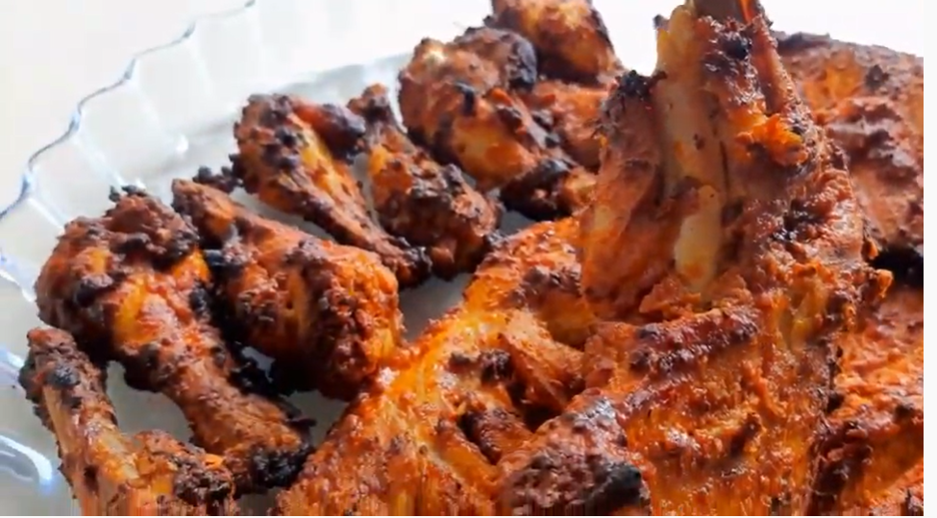
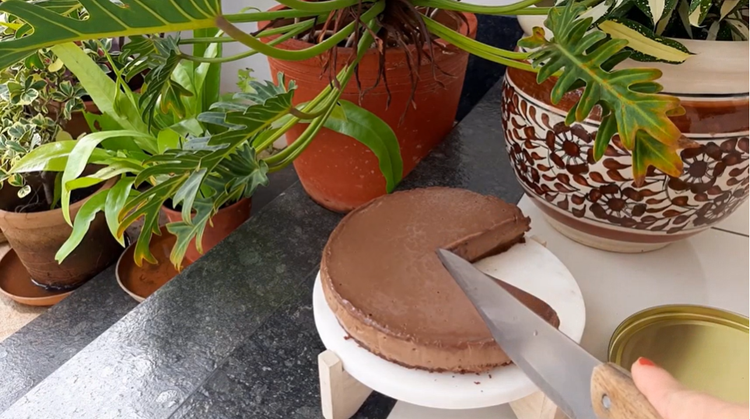


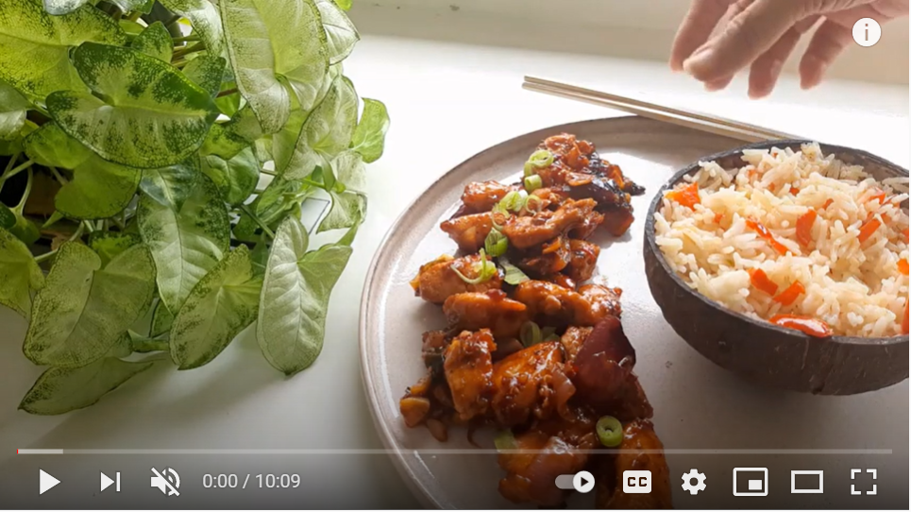
Honey I’m Home
KNOW ME
RECIPES
LIFESTYLE / TRAVEL
COMMUNITY
TRICKS & TIPS
Favorite of the Month
Trending Recipes
*
*
Chocolate Cheesecake
No bake, No gelatin, eggless, without spring form pam
What’s Cooking?
Sweet & Spicy Chicken
One Pot Dish | Quick Stir | LESS OIL
VIEW RECIPE
© 2021 Honey I’m Home

