Slide 1
RESTFul Services with JAX-RS
Authored by :Rajendra Patki Presented by :Rajendra Patki

Slide 2
Agenda
Restful Services with JAX-RS
What is web service & Why do we need them ?
What is SOAP & REST?
What is JAX RS?
JAX RS Annotations
Content Negotiation
Development & Deployment
Example
HTTP methods
Annotations and URL mapping and Response object
Representation and entity
Exception handling

Slide 3
What is Web Service?
Client Server Application composed of
Service Provider (on Server Side)
Service Consumer (on Client Side)
Communicates using HTTP for
Interoperability
Extensibility
2 Types
Big Service – SOAP over HTTP and XML based Messages
RESTFull Service – HTTP, URI and MIME based Messages
Notes:
The W3C defines a "Web service" as "a software system designed to support interoperable machine-to-machine interaction over a network".
Web services are typically application programming interfaces (API) or Web APIs that are accessed via Hypertext Transfer Protocol (HTTP)...
So this means areas that REST works really well for are:
Limited bandwidth and resources; remember the return structure is really in any format (developer defined). Plus, any browser can be used because the REST approach uses the standard GET, PUT, POST, and DELETE verbs. Again, remember that REST can also use the XMLHttpRequest object that most modern browsers support today, which adds an extra bonus of AJAX.
Totally stateless operations; if an operation needs to be continued, then REST is not the best approach and SOAP may fit it better. However, if you need stateless CRUD (Create, Read, Update, and Delete) operations, then REST is it.
Caching situations; if the information can be cached because of the totally stateless operation of the REST approach, this is perfect.
That covers a lot of solutions in the above three. So why would I even consider SOAP? Again, SOAP is fairly mature and well-defined and does come with a complete specification. The REST approach is just that, an approach and is wide open for development, so if you have the following then SOAP is a great solution:
Asynchronous processing and invocation; if your application needs a guaranteed level of reliability and security then SOAP 1.2 offers additional standards to ensure this type of operation. Things like WSRM – WS-Reliable Messaging.
Formal contracts; if both sides (provider and consumer) have to agree on the exchange format then SOAP 1.2 gives the rigid specifications for this type of interaction.
Stateful operations; if the application needs contextual information and conversational state management then SOAP 1.2 has the additional specification in the WS* structure to support those things (Security, Transactions, Coordination, etc). Comparatively, the REST approach would make the developers build this custom plumbing.
here is SOAP best deployed? Where is REST best used? Can they co-exist?
SOAP is best for mission-critical applications that live behind the firewall while REST is made for the cloud. SOAP is all about servers talking to servers, with rigid standards, extensive design, serious programming, and heavyweight infrastructure all essential parts of the equation.
As you might expect, then, SOAP does a better job of maintaining consistency in complex environments through the use of techniques such as a two-phase commit. For example, wiring money to a bank account. Did the transaction fail? It’s probably a bad idea to continue to automatically wire the money over and over again, so SOAP might make more sense if you're orchestrating a set of complex services to effect a transaction -- no transaction takes place unless each and every distributed service succeeds.
If you’re interested in building your applications quickly and with maximum portability -- especially if the Cloud (public, private, or hybrid) is in the picture -- it’s hard to beat REST. It sports a mere handful of simple HTTP API commands, and every object (known as a ‘resource’) has its own unique Uniform Resource Identifier that provides a path and distinct name.
REST’s straightforward API and clear, consistent labeling philosophy is far more developer-friendly than SOAP, which mandates deep understanding of site-specific APIs. REST lets you publish your data and have others -- regardless of where they might be – work with it. Just looking at the URI gives you an indication of how to proceed. Today, REST is clearly winning out when it comes to API protocols.
SOAP and REST can coexist in that you can build your service logic once and then expose two interfaces for it: SOAP for inside the firewall (including all its related qualify-of-service capabilities) and REST for outside the firewall.

Slide 4
SOAP Web service
SOAP – Simple Object Access Protocol
XML based protocol
Needs WSDL (Web service description language)
Soap request & Soap response
Sample SOAP request
<SOAP-ENV:Envelope xmlns:SOAP-ENV="http://schemas.xmlsoap.org/soap/envelope/" xmlns:SOAP-ENC="http://schemas.xmlsoap.org/soap/encoding/" xmlns:xsi="http://www.w3.org/2001/XMLSchema-instance" xmlns:xsd="http://www.w3.org/2001/XMLSchema" SOAP-ENV:encodingStyle="http://schemas.xmlsoap.org/soap/encoding/">
<SOAP-ENV:Body>
<m:getCountries xmlns:m="AddressFinder">
<datasource xsi:type="xsd:string">TA.Address.EU</datasource>
<token xsi:type="xsd:string">MyToken</token>
</m:getCountries>
</SOAP-ENV:Body>
</SOAP-ENV:Envelope>

Slide 5
SOAP Web service
Sample SOAP Response
<?xml version="1.0" encoding="UTF-8"?>
<soap:Envelope xmlns:xsi="http://www.w3.org/2001/XMLSchema-instance" xmlns:xsd="http://www.w3.org/2001/XMLSchema" xmlns:soap="http://schemas.xmlsoap.org/soap/envelope/" xmlns:soapenc="http://schemas.xmlsoap.org/soap/encoding/" soap:encodingStyle="http://schemas.xmlsoap.org/soap/encoding/">
<soap:Body>
<n:getCountriesResponse xmlns:n="http://arcweb.esri.com/v2">
<Result href="#id0"/>
</n:getCountriesResponse>
<id0 id="id0" soapenc:root="0" xsi:type="soapenc:Array" soapenc:arrayType="xsd:string[19]">
<i xsi:type="xsd:string">AN</i>
<i xsi:type="xsd:string">AU</i>
<i xsi:type="xsd:string">BE</i>
<i xsi:type="xsd:string">DA</i>
</id0>
</soap:Body>
</soap:Envelope>

Slide 6
RESTful Web Services
REST – Representational state transfer
Stateless
Uniform interface
Cacheable
Built from resources
Exchange representation of the resources
Notes:
REST and the Rebirth of HTTP
RESTful Architectural Principles
Addressability
The Uniform, Constrained Interface
Why Is the Uniform Interface Important?
Representation-Oriented
Communicate Statelessly
HATEOAS

Slide 7
How RESTFul Services Work?
GET /users/1155 HTTP/1.1
Host: cybintranet
Accept: application/xml
PUT /users/1155 HTTP/1.1
Host: cybintranet
Content-Type: application/xml
<?xml version=“1.0”?>
<user>
<address>CT-2 Cybage </address>
<cell>9860999769</cell>
</user>
POST /users HTTP/1.1
Host: cybintranet
Content-Type: application/xml
<?xml version=“1.0”?>
<user>
<id>1155</id>
<name>Rajendra Patki</name>
<address>on earth</address>
<cell>9657965084</cell>
</user>
Delete /users/1155 HTTP/1.1
Host: cybintranet
Accept: application/xml
Notes:
For example, let’s say we wanted to get a list of products available on a web store. We
do an HTTP GET on http://example.com/webstore/products and receive back:
<products>
<product id="123">
<name>headphones</name>
<price>$16.99</price>
</product>
<product id="124">
<name>USB Cable</name>
<price>$5.99</price>
</product>
...
</products>
This could be problematic if we had thousands of products to send back to our client.
We might overload it, or the client might wait forever for the response to finish downloading.
We could instead list only the first five products and provide a link to get the
next set:
<products>
<link rel="next" href="http://example.com/webstore/products?startIndex=5"/>
<product id="123">
<name>headphones</name>
<price>$16.99</price>
</product>
...
</products>

Slide 8
What is JAX RS?
Specification for RESTFul Web Services
Defined in JSR 311
SPEC LEAD: Marc Hardley, Sun Microsystem
Included in Java EE 6
Java Programming Language API
Helps develop application with REST Architecture
Helps building RESTFul Web Services.
Annotation based Framework, Annotation for
Defining resource
Defining Action to be performed on resource
Notes:
1 /customers/{id}/{name}/address
2 /customers/{id : .+}/address
3 /customers/{id}/address
4 /customers/{id : .+}

Slide 9
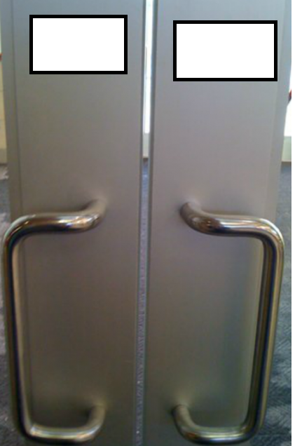
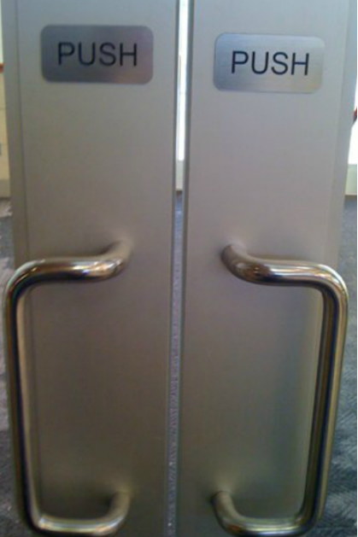
RESTFul Web service - Design

Slide 10
Summary of JAX RS Annotations
@Path
Defines URI Mapping & Templates.
@Produces, @Consumes
MIME Types of Resource Representation.
@GET, @POST, @PUT, @DELETE & @HEAD
Identifies HTTP Method in which Java Method is interested.
@PathParam
Enables extraction of URI Parameter or Segment.
@QueryParam
Accesses specific parameter in Query String.
@HeaderParam
Accesses specific HTTP Header.
@CookieParam
Accesses specific Cookie Value.

Slide 11
JAX RS Example
GET /users/1155 HTTP 1.1
@Path("/users")
public class UserResource {
@Path("/{id}")
@GET
@Produces("text/plain")
public String getUser(
@PathParam("id") int id) {
return "Unknown User";
}
}
@Path
Value is relative URI
Used with Class & Method
Identifies URI Path Template
URL Path Template
Variables embedded in URI
Can have 1 or more variables
Variables are denoted with { }
Variable substituted at runtime.
Variables may be customized using regular expression

Slide 12
Examples of URI Path Template
URI Path Template | URI After Substitution
http://example.com/{id}/{name} | http://example.com/1155/Rajendra
http://example.com/{que}/{que}/{que} | http://example.com/why/this/kolaveri
http://example.com/users/{id} | http://example.com/users/1155
http://example.com/{name}/address | http://example.com/Yogesh/address http://example.com/ /address
Regular Expression With @Path
@Path(“/user/{order_id: [a-zA-Z][a-zA-Z_0-9]}

Slide 13
Content Negotiation
Content Negotiation built-in in HTTP through
Header Accept: application/xml
Header content-type: application/json
JAX RS declares content preferences via
Annotations @Produces & @Consumes
JAX RS request is match with Path & than with Content Type

Slide 14
Content Negotiation
@Path(/users/super)
@GET
public class UserResource {
@Produces(“application/xml”)
public String getSuperUserAsXML() { … }
@Produces(“application/json”)
public String getSuperUserAsJSON() { … }
}

Slide 15
Development & Deployment
JAX RS Libraries
Maven : javaee-api
GlassFish 4.0
Built in support for JAX-RS 2.0
Eclipse IDE
Preferred use Cybage Standard Eclipse IDE
Create Dynamic Web Project / Maven web project
Use GlassFish eclipse plugin for deployment from IDE

Slide 16
Development & Deployment …
Let’s DO IT….
Notes:
Programmatic URI Information
All this à la carte injection of path parameter data with the @PathParam annotation is
perfect most of the time. Sometimes, though, you need a more general raw API to query
and browse information about the incoming request’s URI. The interface
javax.ws.rs.core.UriInfo provides such an API:
public interface UriInfo {
public String getPath();
public String getPath(boolean decode);
public List<PathSegment> getPathSegments();
public List<PathSegment> getPathSegments(boolean decode);
public MultivaluedMap<String, String> getPathParameters();
public MultivaluedMap<String, String> getPathParameters(boolean decode);
...
}
The getPath() methods allow you obtain the relative path JAX-RS used to match the
incoming request. You can receive the path string decoded or encoded. The getPath
Segments() methods break up the entire relative path into a series of PathSegment objects.
Like getPath(), you can receive this information encoded or decoded. Finally,
getPathParameters() returns a map of all the path parameters defined for all matching
@Path expressions.
You can obtain an instance of the UriInfo interface by using the @javax.ws.rs.core.Con
text injection annotation. Here’s an example:
@Path("/cars/{make}")
public class CarResource {
@GET
@Path("/{model}/{year}")
@Produces("image/jpeg")
public Jpeg getPicture(@Context UriInfo info) {
String make = info.getPathParameters().getFirst("make");
PathSegment model = info.getPathSegments().get(1);
String color = model.getMatrixParameters().getFirst("color");
...
}
}
@MatrixParam
Instead of injecting and processing PathSegment objects to obtain matrix parameter
values, the JAX-RS specification allows you to inject matrix parameter values directly
through the @javax.ws.rs.MatrixParam annotation. Let’s change our CarResource example
from the previous section to reflect using this annotation:
@Path("/{make}")
public class CarResource {
@GET
@Path("/{model}/{year}")
@Produces("image/jpeg")
public Jpeg getPicture(@PathParam("make") String make,
@PathParam("model") String model,
@MatrixParam("color") String color) {
...
}
Using the @MatrixParam annotation shrinks our code and provides a bit more readability.
The only downside of @MatrixParam is that sometimes you might have a repeating
matrix parameter that is applied to many different path segments in the URI. For example,
what if color shows up multiple times in our car service example?
GET /mercedes/e55;color=black/2006/interior;color=tan
Here, the color attribute shows up twice: once with the model and once with the interior.
Using @MatrixParam("color") in this case would be ambiguous and we would
have to go back to processing PathSegments to obtain this matrix parameter.

Slide 17
Any Questions?
Notes:
public enum Status {
OK(200, "OK"),
CREATED(201, "Created"),
ACCEPTED(202, "Accepted"),
NO_CONTENT(204, "No Content"),
MOVED_PERMANENTLY(301, "Moved Permanently"),
SEE_OTHER(303, "See Other"),
NOT_MODIFIED(304, "Not Modified"),
TEMPORARY_REDIRECT(307, "Temporary Redirect"),
BAD_REQUEST(400, "Bad Request"),
UNAUTHORIZED(401, "Unauthorized"),
FORBIDDEN(403, "Forbidden"),
NOT_FOUND(404, "Not Found"),
NOT_ACCEPTABLE(406, "Not Acceptable"),
CONFLICT(409, "Conflict"),
GONE(410, "Gone"),
PRECONDITION_FAILED(412, "Precondition Failed"),
UNSUPPORTED_MEDIA_TYPE(415, "Unsupported Media Type"),
INTERNAL_SERVER_ERROR(500, "Internal Server Error"),
SERVICE_UNAVAILABLE(503, "Service Unavailable");

Slide 18
Thank you!

