Slide 1


A D PATEL INSTITUTE OF TECHNOLOGY
(The Charutar Vidya Mandal University)
GSIRE - An ISO 9001:2015 Certified Institute
EXAMINATION
MANAGEMENT SYSTEM
Python Mini Project
Submitted by: Arjun Rameshbhai Sagar
Enrollment No.: 12402080601006 | Batch.: 1A8
Faculty Guide: Mr. Nayankumar Mali, Assistant Professor
Information Technology | Academic Year 2026-27

Slide 2
1. Problem Statement
Why a small examination management application was proposed
Manual record keeping
Common risks
Project response
Student details, exam schedules and marks may be stored in separate registers or files.
Searching and updating can require repetitive work.
Duplicate identifiers, incorrect maximum marks, arithmetic mistakes and inconsistent copies of result data.
A single interface connects students, exams and results; it validates marks and calculates the result consistently.
Goal: make routine record management clearer, faster to search and easier to demonstrate.
EXAMINATION MANAGEMENT SYSTEM | ADIT / CVM UNIVERSITY
2

Slide 3
2. Objectives and Scope
• Maintain student records using a unique roll number.
• Create examination schedules with subject, semester, date and maximum marks.
• Record or update marks and calculate percentage, grade and PASS/FAIL.
• Search records and export result rows to CSV.
• Store data persistently in a local SQLite database.
• Keep the source code modular so each file can be explained separately.
EXAMINATION MANAGEMENT SYSTEM | ADIT / CVM UNIVERSITY
3

Slide 4
3. Main Application Modules
Students
Examination Schedule
Marks & Results
Add, search and delete student records; validate unique roll number.
Add and delete exams; store code, subject, semester, date and max marks.
Save/update marks; calculate grade, percentage and status.
SQLite Database
CSV Export
Persistent linked tables for students, exams and results.
Export filtered result rows to a spreadsheet-compatible file.
EXAMINATION MANAGEMENT SYSTEM | ADIT / CVM UNIVERSITY
4

Slide 5
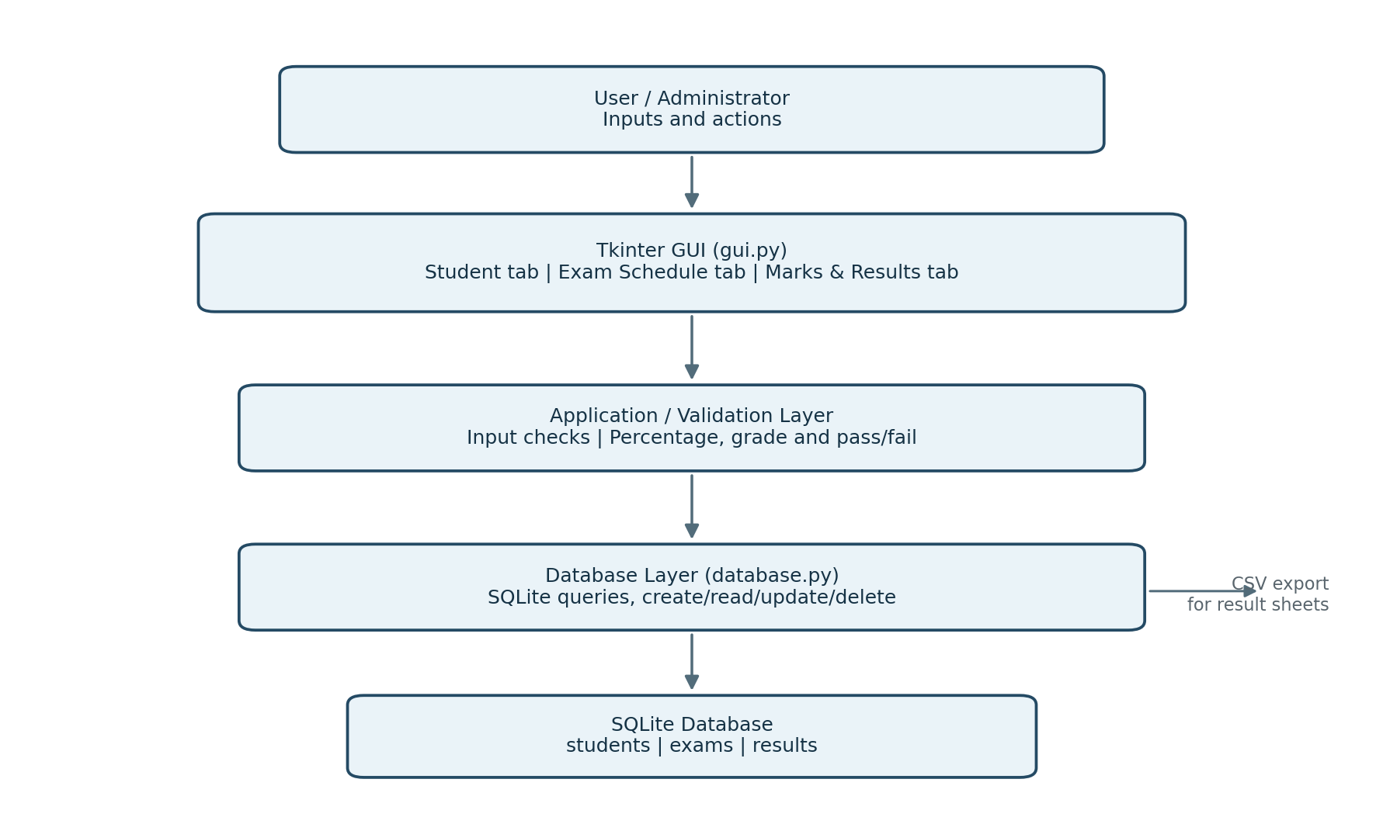
4. System Architecture
EXAMINATION MANAGEMENT SYSTEM | ADIT / CVM UNIVERSITY
5

Slide 6
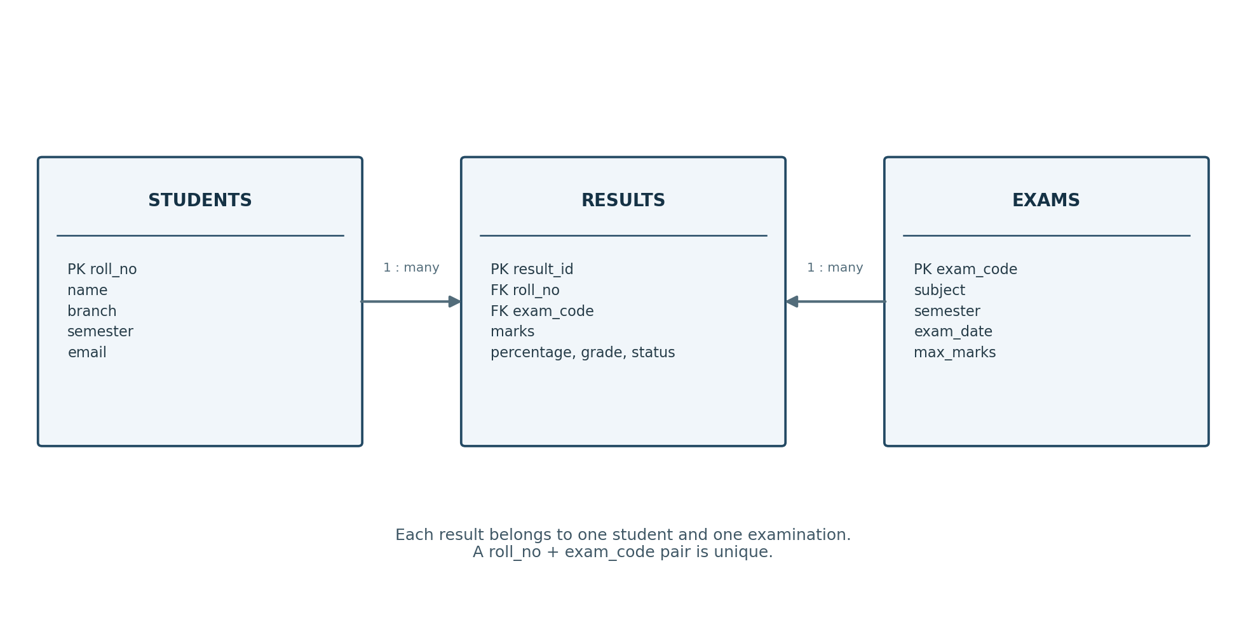
5. Database Design
SQLite schema keeps related records connected
Unique rule: each student can have one saved result per examination; saving again updates it.
EXAMINATION MANAGEMENT SYSTEM | ADIT / CVM UNIVERSITY
6

Slide 7
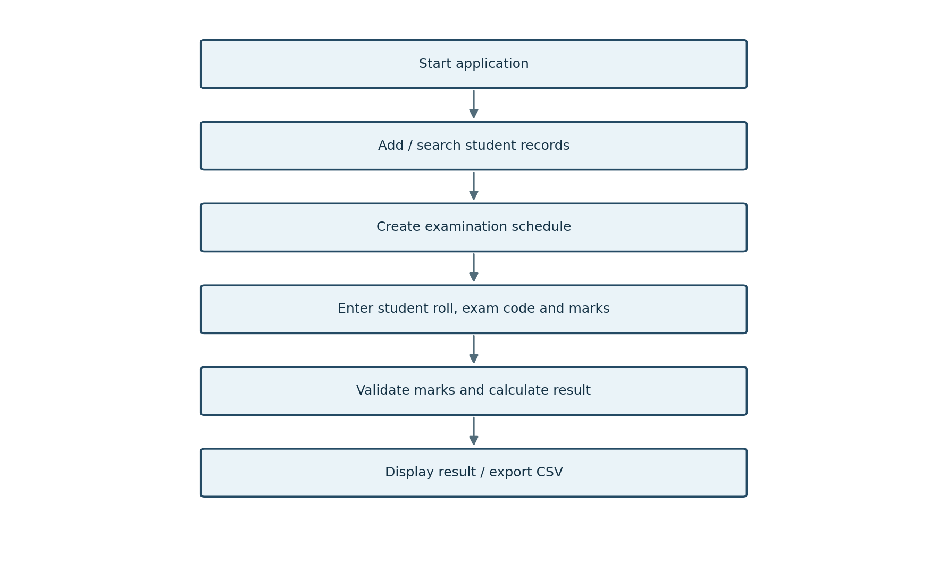
6. How the System Works
EXAMINATION MANAGEMENT SYSTEM | ADIT / CVM UNIVERSITY
7

Slide 8
7. Automatic Result Calculation
Formula
Validation
Percentage = (Marks Obtained / Maximum Marks) × 100
Marks must be between zero and the examination maximum.
A+
90% and above
A
80% to < 90%
Example: 86 / 100 × 100 = 86%
Grade: A | Status: PASS
The grade thresholds are demonstration rules, not a claim about official university policy.
B+
70% to < 80%
B
60% to < 70%
C
50% to < 60%
D
40% to < 50%
F
Below 40%
EXAMINATION MANAGEMENT SYSTEM | ADIT / CVM UNIVERSITY
8

Slide 9
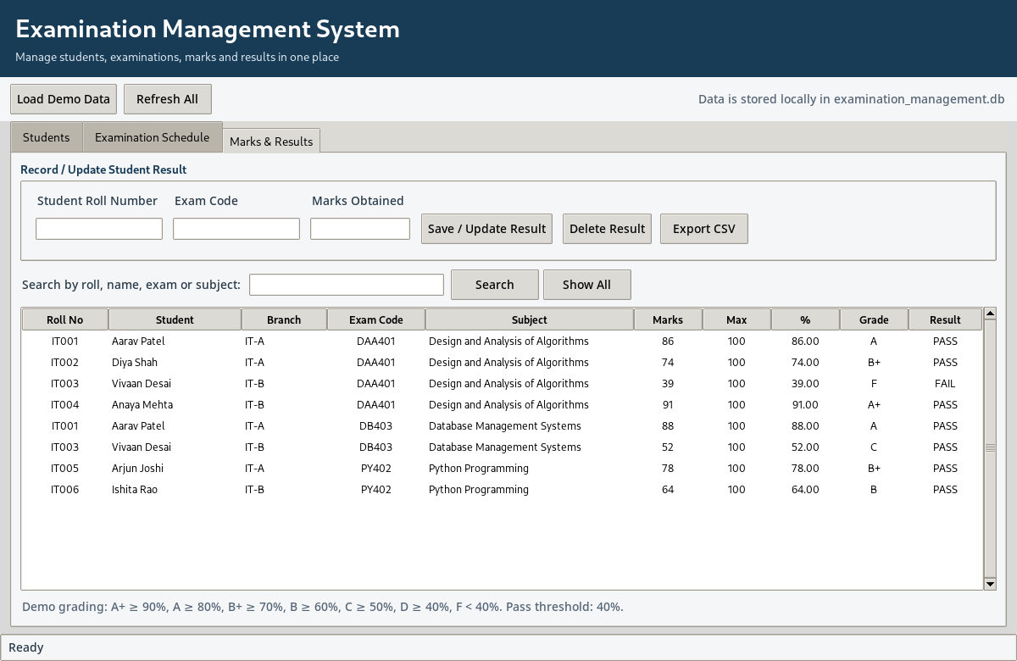
8. Interface Preview
Application screenshot: Marks & Results tab
EXAMINATION MANAGEMENT SYSTEM | ADIT / CVM UNIVERSITY
9

Slide 10
9. Code Organization
main.py
Starts the Tkinter window and launches the application.
gui.py
Builds tabs, forms, tables, searches and export buttons.
database.py
Creates tables and runs CRUD / result queries.
grade_utils.py
Calculates percentage, grade and pass/fail status.
EXAMINATION MANAGEMENT SYSTEM | ADIT / CVM UNIVERSITY
10

Slide 11
10. Functional Tests and Sample Results
Test
Input / action
Expected result
Outcome
T1
Add student
Student appears
Supported
T2
Duplicate roll
Rejected by key
Supported
T3
Marks > maximum
Rejected
Supported
T4
Save result
Grade calculated
Supported
T5
Save same result
Updated, not duplicated
Supported
T6
Export CSV
File saved
Supported
Test database checks covered record creation, result updating, mark validation and sample-data loading. Capture real application screenshots on the target PC before submitting.
EXAMINATION MANAGEMENT SYSTEM | ADIT / CVM UNIVERSITY
11

Slide 12
11. Validation, Limitations and Future Scope
Validation
Limitations
Future Scope
• Unique roll number and exam code
• Required fields checked
• Valid date format and max marks
• Marks limited to [0, maximum]
• Single-user local app
• No login or role permissions
• No online exam / question paper
• Demo grade rules need approval
• User accounts and permissions
• Timetable clash detection
• Hall / seating allocation
• Printable marksheets and reports
EXAMINATION MANAGEMENT SYSTEM | ADIT / CVM UNIVERSITY
12

Slide 13
CONCLUSION
The Examination Management System demonstrated a practical use of Python GUI programming and relational data storage. It maintained student and exam records, validated marks, calculated result values, supported searching, and exported results to CSV.
EXAMINATION MANAGEMENT SYSTEM | ADIT / CVM UNIVERSITY
13

Slide 14
Thank You

