Slide 1
CLAS12
Forward Time-of-Flight
Evan Phelps
University of South Carolina
Department of Physics and Astronomy
ephelps@jlab.org
June 18, 2010

Slide 2
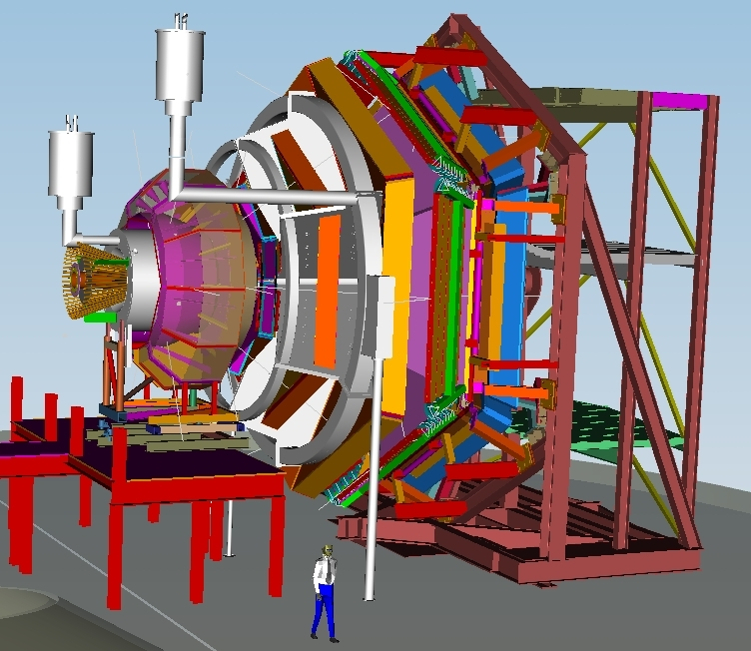
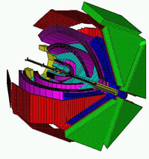
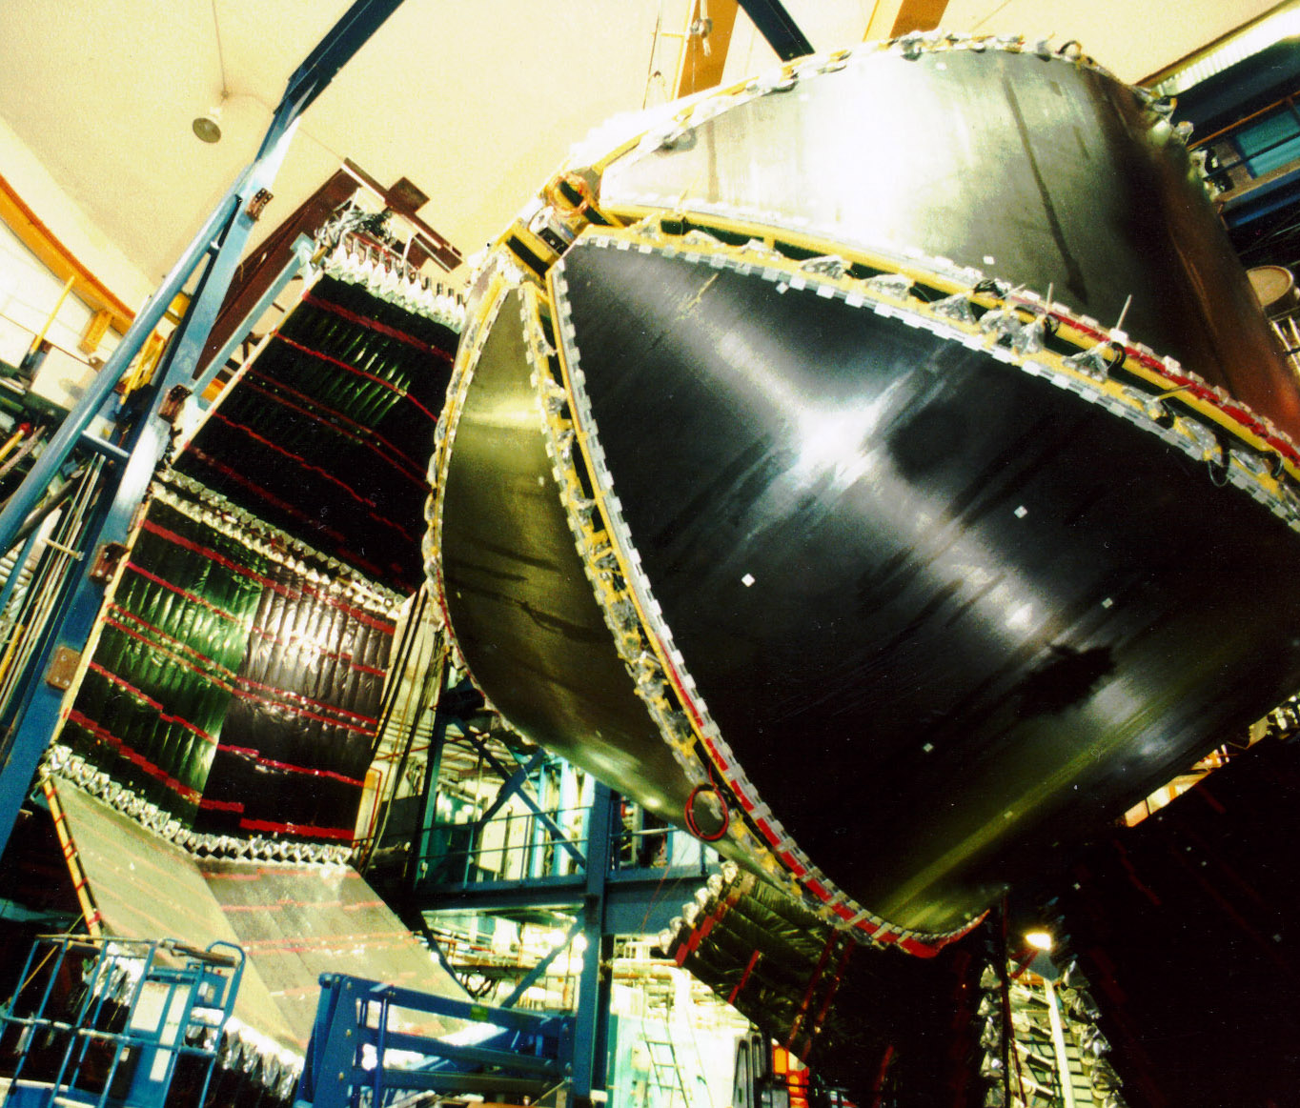
Forward Time-of-Flight Upgrade
CLAS12
LTCC
FTOF Panel 1a
FTOF Panel 1b
JLab Designer
DC R1, R2, R3
Solenoid 5T
PCAL
Central
Detector
EC
CTOF
SVT
HTCC
Forward
Detector
TORUS

Slide 3
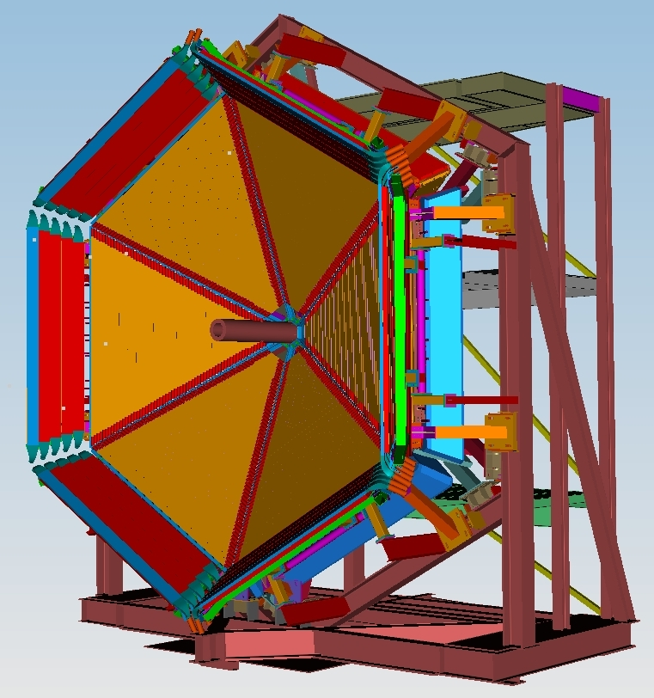
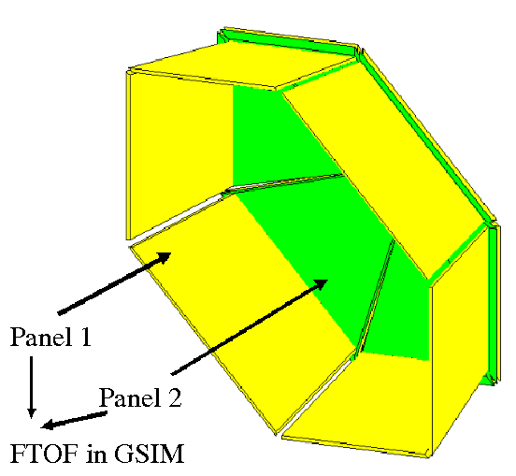
Forward Time-of-Flight Upgrade
JLab Designer
2
1

Slide 4
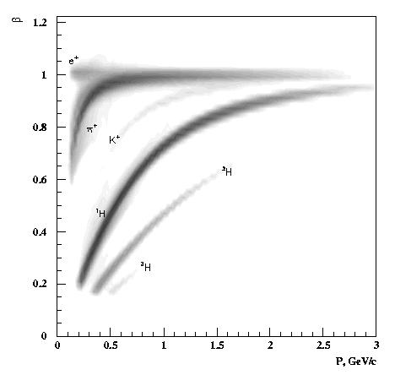
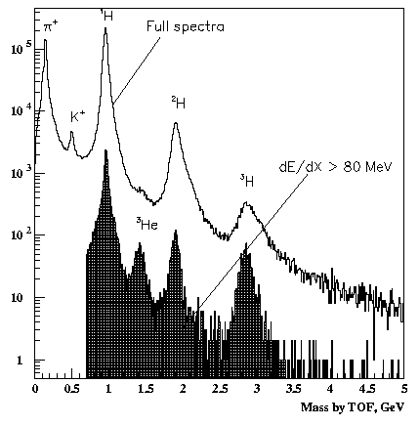
Particle Identification
The TOF detector is the primary component for particle identification.

Slide 5
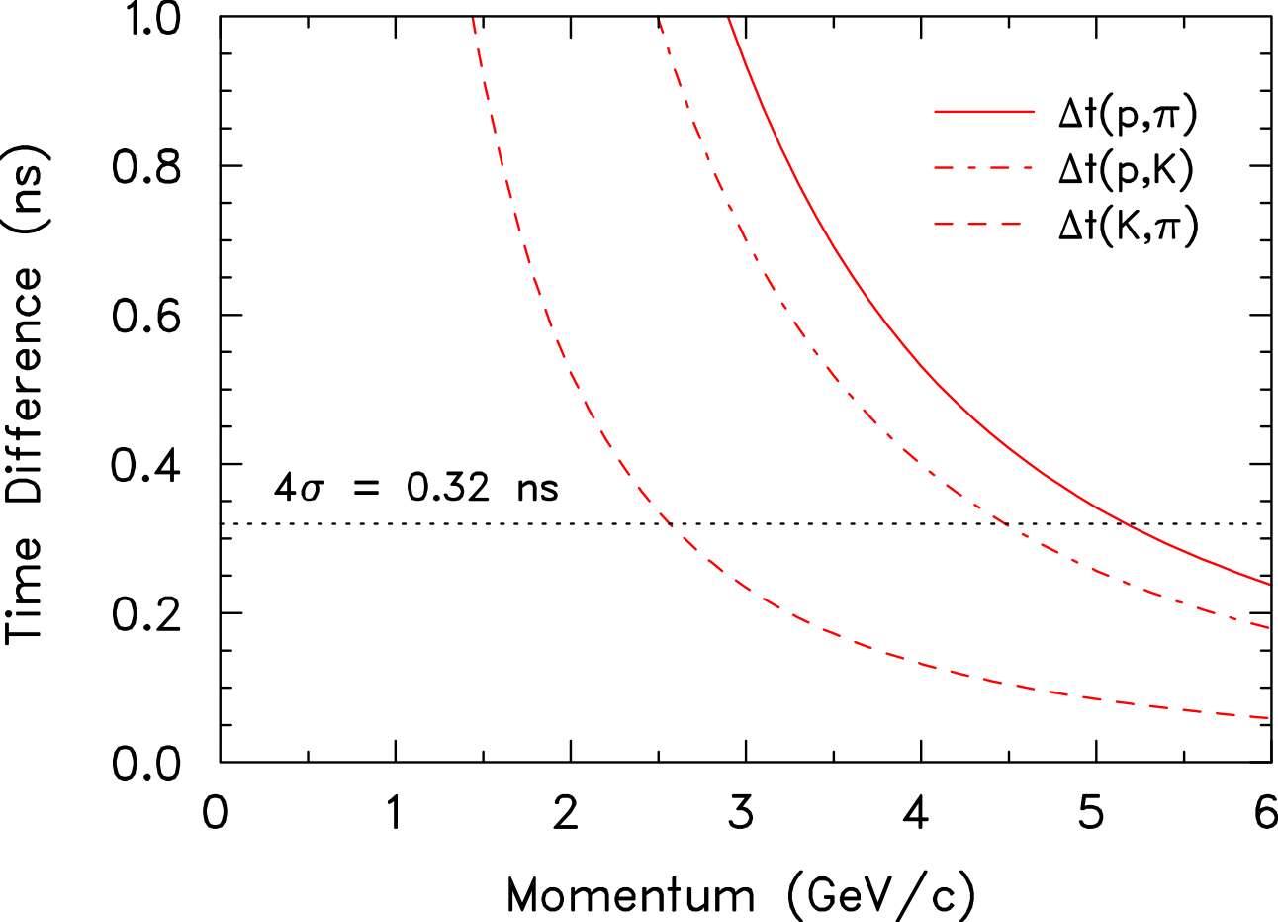
Design Requirements
To achieve
Proton-Pion separation up to 5.3 GeV/c
Proton-Kaon separation up to 4.5 GeV/c
and
Kaon-Pion separation up to 2.6 GeV/c
an improved timing resolution of ơ~ 80 ps is needed

Slide 6
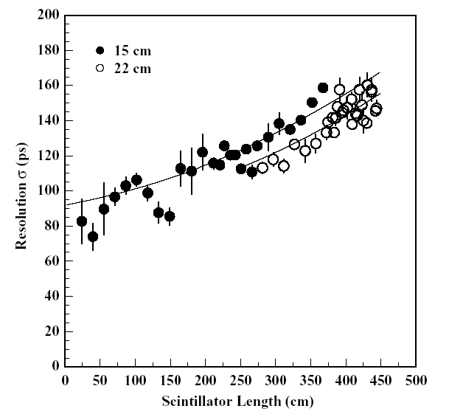
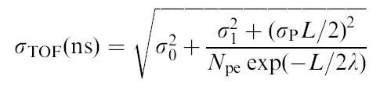
Current Time-of-Flight System
15 cm width (forward angle)
22 cm width (large angle)
σ₀ : Electronics
Has to be optimized!
σ₁ : Scintillator and PMT
Has to be optimized!
σ_{p} : Path-Length Variation
Has to be optimized!
N_{pe}: Number of photoelectrons
Has to be increased!
N_{pe} increases by 5/2 = (A_{FTOF6}/A_{FTOF12}) * (T_{TOF12}/T_{TOF6})

Slide 7
Prototyping and Optimizing
The effect of each detail of the detector must be understood
in order to optimize the system.
Scintillator composition
Scintillator geometry
Photon statistics
PMT response
Noise
Intrinsic TDC resolution
Timewalk
EXAMPLES
Notes:
In order to optimize the time resolution of the system, the contributions to time measurement uncertainties must be well understood. Consider the
optimize TOF detector
• scintillator material (rise time, decay time)
• photon statistics (thick detector)
• light dispersion (detector geometry small)
• count rates (detector geometry small, PMT TT)
• light detection efficiency (PMT QE)
• PMT rise time (PMT HV-divider)
• PMT dispersion (PMT TTS)
1 paddle cross section 3.0 cm x 2.54 cm: cost!
2 faster PMT? micro-channel-plates?: cost!,rate!

Slide 8
Time Resolution Measurement Methods
Independent position measurements
High statistics.
Requires multiple runs per counter.
Energy deposit signature does not match CLAS experimental conditions.
Coordinate method
Reference counter methods
  One reference
  Two reference
Three-bar cosmic ray method
Independent position measurements.
Energy deposit signature matches CLAS experimental conditions.
Very to extremely low statistics.
Requires multiple runs per counter.
Energy deposit signature matches CLAS experimental conditions.
High statistics.
Requires only one data run for full bar.
Does not incorporate independent position measurements.

Slide 9

Reference Counter Resolution
A
B
The middle counter is the one being evaluated; the top and bottom are reference counters of known resolution.
When all three counters are identical...

Slide 10
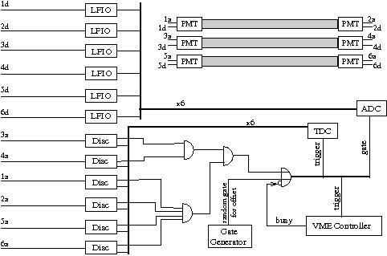
Three-bar Method Implementation

Slide 11
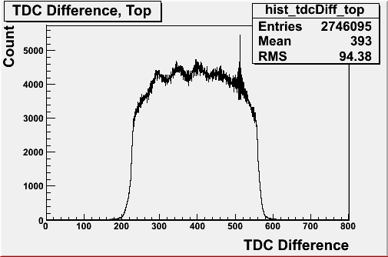
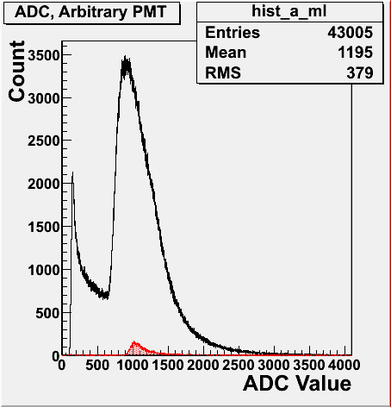
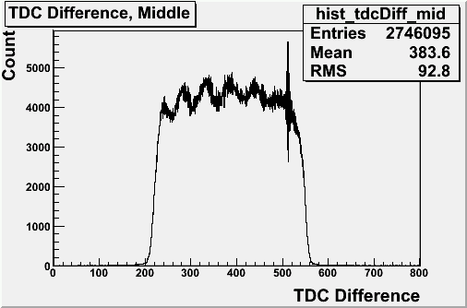
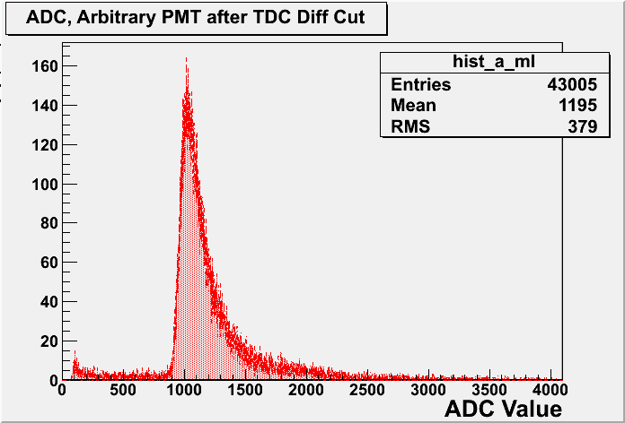
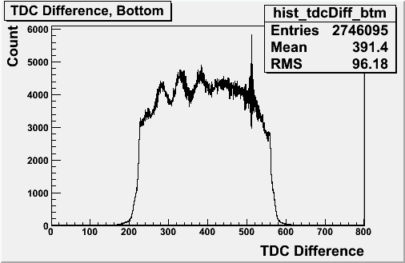
Position-specific Event Selection
Position Cuts via TDC Difference
Full-width Trajectory Cuts via ADC Minimums

Slide 12
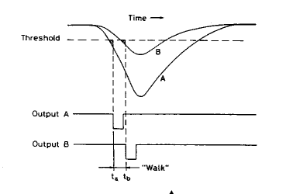
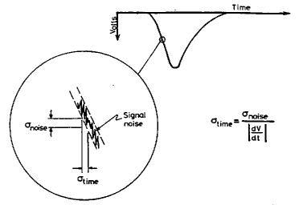
The Timewalk Problem
Sources of Timewalk:
Amplitude or rise-time differences.
Finite charge buildup.
Sources of Jitter:
Noise, statistical fluctuations.

Slide 13
The Timewalk Problem
Solutions for Timewalk:
Constant Fraction Discrimination
Offline corrections *
Solutions for Jitter:
Threshold optimization

Slide 14
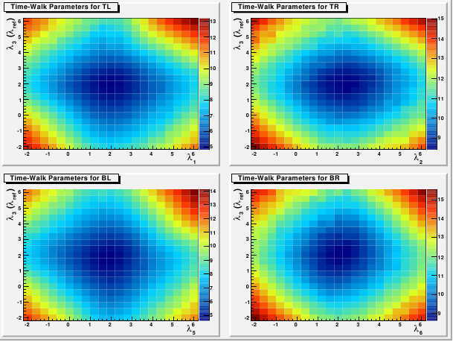
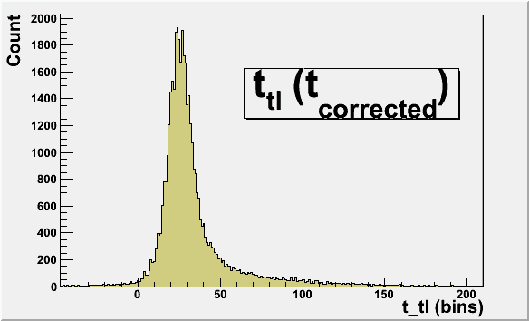
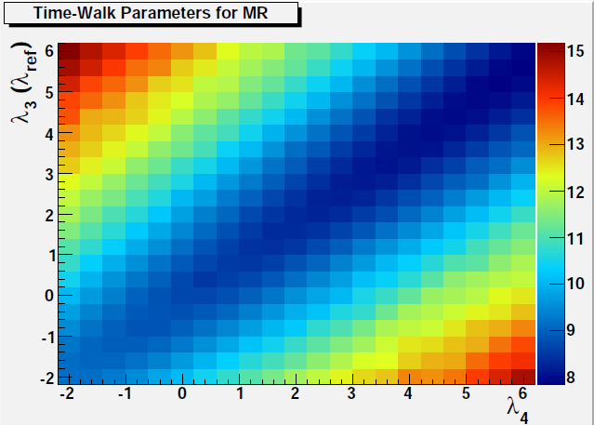
Position-specific Timewalk Correction
After cuts, tcorrected
is distributed about a fixed value
σ
TW parameters λi and λ3 are varied for each of tl, tr, bl, br, and mr to determine values leading to minimum tcorrected spreading.

Slide 15
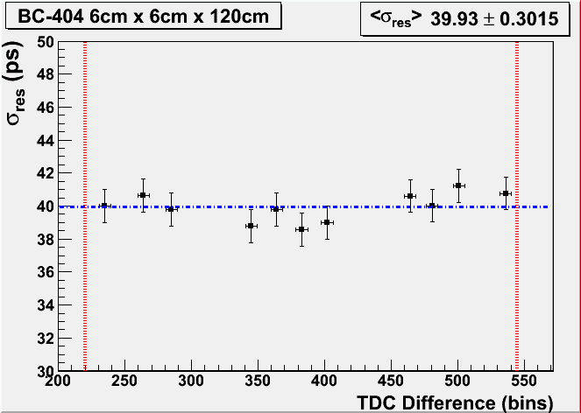
Position-dependent Resolution
Resolution measurements are consistent, within statistical uncertainties, throughout the counter length.
Left edge of scintillator
Right edge of scintillator
The average position-restricted resolution, <σres>,
Is approximately 40ps.
(
)
Scintillator edges are defined by
FWHM of TDC Difference
before cuts or TWC.

Slide 16
Position-dependent TW Parameters
EXAMPLE
Correction function for the time (t3) of the middle-left (ML) PMT

Slide 17
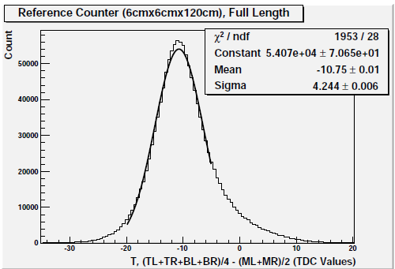
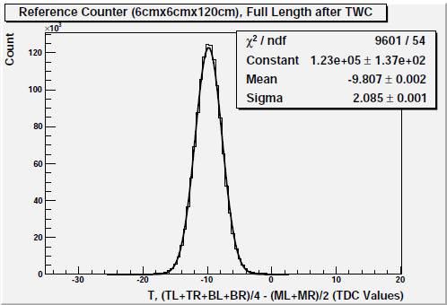
Full-bar Resolution without Vertical Cuts
86.6ps
42.6ps
Timewalk Correction Functions

Slide 18
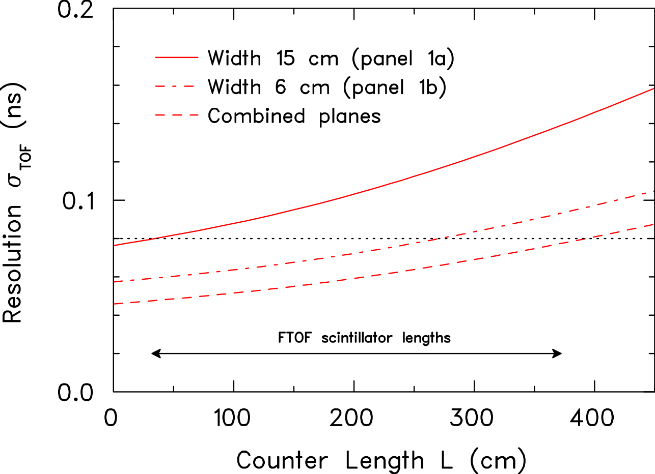
Design Requirements and Results
With a resolution for the longest scintillators of
√2/5
better than ~ 150 ps for the current FTOF panel
and
BC-404
better than ~ 95 ps for the new FTOF panel
a combined timing resolution of ơ ~ 80 ps can be accomplished
FTOF12 design counter yields ơ ~ 40 ps (120 cm long)
FTOF6 counter yields 128 ps < ơ < 148 ps (213 cm long)
FTOF12 design counter yields 65 ps < ơ < 87 ps (400 cm long)

Slide 19
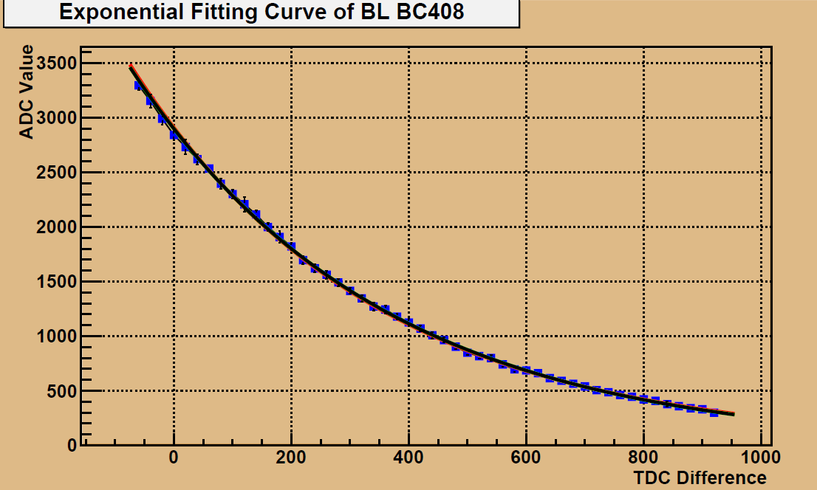
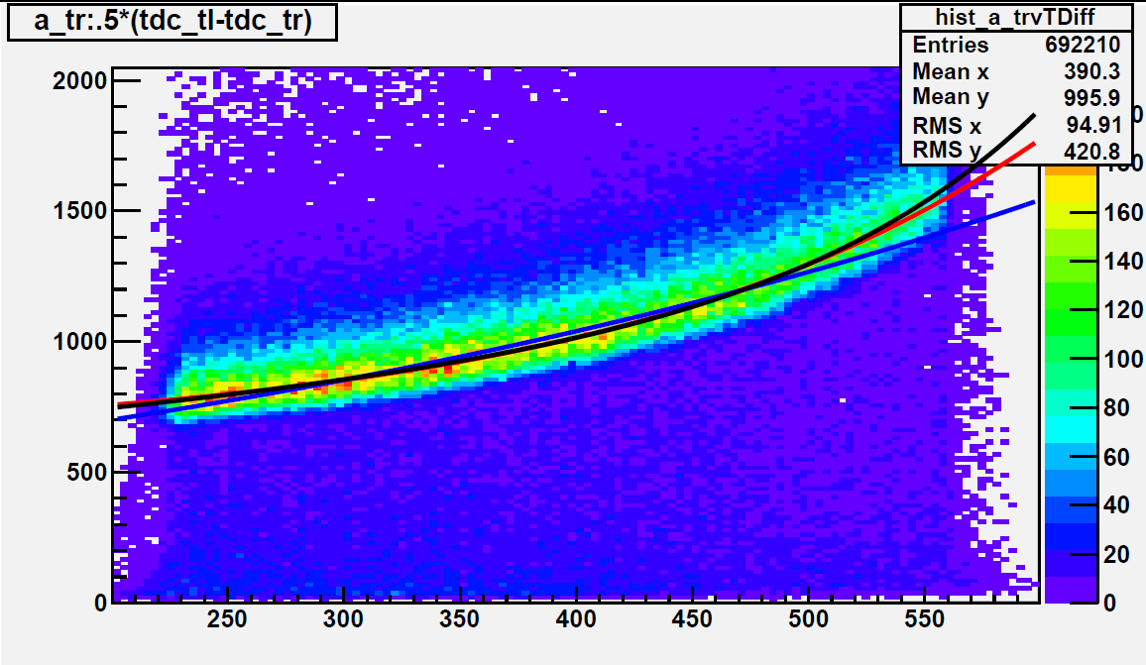
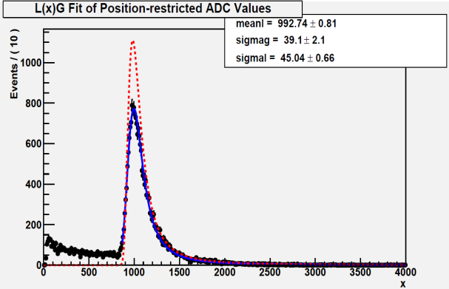
Light Attenuation Length Measurement
A₁exp(-x/λ1)
A₂exp(-x/λ2)+A₃exp(-x/λ3)+y₀
A₄exp(-x/λ4)+y₀
λ2=λ3
Gauss-convoluted Landau
Maximum X

Slide 20
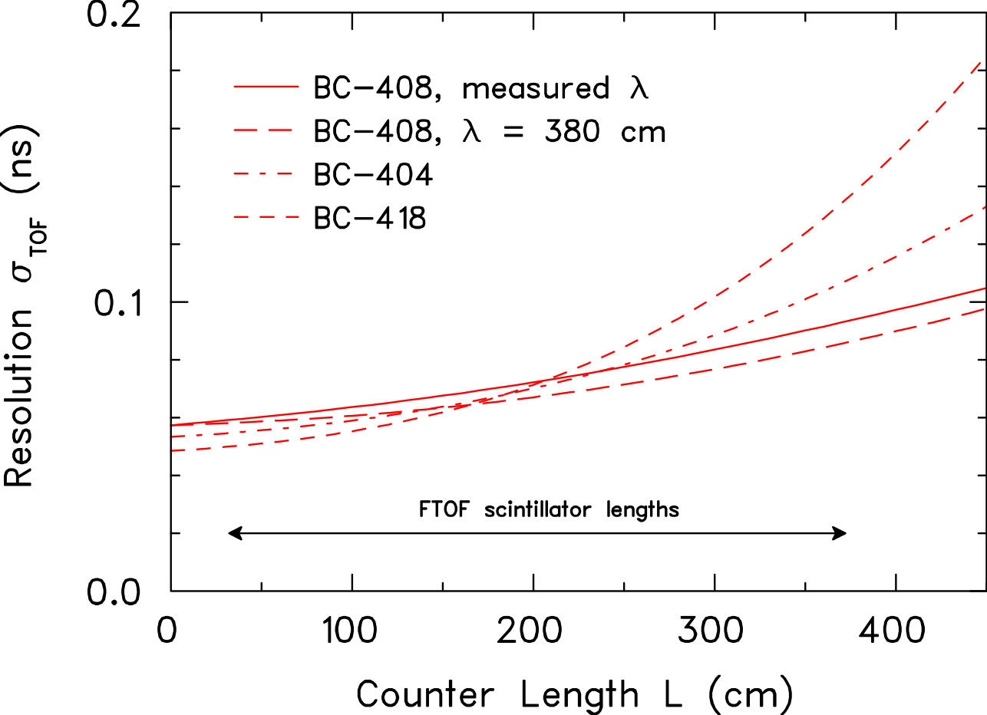
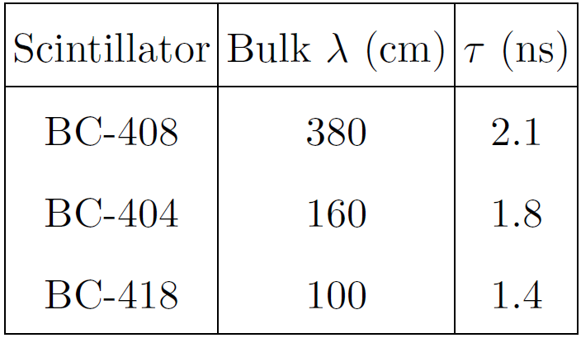
Light Attenuation Length
BC-408
BC-404
BC-404 with λ = 160 cm (Saint Gobain) but ∼325 cm (measured)
BC-408 with λ = 380 cm (Saint Gobain) but ∼230 cm (measured)

Slide 21
Thank you

Slide 22
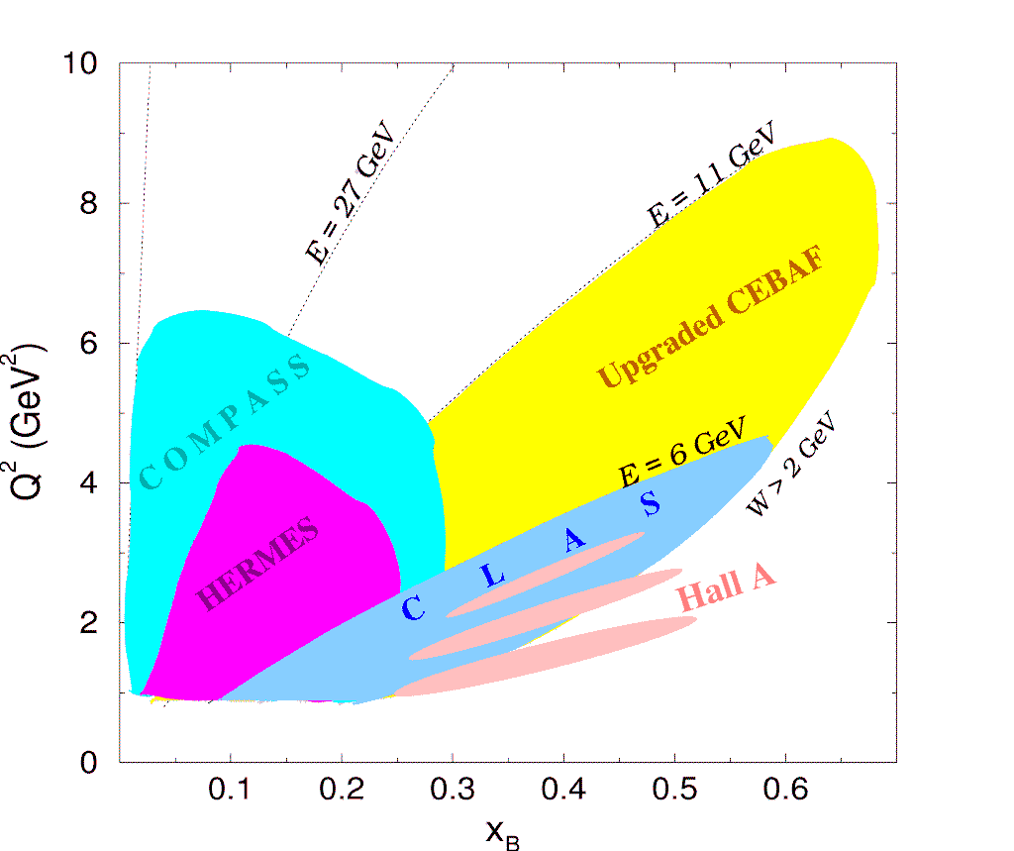
Kinematic Coverage of CLAS12

Slide 23
Recent Results
2009 USC measurement of 213cm x 5cm x 5cm Panel-1A counter
1999 JLab measurement of 213cm x 5cm x 5cm Panel-1A counter
2009 USC measurement (average position-specific resolution) of 120cm x 6cm x 6cm Panel-1B prototype counter

Slide 24
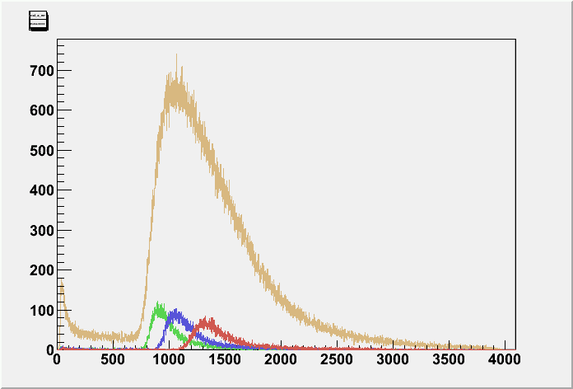
Full-bar Resolution Event Selection
ADC, Arbitrary PMT
FWHM Cut on Reference Bars
Minimum ADC Cut only eliminates VERY Low ADC Values

Slide 25
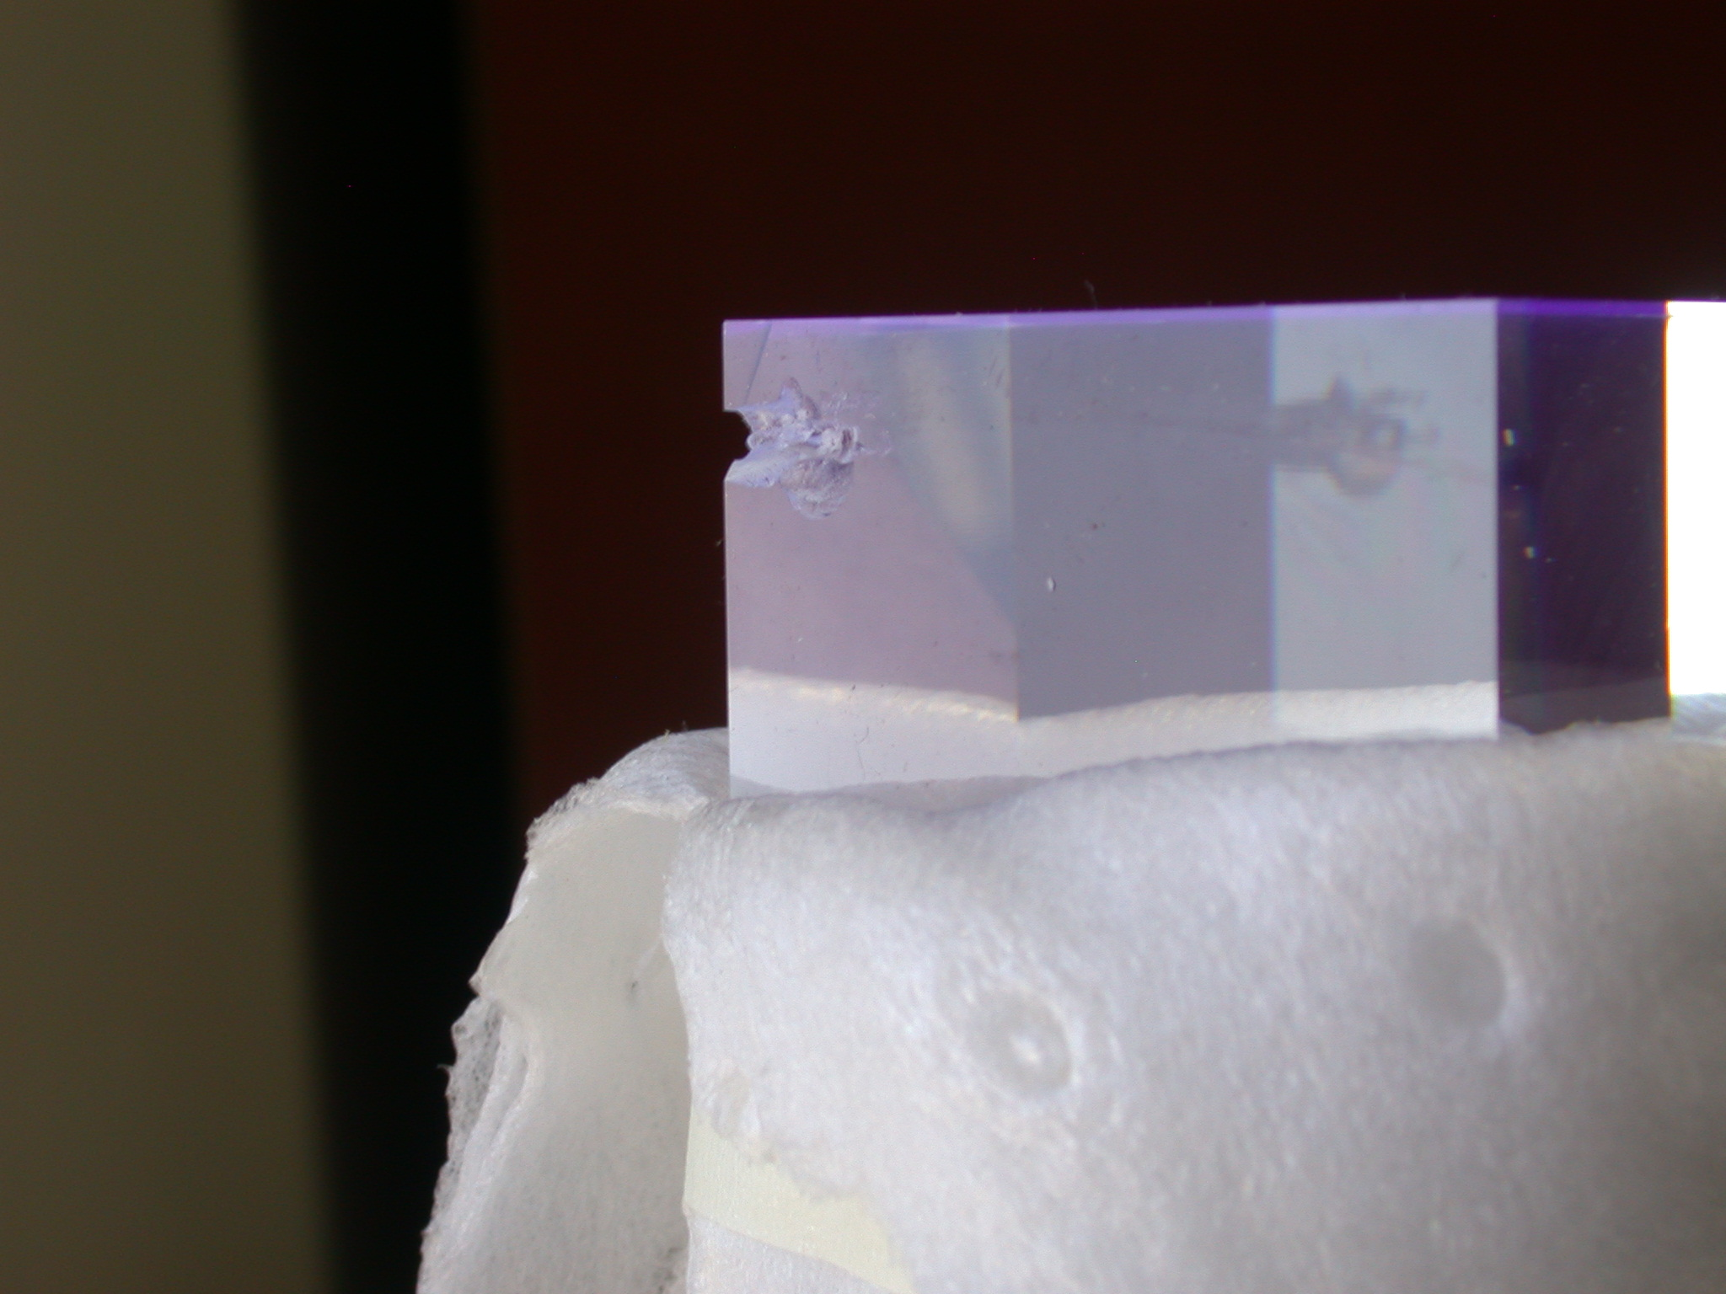
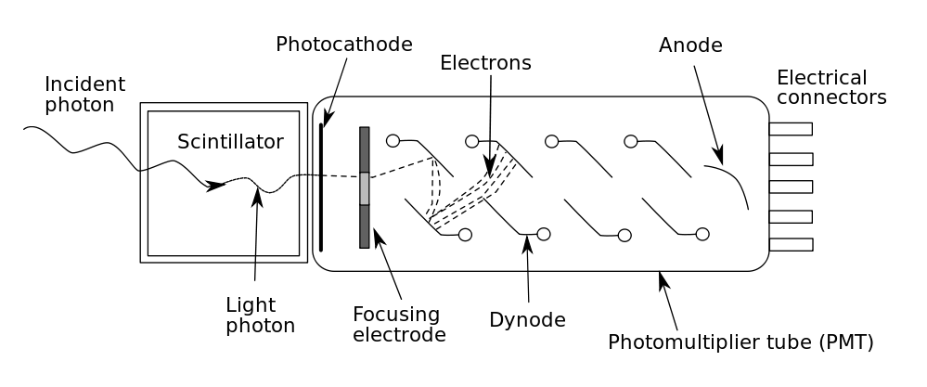
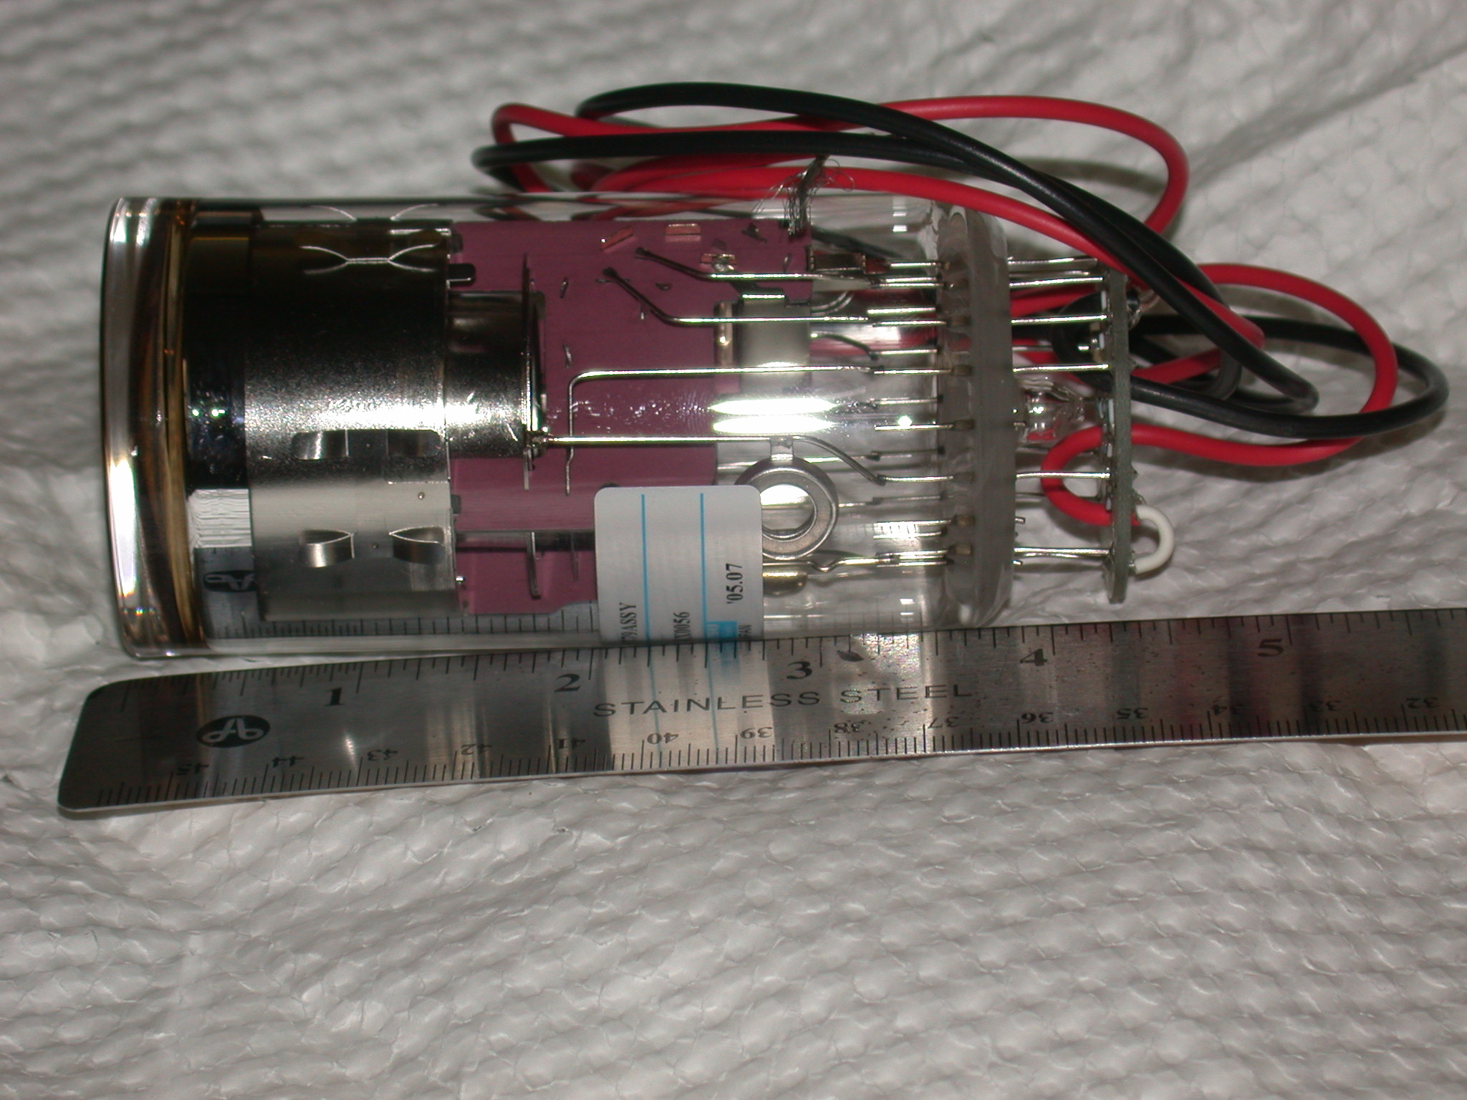
Scintillating Counters
P(E)dE
Landau Tail
Energy Loss
E_{MEAN}
E_{MOST PROBABLE}

Slide 26
TDC Differential Nonlinearity
Random Start
+
Periodic Stop
Uniform Distribution
+
DNL Fluctuations
+
Statistical Fluctuations

Slide 27
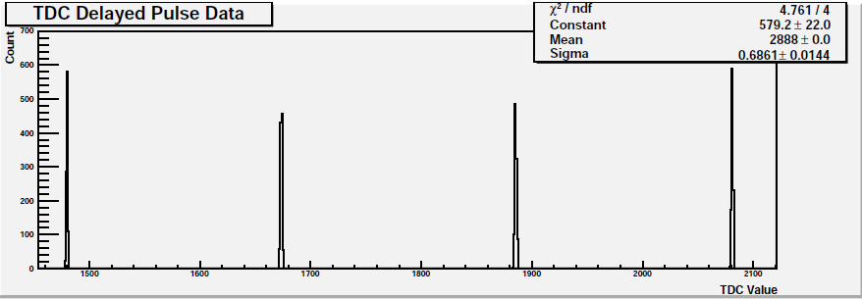
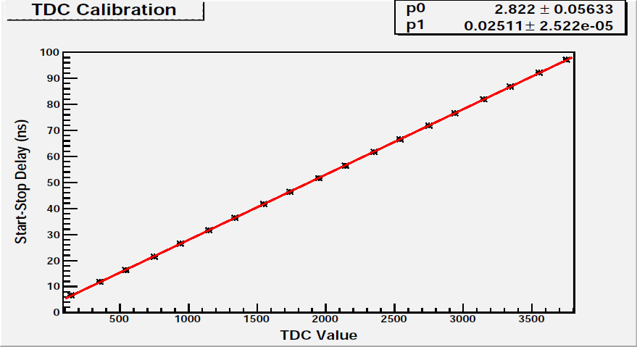
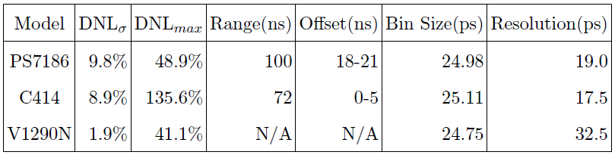
TDC Calibration and Resolution
* 5ns cable delays

Slide 28
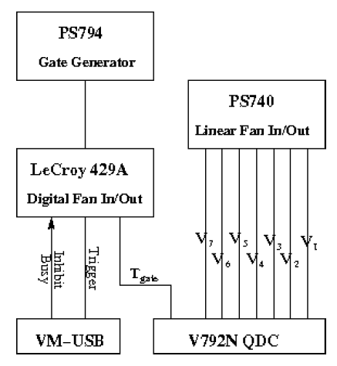
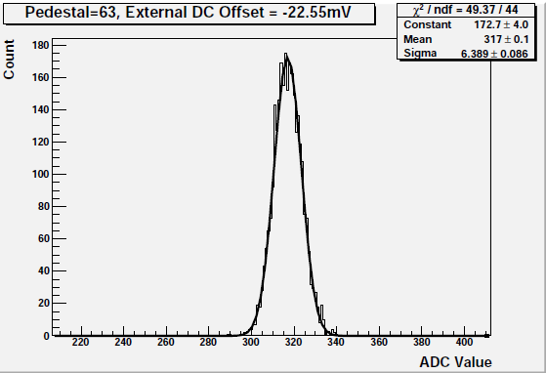
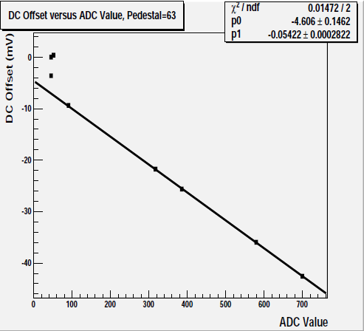
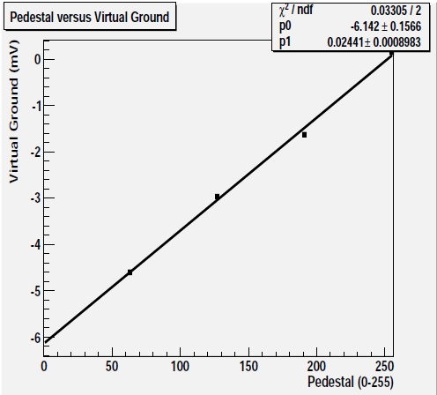

ADC Calibration
V792N testing:
Single channel example
sensitivity
Adjustable pedestal range is insufficient to push system charge offset above the threshold.

Slide 29
Three-bar Method Concept
A
B

Slide 30
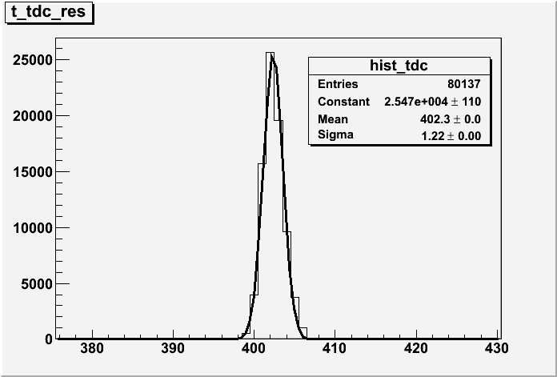
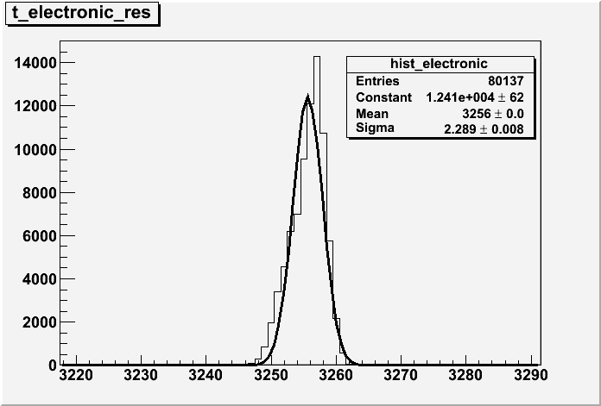
Base Resolution
TDC resolution, between 30ps and 35ps, contributes to the resolution measurements.
Total electronics resolution is measured, but does not contribute to the resolution measurements.

Slide 31
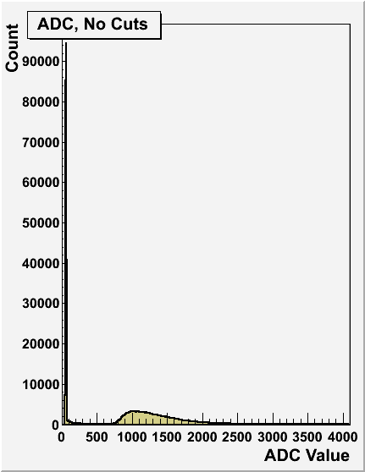
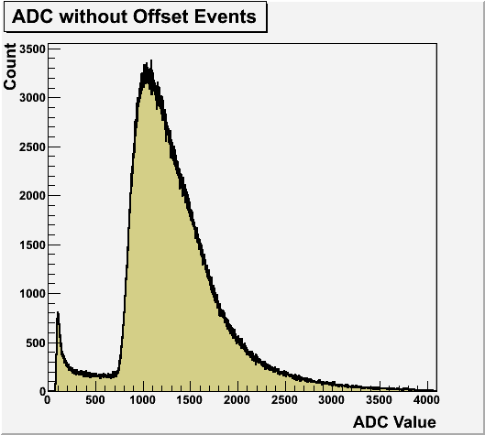
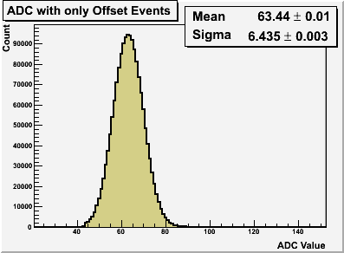
Three-bar System ADC Offset
in-situ offset measurements
σ = 6.435 bins
μ = 63.44 bins

Slide 32
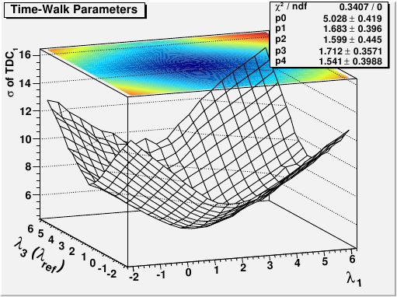
Position-specific Timewalk Correction
A paraboloid fit is sufficient to obtain the minimum value and corresponding TW parameters.
(λ1,λ3) ≈ (1.7,1.7)

