Slide 1
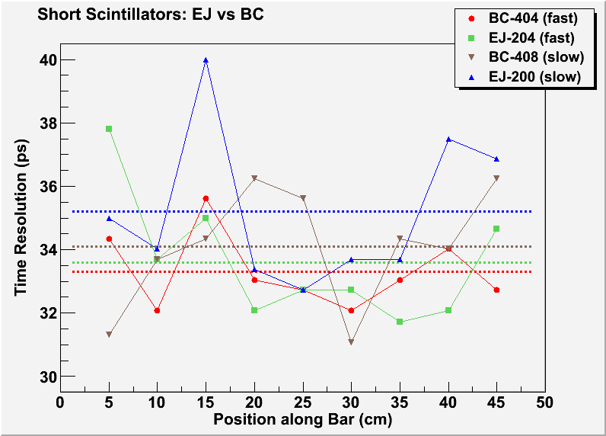
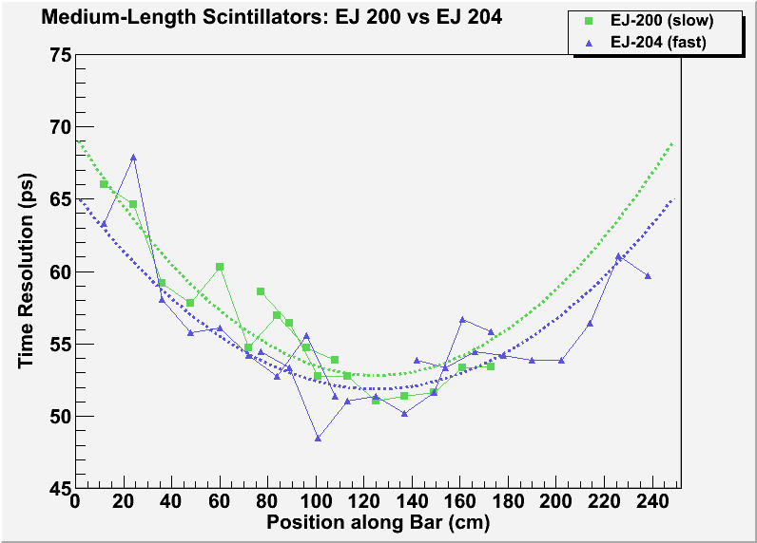
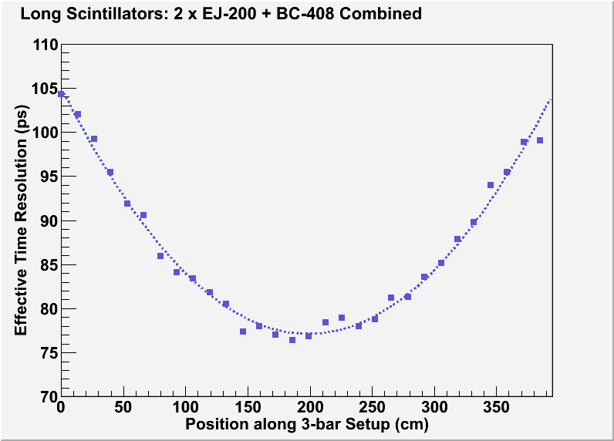
 | 50cm | 250cm | 375cm
BC-404 | 33.3ps | N/A | N/A
EJ-204 | 33.6ps | 56ps | N/A
BC-408 | 34.1ps | N/A | 96ps
EJ-200 | 35.2ps | 58ps | 114ps

Slide 2
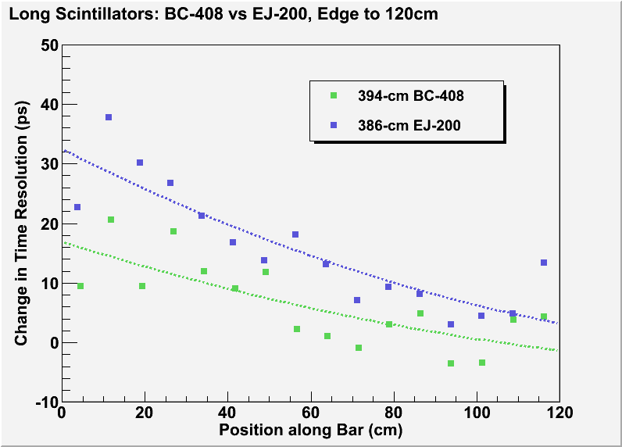
 | 50cm | 250cm | 375cm
BC-404 | 33.3ps | N/A | N/A
EJ-204 | 33.6ps | 56ps | N/A
BC-408 | 34.1ps | N/A | 96ps
EJ-200 | 35.2ps | 58ps | 114ps

Slide 3
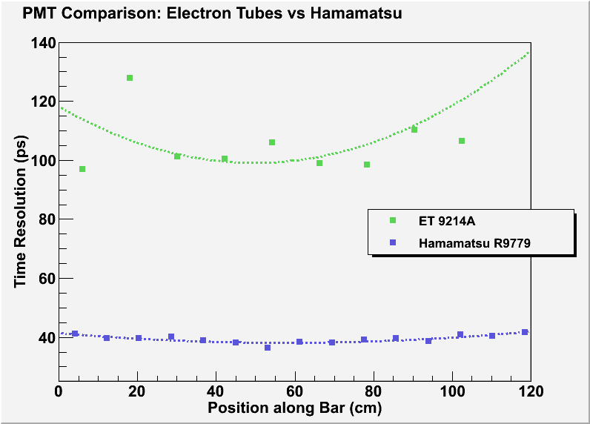
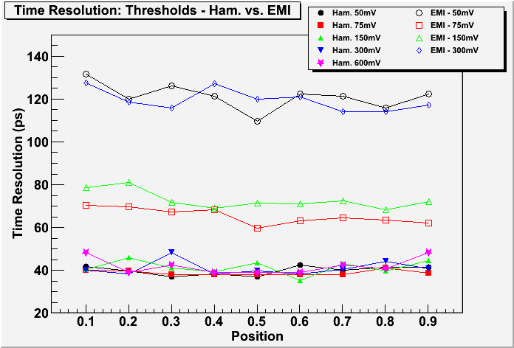
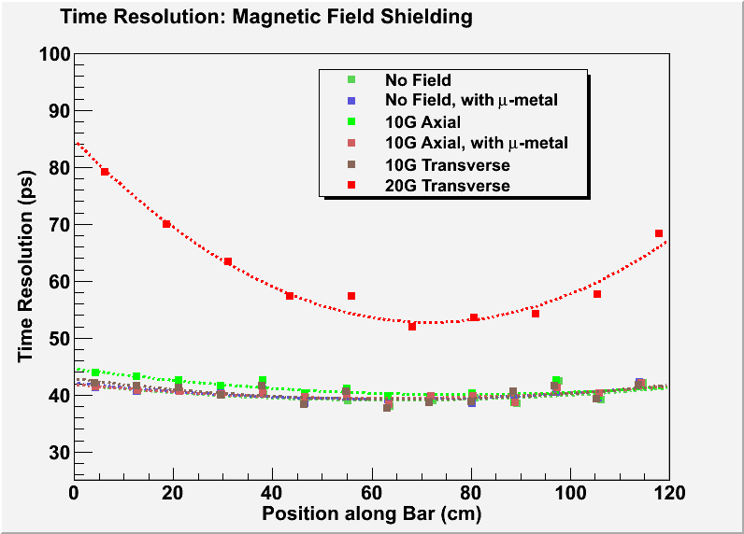
Hamamatsu R9779 PMT:
  superior time resolution
  extremely compact
  built-in shielding effective in transverse magnetic fields
39.91, 38.9, 41.42, 40.99, 42.00

Slide 4
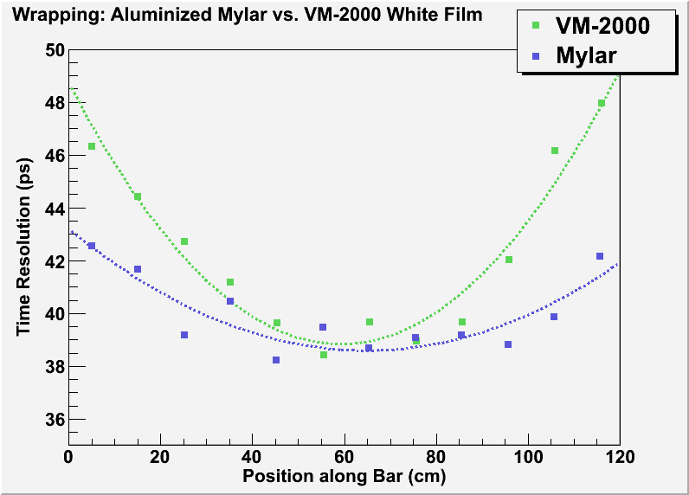
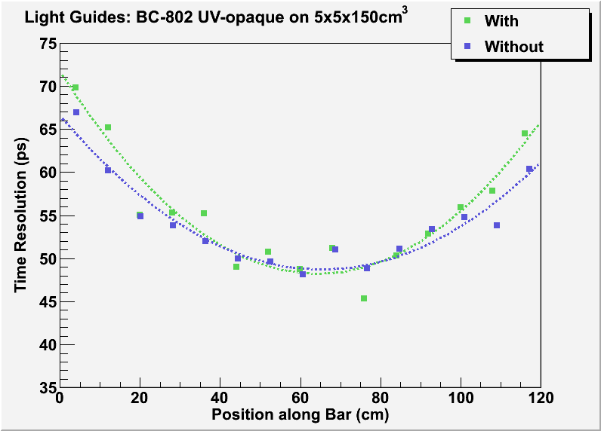
Aluminized Mylar outperforms VM-2000 in preserving photon statistics .
Light guides negatively impact time resolution, especially at the ends of long scintillators.

Slide 5
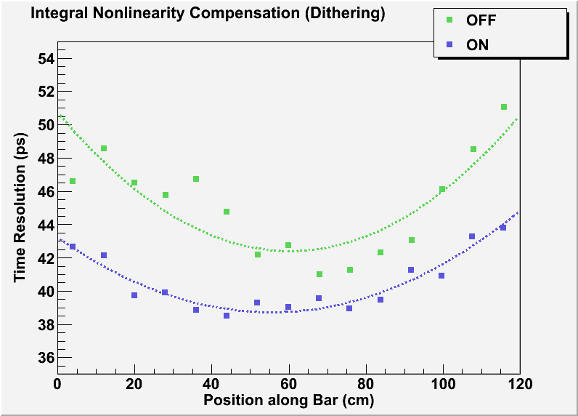
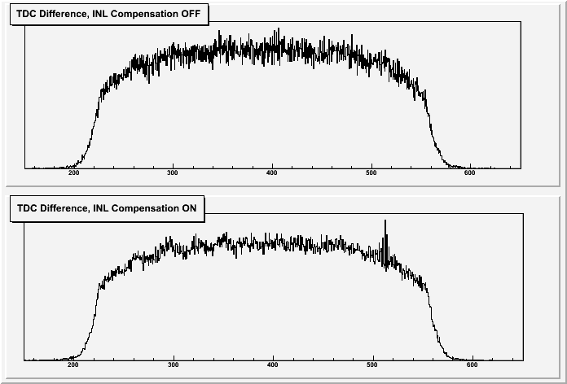
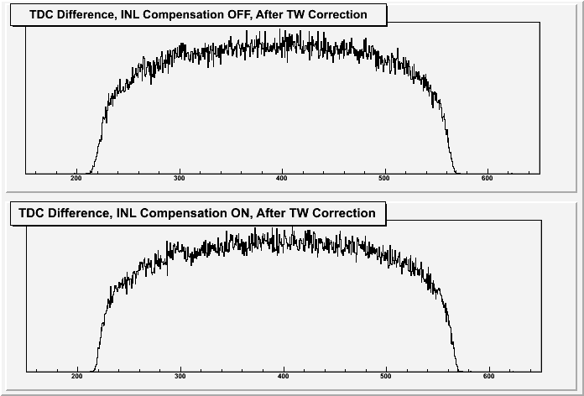
The Caen V792N TDC incorporates INL Compensation for improved time resolution.

