Slide 1

CUSTOMER RATING PREDICTION PROJECT

Slide 2

Problem Statement

Slide 3
Bussiness Problem
We got a client who has a website where people write different reviews for technical products. Now they are adding a new feature to their website i.e. The reviewer will have to add stars (rating) as well with the review. The rating is out 5 stars and it only has 5 options available 1 star, 2 stars, 3 stars, 4 stars, 5 stars. Now they want to predict ratings for the reviews which were written in the past and they don’t have a rating. So, we have to build an application which can predict the rating by seeing the review.
Companies such as flipkart.com, amazon.com etc which are technical sites where most of the people buys technical products. But before buying a product we have to find out good technical products for the client site. Similarly in the given task we have to build a model that can predict best technical product for their site by checking their ratings from the extracted dataset from old buyers.

Slide 4
Purpose of Project
Companies such as flipkart.com, amazon.com, myntra.com, etc which are selling site of technical products. But before buying a product we used to predict good and relevant value of the product by checking their reviews and rating . Similarly in the given task we have to build a model that can predict predict ratings of the customer reviews from the extracted dataset from the older customer reviews and ratings.

Slide 5
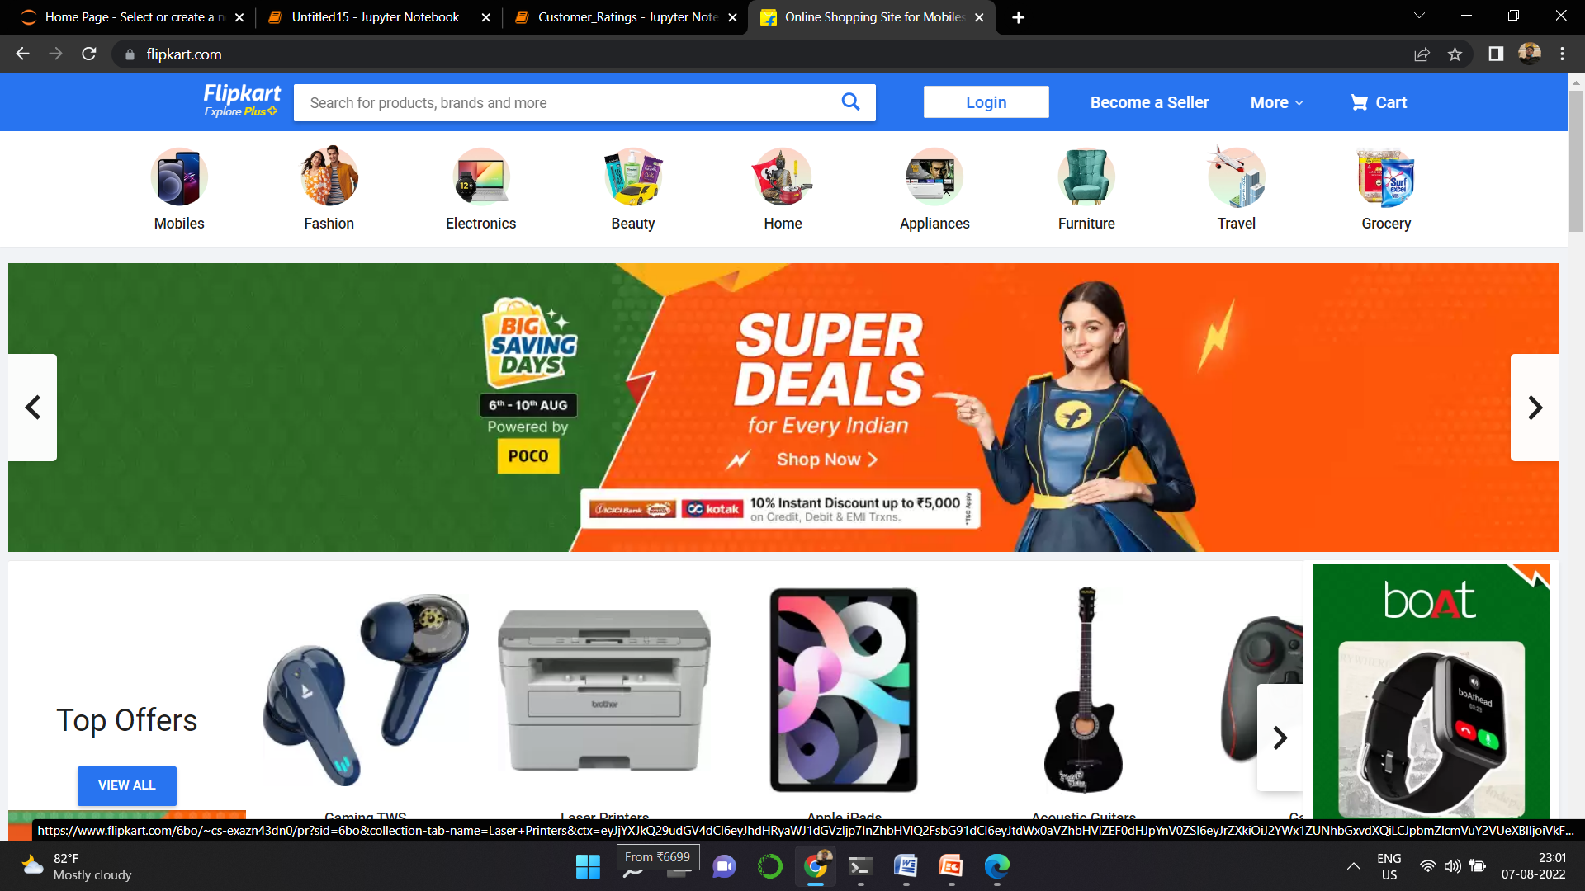

Slide 6
Parameters of Predicting ratings
Customer Reviews
Customer Ratings
Products

Slide 7

Data mining
We have extracted data from Flipkart.com

Slide 8
EDA steps
Data Preprocessing Done adding new columns for better model
Removed stopwords, punctuations
Removed special characters
TFIDF vectorization

Slide 9
Visualization of important features for understanding
Customer ratings values
Observations:
Length of the rating is highest for 4 and lowest for 2

Slide 10
Character Count Density Plot

Slide 11
Average values of each text in reveiw

Slide 12
30 Most Frequent words

Slide 13
30 Least used words

Slide 14
No of Products

Slide 15
Products ratings in a single view

Slide 16
Processed Reviews Texts by wordcloud

Slide 17
Rating 1 Reviews

Slide 18
Rating 2 Reviews

Slide 19
Rating 3 Reviews

Slide 20
Rating 4 Reviews

Slide 21
Rating 5 Reviews

Slide 22
Products

Slide 23
Ratings Distribution
Ratings 1 and 2

Slide 24
Ratings 3 and 4

Slide 25
Ratings 5

Slide 26
Correlation of the Dataset

Slide 27
Model Building and Results
Logistics Regression

Slide 28
Multinomial NB

Slide 29
BernouliNB

Slide 30
SGD Classifier

Slide 31
Best models
- Logistics : Model shows low accuracy score in training and testing accuracy hence we cannot consider it.
- MultinomialNB: Model shows very much difference in training and testing accuracy hence we cannot consider it. Model becames underfit.
- Bernouli: Model shows low accuracy score in training and testing accuracy hence we cannot consider it.
- SGDClassifier : Model shows good results as it gives similar testing and CV score hence we are going to consider it.
-

Slide 32
Final Model and Results
SGDClassifier

Slide 33
Model Deployment

Slide 34
Thanks You

