Slide 1

USED CAR PRICE PREDICTION PROJECT

Slide 2

Problem Statement

Slide 3
Due covid 19 impact in the automotive market
We have seen lot of changes in the car market. Now some cars are in demand hence making them costly and some are not in demand hence cheaper.
With the change in market due to covid 19 impact, our client is facing problems with their previous car price valuation machine learning models.
So, they are looking for new machine learning models from new data. We have to make car price valuation model.

Slide 4
Purpose of Project
It’s a need of the any seller to complete their goal with higher revenue and low expenditure. Hence this model can brings higher revenue because we can predict upcoming selling car prices and bid a price to the seller with lower amount, before their publishment of car prices.
Car Valuation
Valuation requires expertise. And when it comes to valuing an asset as precious as a car, it becomes all the more critical. Despite being an owner, one is unaware of the used car valuation of his/her asset. Getting tricked by the false car valuation isn’t something new so you need to be extra cautious to strike the right chord while evaluating your car resale value.Hence a model needs to be build to evaluate a car price.

Slide 5

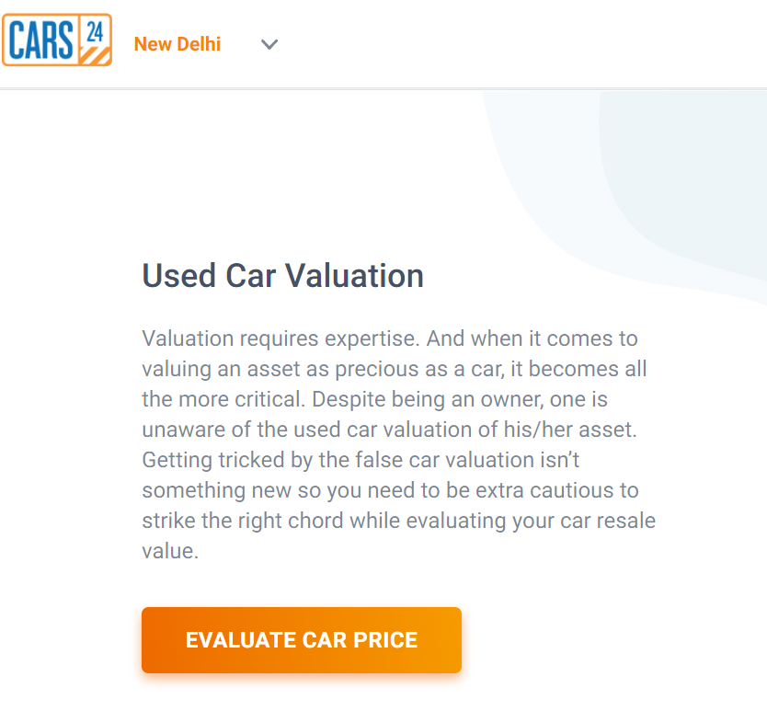

Slide 6
Brand
Parameters of Car Valuation
Model
'Location'
Price of Car
'Kilometers_Driven'
'Fuel_Type'
Transmission
Owners

Slide 7



Data mining
We have extracted data from these 3 sites

Slide 8
EDA steps
Converting driven kms and price into interacting format
Removed skewness
Detected outliers
Ordinal encoding and PCA done

Slide 9
Visualization of important features for understanding
Price in Lakh vs Location

Slide 10
Price vs Fuel
Price vs Transmission

Slide 11
Price vs Owners
Price vs Brands

Slide 12
Location
Fuel Type

Slide 13
Transmission
Owners

Slide 14
Brand
Observations
Most of the seller are lies in the location Mumbai, Hyderabad, Coimbatore, Kochi, Pune as compared to other location.
Diesel and Petrol cars are more in the sell dataset.
Manual cars are more as compared to automatic cars.
First owners cars are more as per dataset.
Maruti and Hyundai brands are more in sell as compared to other brands.

Slide 15
Different numerical columns via pair plot

Slide 16
Correlation of the Dataset

Slide 17
Describe of the Dataset

Slide 20
Model Building and Results

Slide 21
Best models
KNeighborsRegressor : Model shows low r2 score in training and testing accuracy hence we cannot consider it.
DecisionTreeRegressor: Same as DecisionTreeRegressor shows very much difference in training and testing accuracy hence we cannot consider it. Model becames underfit.
XGBRegressor: Same as above two model it shows similar in CV score and testing r2 score hence we can consider it.
GradientBoostingRegressor: GradientBoostingRegressor shows closer R2 test
ing and crpss val score but still training score it much greater than it testings R2 score which makes model underfit also R2 score not good yet from all models hence we can’t consider it.
- LGBMRegressor : Moder shows very close differenct R2 score of testing obtaining also CV score is also not good hence we can consider it for model building.

Slide 23
Thanks You

